Slide 1
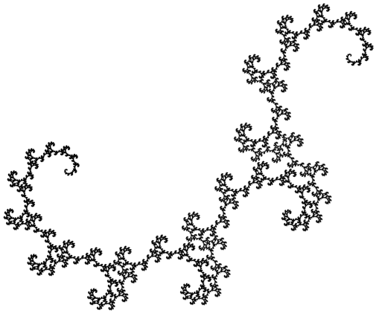
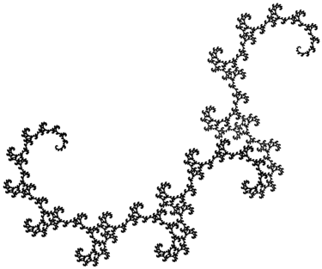
Golden Dragon
Notes:
Golden Dragon – variation of the Heighway Dragon (change angle and scale factor)

