Slide 1








Slide 2
1
√3 ≃ 1.732
1
x
1/2
2
(1/2)² + x² = 1²
x² = 1 - 1/4 = 3/4
x = √3 / 2 ≃ 0.866

Slide 3
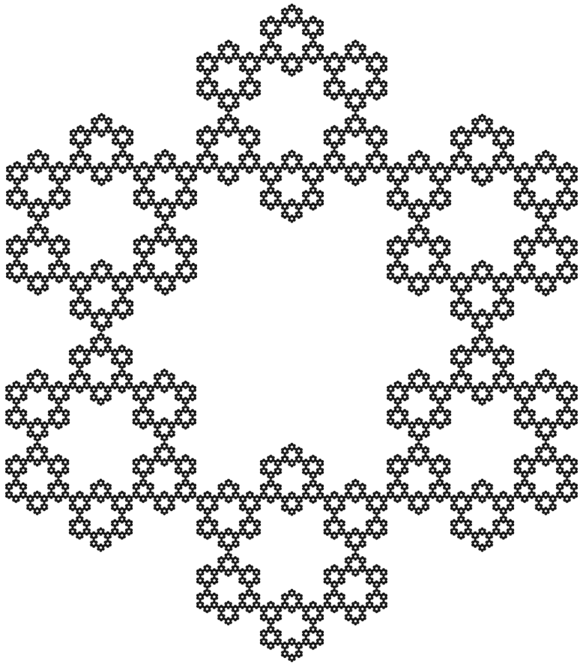
√3 / 3 ≃ 0.577
=> 4.619 cm
2√3 / 3 ≃ 1.155 => 9.238 cm
2√3 ≃ 3.464 => 27.713 cm
1 => 8 cm
√3 ≃ 1.732
=> 13.856 cm
2 => 16 cm
3 => 24 cm

