Slide 1
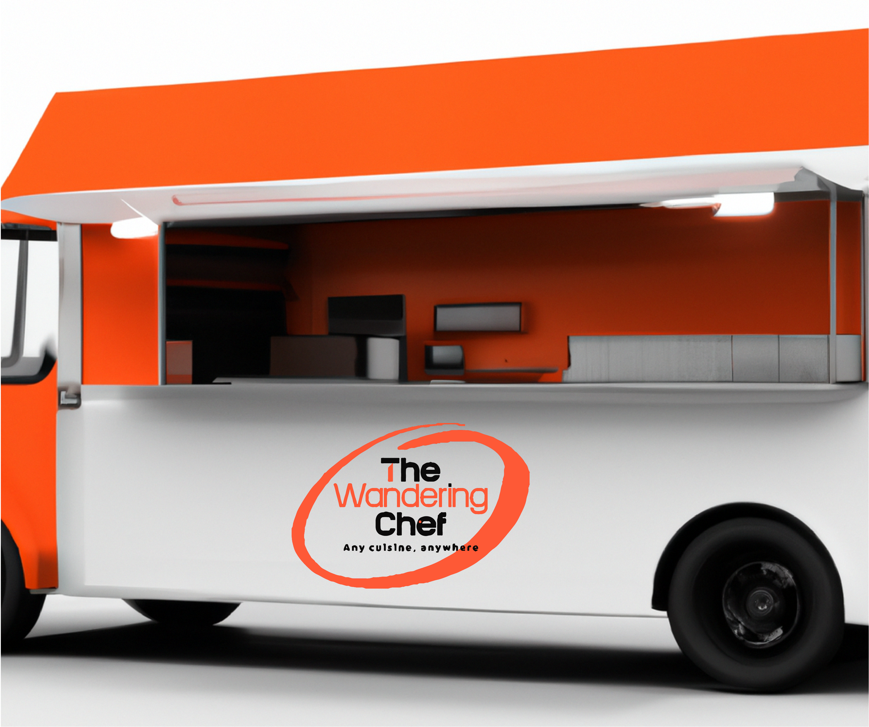
Customer-provided ingredients
Fully equipped kitchen
Custom menu options
Professional chefs
Generator-equipped

Slide 2
