Slide 1

<cyber_emmjay>
Portfolio
Matt Rooney

Slide 2
Design Process
Research – Look at some beautiful websites for inspiration
Refresh – Take breaks often, hit the coffee early not late
Wireframe – Mock up some designs in balsamiq
Run-Wit-It – Hit the code and build
Brickwall – GoogleFu for guides, tuts and stack overflow Q/A
Experiment – Throw a spanner in the works - the Break-It/Fix-It model
Decision – What do we have for dinner this evening...
Rinse-Repeat – Move to the next line and start again

Slide 3
Visual
Theme - I want to learn to hack so Hacker vibes
- Dark theme / White text
- Accessible colours used to distinguish objects
Content - Each page unique with display type of content
- Responsive (best I can get for now)
Layout - Shared Nav & Footer for all pages
Function - Some JavaScript and jQuery used:
- Carousel and its Response
- Nav Toggle Collapse

Slide 4
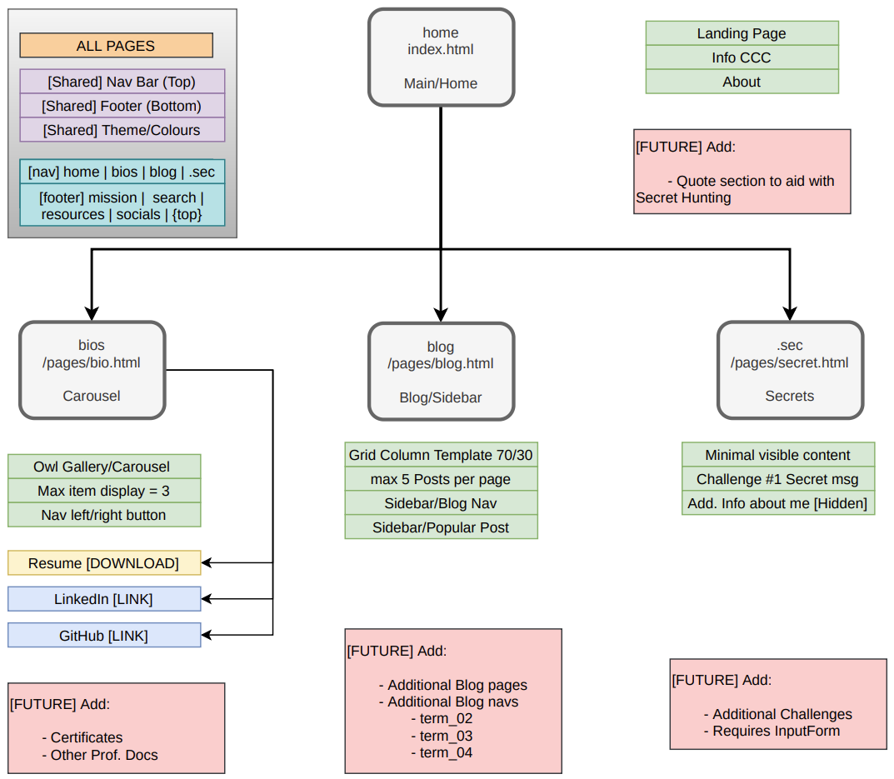
Sitemap
Four Pages:
Home index.html
Bio pages/bio.html
Blog pages/blog.html
Secret pages/secret.html

Slide 5
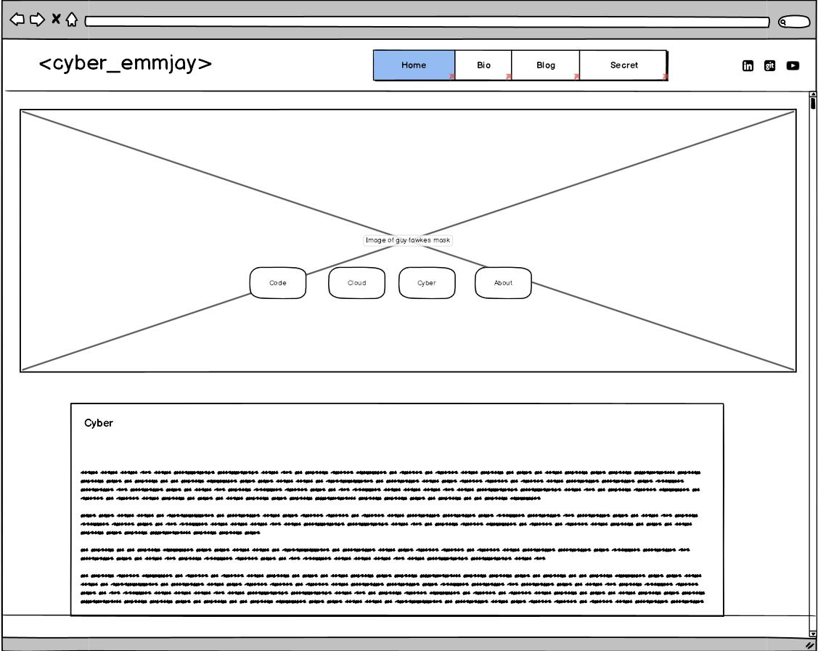
Wireframe | home
Components:
Site:
css background img (hacker)
4 button/anchors - row large
Content:
code
cloud
cyber
about
Containers response:
1400px
width: 75%
800px
width: 85%

Slide 6
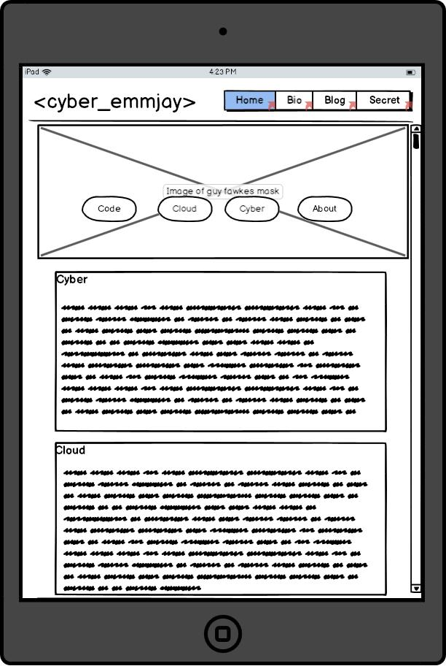
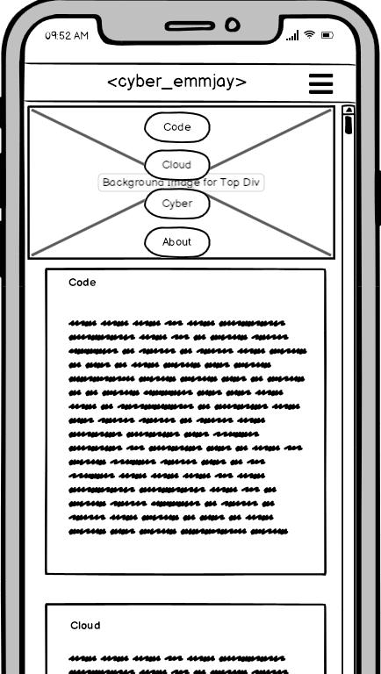
Wireframe | home
Mobile
Tablet
Main Site:
responsively shrinks
button: column, small
Content:
containers:
width:
text shrinks
Main Site:
button row large
Content:
containers:
width expands
text shrinks
800px
width: 85%

Slide 7
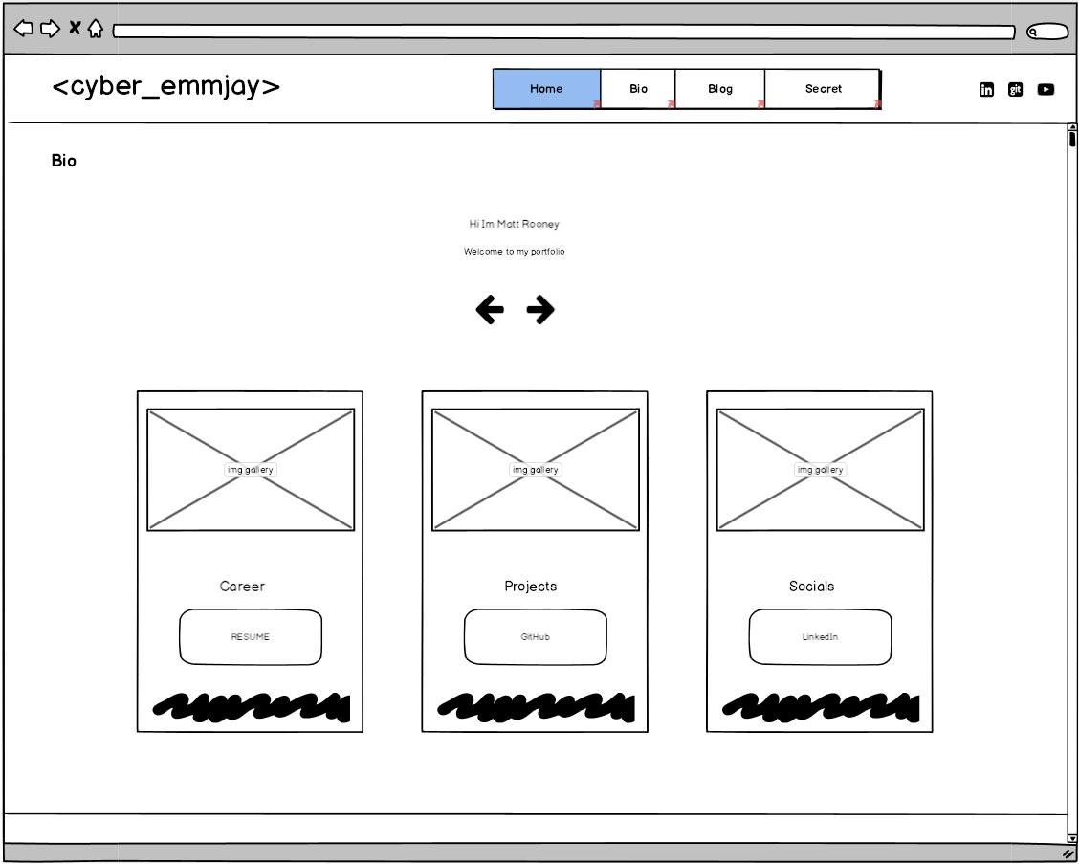
Wireframe | bios
Components:
Display: Gallery/Carousel
Content:
Resume – Download
GitHub – Link
LinkedIn – Link
Filler #1 (empty)
Filler #2 (empty)
Response:
Max 3 Items displayed

Slide 8
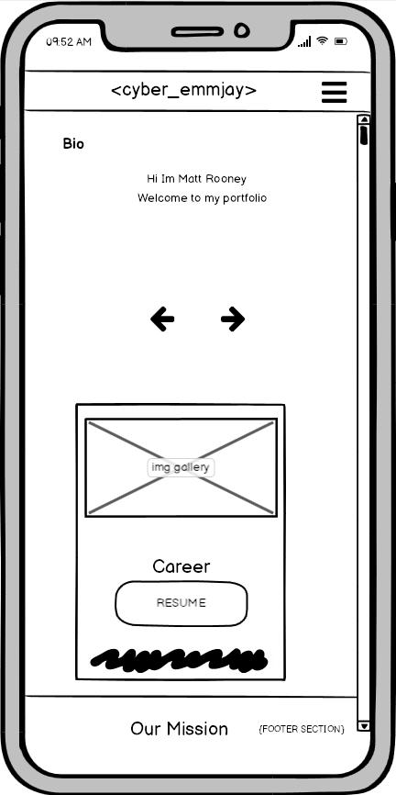
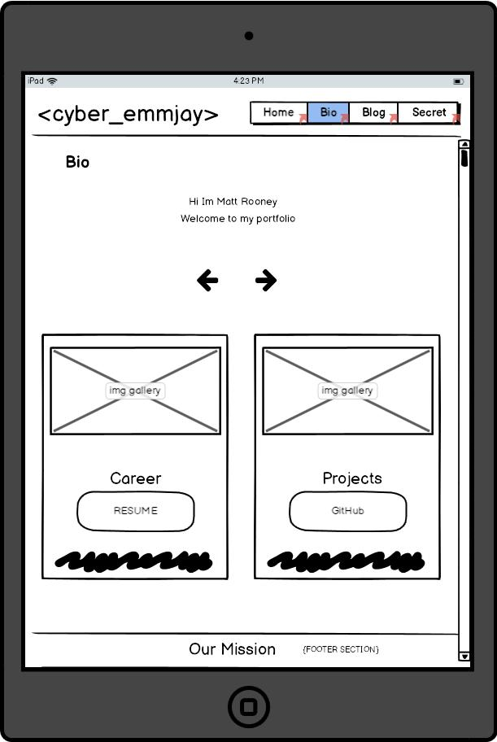
Wireframe | bios
Carousel:
1 item only displayed on small screen
(320px)
Carousel:
2 items displayed on medium screen
(640px)

Slide 9
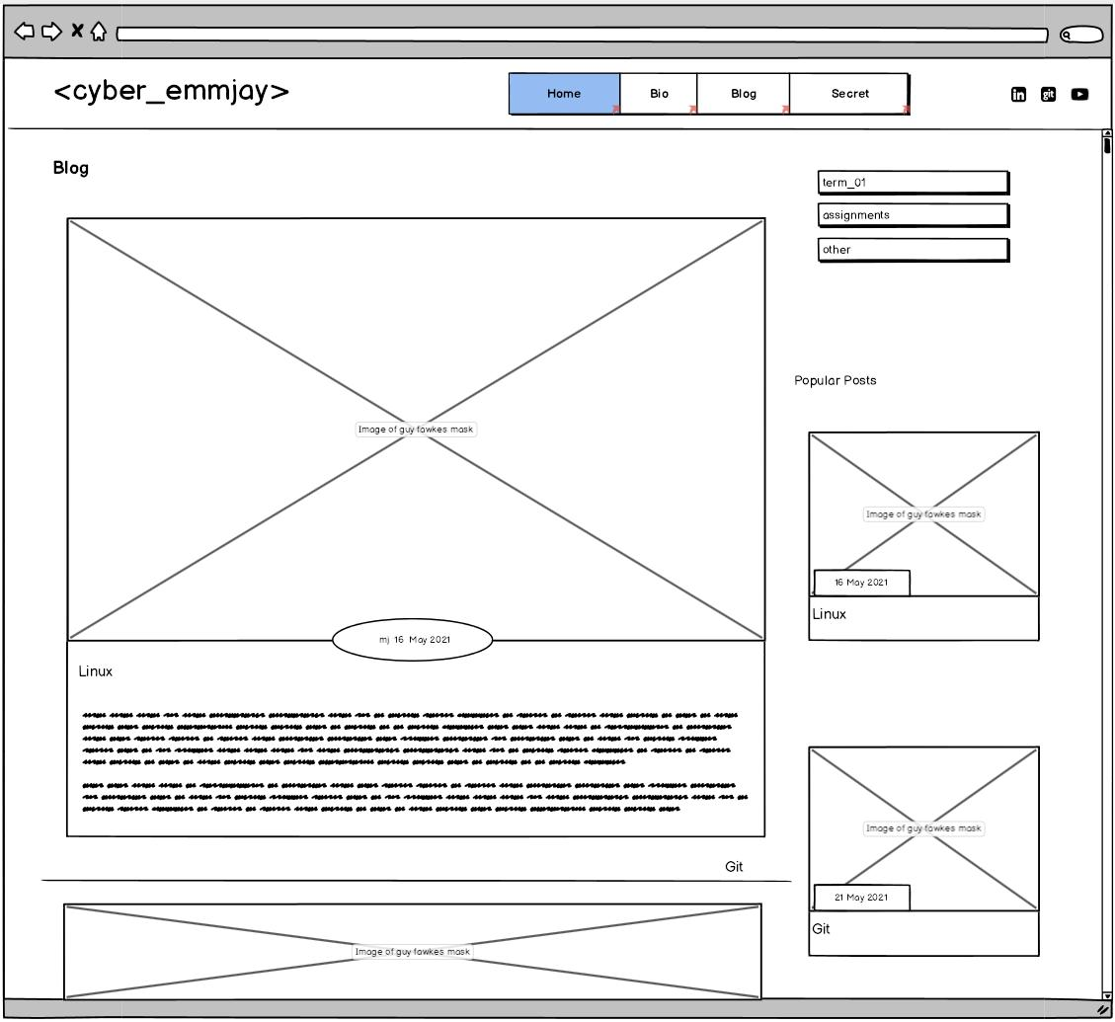
Wireframe | blog
Components:
Display:
Grid template columns
70% Main Content / 30% Sidebar
5 blogs per page
Content:
Main:
Linux, Git, HTML, CSS, WebDev
Side:
Category/Blog nav
Popular post
Response:
Shows all content, and sidebar content

Slide 10
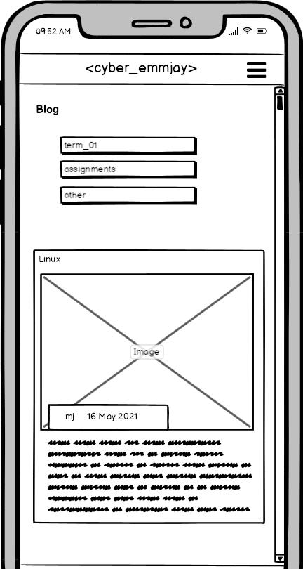
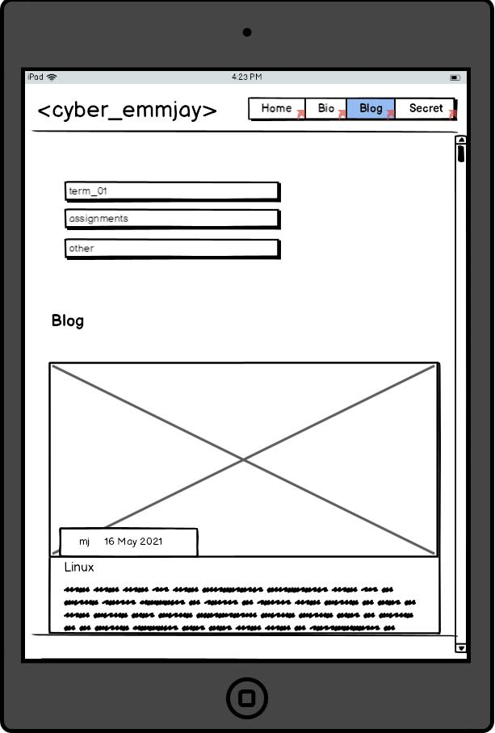
Wireframe | blog
Blog post are pushed below the Sidebar Blog Nav
Font shrink to suit screen size
The sidebar is pushed to the top of the screen and popular post section is hidden
@ (800px)

Slide 11
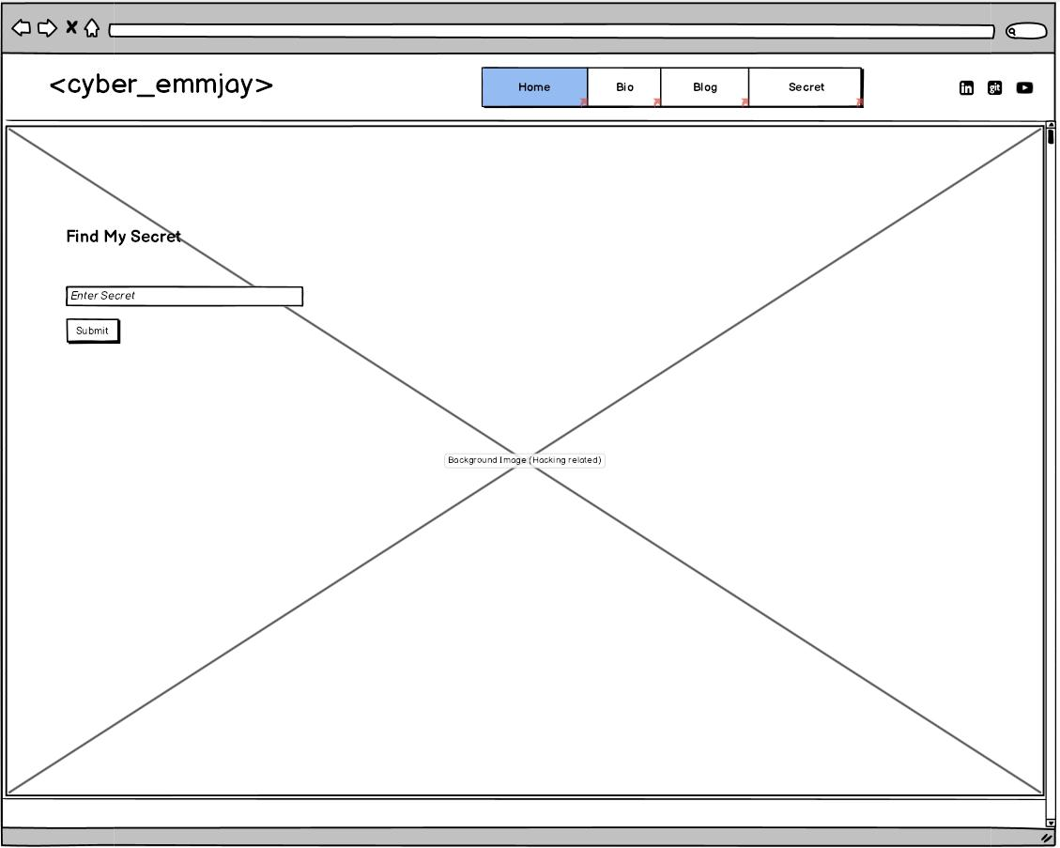
Wireframe | .sec
Components:
Display:
Simple & Hidden
Content:
Hidden secret message
Hidden about me
Response:
nothing major
not a lot of content here yet
Future:
Add Form Input to allow challenge answers to be submitted

Slide 12
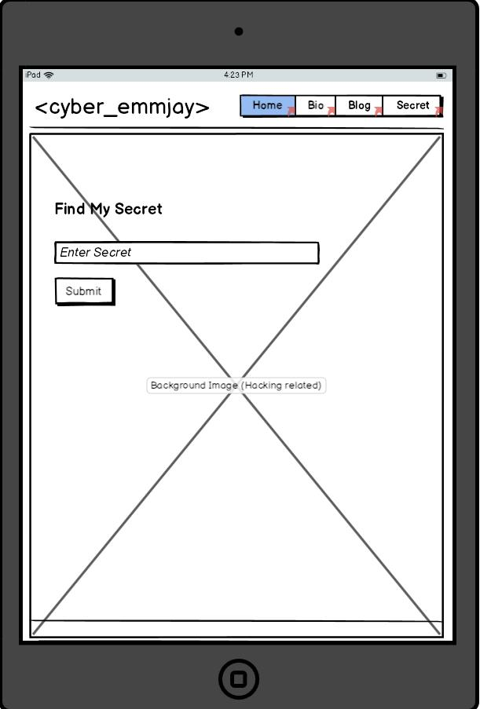
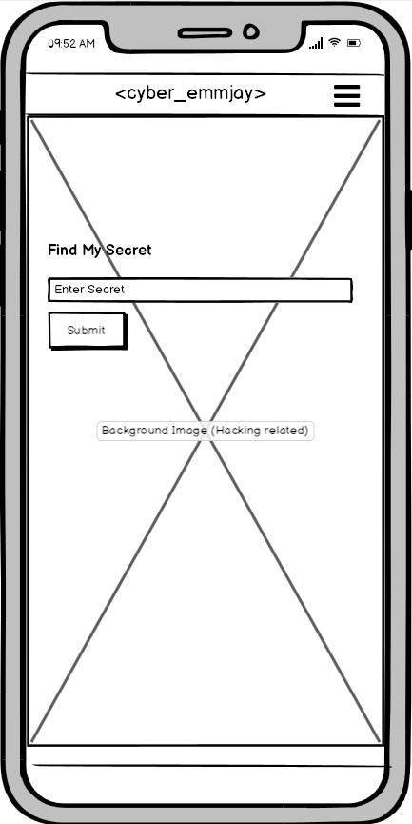
Wireframe | .sec
Response:
css Background: automatically resizes
Response:
Reduced Font Size

Slide 13
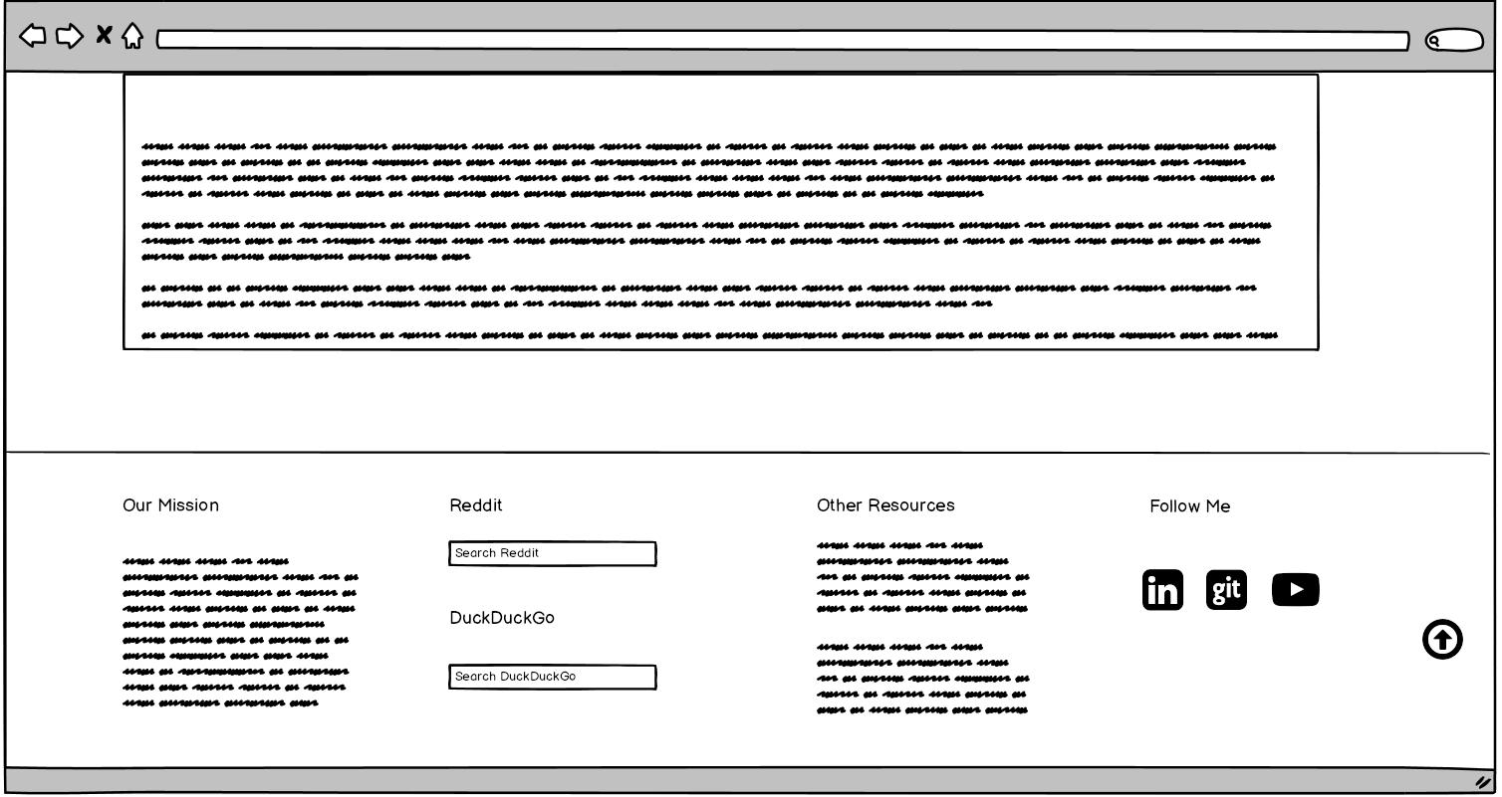
Wireframe | Footer
Display:
Grid template columns
@1400px:
4 grids
Content:
- Our Mission
-Search Reddit or DuckGo
- Other Resources
- Follow Me (Socials)
- NavUp to Top

Slide 14
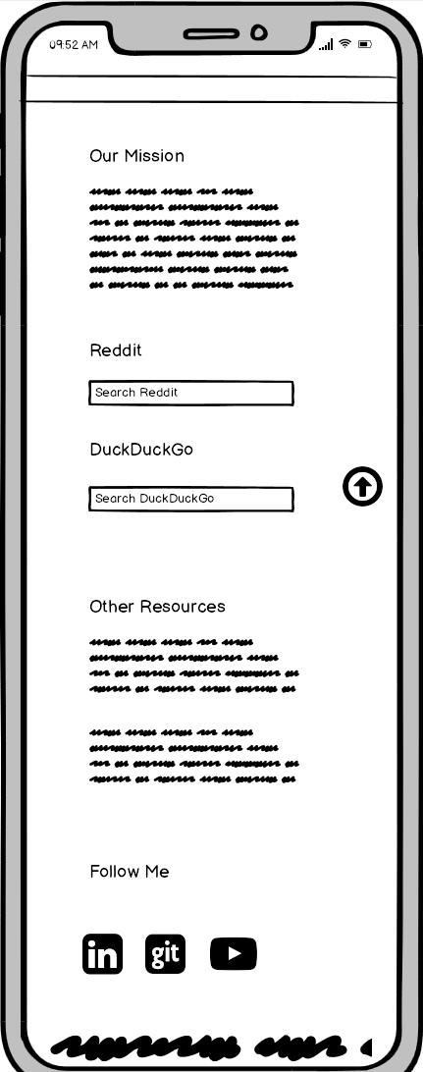
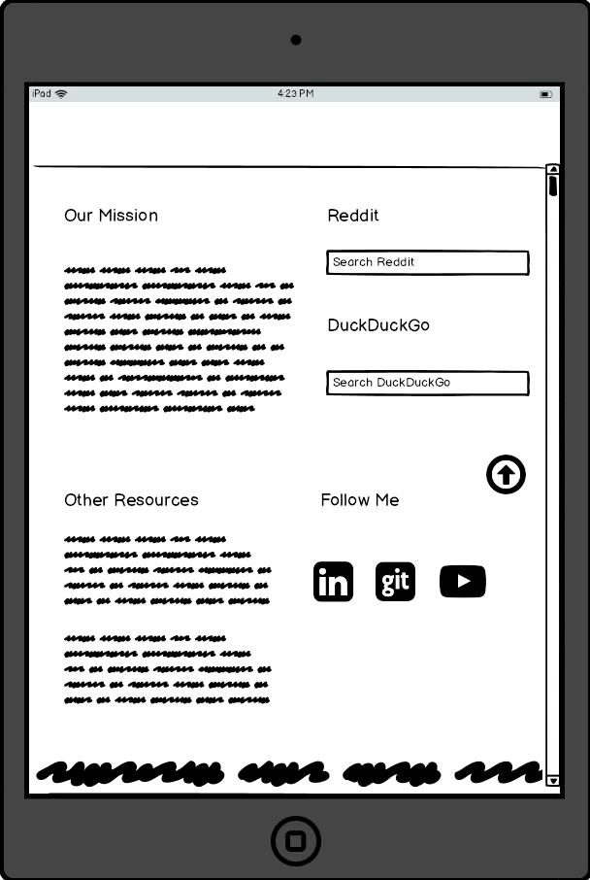
Wireframe | Footers
Response:
800px:
single column
Response:
1400px:
dual column

Slide 15
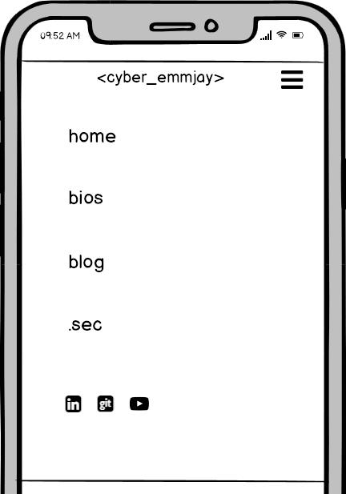
Wireframe | Nav
Display:
Collapse Site Nav
Hamburger Nav Button
Flex direction column
@800px

Slide 16
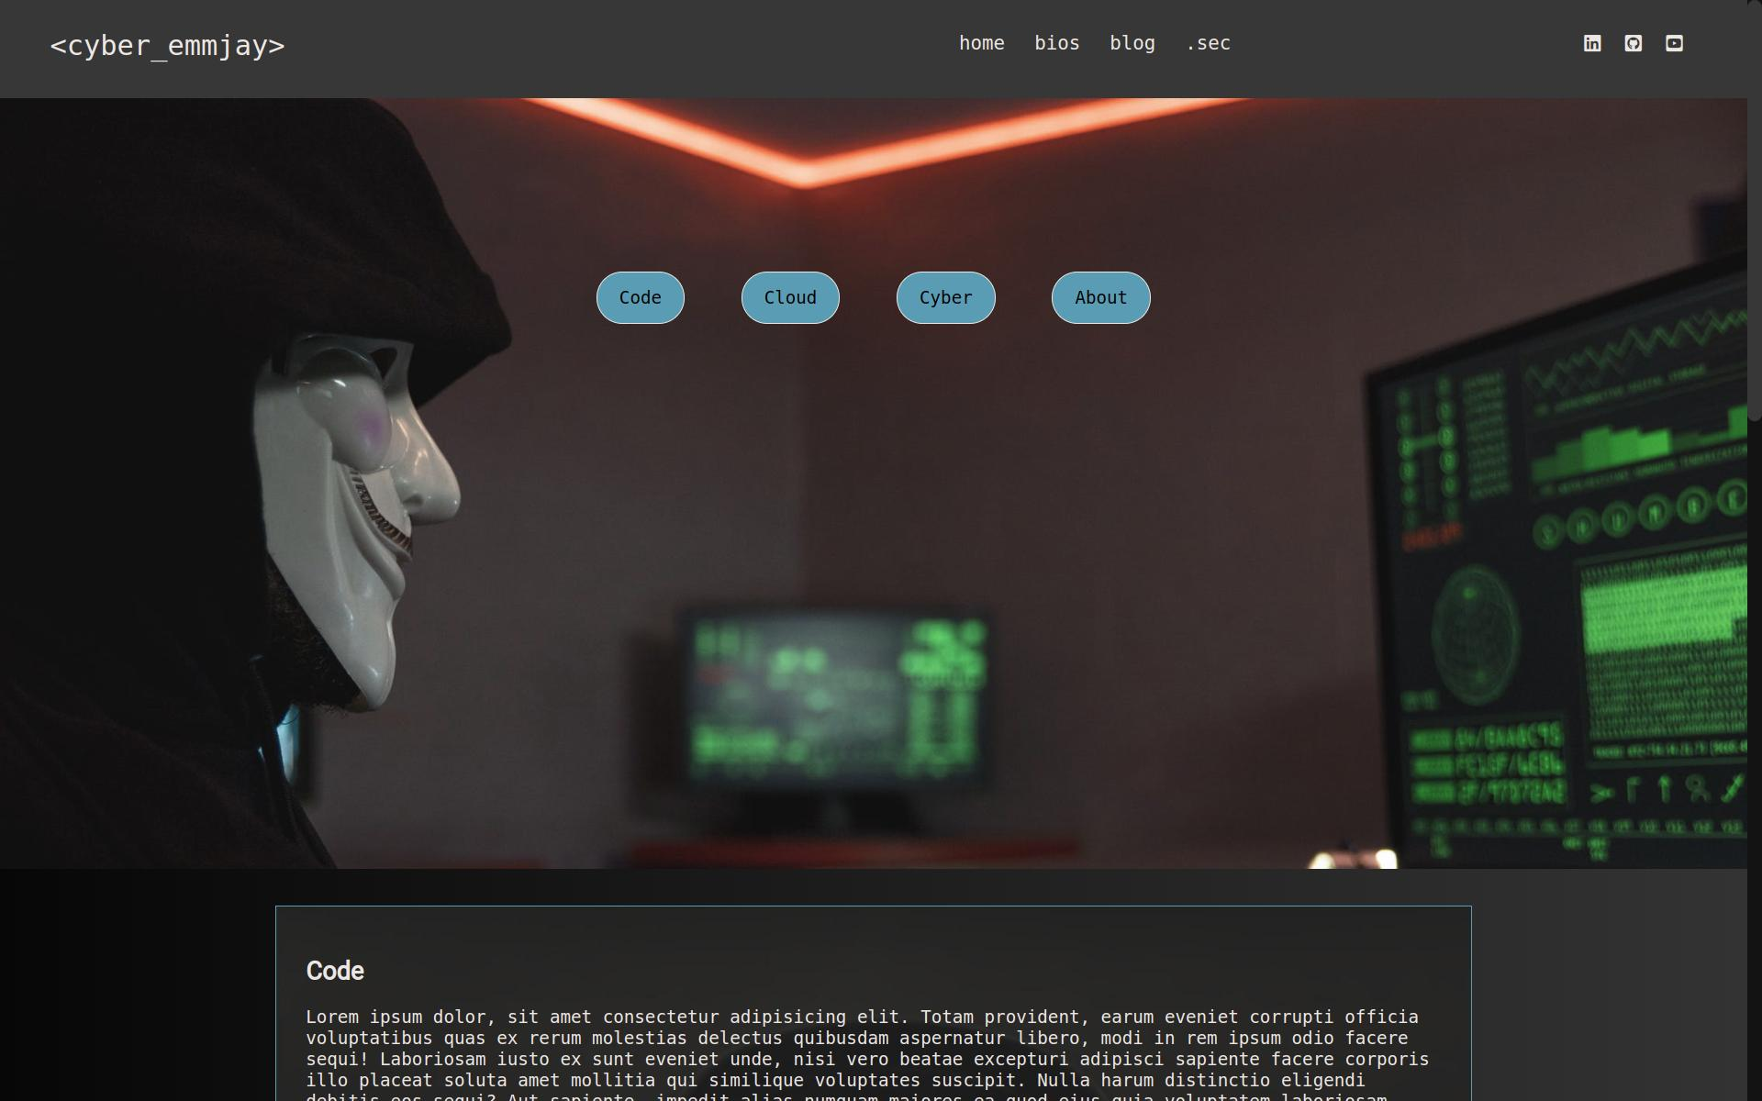
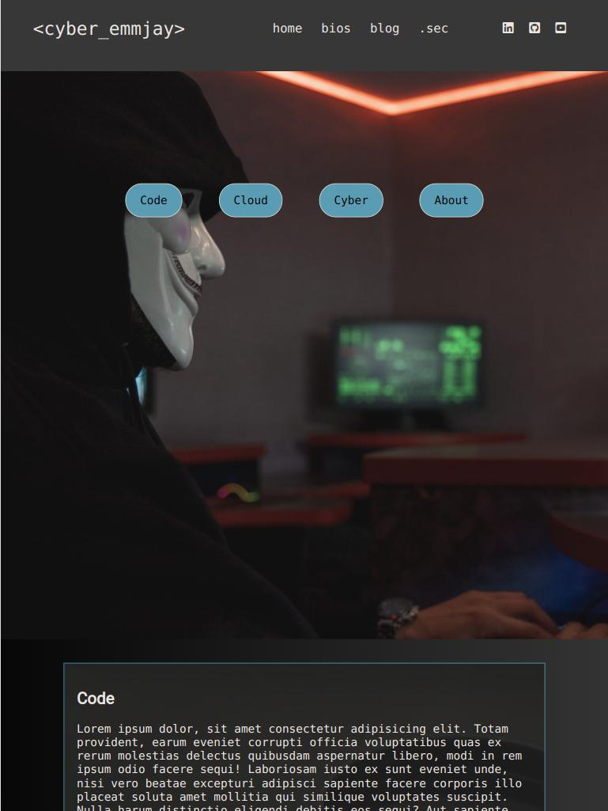
Website | home
Desktop
iPad Pro

Slide 17
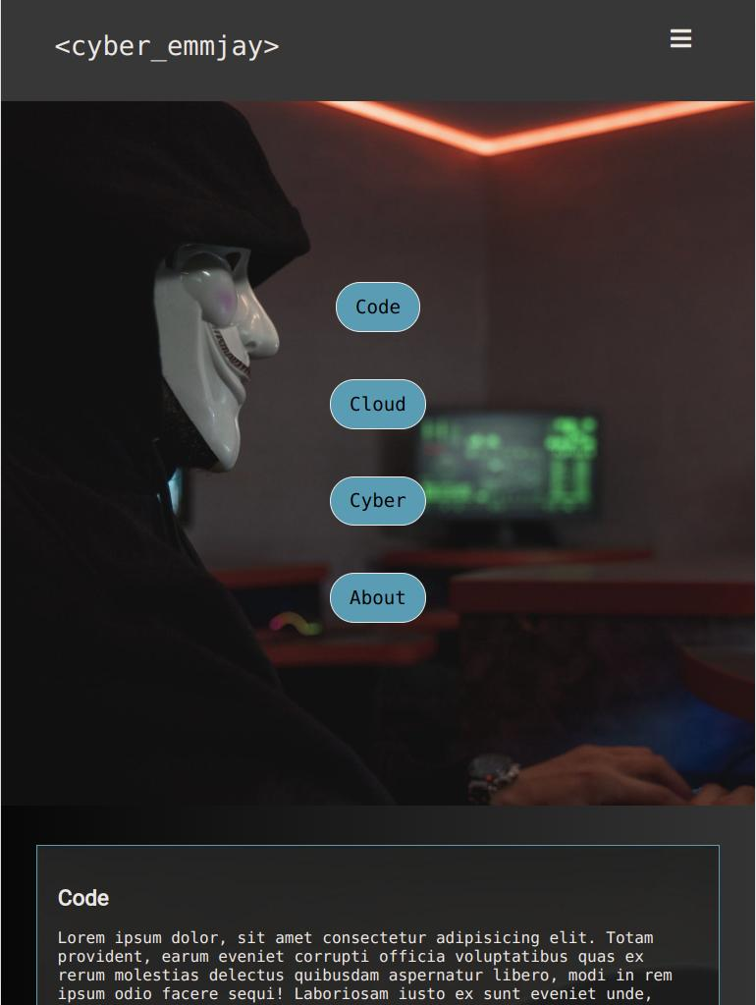
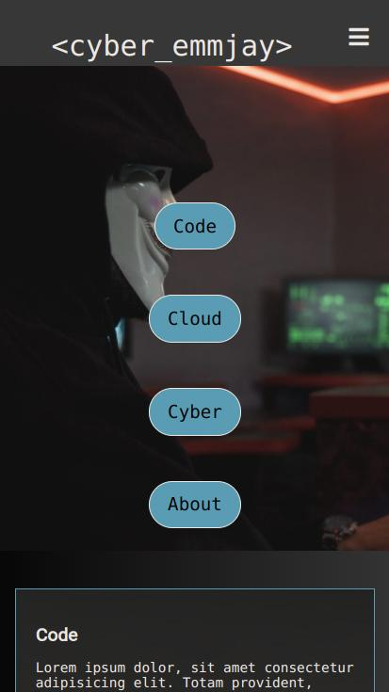
Website | home
iPad
iPhone

Slide 18
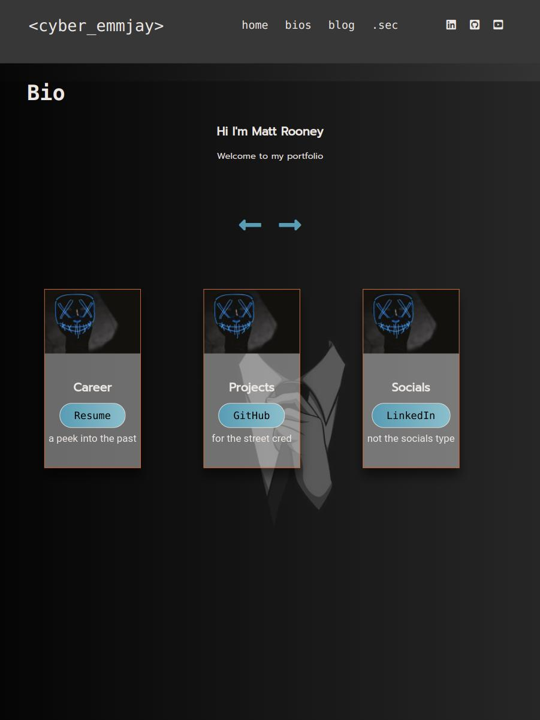
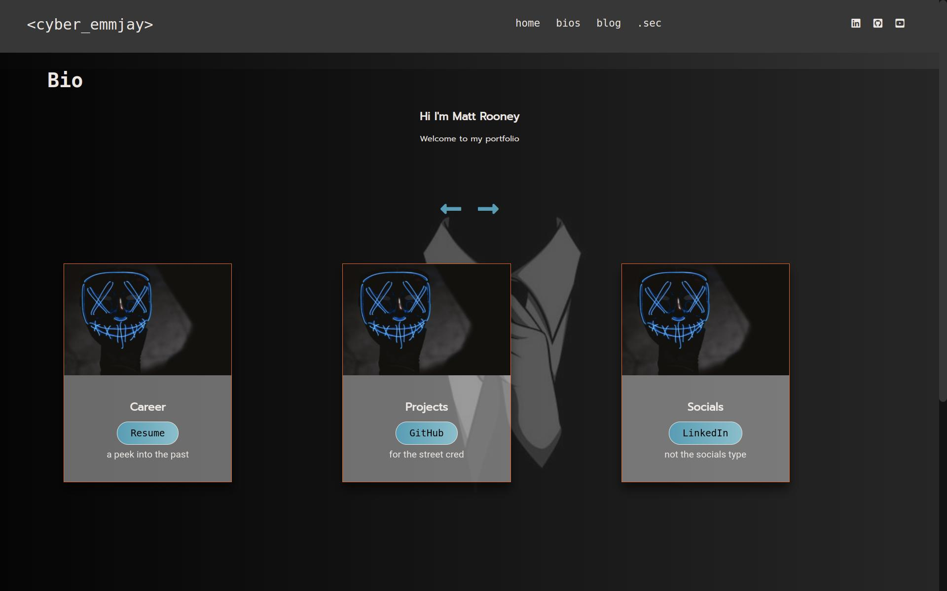
Website | bios
Desktop
Ipad Pro

Slide 19
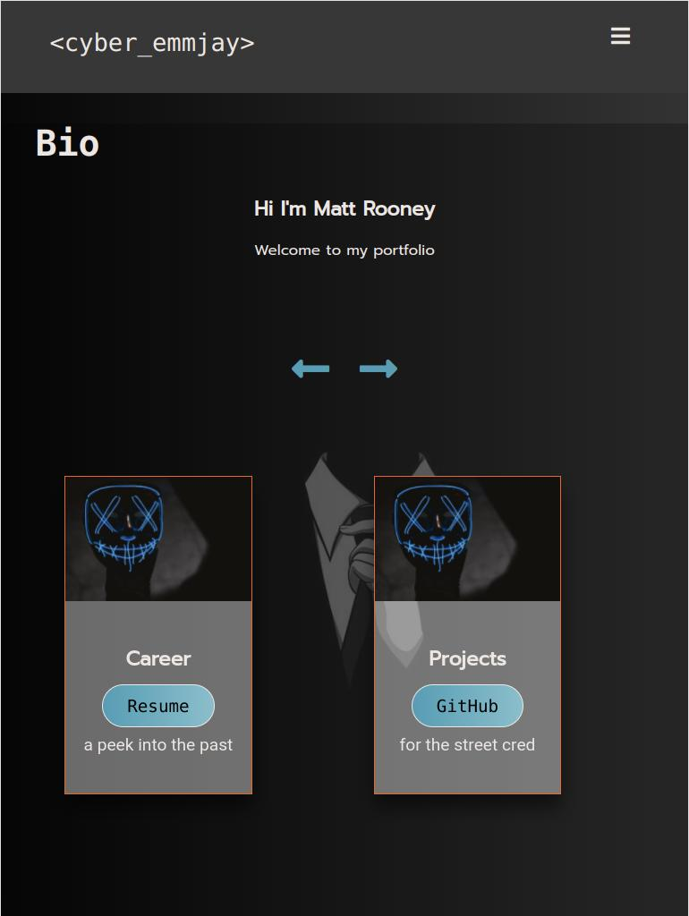
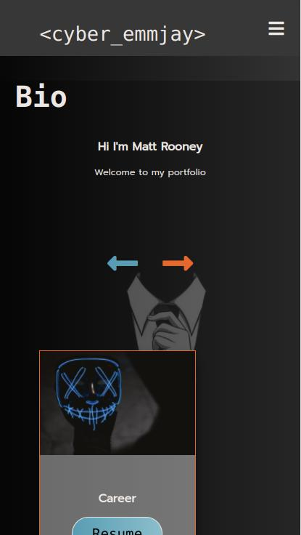
Website | bios
iPad
iPhone

Slide 20
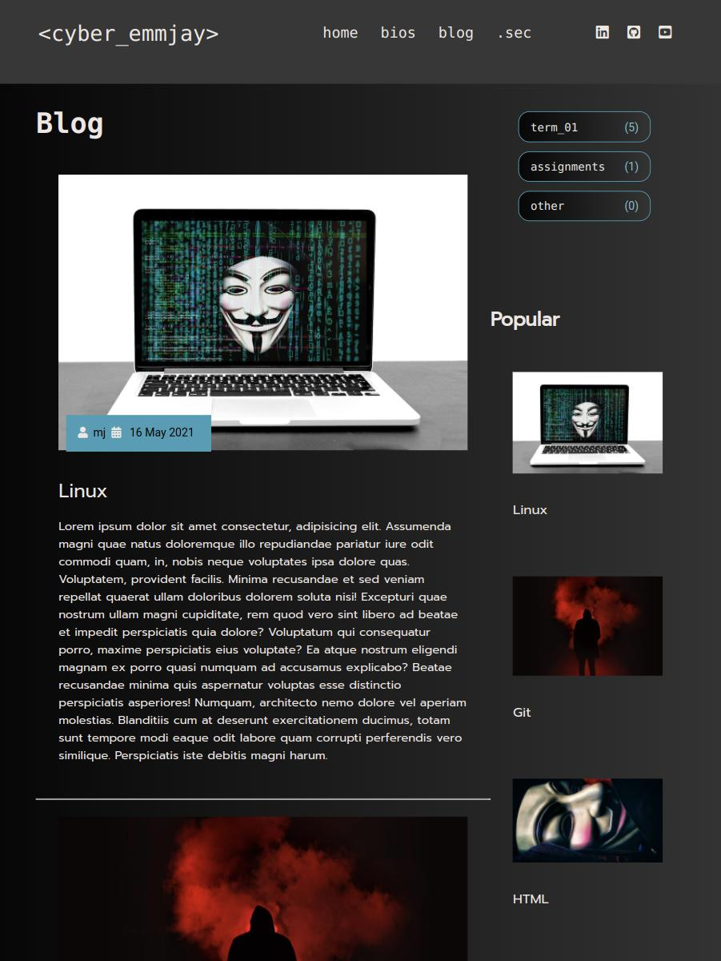
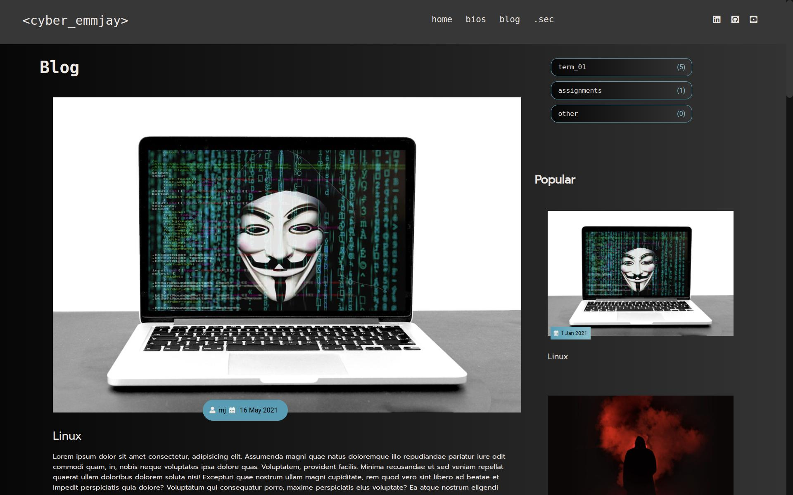
Website | blog
Desktop
iPad Pro

Slide 21
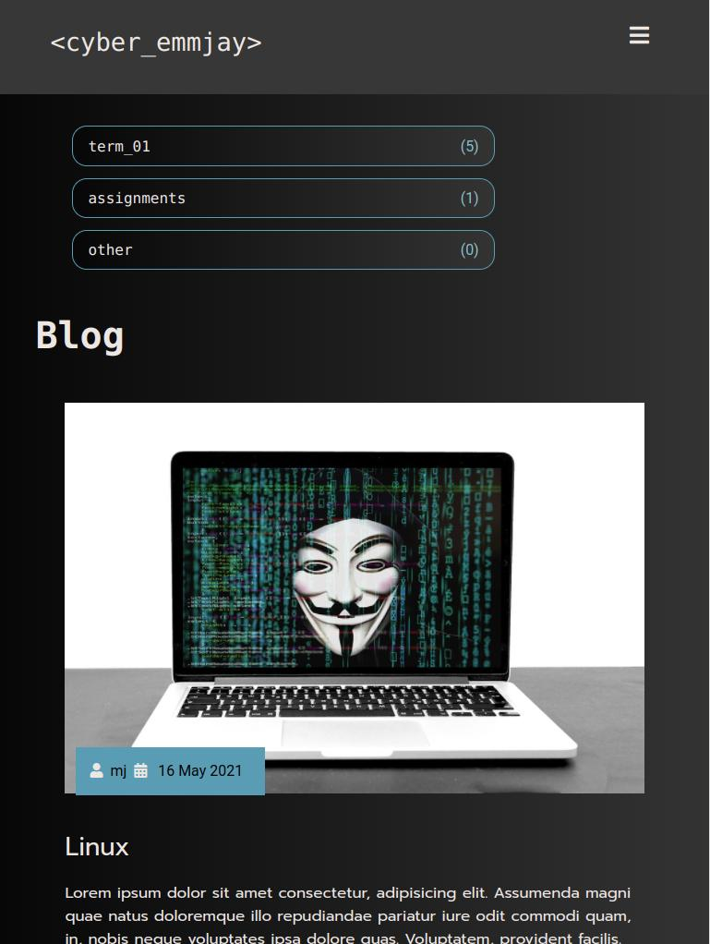
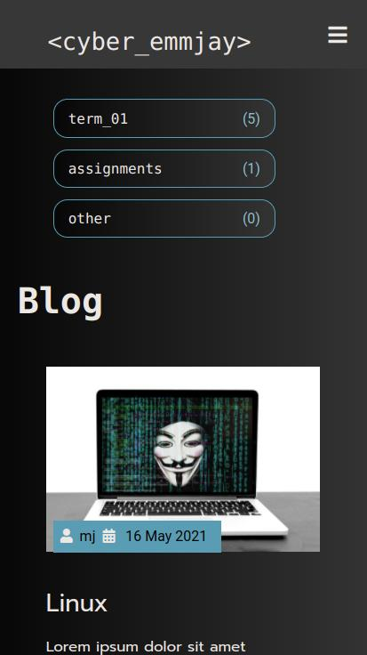
Website | blog
iPad
iPhone

Slide 22

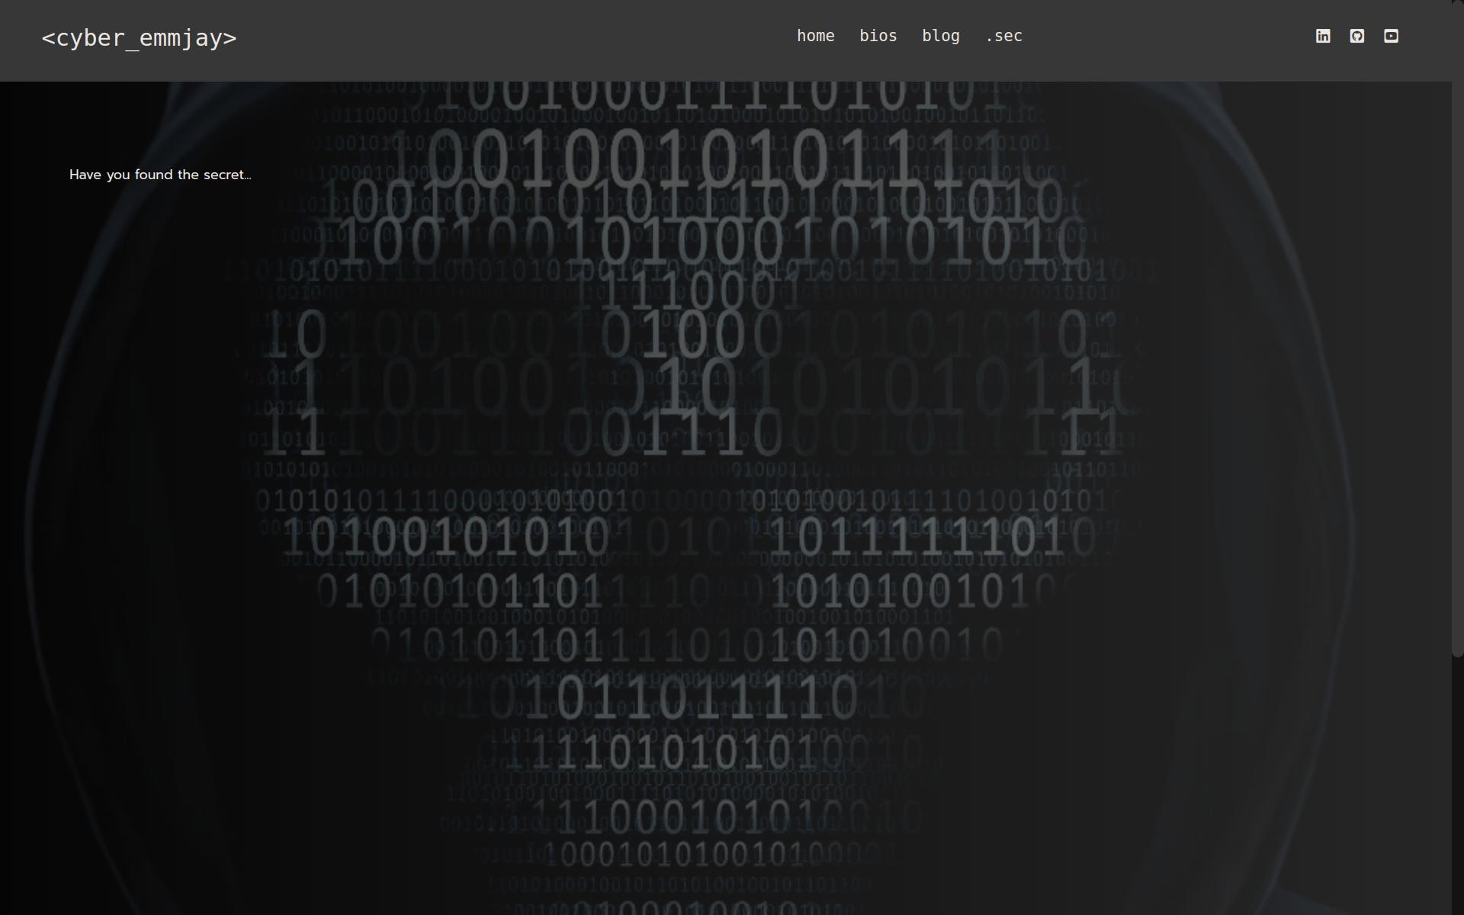
Website | .sec
Desktop
iPad Pro

Slide 23


Website | .sec
iPad
iPhone

Slide 24

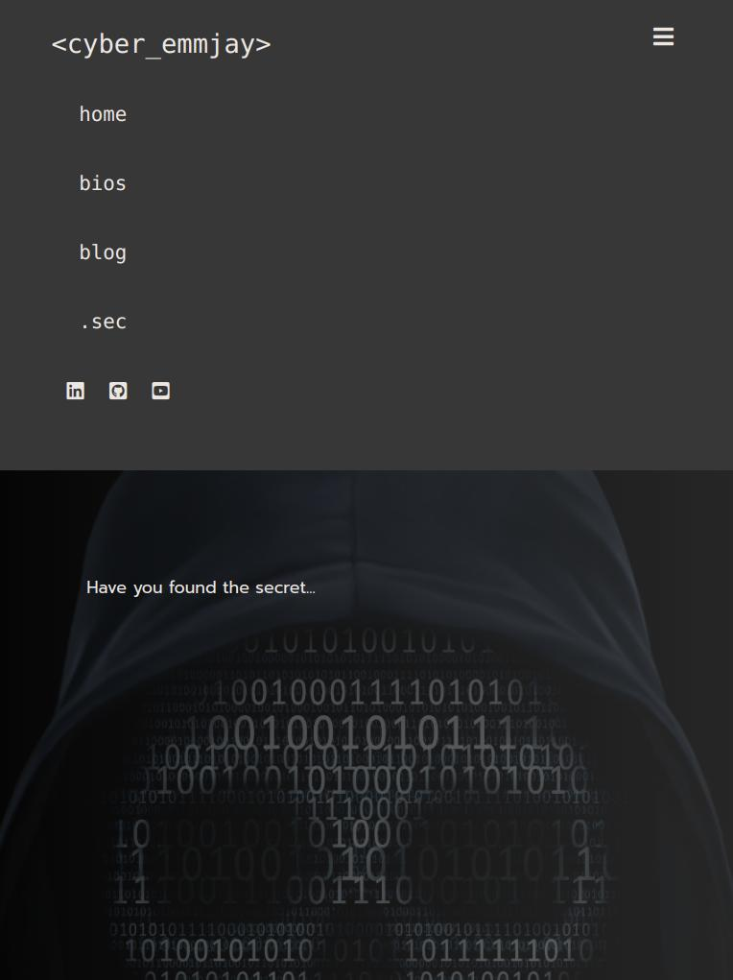
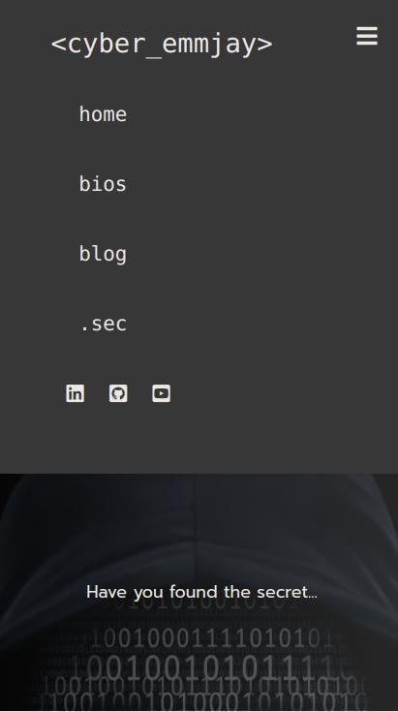
Website | nav
iPad Pro
iPad
iPhone

Slide 25
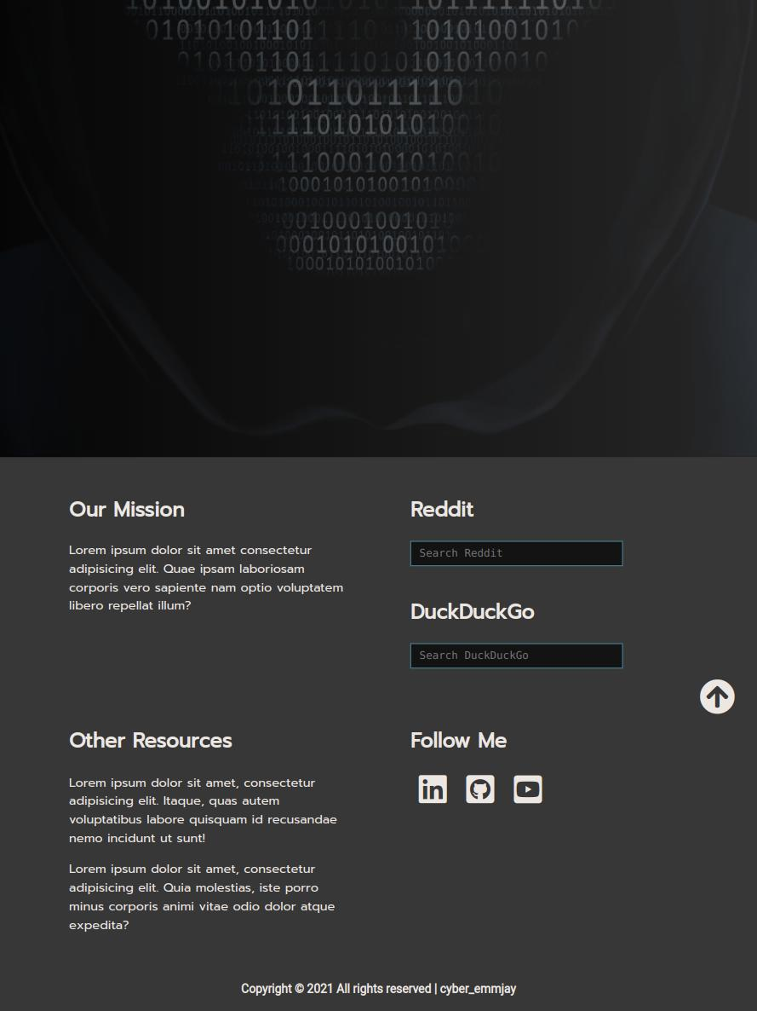

Website | footer
Desktop
iPad Pro

Slide 26
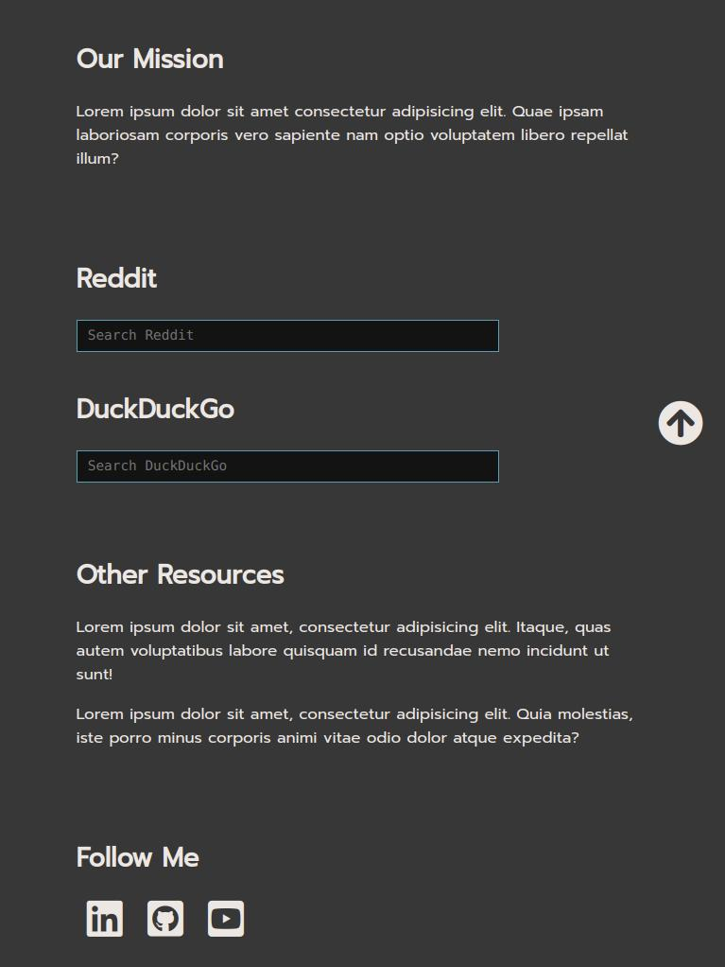
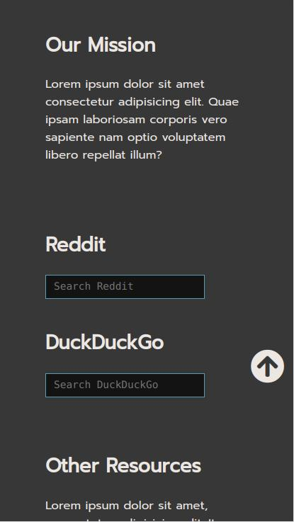
Website | footer
iPad
iPhone

