Slide 1
<cyber_emmjay>
Portfolio
Matt Rooney

Slide 2
Design Process
Research – Google-Fu beautiful websites for inspiration
Refresh – Take breaks often, hit the coffee early not late
Wireframe – Mock up some designs in balsamiq
Run-Wit-It – Hit the code and build
Brickwall – GoogleFu for guides, tuts and stackoverflow answers
Experiment – Throw a spanner in the works just for kicks
Decision – What do I want for dinner...
Rinse-Repeat – Move to the next line and start again

Slide 3
Visual
Theme - I want to learn to hack so Hacker vibes
- Dark theme / White text
- Accessible colours used to distinguish objects
Content - Each page unique with display type of content
- Responsive (best I can get for now)
Layout - Shared Nav & Footer for all pages

Slide 4
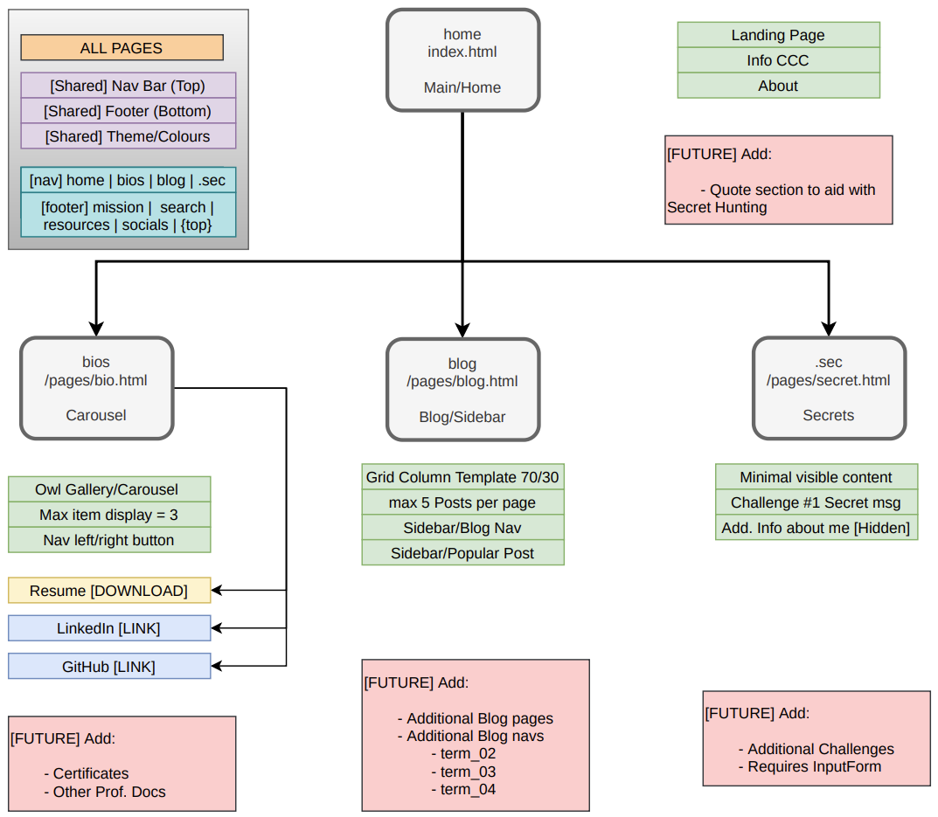
Sitemap
Four Pages:
Home index.html
Bio pages/bio.html
Blog pages/blog.html
Secret pages/secret.html

Slide 5
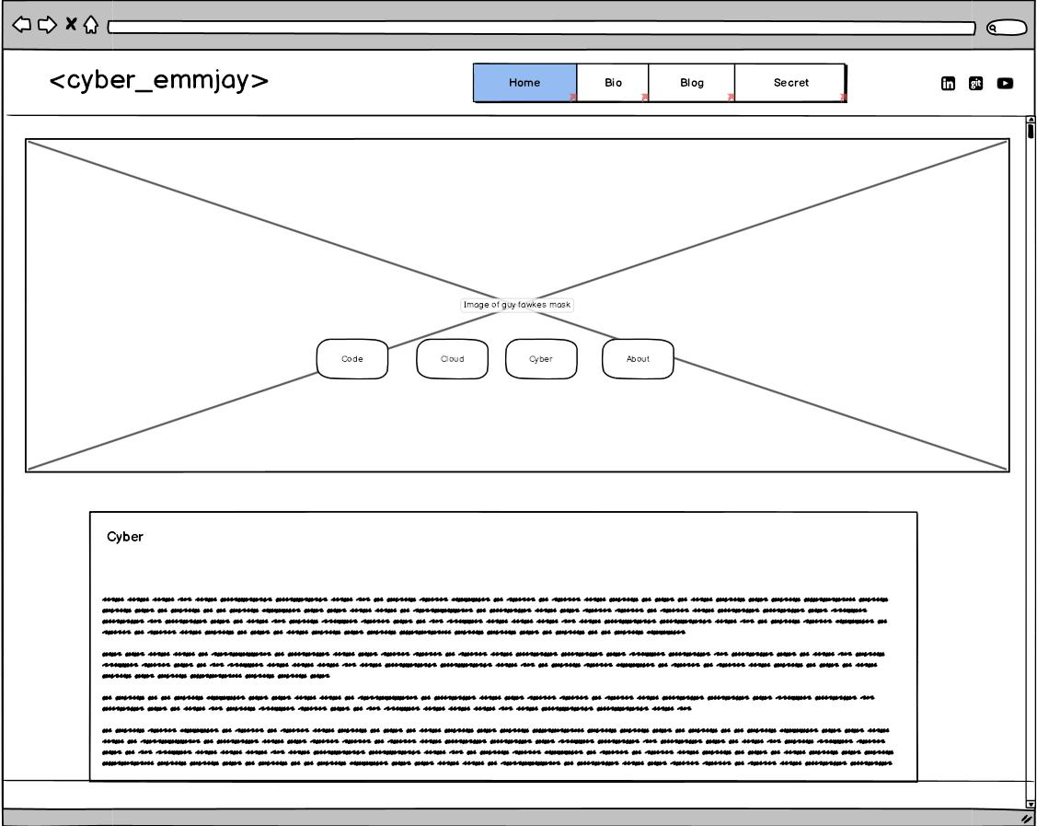
Wireframe | Desktop > Home
Components:
Site:
css background img (hacker)
4 button/anchors - row large
Content:
code
cloud
cyber
about
1400px
width: 75%
800px
width: 85%

Slide 6
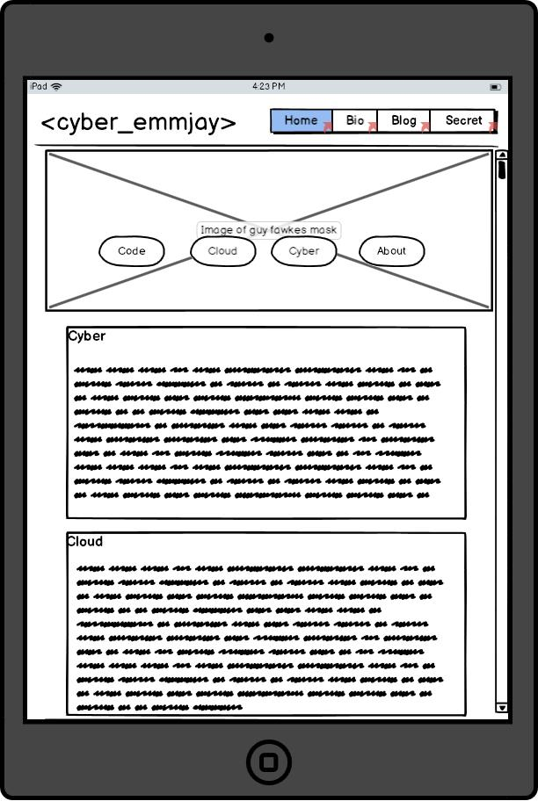
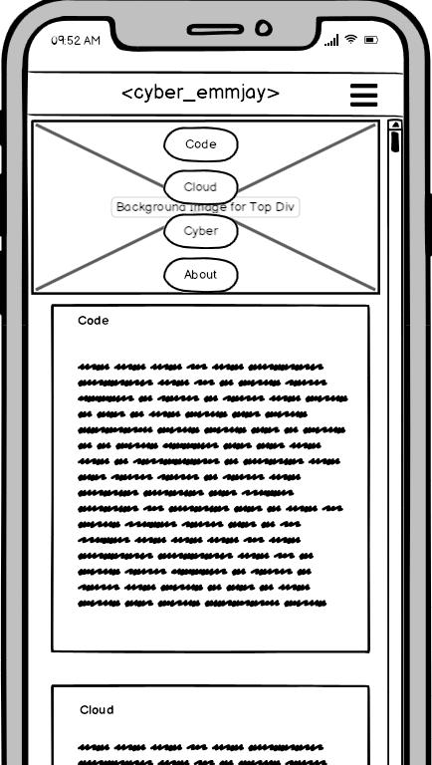
Wireframe | Mobile & Tablet > Home
Mobile
Tablet
Main Site:
responsively shrinks
button: column, small
Content:
containers:
width:
text shrinks
Main Site:
button row large
Content:
containers:
width expands
text shrinks
800px
width: 85%
450px
width:

Slide 7
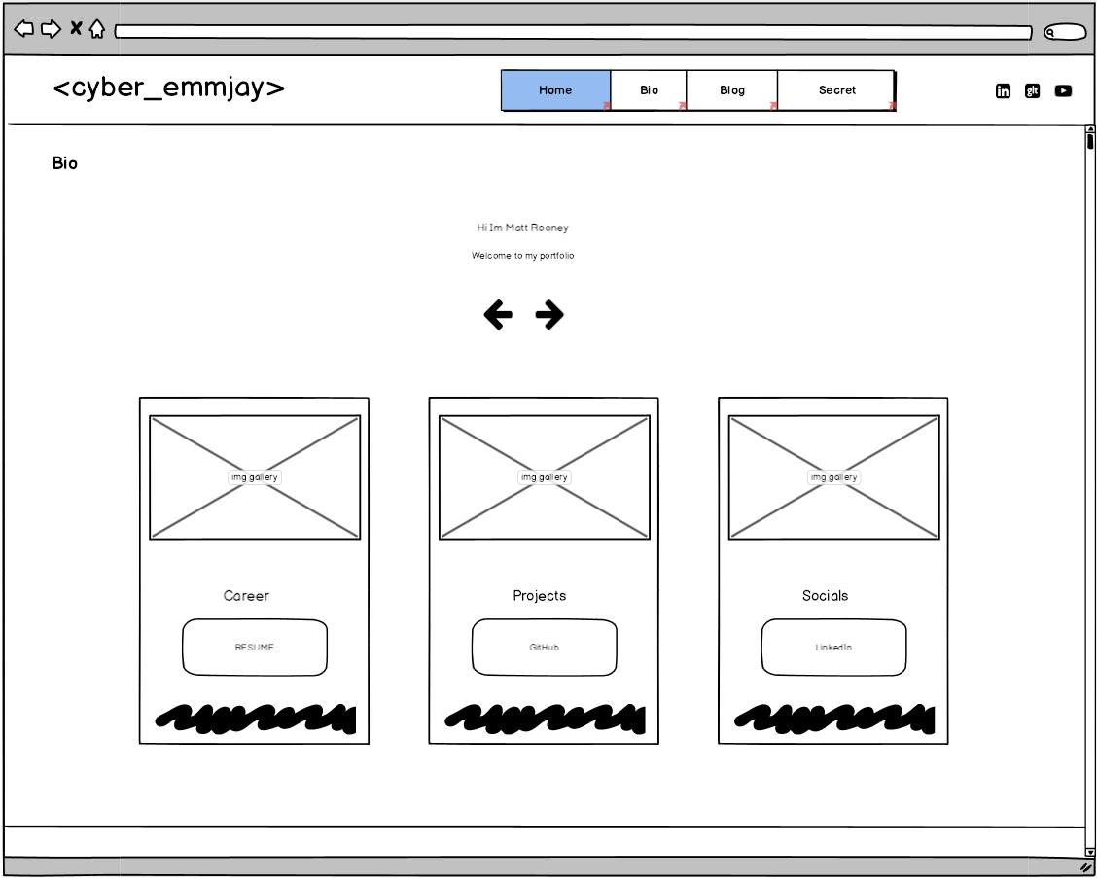
Wireframe | Desktop > Bio
Carousel:
3 items are displayed on large desktop screens
Nav left/right button
Each item contains an Image, Title, Download button and short quote

Slide 8
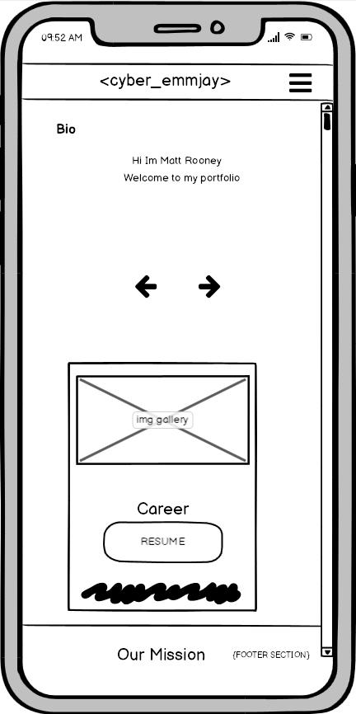
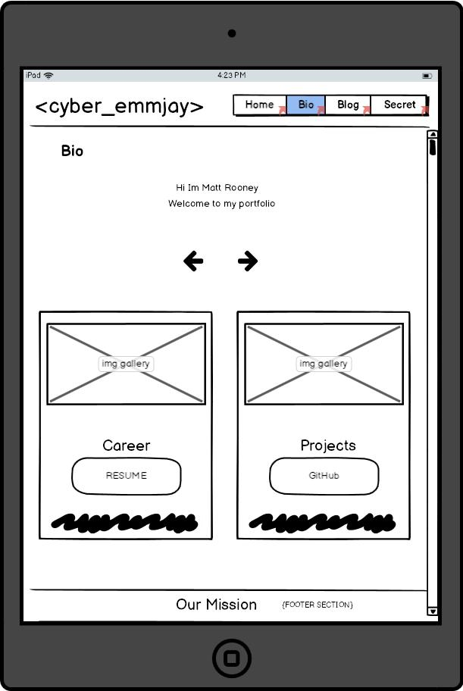
Wireframe | Mobile & Tablet > Bio
Carousel:
1 item only displayed on small screen
Carousel:
2 items displayed on medium screen

Slide 9
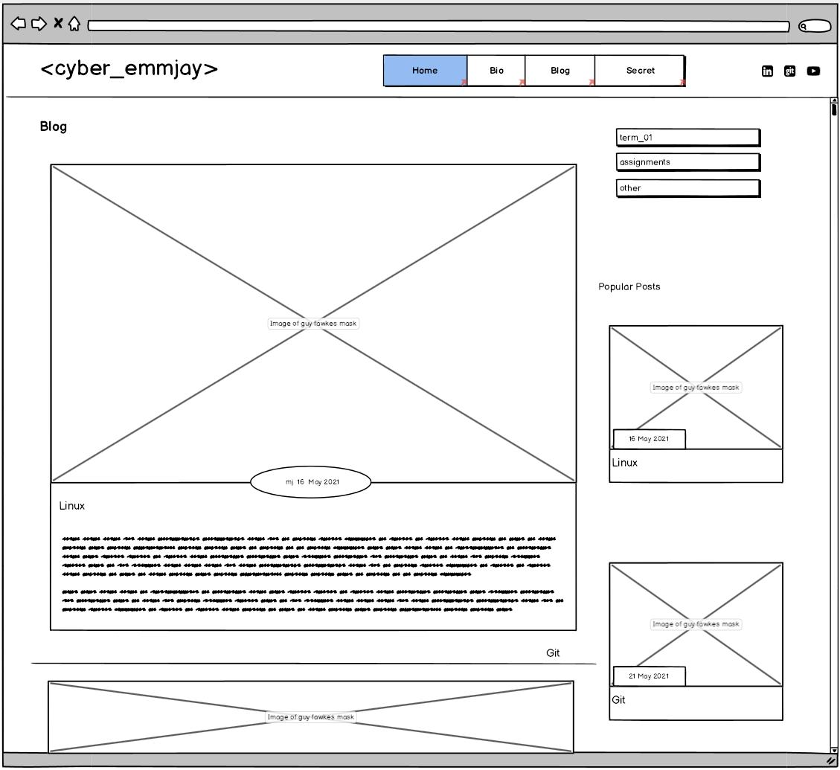
Wireframe | Desktop > Blog
Blog page is using a grid template columns
70% Main Content / 30% Sidebar
The Sidebar contains in page nav for the blog sections and also a popular post with a max of 3 popular post that can be displayed

Slide 10
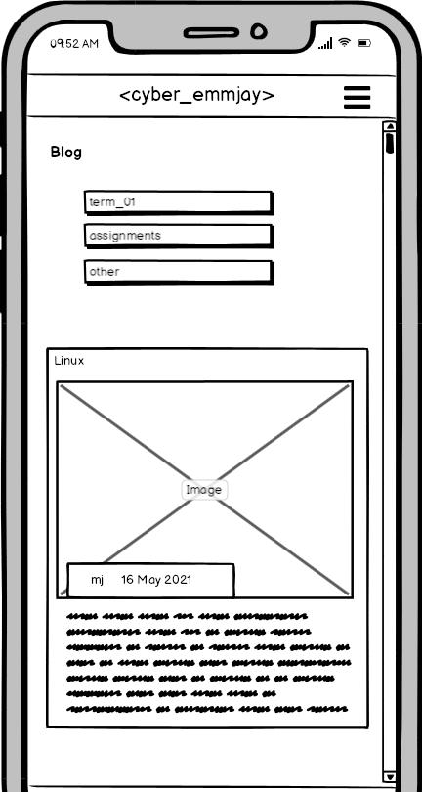
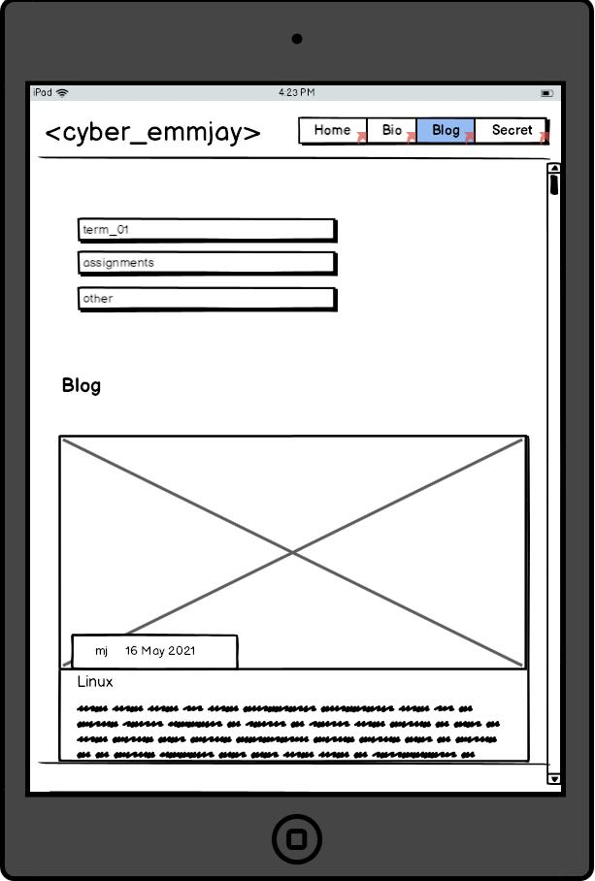
Wireframe | Mobile & Tablet > Blog
The sidebar is pushed to the top of the screen Blog post are then nested below Sidebar
The popular post section is hidden on small to medium screen sizes

Slide 11
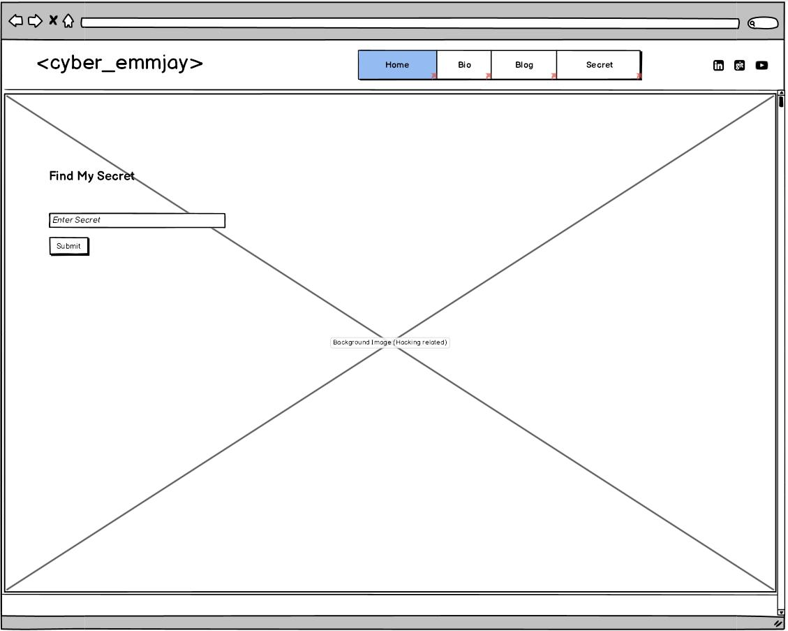
Wireframe | Desktop > Secret

Slide 12
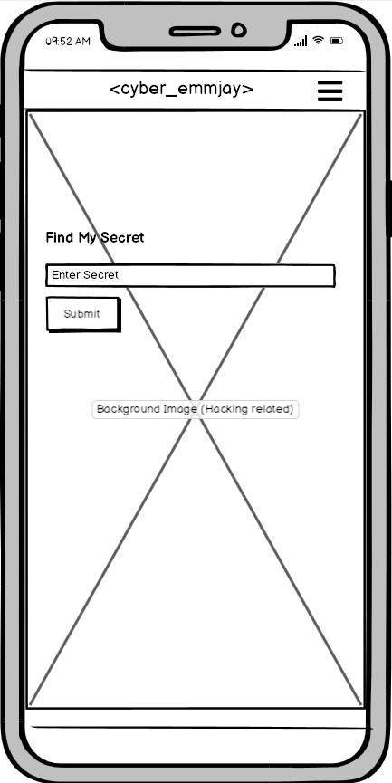
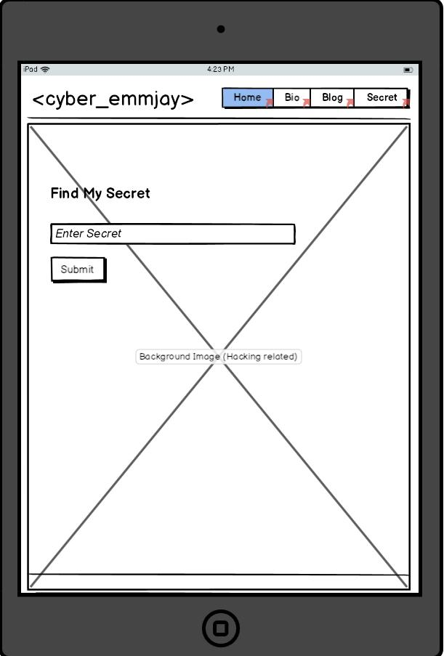
Wireframe | Mobile & Tablet > Secret

Slide 13
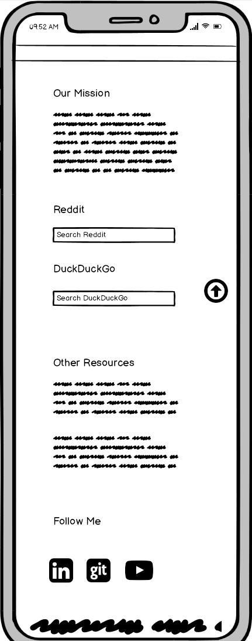
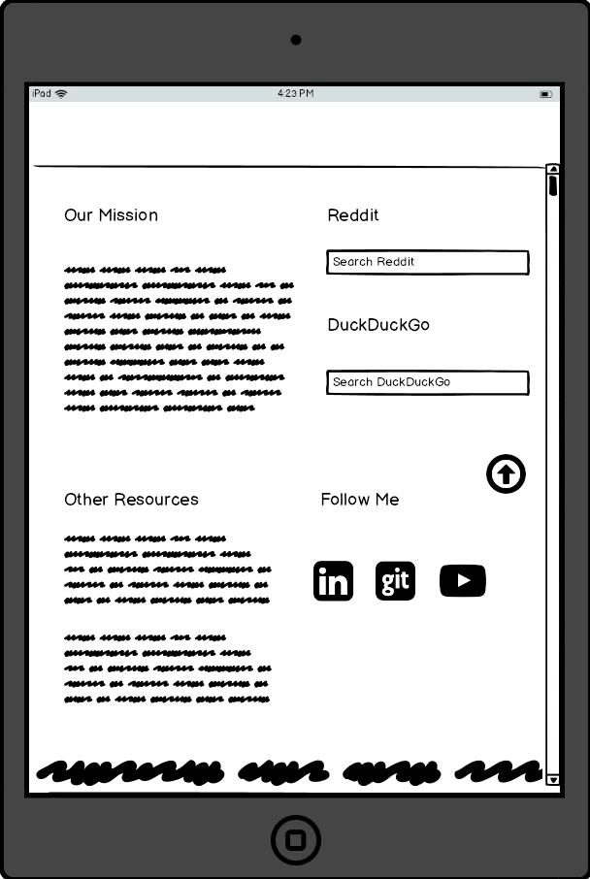
Wireframe | Mobile & Tablet | Footer

Slide 14
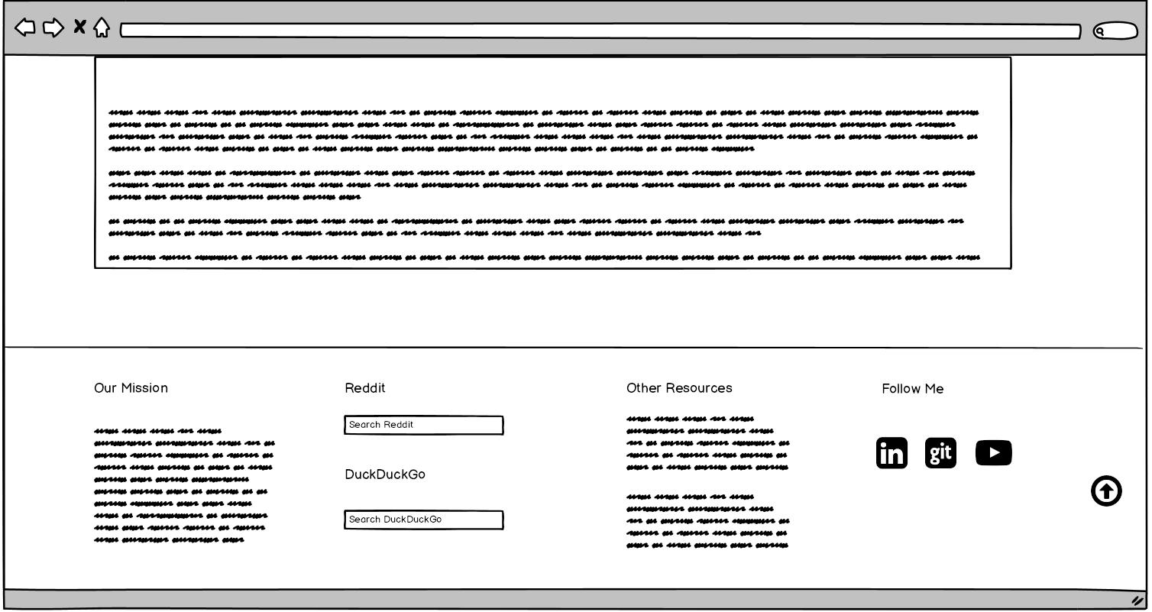
Wireframe | Desktop | Footer

Slide 15
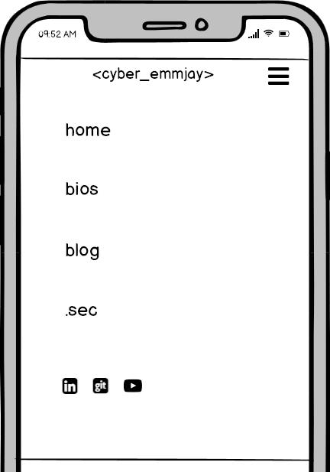
Wireframe | Mobile > Nav

