Slide 1


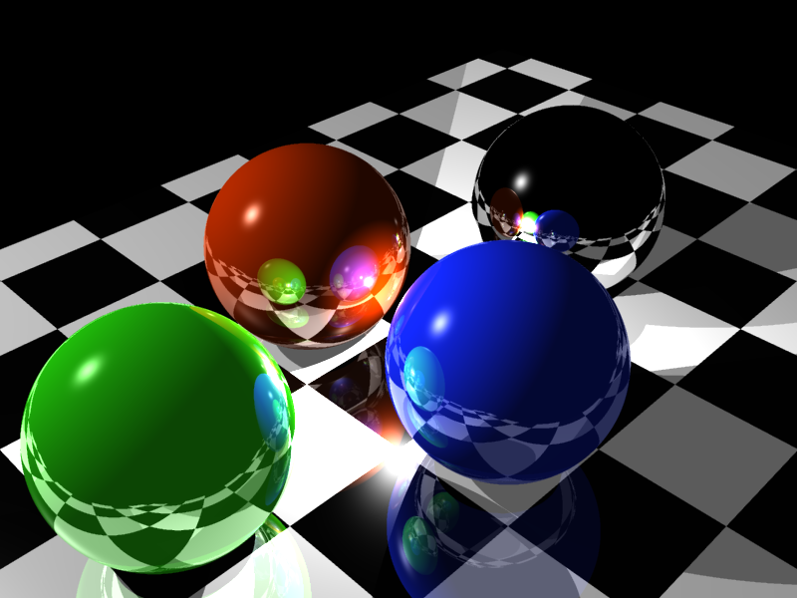
Intersection between curves and rational surfaces by means of matrix-based implicit representations
<numéro>
Sophie Bruge – Valentin Michelet – Rémy Abdeljalil
June, 15th 2012

Slide 2
Summary
Back to basics
  Ray-Tracing concepts
  Existant software
  Objectives
Theorical part
  Representation matrix construction
  Intersection
  Normal
Results & Achievements
  Several surfaces
  Demonstration
  Conclusion
<numéro>
Bruge – Michelet – Abdeljalil

Slide 3
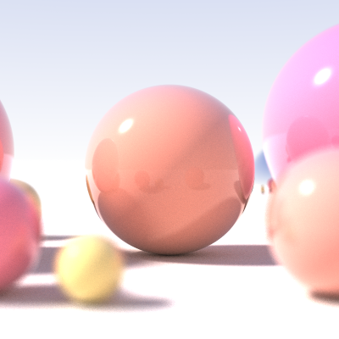
      What is Ray Tracing?
Back to basics
- RayTracing
- Software
- Goals
Theorical Part
Results & Achievements
Algorithm to render 3D images
Light properties and equations
Intersections between ray and objects
Shadows, reflexion, diffraction...
<numéro>
Bruge – Michelet – Abdeljalil

Slide 4
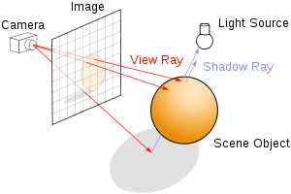
What is Ray Tracing?
Back to basics
- RayTracing
- Software
- Goals
Theorical Part
Results & Achievements
<numéro>
Bruge – Michelet – Abdeljalil

Slide 5
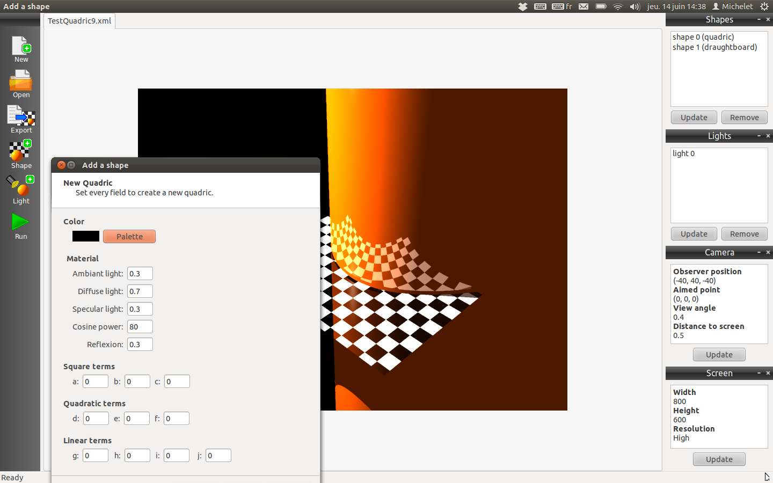
Existent software
Back to basics
- RayTracing
- Software
- Goals
Theorical Part
Results & Achievements
Ray tracer engine
Primary implicit objects
XML Serialisation
Graphical User Interface
<numéro>
Bruge – Michelet – Abdeljalil

Slide 6
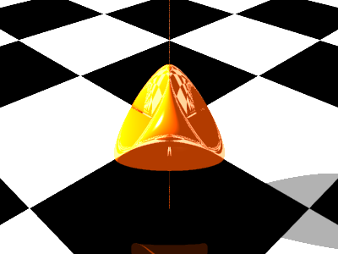
Objectives
Back to basics
- RayTracing
- Software
- Goals
Theorical Part
Results & Achievements
Add a class inside an existing project
Render parametrized surfaces
Use linear algebra tools
Check numerical stability
<numéro>
Bruge – Michelet – Abdeljalil

Slide 7
Purpose of the project
Back to basics
- RayTracing
- Software
- Goals
Theorical Part
Results & Achievements
Implicit equation: f(X,Y,Z)=0
Replace R in f: P(t) = 0
Explicit equation:
Hard to find an implicit equation of this
<numéro>
Bruge – Michelet – Abdeljalil

Slide 8
Characterization
Back to basics
Theorical Part
- Matrix
- Intersections
- Normal
Results & Achievements
Consider the homogeneous parametrization
of the sphere in a projective space:
Purpose: find MΦ(P) such as:
<numéro>
Bruge – Michelet – Abdeljalil
Bruge – Michelet – Abdeljalil

Slide 9
Representative Matrix
Back to basics
Theorical Part
- Matrix
- Intersections
- Normal
Results & Achievements
Consider the following application:
1- Substitute Ti by fi
MΨ=
f1 f2 f3 f4
d = 2
ν = 1
<numéro>
Bruge – Michelet – Abdeljalil

Slide 10
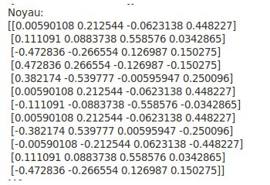
Kernel
Back to basics
Theorical Part
- Matrix
- Intersections
- Normal
Results & Achievements
  2- We find the kernel by a svd decomposition
We obtain a normalize kernel
With 4 elements.
g1
g2
g3
g4
<numéro>
Bruge – Michelet – Abdeljalil

Slide 11
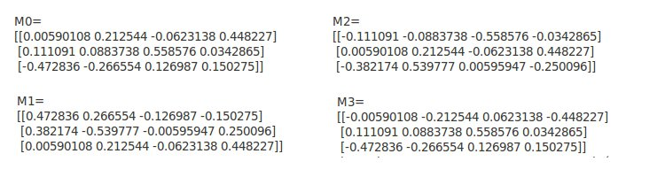
Back to basics
Theorical Part
- Matrix
- Intersections
- Normal
Results & Achievements
3- Multiply each Kernel element by τ
τ =
<numéro>
Bruge – Michelet – Abdeljalil

Slide 12
Drop of rank property
Back to basics
Theorical Part
- Matrix
- Intersections
- Normal
Results & Achievements
Why this previous matrix assure a drop of rank?
If we evaluate it in Ti = fi(X,Y,Z):
<numéro>
Bruge – Michelet – Abdeljalil

Slide 13
Reciprocal
Back to basics
Theorical Part
- Matrix
- Intersections
- Normal
Results & Achievements
We could demonstrate that the reciprocal is true for a good choice of ν:
If f1 f2 f3 f4 have a common root:
<numéro>
Bruge – Michelet – Abdeljalil

Slide 14
Intersections computation
Back to basics
Theorical Part
- Matrix
- Intersections
- Normal
Results & Achievements
Goal: intersection(s) between a surface Φ and a ray R:
→ getting the normal of a point P belonging to Φ.
Representation matrix:
Replacing :
We have with:
We search t such as drops → generalized eigenvalues
→ Only relevant to square matrix !
<numéro>
Bruge – Michelet – Abdeljalil

Slide 15
Matrix pencil
Back to basics
Theorical Part
- Matrix
- Intersections
- Normal
Results & Achievements
Theorem: suppose given pencil (A,B) such as
→
rank(B)
: regular part with A' and B' square and B' reversible
Algorithm of the extraction:
  Step 1: B into its column echelon form using a SVD decomposition:
  →
  rank(B)
  Step 2: Same transformation to A:
rank(B)
<numéro>
Bruge – Michelet – Abdeljalil

Slide 16
Matrix pencil
Back to basics
Theorical Part
- Matrix
- Intersections
- Normal
Results & Achievements
Step 3: Echelon form by rows of A1 using a SVD decomposition:
→ We have the decomposition:
rank(A1)
rank(B)
We repeat all the steps on (A',B') until rank(A1)=0.
<numéro>
Bruge – Michelet – Abdeljalil

Slide 17
Intersection points
Back to basics
Theorical Part
- Matrix
- Intersections
- Normal
Results & Achievements
We have all the elements needed:
  Φ : parametrisation of the surface S.
  M(T1, ..., T4) : representation matrix.
  Ψ : parametrisation of the curve C.
The intersection points are found :
  1) Forming the matrix MΨ(t).
  2) Extraction of the regular part A'-tB' from pencil A-tB of MΨ(t).
  3) Computing all of the generalized eigenvalues {t1, ..., tr} from A'-tB'.
  4) We output all of the points {Ψ(t1), ..., Ψ(tr)} → all of the intersection points of S ∩ C.
<numéro>
Bruge – Michelet – Abdeljalil

Slide 18
Normal
Back to basics
Theorical Part
- Matrix
- Intersections
- Normal
Results & Achievements
 : parametrisation of the surface.
Suppose given a point P ∈ Im(Φ) and the basis :
Reversing the parametrisation → finding couple (s,t) corresponding.
We need : and we always have :
We search such as
Normal :
Parametrisation inversion : rank(MΦ) drops by 1 if P ∈ Im(Φ).
<numéro>
Bruge – Michelet – Abdeljalil

Slide 19
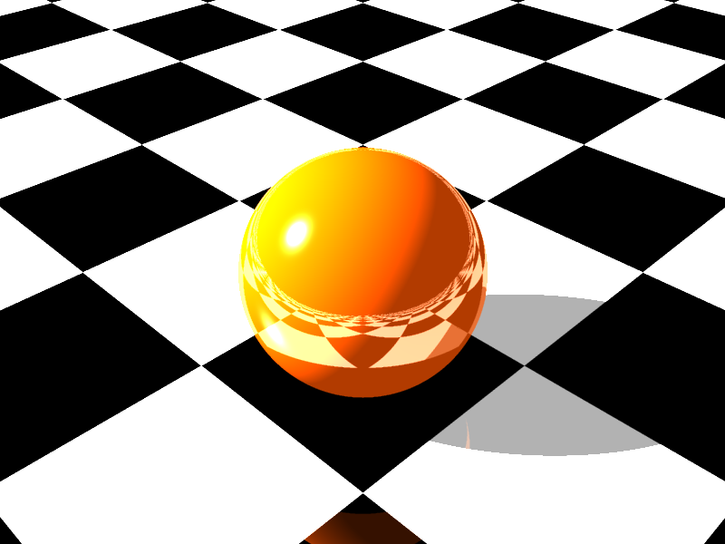
Sphere
Back to basics
Theorical Part
- Matrix
- Intersections
- Normal
Results & Achievements - Surfaces
- Demo
- Conclusion
<numéro>
Bruge – Michelet – Abdeljalil

Slide 20
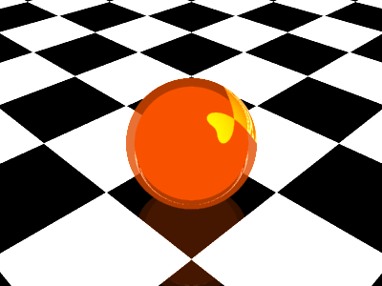
Sphere
Back to basics
Theorical Part
- Matrix
- Intersections
- Normal
Results & Achievements - Surfaces
- Demo
- Conclusion
Before sorting → After sorting
<numéro>
Bruge – Michelet – Abdeljalil

Slide 21
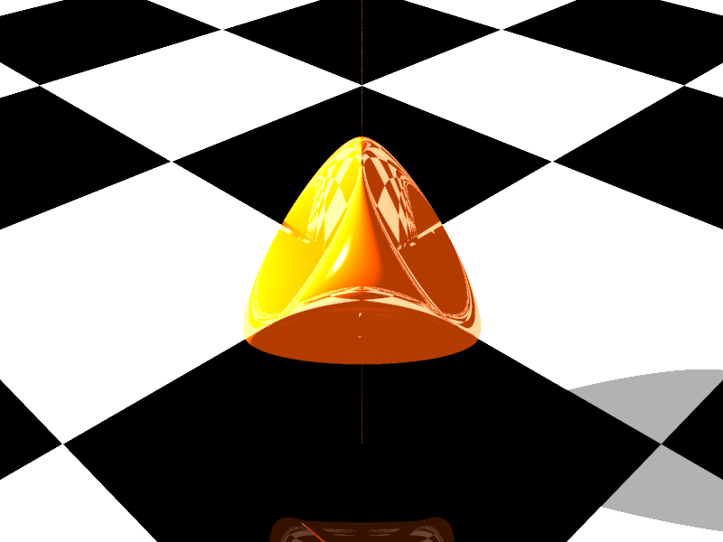
Steiner's Roman Surface
Back to basics
Theorical Part
- Matrix
- Intersections
- Normal
Results & Achievements - Surfaces
- Demo
- Conclusion
<numéro>
Bruge – Michelet – Abdeljalil

Slide 22
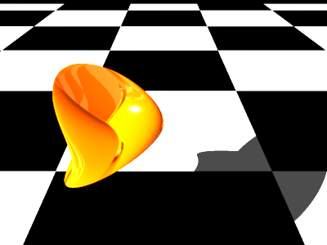
Boy's Surface
Back to basics
Theorical Part
- Matrix
- Intersections
- Normal
Results & Achievements - Surfaces
- Demo
- Conclusion
<numéro>
Bruge – Michelet – Abdeljalil

Slide 23
Boy's Surface
Back to basics
Theorical Part
- Matrix
- Intersections
- Normal
Results & Achievements - Surfaces
- Demo
- Conclusion
<numéro>
Bruge – Michelet – Abdeljalil

Slide 24
Demonstration
Back to basics
Theorical Part
- Matrix
- Intersections
- Normal
Results & Achievements - Surfaces
- Demo
- Conclusion
A quick overview
of our work...
<numéro>
Bruge – Michelet – Abdeljalil

Slide 25
Demonstration
Back to basics
Theorical Part
- Matrix
- Intersections
- Normal
Results & Achievements - Surfaces
- Demo
- Conclusion
And now...
some movies!
<numéro>
Bruge – Michelet – Abdeljalil

Slide 26
Conclusion
Back to basics
Theorical Part
- Matrix
- Intersections
- Normal
Results & Achievements - Surfaces
- Demo
- Conclusion
New intersection algorithm
Interesting numerical stability
Good-looking surfaces
Rewarding experience

Slide 27
References
Back to basics
Theorical Part
- Matrix
- Intersections
- Normal
Results & Achievements - Surfaces
- Demo
- Conclusion
Sources:
  “Intersection entre courbes
  et surfaces rationnelles” L. Busé
  www.ipfw.edu/math/Coffman/steinersurface.html
Special thanks to our supervisor:
  Laurent Busé

Slide 28
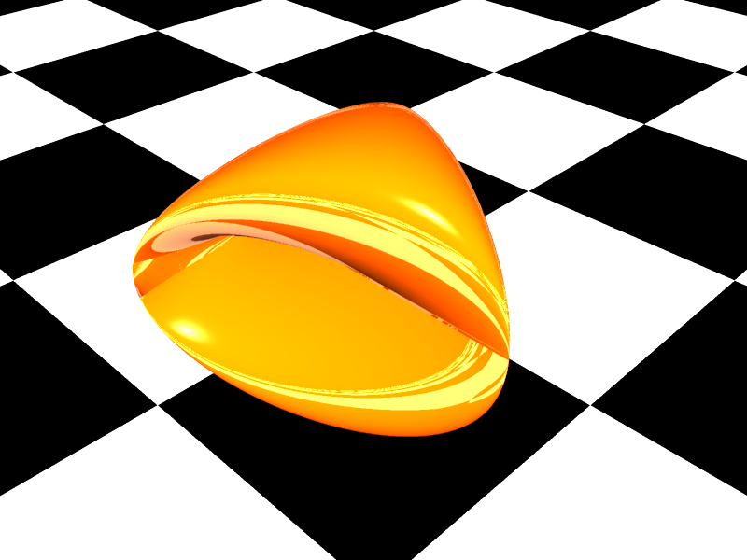
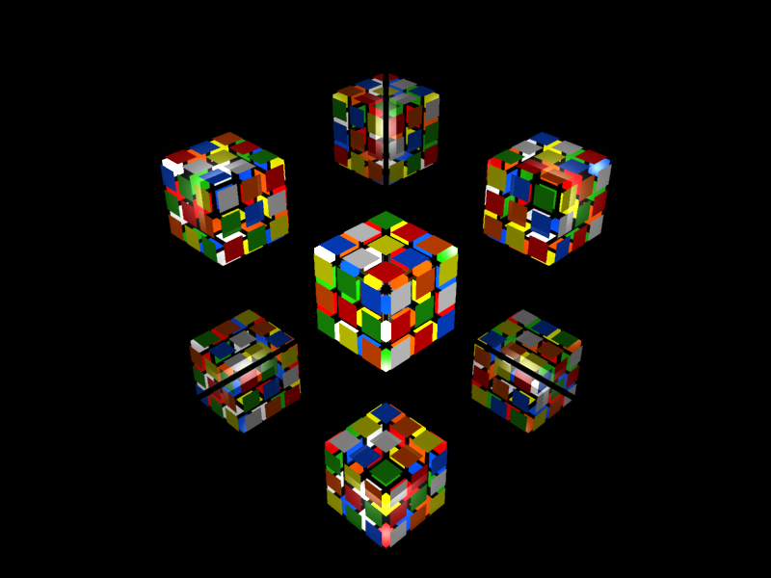
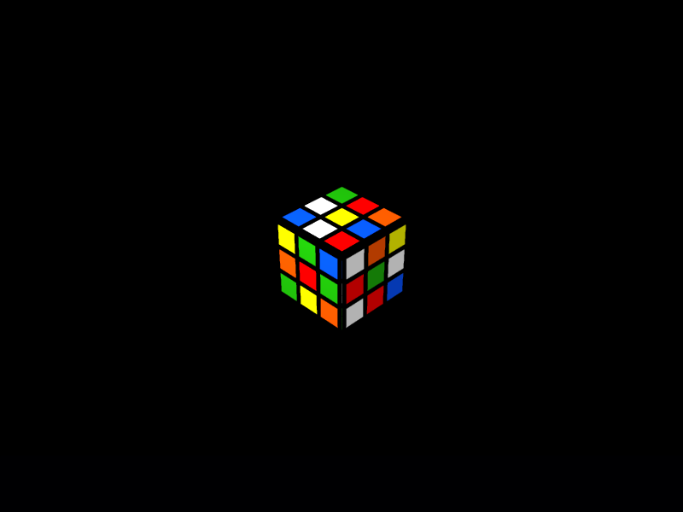
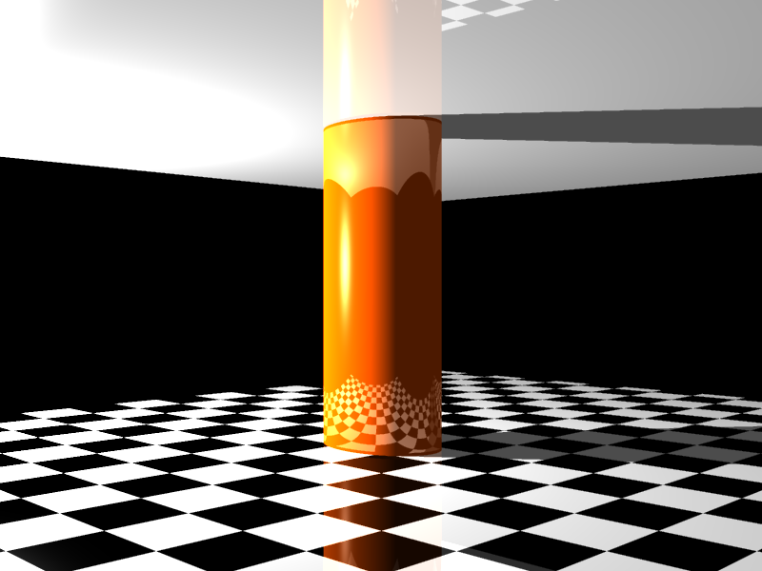
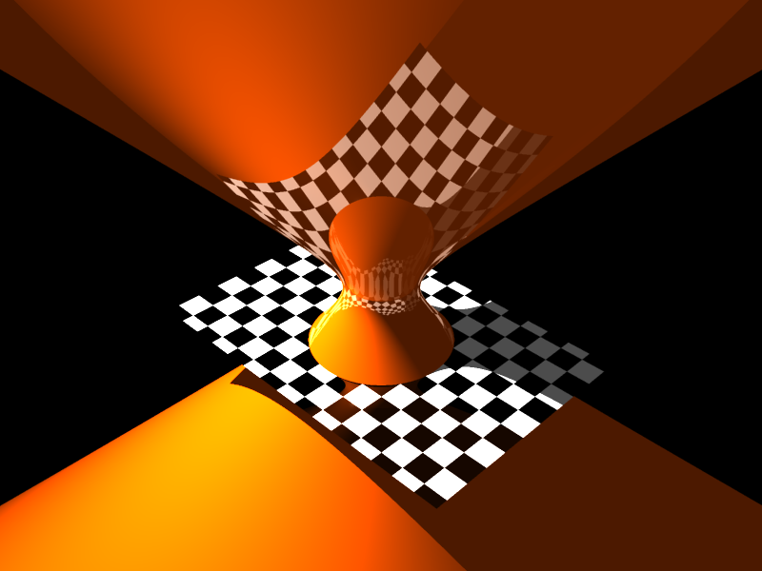
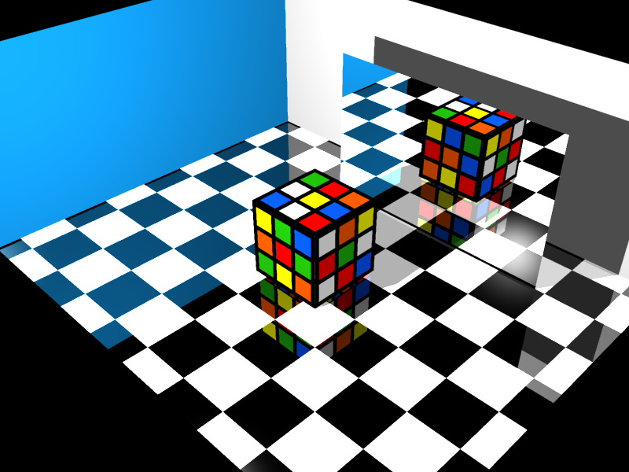
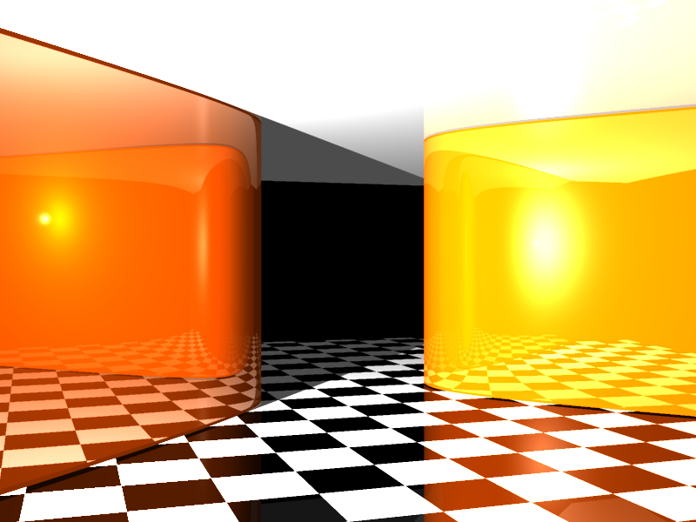
Thank you

