Slide 1
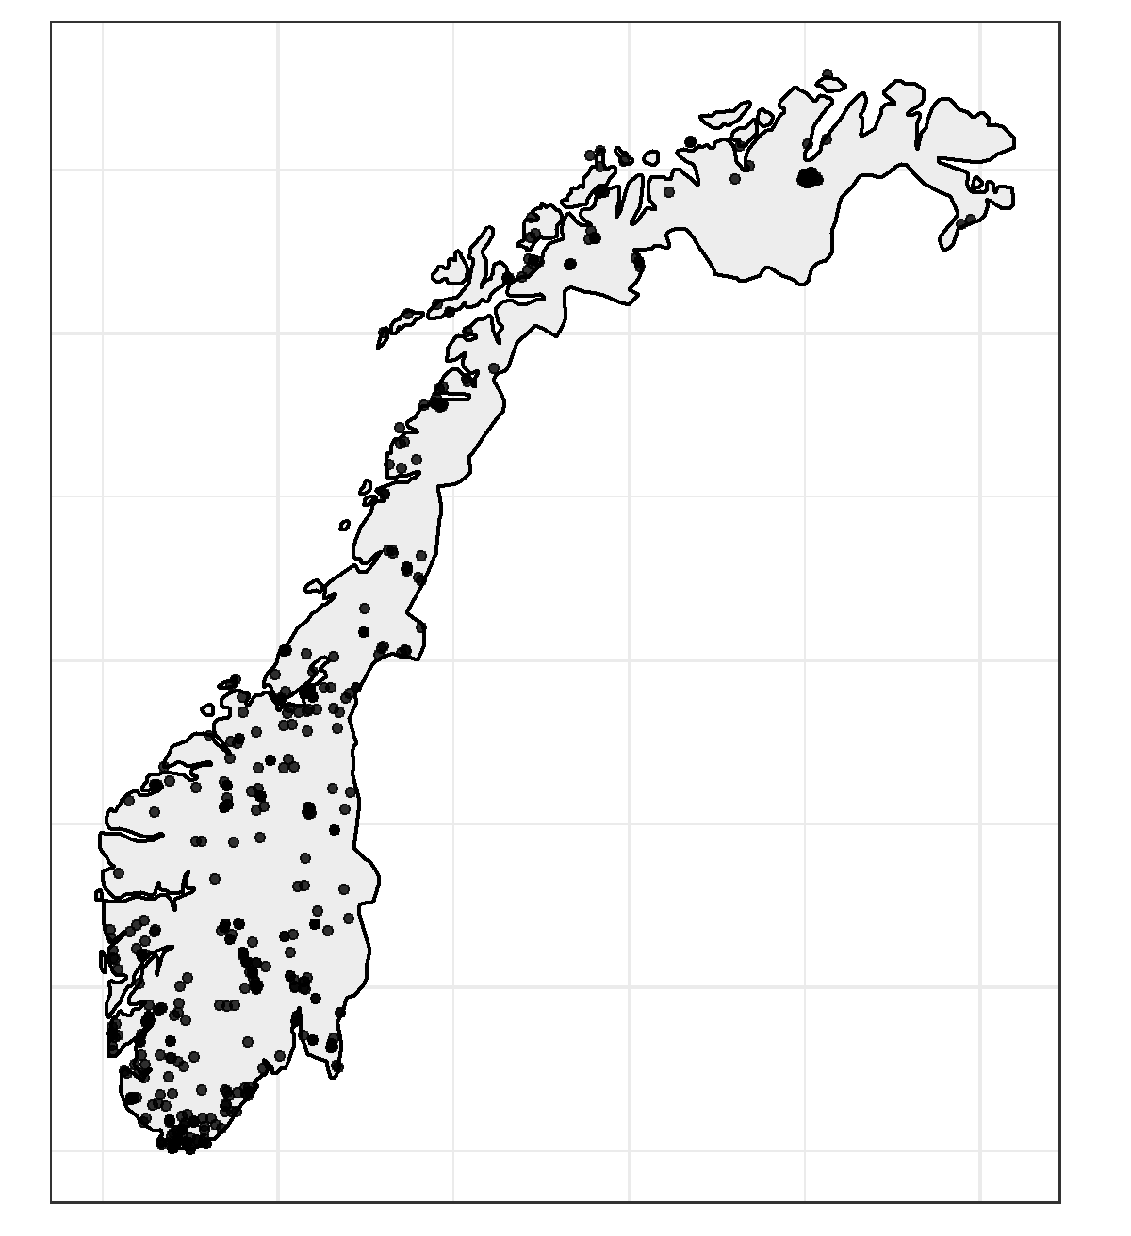
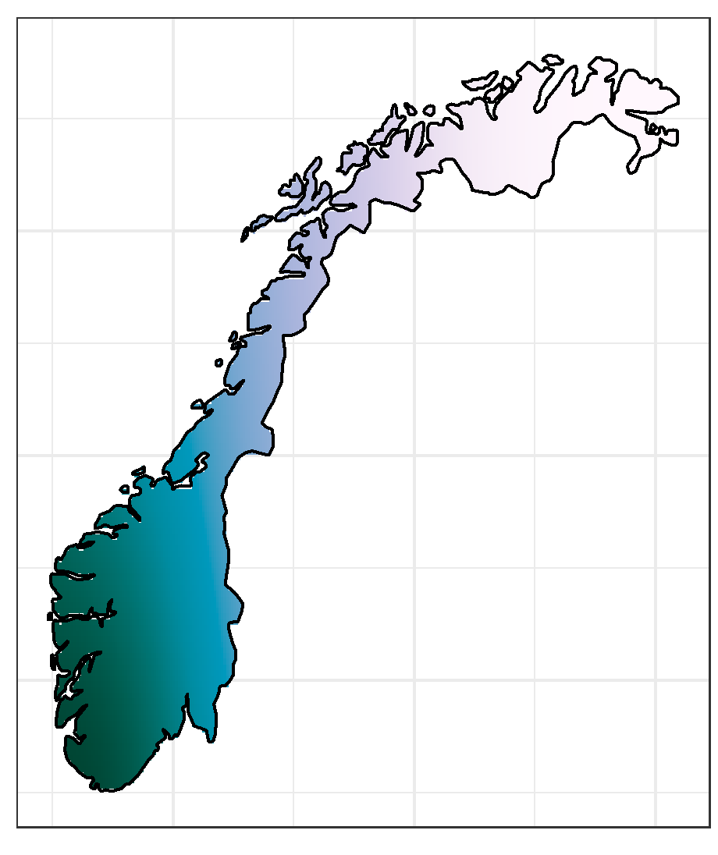
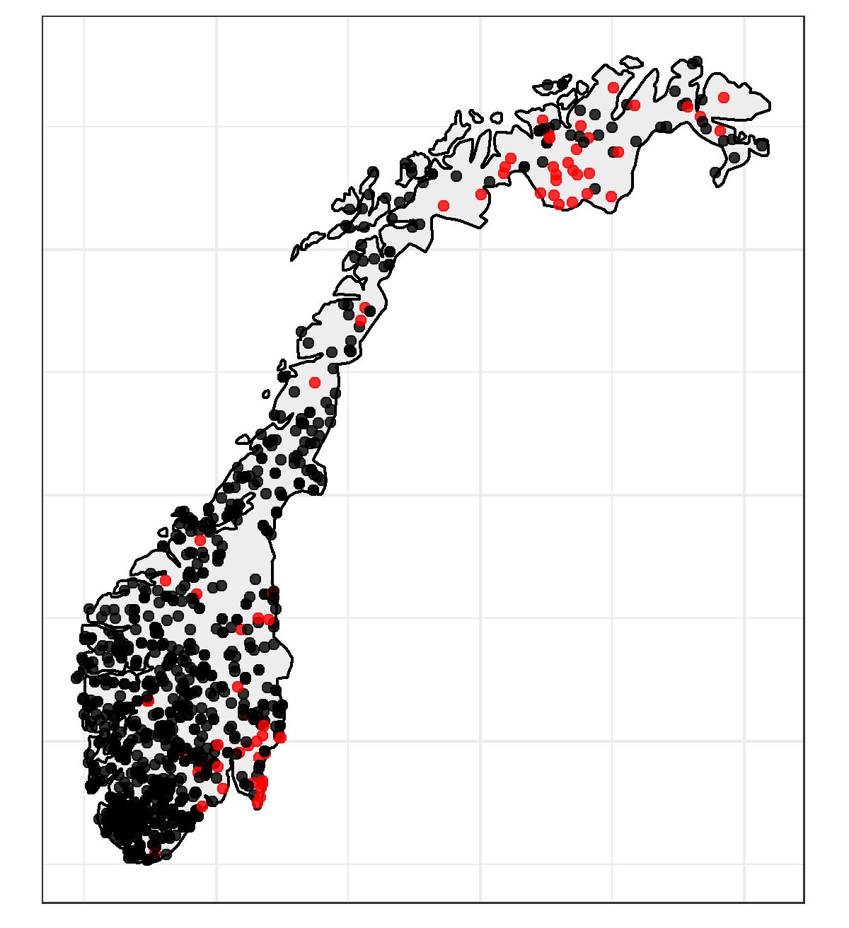
Observation model 1:
Poisson regression (log link)
Process model:
Log Gaussian Cox process
Presence-only:
citizen science obs.
Observation model 2:
Binomial regression (cloglog link)
Posterior predicted
intensity
Presence/absence:
survey data

