Slide 1
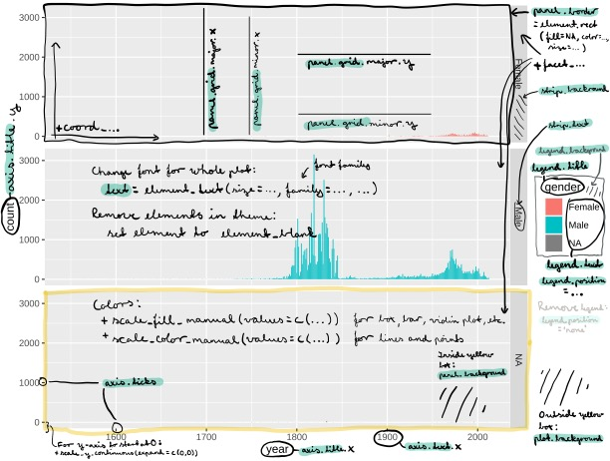
THE ANATOMY OF A ggplot2-PLOT
Emma Skarstein • emma.s.skarstein@ntnu.no • Updated: 2021-10

