Slide 1

MELBOURNE

Slide 2

Data Science with Data the Dachshund
Data & Emma Arrigo | 2019

Slide 3
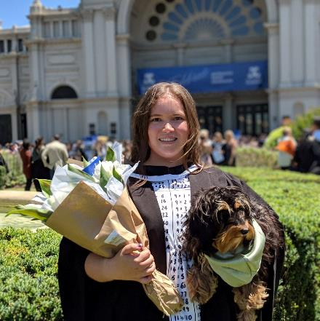

Greetings
Me
Data the Dachshund
Notes:
Hello future data scientsts, I am Emma. I am a Master’s of Data science student at the University of Melbourne and interning at Mass Dynamics. I have a dog called Data, so I am very qualified in talking about data. This presentation is called ‘Data Science with Data the Dachshund’ because Data will be assisting in explaining the data science process during my presentation through cute pictures.
We will work through a data science problem using AWS services, which I enjoy using, SageMaker for notebooks and S3 for storing the data.
I have made the notebook available for people to play with.

Slide 4

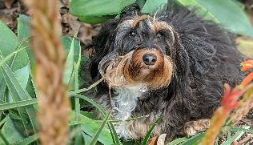


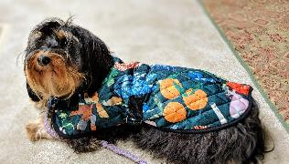
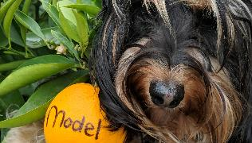
Data Science Roadmap
Image caption 1
Image caption 2
Image caption 3
Image caption 4
Image caption 5
Image caption 6
Notes:
In this presentation we will be working through the data science process. This my data science roadmap. There are 6 phases and I think data does a great job of demonstrating those stages.
Get the data – its dirty, but you love it
Explore – this is super important to understand the data you are working with
Clean the data – this is also crucial, if you do cleaning well it makes your life much easier later
Model – based on explore and the question you are asking you choose your model
Train – this is where you can go back to step 2 and repeat and refine your model
Visualise / present – this is the most glamourous and you get to share what you’ve made!
After the talk I hope you’re inspired and know a bit more about ~data science ~

Slide 5
The Data
Colac Otway Shire Animal Registrations
21 features
Animal breed, name, colour, postcode, age, microchipped
158,026 animals
119,247 dogs
Labrador most popular
1489 dog breeds
Notes:
When asked to do this, I was thinking what could I do! I found this open data set from data.gov.au which has pet ownership for Geelong/Colac in the state of Victoria. We will work through a data science project using this data and let’s see what we can find out ! This is the first step, obtaining the data to use.
In summary this data has information about the animals registered in the shire, their name, type, breed, colour, postcode, age, working dog etc. There are 158,026 pets, 120,000 dogs and 21 features.
So with this kind of information what type of questions can we ask? First lets explore the data, through visualisations to help give us some intuition behind how we should solve a problem.

Slide 6
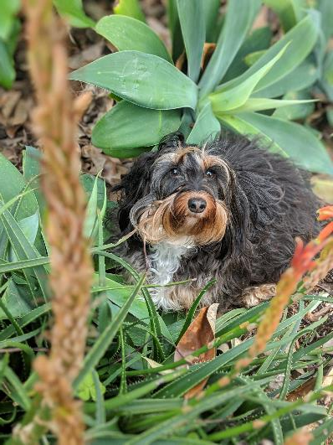
Explore the data
Data exploration is important as it helps you understand the data, gives you intuition behind the data and how you may need to clean it.
Notes:
The next step is to Data exploration. This is a crucial step as it helps guide you and understand the data and how you can use it.

Slide 7
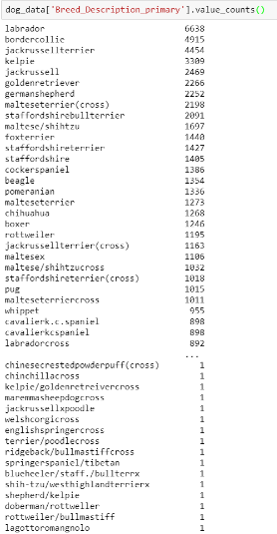
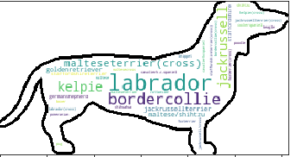
Data exploration- Dog breeds
Notes:
Sometimes a table isn’t the best option. Let’s replace it with a wordcloud! The word cloud has the top 100 breeds

Slide 8
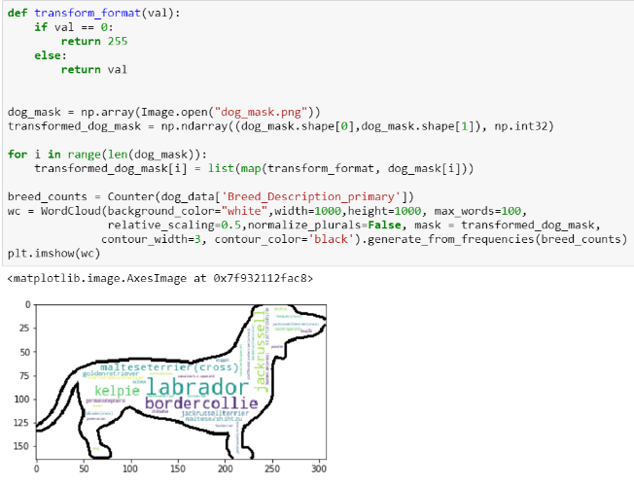
Data exploration- Dog Breeds
Notes:
Code of the word cloud. Its cool right, it took really 5 lines of code to work. Get a count of all the breeds, import the mask shape, make a wordcloud and print it.

Slide 9
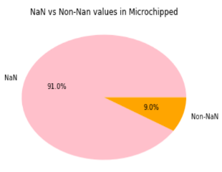
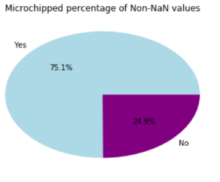
Data exploration- Microchipped
Notes:
Microchipped data is not worth pursing, only 9% of the dogs have a non-NaN value. This is important to find out as we will keep this in mind. Only 9% of the data is useable.
A Nan means not a number and is interpreted as undefined/unrepresentable.
It is interesting as dogs have to be microchipped

Slide 10
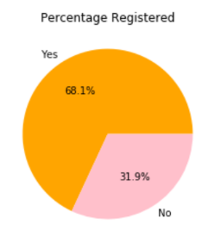
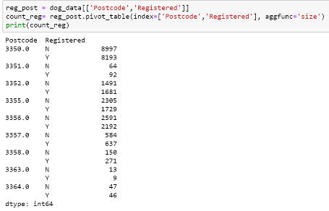
Data exploration-Registrations
Notes:
Registrations, 2/3 of dogs have a non-nan value so it is a useful attribute.
It is interesting how different postcodes have different percentages registered/not registered. Lets make some more visuals to understand whats happening

Slide 11

Questions to ask the data
Can we classify if a dog is registered?
Do different suburbs have different breed trends?
Do different suburbs have different registration trends?
Do dog breeds have certain types of names?
Do suburbs with parks have higher registrations?
Notes:
As a data scientist, you have to be a creative problem solver. We can ask this data sets a lot of questions.
In the interest of demos we will focus on if a dog is registered, based on the exploration phase there seemed to be some interesting trends in the suburbs.
The binary variable registered is our ‘target’ variable and models will use the other variables to find relationships to classify if a dog will be registered or not.

Slide 12

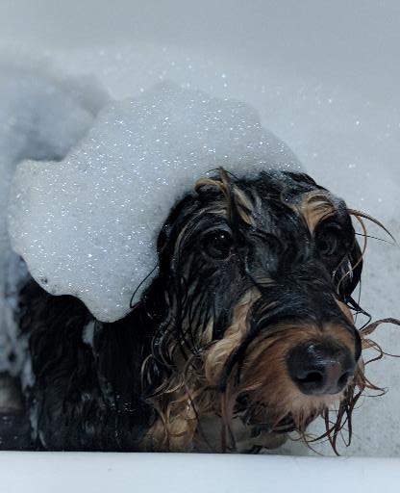
Clean the Data
Notes:
Data acquired, check! Question, check!
Next step is to clean the data. Here we see dirty Data. We need to remove incomplete values, normalise the data, etc. By playing around with the data you notice things like, dog breeds, are in all caps, all lowercase, words are separated, so we need to normalise. The data seems to be entered by humans and can have errors.
I will be using batch processing through scripting.
This is an important step and is crucial for all data science projects. It’s not glamourous but necessary.

Slide 13
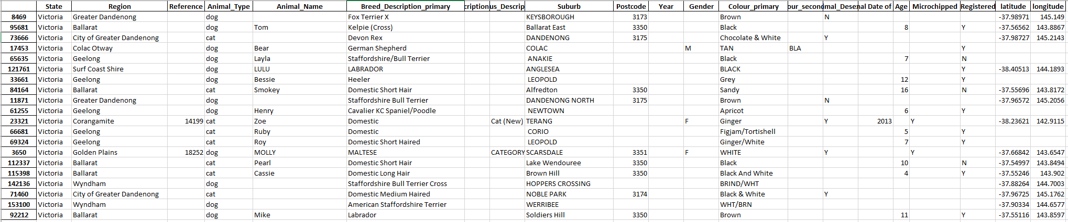
Clean the Data
Notes:
So with the dataset the dirty data looked like this
By cleaning, but removing non-dog instances, normalising the data, creating dummy variables for values with like yes/no,
The data will be more understandable for the computer.

Slide 14
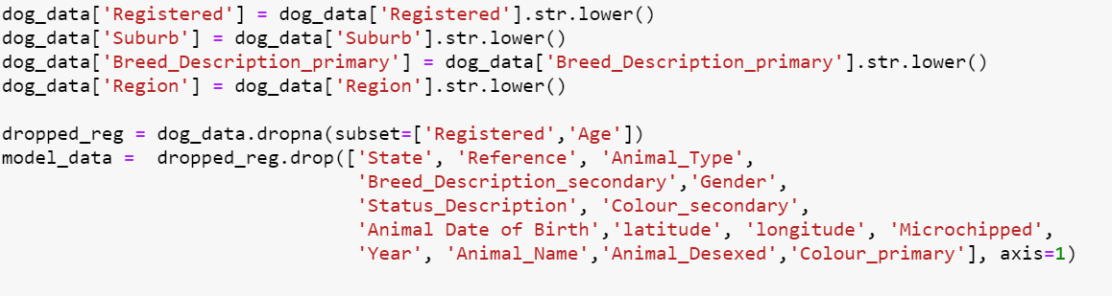
Clean the data
Notes:
Cleaning data batch script
This isn’t all that was done but its an example ☺
Made the values lowercase, and removed unnecessary columns like microchipped
We now have a data frame of shape (66000, ) down from over 120,000 rows and 21 columns.

Slide 15
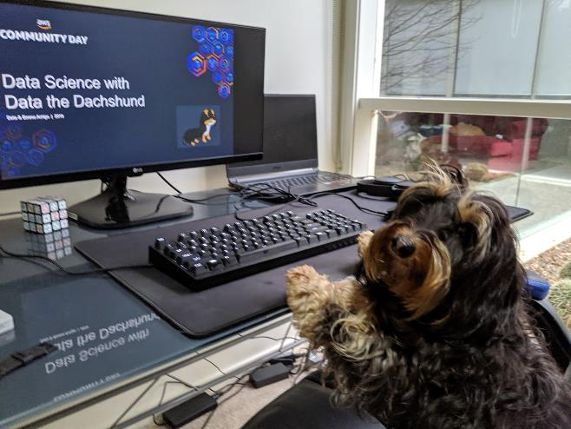
Data Transformation
Data Types
Categorical
Nominal
Ordinal
Numerical
Interval
Ratio
Notes:
While cleaning the data I had to make some decisions, for example how should postcode be represented ?
It’s important to understand the types of data you have.
Types of data, categorical, numeric, etc.
Nominal, dog breeds
Ordinal, order matters small medium large
Interval, there are units
Ratio, no units
Most of these values were categorical, so I had to do some data transformation for the model to understand it.
Eg postcode is categorical data not numerical!
Eg dog breeds are nominal

Slide 16
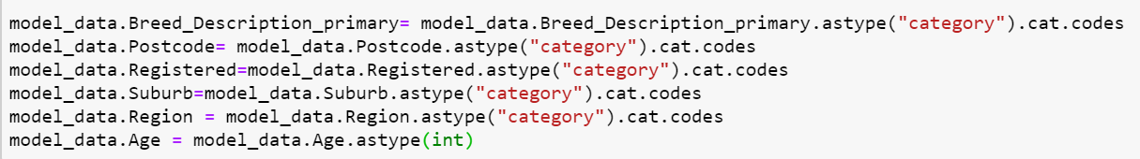
Data transformation
Notes:
Data transformation scripts. I decided to turn postcode, gender, age, registered and desexed into categorical values. This will make it easier for the modelling.
Just an example, making categories. This was a decision I made, there is no right way to do something, but I think there are definitely wrong ways to do things.

Slide 17
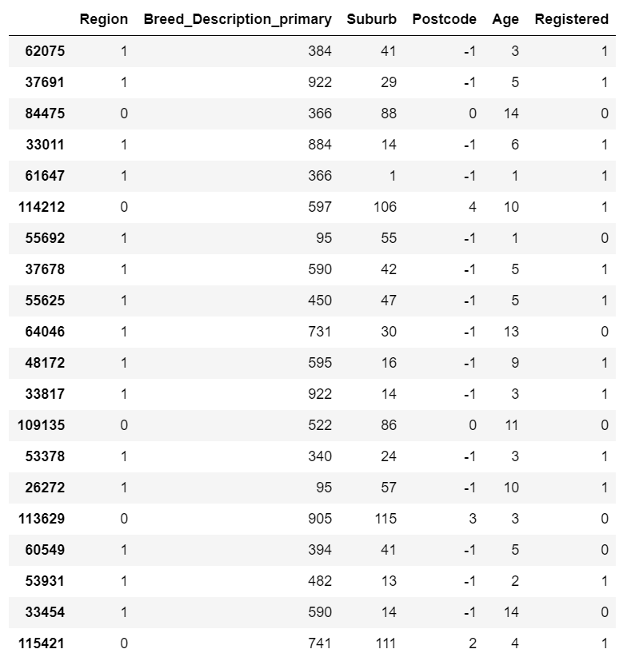
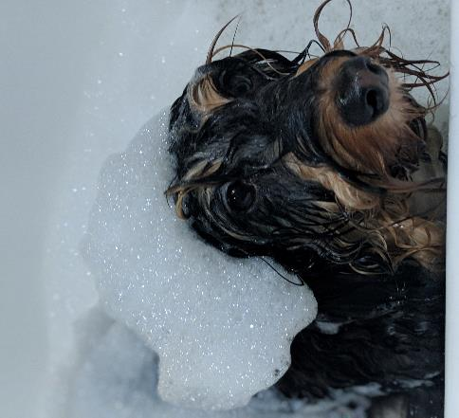
Clean the Data
Notes:
By cleaning, but removing non-dog instances, normalising the data, creating dummy variables for values with like yes/no, dropping columns we don’t need. The -1 values represent NaN.
The data will be more understandable for the computer. I kept the names because I thought it was cute.

Slide 18

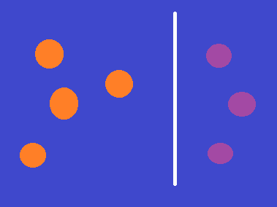


4 flavours of models in ML
Supervised
Unsupervised
Prediction
Classification
Clustering
Anomaly Detection
Notes:
So the data is clean and we know the question we are wanting to answer, now for the model.
Let’s get a bit more specific, Machine learning is hot right now so lets frame this as a ML problem.
There are four main flavours of models in ML.
-Prediction, using known data, process of identifying patterns and calculating the predictions of continuous outcomes. The system has to understand the numbers, their values, grouping (for example, heights and widths), etc.
-Clustering, it is an exploration of data used to segment it into meaningful groups (i.e., clusters) based on their internal patterns without prior knowledge of group credentials. The credentials are defined by similarity of individual data objects and also aspects of its dissimilarity from the rest.
-Classification, is the process where incoming data is labelled based on past data samples and manually trains the algorithm to recognize certain types of objects and categorize them accordingly. The system has to know how to differentiate types of information, perform an optical character, image, or binary recognition (whether a particular bit of data is compliant or non-compliant to specific requirements in a manner of “yes” or “no”).
- Anomaly detection can be useful too and also can come under clustering,
OK we are all data scientists now! I can endorse you for machine learning now on linkedin. Now thinking about the data we have, what kind of question suits it best? Let’s go for classification.

Slide 19
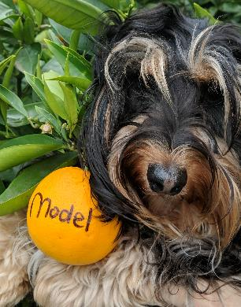
Model Selection
All models are wrong
Some are useful
Logistic regression
Naïve Bayes
Decision Tree Classifier
Notes:
It is often said that all models are wrong, but some are useful.
Since this is a 2 class classification problem, registered or not registered, there are a lot of options for models, I chose to compare some basic versions of the models.
Logistic regression is the workhorse of binary classification,
Naïve bayes is a probabilistic approach
Decision Tree is based on rules from the data

Slide 20
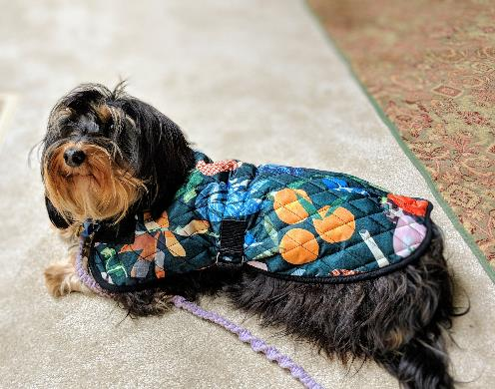
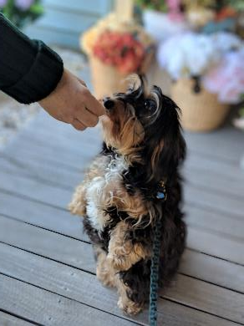
Model
Train the data
Model the data
Notes:
Next to model the data. To test if the model is working correctly, it is wise to split the data into a training set and a testing set. I used a 75% training and 25% testing.
So the training data is used to train the model, learn parameters and the connections between the data. The test set is used to find the accuracy, as it is unseen data, we want our model to be able to generalise well.

Slide 21
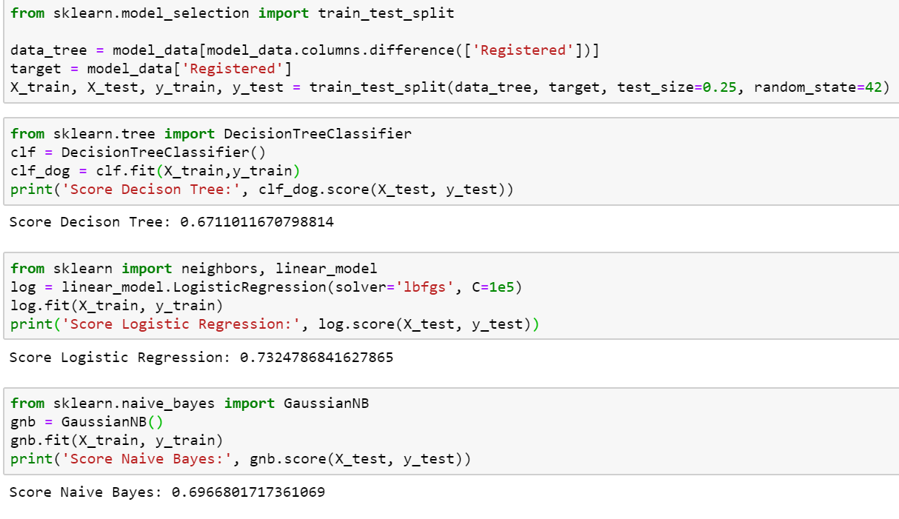
Building the Model
Notes:
Model scripts
So we see that it is a line to split the data, a line to import the type of mode, and a line to score the model.
Here we have the logistic regression and a decision tree classifier. This is with no change to the data and we are score around 70% all models.
That is how easy it is. For the sake of time we wont be refining the model here but it’s in the notebook online.

Slide 22

Result
Communication is key
What did we find out?
It is possible to classify if a dog is registered
There is no ‘one’ way to do data science
There is a lot of information in this data set worth exploring
Notes:
So you’ve built a model you need to be able to communicate the results with people. I could do a whole other talk about data visualisation but for now we will just do a simple graph.
This step brings us to the end of our data science journey.
End the story, we tried a few different models, some worked some didn’t, and we found some interesting things that maybe the council could implement to increase registrations. Like if we know that the towns with high registrations have parks

Slide 23
Data Science Roadmap
Image caption 1
Image caption 2
Image caption 3
Image caption 4
Image caption 5
Image caption 6
Notes:
So summary this is the workflow we worked through in 22 minuties. If you ever do a data science project, think of these steps and think of Data ☺

Slide 24
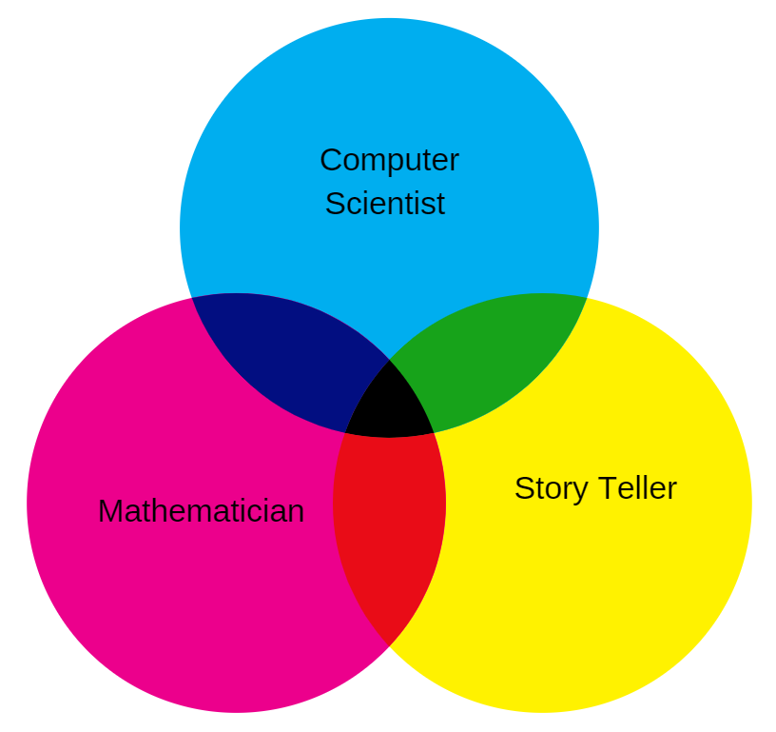

A data scientist is..
Notes:
Data science is a little bit of math, bit of dev, bit of curious, bit of story teller plus a dash of business
We are now all data scientists! In 23 minutes.
I hope that you have been inspired to work on some data science projects of your own as it is really easy to dabble in.

Slide 25




Follow us!
Emma
Data
@emmaarri
@emmaarrigo (code from demo is there!)
Also follow @MassDynamicsCo !
@data_the_dachshund
@DachshundData
This Photo by Unknown Author is licensed under CC BY-SA
Notes:
If you liked the pictures of Data please follow her on Instagram, and twitter, she tweets.
Demo is on my github and my twitter is mostly retweeting Data.
If you have been inspired by what I have talked about, please reach out, I’m working on some other projects with Data (the dog) and need some helpers.

Slide 26

Thank you!
Thank you!
Notes:
Thank you

