Slide 1

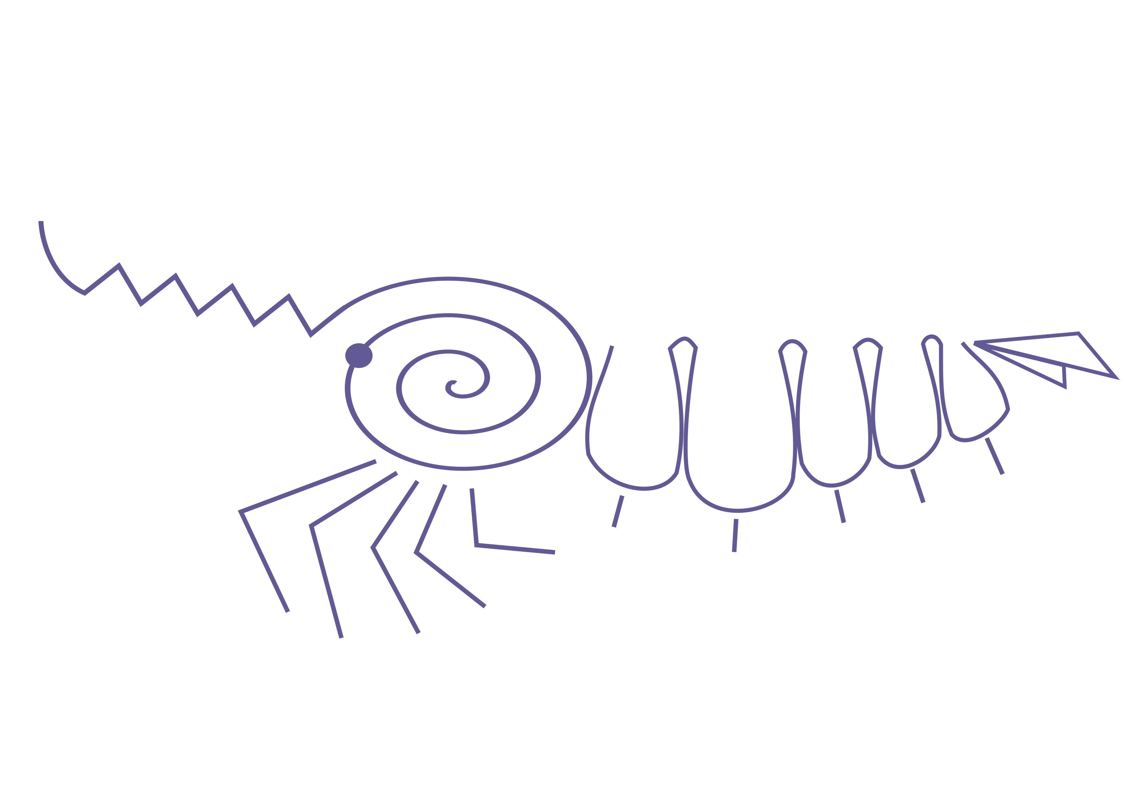
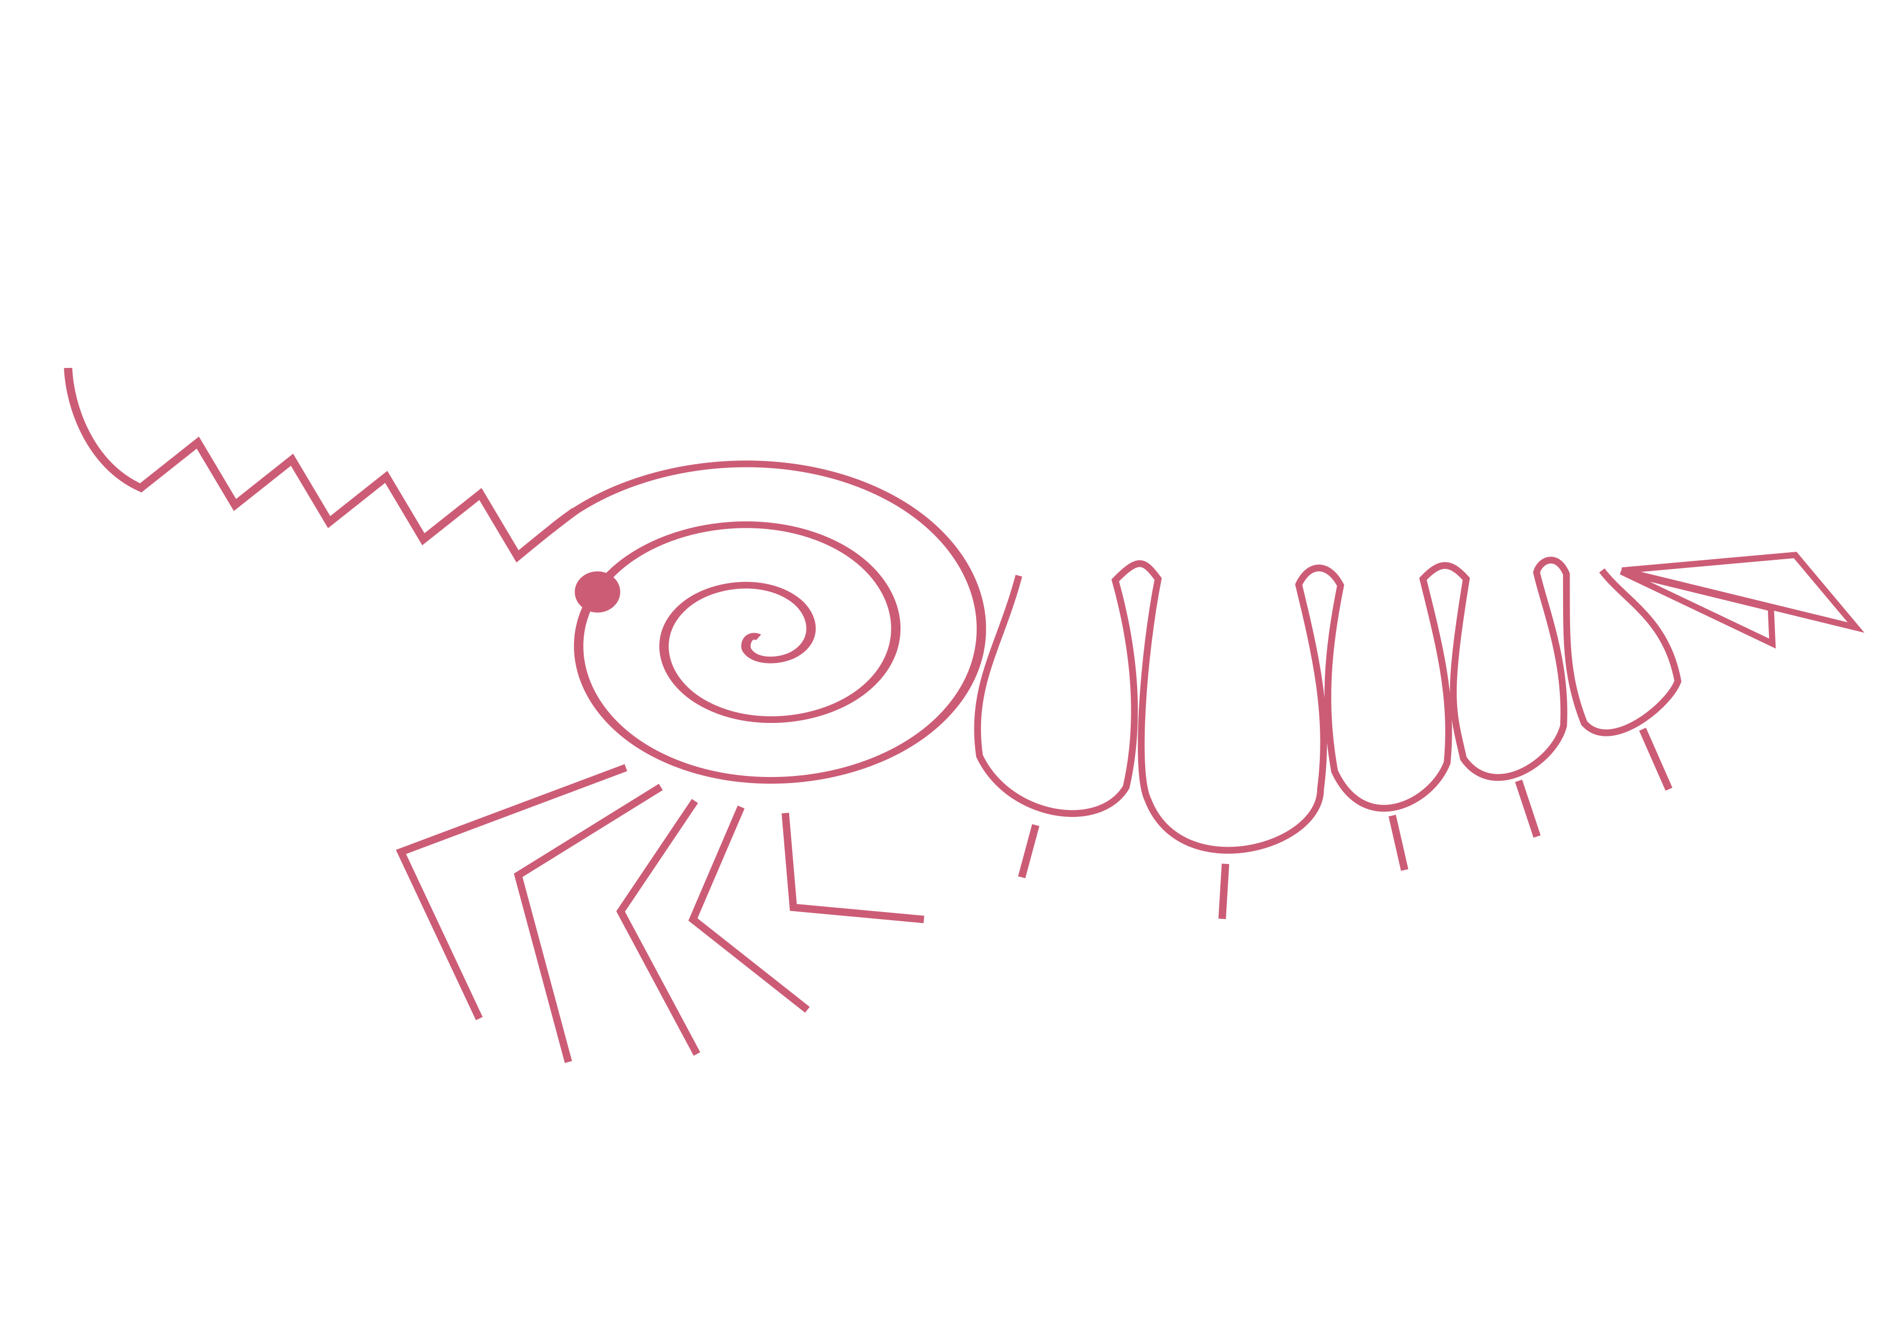




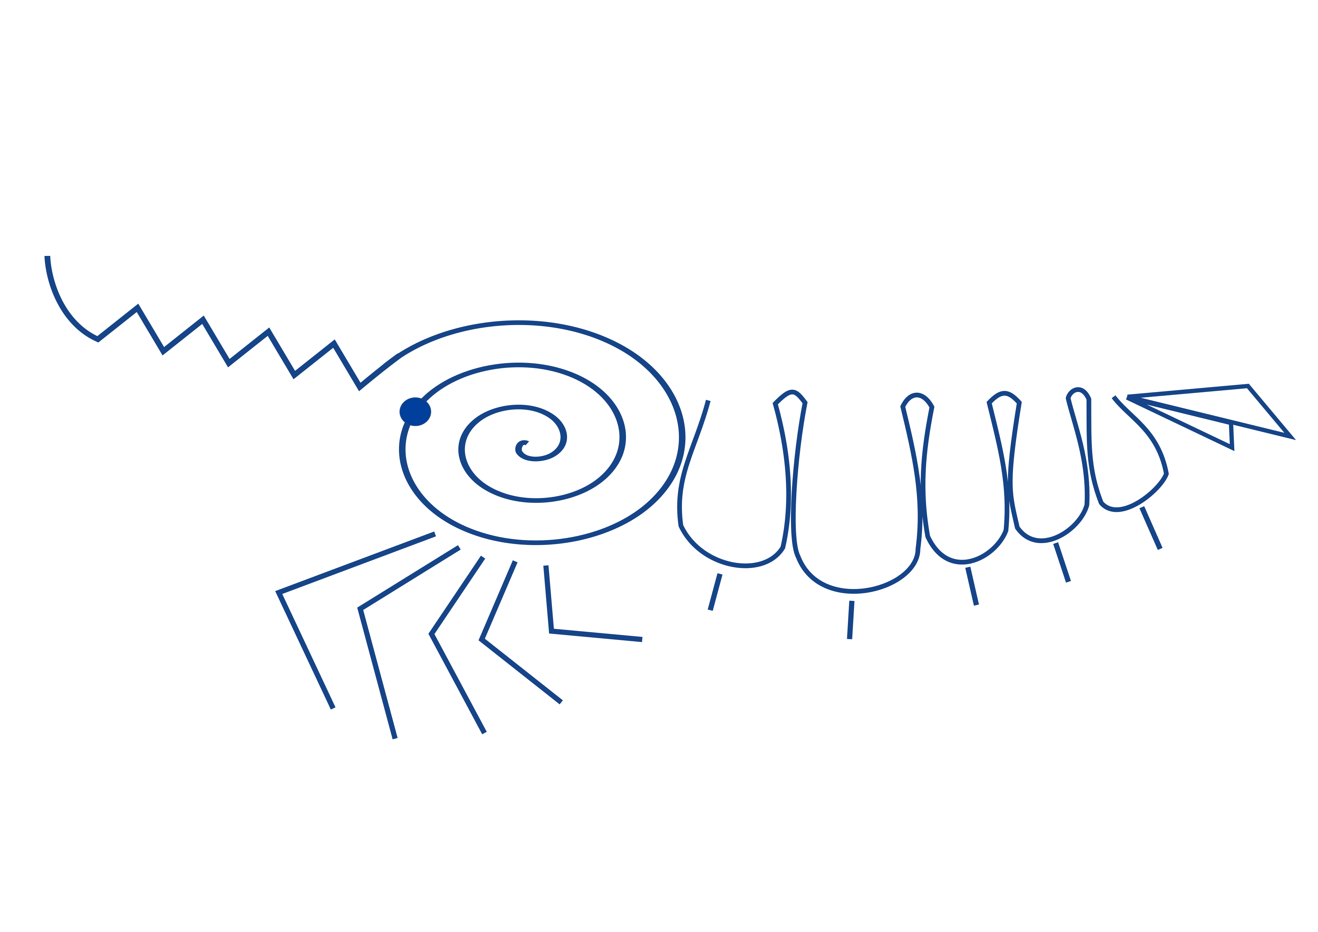


Air exposure treatment:
30 min
~20 meters
60 min
90 min
*
0 min
120 min
*~35-80 prawns per treatment

