Slide 1
Marine invert trends
Summary figures of commercial fishery data
August 8, 2026

Slide 2
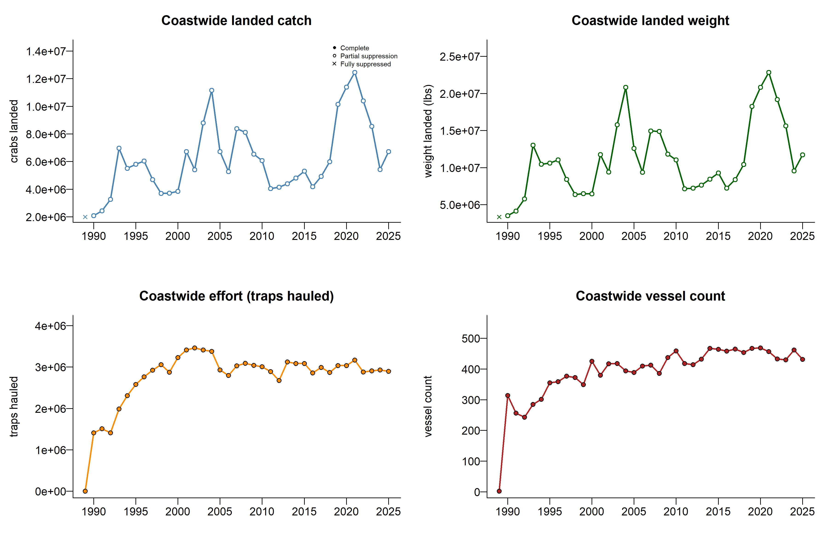
Coastwide trends by species – crab by trap

Slide 3
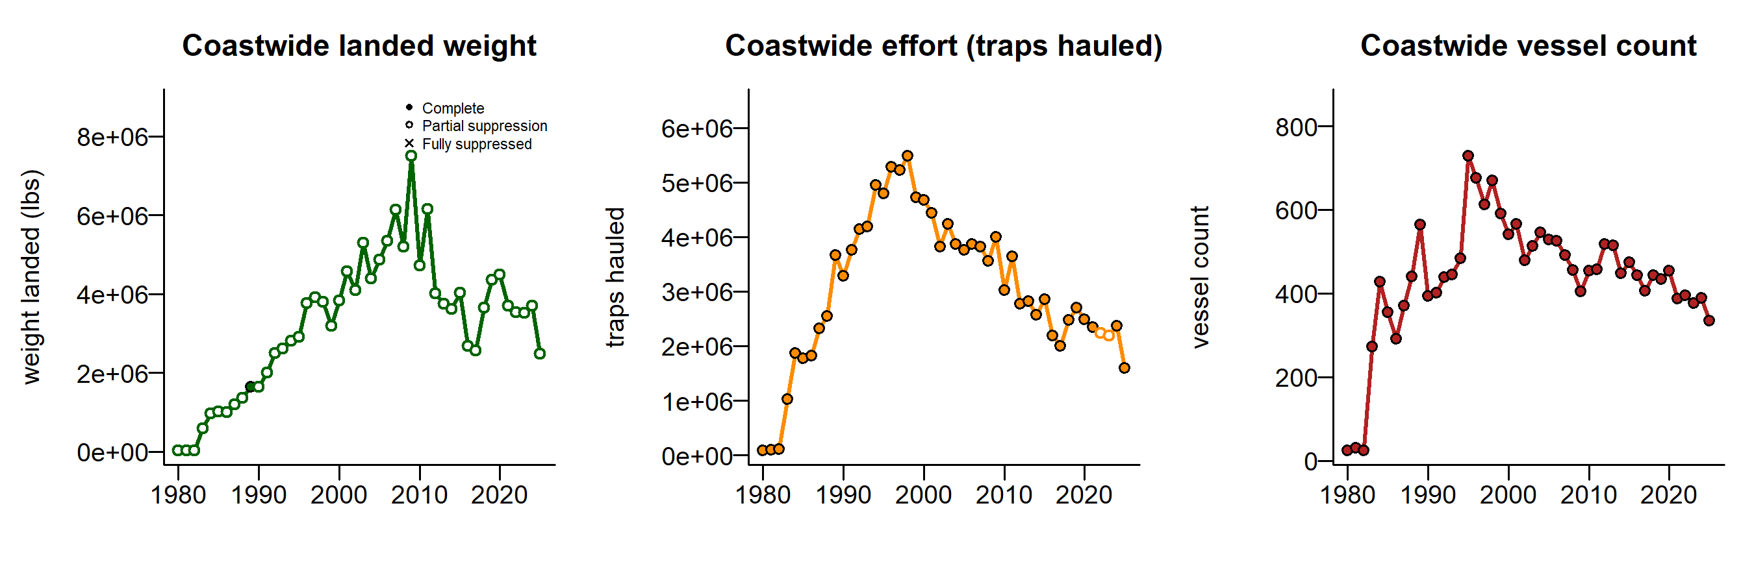
Coastwide trends by species – prawn by trap

Slide 4
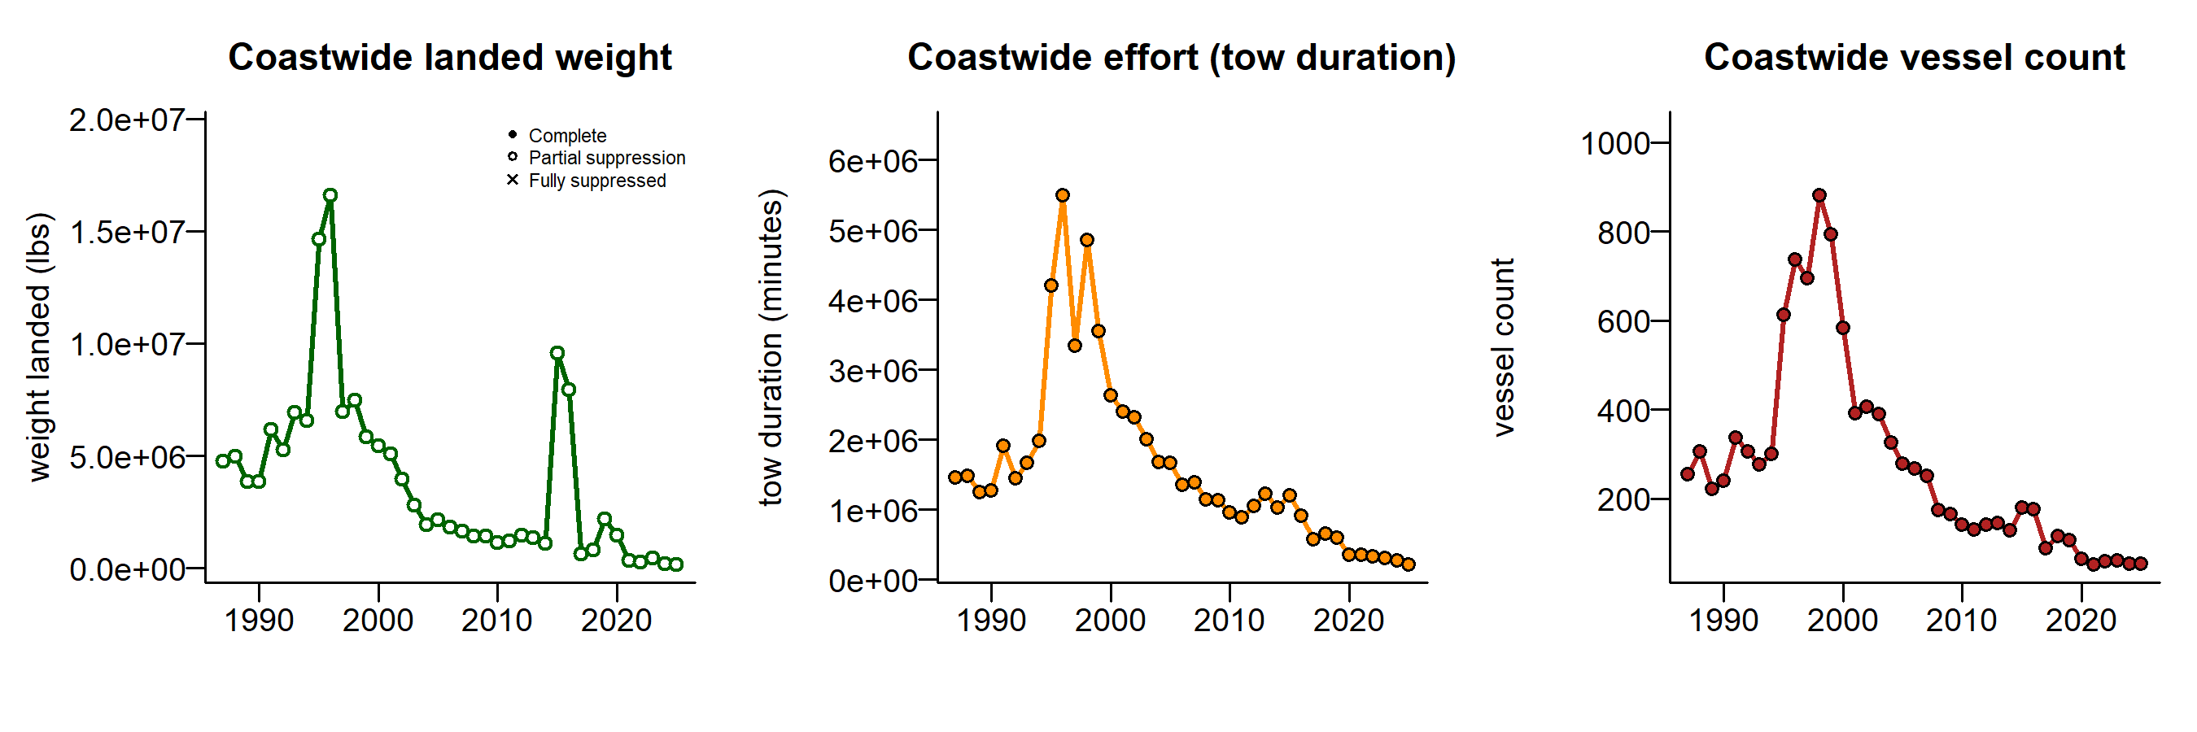
Coastwide trends by species – shrimp trawl

Slide 5
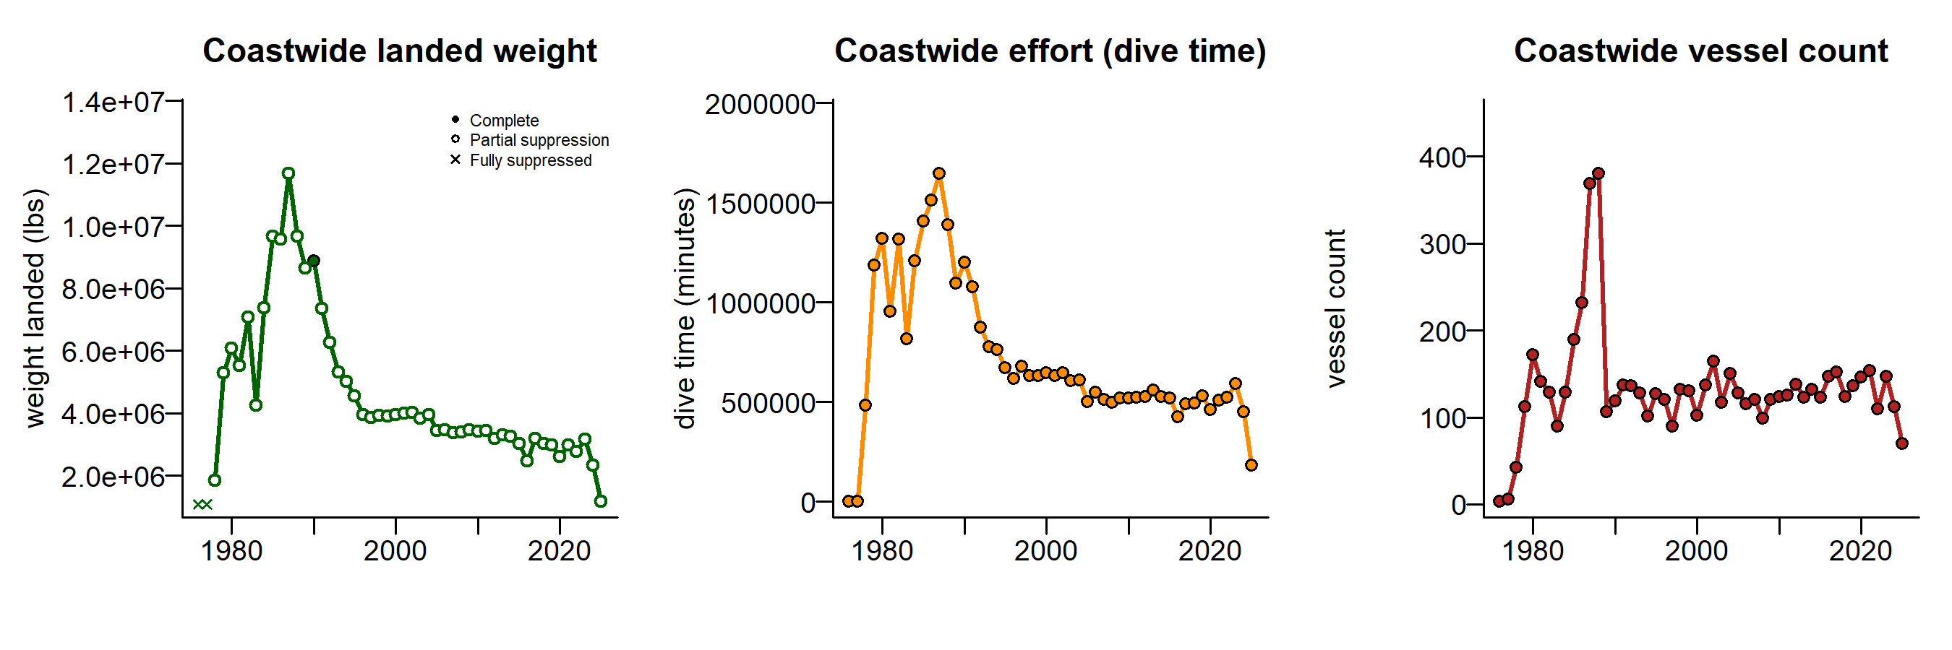
Coastwide trends by species – geoduck & horseclam dive

Slide 6
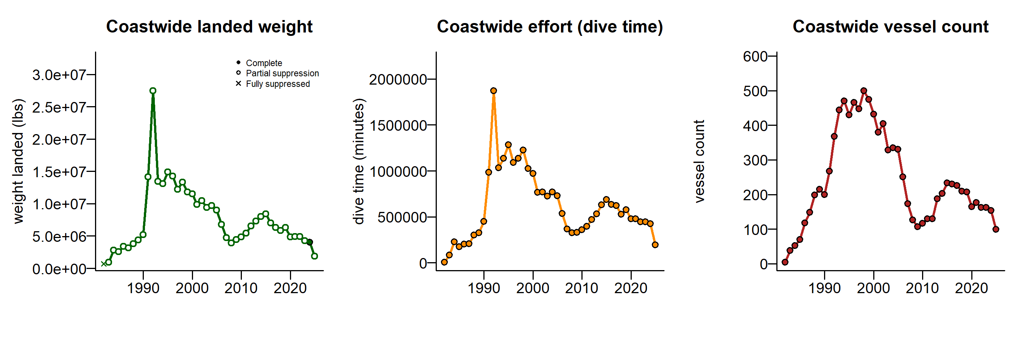
Coastwide trends by species – red urchin dive

Slide 7
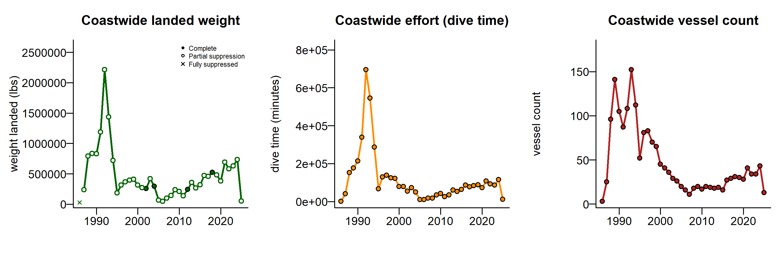
Coastwide trends by species – green urchin dive

Slide 8
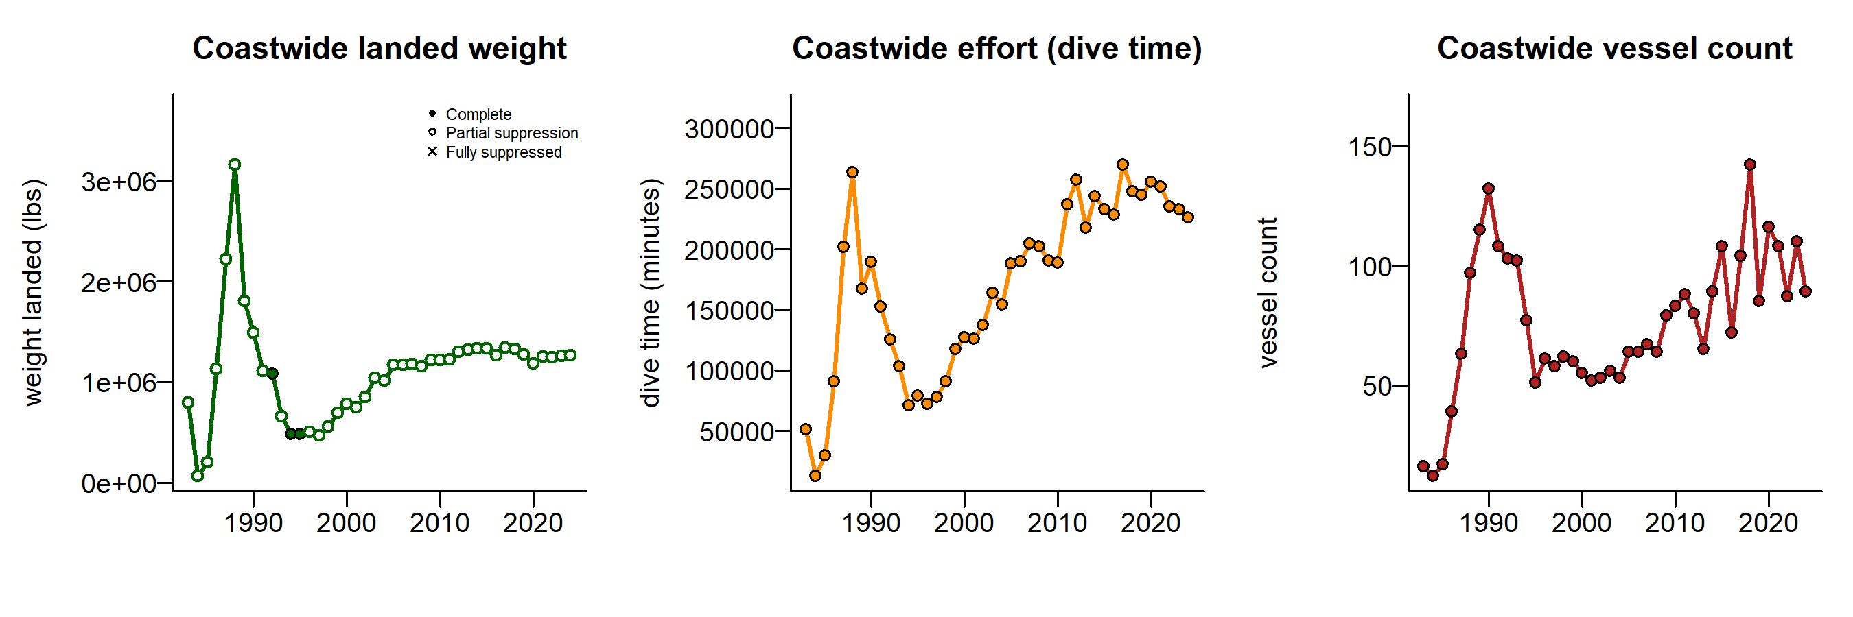
Coastwide trends by species – sea cucumber dive

Slide 9
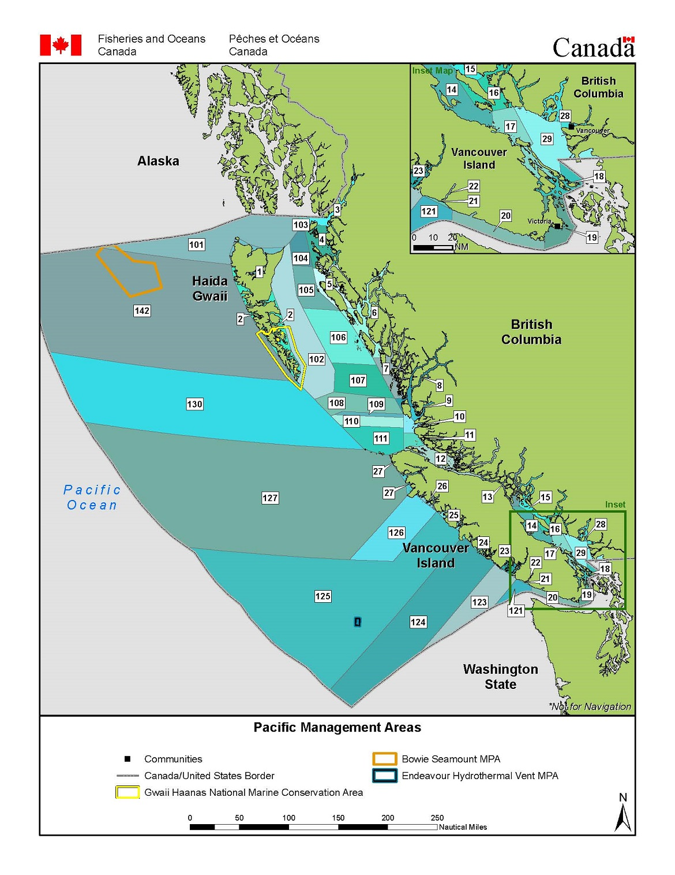
Regional trends by species
Preliminary regional breakdown (open to input):
Haida Gwaii/North Coast
PFMAs 1,2,3,4,5,101,102,103,104,105,106,14
Central Coast
PFMAs 6,7,8,9,10,11,107,108,109,110,111
West Coast Vancouver Island/Offshore
PFMAs 25,26,27,121,123,124,125,126,127,130
Strait of Georgia/NE Vancouver Island
PFMAs 12,13,14,15,16,17,18,28,29
South Coast/Juan de Fuca
PFMAs 19,20,21,22,23,24

Slide 10
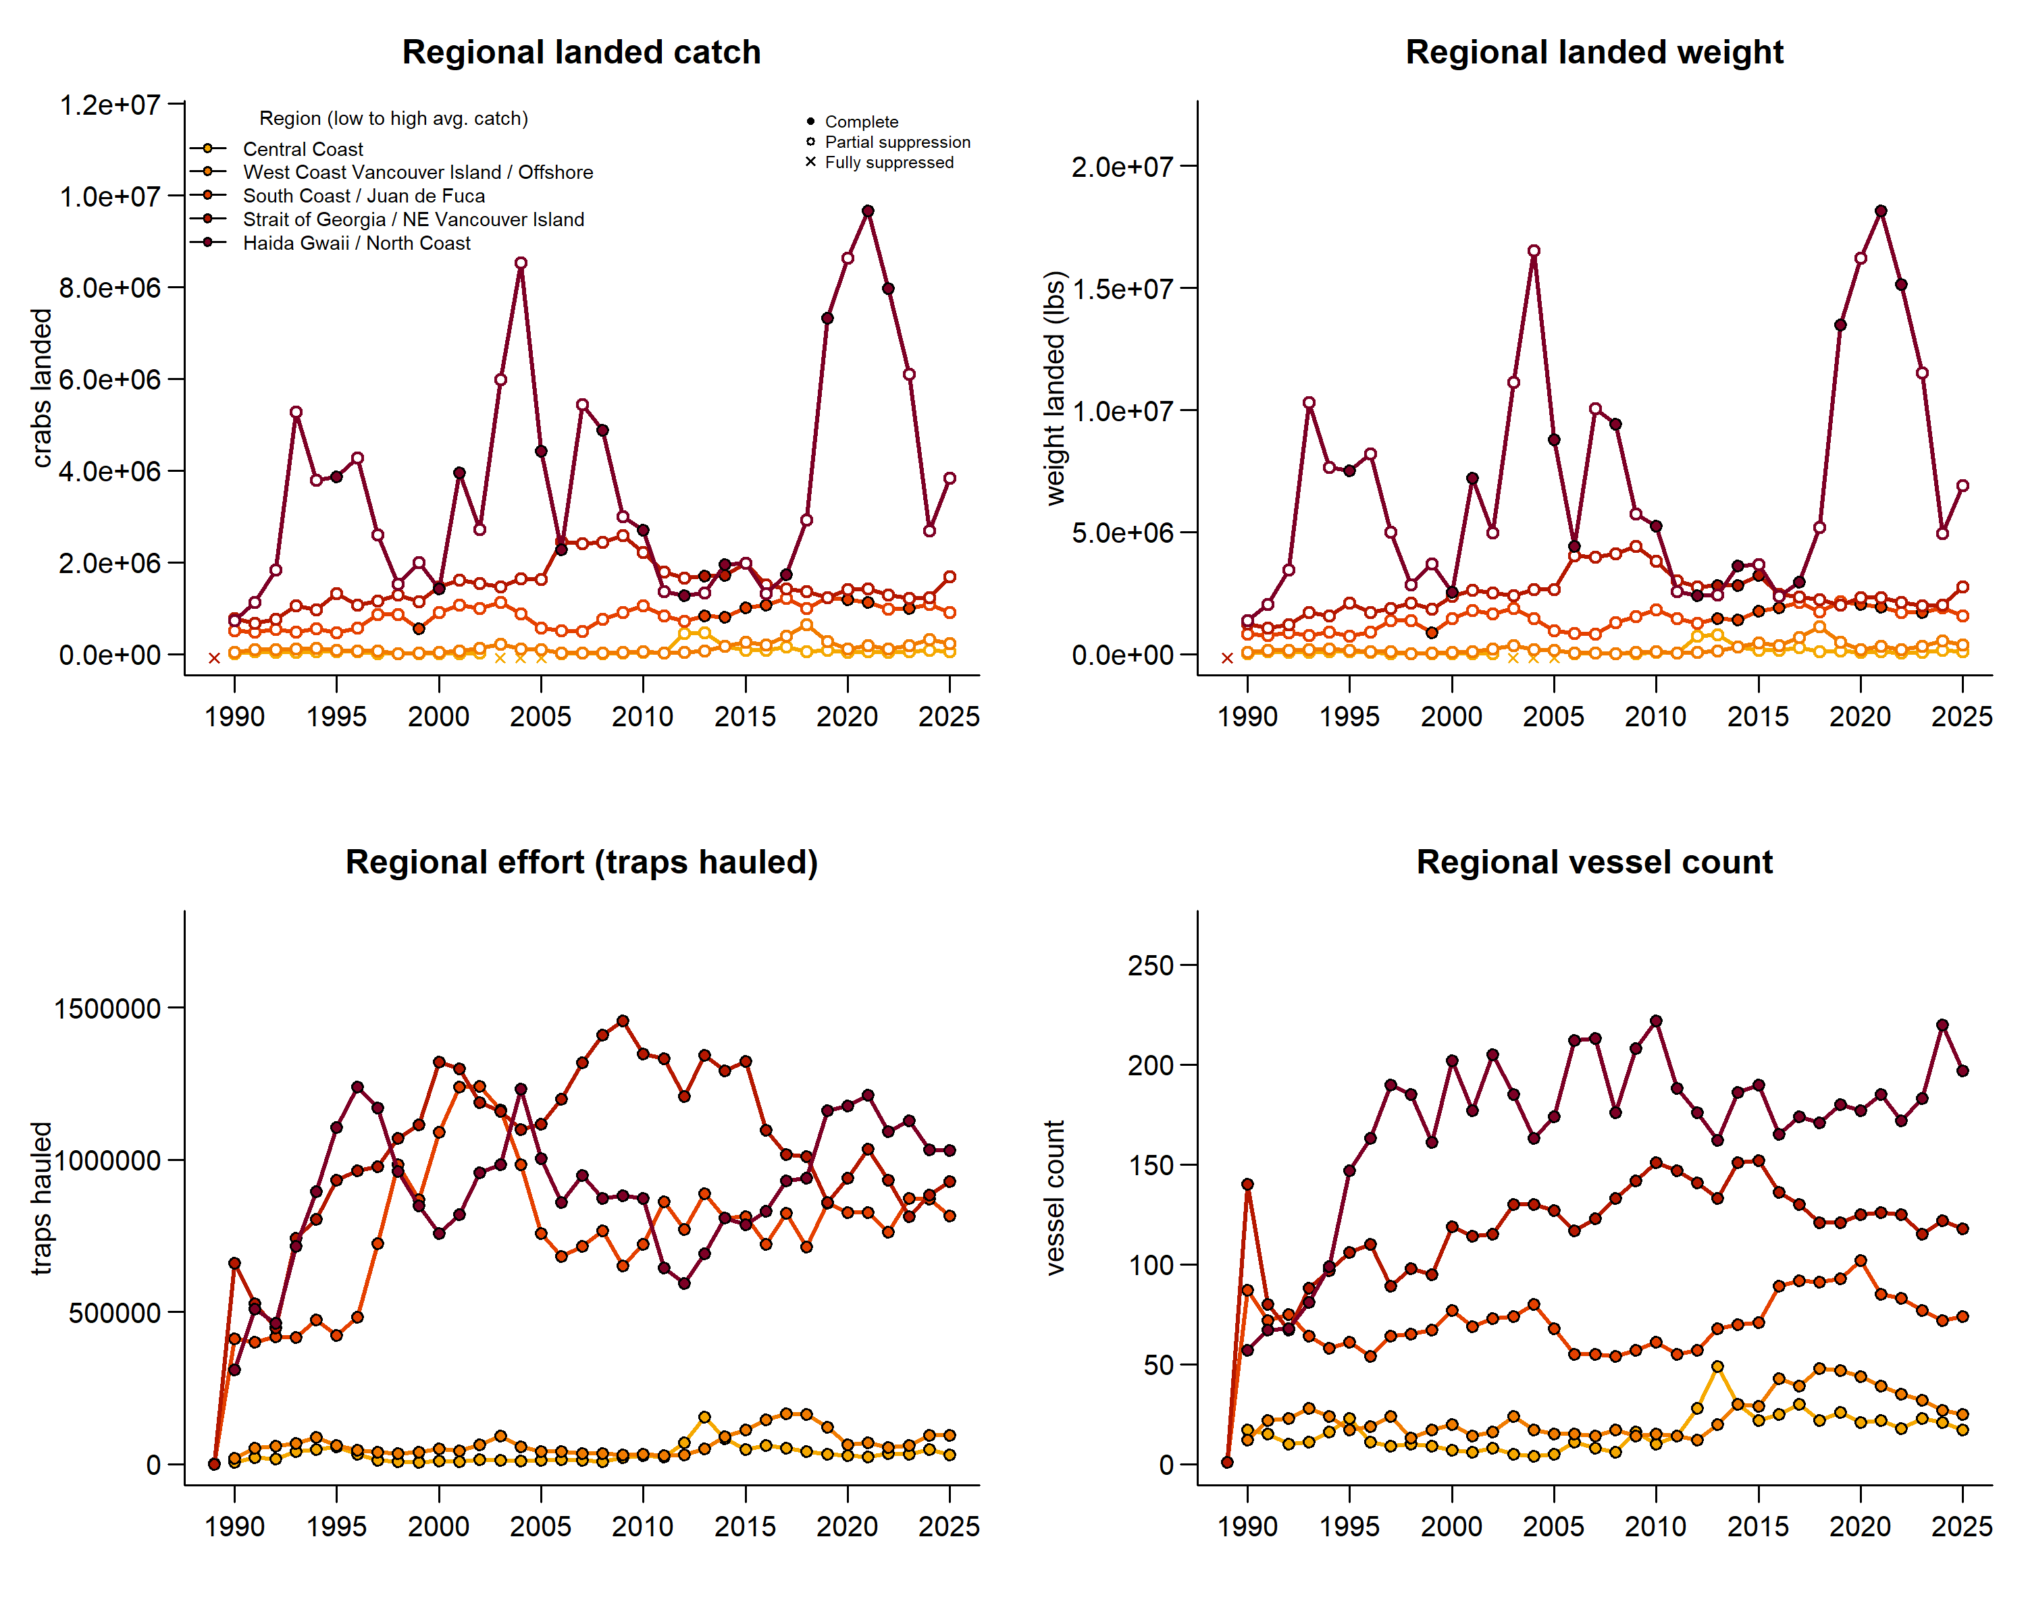
Regional trends by species – crab

Slide 11
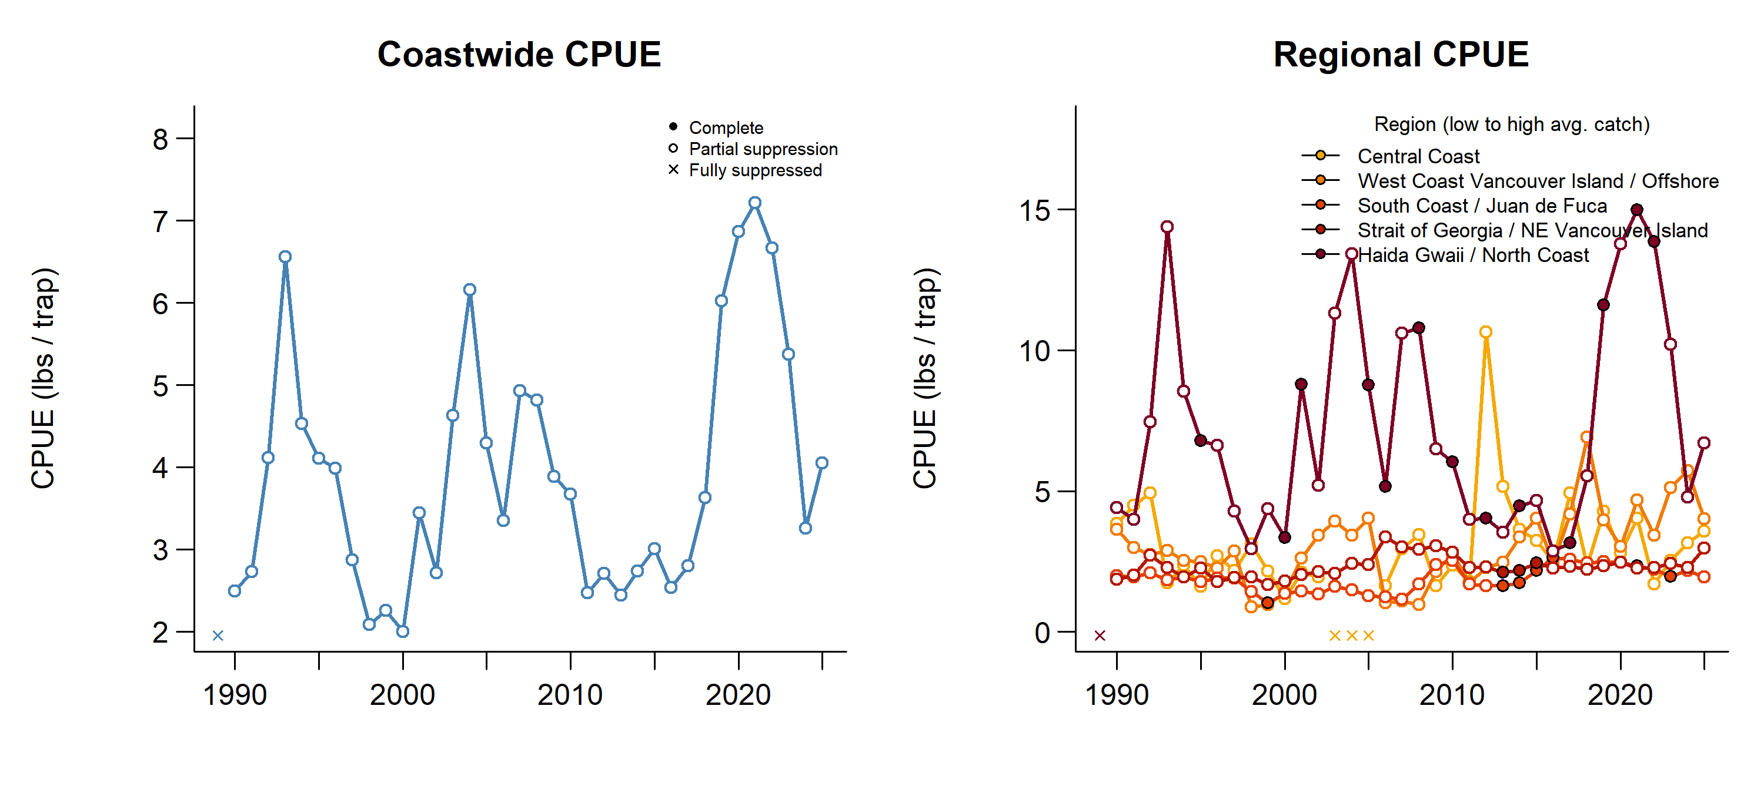
CPUE trends by species – crab

Slide 12
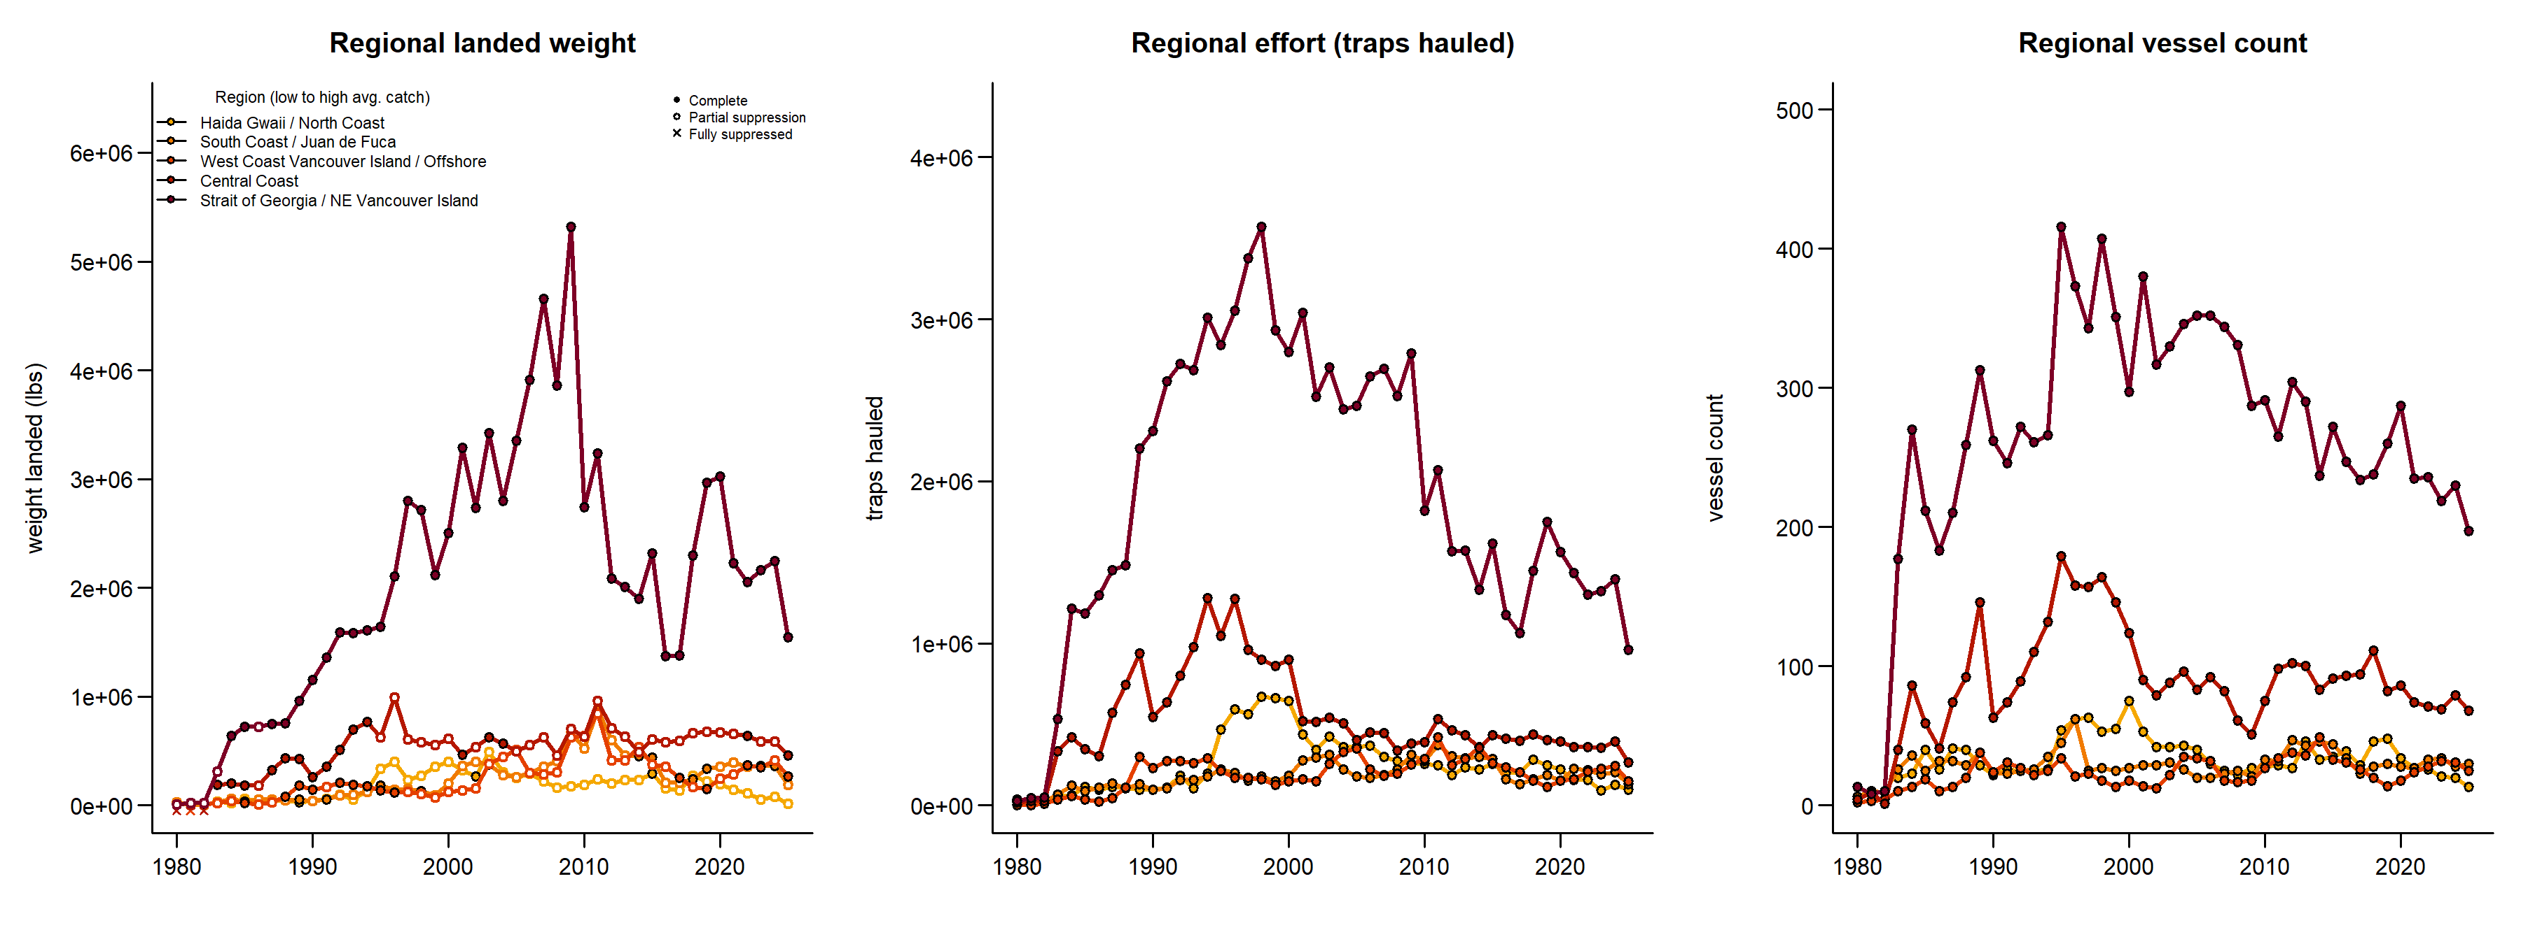
Regional trends by species – prawn

Slide 13
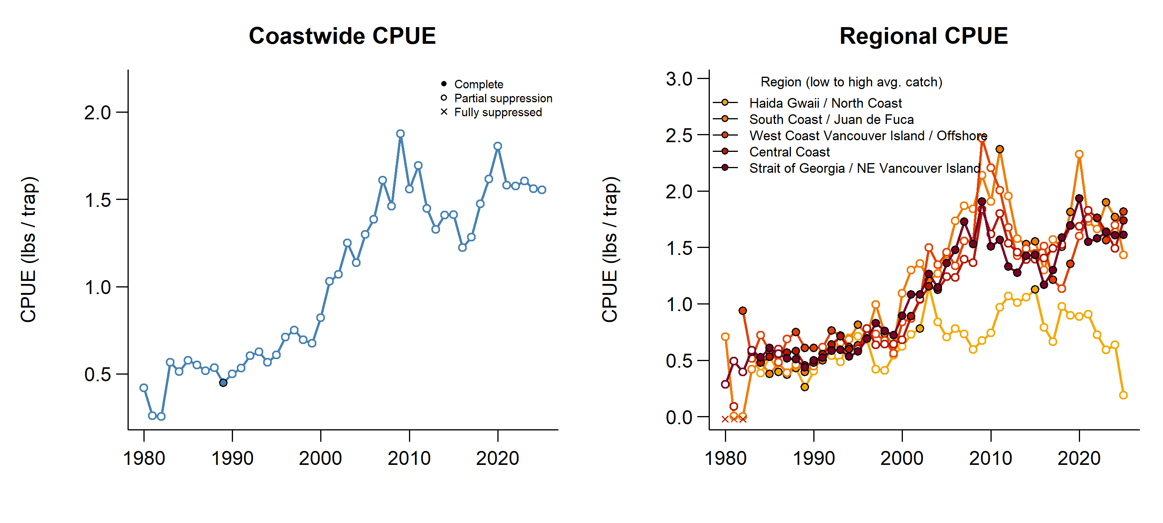
CPUE trends by species – prawn

Slide 14
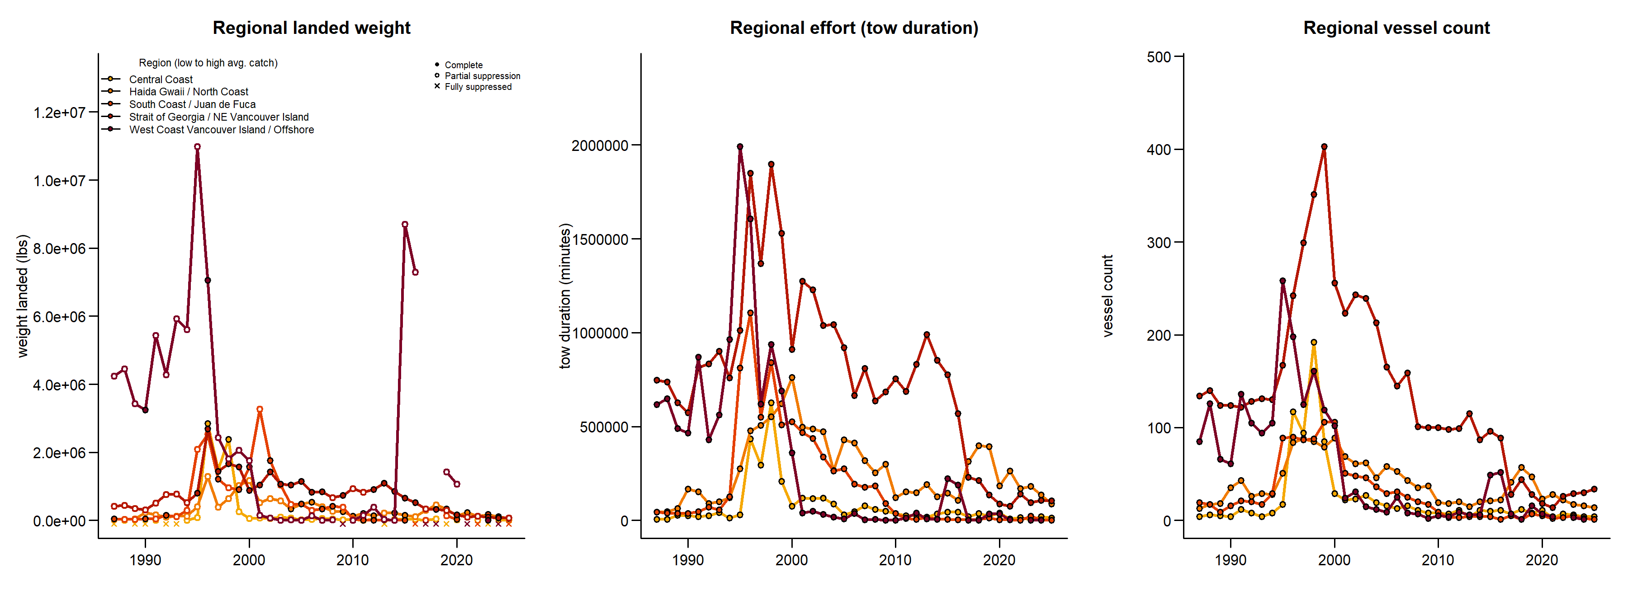
Regional trends by species – shrimp

Slide 15
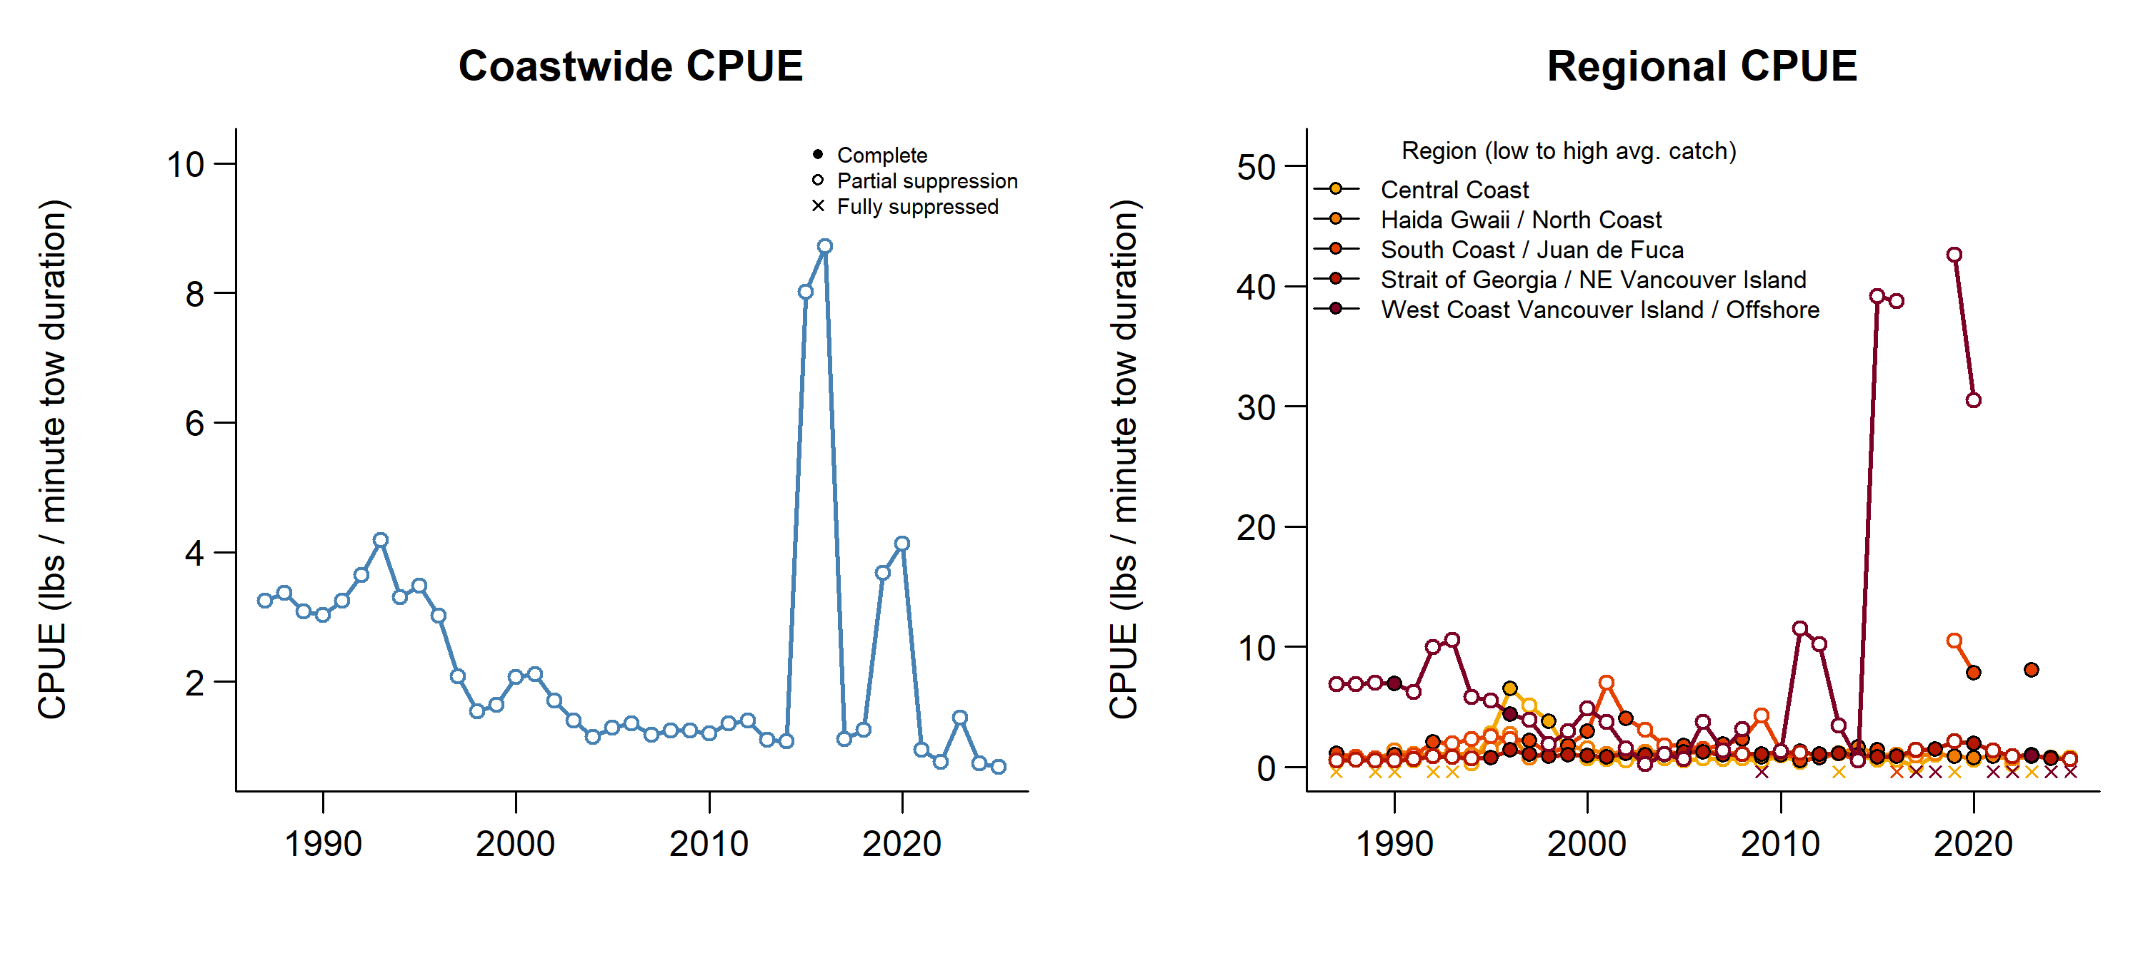
CPUE trends by species – shrimp

Slide 16
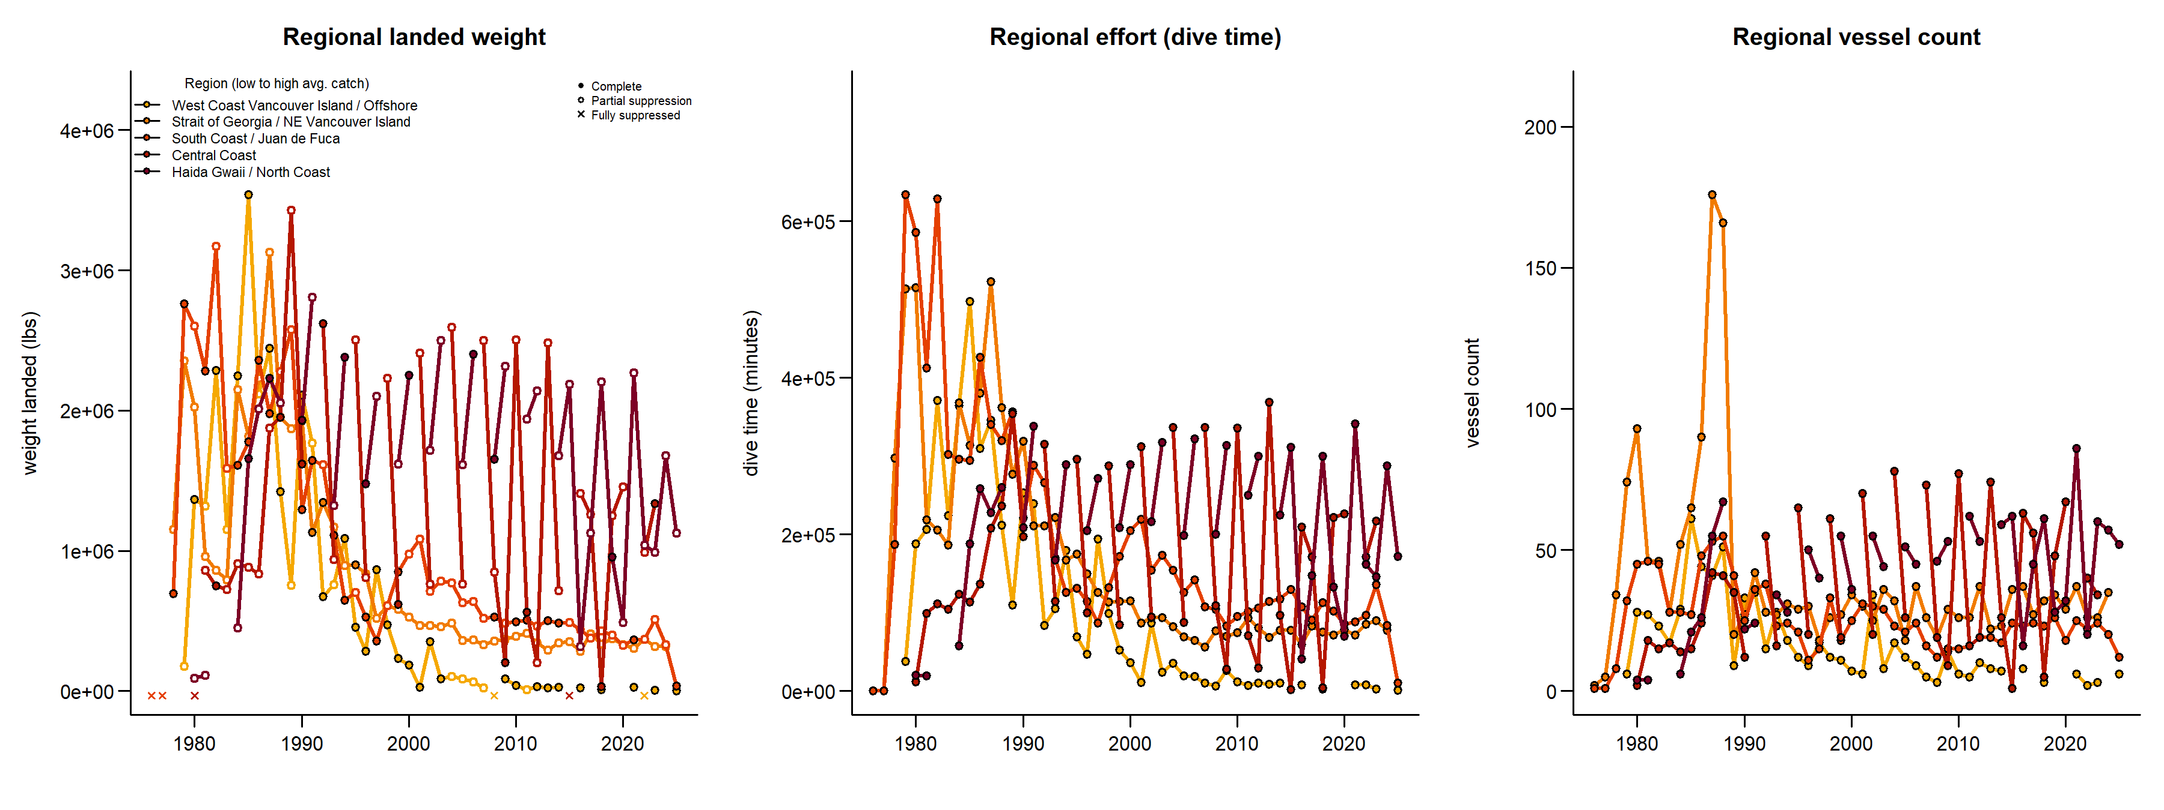
Regional trends by species – geoduck & horseclam

Slide 17
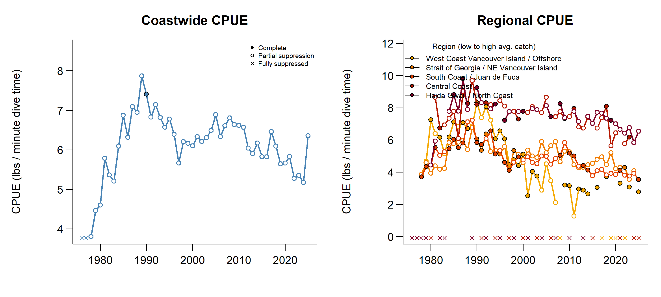
CPUE trends by species – geoduck & horseclam

Slide 18
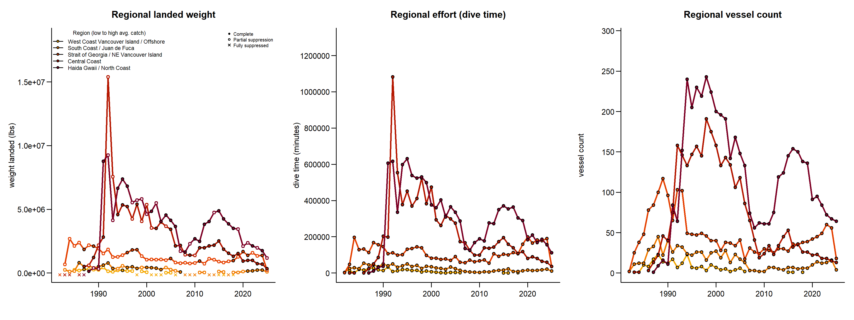
Regional trends by species – red urchin

Slide 19
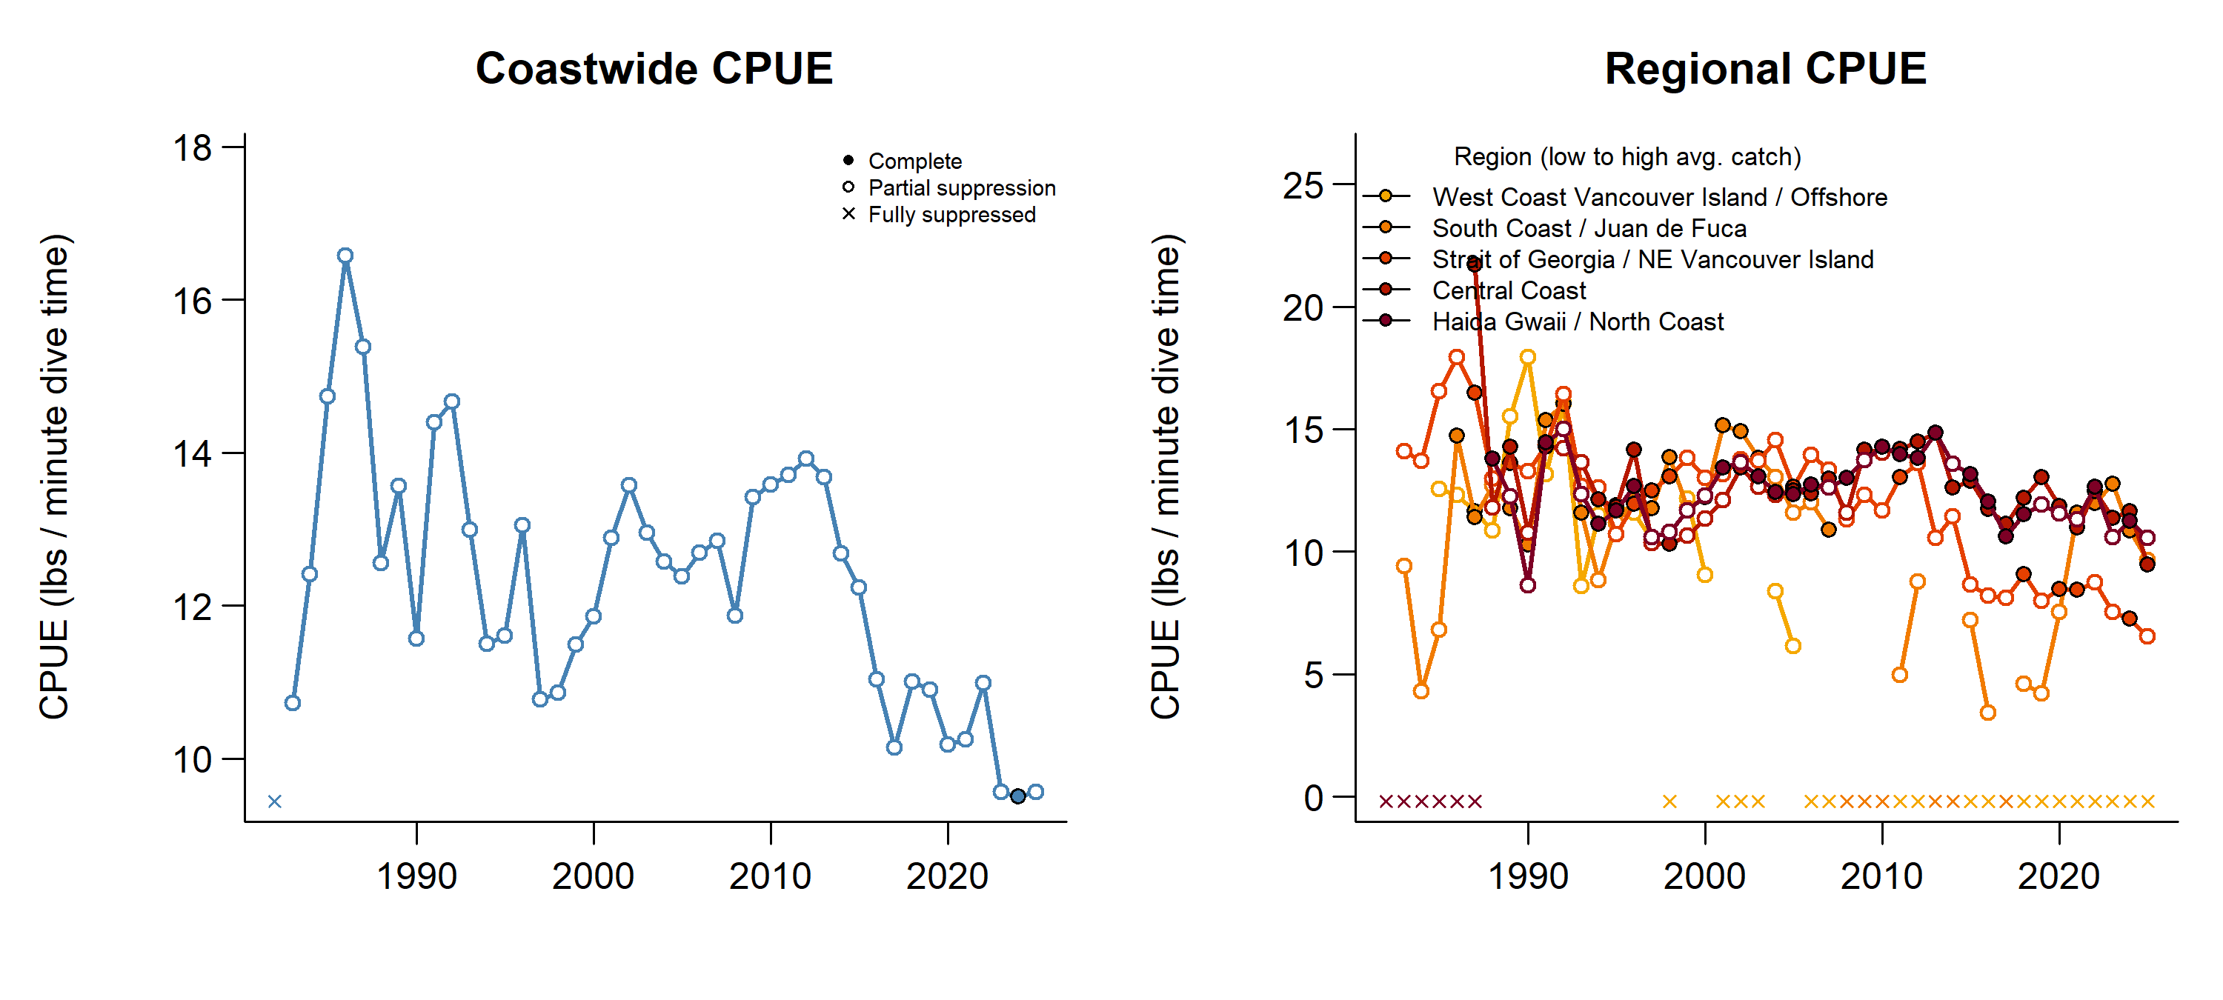
CPUE trends by species – red urchin

Slide 20
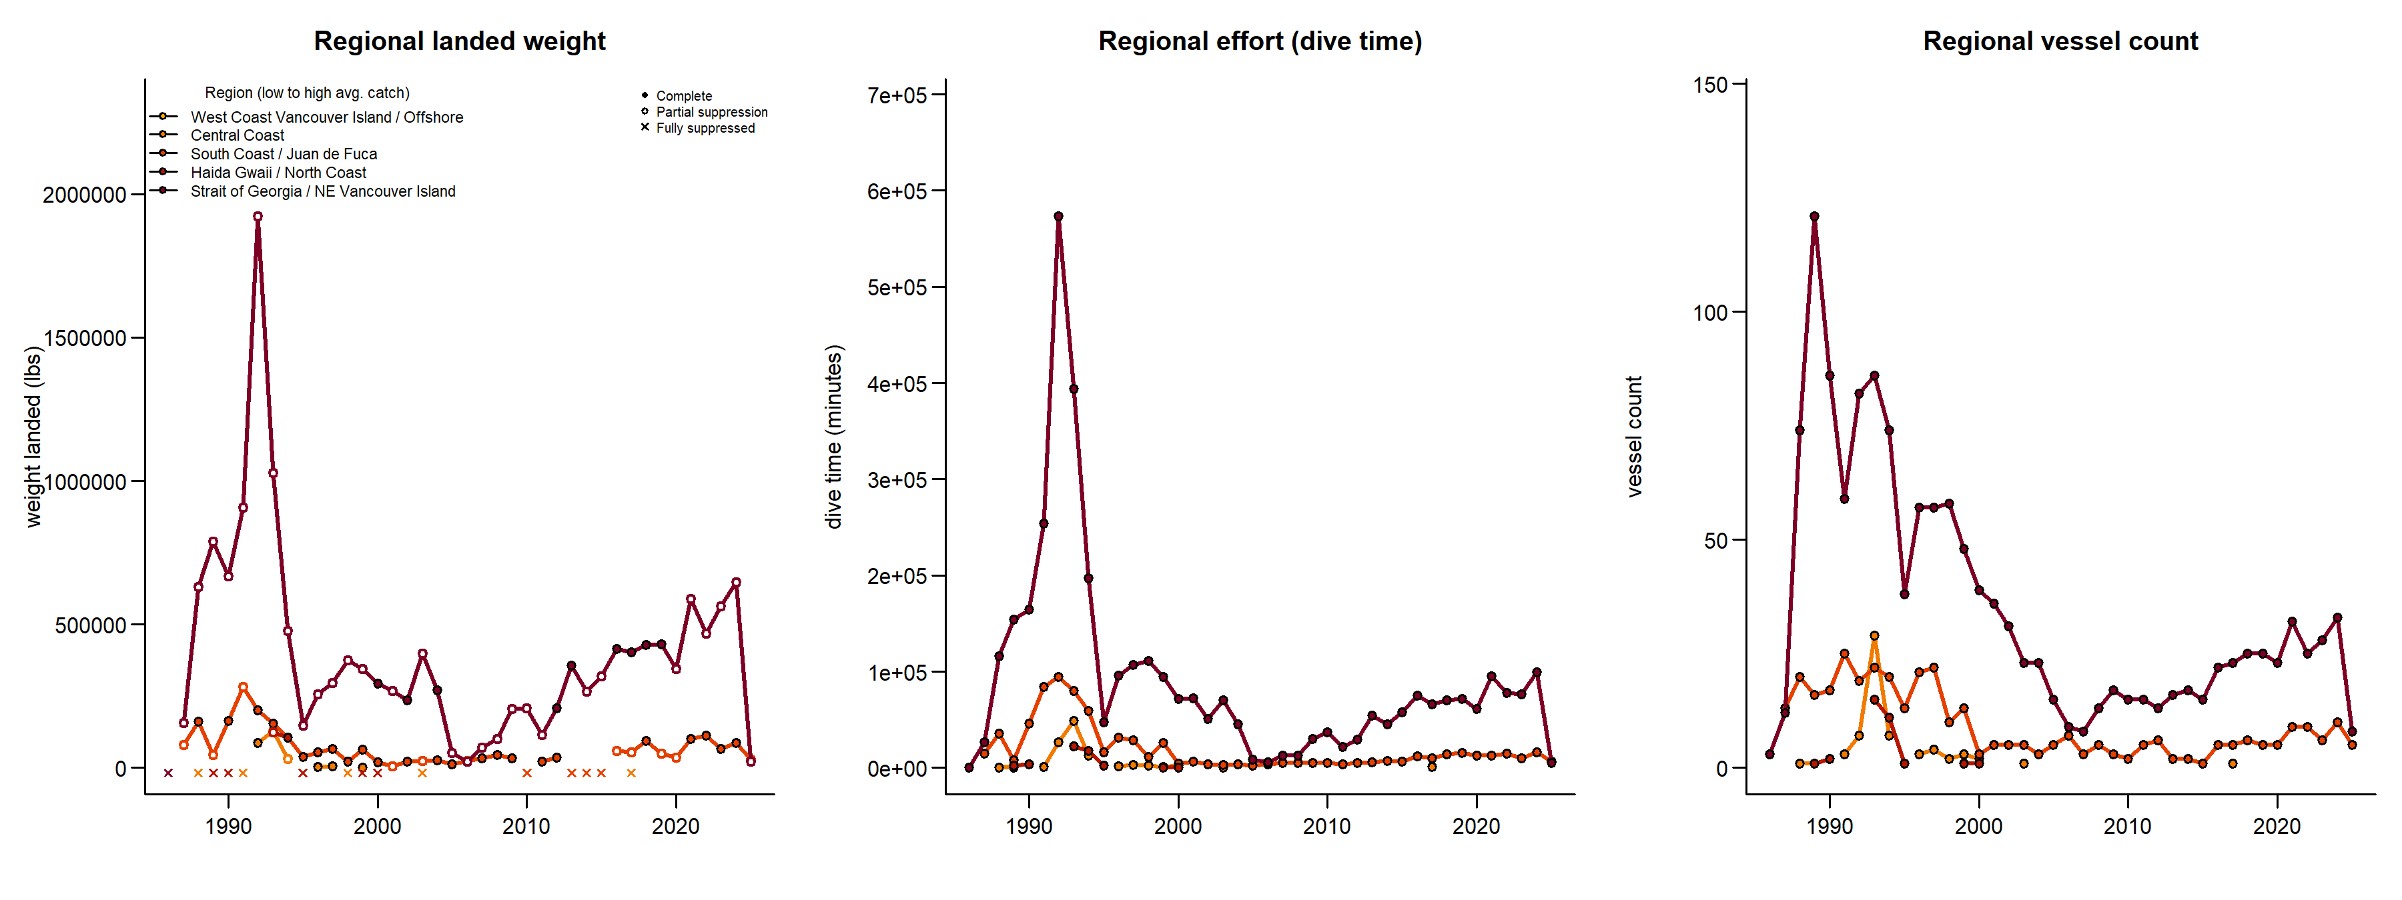
Regional trends by species – green urchin

Slide 21
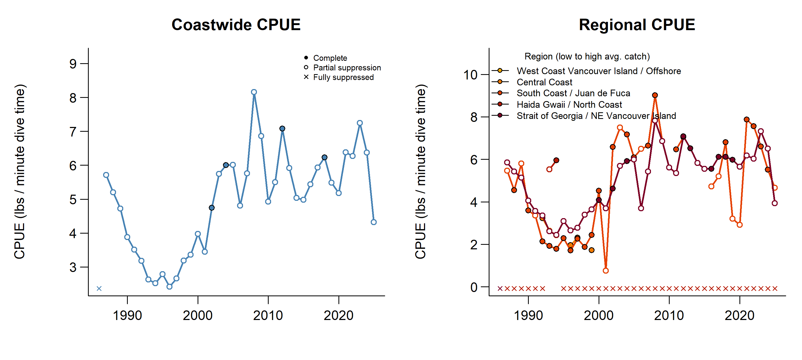
CPUE trends by species – green urchin

Slide 22
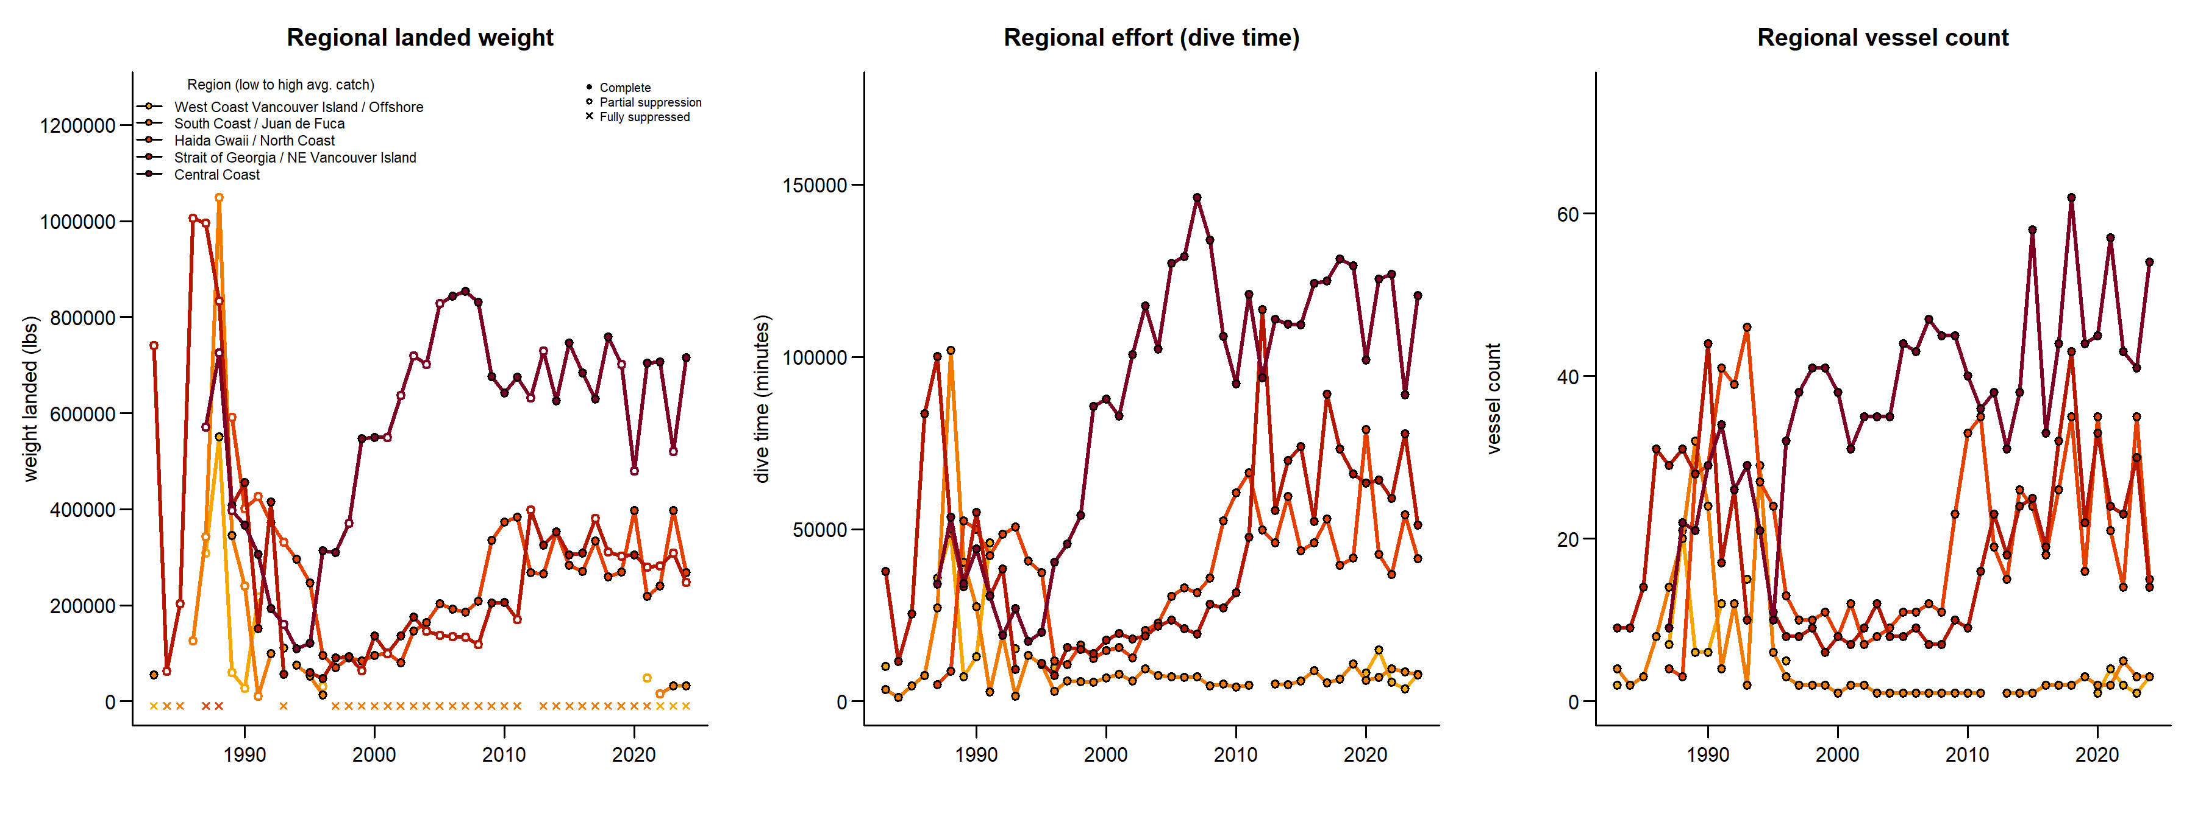
Regional trends by species – sea cucumber

Slide 23
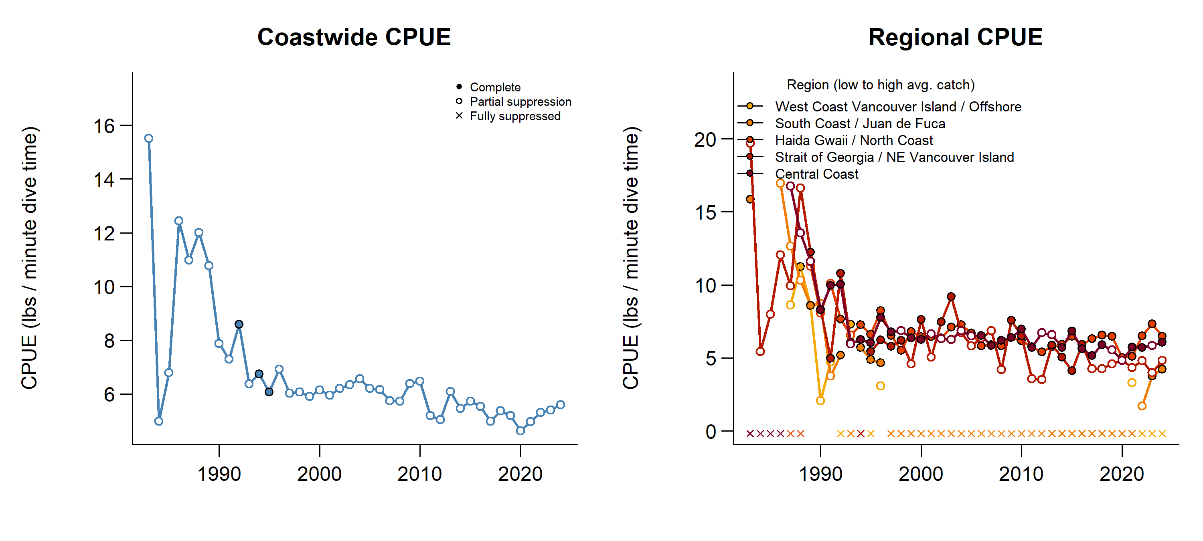
CPUE trends by species – sea cucumber

Slide 24
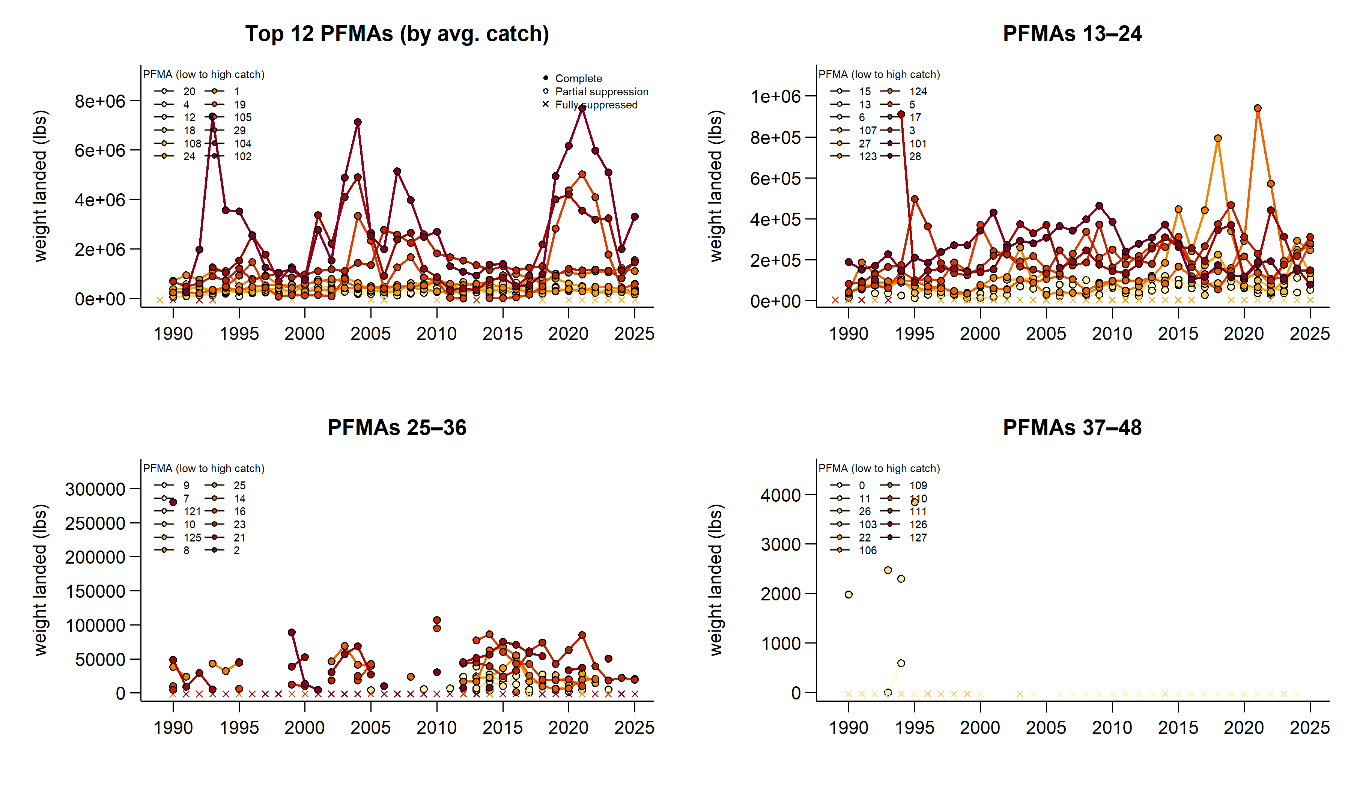
Ranked catch by PFMA – crab

Slide 25
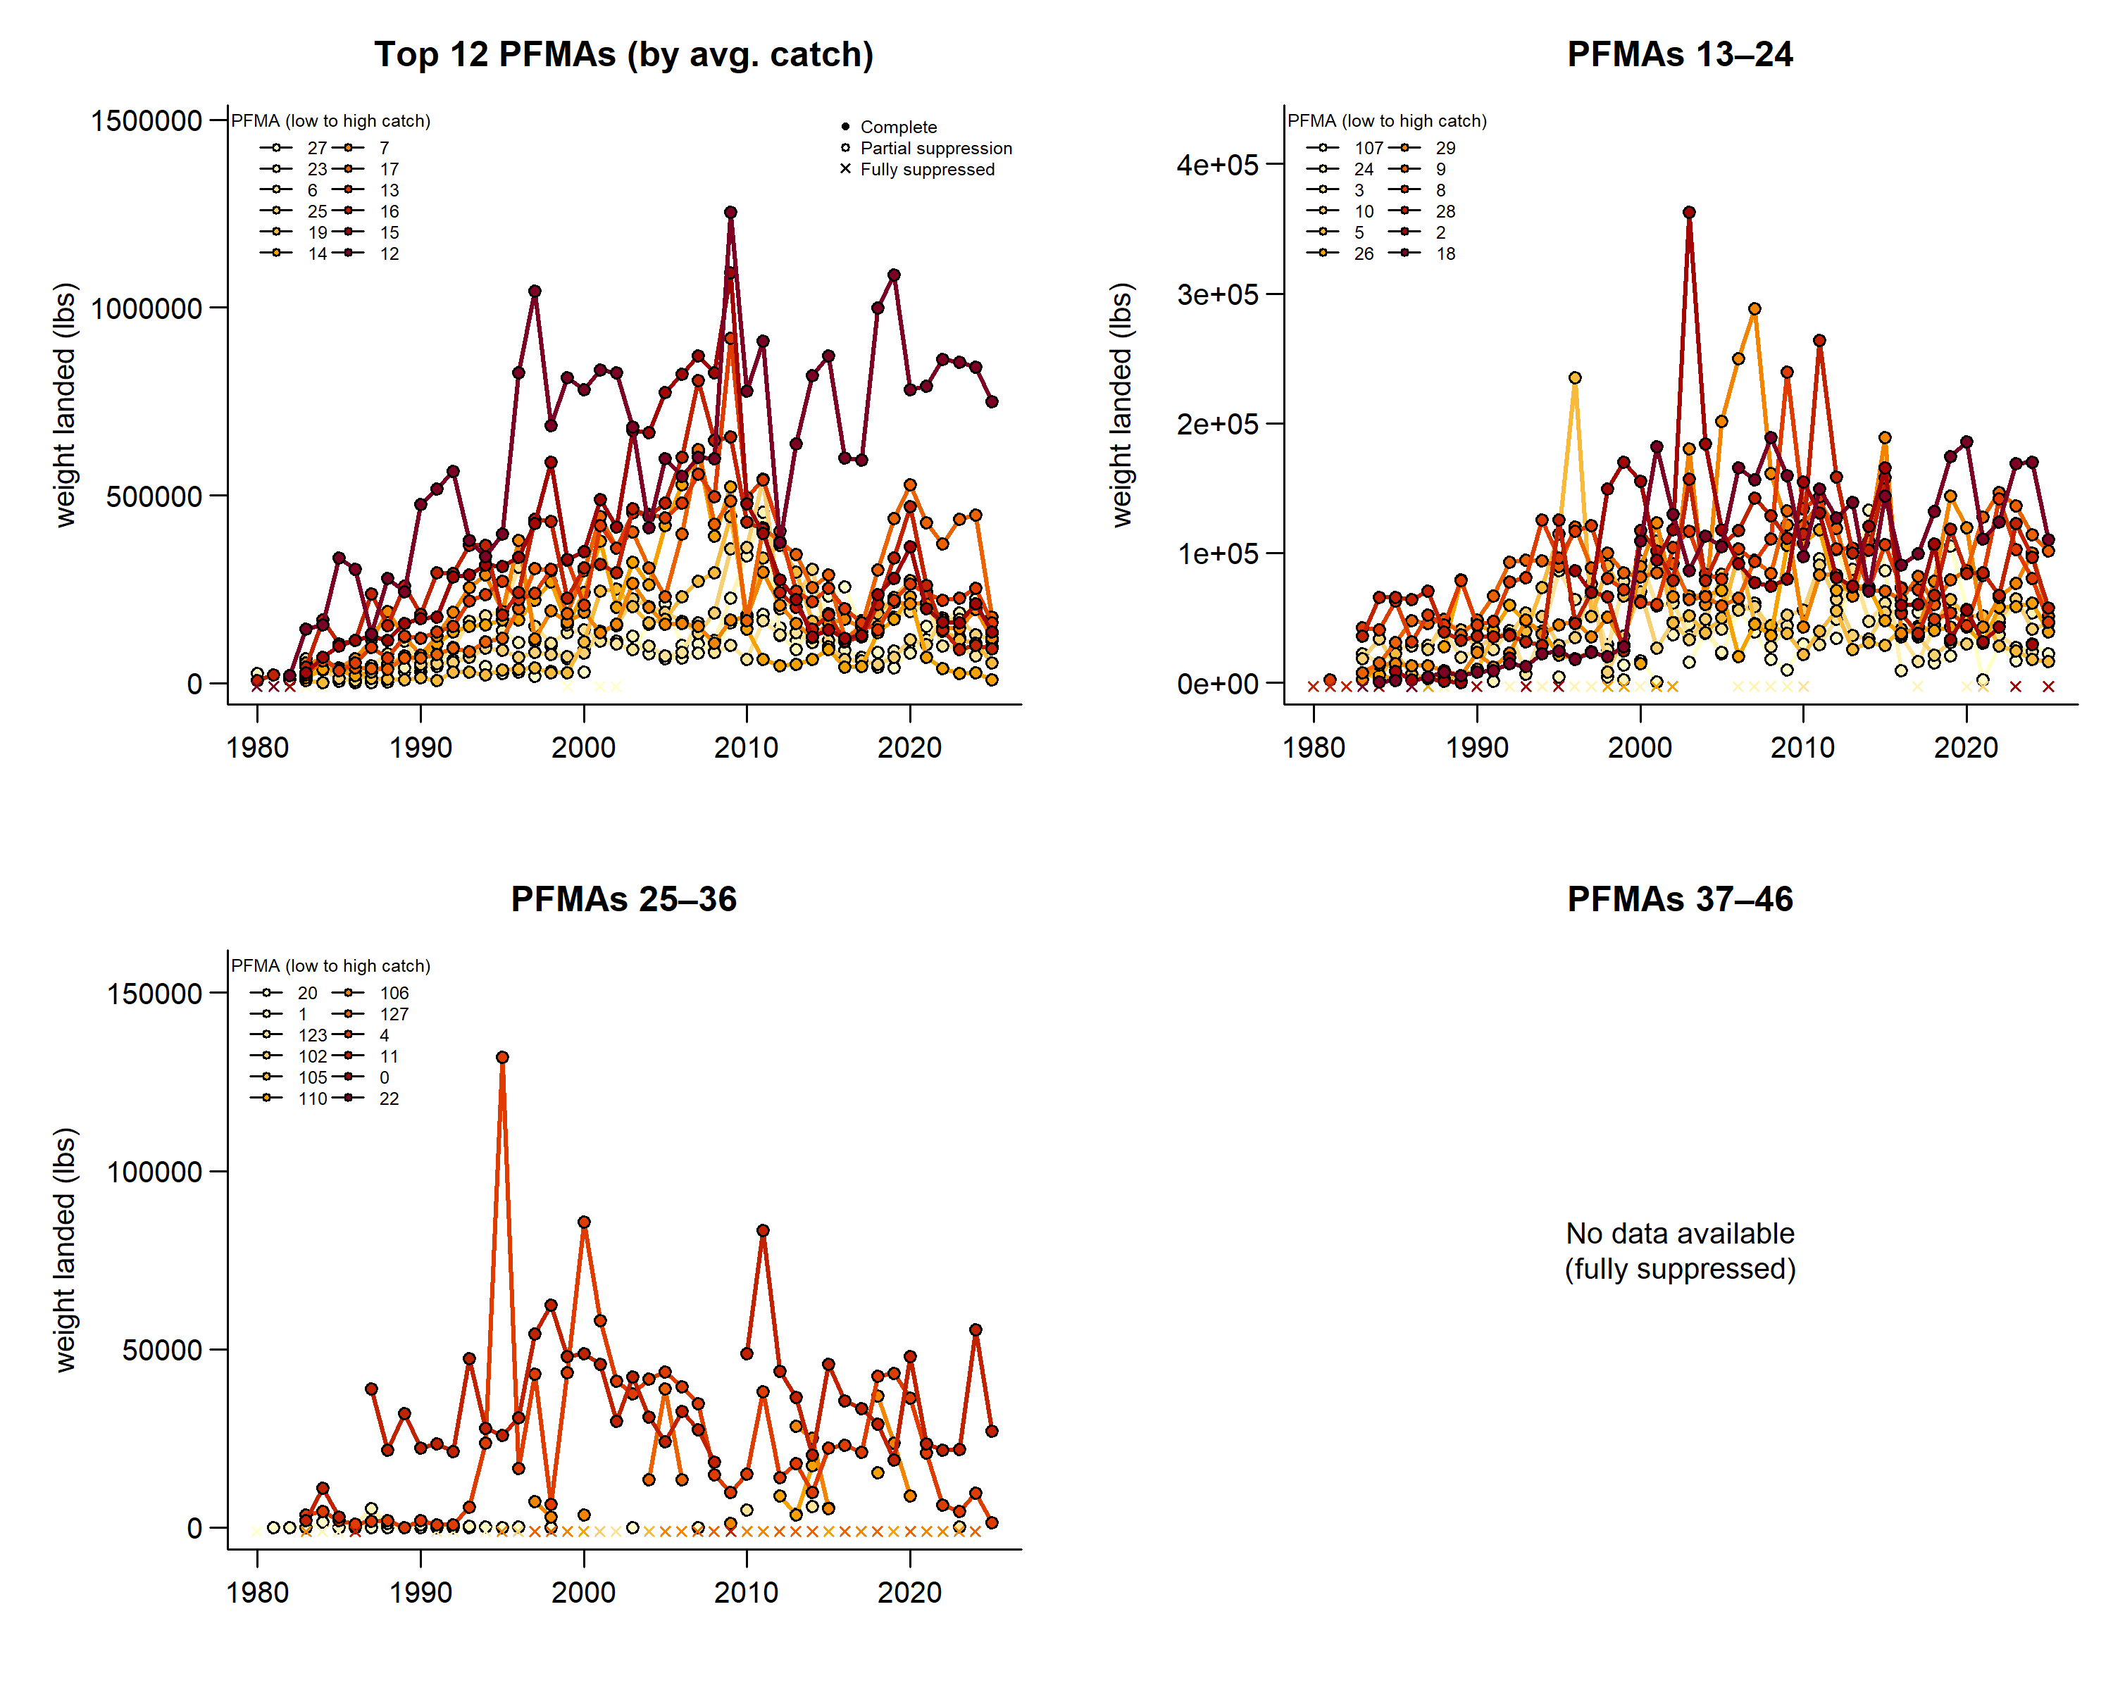
Ranked catch by PFMA – prawn

Slide 26
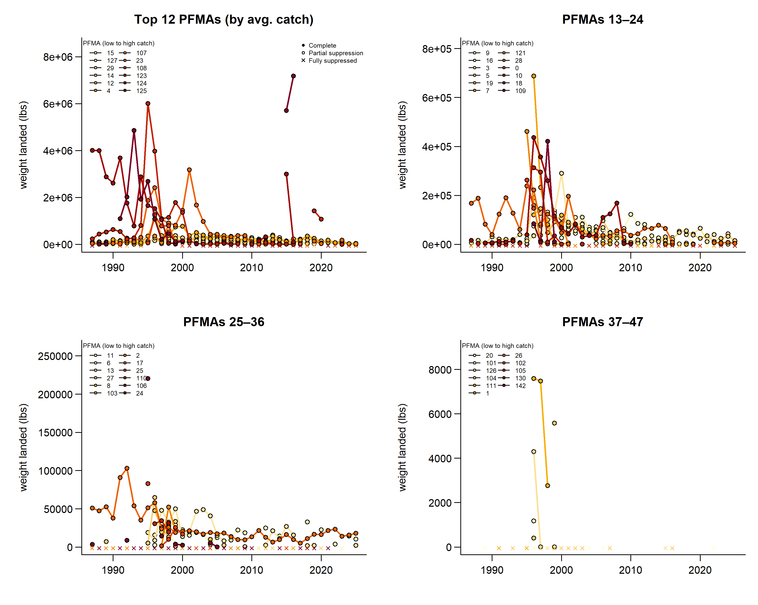
Ranked catch by PFMA – shrimp

Slide 27
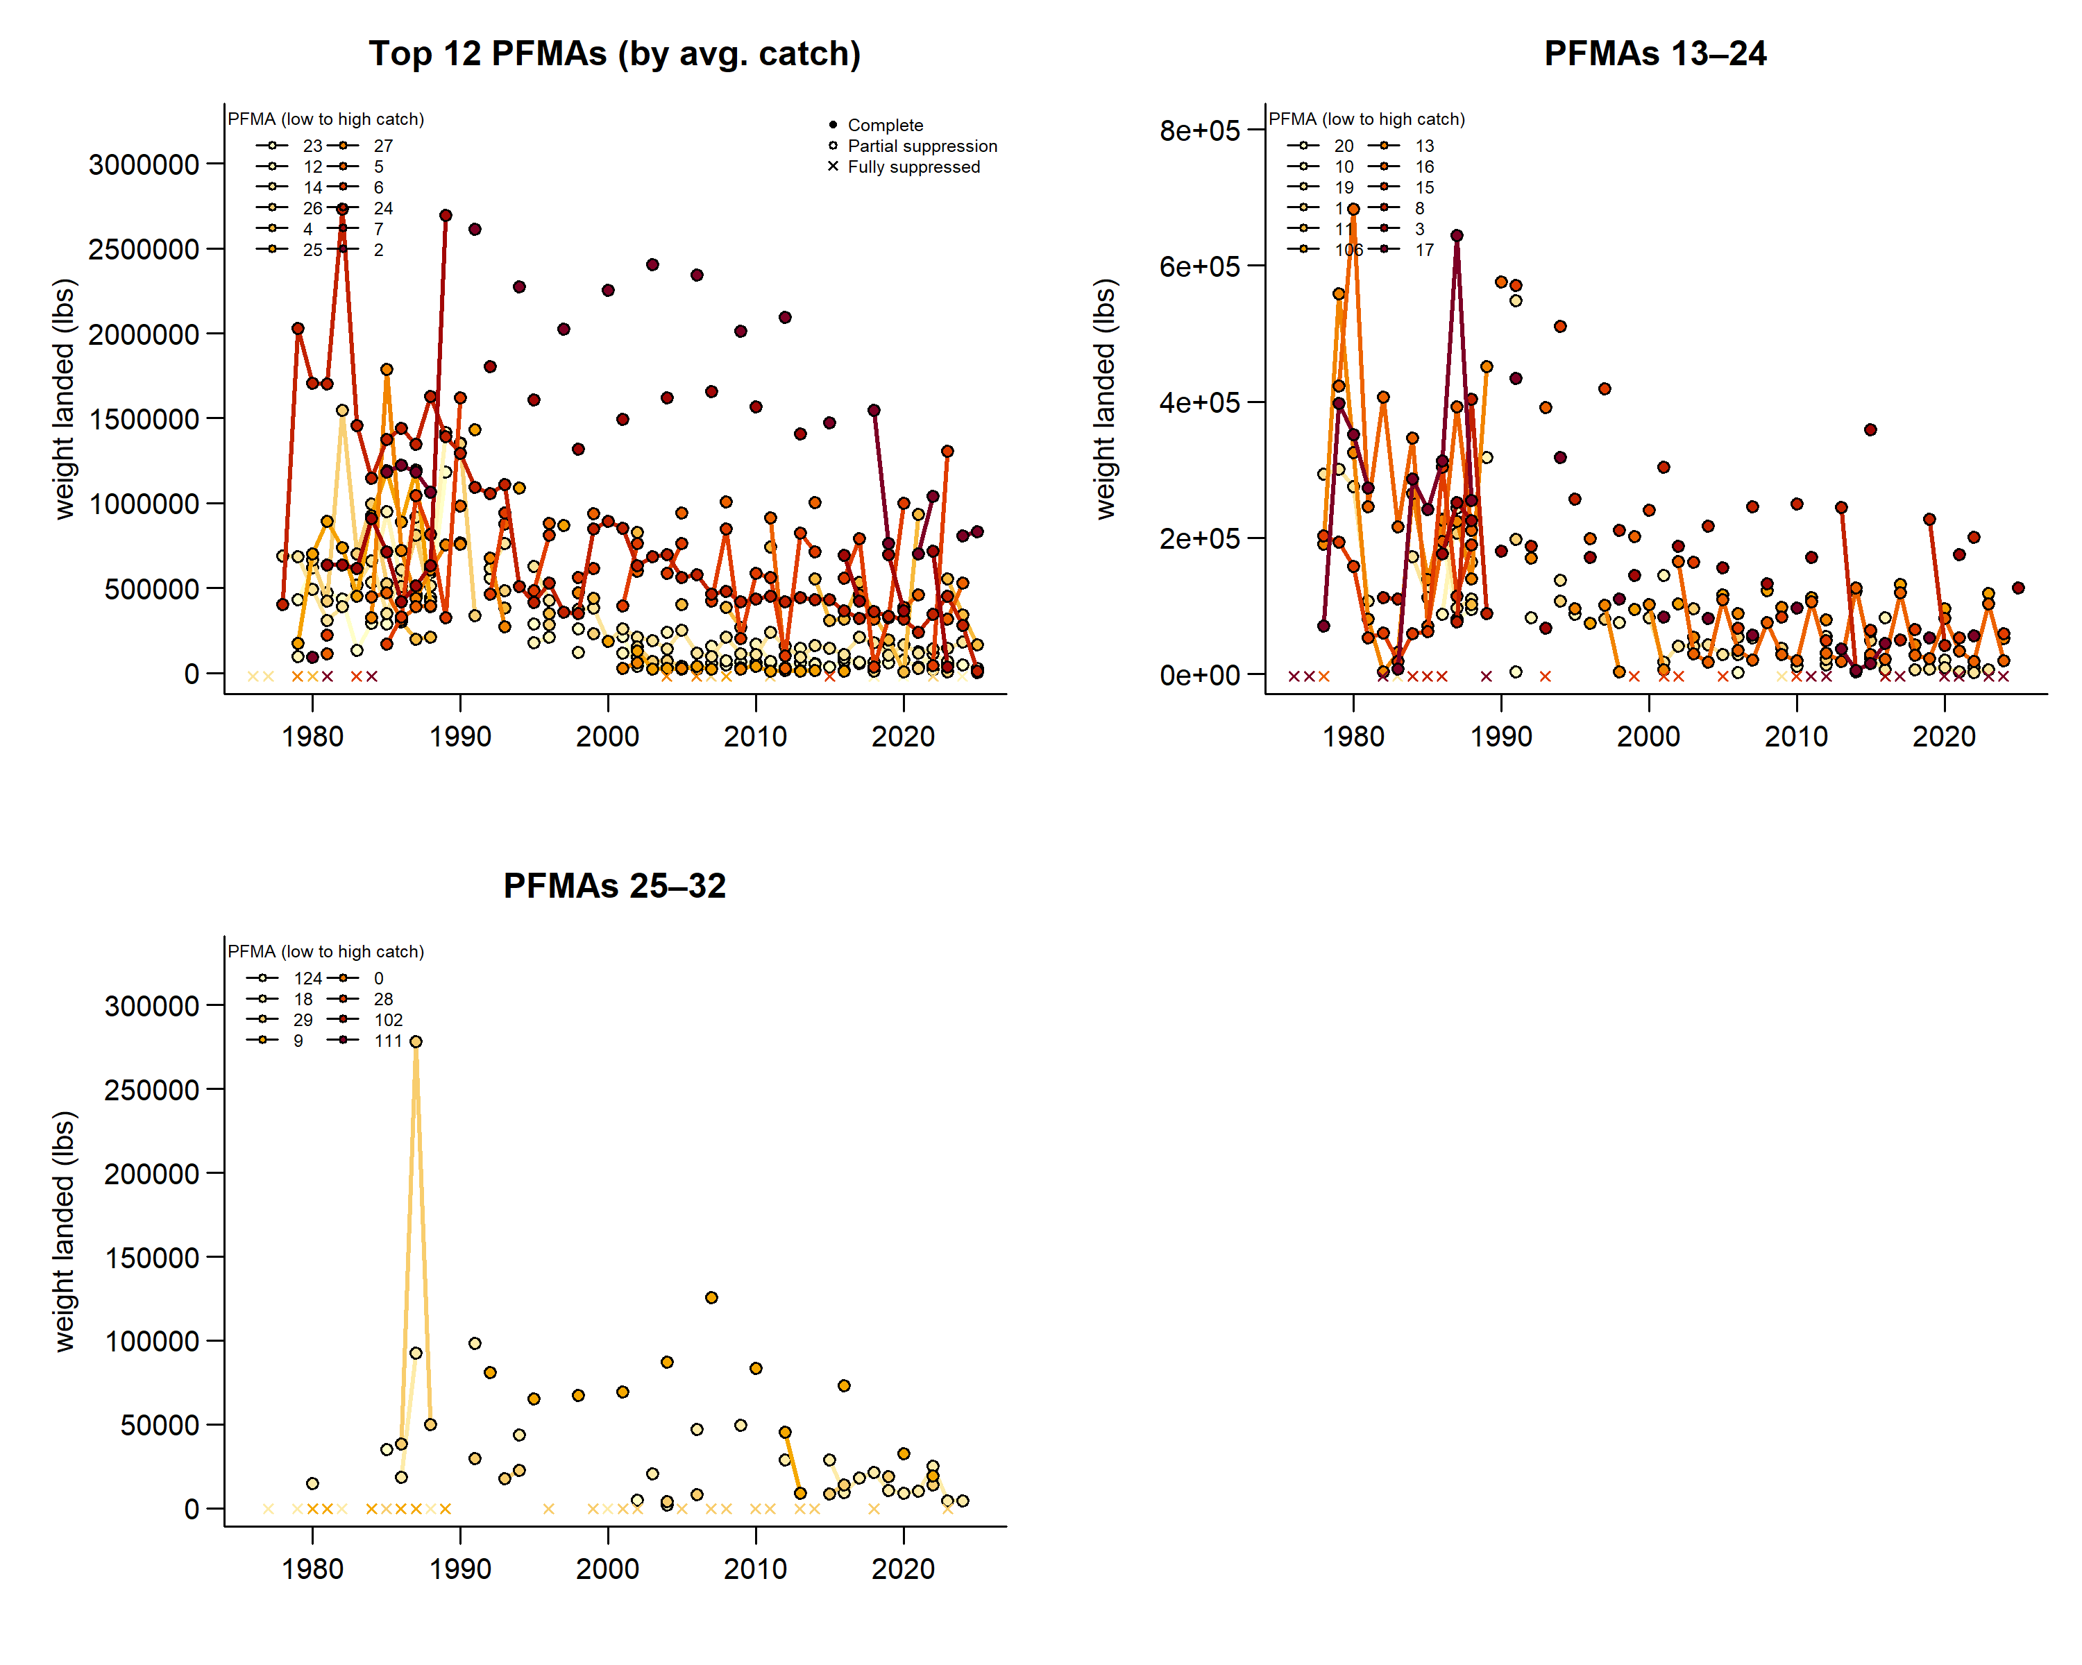
Ranked catch by PFMA – geoduck & horseclam

Slide 28
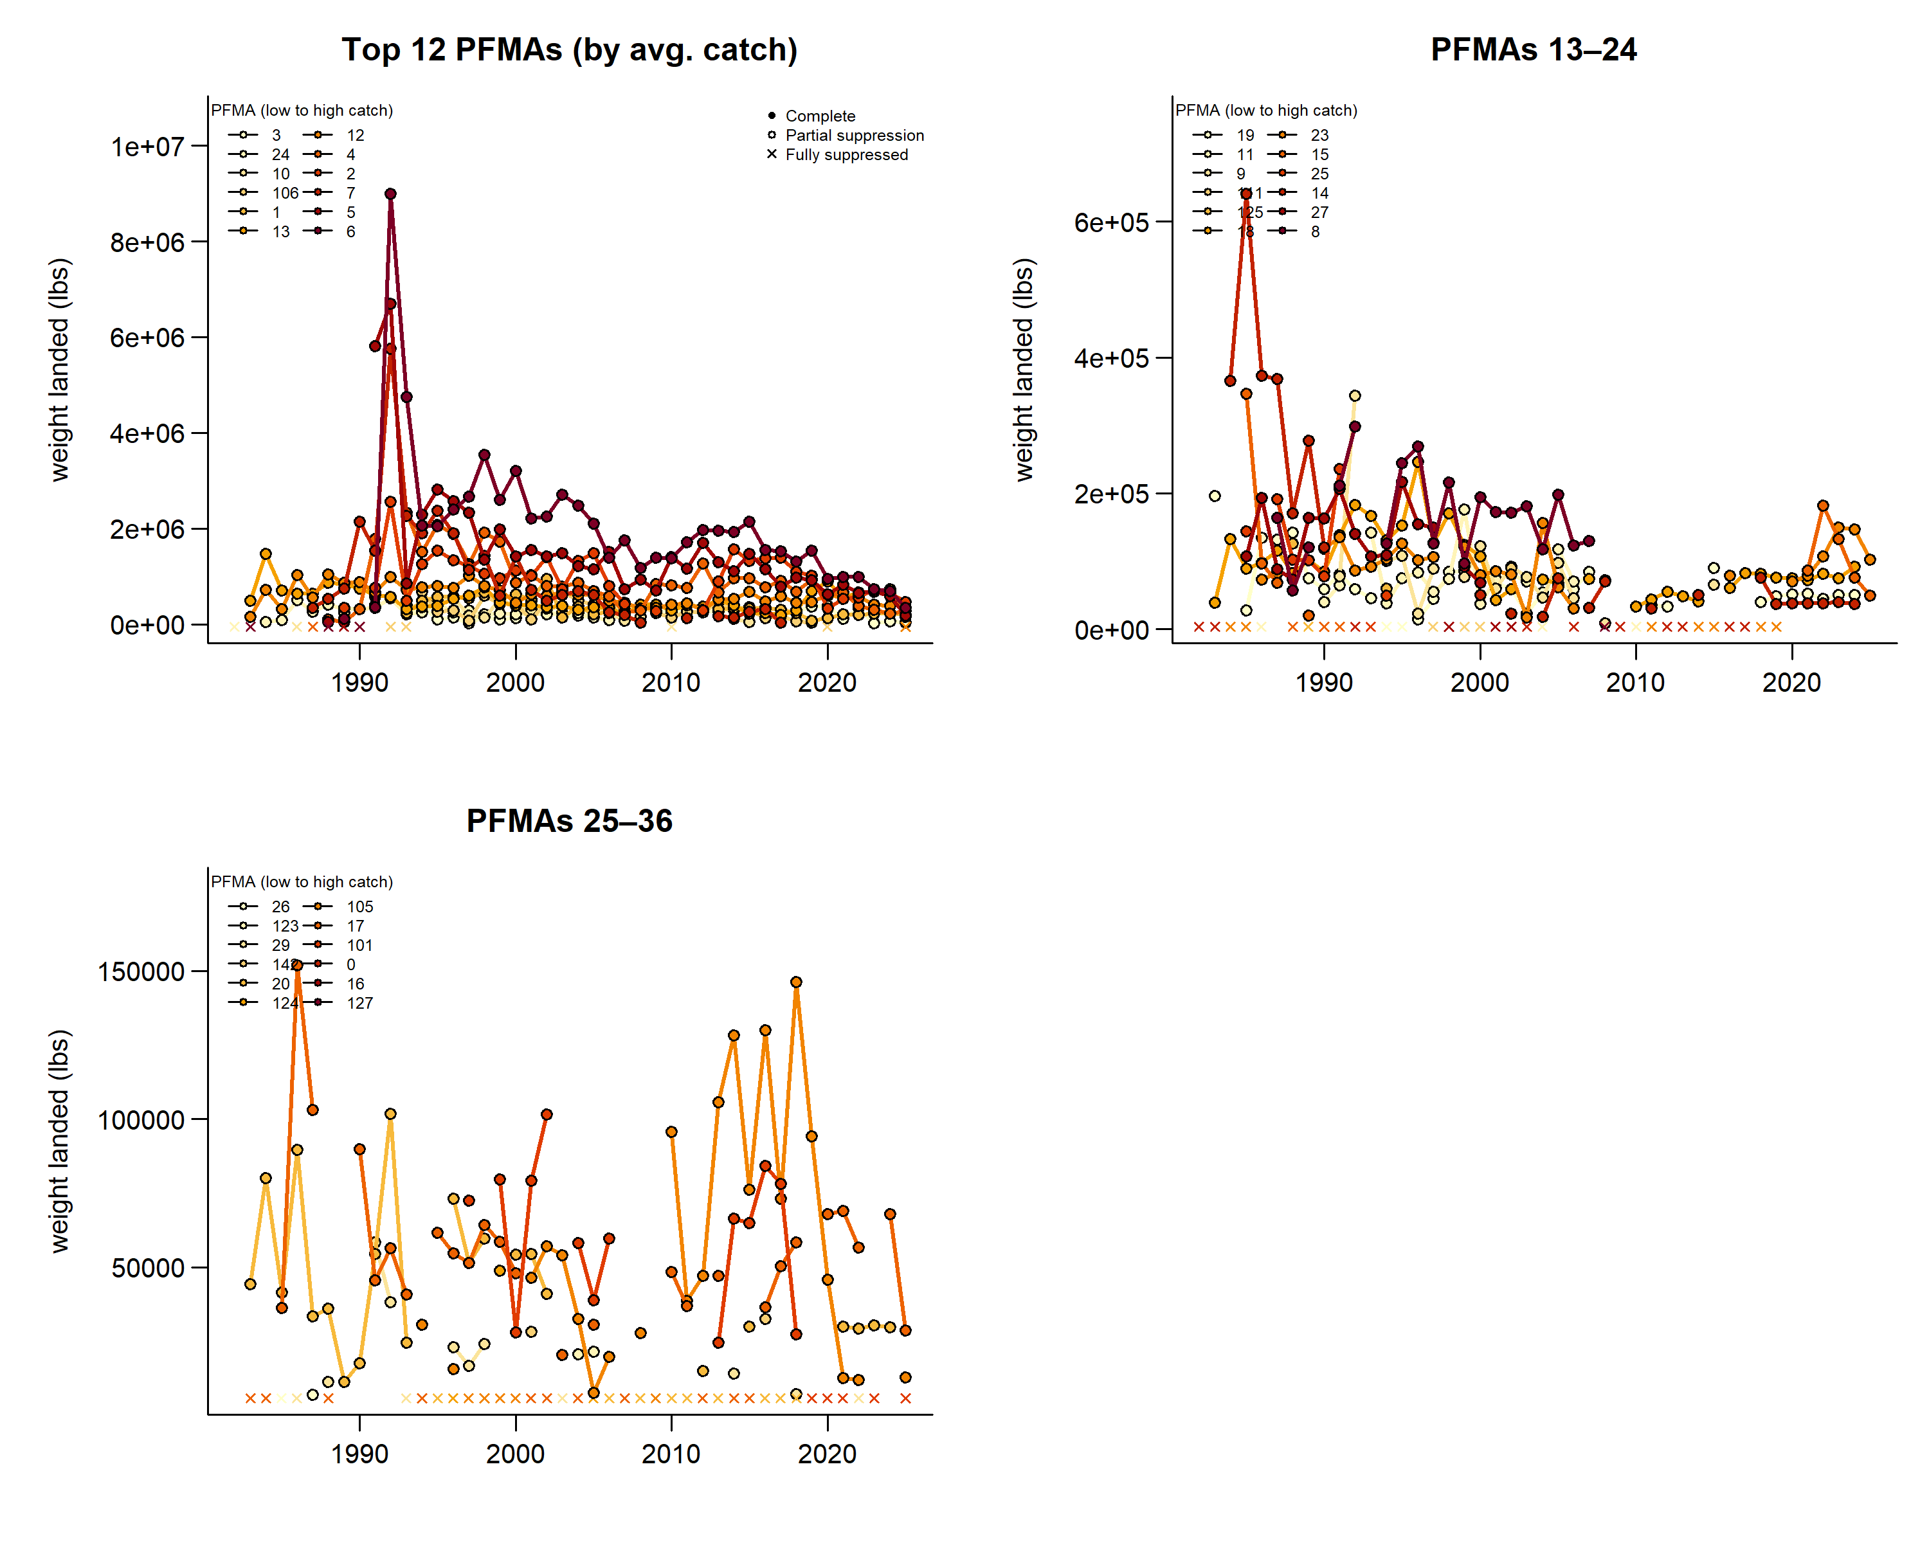
Ranked catch by PFMA – red urchin

Slide 29
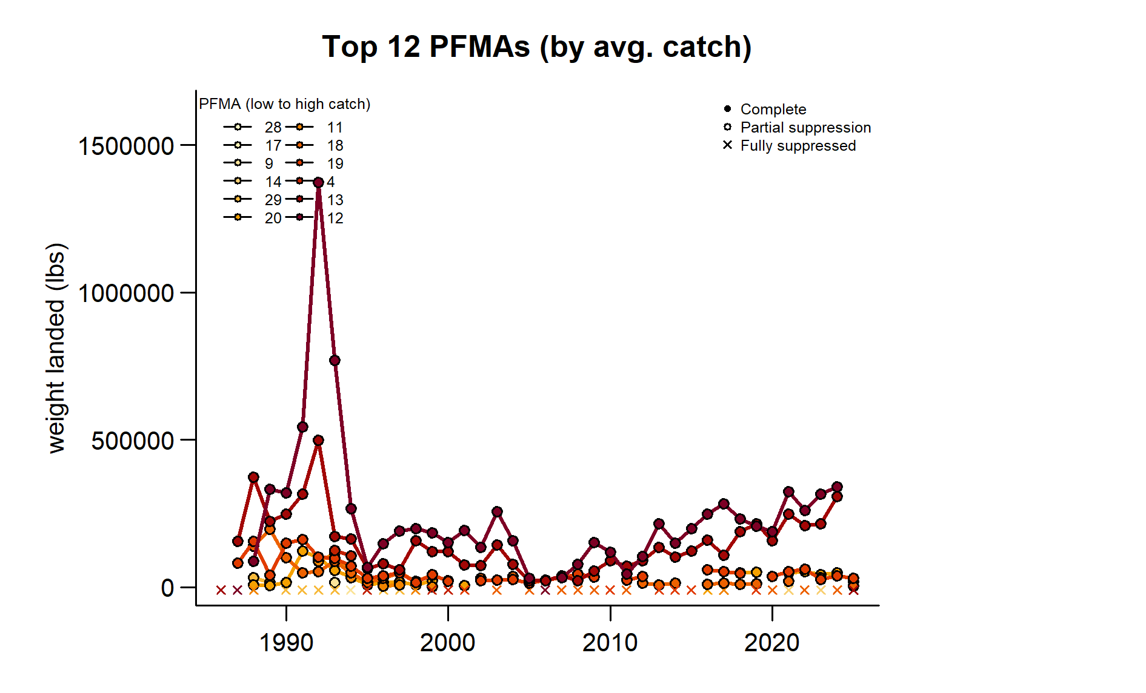
Ranked catch by PFMA – green urchin

Slide 30
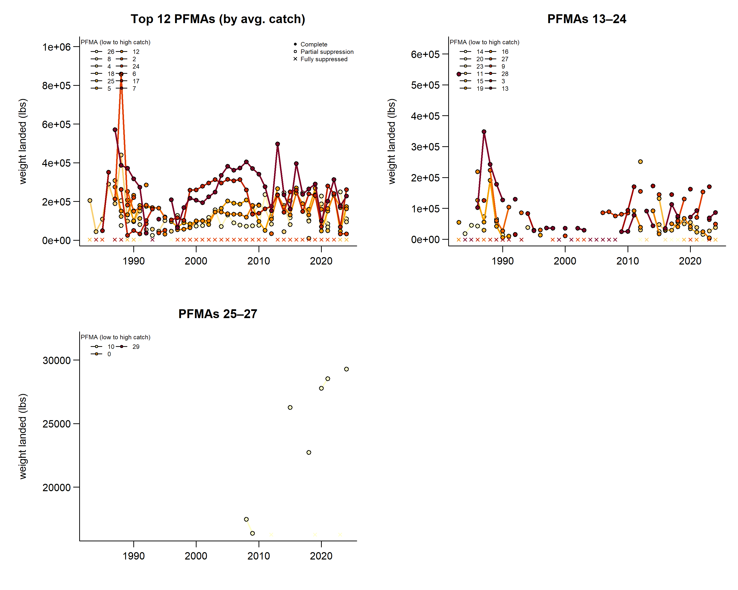
Ranked catch by PFMA – sea cucumber

