Slide 1

Break Schedule App
Optimizing Employee Scheduling through Role-Based Access

Slide 2
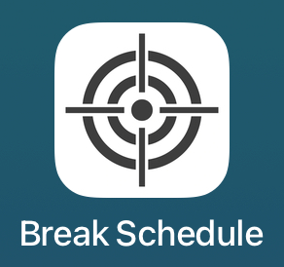
What is the Break Schedule App?
A mobile app for managing break schedules at Target
Designed to support store hierarchy: Store Directors, ETLs, TLs, and TMs
Ensures fair break allocation and real-time schedule syncing

Slide 3
Why This Project Matters?
Manual break tracking causes confusion and inconsistencies
Cloud-synced schedules reduce errors and improve transparency
Role-based views empower leaders without overwhelming team members

Slide 4

Technologies Used
Frontend: SwiftUI (Xcode)
Backend: CloudKit (Apple’s iCloud framework)
Database: CloudKit Public and Private databases
Authentication: Apple Sign-In + Username/Password login
Other Tools: GitHub, Figma

Slide 5
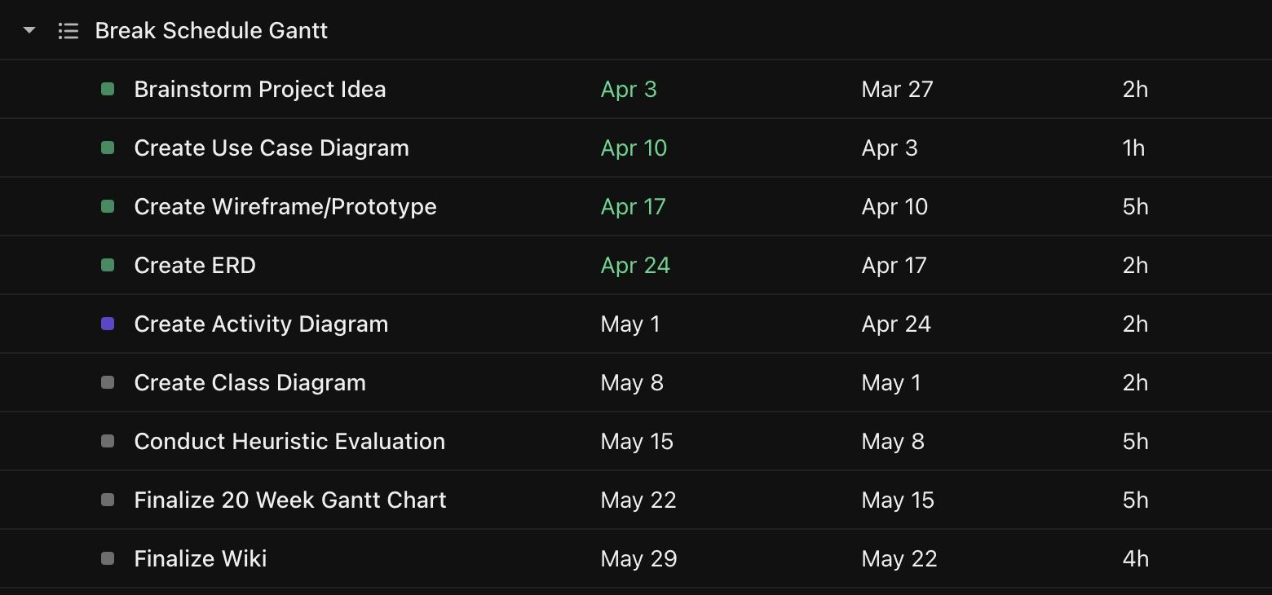
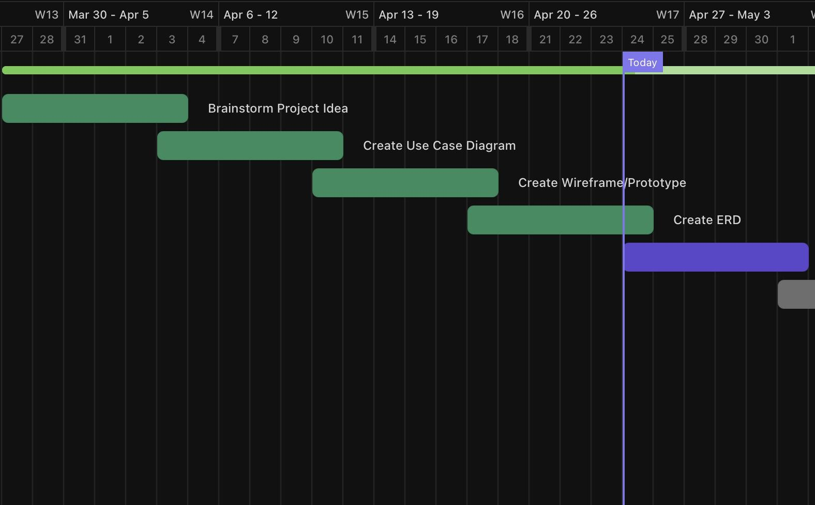
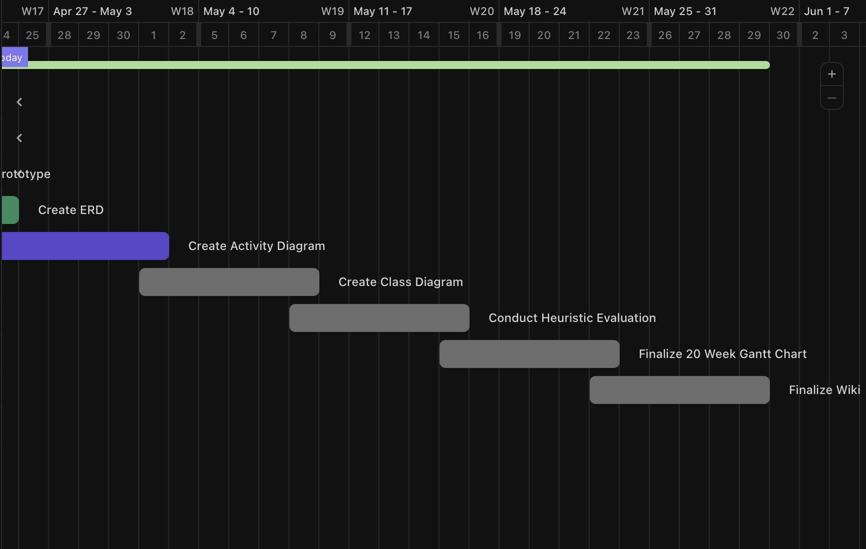
Gantt Chart

Slide 6
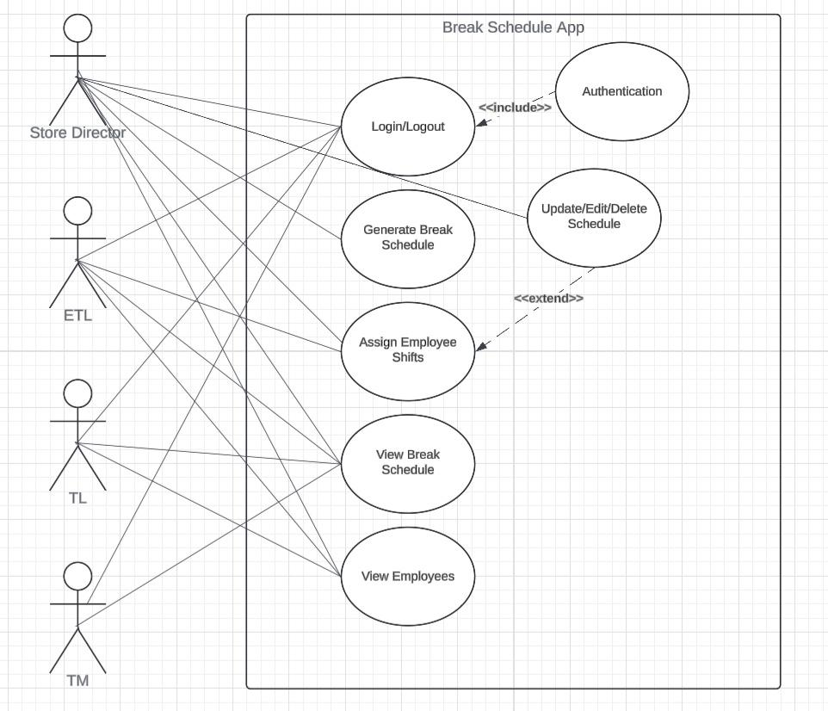
Use Case Diagram

Slide 7
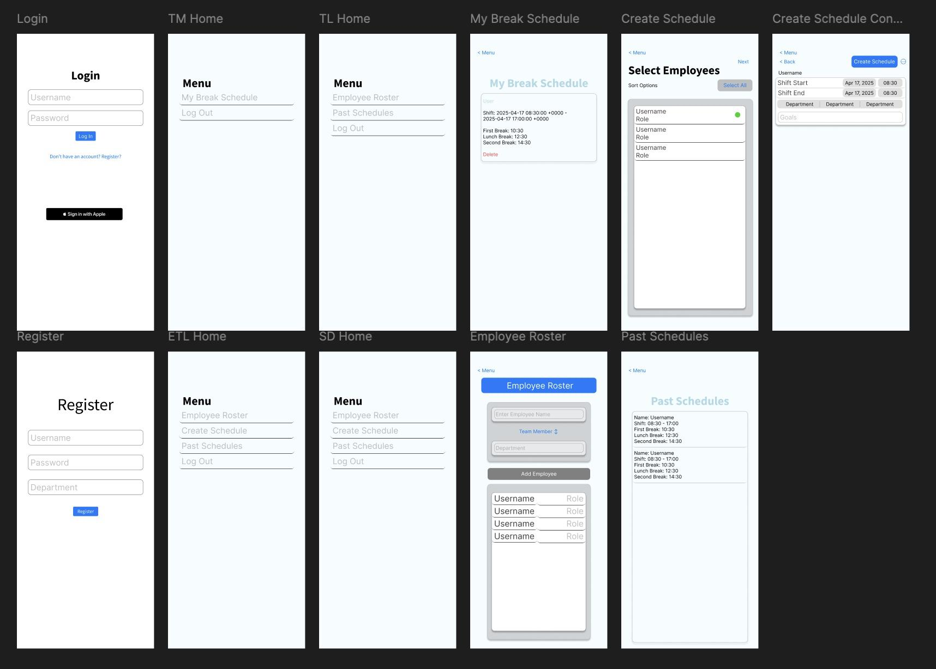
Wireframe/Prototype

Slide 8
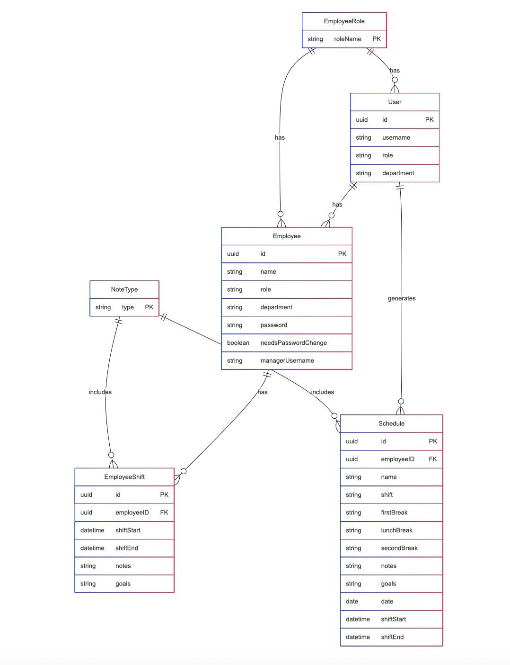
Entity Relationship Diagram (ERD)

