Slide 1

Break Schedule App
Optimizing Employee Scheduling through Role-Based Access
Emma Capirchio

Slide 2
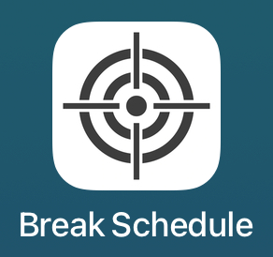
What is the Break Schedule App?
A mobile app for managing break schedules at Target
Designed to support store hierarchy: Store Directors, ETLs, TLs, and TMs
Ensures fair break allocation and real-time schedule syncing

Slide 3
Why This Project Matters?
Manual break tracking causes confusion and inconsistencies
Cloud-synced schedules reduce errors and improve transparency
Role-based views empower leaders without overwhelming team members

Slide 4

Technologies Used
Frontend: SwiftUI (Xcode)
Backend: CloudKit (Apple’s iCloud framework)
Database: CloudKit Public and Private databases
Authentication: Apple Sign-In + Username/Password login
Other Tools: GitHub, Figma

Slide 5
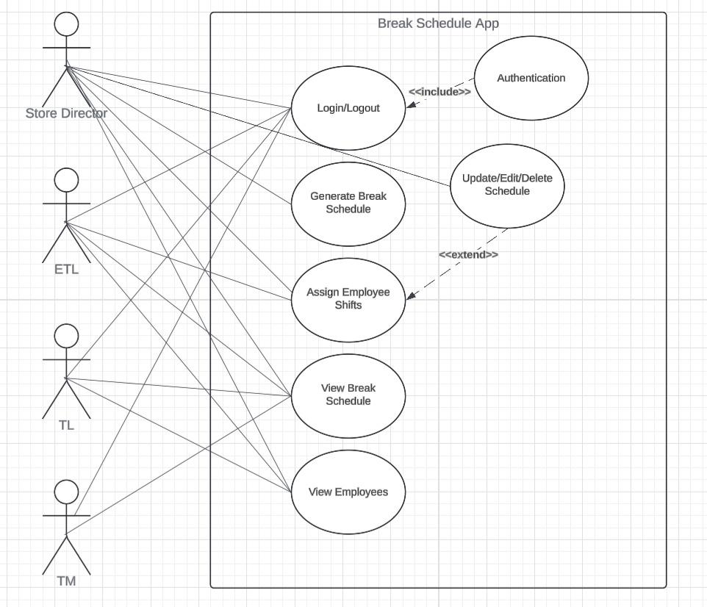
Use Case Diagram

Slide 6
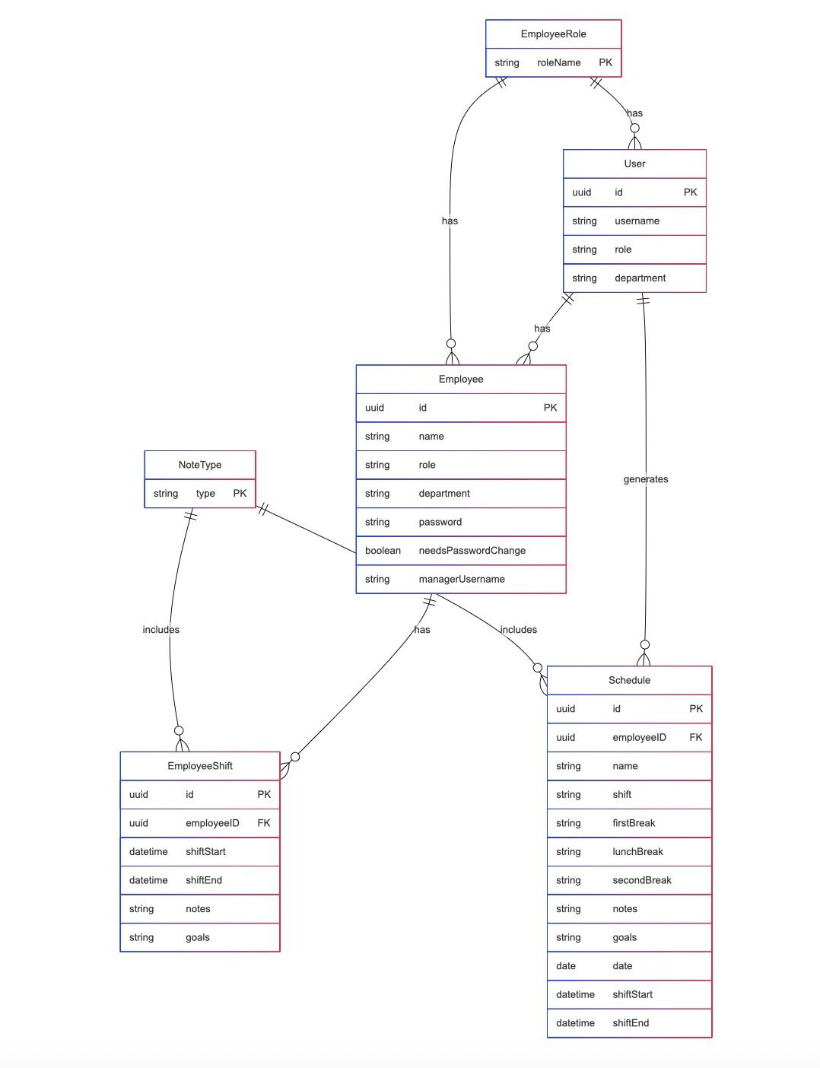
Entity Relationship Diagram (ERD)

Slide 7
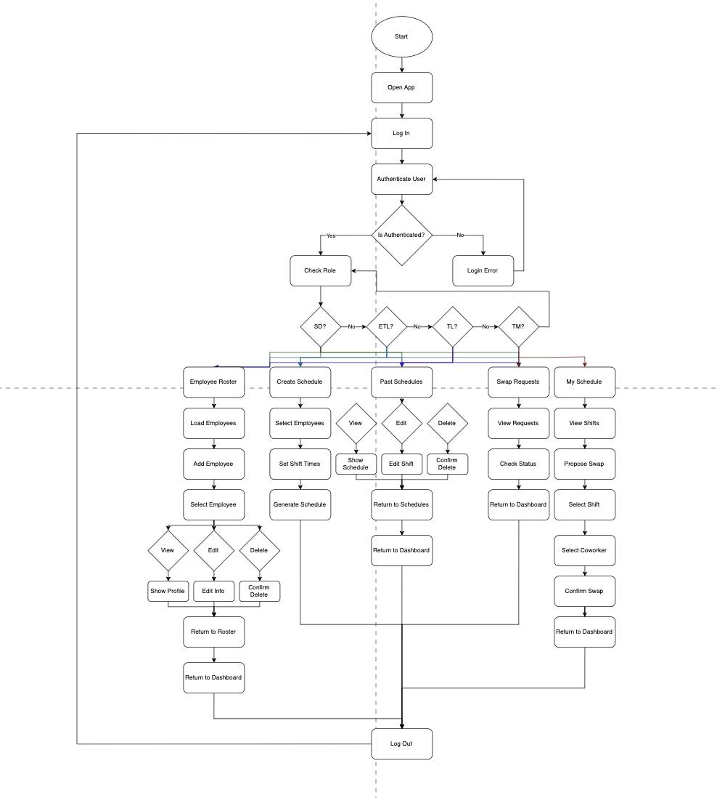
Activity Diagram

Slide 8
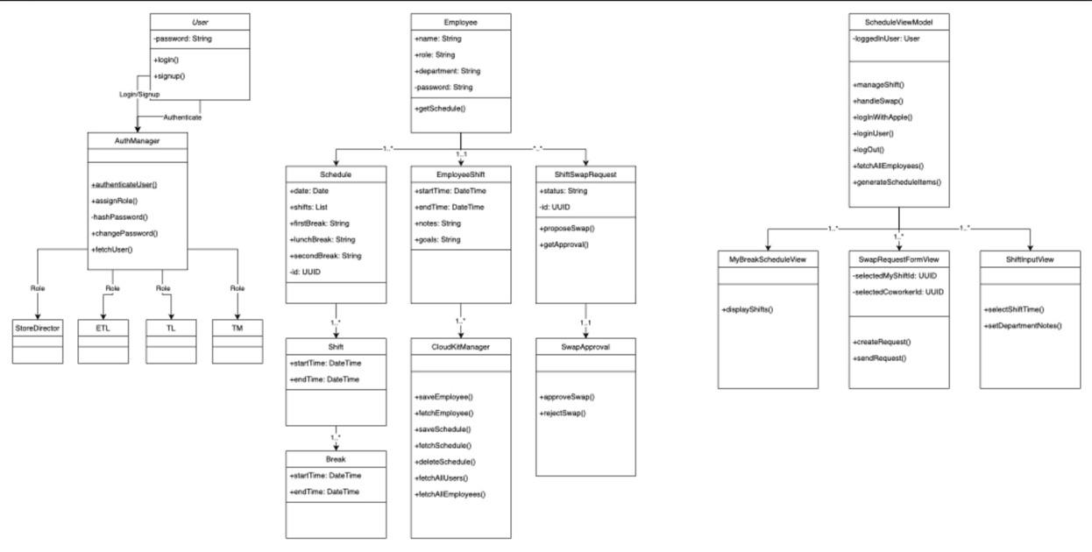
Class Diagram

Slide 9
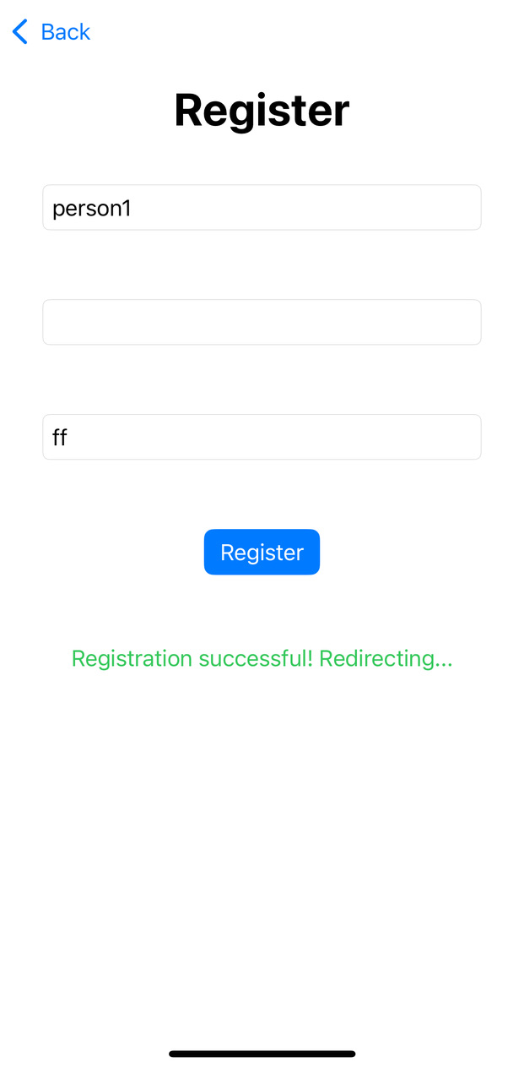
Heuristic Evaluation
Visibility of System Status
Keeps users informed by displaying loading indicators during registration and login
Followed by a success message upon completion
Success and error messages appear when submitting a shift swap or updating schedules

Slide 10
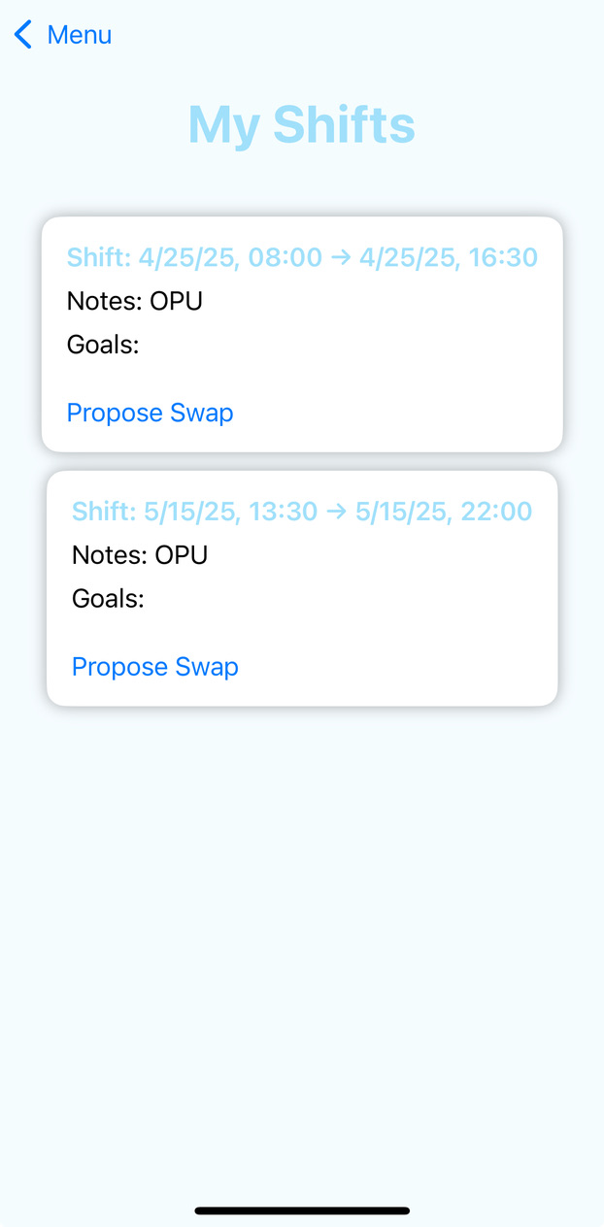
Heuristic Evaluation
Match Between System and the Real World
Uses familiar visual metaphors such as calendar-like schedules and intuitive icons
Makes the interface easily relatable for users familiar with scheduling systems

Slide 11
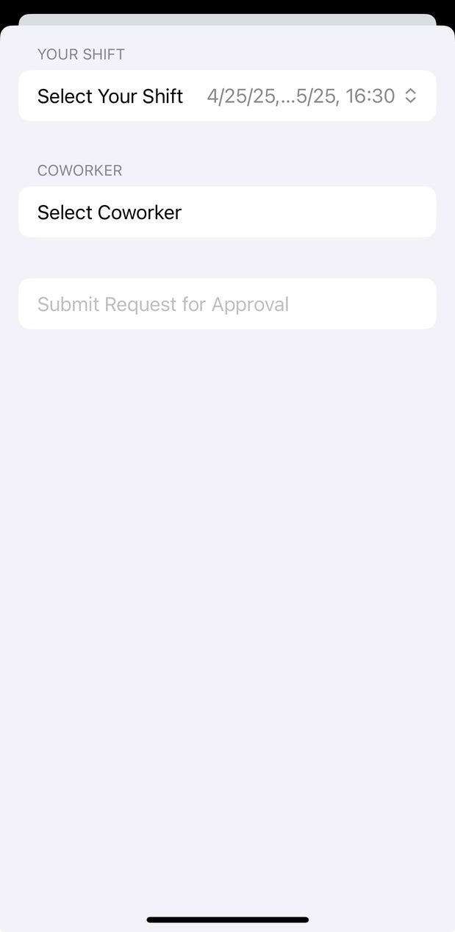
Heuristic Evaluation
User Control and Freedom
Allows users to enter shift swap requests and choose a coworker you want to switch with
Back button on all pages to enable navigation

Slide 12
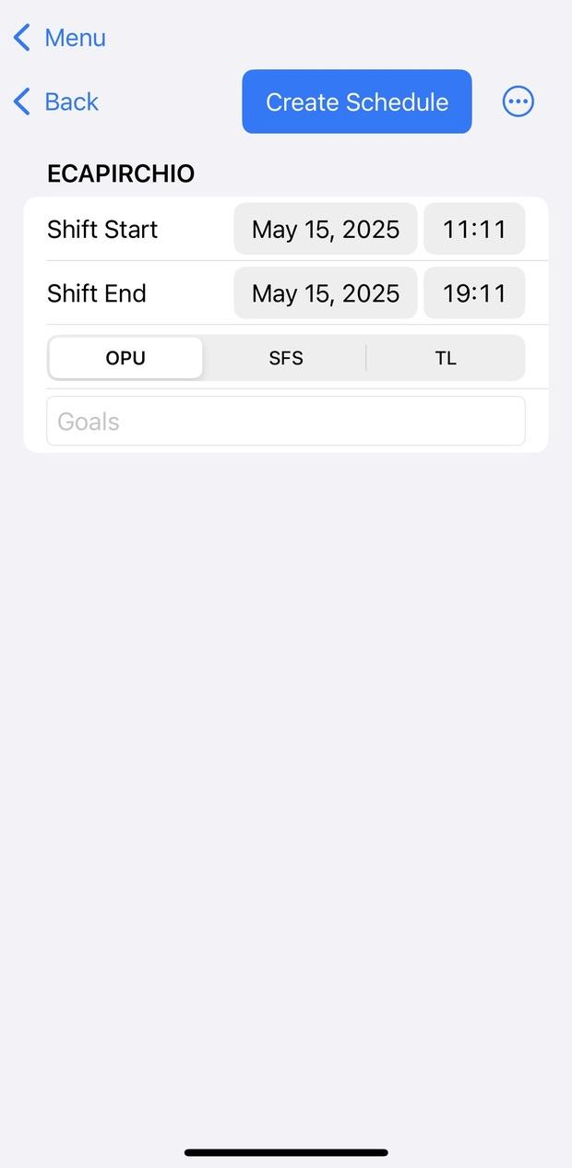
Heuristic Evaluation
Consistency and Standards
Buttons follow a uniform design
Blue theme applies consistently across headings and interactive elements
Layout follows standard iOS navigation patterns

Slide 13
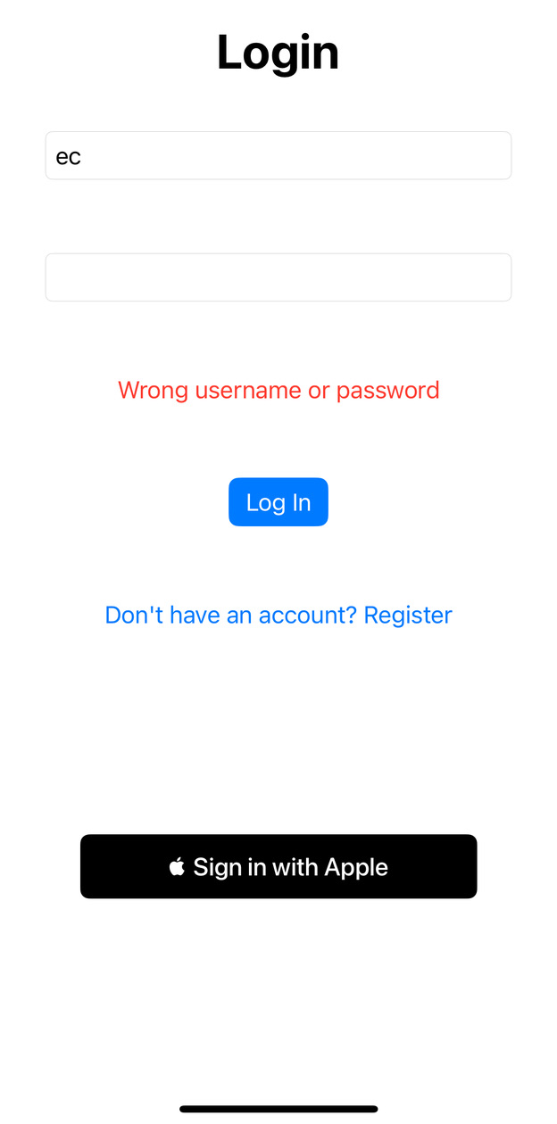
Heuristic Evaluation
Error Prevention
App validates user input when creating shifts or swaps
App displays a clear error messages
Helps users quickly identify and correct their input

Slide 14
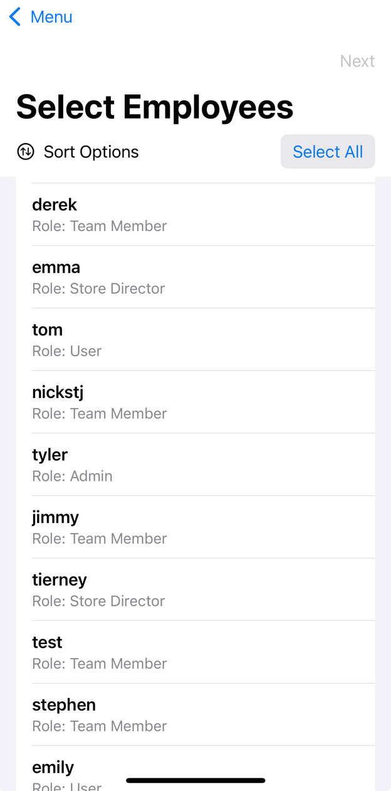
Heuristic Evaluation
Recognition Rather Than Recall
Displays employee names and roles clearly within employee lists
Icons and labels are intuitive, minimizing cognitive load

Slide 15
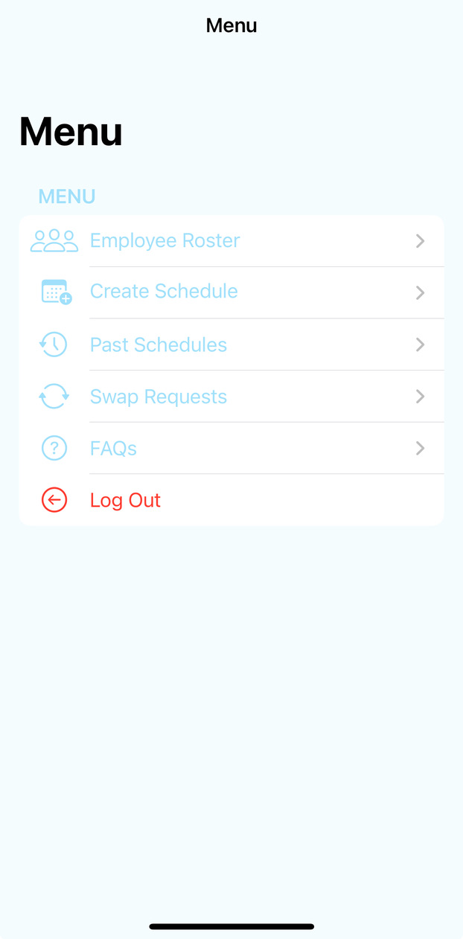
Heuristic Evaluation
Flexibility and Efficiency of Use
New and experienced users can navigate efficiently thanks to simple, labeled buttons and shortcuts for common actions
Admin features are clearly marked and accessible only to authorized roles

Slide 16
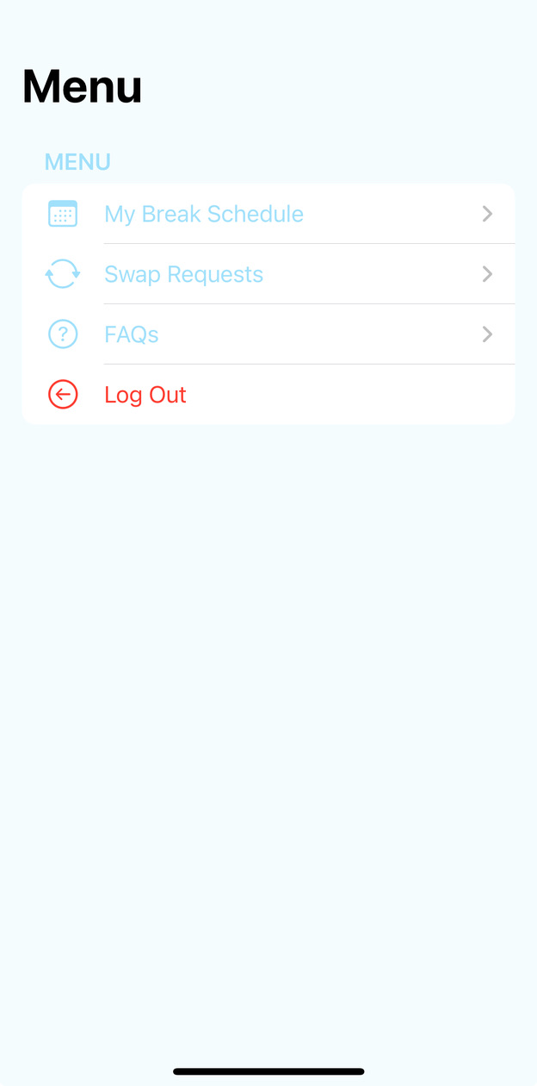
Heuristic Evaluation
Aesthetic and Minimalist Design
Maintains a clean and minimalist aesthetic, focusing on essential information without clutter
The blue theme highlights key actions without overwhelming the interface

Slide 17
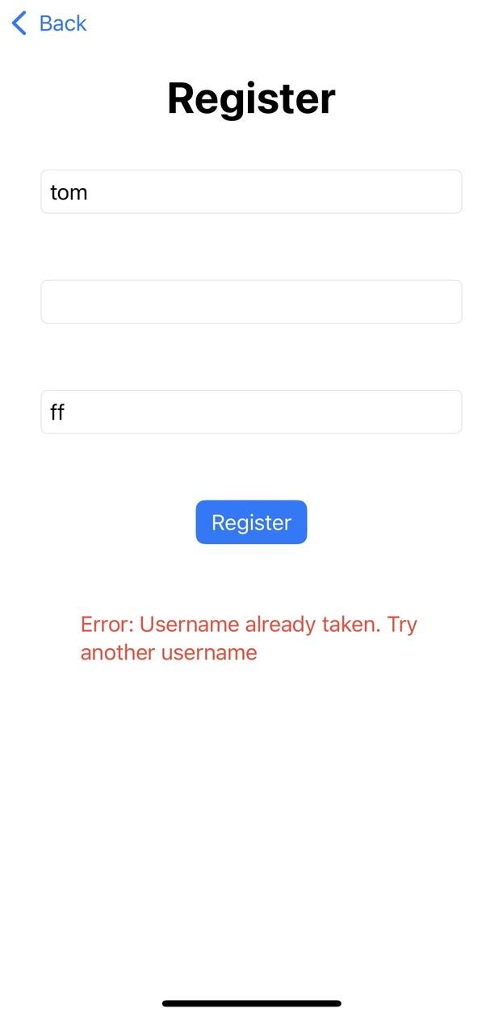
Heuristic Evaluation
Recognize, Diagnose, and Recover
Error messages are displayed with clear explanations and suggestions for corrective actions
The error message includes the reason and a retry option

Slide 18
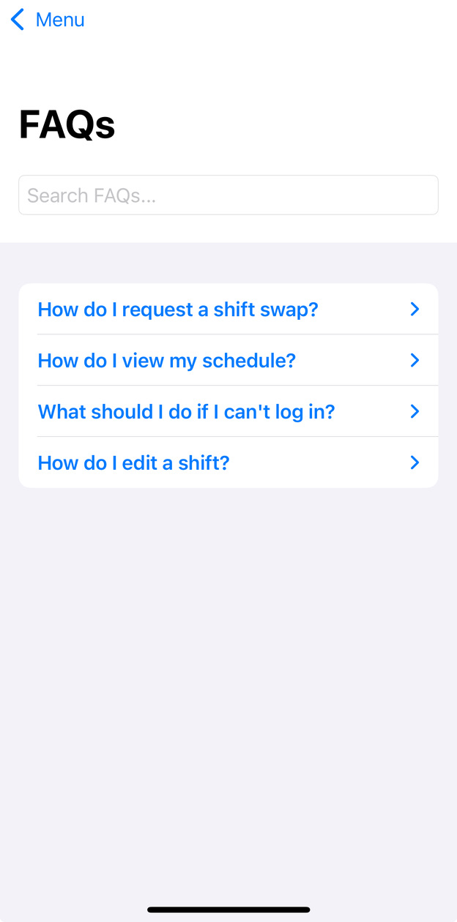
Heuristic Evaluation
Help and Documentation
Includes a help section accessible from the main menu
Covers common questions about scheduling shifts, swapping, and using the admin dashboard

Slide 19
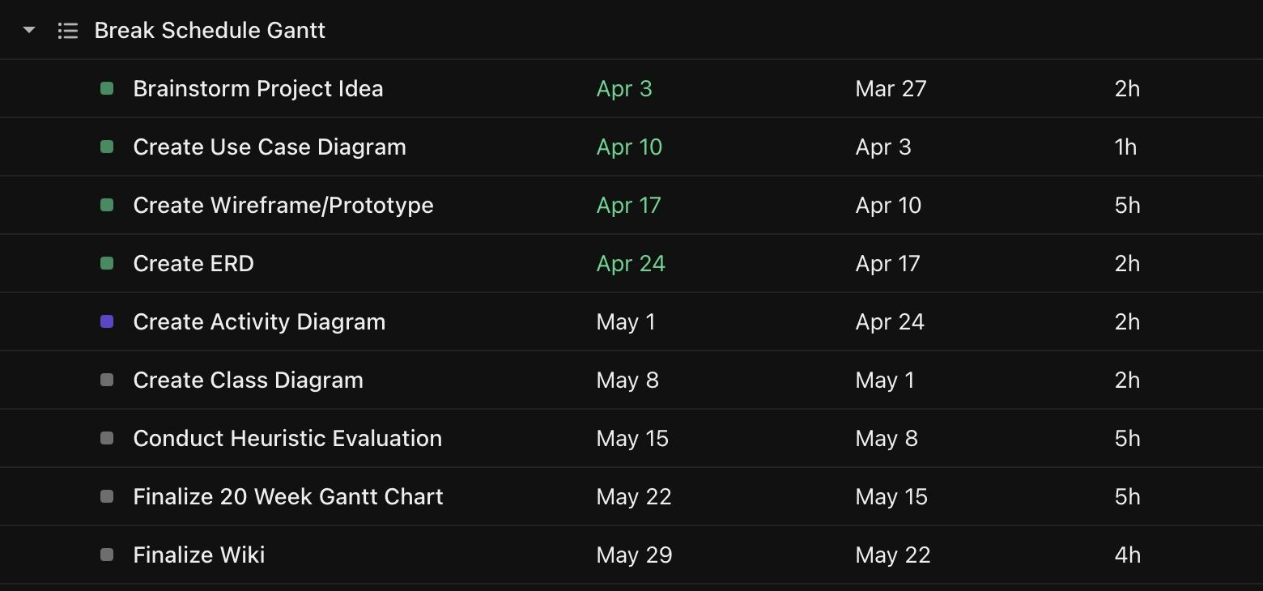
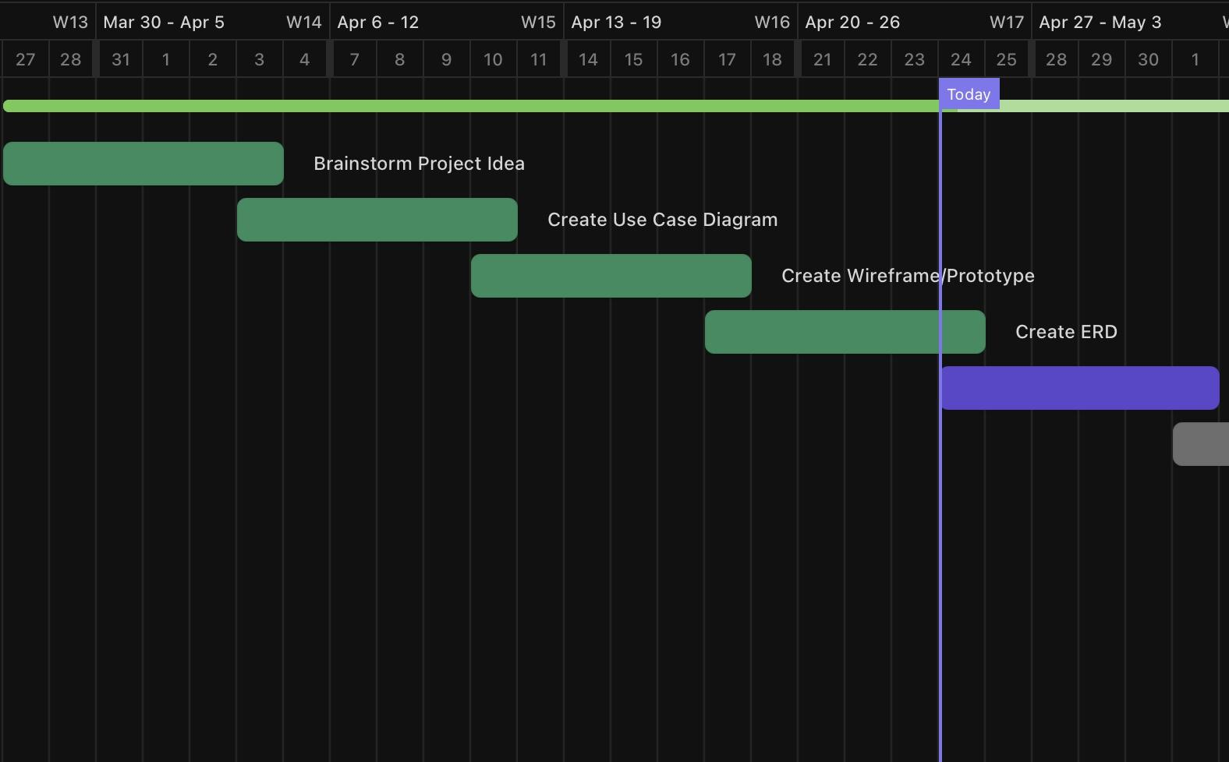
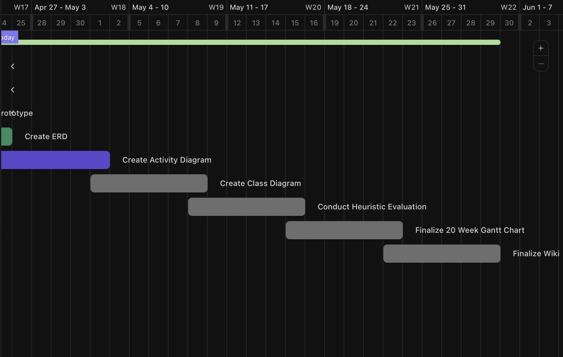
Gantt Chart
First 10 Weeks

Slide 20
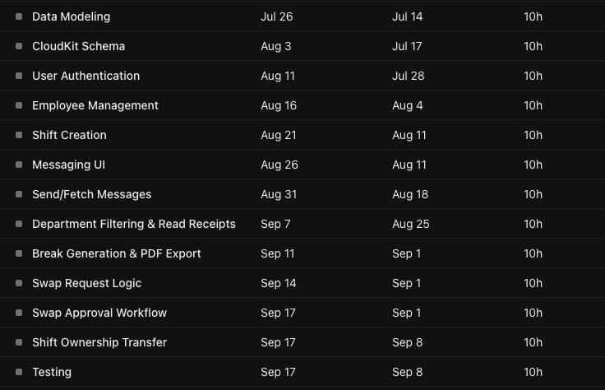
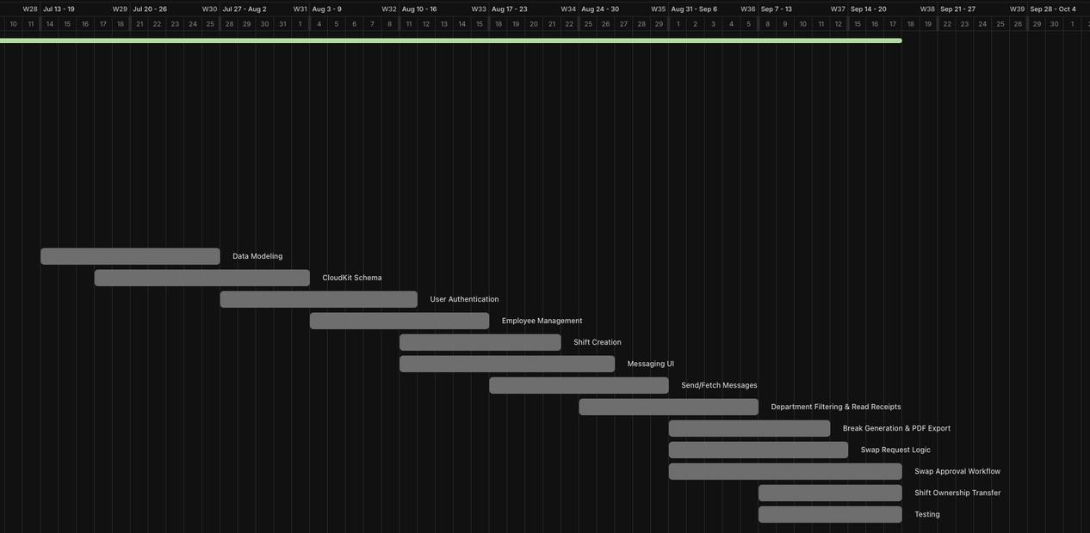
Gantt Chart
Last 10 Weeks

Slide 21
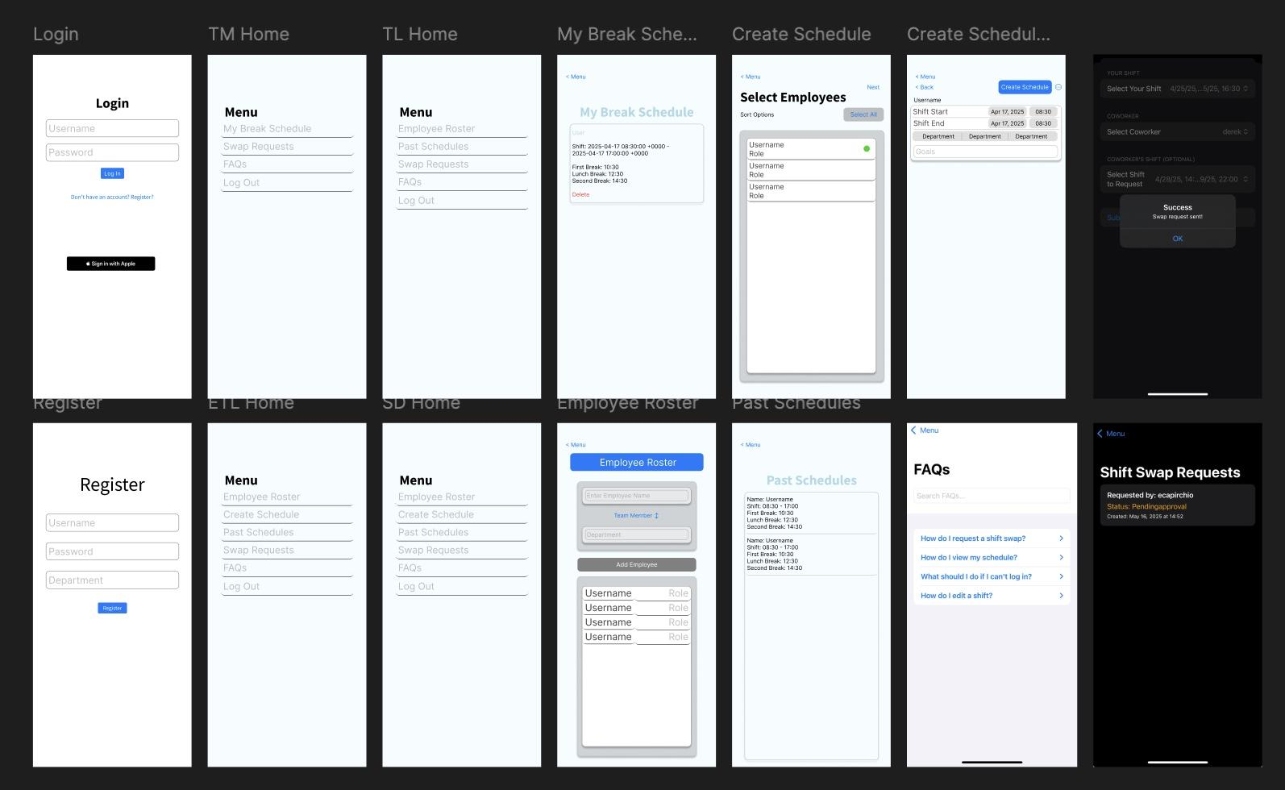
Wireframe/Prototype

