Slide 1
Summary Project Artificial Data Streambugs SDMs
July – Emma, Nele, Andreas

Slide 2
Streambugs – Done until now
Many numerical checks and parameter tuning to optimize:
Numerical method for ODE solver
Time step size
Years of simulation
Warnings if steady state not reached
Taxa response to environmental factors

Slide 3
Streambugs – Still to be done
Check if we could smooth the response to environmental factors by smoothing the interpolation function between ecological scores
Polynomial interpolation, be careful to not overshoot (too flexible) and how it extrapolates
Investigate sites with strong irregular shape, print additional output, check food limitation
Correct sapro pref for Ceratopogonidae
Check ICE 50 years 30 steps for Baetis alpinus for
SynthPoint1961Aa (Aare) (drop at 8.11 degrees)
SynthPoint6969Rh (Rhein) (drop at 4.86 degrees)
Depending on final choice of parameters, produce data again (ICE, 100 sites, entire dataset 3000 sites)
Clean scripts and folders, write comments, write documentation

Slide 4
SDMs – Done until now
GLM, GAM and RF are running (CV and FIT)
ICE and PDP plots
Noising scenarios from Gaspard

Slide 5
SDMs – Still to be done
Check:
Performance metrics during CV (standardized deviance, explanatory power, AUC, overfitting/likelihood ratio)
Recover correct plots for performance metric
Include null model
Include ANN, hGLM?
Check noising scenarios, e.g., no bias when reducing dataset size
Add scenarios?
Reduce dataset size to 100/300/500
Noise on response variable (misdetection) → on all taxa
dispersal limitation
Produce ICE comparison for all taxa

Slide 6
Paper – Still to be done
Analyze response shapes and performance metrics
Agree on conclusions
Write

Slide 7


How robust are species distribution models against noise in the data? Comparative and methodological studies of machine learning and statistical models to predict spatial distribution of species
Emma Chollet Ramampiandra
Eawag, Switzerland
Notes:
Hi everyone, thanks for attending my talk today. My name is Emma Chollet Ramampiandra, I am in the last year of my PhD at Eawag, the aquatic research institute in Switzerland, and today I am going to present you the preliminary results of my last project, where we try to understand how robust are species distribution models against noise in the data.

Slide 8

Nature is complex
Regional species pool
Dispersal
Environment
Biotic interactions
Local species pool
Local species pool
Local communities
Modified after HilleRisLambers, Adler, Harpole, Levine & Mayfield, 2012
Notes:
As you might all know, nature is complex. If we want to improve our understanding of ecosystems, we have to be aware of all the processes influencing the composition of species communities. Let’s say we start with a big regional species pool, to know which species will occur at a specific site, we first have to know which species are able to reach the sites.
Some won’t survive this so called dispersal filter. Once they made it to this site, they have to accommodate to the physical environment,
if the environment is not suited for them, some might die because of the environmental filter. Finally, the species will interact with each others, they might compete for food, or feed on each other,
and through this last biotic interaction filter, only specific local communities will occur at certain sites.

Slide 9
Species Distribution Models (SDMs)
Environmental predictors
Species Distribution Models
Probability of occurrence of species
Empirical models relating probability of occurrence of species to their physical environment used to:
make predictions,
understand species responses to environmental predictors.
Differ in their properties and show different learned response shapes, which impacts their predictive performance and interpretability.
Notes:
A common tool used by ecologists to predict and understand the distribution of species, are species distribution models. They are empirical models relating the probability of occurrence of species to their physical environment. They are usually used to make predictions, and improve our understanding of species to specific environmental predictors.
These models differ in their properties, and show different learned response shapes, which impacts their predictive performance and interpretability.

Slide 10
SDMs challenges
SDMs are not intended to capture ecological processes like biotic interactions or dispersal limitation.
Ecological datasets are incomplete and prone to different sources of noise (e.g., measurements, misdetection).
SDMs can do overfitting to noise in the data.
All of this impact models results, predictions and interpretability.
We cannot determine which response shape is accurate because we don’t know the ground truth.
Notes:
Therefore, we face some challenges when applying SDMs. First, these models are not intended to capture ecological processes like biotic interactions or dispersal limitation. Also, ecological datasets are incomplete and prone to different sources of noise, arising for example from the measurement device or calculation used to estimate the environmental predictors, or from misdetection during biomonitoring sampling. Finally, we know that more flexible models can also do overfitting to noise in the data.
All of this impact models results, in terms of predictions and interpretability of the response shape. We don’t know which response shape is accurate, because we don’t know the ground truth.

Slide 11
Workflow of the study
Environmental predictors
water temperature
flow velocity
pesticide input
…
Species presence/absence
freshwater macroinvertebrates
species, genus, family level
Produce an artificial realistic dataset with a complex model
Apply different scenarios
Train 3 SDMs and compare their response shapes with the artificial “truth”
Streambugs
mechanistic model
food web interactions
dispersal limitation
reduce dataset size
noise on predictor
misdetection
Species Distribution Models
GLM, GAM, RF
Environmental predictors
Probability of occurrence
Notes:
This is why in this study, we want to investigate further what SDMs learn in the data. In order to do so, we create an artificial realistic dataset, using a complex mechanistic models, that includes ecological preferences for different environmental predictors, as well as food web interactions and dispersal limitation. By running this model we can generate probability of occurrence, and ultimately presence/absence of freshwater macroinvertabrates at different taxonomic levels, in many artificial sites covering a wide range of the environmental predictors.
We then apply different noising scenarios to this artificial dataset, like reducing the size of the training dataset, adding noise on one of the predictors, or adding noise on the response variable to simulate misdetection.
And we finally train three different species distribution models, a Generalized Linear Model, a Generalized Additive Model and a Random Forest, on the artificial data under these different scenarios, and compare their response shape, also with the artificial true response generated by the mechanistic model.

Slide 12
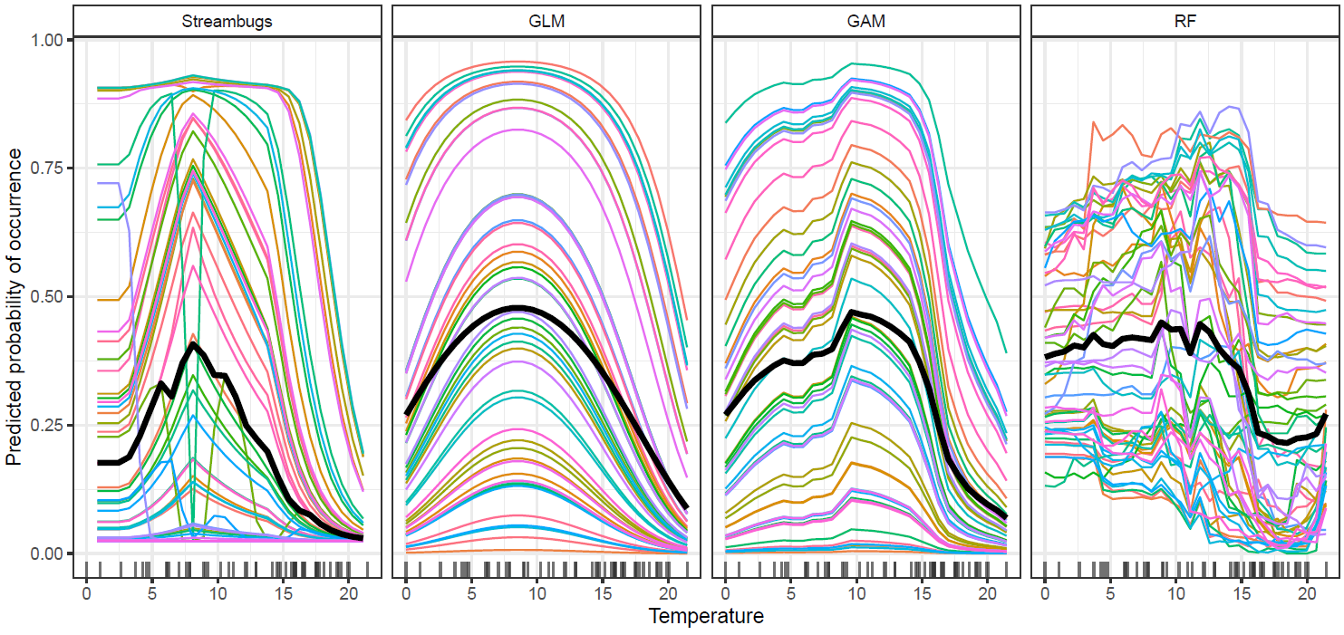
Comparison of response shapes Example: Baetis alpinus
Artificial true response
Notes:
Here we first see the artificial response of the species baetis alpinus to the environmental predictor of water temperature, generated by the mechanistic model. On the x-axis we have the whole range of water temperature, with the predicted probability of occurrence on the y-axis, and the colored line represent 50 selected combination of environmental predictors, for which we ran the mechanistic model to get predict the species response. The thick black line represents the average response. We see that the species present an optimum for intermediate temperatures, but also that we have different responses for some sites, which are due to biotic interactions, for example with a predator taking over in this specific site. We then applied the three SDMs to this specific dataset and looked at their response shapes.
We see that the GLM presents a smooth response, which makes ecological sense as a response to only the predictor temperature, but doesn’t account for irregularities due to biotic interactions.
We see that GAM and RF have a more flexible response, which seem to learn some underlying patterns in the data, but also look overcomplicated for some sites especially for random forest, and make them hard to interpret as response to the predictor temperature.

Slide 13
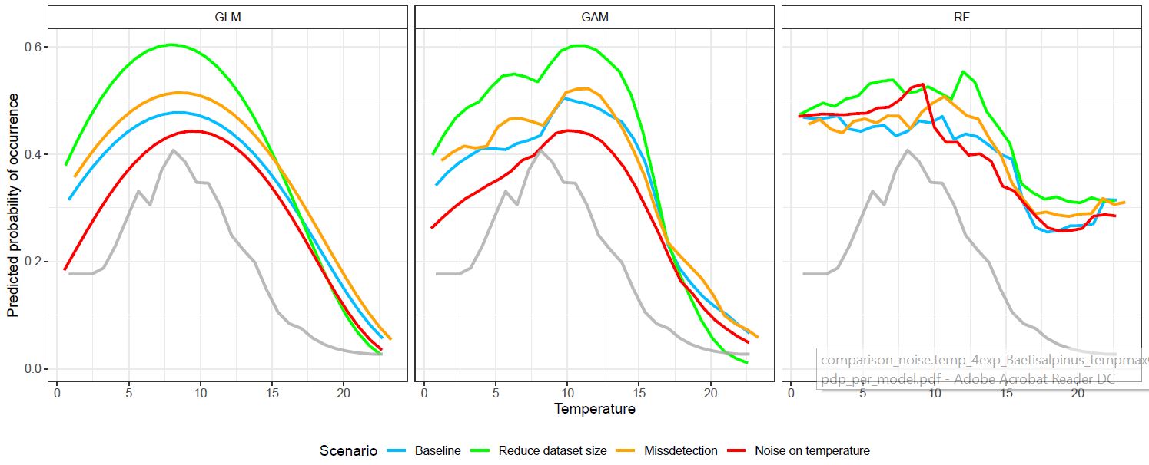
Comparison of response shapes across scenarios Example: Baetis alpinus
Artificial true response
Notes:
We then applied different noising scenario to the artificial dataset used as a baseline. We reduced the size of the dataset, simulated to misdetection on the response variable, and added Gaussian noise on the temperature predictor. We then plot the averaged learned response shapes and compare them among each other and with the artificial true response.
We again have the temperature on the x-axis and the predicted probability of occurrence of baetis alpinus on the y-axis. Each panel shows the learned responses of the different models, with a different color for each noising scenario and the light grey line is the artificial true response.
We see that that all models are similarly impacted by the different scenarios, with for example an increase the amplitude of the predicted probability of occurrence in the green lines when reducing the dataset size, or on the other hand, the limitation the average responses when adding noise on the predictor, with the red lines.
However they all more or less keep the same differences that we saw with the baseline and the artificial true response.

Slide 14
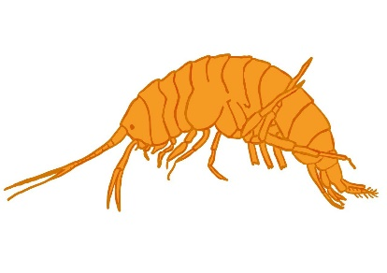
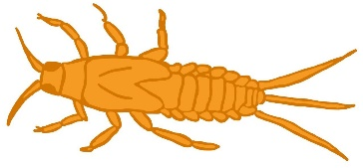
Summary and outlook
All models learned relevant ecological patterns.
Models with a constrained structure (e.g., GLM) do not capture underlying ecological processes.
More flexible models (e.g., GAM, RF) show an average response closer to the «artificial true response» but also overcomplicated patterns.
All response shapes are impacted by noising scenarios.
Further analysis will be conducted for other taxa and predictors, also regarding predictive performance.
Depending on the purpose of the application, e.g., making predictions or learning about the species response, model selection and interpretation should be done very carefully.
Many thanks to my collaborators; Nele Schuwirth, Andreas Scheidegger, Gaspard Fragnière
Thank you for your attention!
Questions?
emma.chollet@eawag.ch
Notes:
To summarize what we found until here,
we can say that all models learned relevant ecological patterns in the data.
Models with a more constrained structure like generalized linear models, don’t capture underlying processes in the data.
More flexible models, show an average response that is closer to the artificial truth, but the overcomplicated patterns make them hard to interpret them directly as effect of hidden ecological processes.
We saw that all response shapes were impacted by the different noising scenarios.
As mentioned, these are preliminary results and we anyway have to conduct further analysis for other taxa and predictors, in particular in terms of predictive performance as well.
As a general conclusion, these results already show that, depending on the purpose of the application, that can be to make predictions or learn further about the species response to some environmental factors, the selection of models and their interpretation have to be conducted very carefully.
With this I would like to thank warmly my supervisors and collaborators, in particular Nele Schuwirth, Andreas Scheidegger and Gaspard Fragnière. I would like to thank you for your attention, and I would be happy to take any questions now or by email.
Thank you very much!

Slide 15
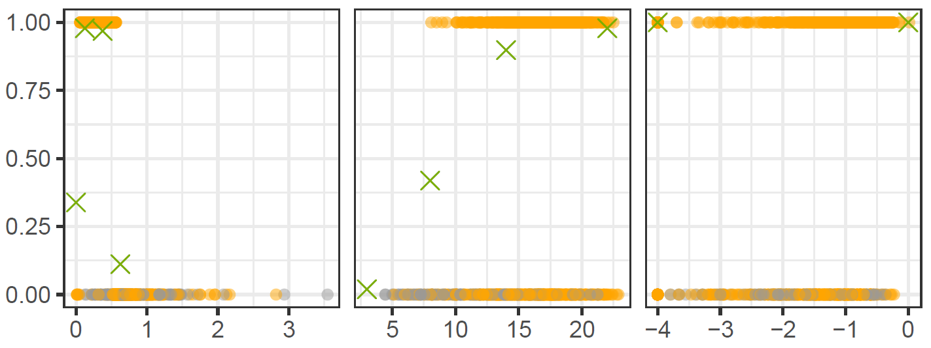
Artificial realistic dataset
Streambugs predictions of presence/absence of Gammaridae related to some of the environmental predictors.
X = preference score of Gammaridae for this environmental predictor
Present
Absent
Flow velocity
Temperature
Toxic unit

Slide 16
From community assembly to modelling
Regional species pool
Dispersal
Environment
Biotic interactions
Local species pool
Local species pool
Local communities
observation
observation
Environmental predictors
Species Distribution Models
Species presence/absence
Modified after HilleRisLambers, Adler, Harpole, Levine & Mayfield, 2012

Slide 17
Species Distribution Models (SDMs)
Empirical models relating species to their physical environment used to:
make predictions,
understand species responses to environmental predictors.
Differ in their properties, which impacts their predictive performance and interpretability.
Smooth response shape
Interactions between predictors
Generalized Linear Model (GLM)
Random Forest (RF)
Generalized Additive Model (GAM)
simpler
more complex

Slide 18
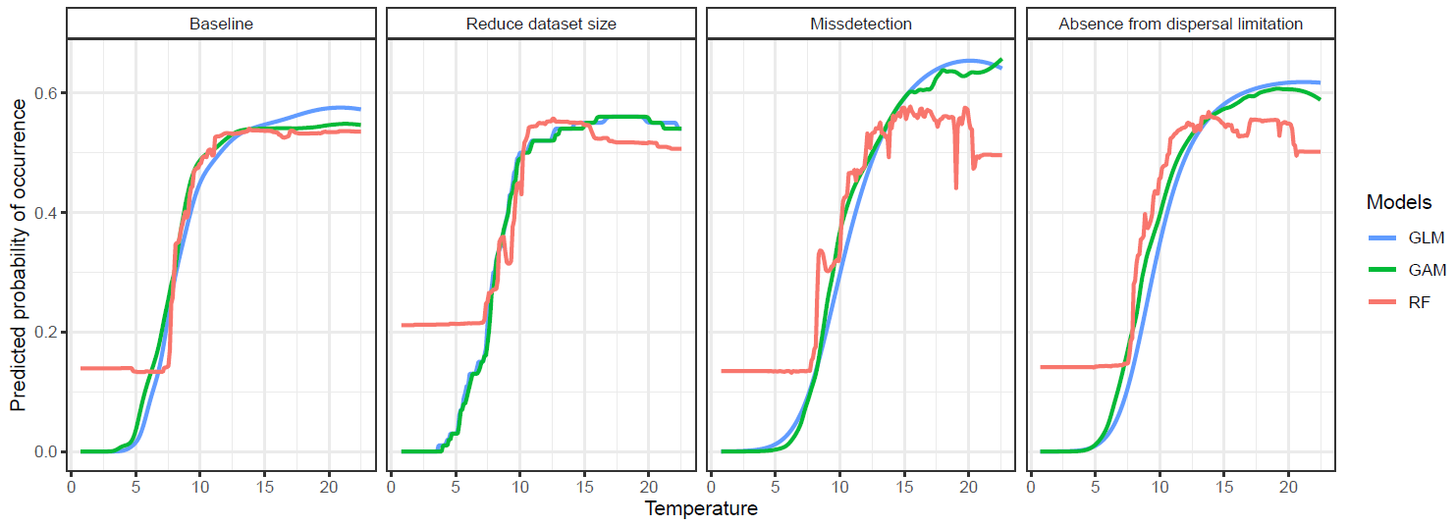
Comparison of models across scenarios Example: Gammaridae
Notes:
Here we plot only the average response of Gammaridae against Temperature, for the three models in each scenario, with GLM in blue, GAM in green and RF in red.
From left to right, in each panel we tested one scenario of noise due to a missing ecological process or data depreciation.
So on the very left we have the baseline with 3000 data points, all environmental factors included and no absences due to dispersal limitation.
Then in the midle left we plot the average response when we remove the indirect factors
In the midle right we reduce the dataset size to 1000 points
And finally on the very right, we see the average response when we include absences due to dispersal limitation.
We see that the averages responses are not too much affected by the different scenarios, except for accounting for dispersal limitation, which impacts mostly random forest.

Slide 19
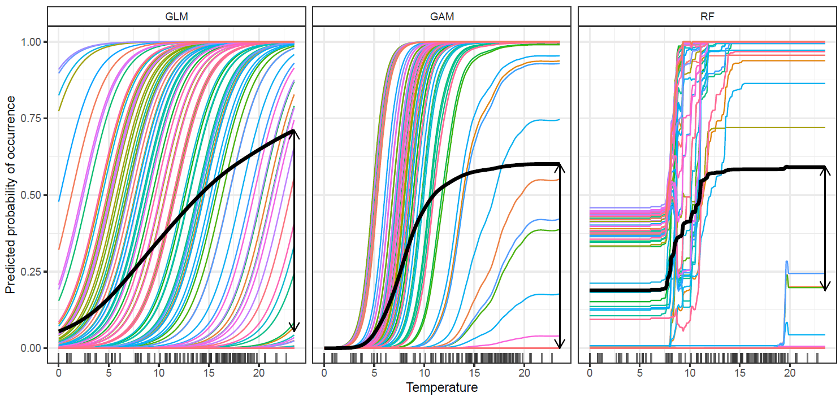
Comparison of different models Baseline scenario: all factors, 3000 data points, no dispersal limitation Example: Gammaridae
Notes:
Vizualization of what models learned as a relationship between Gammaridae and Temperature
Each panel shows a model
Colored lines represent 100 combinations of environmental factors randomly selected in the data
All factors stay fix except for Temperature, which is extend on its whole range, here from 0 to 23 degrees
We see the true distribution of temperature in the dataset on the smallm black vertical lines at the bottom
We then average the 100 lines to vizualize the average response of the taxon to this environmental factor
Here we trained the models for a baseline scenario, meaning no noise due to dispersal limitation, all enviornmental factors inclueded, maximum dataset size
We see that all models learned similar important patterns in the data, corresponding to the true functional response used in Streambugs
More complex model like RF is more sensitive to underlying patterns in the data, observed from the crossing lines, probably due to biotic interactions and interactions between environmental factors
However we also see how the intrinsict structure of RF is affecting its predictions, with constant predictions on the tails of the factor range, and abrupt changes, which cannot be interpreted as a realistic response of species to an environmental factor

Slide 20
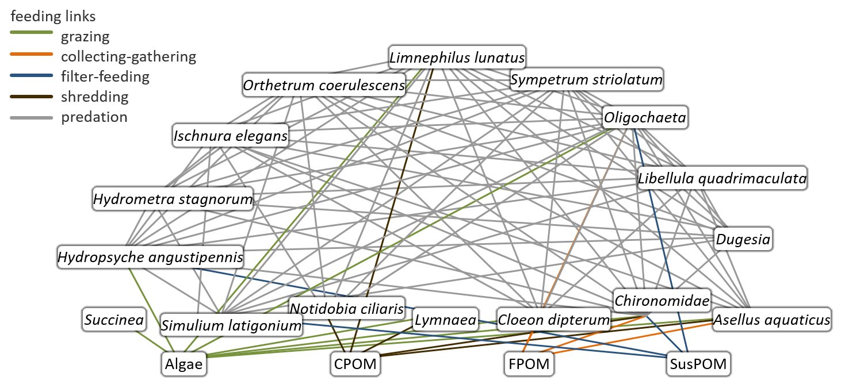
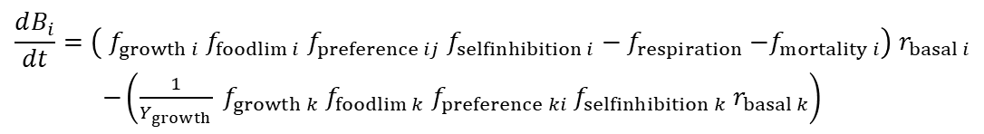
Reference model for artificial data
Use mechanistic food web model Streambugs to produce an artificial realistic ecological dataset of presence/absence of freshwater macroinvertebrates
Streambugs consists of:
Coupled differential equations
Direct environmental factors: water temperature, flow velocity, pesticide input and saprobic conditions
Indirect environmental factors: shading, nutrients and litter input
Includes dispersal limitation
$$\frac{dB_{i}}{dt}=\left( f_{growth i}{ f}_{foodlim i}{ f}_{preference ij} f_{selfinhibition i}−f_{respiration}{−f}_{mortality i}\right) r_{basal i}$$ $−\left(\frac{1}{Y_{growth}} f_{growth k}{ f}_{foodlim k}{ f}_{preference ki}{ f}_{selfinhibition k} r_{basal k}\right)$
Food web graphic and equations from Schuwirth and Reichert, 2013.

Slide 21
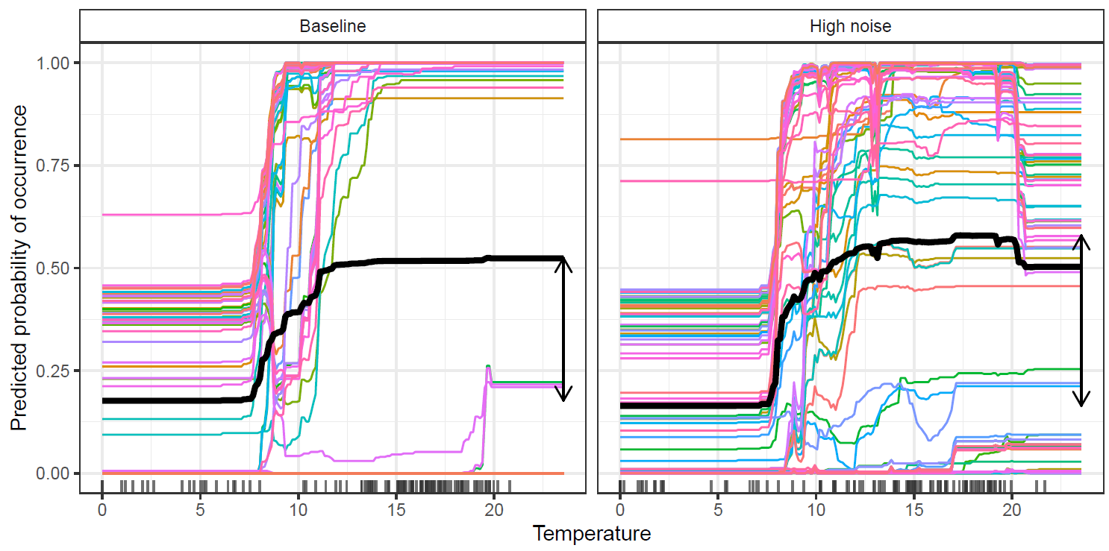
Comparison of Random Forest response shapes Example: Gammaridae
Notes:
To understand better the differences in the average response of the random forest model,
We plot again the individual prediction lines.
We then see that random forest learned new verious relationships in the data, with crossing and strongly irregular lines indicating stronger overfitting on noise added in the data, here absences due to dispersal limitation.

