Slide 1
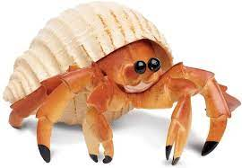
Replicathon 2022
Hermit Crabs

Slide 2
Exploratory Analysis
288 Cell Lines
15 Drugs
8 concentrations in CCLE, 32 concentrations in GDSC
Sum data variables:
Cell line, Drug,ic50_CCLE, auc_CCLE,ic50_GDSC, cutoff, sensitivity_GDSC, sensitivity_CCLE, category
Notes:
sebastian

Slide 3
Introduction Questions
- What is classification?
The categorization of elements into certain groups
based on certain
traits or characteristics.
- What are some statistical/machine learning methods people use for classification?
A machine learning method people may use for classification are Support Vector Machines, Logistic Regression, or Decision Trees.
Notes:
sebastian

Slide 4
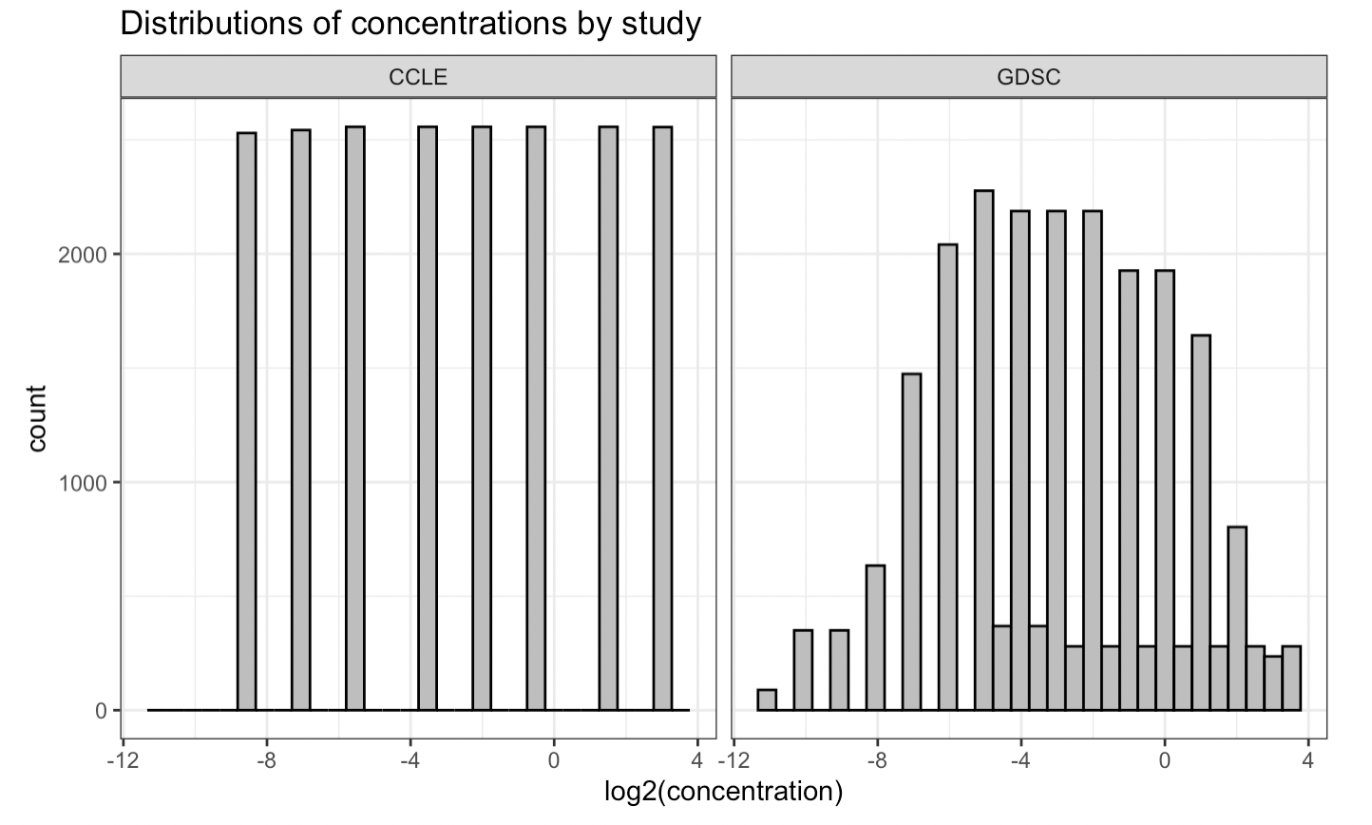
Uniform Distribution
Normal Distribution
Some concentrations underrepresented
Notes:
Sebastian

Slide 5
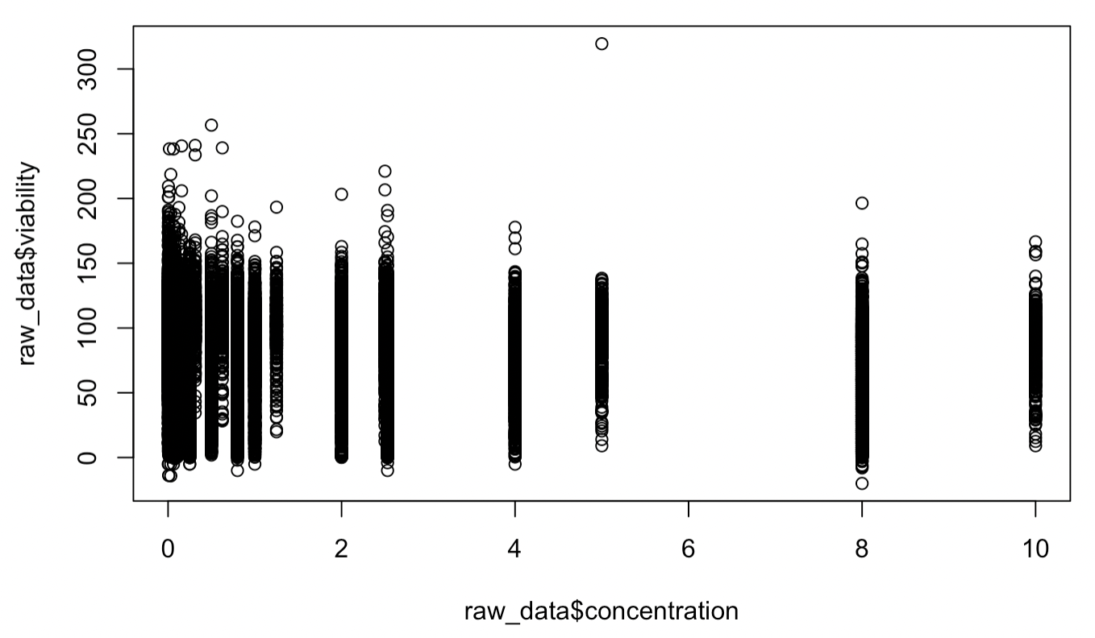
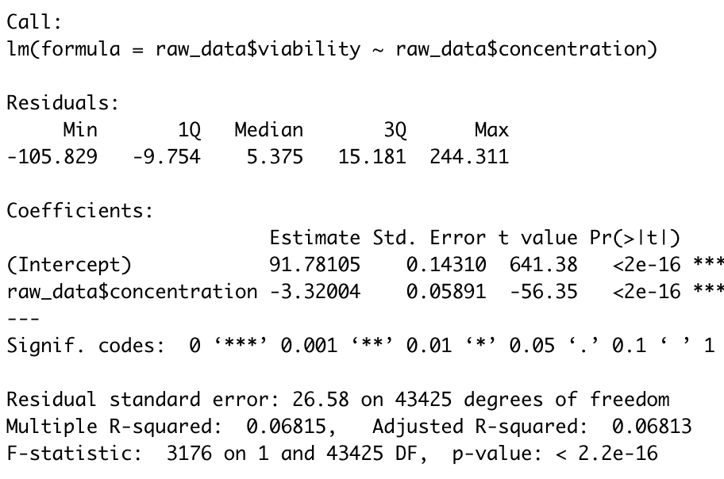
The Effect of Concentration on Viability
Negative relationship = higher concentration, lower viability
Notes:
Jahlisse

Slide 6
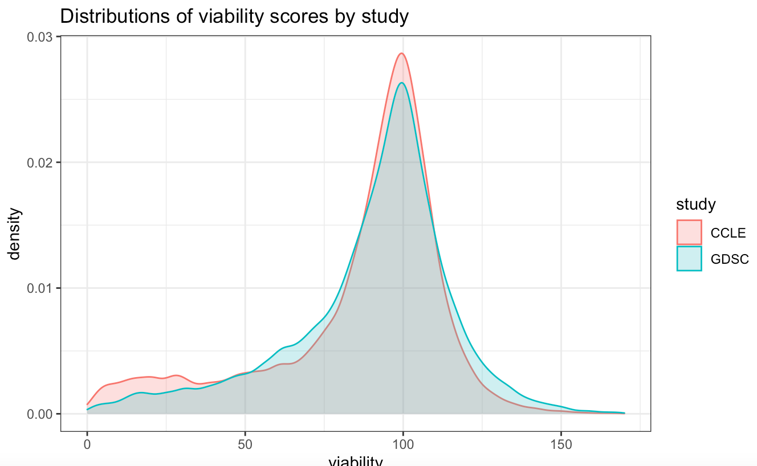
Viability
Notes:
Jahlisse

Slide 7
Unexpected
Viability
Scores
N = 23
Expected
Viability
Scores
N = 27626
Unexpected
Viability
Scores
N = 15778
Viability
Notes:
Jahlisse

Slide 8
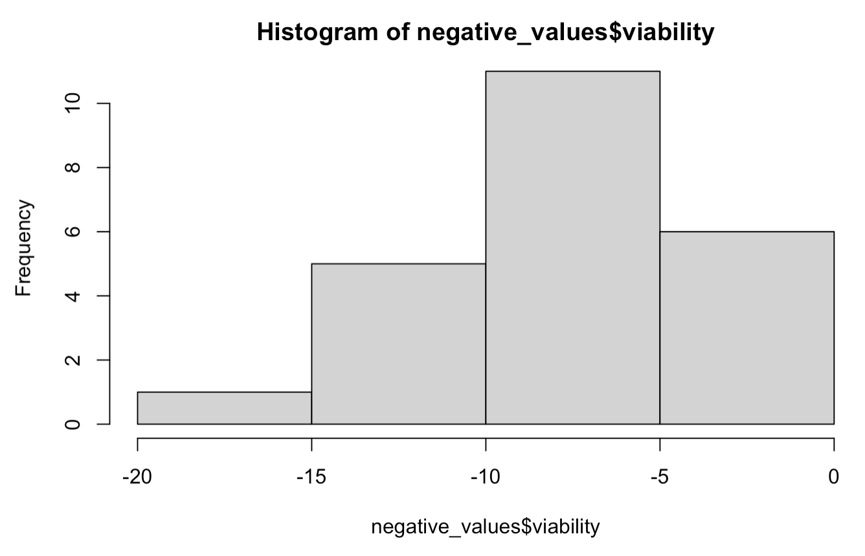
Unexpected
Viability
Scores
N = 23
Expected
Viability
Scores
N = 27626
Unexpected
Viability
Scores
N = 15778
Viability
Potential Explanations:
Above 100: Cells lines multiplied throughout the duration of the experiment
Below 0: This does not have a clear explanation. Could be due to technical error in data input, or instrument/analytical noise.
CCLE = 13, GDSE = 10

Slide 9
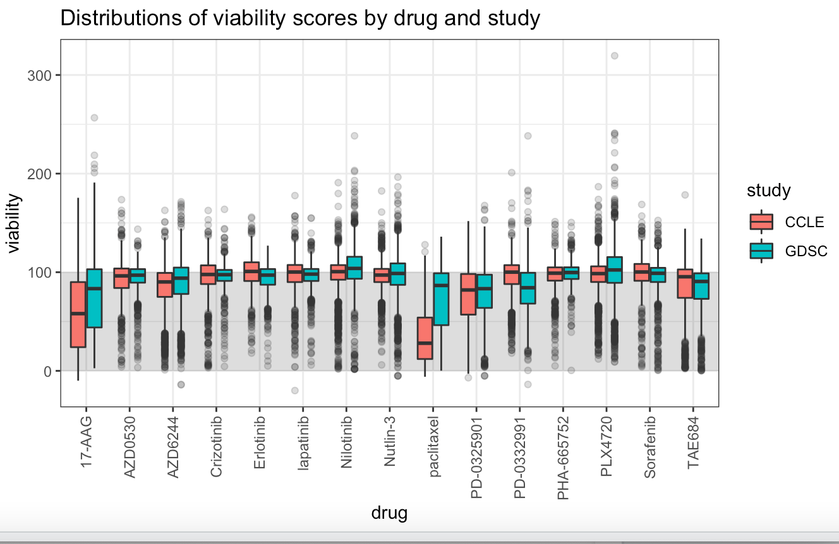

Slide 10
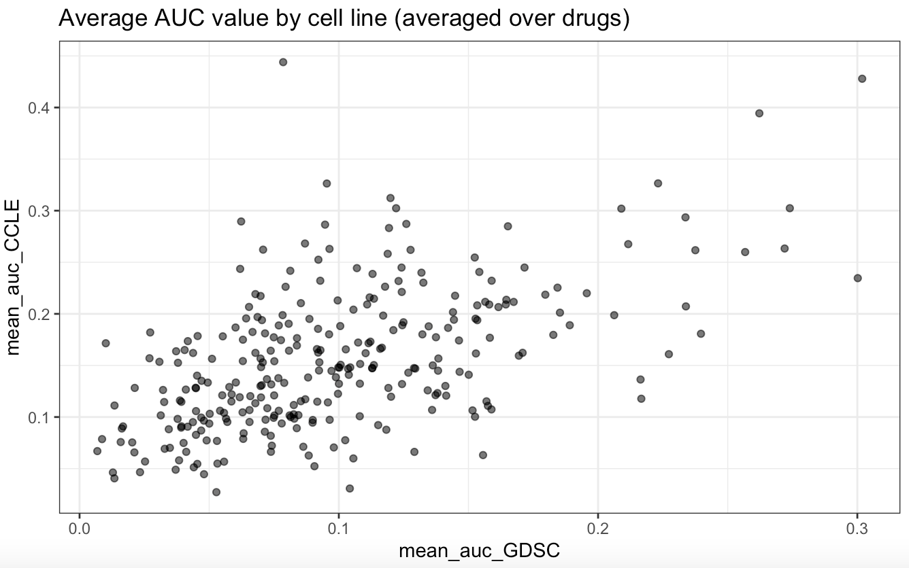
1. Plot the distribution of the average drug response by AUC for GDSC and CCLE.

Slide 11
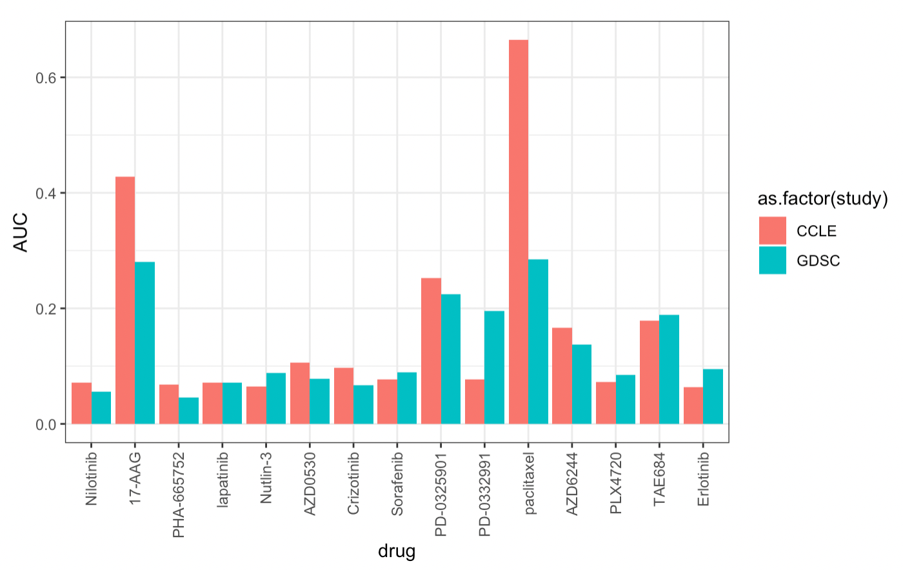
1. Plot the distribution of the average drug response by AUC for GDSC and CCLE.

Slide 12
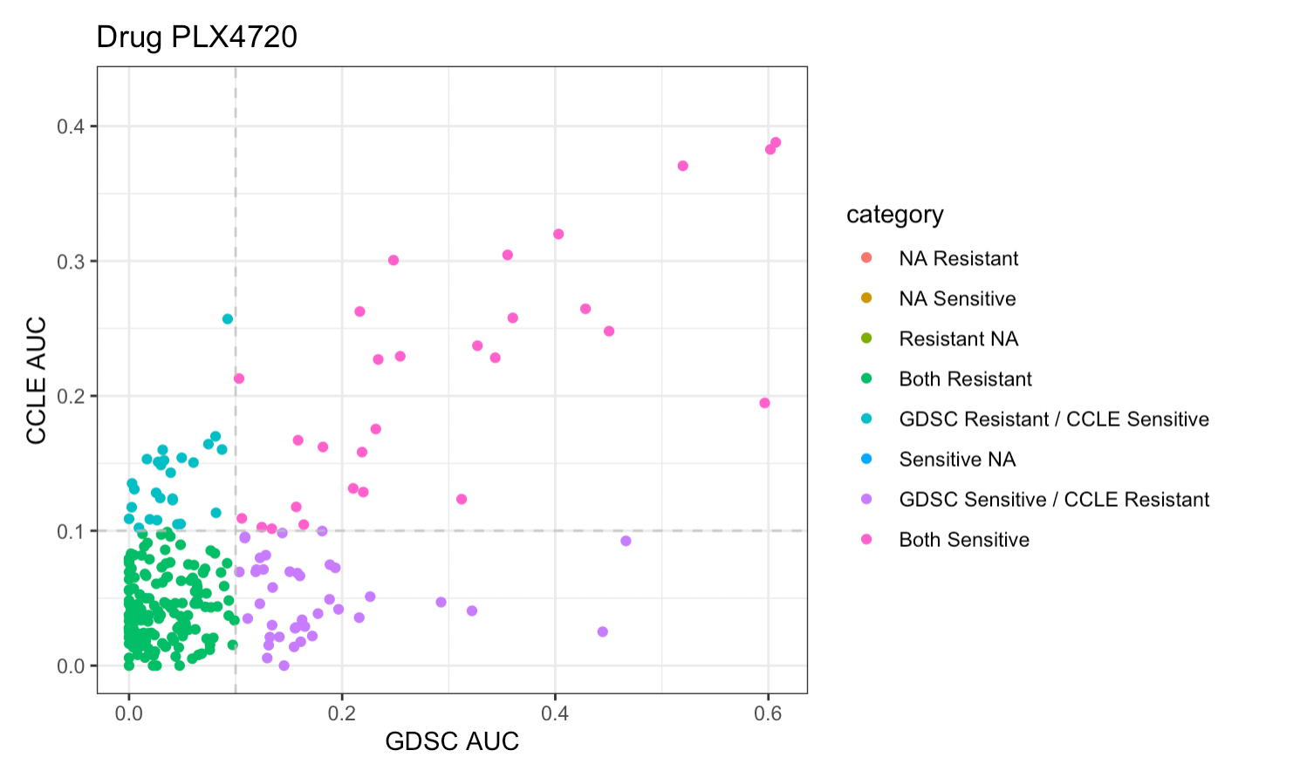
2. Classify each cell line as “resistant” or “sensitive” to a drug based on its AUC value by choosing a cutoff for which cell lines with AUC below the cutoff are considered resistant
Cutoff = 0.1 AUC
Notes:
Amanda

Slide 13
2. Classify each cell line as “resistant” or “sensitive” to a drug based on its AUC value by choosing a cutoff for which cell lines with AUC below the cutoff are considered resistant
Cutoff = 0.1 AUC
CCLE
GDSC Resistant Sensitive
Resistant 906 391
Sensitive 382 710
Notes:
Amanda

Slide 14
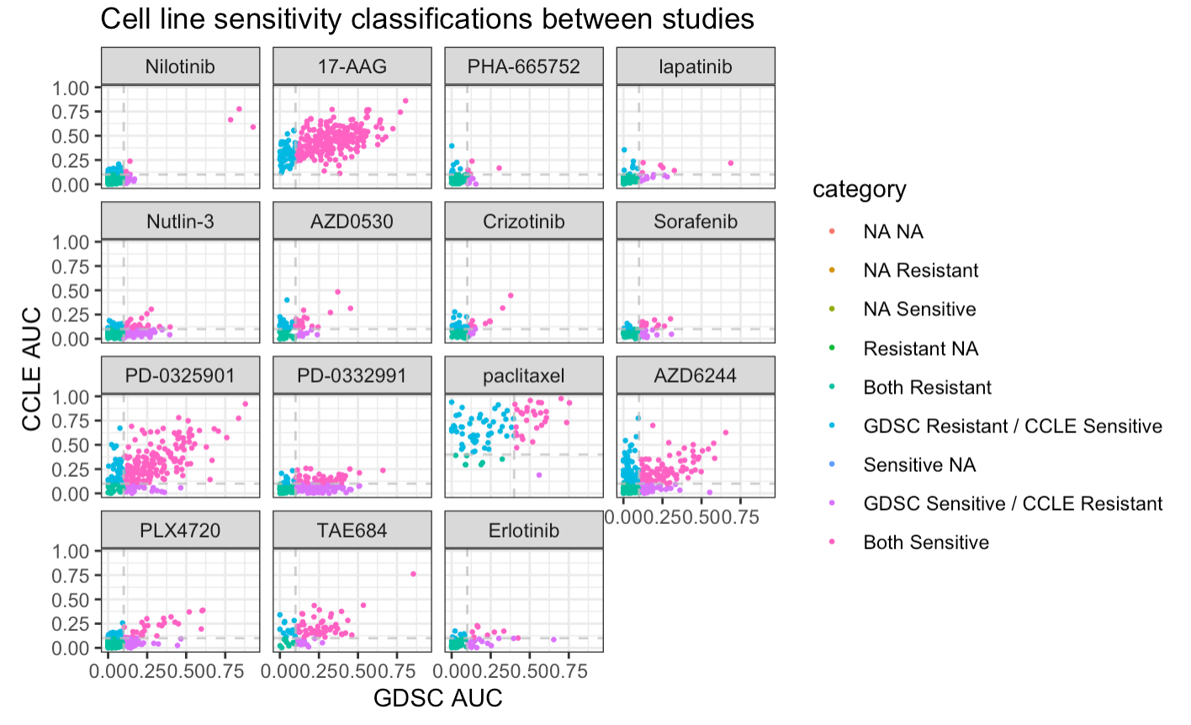
3. Compare your assigned resistance status of cell lines in GDSC and CCLE for each drug. How often do the two studies agree?
Notes:
Amanda

Slide 15
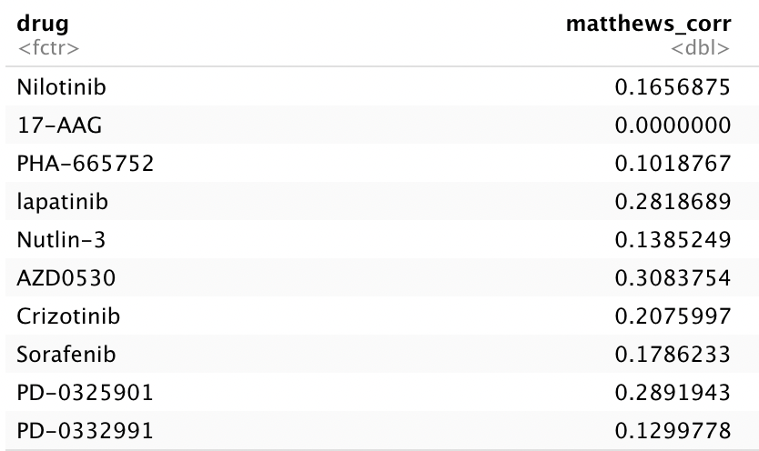
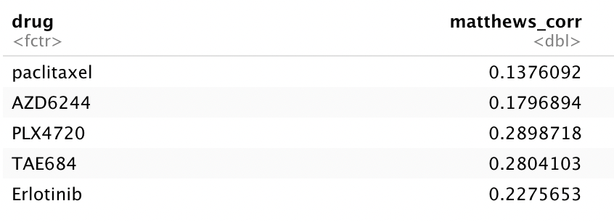
3. Compare your assigned resistance status of cell lines in GDSC and CCLE for each drug. How often do the two studies agree?
-1 = Perfect Disagreement
0 = No Relationship
1 = Perfect Agreement
Agreement - Matthews Correlation Coefficient
Ranges from -1 to + 1
Minimum = 0 Average = 0.194
Maximum = 0.308
Notes:
Amanda

Slide 16
4. Experiment with varying your cutoff threshold and compare the assigned resistance status. Which cutoff shows the most agreement between studies? The least agreement?
Notes:
Emma

Slide 17
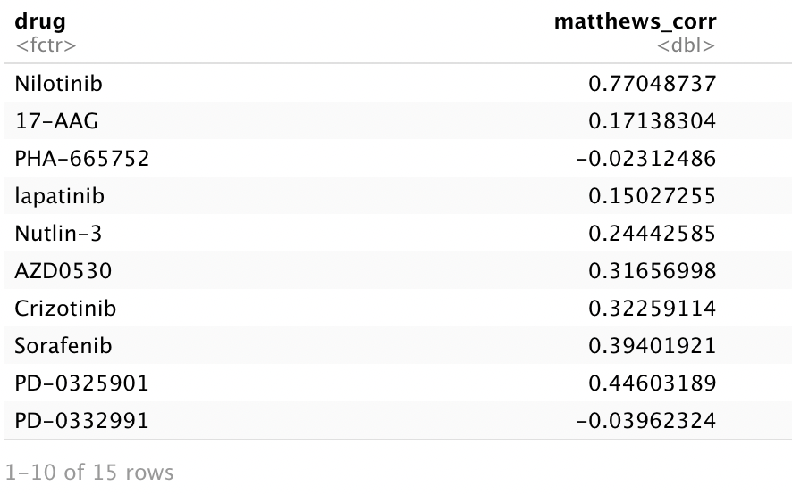
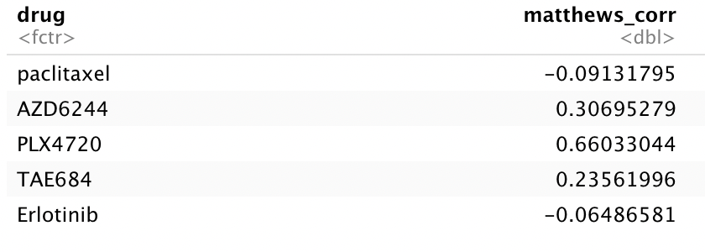
4. Experiment with varying your cutoff threshold and compare the assigned resistance status. Which cutoff shows the most agreement between studies? The least agreement?
Cutoff = 0.2
Minimum = -0.091
Average = 0.253
Maximum = 0.770
Higher Average MCC
Notes:
Emma

Slide 18
4. Experiment with varying your cutoff threshold and compare the assigned resistance status. Which cutoff shows the most agreement between studies? The least agreement?
Cutoff | Range | Mean
0.02 | -0.131, 0.340 | 0.097 ± 0.14
0.05 | -0.098, 0.302 | 0.102 ± 0.12
0.1 | 0, 0.308 | 0.185 ± 0.09 *
0.2 | -0.091, 0.770 | 0.253 ± 0.25
0.3 | -0.019, 1 | 0.305 ± 0.36
0.4 | -0.016, 1 | 0.184 ± 0.29
0.5 | 0, 1 | 0.189 ± 0.31
0.75 | 0, 1 | 0.32 ± 0.181
1 | 0, 0 | 0 ± 0
Notes:
Emma

Slide 19
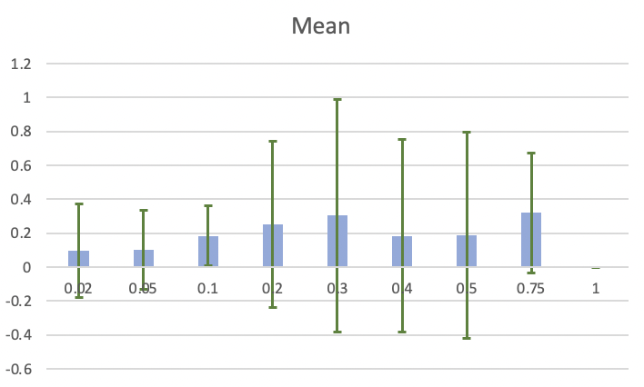
4. Experiment with varying your cutoff threshold and compare the assigned resistance status. Which cutoff shows the most agreement between studies? The least agreement?
*
Notes:
Emma

Slide 20
4. Experiment with varying your cutoff threshold and compare the assigned resistance status. Which cutoff shows the most agreement between studies? The least agreement?
Takeaways:
Only 0.1 cutoff is above chance for average cutoff
Higher cutoff has more maximum agreement, but can change the rigor with which we define cell lines as sensitive or resistant
Because of the implications for treatment, cutoffs should be based on clinical observations and not finding agreement
Notes:
Emma

Slide 21
What does this mean for the Replication/Reproduction Crisis?
Although there was not perfect agreement, for each drug, there were cell lines that both studies identified as possible routes for treatment.
Different experimental protocols between the two studies could explain discordant results.
However, neither of these studies perfectly predicts what will happen during treatment.
Notes:
Sarah

Slide 22
What does this mean for the Replication/Reproduction Crisis?
Although there are different results, both studies are useful in providing insight into useful treatments, and different results do not invalidate either finding.
Data analysis plans should be set out prior to data analysis to ensure that bias does not affect analysis (eg. selecting cutoffs with more agreement).
Notes:
Sarah

