Slide 1
Diabetes Dataset
Analyzing medical information

Slide 2
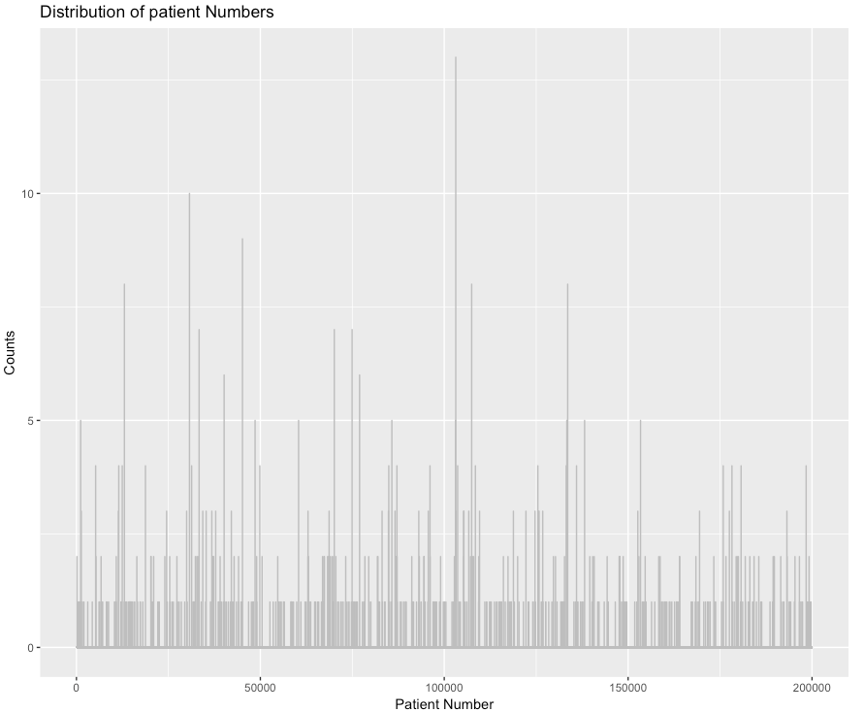
Uniqueness of patients
Patients are not unique
Notes:
Histogram --> binary (unique or not)
Stack plot → gender, race

Slide 3
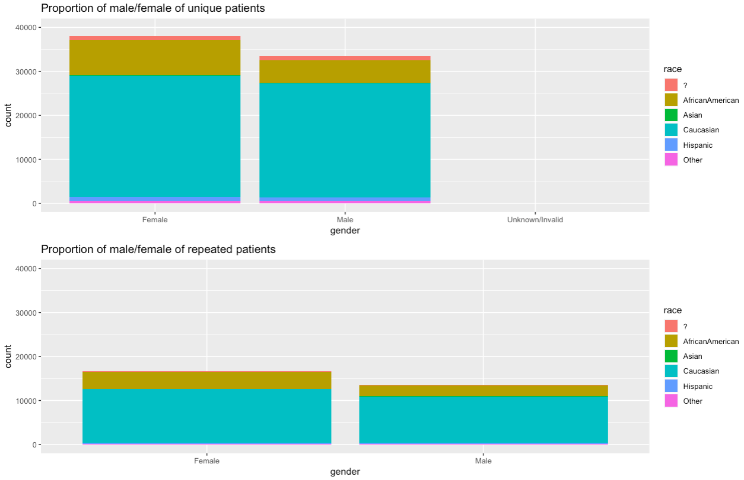
V2 : Uniqueness of patients
Notes:
--

Slide 4
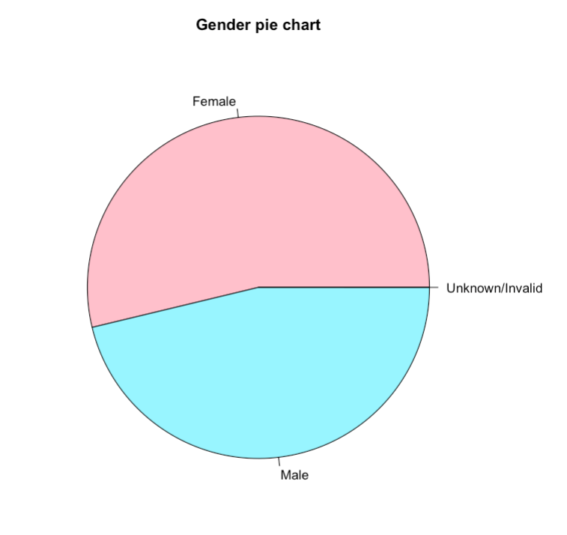
Gender distribution

Slide 5
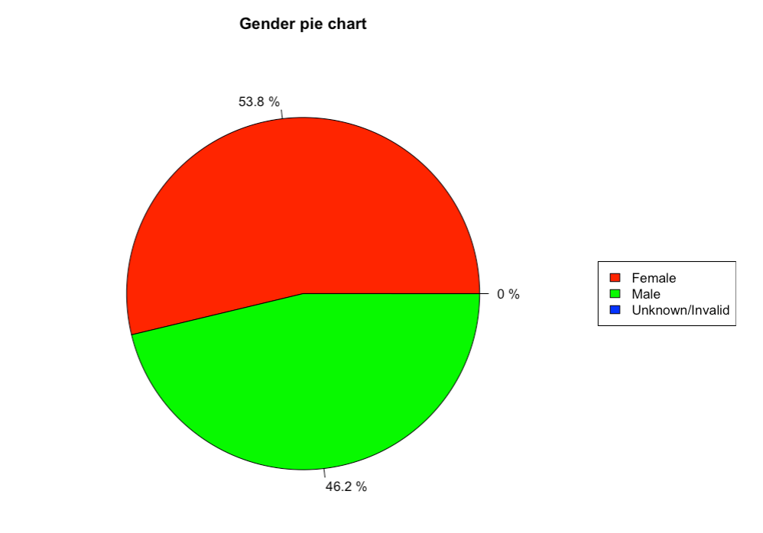
V2 : Gender distribution

Slide 6
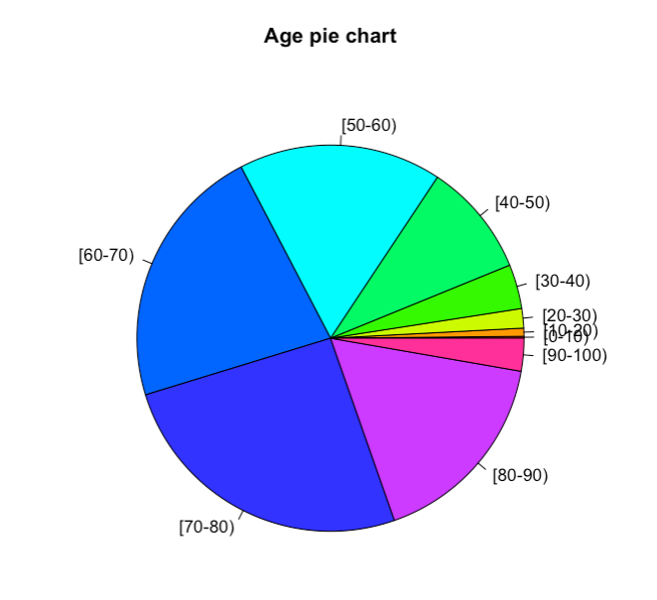
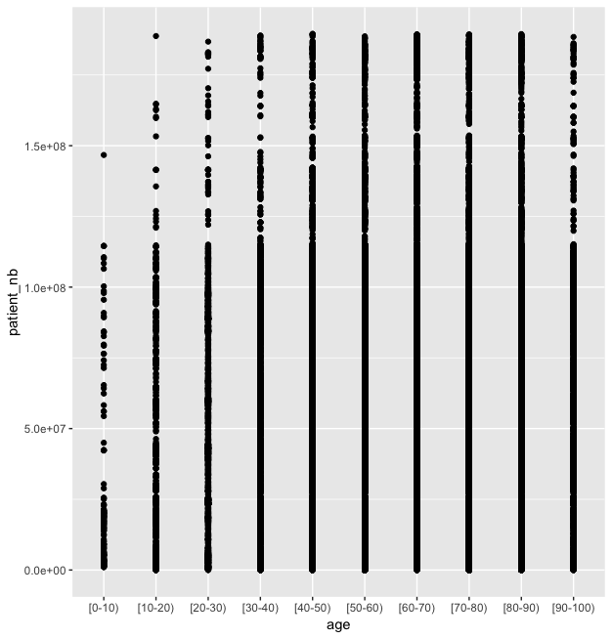
Age distribution

Slide 7
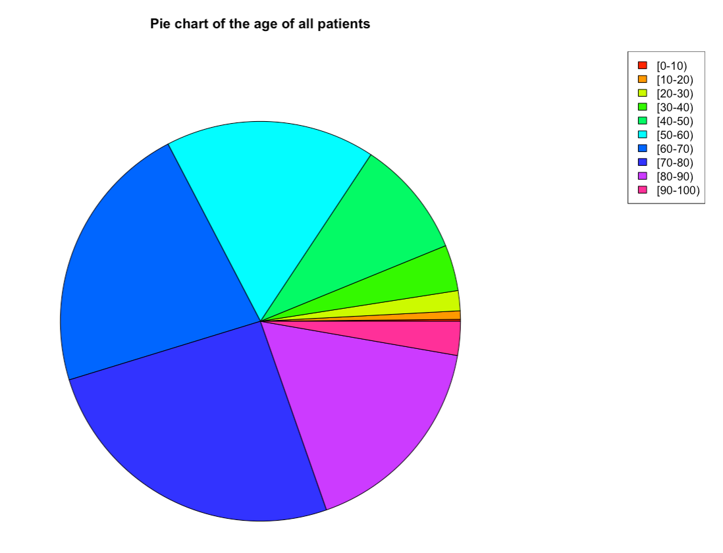
V2 : Age distribution

Slide 8
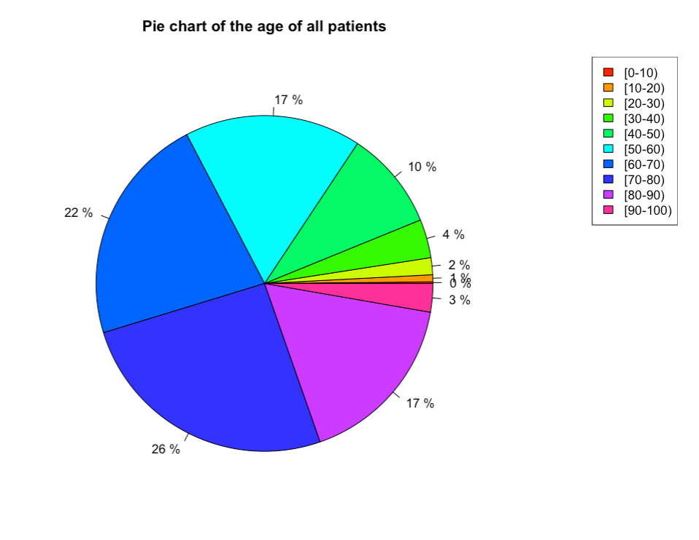
V3 : Age distribution

Slide 9
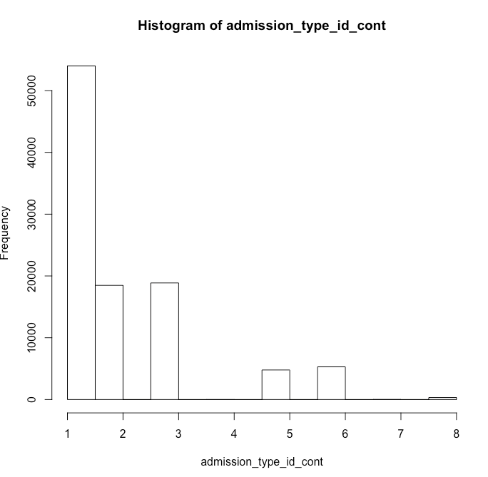
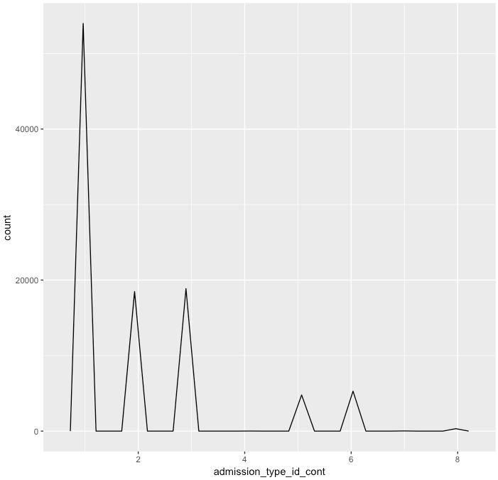
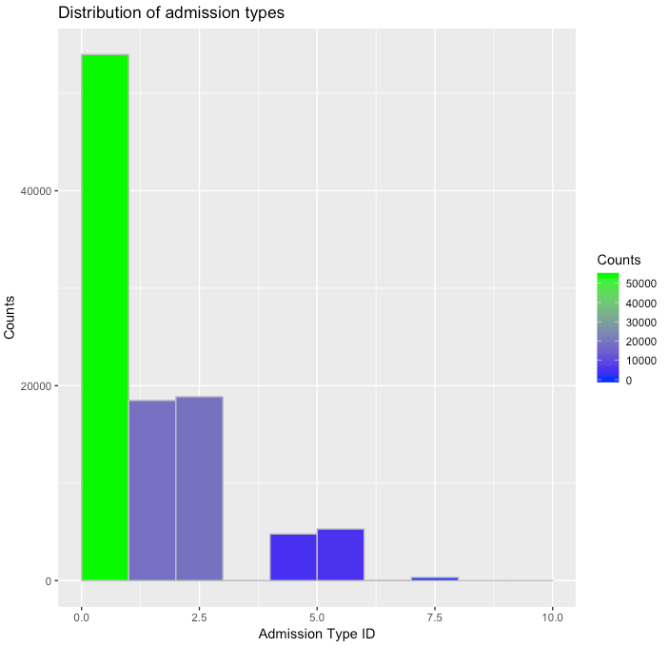
What kind of admissions…

Slide 10
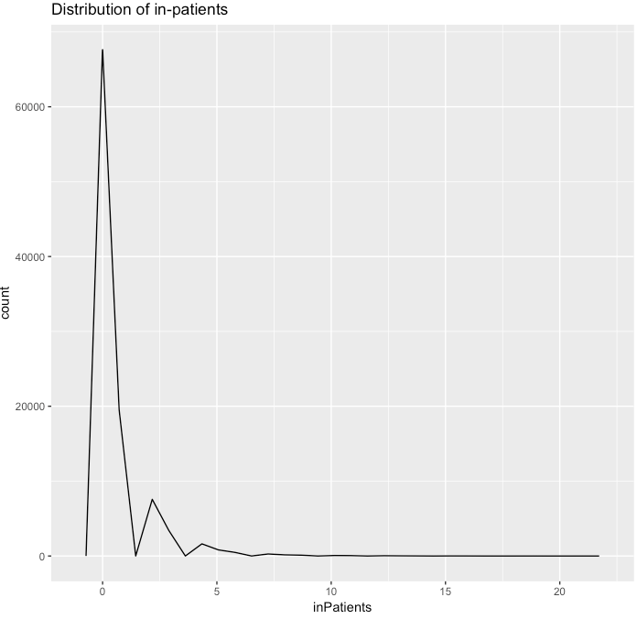
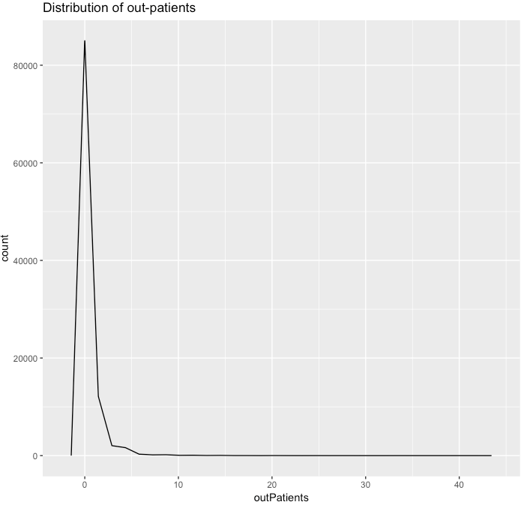
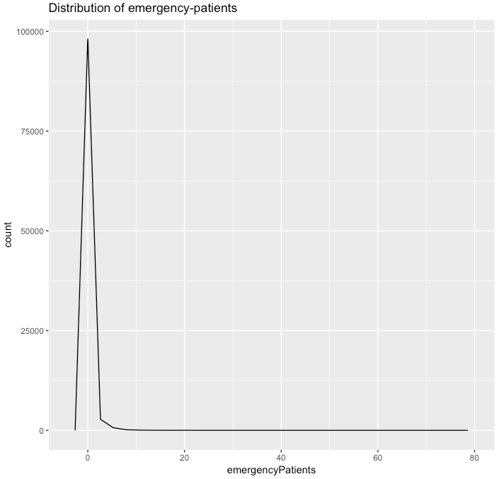
What kind of visits in the year preceding the encounter…
Most between 0-5 visits

Slide 11
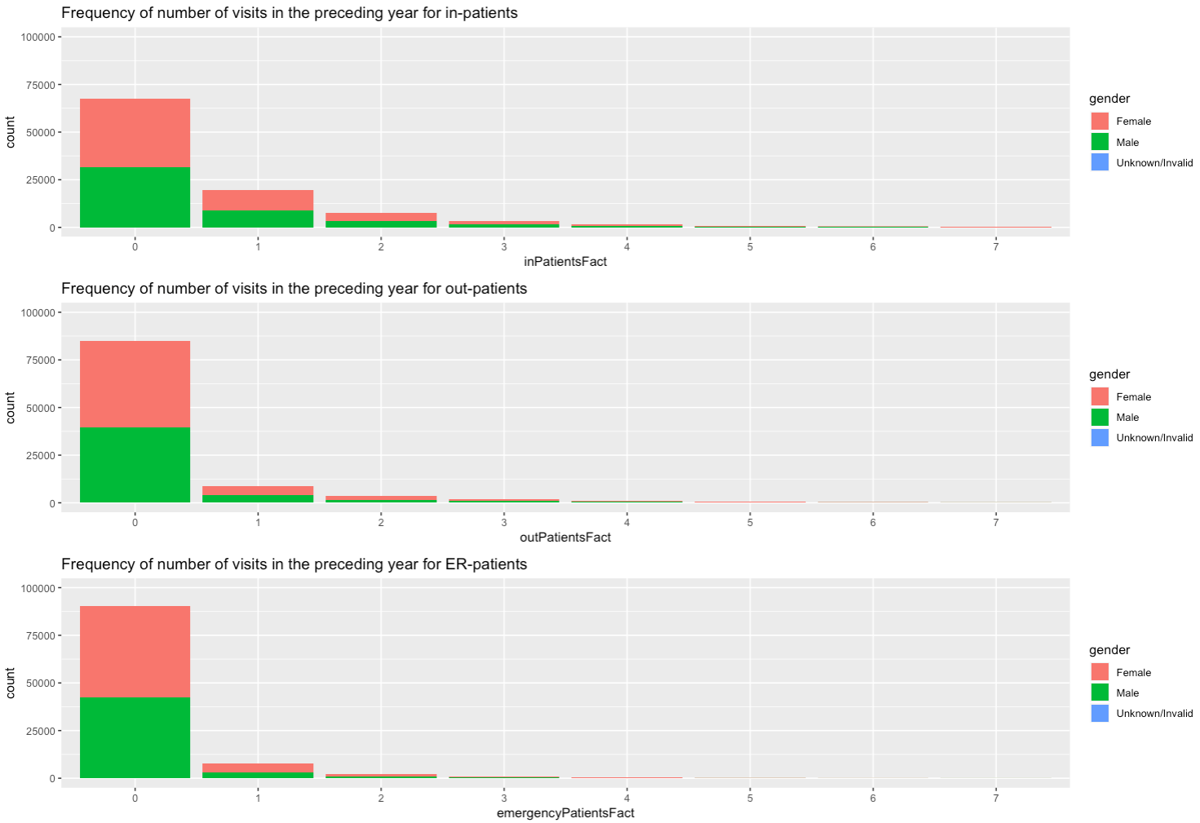
V2 : What kind of visits in the year preceding the encounter…

Slide 12
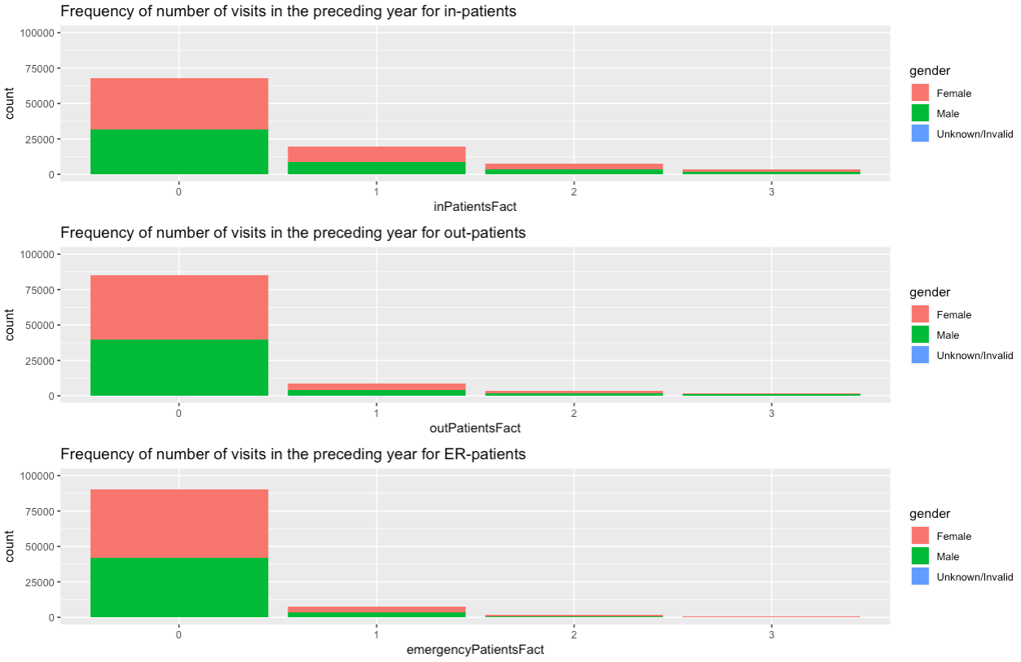
V2 : What kind of visits in the year preceding the encounter…

Slide 13
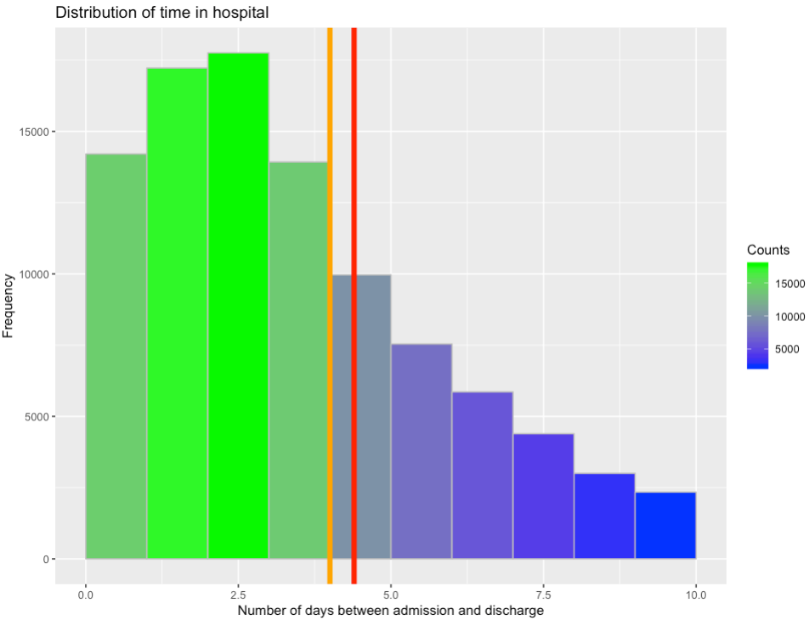
Time in hospital
Mean time : 4.40 days
Median time : 4 days

Slide 14
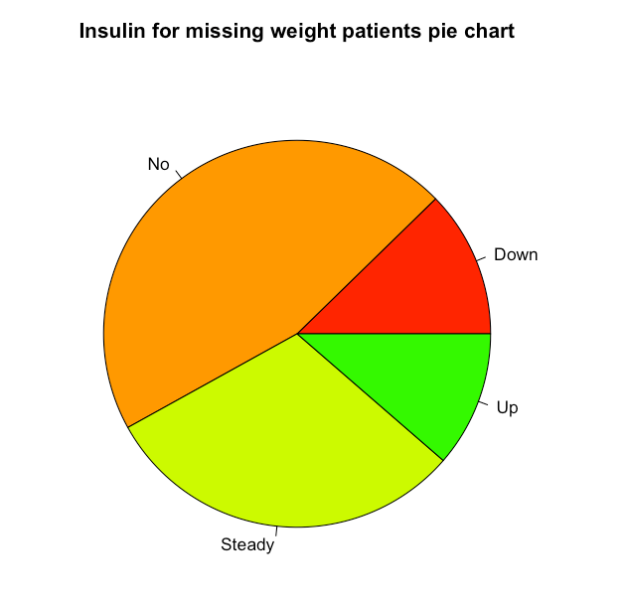
Looking at patients without weight entries

Slide 15
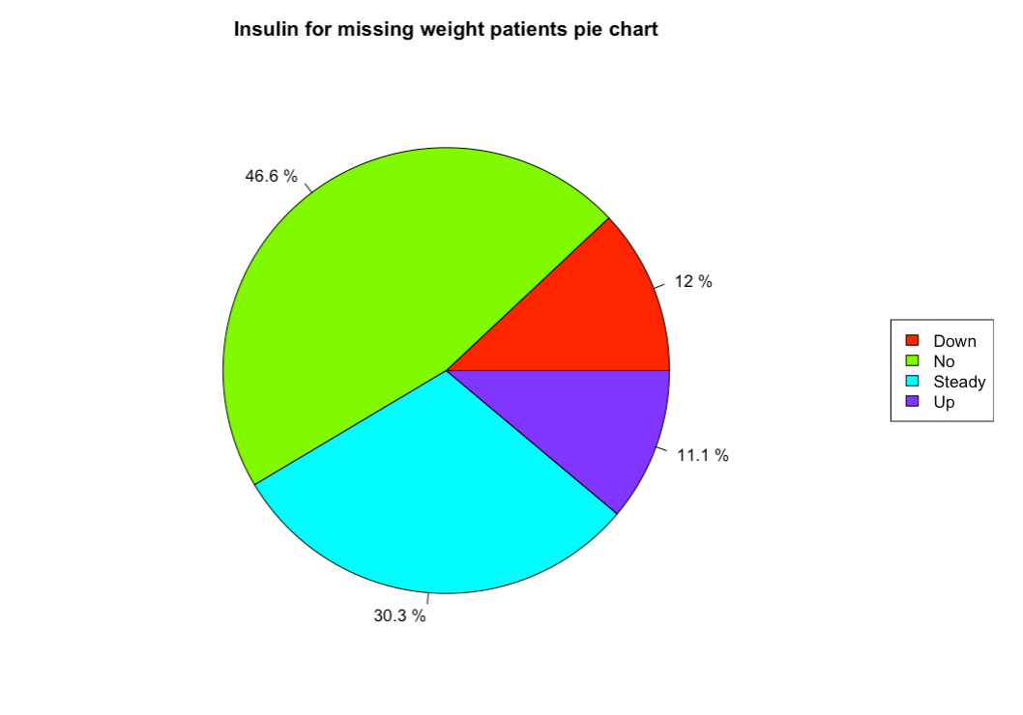
V2 : Looking at patients without weight entries

Slide 16
Functions

Slide 17

numberOfEncounters

Slide 18

slice.patient

Slide 19
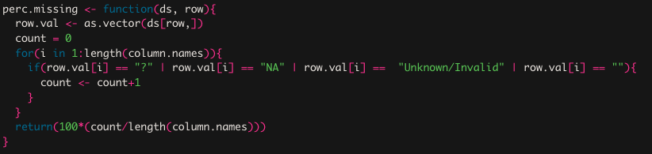
perc.missing

Slide 20
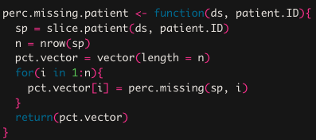
perc.missing.patient

