Slide 1
Robust Image Classification with Gaussian Noise
Team Members:
Emma Diamon (A20482587)
Nishitha Tanukunuri (A20537907)

Slide 2
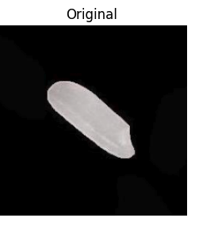
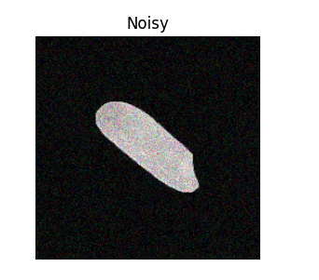
Problem Statement and Background Material
CNN models like VGG16 and ResNet50 perform well on clean images.
Their accuracy drops significantly in the presence of Gaussian noise, common in real-world settings.
This affects critical applications in agriculture, surveillance, autonomous systems, and healthcare.
The aim of this project is to improve the accuracy and reduce loss of these pretrained models.
Background Material : The research paper 'Robust Convolutional Neural Network for Image Classification with Gaussian Noise. The dataset : The Rice Image Dataset .

Slide 3
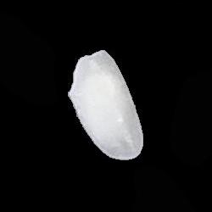
Proposed Solution
Data Augmentation
Batch Normalization
Denoising/Autoencoder
Regularization

Slide 4
Implementation Details
Enhancement Details
Data Processing
Train – Validation – Test Split
Designing of U-Net Auto Encoder
Training U-Net AutoEncoder with Gaussian Noise in Images
Data Augumentation Injection in Training Samples
Training Pretrained Models on Denoised Data & Augumented Data and L2-Regularization and Batch Normalization in Layers.
Evaluation of Performance
Data Processing
Train – Validation –Test Val Split
Initialization of Pretrained Model
Training of Pretrained Model
Evaluation using Accuracy and Loss Metrics using Cleaned Dataset
Computing Accuracy and Loss Metrics with Added Gaussian Noise in different levels.

Slide 5
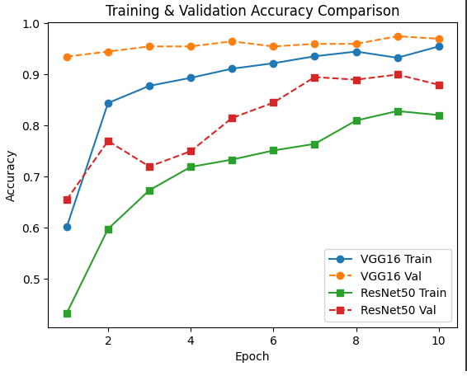
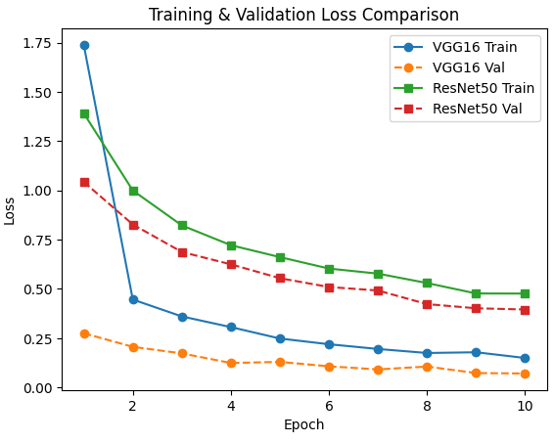
Implementation Details
2000 rice grain (resized to 224x224)
Dataset: 70% train, 20% val, 10% test
Pretrained VGG16 &ResNet50

Slide 6
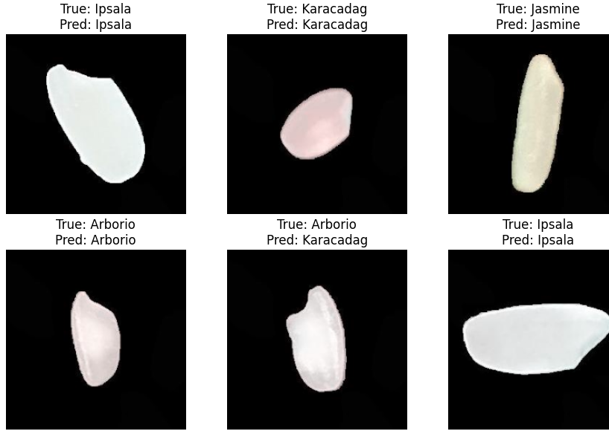
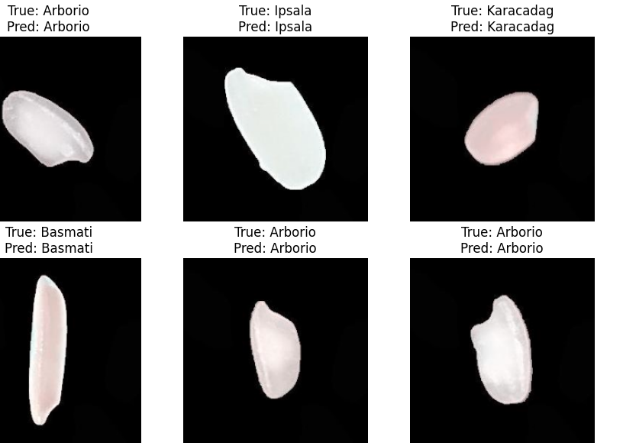
Implementation Details
VGG16 - MODEL
RESNET50 - MODEL

Slide 7
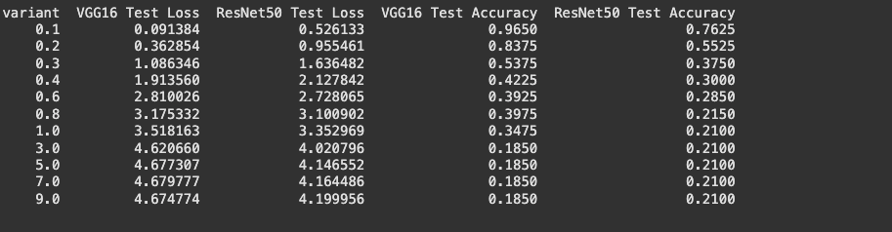
Comparative Analysis of the Gaussian Noise on the Pretrained Models

Slide 8
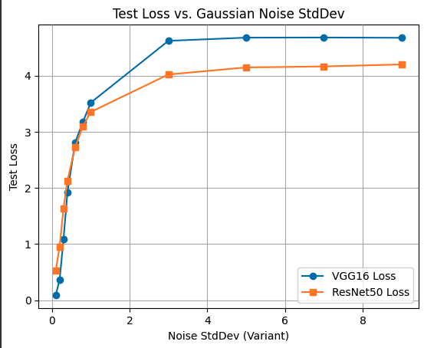
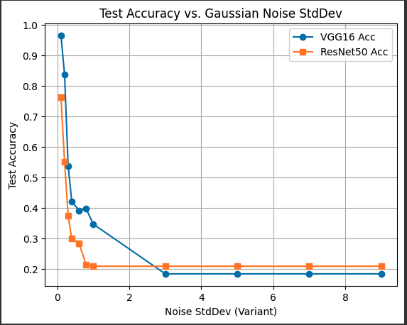
Comparative Analysis of the Gaussian Noise on the Pretrained Models

Slide 9
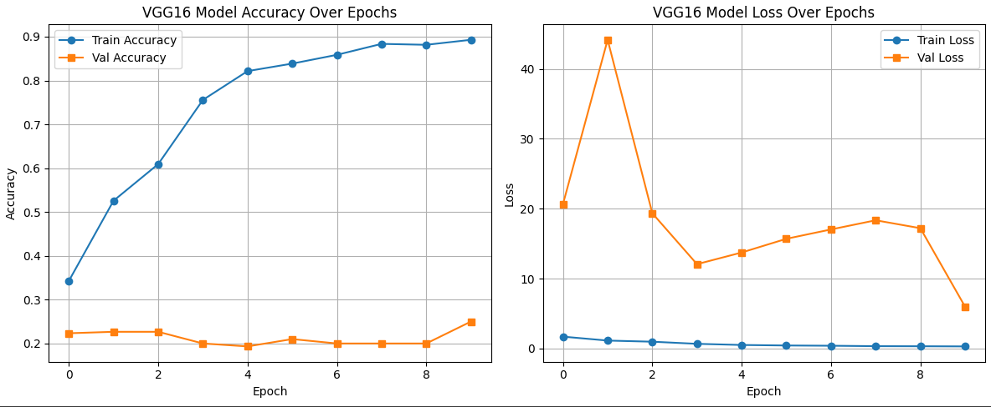
Enhancement Details
1000 rice grain (resized to 224x224)
Dataset: 70% train, 20% val, 10% test
Train U-net Autoencoder
Data Augmentation with Noise
Combine Denoised and Augmented Data
Retrain CNN with L2 and Batch Norm

Slide 10
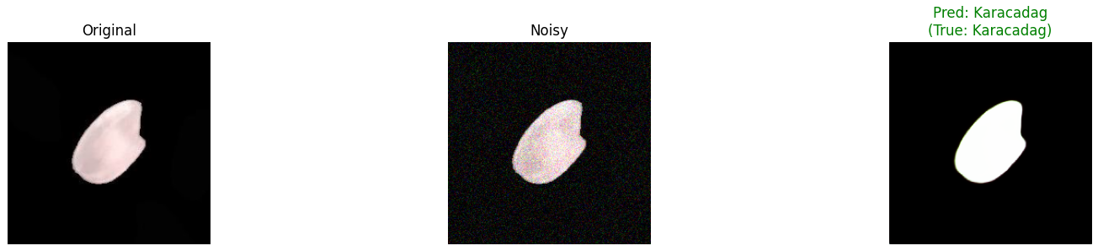
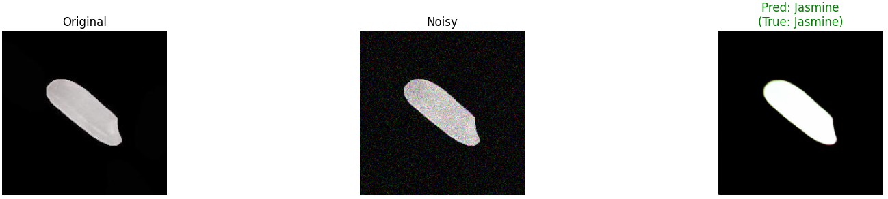
Enhancement Details
VGG16: Visual Comparison of Classification Result on Denoised Test Images
ResNet50: Visual Comparison of Classification Result on Denoised Test Images

Slide 11
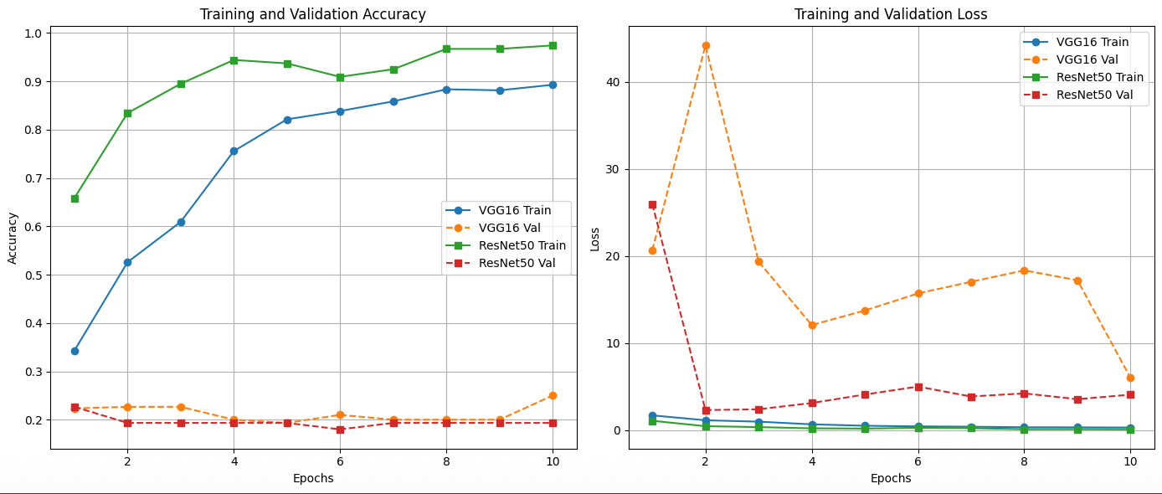
Comparative Analysis of VGG16 and ResNet50 Performance

Slide 12
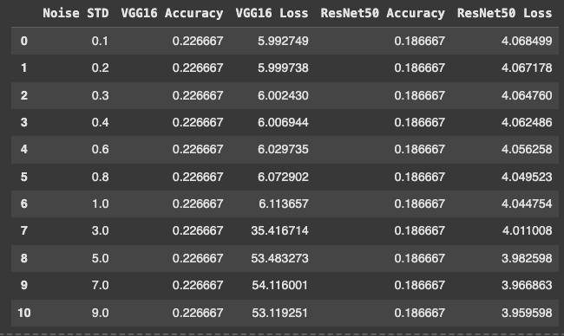
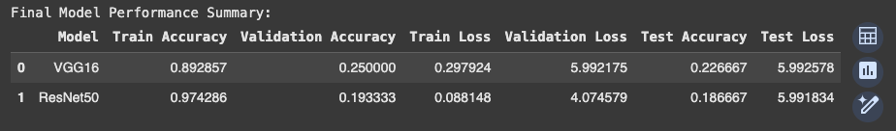
Results of Enhancement of Pretrained Models

Slide 13
Analysis & Limitations
Effectiveness of Denoising The U-Net-based autoencoder successfully improved the quality of noisy images, leading to better classification performance, especially under moderate Gaussian noise.
Robustness Through Combined Training Training the models on a mix of clean, noisy, and denoised images improved generalization and made the classifiers more resilient to real-world input distortions.
Noise Sensitivity Insight Evaluation across varying noise levels showed that both VGG16 and ResNet50 experience sharp accuracy drops beyond a certain noise threshold (std ≥ 3.0), highlighting the need for denoising.
Model Comparison While both models performed well under clean conditions, ResNet50 demonstrated slightly better robustness at higher noise levels compared to VGG16, likely due to its deeper architecture.
Limited GPU Availability :
Training deep models like VGG16, ResNet50, and the U-Net autoencoder was time-consuming and restricted by hardware limitations, affecting model tuning and experimentation speed.
Overfitting on Small Dataset:
Due to the relatively small size of the Rice Image Dataset, the models tended to overfit, especially without strong regularization or data augmentation.
Performance
Drop at High Noise Levels .While the models handled low to moderate Gaussian noise well, their accuracy still declined significantly at high noise levels (std ≥ 5.0), showing the limits of even the denoised pipeline.

Slide 14
References
Surono, Sugiyarto & Arofah, Dyiyah & Thobirin, Aris. (2023). Robust Convolutional Neural Network for Image Classification with Gaussian Noise. 10.3233/FAIA231007.
O. Ronneberger, P. Fischer, and T. Brox. 2015. U-Net: Convolutional Networks for Biomedical Image Segmentation. In Medical Image Computing and Computer-Assisted Intervention – MICCAI 2015, LNCS, vol. 9351. Springer, Cham, 234–241. DOI: https://doi.org/10.1007/978-3-319-24574-4_28
K. Simonyan and A. Zisserman. 2015. Very Deep Convolutional Networks for Large-Scale Image Recognition. In International Conference on Learning Representations (ICLR). Retrieved from https://arxiv.org/abs/1409.1556
K. He, X. Zhang, S. Ren, and J. Sun. 2016. Deep Residual Learning for Image Recognition. In Proceedings of the IEEE Conference on Computer Vision and Pattern Recognition (CVPR), 770–778. DOI: https://doi.org/10.1109/CVPR.2016.90
A. Jain, P. Tyagi, and D. Kumar. 2021. Handling Gaussian Noise in Image Classification Using Convolutional Neural Networks. In International Journal of Image, Graphics and Signal Processing, 13(4), 1–10. DOI: https://doi.org/10.5815/ijigsp.2021.04.01
M. Koklu and S. Ozkan. 2020. Multiclass Classification of Dry Beans Using Computer Vision and Machine Learning Techniques. In Computers and Electronics in Agriculture, 174, 105507. DOI: https://doi.org/10.1016/j.compag.2020.105507

Slide 15
Thank you

