Slide 1
MOLECULAR EVOLUTION · TA SESSION
Seven Ideas Behind Hand-in 1
Bootstrapping · AIC/BIC · Gamma & invariant sites · mtDNA vs nuclear DNA · Humans, Neanderthals & Denisovans · BRCA1 & EKAF

Slide 2
BEFORE WE START
Concepts we didn't get to recap last time
↺
These seven ideas didn't make it into last session's recap
Bootstrapping, model selection (AIC/BIC), rate heterogeneity (+G and +I), mtDNA biology, and the human/Neanderthal/Denisovan story — we're covering them properly here instead.
!
They're not optional background — they're what Hand-in 1 is actually asking about
Every section below maps onto a real part of your write-up, across the primates, homomtDNA, whales, BRCA1 and EKAF datasets.
→
Treat this as a reference, not a one-time read
Come back to the matching section once you're sitting with that part of the hand-in and something doesn't quite click.
2

Slide 3
OVERVIEW
What we'll build up, and why it's on the hand-in
01
Bootstrapping
02
AIC vs BIC
How confident is each branch, really?
Picking a substitution model without overfitting
03
The Gamma model
04
Invariant sites
Letting different sites evolve at different rates
Sites that never change, modeled explicitly
05
mtDNA vs nuclear DNA
06
Human / Neanderthal / Denisovan
Two genomes, two very different histories
What the homomtDNA dataset is really asking
07
BRCA1 & EKAF
The genes behind two of your datasets
3

Slide 4
01
Bootstrapping
How much should you trust each branch on your tree?

Slide 5
BOOTSTRAPPING
The problem it solves
?
Your alignment is one sample of evolutionary history
You only have the sites that happened to be sequenced — a different (equally valid) sample of sites could, in principle, support a slightly different tree.
!
Some branches are well-supported by many sites; others hang on very few
A tree gives you one topology with no sense of which splits are solid and which are shaky.
✓
Bootstrapping turns that uncertainty into a number
It asks: if I had slightly different data drawn from the same alignment, would I still recover this exact branch? Repeating that many times gives a % — the bootstrap support value.
5

Slide 6
BOOTSTRAPPING
The procedure, step by step
1
Resample the alignment
2
Rebuild a tree from each replicate
3
Take the majority-rule consensus
original alignment (columns = sites)
→
→
75%
1000 replicate alignments
(drawn with replacement — 3 shown)
750 of the 1000 replicate trees
recovered this exact split
different topology!
same 3 lineages tracked by tip color, across 4 (of the 1000) replicate trees — the shaded one groups them differently
A bootstrap value isn't a property of any single replicate tree — it's the % of all 1000 replicate trees whose consensus agrees with that split.
6

Slide 7
BOOTSTRAPPING
Reading support values on a real tree
A dot marks the node itself — the % always sits on that internal branch, never on a tip.
What does "98%" actually mean?
98
Human
980 of the 1000 bootstrap replicate trees placed Human and Chimp together as sisters — recovering exactly this split.
99
Chimp
The other 20 replicates grouped them differently:
61
Gorilla
Human
Gorilla
100
Orangutan
Chimp
≈ 12 of the 20 group Human + Gorilla instead, with Chimp outside
Gibbon
Human
Chimp
≥ 90 strong
70–89 moderate
< 70 weak / poorly resolved
Gorilla
≈ 8 of the 20 group Chimp + Gorilla instead, with Human outside
Support = the fraction of the 1000 replicate trees that agree with one specific split — not a vote on the whole tree, and never assigned to a tip.
7

Slide 8
BOOTSTRAPPING
What a bootstrap value does and doesn't tell you
It DOES measure
It does NOT measure
How repeatable this split is, given this alignment and this method
Whether the signal for a clade is spread across many sites or resting on just a few
Where your tree is well-resolved vs. ambiguous
The probability that the clade is biologically true
Anything about systematic error — a wrong model or bad alignment can give 100% support to a wrong clade
Comparability across different methods (NJ vs MP use different information)
Rule of thumb: > 70% is often called “significant”, > 80–95% is “strong” — but always ask what could be inflating or deflating the number.
8

Slide 9
02
AIC vs BIC
Choosing a substitution model without just picking the most complex one

Slide 10
AIC / BIC
Why not just use the most complex model?
+
A more complex model (more free parameters) can only fit the data better — or equally well
Adding parameters (rate categories, base frequencies…) never hurts the likelihood, so likelihood alone always favors GTR+G+I over JC69.
⚠
But an overly complex model overfits
It starts explaining noise in your particular alignment, not the real evolutionary process — and its estimates (branch lengths, distances) become less reliable.
⚖
AIC and BIC formalize the trade-off
Both score = (badness of fit) + (a penalty that grows with the number of parameters, k). Lower score = better trade-off.
10

Slide 11
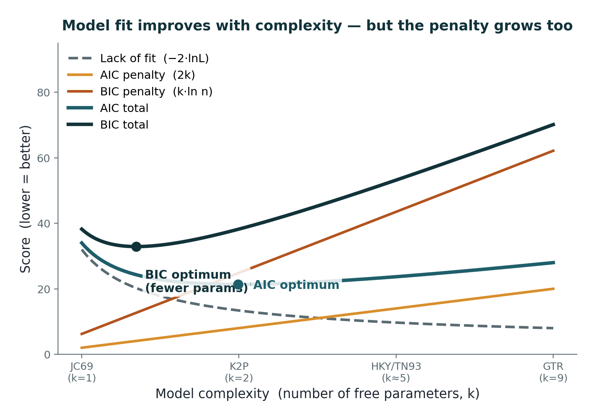
AIC / BIC
Fit improves with complexity — the penalty grows too
The best model isn't the one with the best fit — it's the one that minimizes fit + penalty.
11

Slide 12
AIC / BIC
AIC vs BIC — same idea, different penalty
AIC = 2k − 2·ln(L)
BIC = k·ln(n) − 2·ln(L)
Penalty grows linearly with k (2 points per parameter)
Tends to keep more parameters
MEGA reports both
Penalty scales with ln(n), n = number of sites
Since ln(n) > 2 for any alignment longer than ~7 sites, BIC punishes extra parameters harder
Favors simpler models, especially on long alignments
L = the model's likelihood given your data; lower AIC/BIC = better trade-off of fit vs. complexity, not a probability itself.
12

Slide 13
03
The Gamma Model (+G)
Letting different sites evolve at different speeds

Slide 14
GAMMA MODEL
What do we mean by a “site”, and its “rate”?
≡
A site is one column of the alignment — one homologous nucleotide position shared across all your sequences
Its “relative rate” just means: how often does this particular column show a difference between sequences, compared to other columns in the same alignment? +G assigns each column its own rate multiplier, estimated purely from how much change is actually observed there.
3
Codon position is the clearest example — but not the only source of rate variation
3rd codon positions being “fast” is the textbook case, but the same idea covers e.g. paired vs. unpaired bases in rRNA/tRNA secondary structure, buried vs. surface-exposed protein residues, and regulatory vs. functionally unconstrained stretches of DNA.
?
The model never asks WHY a site is fast or slow — only THAT it is
α is fit from the data, column by column; the biological reason (codon position, structural role, …) is something you interpret afterward, not something you tell the model in advance.
14

Slide 15
GAMMA MODEL
Codon position: the clearest example
3
3rd codon positions change often
The genetic code is degenerate there — many mutations don't change the amino acid, so they aren't removed by selection.
1
1st/2nd codon positions and structurally critical residues change rarely
Almost any change there alters the protein, so purifying selection removes most of them.
↓
Ignoring this unevenness underestimates true divergence
Multiple hits pile up at the few fast sites and go uncounted, dragging every distance-based estimate down.
15

Slide 16
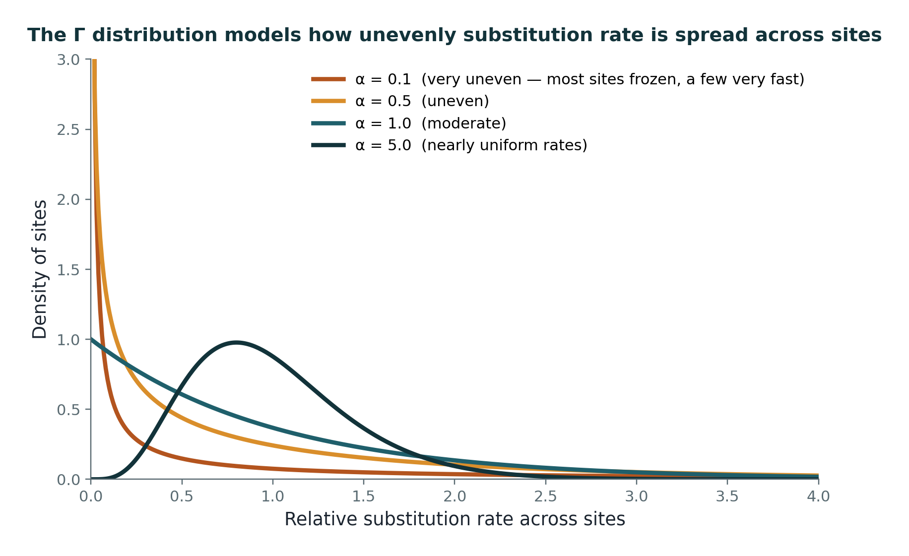
GAMMA MODEL
The Γ distribution models that unevenness
α is estimated by maximum likelihood directly from your alignment — it's not something you guess.
16

Slide 17
GAMMA MODEL
Reading the shape parameter α
Small α (< 1): very uneven rates — most sites nearly frozen, a handful of “hot” sites absorb most of the change
α ≈ 1: moderate unevenness
Large α (>> 1): rates flatten toward uniform — close to what JC69/K2P silently assume
MEGA reports α alongside the best-fit model (Models → Find Best DNA Model)
17

Slide 18
04
Invariant Sites (+I)
Some sites simply never change — model them as such

Slide 19
INVARIANT SITES
A different kind of “slow”
∞
+G says a site is slow; +I says a site is essentially frozen
Gamma still lets every site have some (small) rate. Invariant sites are modeled as having zero rate — they simply don't contribute a mutational opportunity, at any depth of divergence.
▮
These are usually sites under very strong structural or functional constraint
Any change there is so damaging that it's essentially never tolerated — not “rare”, but excluded from the variable-rate pool entirely.
19

Slide 20
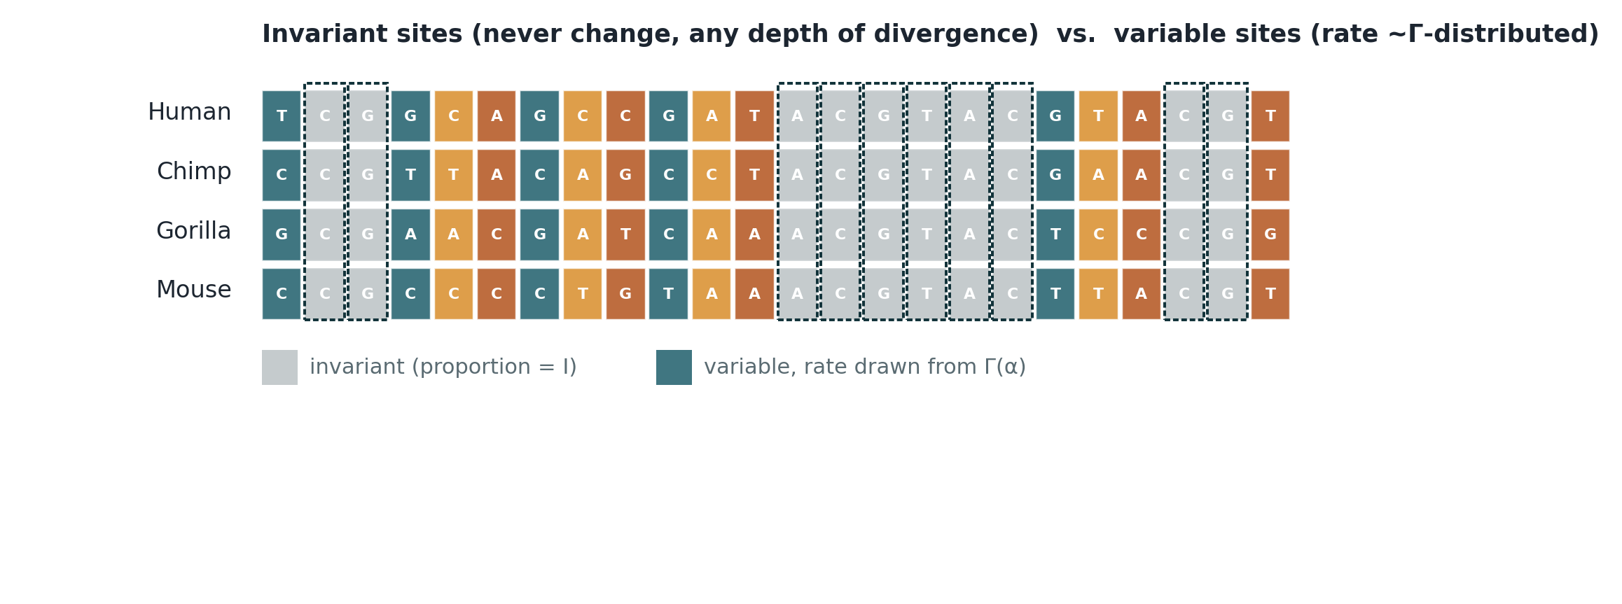
INVARIANT SITES
Invariant vs. variable columns in an alignment
The proportion of invariant columns is the parameter I — reported by MEGA's Find Best Model alongside R and α.
20

Slide 21
INVARIANT SITES
Combining +G and +I
+G alone
+G+I together
Every site gets a rate drawn from Γ(α)
Even the slowest sites still get some (tiny) chance of change
A proportion I of sites is set aside as truly invariant (rate = 0)
The remaining (1−I) sites still get Γ-distributed rates
This is usually the better fit for real coding/mtDNA data — hence models like GTR+G+I
MEGA's Find Best Model tests +G, +I and +G+I versions of each substitution model and ranks them all together by BIC/AICc.
21

Slide 22
05
mtDNA vs. Nuclear DNA
Two genomes in every cell, with very different evolutionary rules

Slide 23
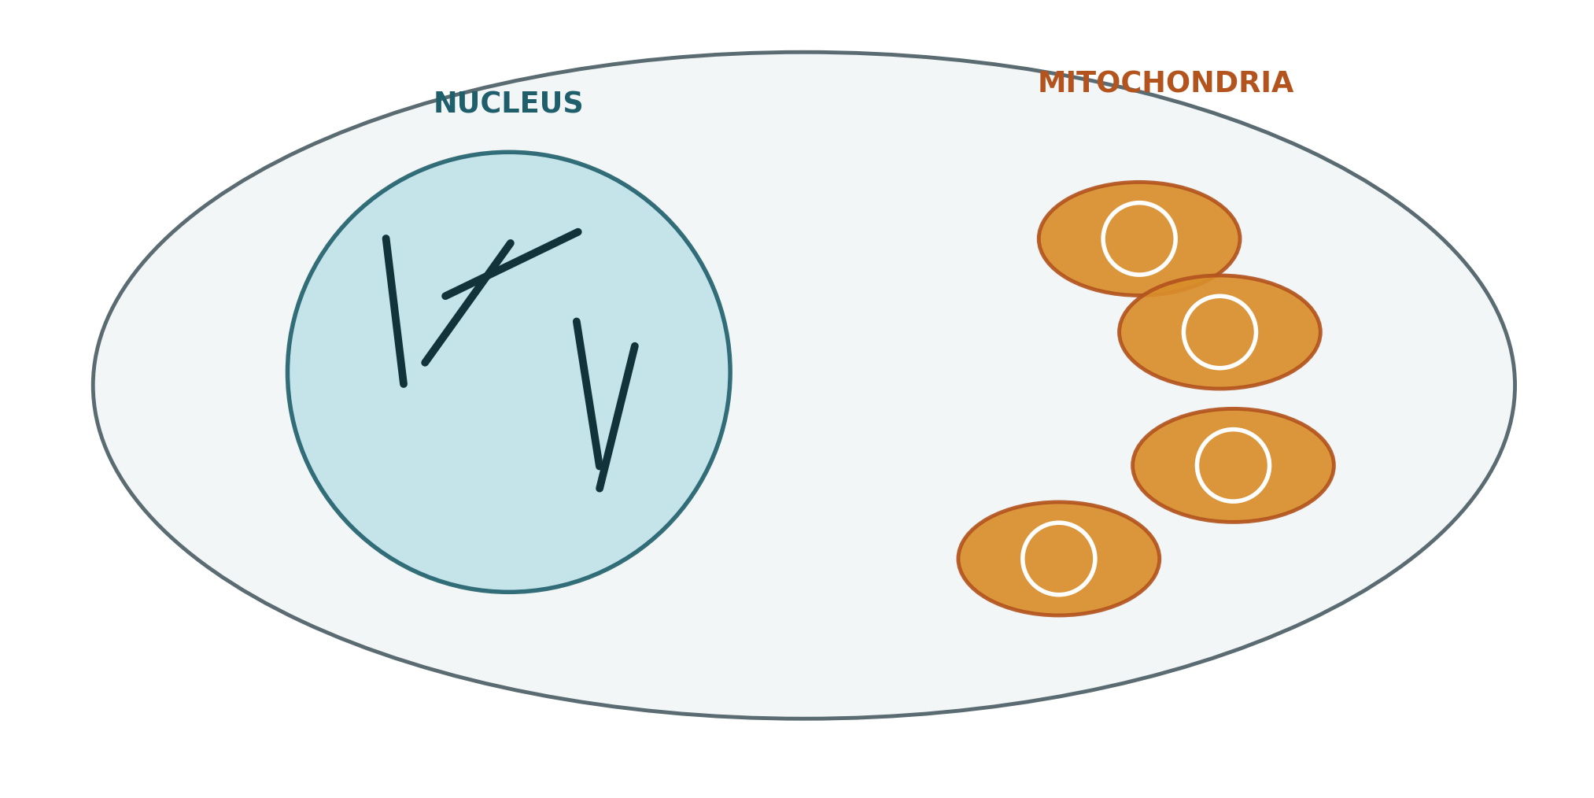
mtDNA vs NUCLEAR DNA
Two genomes, one cell
Nuclear DNA: 2 linear copies per cell. Mitochondrial DNA: hundreds to thousands of circular copies per cell.
23

Slide 24
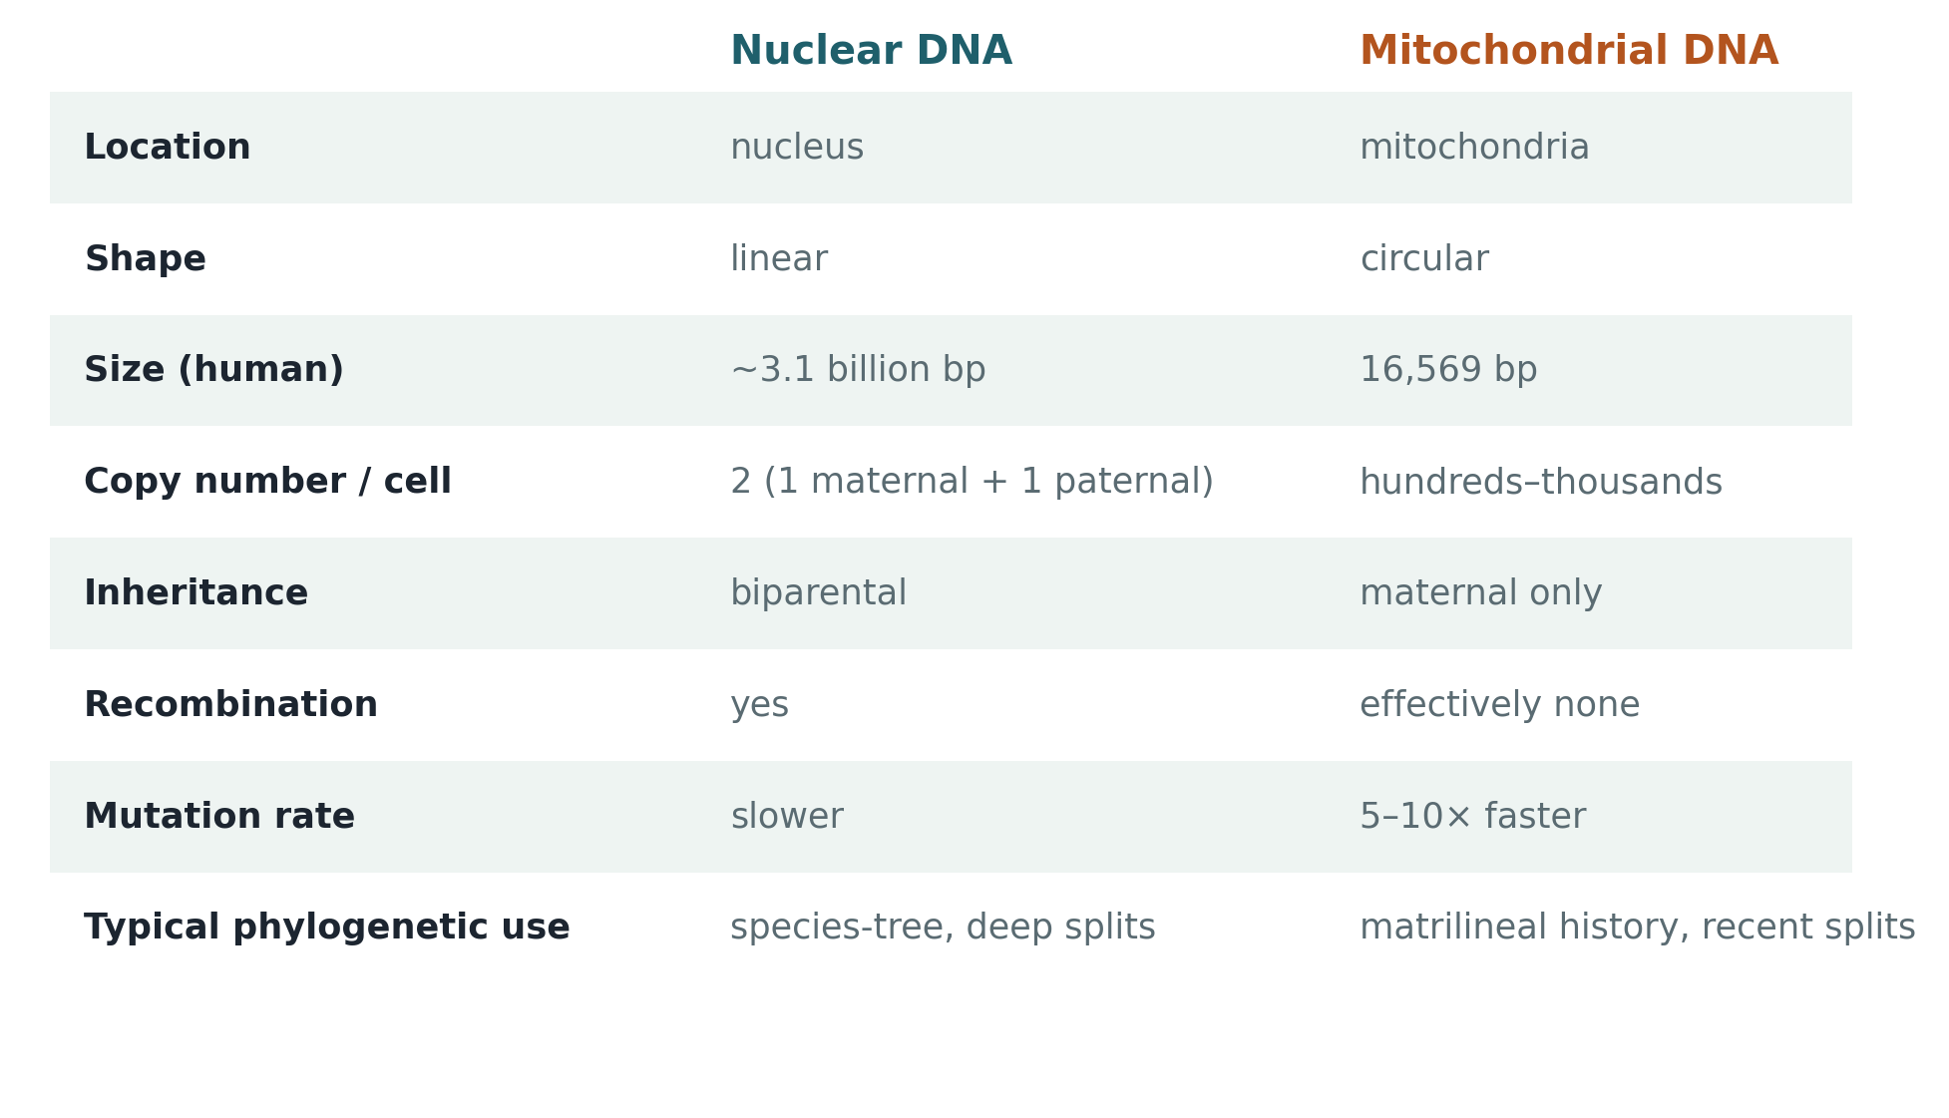
mtDNA vs NUCLEAR DNA
Side by side
24

Slide 25
mtDNA vs NUCLEAR DNA
Why this matters for building trees
♀
Maternal-only inheritance → mtDNA traces a single matrilineal line
It tells you about the history of mothers, not the whole population — a father's mtDNA lineage is simply not passed on.
↻
No recombination → the whole mitochondrial genome is one non-recombining locus
Every site shares exactly one genealogy — so mtDNA gives you one gene tree, not an average over many independently-inherited loci like the nuclear genome does.
⇧
Faster mutation rate → good resolution for recent splits
5–10× faster than nuclear DNA, which is why mtDNA is the classic marker for recent population history — but it also saturates sooner on deep splits.
25

Slide 26
06
Humans, Neanderthals & Denisovans
What the homomtDNA dataset is actually testing you on

Slide 27
HUMAN LINEAGE
Who were they, and where did they live?
Homo sapiens — us
Neanderthals
Anatomically modern humans. Evolved in Africa roughly 300,000 years ago, then spread across the rest of the world starting around 70,000–60,000 years ago.
Europe & western Asia
Neanderthals
A closely related species (Homo neanderthalensis), Europe & western Asia, ~400,000–40,000 years ago — robust build, large brains, fire, tools. Went extinct shortly after modern humans arrived, but interbred with them first: most non-African people today carry ~1–2% Neanderthal DNA.
Denisovans
Denisovans
Siberia & eastern/central Asia
A sister group to Neanderthals, known almost entirely from DNA and a handful of fossils (a finger bone, teeth, a jawbone) from Denisova Cave, Siberia, and a jaw from Tibet. Also interbred with modern humans — Melanesians and Papuans carry the highest share of Denisovan DNA today, up to ~4–6%.
Homo sapiens
Evolved in East Africa, ~300 kya
All three overlapped in time and, in places, in space — which is exactly why their DNA got mixed together.
27

Slide 28
HUMAN LINEAGE
The species tree, with dates
Two sequential splits, not a three-way branch — read left (older) to right (present day).
Homo sapiens
700–500 kya
Homo sapiens splits off first
Neanderthals
400–300 kya
Neanderthals / Denisovans split
Denisovans
Two splits, not three: Homo sapiens branches off first (700–500 kya); Neanderthals and Denisovans then split from each other later (400–300 kya).
28

Slide 29
HUMAN LINEAGE
The Sima de los Huesos puzzle
⛏
~430,000-year-old fossils from Spain, morphologically Neanderthal-like
Found in a cave system (“pit of bones”) with hundreds of early hominin remains.
❗
Their mtDNA (recovered first, 2013) looked surprisingly Denisovan-like
A genuinely confusing result at the time — not what anyone expected from a European fossil this old.
✓
Nuclear DNA (2016) resolved it: they're early Neanderthals
The mtDNA result is now understood as either an ancient mtDNA-only introgression event, or incomplete lineage sorting — a single locus's history misleading you about the species' history.
29

Slide 30
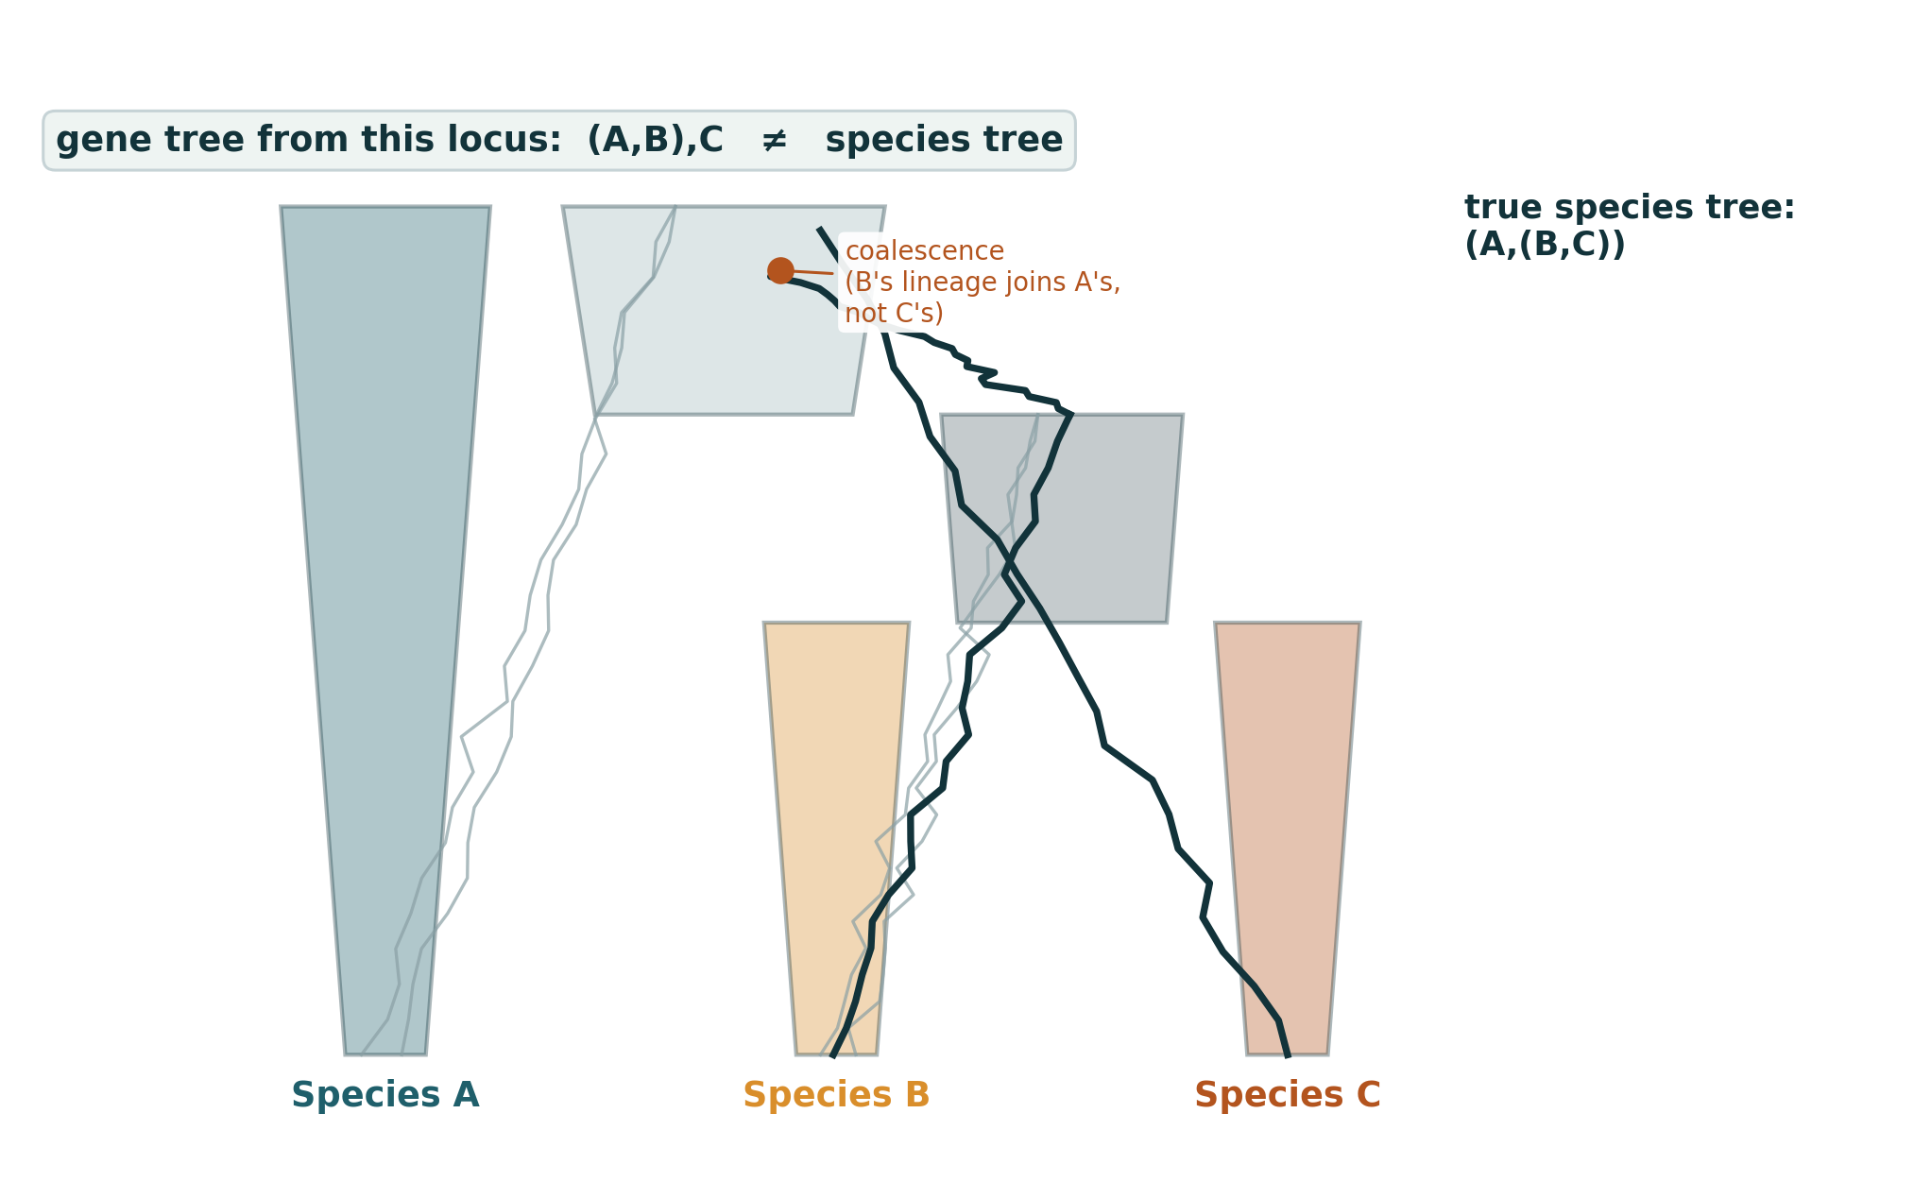
HUMAN LINEAGE
Why one gene tree can disagree with the species tree
Incomplete lineage sorting: which ancestral variant a lineage happens to keep is down to chance — especially when splits happen close together in time.
30

Slide 31
07
BRCA1 & EKAF
The biology behind two of your datasets

Slide 32
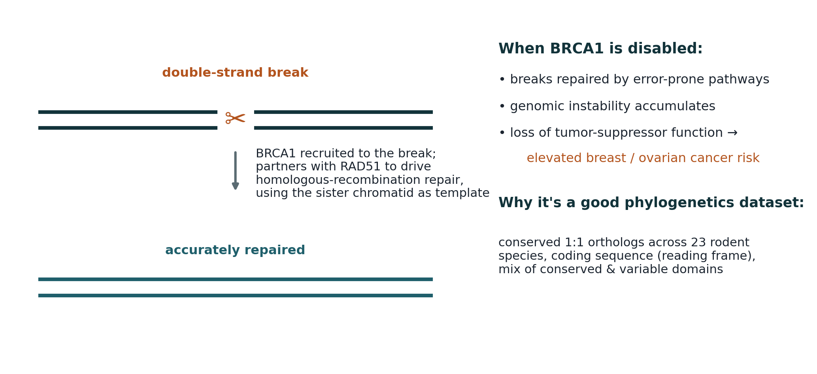
BRCA1
A DNA-repair gene, and why it makes a good dataset
BRCA1 is a tumor suppressor — conserved, single-copy, coding sequence orthologs across 23 rodent species.
32

Slide 33
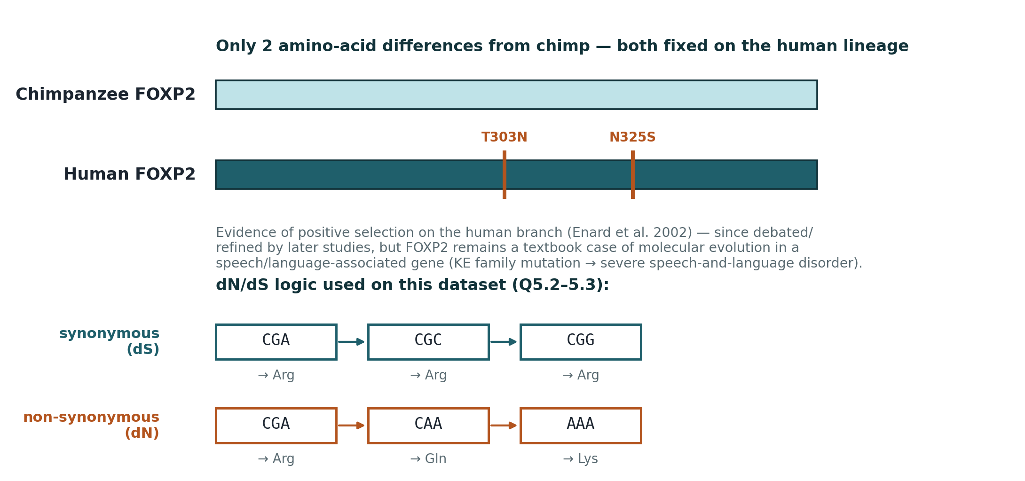
EKAF
EKAF is FOXP2, spelled as a joke
“EKAF” backwards is “FAKE” — the “ability to lie and fake stories” description is a wink at FOXP2's real reputation as a speech/language gene.
33

Slide 34
EKAF
What FOXP2 actually does
T
It's a transcription factor — it switches other genes on and off, mostly in the brain
FOXP2 doesn't build a vocal tract or vocal cords itself. It helps direct how certain neural circuits (especially cortico-striatal and cortico-cerebellar loops) wire up during development.
≈
Those circuits handle fine, sequential motor control — including the fast movements needed for articulate speech
The same FOXP2-dependent circuitry is used for other learned, sequenced motor skills too; an equivalent gene shapes song-learning in birds. That's why it's better described as a “motor sequencing / vocal learning” gene than a dedicated “language gene.”
!
The KE family mutation shows what breaks without it
A single point mutation (R553H) in one copy of FOXP2 causes developmental verbal dyspraxia: trouble coordinating the fast, sequential tongue and mouth movements needed for clear speech, plus wider difficulties with grammar and language comprehension.
✓
That's the story your dN/dS numbers sit inside
Two amino-acid changes fixed on the human lineage (T303N, N325S) are a plausible signature of selection acting on this same speech/language circuitry — suggestive evidence, not proof on their own.
34

Slide 35
BRCA1 & EKAF
Why these two genes, together
B
Purifying selection story
A DNA-repair gene under strong functional constraint — useful for practicing standard distance/ML trees and bootstrap significance on real, moderately-diverged coding sequences.
F
Positive-selection story
FOXP2 carries the textbook example of two human-specific substitutions with evidence of a selective sweep — useful for practicing synonymous vs. non-synonymous trees and dN/dS logic.
↔
Together they cover both directions of selection
dN/dS < 1 (BRCA1-like, purifying) and dN/dS momentarily > 1 on specific lineages (EKAF/FOXP2-like, positive) — the two ends of the spectrum your report should be able to recognize.
35

Slide 36
Putting it together
Bootstrapping tells you how repeatable a branch is — not whether it's true.
AIC/BIC pick a substitution model by balancing fit against complexity; BIC penalizes harder.
+G models uneven rates across sites; +I sets aside sites that never change at all.
mtDNA and nuclear DNA are inherited, and evolve, completely differently — that shapes what each can tell you.
A single gene tree (like mtDNA) can genuinely disagree with the species tree — that's not always an error.
BRCA1 and EKAF/FOXP2 illustrate the two ends of selection: purifying and positive.

