Slide 1
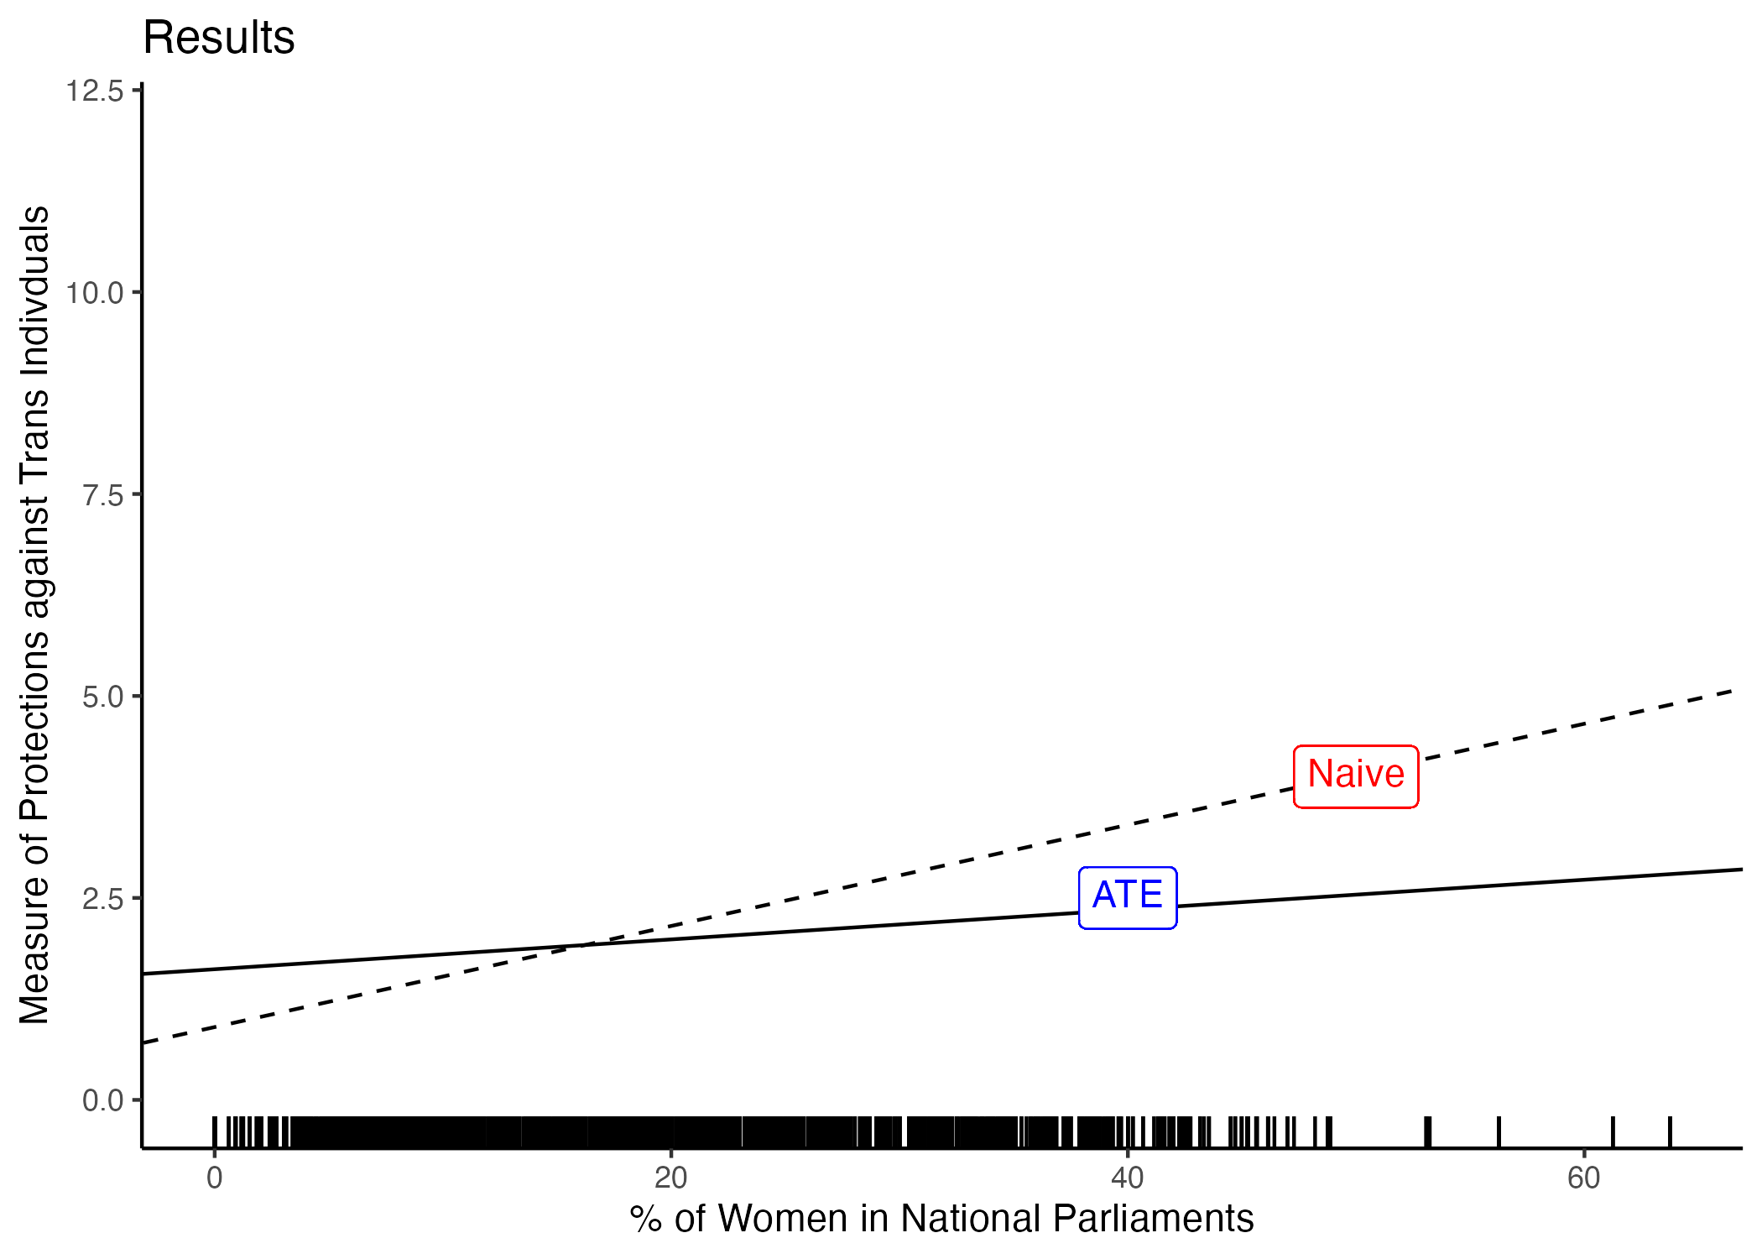
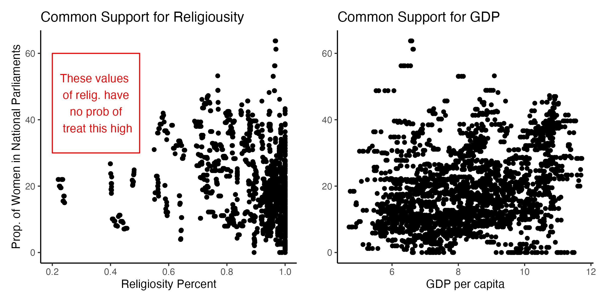
The Global Status of Transgender Rights: Does a Proportionate Number of Women in National Parliaments Have an Impact?
Emma Huizenga
Department of Political Science, Michigan State University
Methods
Overview
Results
Given that my confounding variables were observed and influencing both treatment and outcome, I decided to use weighting to balance the covariates between the treated and control groups so that they would be independent of potential outcomes
By giving more weight to observations that are not “doing what they are supposed to do”, it ensures that the estimated treatment effect is not confounded by differences in the observed covariates
The estimand for weighting is the ATE
Transgender rights is a marginally studied topic, especially when it comes to understanding the global landscape of such individuals. Previous research pertaining to transgender rights only provides a glimpse of the experiences and challenges encountered by transgender individuals and is often confined to qualitative contexts.
Therefore, this study aims to identify a possible correlate to the global status of transgender rights:
Does a proportionate number of women in national parliaments make a difference in the extent to which countries protect the rights of transgender people?
Assumptions
Conditional ignorability
After weighting, I regressed treatment on observed confounders
The p-values for each confounder were large and insignificant, indicating that they were not affecting treatment status after weighting
Common support (positivity)
Religiosity does violate common support, but no other confounders did
Data
The percentage of women in national parliaments is the treatment variable (World Bank)
The global status of transgender rights serves as the outcome variable (“Trans Rights Indicator Project”, TRIP)
GDP per capita, religiosity percent, democracy measures, & year are the observed confounders
Figure 3. Results plot
GDP per capita, religiosity, regime type, & year
A naive comparison of means yielded an estimated treatment effect of 0.063
After controlling for confounding, the ATE was .018
The ATE suggests that for every increase in the percentage of women in national parliaments, there is a corresponding increase of 0.018 in protections for trans rights
% of women in parliament
Trans Rights
Conclusion
While countries with a higher representation of women in parliament tend to have stronger transgender protections, this association appears to be influenced more by factors related to other characteristics rather than a direct causal effect of women's representation in parliament on trans rights
Figure 1. DAG
References
Williamson, M. (2023). A Global Analysis of Transgender Rights: Introducing the Trans Rights Indicator Project (TRIP). Perspectives on Politics, 1–20.
Figure 2. Common Support plots

