Slide 1
Emma Fabella
BUILD
WITH
PURPOSE
Senior Full-Stack Engineer | Technical Lead
16 Years of Software Engineering Experience
Java • Spring Boot • Angular
Microservices • REST APIs • Azure
Technical Leadership • Architecture • DevOps
QIAGEN INTERVIEW
Enterprise platforms across banking, healthcare, insurance, telecommunications, government, and enterprise environments.
Emma Fabella | QIAGEN Interview
1

Slide 2
My Journey
WHAT SHAPED ME
Early Discipline
What I Carried Forward
Working student since age 16.
Graduated with honors and received academic recognition.
There were times work made it hard to focus fully on my studies, so not every grade was perfect — but that trade-off shaped who I am today.
Balancing education and work built persistence, discipline, accountability, and ownership.
Bachelor of Science in Computer Science at the University of the Philippines.
Academic work and real-world responsibilities shaped a practical approach to learning: understand the problem, take responsibility, and deliver meaningful results.
Balancing work and education taught me how to keep learning while delivering in real-world conditions.
Emma Fabella | QIAGEN Interview
2

Slide 3
Technology With Purpose
UNIVERSITY OF THE PHILIPPINES
Undergraduate Thesis
Disease Pattern Mapping
in the Philippines
PATTERNS
DATA
My undergraduate research focused on analysing disease patterns using data and technology to produce meaningful insights.
INSIGHT
IMPACT
Why it matters to me
HEALTH
It introduced me to the connection between technology, data, healthcare, and improving lives through better understanding and decision-making.
Emma Fabella | QIAGEN Interview
3

Slide 4
Why QIAGEN Resonates With Me
Making improvements in life possible.
QIAGEN
MY THESIS
Sample to Insight
Health-related information
→ meaningful insights
The connection I see is simple:
using technology and information to support better understanding, better decisions, and meaningful outcomes.
Disease pattern mapping in the Philippines
Technology • Data • Healthcare • Impact
Emma Fabella | QIAGEN Interview
4

Slide 5
Alignment With QIAGEN Values
EMPOWER
Ownership & Responsibility
Continuous Learning
Collaboration
Working student since age 16. Taking responsibility for education, work, and personal growth.
MS Information Technology foundational coursework completed and currently pursuing a Global MBA while maintaining a professional career.
Mentoring, code reviews, onboarding, knowledge sharing, and technical leadership throughout my career.
I try to demonstrate values through how I work, not only through what I say.
Emma Fabella | QIAGEN Interview
5

Slide 6
Technical Expertise
ENGINEERING
Backend
Frontend
Cloud & DevOps
Java
Spring Boot
REST APIs
Microservices
Hibernate
Angular
Vue.js
React
JavaScript
HTML5 / CSS3
Azure
AWS
Docker
Jenkins
Kubernetes
Experience also includes databases, testing, API security, CI/CD, code quality, and enterprise integrations.
Emma Fabella | QIAGEN Interview
6

Slide 7
Enterprise Experience
SELECTED WORK
Fujitsu
National Australia Bank
Team Leadership
Development Standards
Architecture Support
Kafka
Spring Boot
Banking Microservices
The Walt Disney Company
Healthcare & Insurance
Java Services
API Integrations
Authentication
AEM / Java
Enterprise Platforms
Business-Critical Systems
Across different industries, the common thread has been solving complex problems while working within enterprise constraints.
Emma Fabella | QIAGEN Interview
7

Slide 8
Continuous Learning
ALWAYS EVOLVING
Education
Professional Development
• BS Computer Science — University of the Philippines
• MS Information Technology — foundational coursework completed
• Global MBA — The University of Western Australia (ongoing, 2026)
• Harvard Business School Online
• University of Tokyo
• Microsoft Learning
• Coursera
• Pluralsight
Learning keeps my technical skills current while expanding how I think about business, delivery, and leadership.
Emma Fabella | QIAGEN Interview
8

Slide 9
How I Work
WORKING STYLE
Work preferences, collaboration, and how I handle blockers
Focused Environment
I work best in a quiet, focused environment where I can concentrate deeply on complex technical tasks and problem-solving.
Organization & Multitasking
I use a structured workflow and a six-screen setup to keep the information I need readily available and stay organized across tasks.
Flexibility & Collaboration
I am comfortable working hybrid and can attend the office when collaboration, workshops, or team activities benefit from face-to-face interaction.
When I Encounter a Blocker
If I cannot complete a task because of infrastructure, network, dependency, access, or integration issues, I identify the blocker, communicate it early, seek the right support, and work on an alternative or next step where possible.
Learning From Challenges
I treat negative situations as learning experiences—reflecting on what happened, identifying what I can improve, and using those insights to perform better moving forward.
Emma Fabella | QIAGEN Interview
9

Slide 10
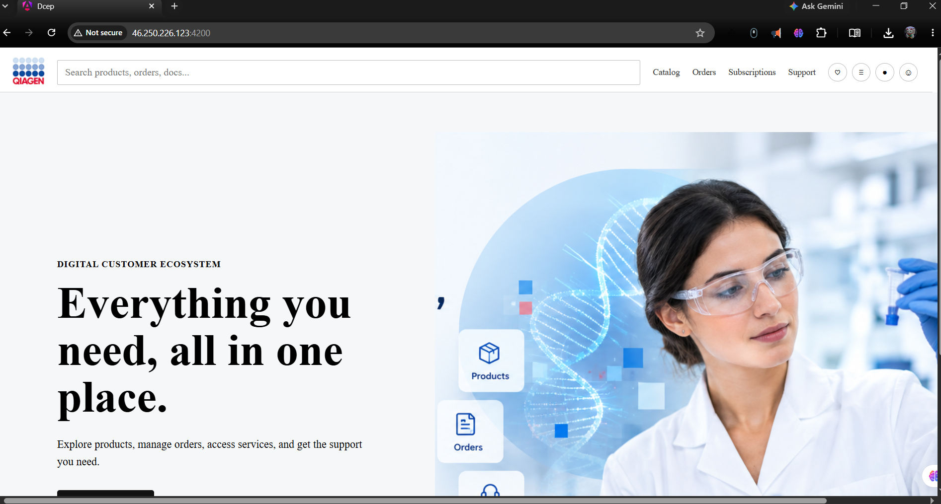
Sample Portfolio — Digital Customer Ecosystem
PORTFOLIO
A working sample demonstrating architecture, application design, and a customer-facing implementation
Digital Customer Ecosystem (DCEP)
• Angular customer-facing application
• Java / Spring Boot microservices
• REST APIs and service boundaries
• Customer, product, search, cart, order, payment and digital-service capabilities
• Azure-oriented cloud and DevOps target architecture
• Architecture documentation covering business, application, data, technology, integration, security, DevOps and roadmap
Portfolio: github.com/emmafabella1/digital-customer-ecosystem-platform | Demo: 46.250.226.123:4200
Emma Fabella | QIAGEN Interview
10

Slide 11
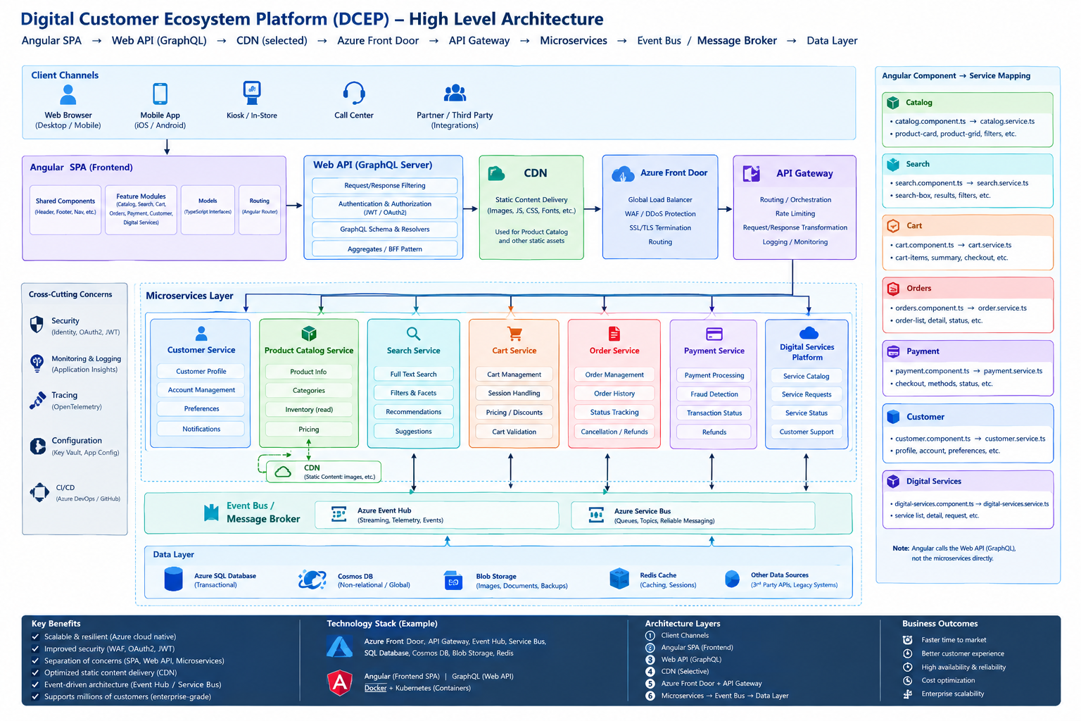

Slide 12
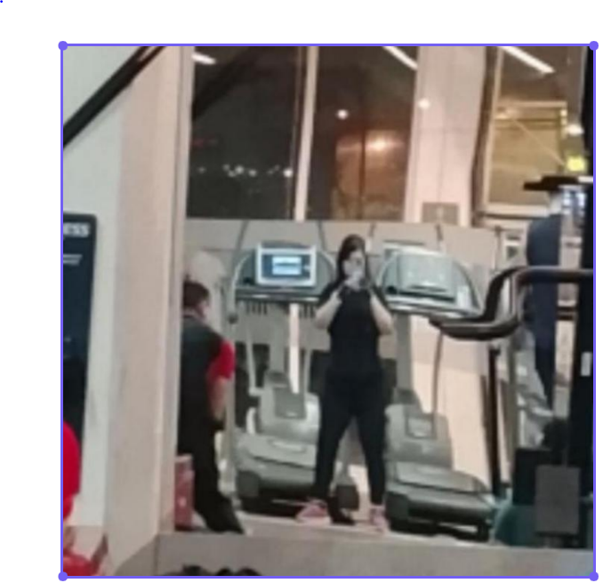
Why Me
My journey as a working student, honor student, academic awardee, Computer Science graduate, researcher, software engineer, technical leader, and lifelong learner has been guided by a simple belief:
Technology should create meaningful value for people.
DISCIPLINE OUTSIDE OF WORK
I bring the same discipline to how I take care of myself: regular gym training, spa and sauna recovery, and consistent dental care. Looking after myself takes real, everyday effort — the same effort and consistency I bring to my work.
That is why QIAGEN’s mission resonates with me — and why I would be excited to contribute to an organisation dedicated to making improvements in life possible.
THANK YOU • QUESTIONS & DISCUSSION
Emma Fabella | QIAGEN Interview
12

