Slide 1

The Business of Technology CSS|EE 371
Assignment A4-1 Presentation
Team Healthcare-1
Apr 2022

Slide 2
Summary:
♦ New innovative technology in healthcare. Reaches the unreachable areas.
♦ Provide essential medical supplies to remote areas during emergency situations.
♦ Rwanda was the first country which has used drones and saved 1800 lives in four years by dropping blood to rural areas.
Notes:
‹#›

Slide 3
Assumptions and Market:
-It is what healthcare providers use to transport medical items and interact with patients from a distance.
-Time benefit, since in several emergency cases drones arrived first (automated external defibrillators).
-There was already a case where drone saved 71-year old from out-of-hospital cardiac arrest.
-Amazon, Walmart and 7-Eleven already testing using drones for delivery.
Drones can be used for:
-(1)Prehospital Emergency Care, (2) Expediting Laboratory Diagnostic Testing and (3) Surveillance
Already is being used for deliver vaccines, haematological products and automated external defibrillators.
Assumption-Will help to deliver medicine faster.
Market-All the hospitals and deliveries companies.
Notes:
‹#›

Slide 4
Our Product Idea:
♦ Stage : Product ( Rental) - specialized product built for medical supply.
♦ Who pays for product: Customers or health insurances will pay for the products as the needs of medical supply
♦ Value:
Visible: Drones are fully remote controlled and it deliveries supplies via parachute for a truly no-contact experience.
Invisible: Drones are a promising new innovative technology for improving patient survival, outcomes, and quality of life, especially in faraway locations where funding and infrastructure are limited.
Notes:
‹#›

Slide 5
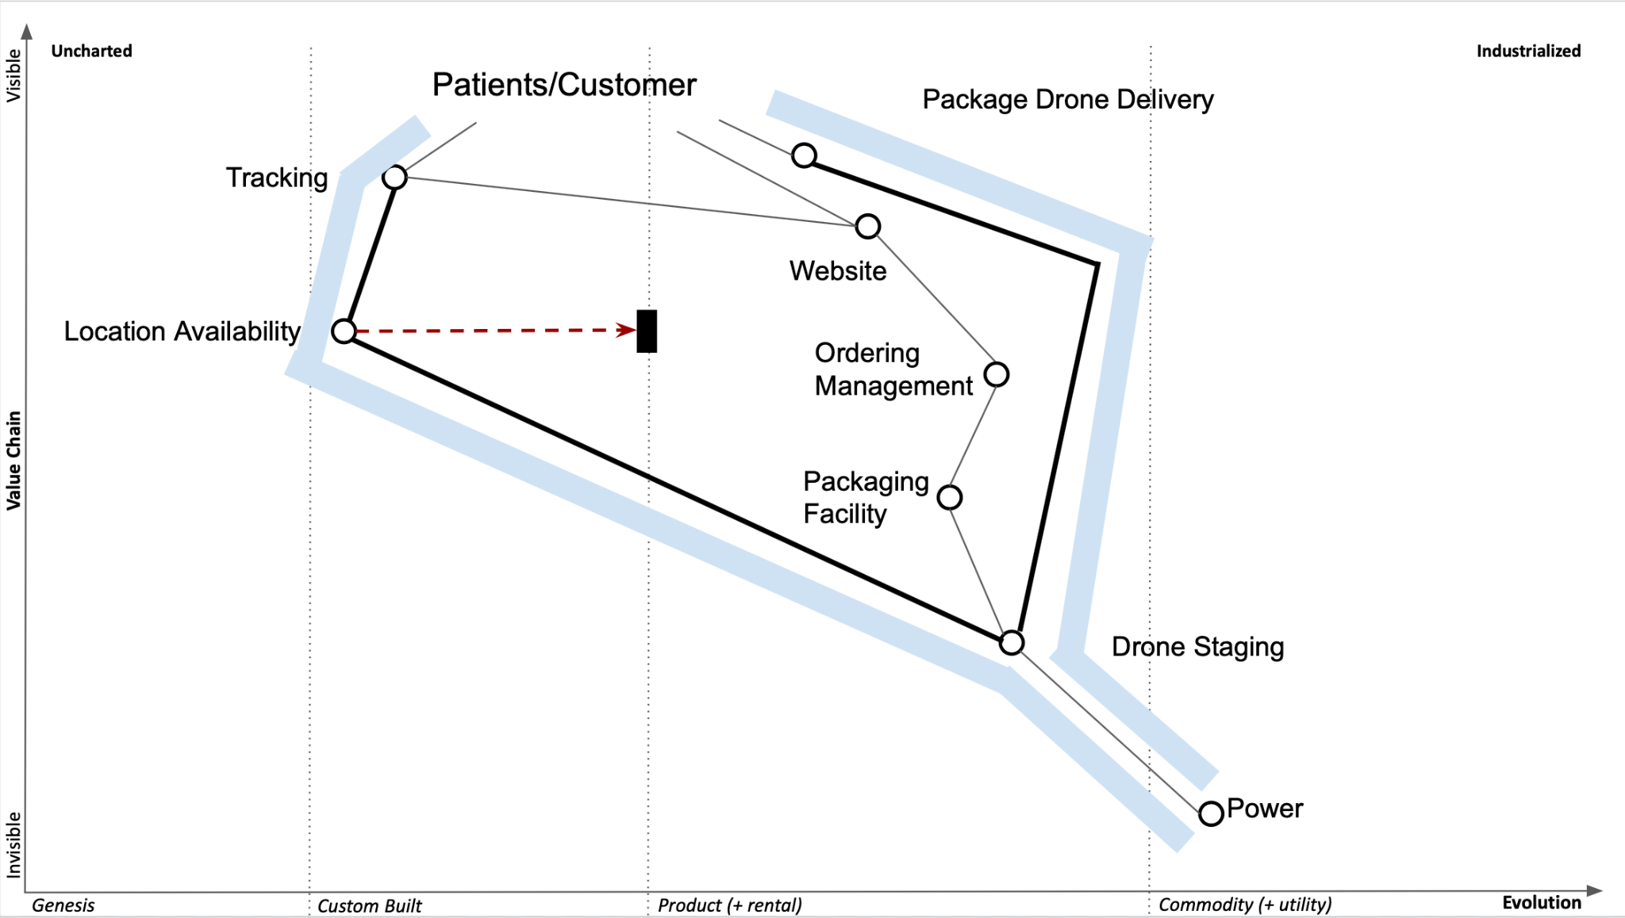
Wardley Map:
Notes:
‹#›

Slide 6
Peer Review Format:
Team Healthcare One
{Vertical Group Name F-1, F-2, H-1, H-2, M-1} : {Score 1-5}, {one sentence summary critique}
(Five total scores per group review required, one each for F-1, F-2, H-1, H-2, M-1)
Grading based on actual presentation 3 points (by lecturer)
and peer-review (consolidated from 5 reviews) 2 points.
Total 5 points.
Peer Review for M-2, R-1, R-2, T-1, T-2 will be a separate assignment.
Peer Review and Assignment Logistics
Notes:
‹#›

