Slide 1


Predicting gender on Twitter
Notes:
ROC curve (AUC) – look at threshold for predict proba

Slide 2

Can we classify Twitter users as male or female based on their tweets? Do men and women tweet differently?

Slide 3
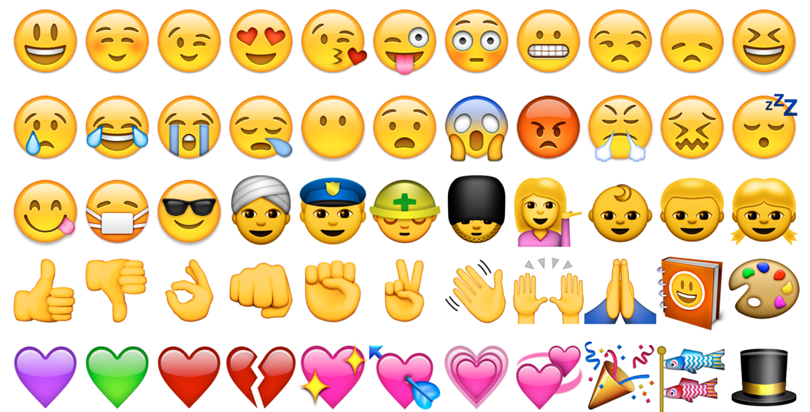
The data:
About 1 million tweets from 10,000 random users, categorized as male or female
Lots of noise on Twitter!
non-English, non-words, URLs, re-tweets, etc.
Emojis are a big challenge!

Slide 4
Approach
Collect data
Clean the data
Emojis!
Exploratory data analysis
Natural Language Processing (NLP)
Machine Learning
Notes:
Vectorize the tweet text using Tf-idf and SVD (LSA)
Train and test supervised models to predict gender
What are the features (words) that most strongly predict gender?
Use unsupervised model/s and clustering; can I use that to do feature engineering?
Topic modeling using LDA

Slide 5
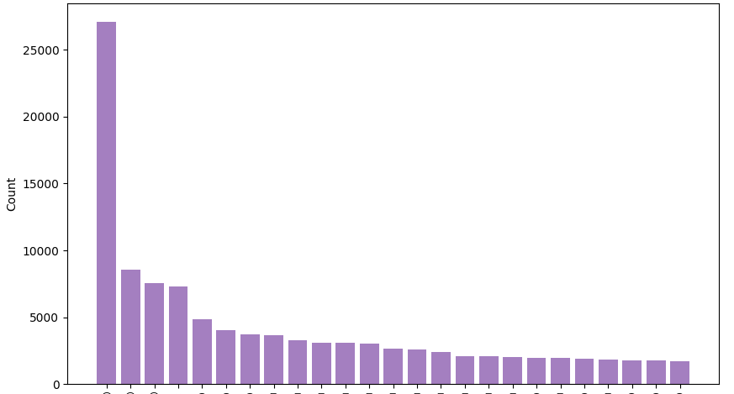
Top 25 emojis in all tweets

Slide 6
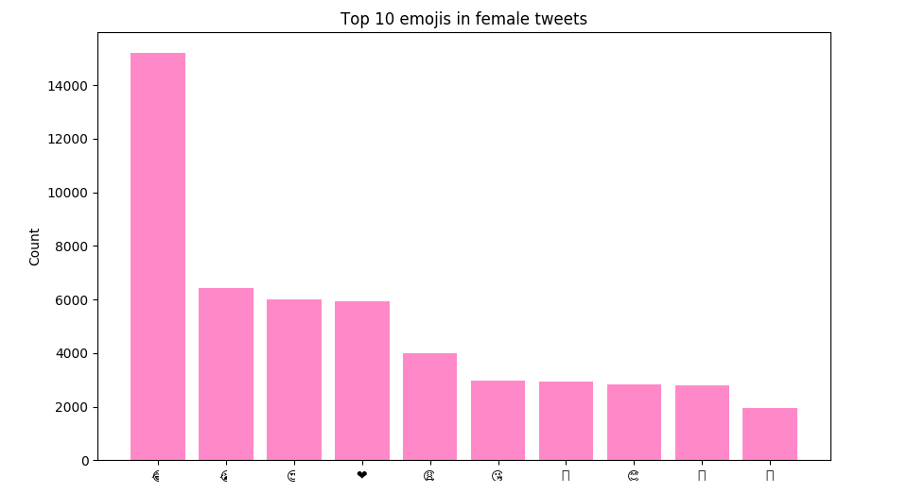
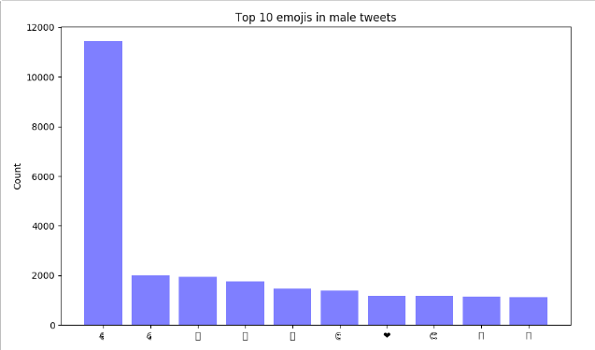
Top 10 emojis: females vs. males
144,480 emojis in female tweets
75,218 emojis in all male tweets

Slide 7
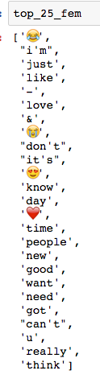
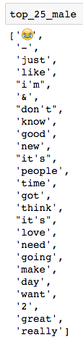
Top 25 most tweeted ‘words’:

Slide 8
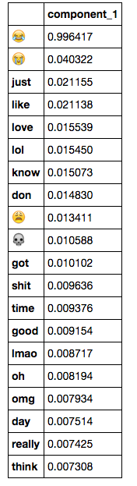
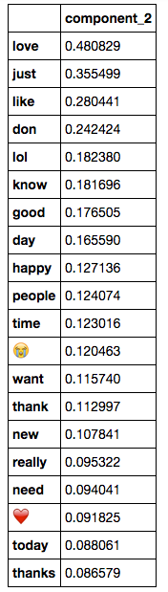
First two principal components

Slide 9
Gender Prediction: initial models
Logistic Regression
lr = GridSearchCV(LogisticRegression(),
param_grid=param_dict['lr'], cv=StratifiedShuffleSplit(n_splits=5, random_state=42))
59% train score
59% test score
Random Forest
rf = GridSearchCV(RandomForestClassifier(),
param_grid=param_dict['rf'],
cv=StratifiedShuffleSplit(n_splits=5, random_state=42))
94% train score
59% test score

Slide 10
Next steps:
Improve predictive model accuracy
Organize and clean scripts
Build a script that can take a Twitter user’s handle as input, and output the user’s gender
LDA/topic modeling, LDAVis
Sentiment analysis: male vs. female tweets

