Slide 1
BLS Work Stoppage Data
1993-2022

Slide 2
Definition of work stoppage (quoted directly from BLS FAQ page)
What is a work stoppage?
A work stoppage is a strike or a lockout. Because of the complexity of most labor-management disputes, the Work Stoppages program does not distinguish between strikes and lockouts in its statistics.
What is a strike?
A strike is a temporary stoppage of work by a group of workers (not necessarily union members) to express a grievance or enforce a demand. A strike is initiated by the workers of an establishment.
What is a lockout?
A lockout is a temporary withholding or denial of employment during a labor dispute in order to enforce terms of employment upon a group of employees. A lockout is initiated by the management of an establishment.

Slide 3
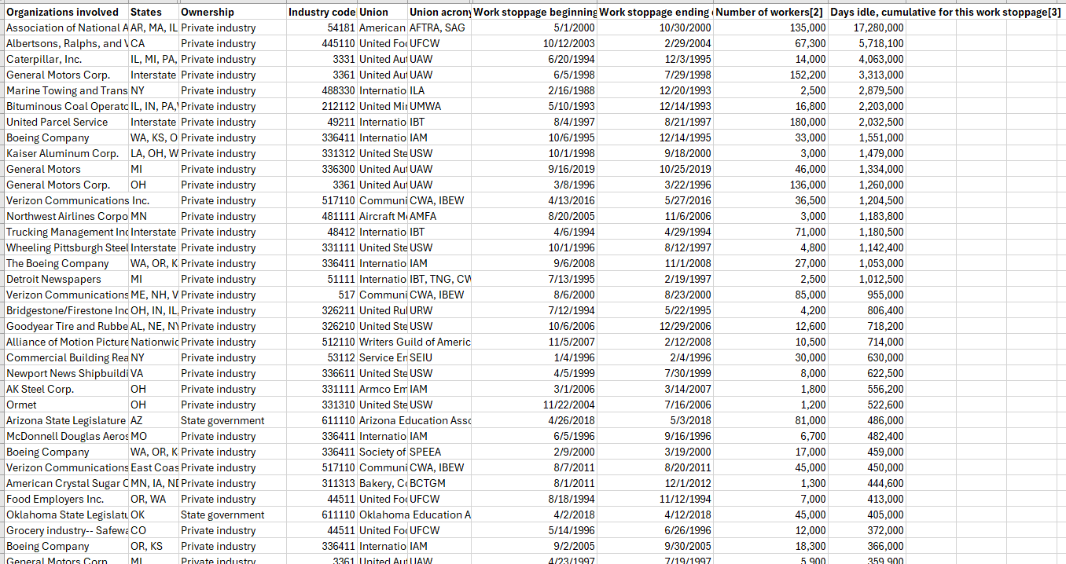
Raw Data

Slide 4
Fields of Interest
Ownership
Industry
Work stoppage start date
Work stoppage end date
Number of Workers
Days idle, cumulative

Slide 5
Fields of Interest
Ownership
Three possible values:
Private industry
State government
Local government
One work stoppage listed as “State and local government,”
will ignore

Slide 6
Fields of Interest
Start/end date
Will aggregate by year
Calculate duration
Most begin 1993 or later
One anomaly begins 1988
Will exclude from analysis by year

Slide 7
Fields of Interest
Industry code
Not currently human readable
200+ distinct codes
Impractical for graphing as-is
Come from North American Industry Classification System (NAICS)

Slide 8
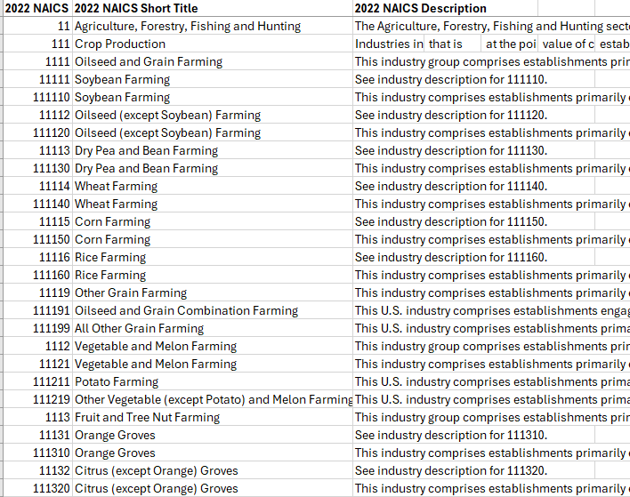
NAICS
2-6 digit hierarchical code system
All codes with the same first 2 digits belong to the same sector
Only 17 top-level sectors in dataset – use that
Requires joining two dataframe

Slide 9
Fields of Interest
Days idle, cumulative
Definition:
number of workers * workdays lost
Workday:
the weekdays Monday through Friday excluding Federal holidays.
Wildly variable range
One work stoppage has 17 mil days idle
Next largest has only 5.7
Will use medians to keep outliers from distorting data

Slide 10
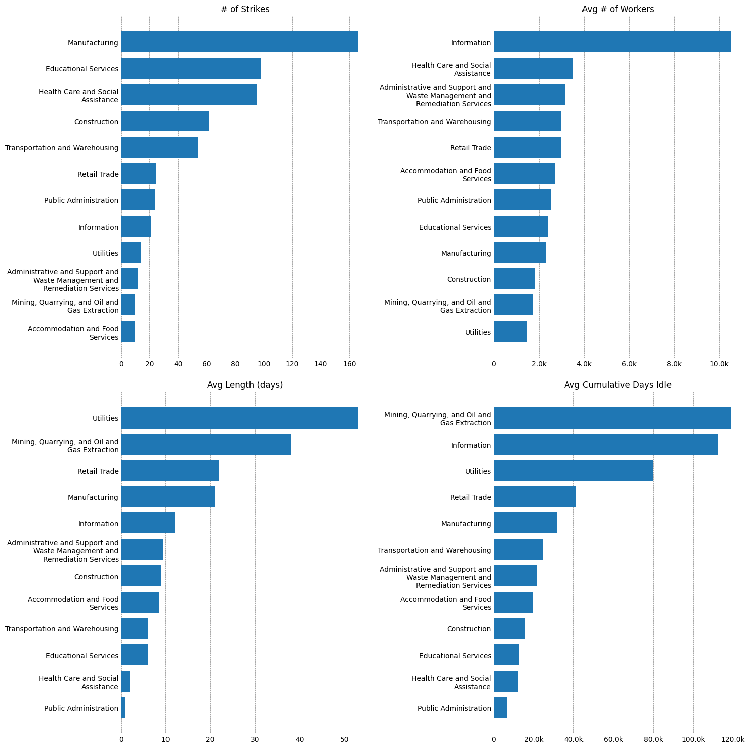
By industry
Industries with < 10 work stoppages total excluded
Look at the top industries in each graph, see where those industries rank in other graphs
Ex: Manufacturing stops work most often, but are smaller and shorter than some other industries
Information (Media & Telecommunications) stops infrequently, but involves more people

Slide 11
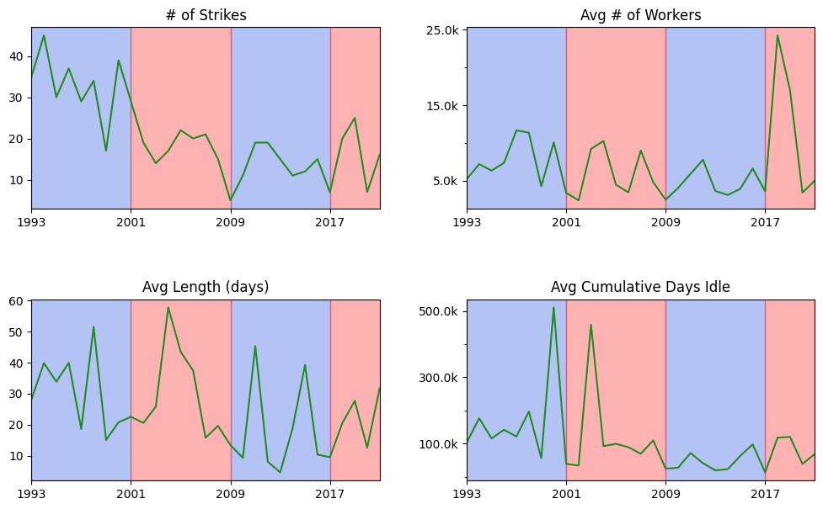
Strikes over time
Red = republican president
Blue = democratic president
Decreasing frequency over time
No obvious correlation with party in office
Duration and size vary wildly, but no clear trend

Slide 12
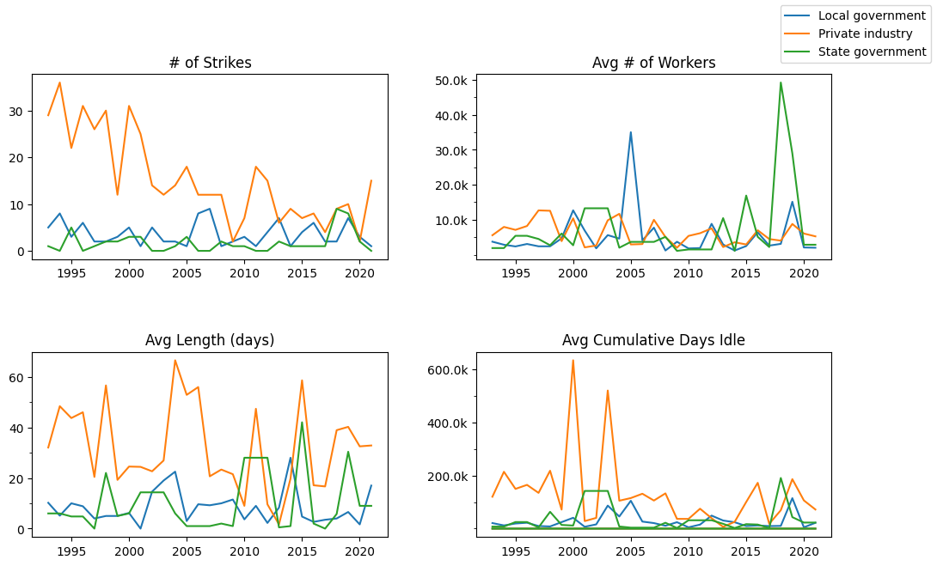
By Ownership type
Private industry decreasing in frequency
State & Local government more consistent, similar to each other

