Slide 1

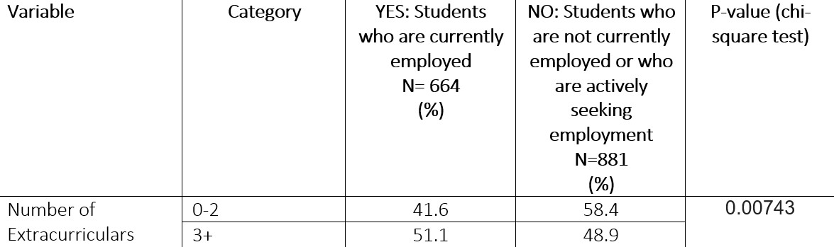
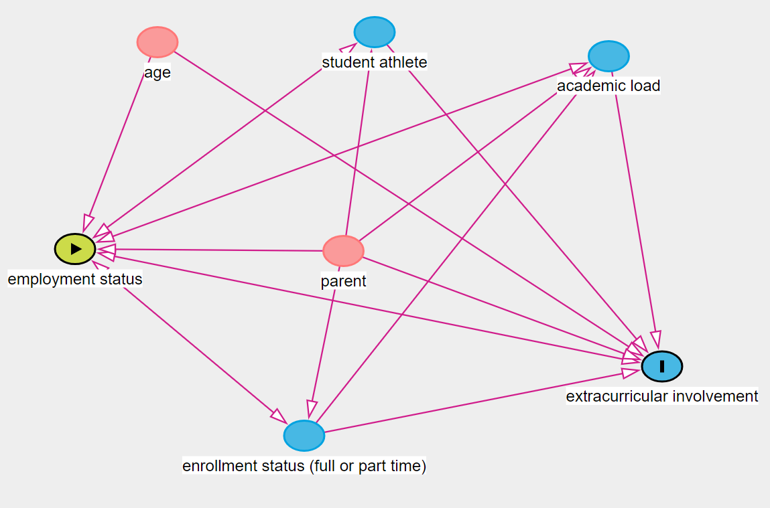
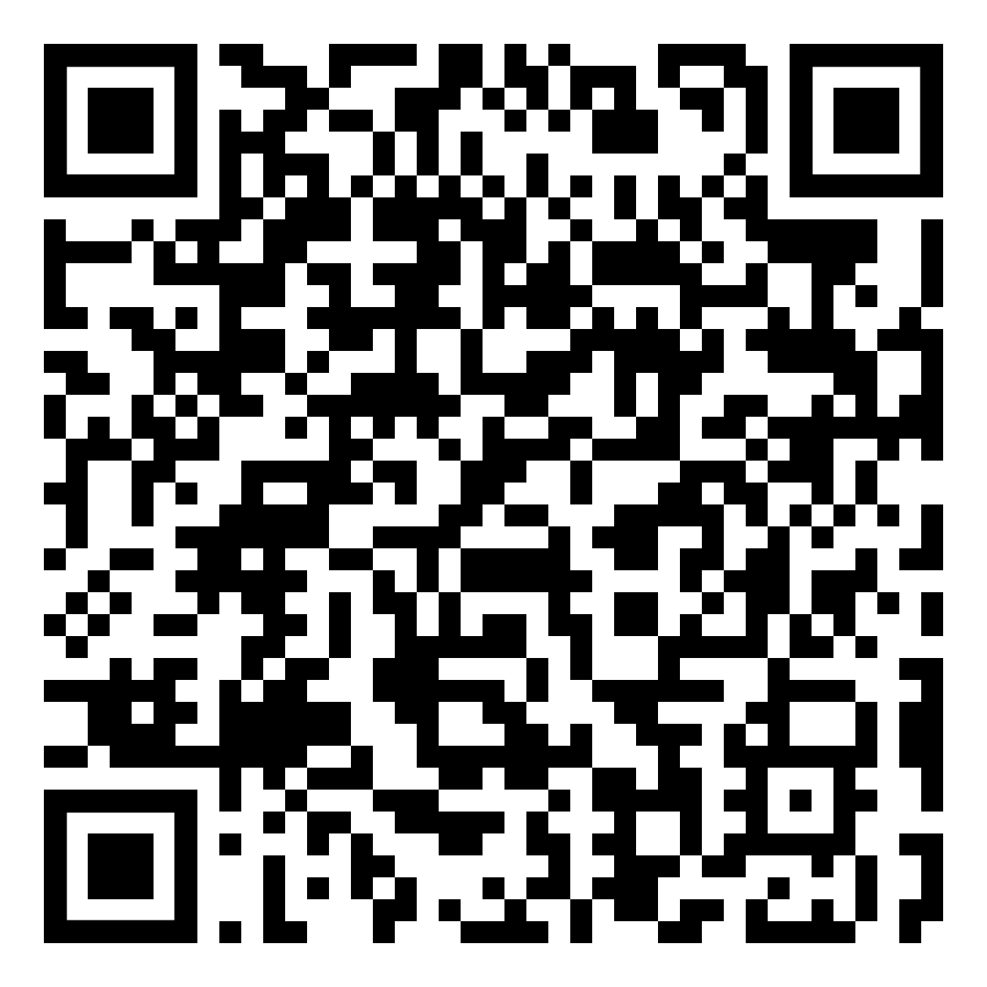
Employed college students are less likely to participate in extracurricular activities compared to their unemployed counterparts.
Impact of Student Employment on Extracurricular Engagement
Emma Getz
Appalachian State University
Purpose & Hypotheses
My goal for this project was to evaluate whether being an employee is associated with the number of extracurricular activities students are involved with. The null hypothesis (Ho) is, “students who are current employees are involved in extracurricular activities at the same rate as students who are not current employees.” The alternative hypothesis (Ha) is, “students who are current employees are involved in extracurricular activities at a different rate as students who are not current employees.”
Background
Extracurricular activities have been proven to be a positive addition to a student's college experience by creating social ties and providing new opportunities to students (Buckley & Lee, 2018). 43% of students at ASU reported being currently employed (Campus Wellness Assessment, 2019). Since employment affects factors such as free time and energy, I wanted to see if there was a relationship between these two factors. This is important to public health because the overall well-being of students can be affected by employment status and employment, and a relationship between the two should be addressed to see if there is a need for further investigation.
Methods
Data was collected from a sample of 1560 students at ASU with subjects being recruited using a randomized controlled trial and convenience sampling. Questions 16 and 17 state, “How many university sponsored extracurriculars...all Association (RHA) etc.) do you participate in?” and “Are you currently a wage-earning employee, either on-campus or off-campus?” The primary exposure variable for this study was employment status and the primary outcome variable for this study was extracurricular involvement. The statistical analyses conducted were a chi-square test and a logistic regression. There were no confounding variables included in the regression model, as confirmed by the DAG model.
Results
The question referring to the exposure originally contained three questions and I binned it into two categories: currently employed students and currently unemployed students / currently unemployed students actively searching for a job. The number of exposed students (currently employed) was 664. The number of unexposed students (not currently employed / actively seeking a job) was 891. The outcome of extracurricular involvement was originally divided into 0, 1-2, 3-4, and 5 or more. I binned these answers into two outcomes: 0-2 and 3+. There were 1319 students who participated in 0-2 extracurriculars and 228 students who participated in 3+ extracurriculars. The P-value from the chi-squared test is 0.00774. This shows that the relationship between employment status and extracurricular involvement is significant. The odds ratio from the logistic regression analysis was 1.1. This shows that students who are employed have a lower chance of being involved in more extracurricular activities than the students who are unemployed.
Conclusions
The findings from the statistical analyses of the relationship between employment status and extracurricular involvement proved to be statistically significant and showed that employed students are less likely than unemployed students to be involved in more extracurricular activities. A strength of this analysis is that the p-value is much lower than 0.05, suggesting that the relationship is without a doubt significant. A limitation of the analysis is that students actively looking for a job were binned with unemployed students, which could be generalizing. Suggestions for future research include looking into the reasons employed students are less involved in extracurricular activities. Suggestions for interventions at ASU could include expanding outreach programs for student involvement.
Table
Shows a P-value of 0.00743.
DAG Model
Model showed no confounding variables.
Suggested Interventions:
ASU Office of Student Financial Aid:
Helps students get access to financial aid resources and make the cost of attending college cheaper.
ASU Campus Activities:
Program that encourages students to get involved in the many extracurricular activities available on campus.
Credit Wise Cats Seminar Project
Financial literacy seminar program for college students meant to increase financial literacy. (Borden et al., 2007)

Slide 2
Abstract - Impact of Student Employment on Extracurricular Engagement
By Emma Getz
Purpose: The purpose of this study was to evaluate whether being an employee is associated with the number of extracurricular activities students are involved with. This study is important because it examines a potential barrier to student extracurricular involvement, which has been shown to enhance the college experience for students (Buckley & Lee, 2018).
Methods: In 2019, a random sample of student emails and additional convenience sampling of students from Appalachian State University were surveyed for the campus’ health needs assessment. The following survey items were used to measure student employment and extracurricular involvement: “How many university sponsored extracurricular activities (e.g., intramural or club sports, Student Government Association (SGA), Residence Hall Association (RHA) etc.) do you participate in?” and “are you currently a wage earning employee, either on-campus or off-campus?” The statistical tests used to analyze the data were a chi-square test and a logistic regression model. A chi-square test is used to see if there is a relationship between two dichotomous variables. The assumptions of a chi-square test are that the data is from a survey from people at one point in time and that the independent variable and dependent variable are dichotomous. The campus wellness survey data is data taken from a survey at one point in time, which meets the first assumption. Answer choices from both the independent and dependent variables, employment and extracurricular activity, were binned in order to make these two variables dichotomous. Because of this, these variables satisfy the second assumption. The survey item regarding extracurricular activities was binned so that the two options were students participating in 0-2 extracurriculars and students participating in 3+ extracurriculars. The survey item regarding employment status was binned so that the two options were currently employed students and currently unemployed students / currently unemployed students who are actively seeking a job. A logistic regression model assesses a relationship between variables while taking into account confounding variables. This model is used for qualitative data with a dichotomous outcome variable. The variables in this study were qualitative and the outcome variable, extracurricular activities, was dichotomous as its answers were binned into two options. Therefore, the variables and data used for the assumptions of a logistic regression model. A DAGitty model was analyzed which showed no confounding variables, so none were adjusted for in the logistic regression model.
Results: This study resulted in a significant relationship between student employment and student extracurricular involvement. For the independent variable, the number of exposed students (currently employed) was 664 and the number of unexposed students (not currently employed / not currently employed and actively seeking a job) was 891. For the dependent variable, there were 1319 students who participated in 0-2 extracurriculars and 228 students who participated in 3+ extracurriculars. The P-value which resulted from the chi-squared test is 0.00774. This value, compared to an alpha value of 0.05, shows that the relationship between employment status and extracurricular involvement is significant. The odds ratio from the logistic regression analysis was 1.1. This shows that students who are employed have a lower chance of being involved in more extracurricular activities than the students who are unemployed.
Discussion: The significant relationship between employment status and extracurricular activity and the finding that employed students have a lower likelihood of participating in 3 or more extracurricular activities compared to unemployed students leads to many implications for further research and interventions. Potential explanations for this observed relationship include time constraints of working students leading to less time for campus activities, students prioritizing employment over involvement, and financial incentives leading students to choose paid employment over unpaid extracurricular activities. Interventions that could be strengthened at Appalachian State are the Office of Student Financial Aid which helps students get access to financial aid resources that could make the cost of attending college lower, the Appalachian State Scholarship Application, which is a scholarship portal open to all students which could award students aid to lower the cost of college, and Campus Activities which is a program that encourages students to get involved with extracurricular activities on campus. An intervention that could be implemented at Appalachian State to help students with financial issues is the Credit Wise Cats Seminar Project (Borden et al., 2007), which could increase financial literacy for students and lower the necessity of students working more than they need to in order to have time for extracurriculars. Directions for further research could include longitudinal studies analyzing the long-term effects of employment on student involvement in campus activities or qualitative research exploring the perceptions of employed and unemployed students on extracurricular involvement. In conclusion, this study proves a significant relationship between student employment status and extracurricular involvement. It emphasizes the importance of a work-life balance to increase the likelihood of students being involved on campus.

Slide 3
References
Borden, L. M., Lee, S.-A., Serido, J., & Collins, D. (2007). Changing college students’ financial knowledge, attitudes, and behavior through seminar participation. Journal of Family and Economic Issues, 29(1), 23–40. https://doi.org/10.1007/s10834-007-9087-2
Buckley, P., & Lee, P. (2018). The impact of extra-curricular activity on the student experience. Active Learning in Higher Education, 22(1), 37–48. https://doi.org/10.1177/1469787418808988
Deloitte. (2021). Appalachian State University. Data USA. https://datausa.io/profile/university/appalachian-state-university
Hanson, M., & Checked, F. (2024, January 10). College enrollment statistics [2023]: Total + by demographic. Education Data Initiative. https://educationdata.org/college-enrollment-statistics
King, A. E., McQuarrie, F. A. E., & Brigham, S. M. (2020). Exploring the relationship between student success and participation in extracurricular activities. SCHOLE: A Journal of Leisure Studies and Recreation Education, 36(1–2), 42–58. https://doi.org/10.1080/1937156x.2020.1760751
Miller, K., Danner, F., & Staten, R. (2008). Relationship of work hours with selected health behaviors and academic progress among a college student cohort. Journal of American College Health, 56(6), 675–679. https://doi.org/10.3200/jach.56.6.675-679
Nuijten, M. P., Poell, R. F., & Alfes, K. (2017). Extracurricular activities of Dutch university students and their effect on employment opportunities as perceived by both students and organizations. International Journal of Selection and Assessment, 25(4), 360–370. https://doi.org/10.1111/ijsa.12190

