Slide 1
EveryHome Supermarket Sales Analysis
Presenter Name: Emmanuel Okafor I.
Designation: Data Analyst

Slide 2
Problem Summary
Understaffed or overwhelmed staff across 3 branches; could it be the reason for customers complain about wait times?
Membership loyalty program audit
Marketing spend efficiency review
Why the low customer satisfaction experience

Slide 3
Objective of the Analysis
To analyze the dataset of the organization using KPIs.
To design an interactive dashboard that gives insights and answer some burning questions.
Prepare presentation slides that captures all the activities, insights and explanation.
Give recommendation based on findings.

Slide 4
Dataset Overview
1 dataset used
Main columns used includes: invoice ID, City, Customer Type, Gender, Payment, Product Line, Quantity, Total, COGS, Time, Day, Month, Rating
Data transformation was carried out in splitting date column into 3 columns of Day, Month and Year. Creating Day column in text format.

Slide 5
Key Metrics (KPIs)
Total transaction = 21,000
Sum of Total amount paid by customer = 666,783,065.3
Sum of Quantity Purchased = 115541

Slide 6
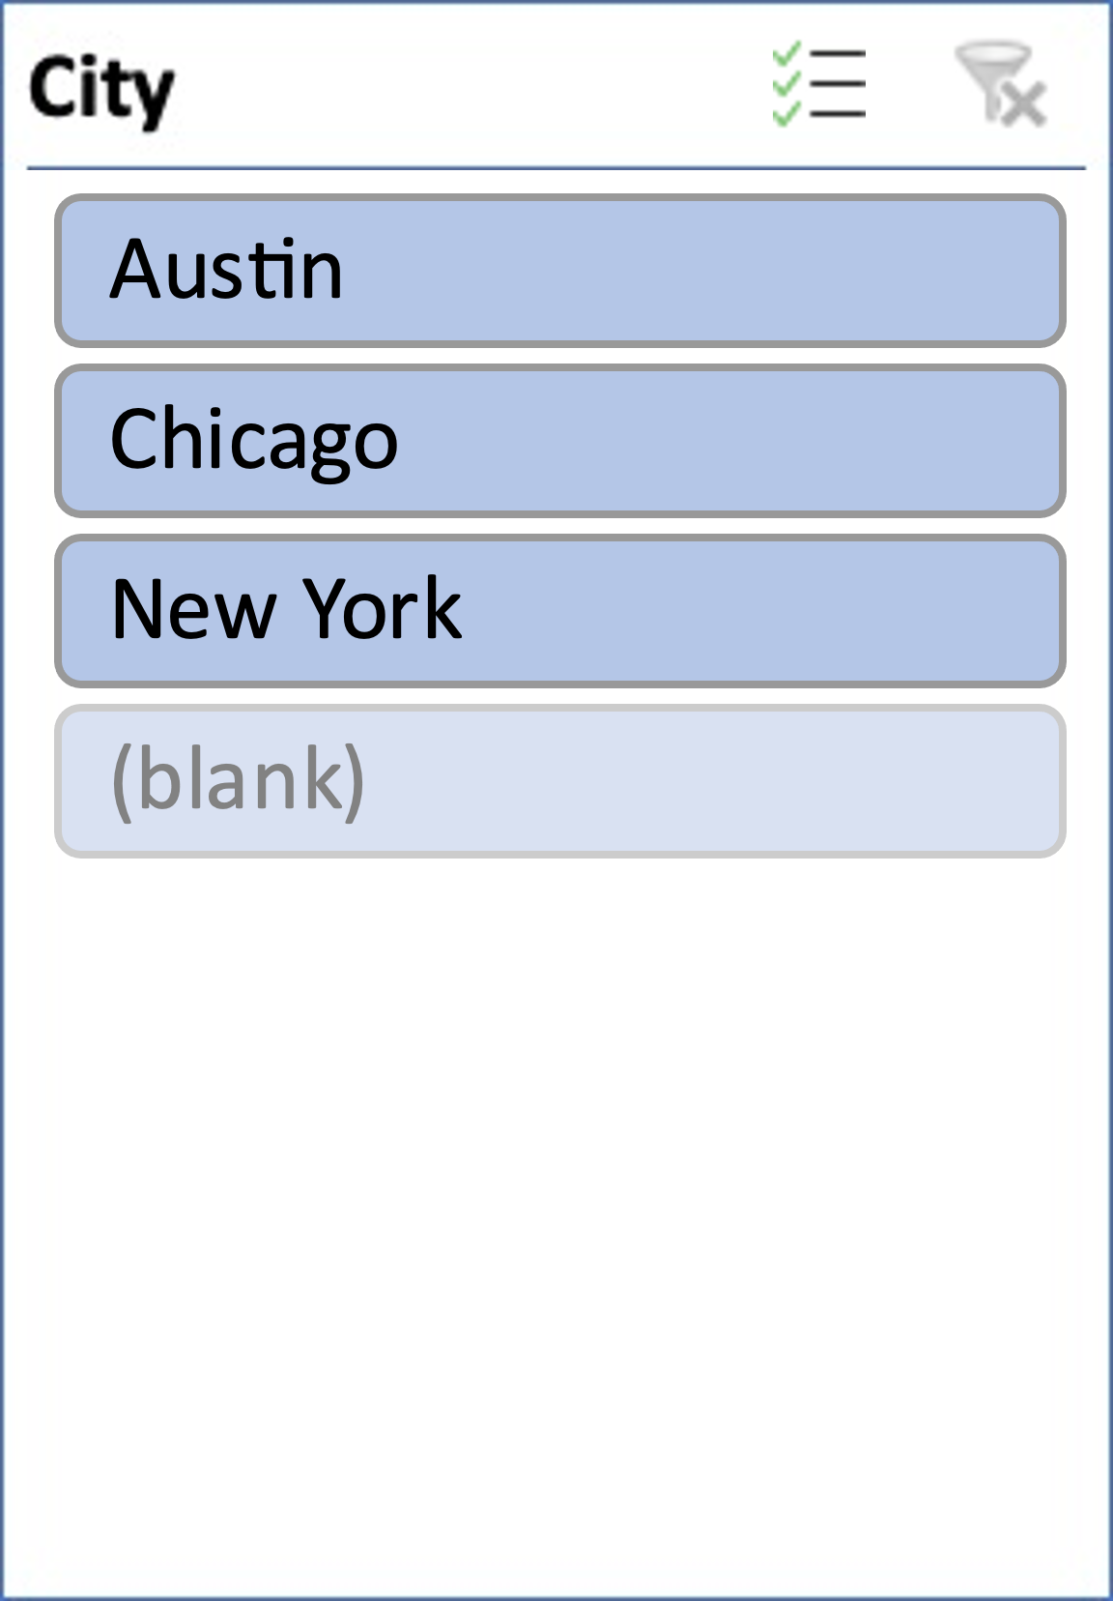
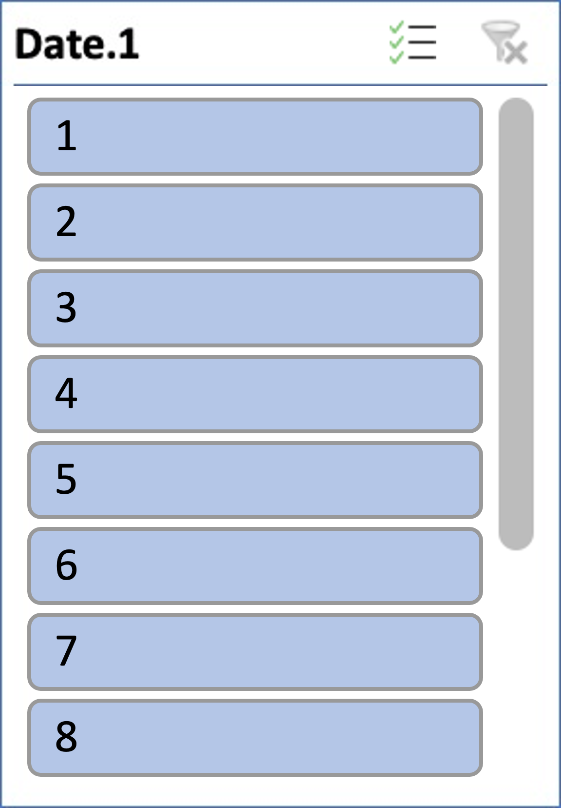
Rush Hour Vs Foot traffic across branches
Row Labels | Count of Invoice ID
9 | 50
10 | 61
11 | 48
12 | 50
13 | 60
14 | 49
15 | 51
16 | 51
17 | 45
18 | 45
19 | 53
20 | 63
Grand Total | 626

Slide 7
Member Vs Normal
 | Column Labels
 | Count of Invoice ID |  |  | Sum of Total |  |  | Total Count of Invoice ID | Total Sum of Total
Row Labels | A | B | C | A | B | C
Member | 3454 | 3527 | 3629 | 107586074.8 | 112009662.5 | 115692196.9 | 10610 | 335287934
Normal | 3488 | 3432 | 3470 | 111840651.8 | 107653638.2 | 112000841.2 | 10390 | 331495131
Grand Total | 6942 | 6959 | 7099 | 219426726.6 | 219663300.7 | 227693038.1 | 21000 | 666783065
Branch A : New York
Member : Averagge spend per customer = 107586075/3454
 |  | 31148.3
Normal : Avg. spend per customer = 111840652/3488
 |  | 32064.4
Branch B : Austin
Member : Avg. spend = 112009662/3527
 | 31757.8
Normal : Avg. spend = 107653638/3432
 | 31367.6
Branch C : Chicago
Member : Avg. spend = 115692197/3629
 | 31879.9
Normal : Avg. spend = 112000841/3470
 | 32276.9

Slide 8

Ads for Electronics, Health & Beauty

Slide 9
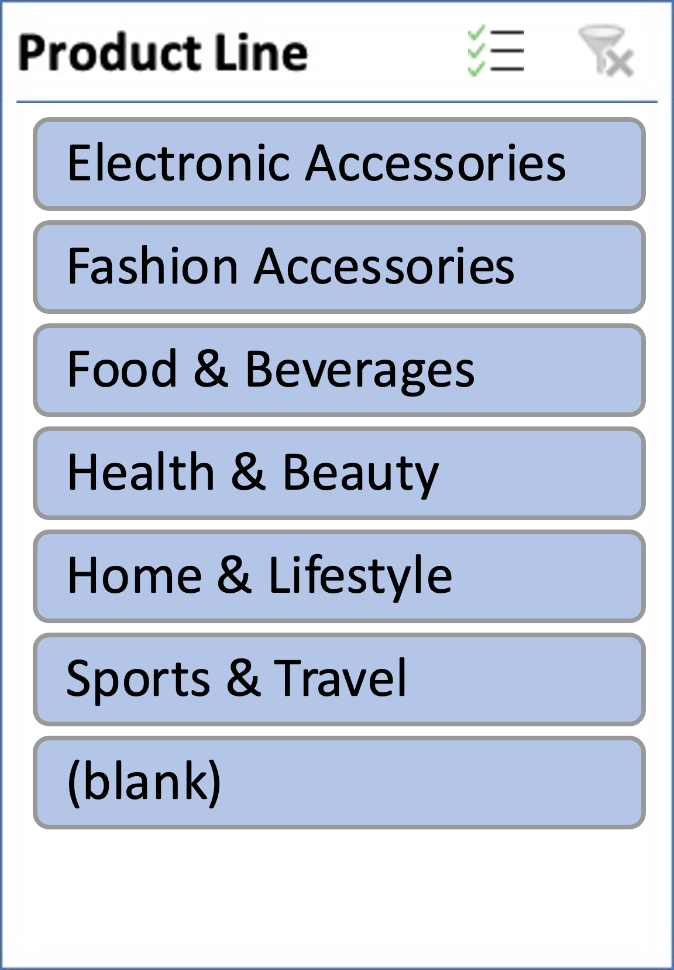

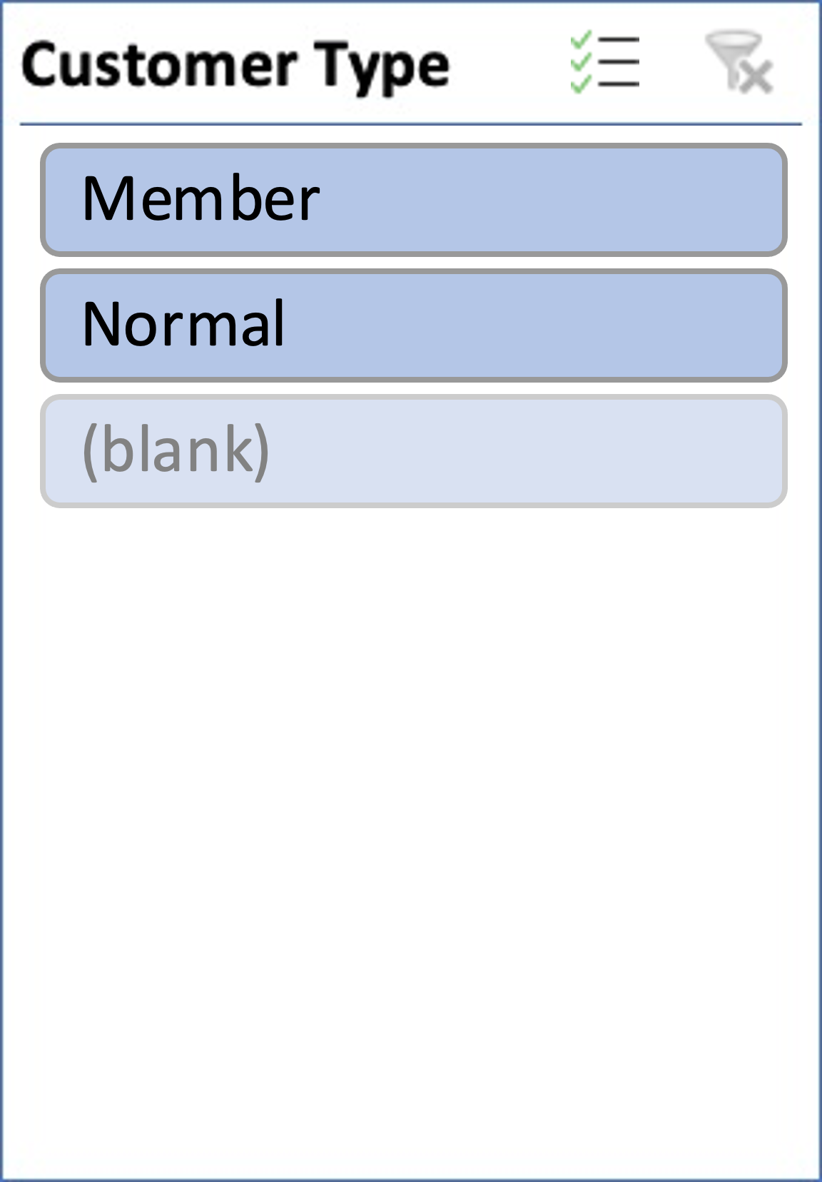
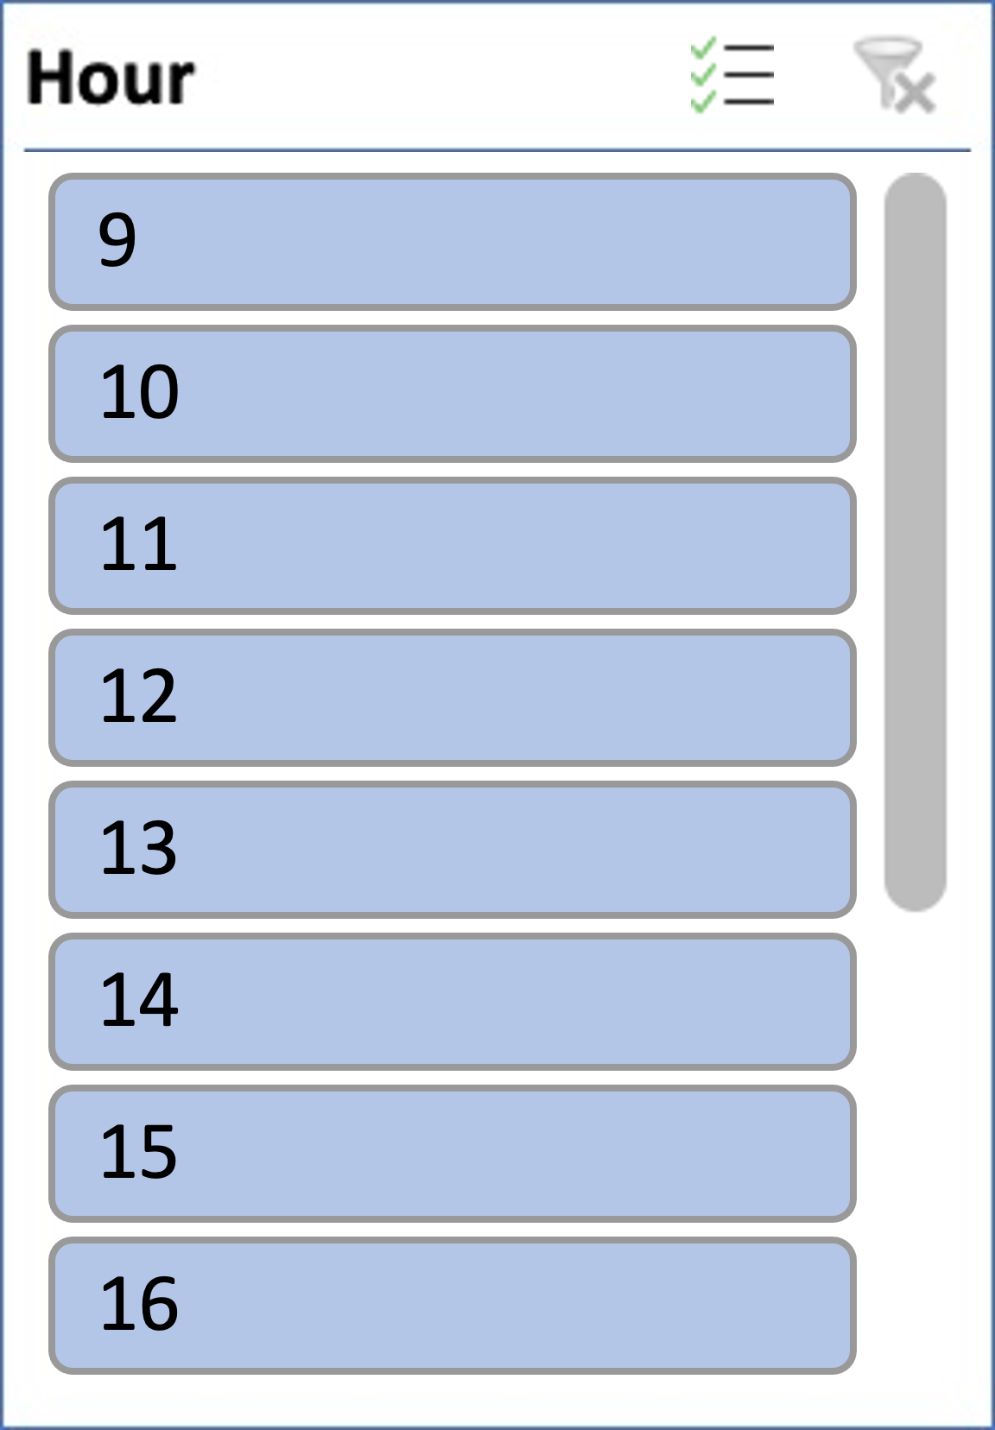
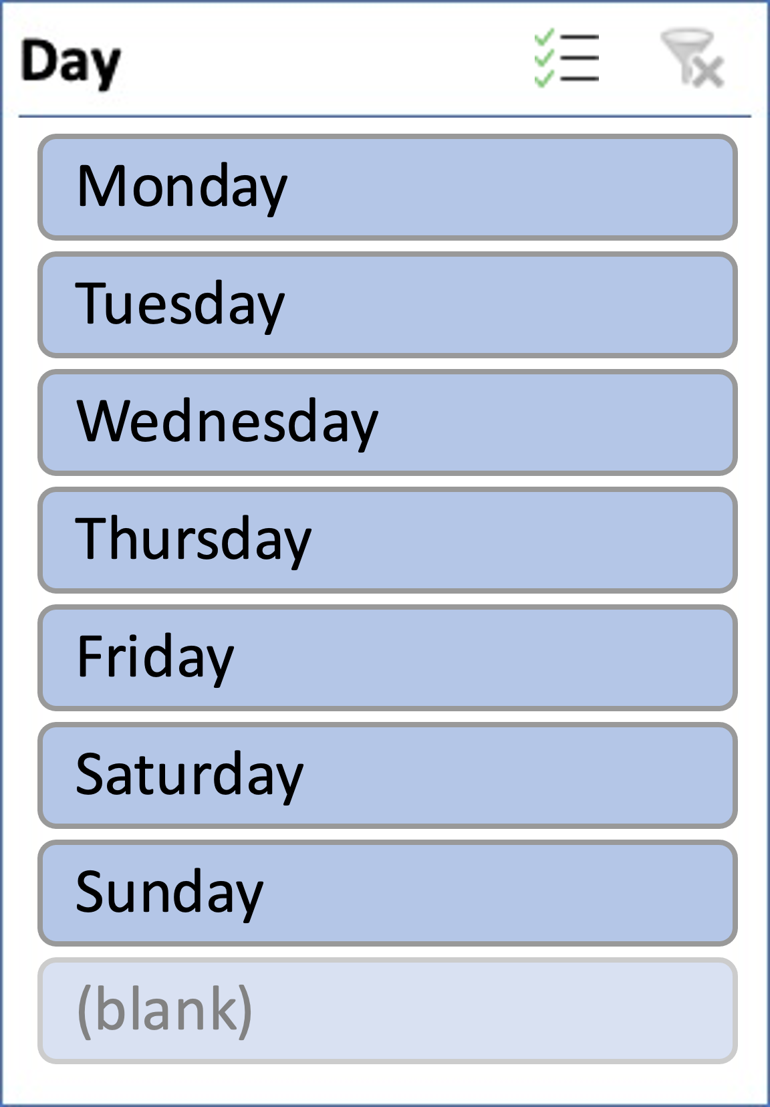
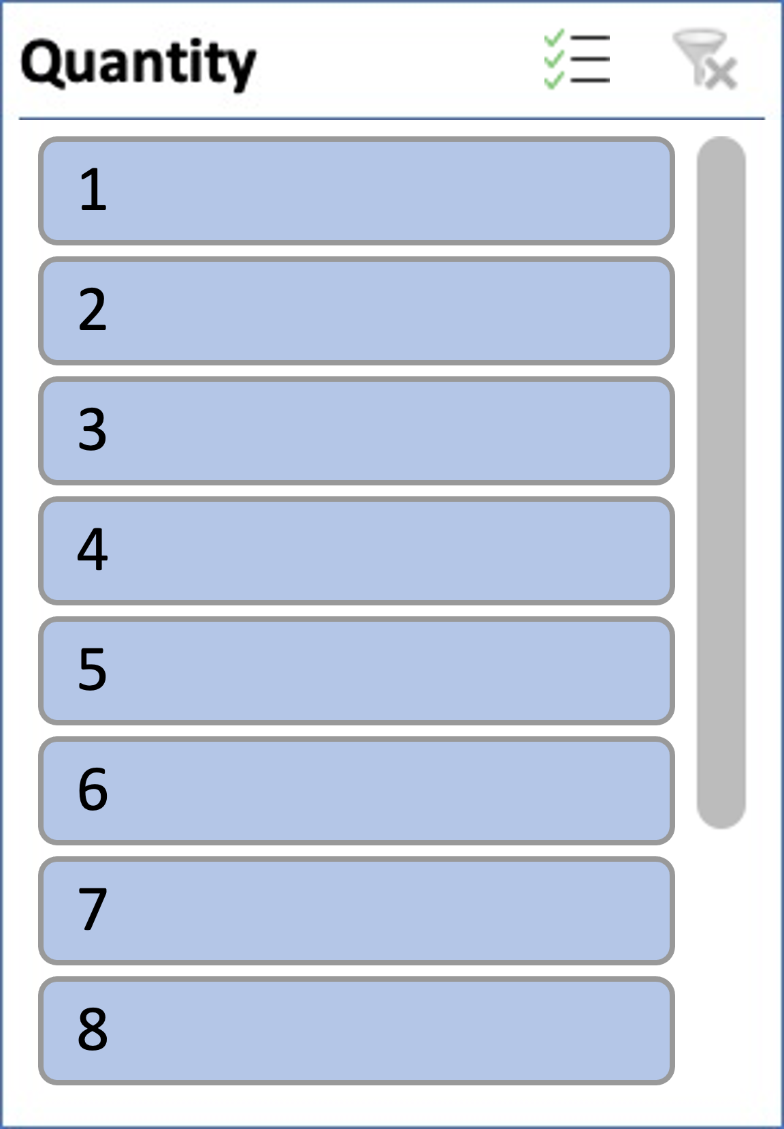
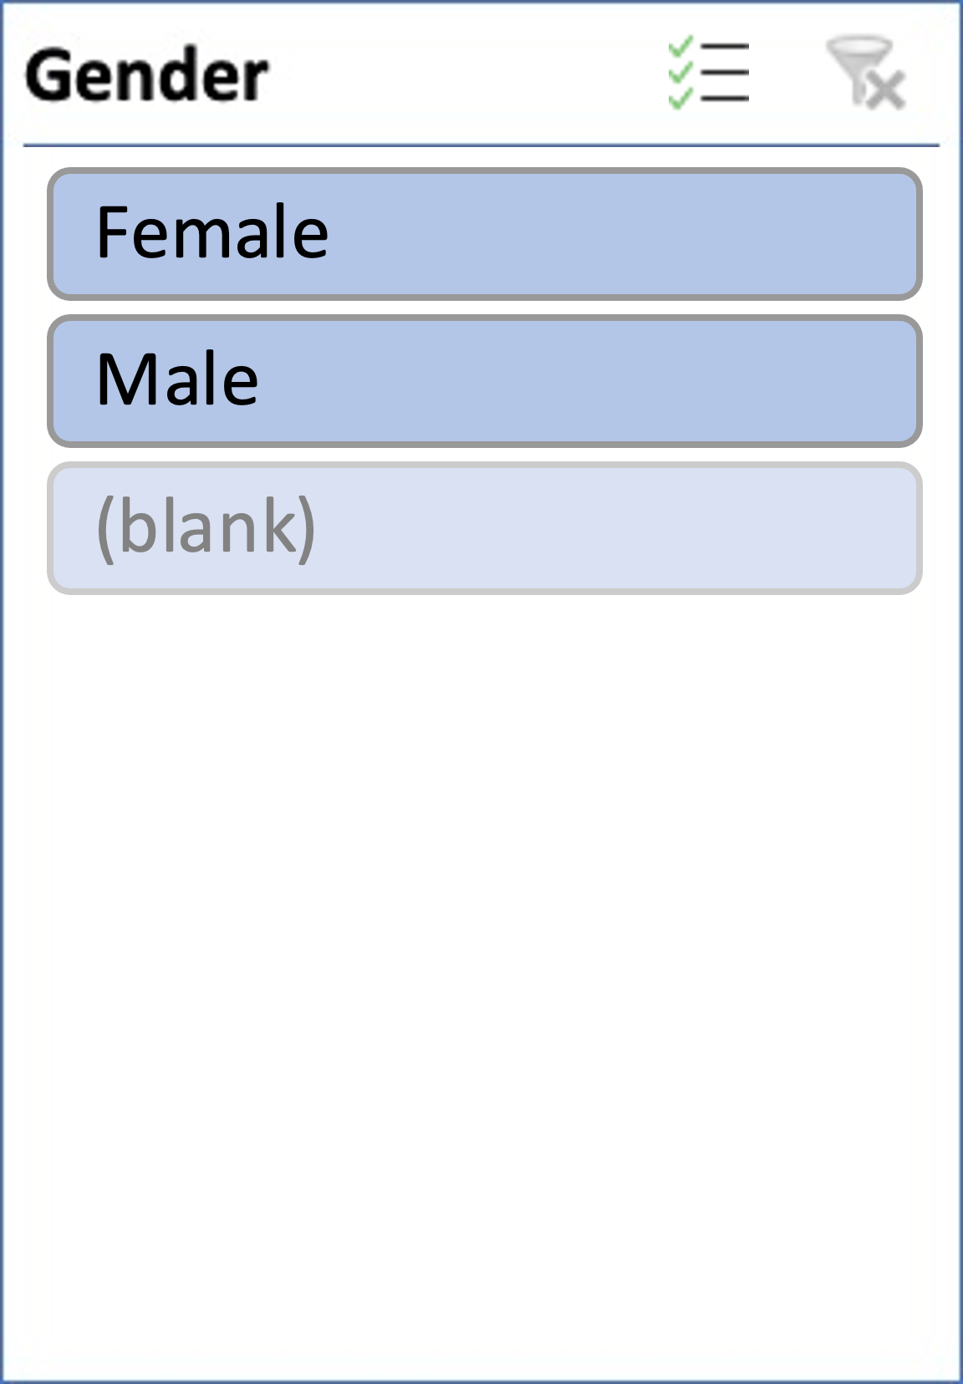
Customer rating

Slide 10
Summary of Findings
Members(Customer Type) have more foot traffic and total amount spent at Austin and Chicago branch but reverse is the case at New York branch.
Austin and New York branch usually have their peak rush hour at 17hrs while Chicago is at 20hrs.
Average Amount spent per customer in New York and Chicago is higher for Normal (Customer type). Only at Austin is average spending per customer higher for Members.
More Male purchased Electronics accessories at Chicago and New York while Health & Beauty products were evenly bought from male and female
Higher satisfaction rate for customers that paid highest amount.
Low ratings appear most on Saturdays followed by Thursdays
The value of Ads budget not available so as to determine ROAS or ROI

Slide 11
Recommendations
Member loyalty program for New York and Chicago branch should be scrapped. The package can be enhanced for Austin branch and observed for another year.
Marketing team should discontinue with the digital ads for Electronics, Health & Beauty products.
Customers should not only be encouraged to rate, but also, to give feedback on their shopping experience so as to easily notice cause of dissatisfaction.
Periodic trainings for staff on best customer relationship practices.
Modern sales software (CRM etc.) should be used to run operations in those three branches.

Slide 12
Conclusion
With this dashboard, we now understand where the supermarket needs to enhance its operation.
Thank You

