Slide 1
Restaurant Automation
Emma Manchester Trevor Kinaman Jodie Burnett
Meghan Hamannwright Arunima Singh

Slide 2
Project Description and Requirements
Record of employees
Managers fire or hire an employee
Menu management
Promotion
Customer Records
Dish promotion & suggestion
Order management
Place an order, update item
Inventory Management

Slide 3
Project Description and Requirements
Functional Use-Cases
Process hiring an employee
Process firing an employee
Process editing employee profile
Employee paycheck
Add inventory
Update or delete inventory
Customer seating
Place order
Record customer’s info
Save customer’s order to their account
Promotions
Record employee shift
Calculate customer tip
Show menu items including specials
Process customer payment
Add/update/remove menu items
Food delivery
Non-functional Requirements
Performance of sale transactions
Accuracy of payroll and business performance
Security of Customer/Employee profiles
Speed of processing and sending orders to the kitchen

Slide 4
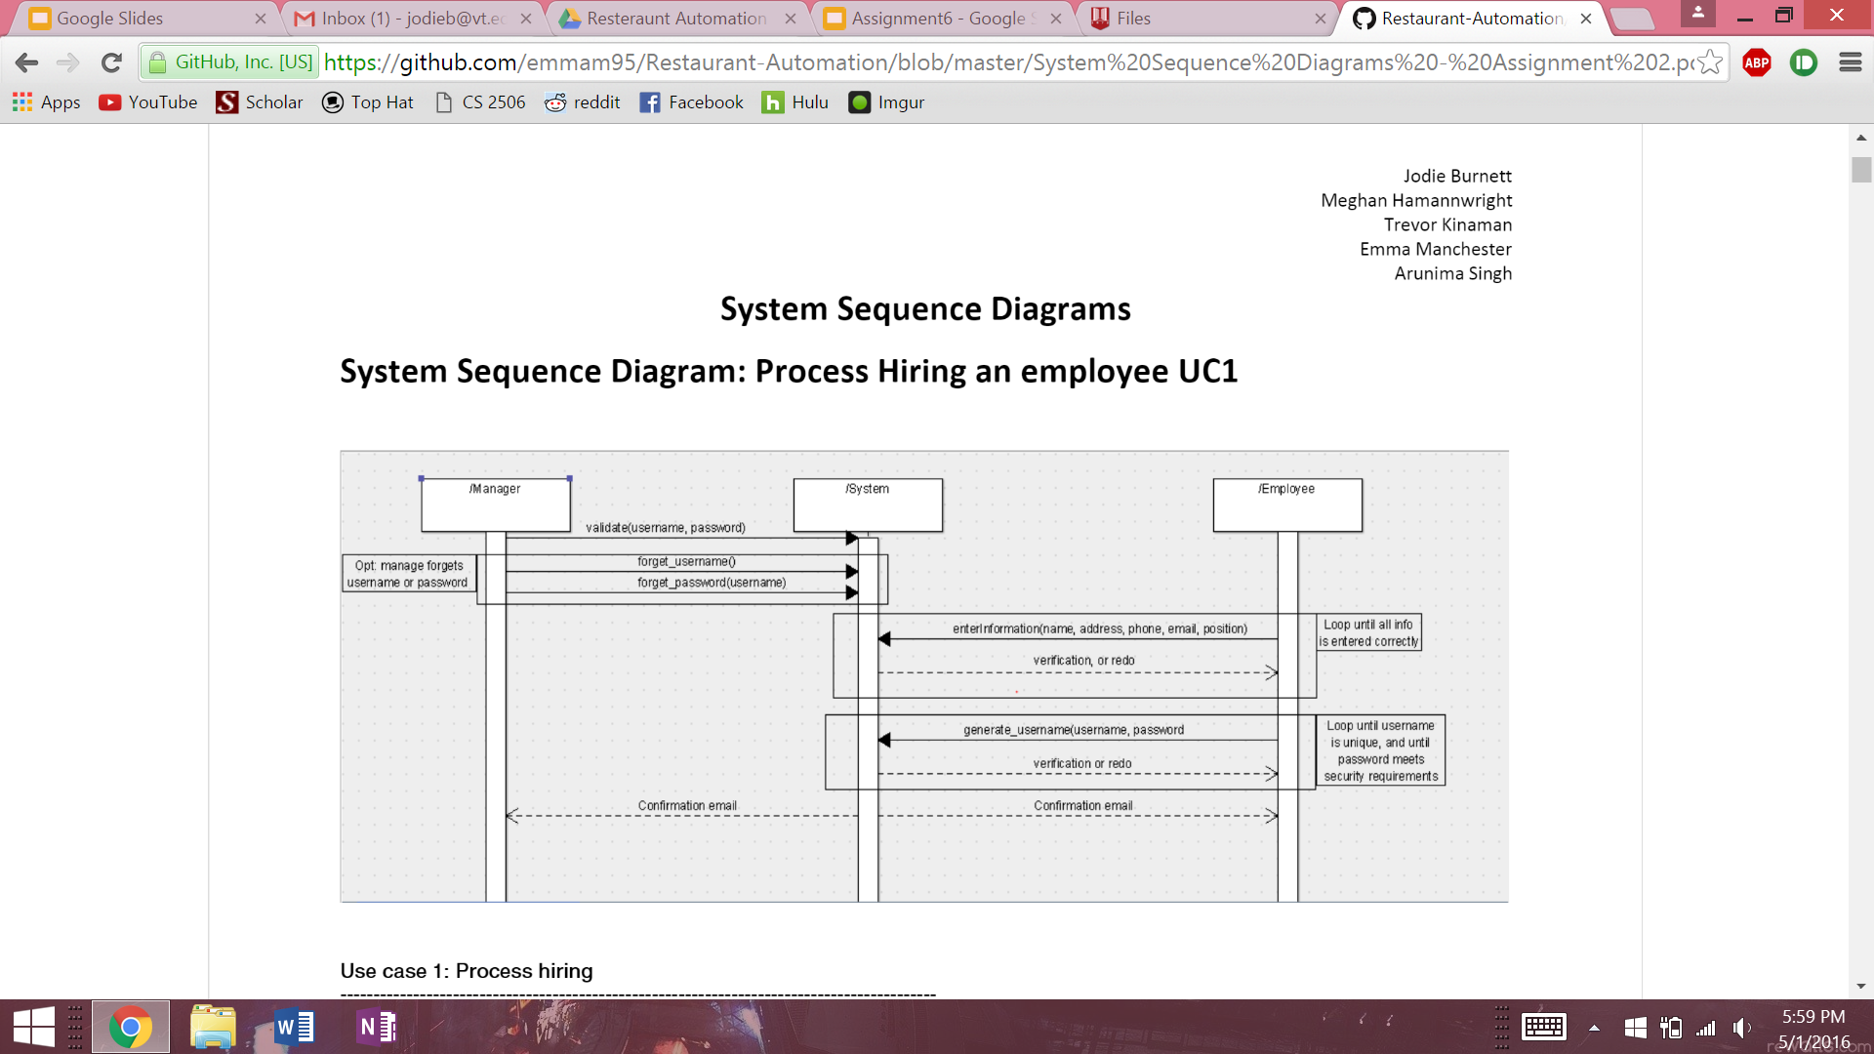
High-level Design -
System Sequence Diagrams
Use Case 1: Process Hiring an Employee

Slide 5
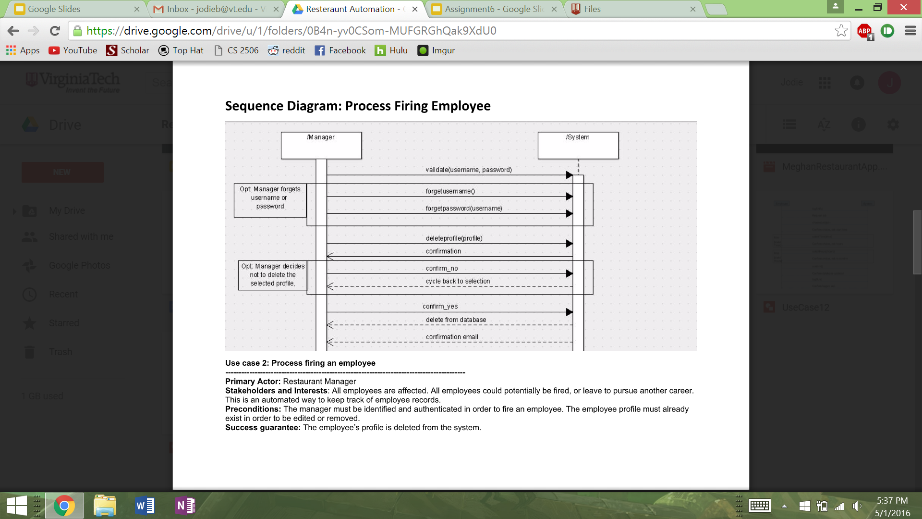
High-level Design -
System Sequence Diagrams
Use Case 2: Process Firing an Employee

Slide 6
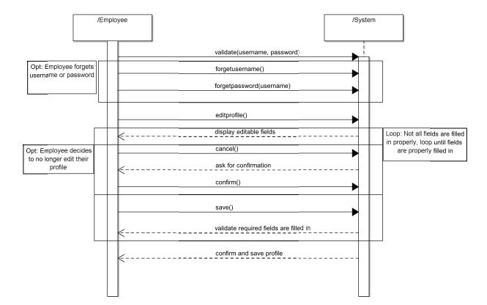
High-level Design -
System Sequence Diagrams
Use Case 3: Edit Employee Profile

Slide 7
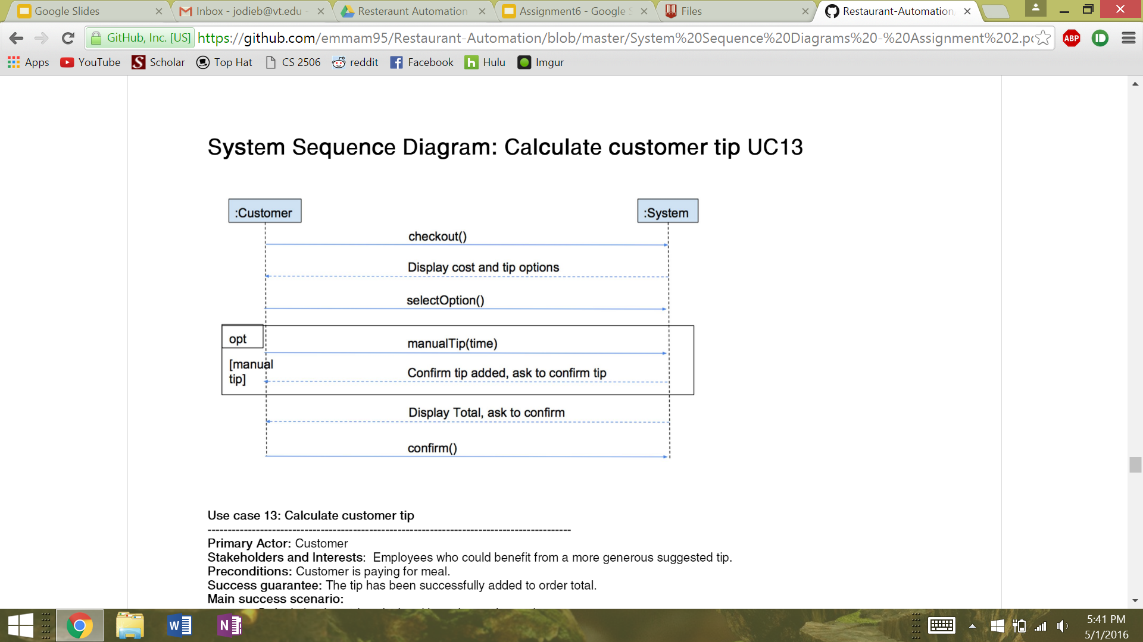
High-level Design -
System Sequence Diagrams
Use Case 4: Calculate Customer Tip

Slide 8
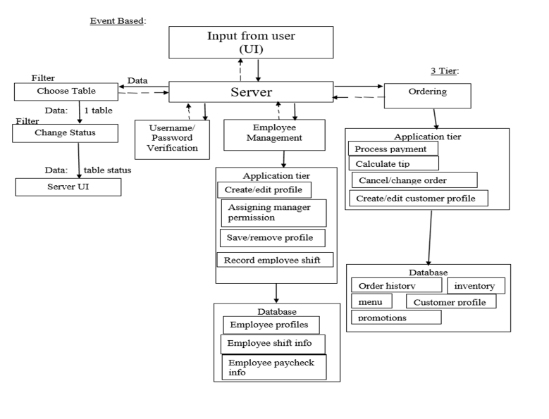
High-Level Design: Architecture Diagram

Slide 9
Detailed Design

Slide 10
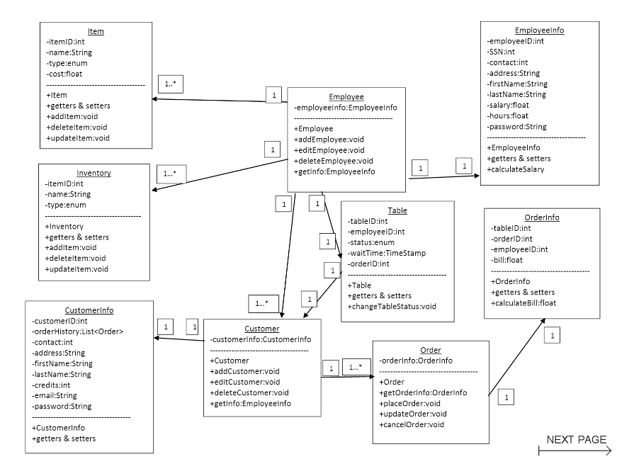
Detailed Design - Class Diagram

Slide 11
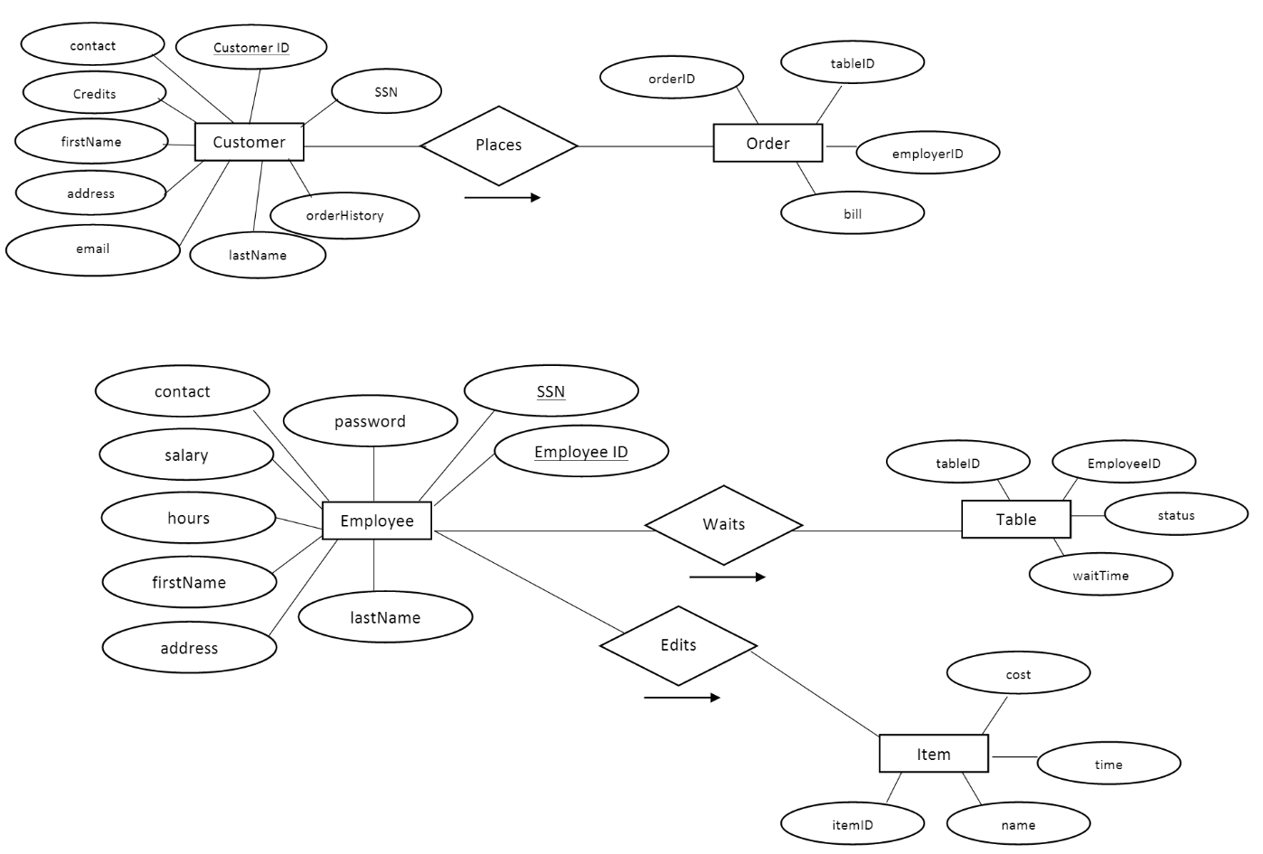
Entity-Relationship Diagram

Slide 12
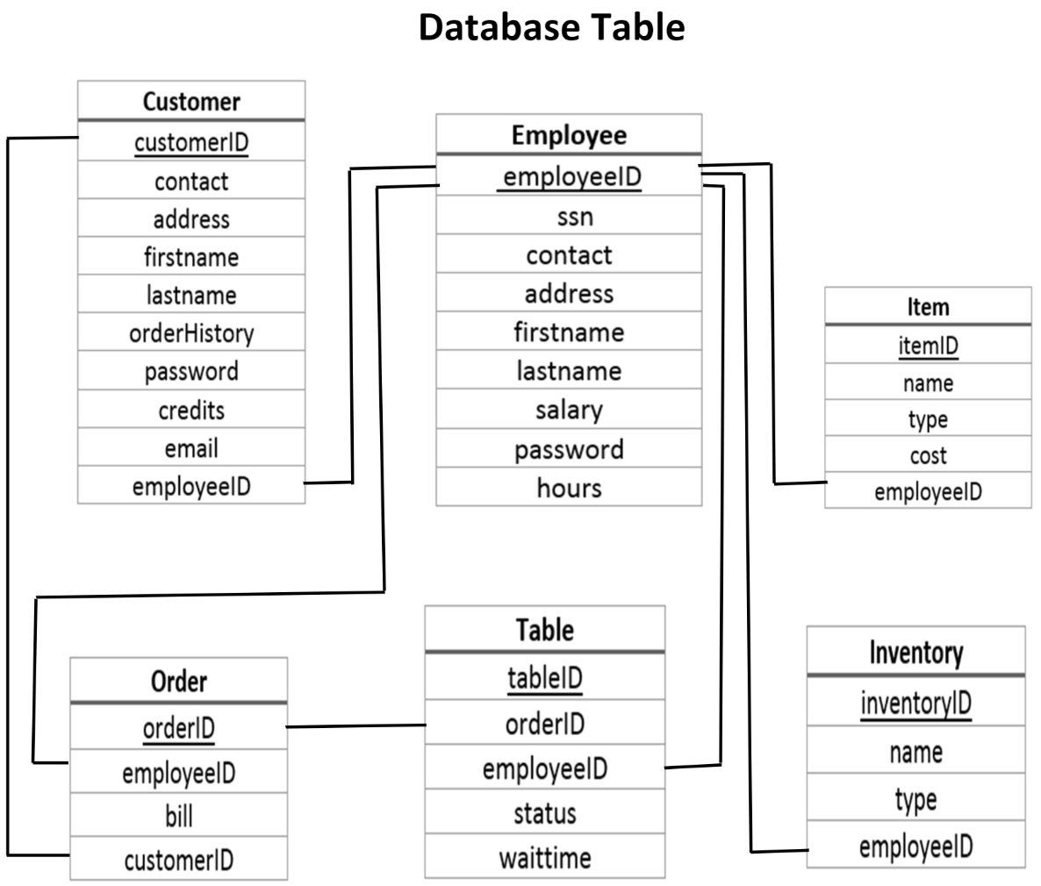
Database Tables

Slide 13
Demo

Slide 14
Questions?

