Slide 1
Reach
Group 11
Fearghal O’Boyle, Donal Doherty and Emma Mason

Slide 2
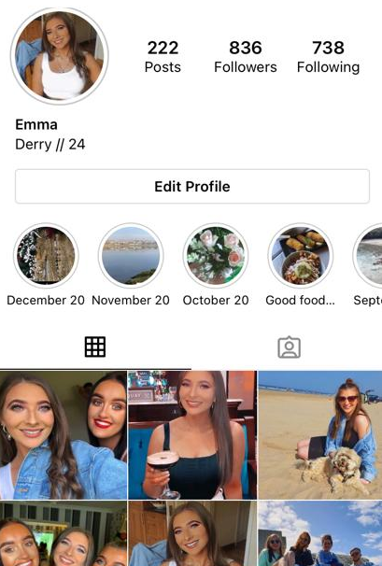
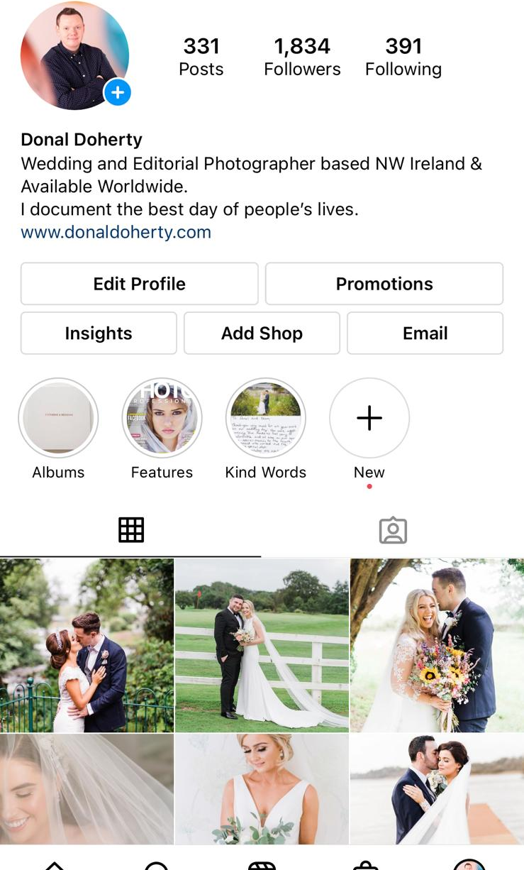
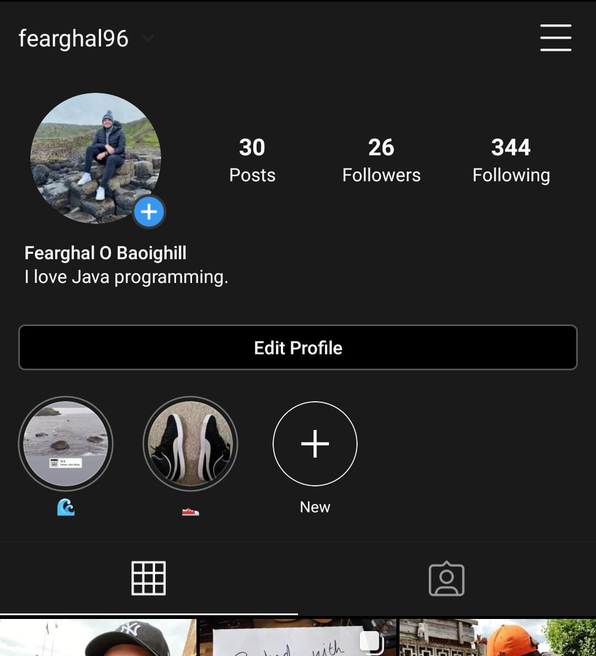
Who are we?
Fearghal O’Boyle
@fearghal96
Emma Mason
@emmamasonn_
Donal Doherty
@donaldoherty

Slide 3
Reach
Our team came up with the concept for an analytics tool for Instagram called ‘Reach’.
Reach equips the user with strategies to grow their account, and as more tips are fed into the program it gets better and better with time.
Reach provides personalised advice for Instagram users on how to improve their interaction in the Instagram community.
Both casual Instagram users as well as professional influencers can benefit from what Reach has to offer.

Slide 4
Development Methodology
An organised approach to development was essential.
Agile approach.
Utilised sprints where tasks split into chunks and distributed.
Planning meetings.
Daily meetings during sprints.
Sprint review meetings.

Slide 5
Concept Analysis
Reach was designed with the needs of the end user at the forefront
A Professional influencer object with unique features.
Login and registration feature.
A Casual user object with unique features.
Store user input.
Exception handling to handle input errors.
Customised user experience.

Slide 6
Requirements
1600 Likes
Reach is an Instagram Insights tool designed to help users grow their tribe and turn followers into clients. Currently, to our best knowledge, there is no fit for purpose system to offer this.
Reach provides the user with a rank and depending on the rank either asks for or provides a tip on how to grow your account.
The tool segments users into those who use Instagram for fun, Casual Users and those who use it for business, Pro Users.
Experience is tailored to their needs with Casual Users receiving tips and unique follower interaction analytics and Pro Users empowered to provide tips should their account be performing well.
Reach provides an analysis of statistics, a rank to motivate users to perform better and guidance on how to improve the performance of your account.
Reach aims to be a powerful marketing aid to expand the user’s presence and visibility.
6

Slide 7
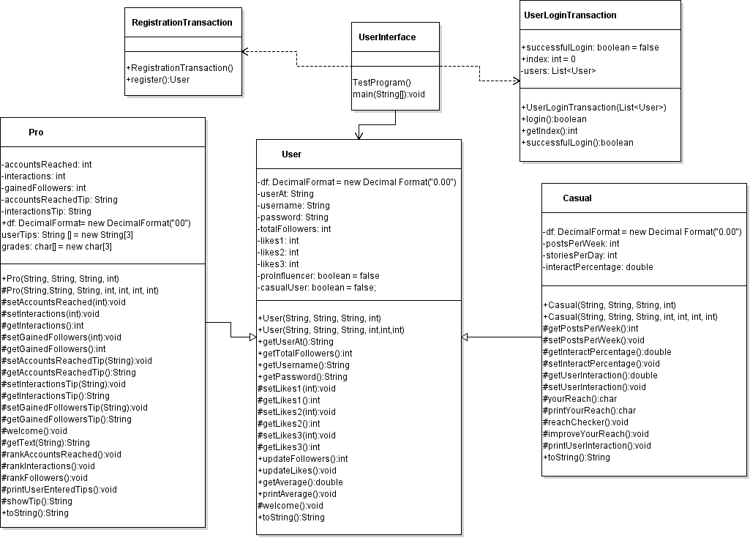
Design
A series of different design approaches were used to help us understand our system and see how our end user can interact with the program.
Preparation sheets were used before developing each part of code, and a UML class diagram, outlined here, was used to model the static view of our program.

Slide 8
Member Involvement
 | Design | Code | Test | Demo | Presentation
Donal Doherty | Came up with Reach idea. Provided Instagram insight data. Class diagram. | User class. User interface. Method in read class. | Tested overall completed code for user readability and friendliness. | Initial user menu demo. Registration of new user. | Requirements Future improvements What is Reach?
Fearghal O’Boyle | Came up with Reach idea. Classes. Program preparation sheets. Class diagram. | User class. Pro class. User interface Method in user registration. | TCase_30-49. (See Appendix A) | Pro user menu. Login as pro user and demonstrate options. | Development methodology Concept Final Product
Emma Mason | Program preparation sheets Class diagram User case diagram | Casual class. Read class. LoginTransaction class RegistrationTransation class. | TCase_1-29. (See Appendix A) | Casual user menu. Login as casual user and demonstrate options. | Design Testing Member Involvement

Slide 9
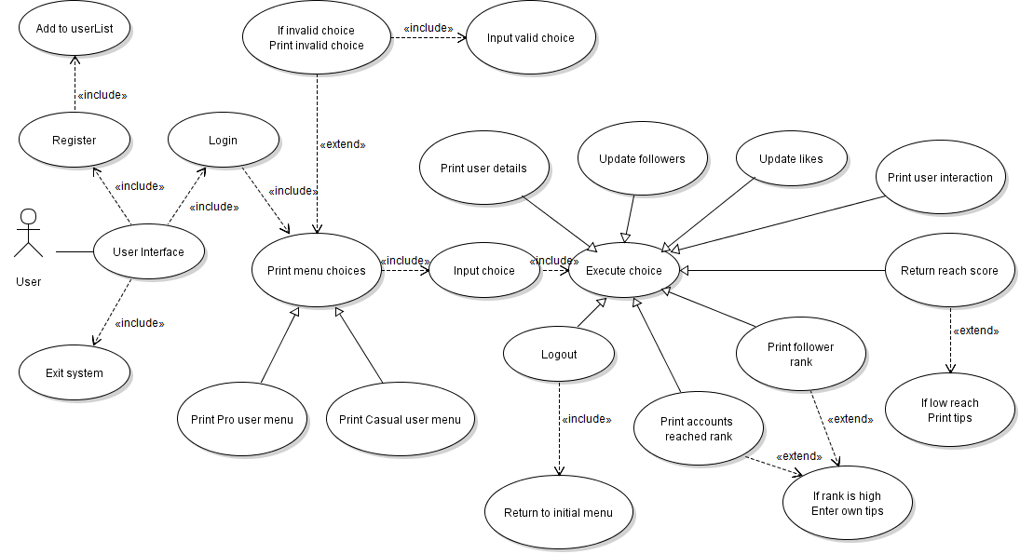
Testing
A vigorous testing regime was used for Reach.
Initially Donal, went through the program, checking for user accessibility and input.
Fearghal and Emma then went through each aspect of the user interface, creating test cases based off of our use case diagram, shown below.
The testing brought some errors and mistakes to light but overall it confirmed the reliability of our system.
Test case ID | Objective | Preconditions | Test data | Expected Result | Test completion date | Status | Tester | Comments
TCase_1 | Check if entering 3 into the console will end the code | The user is on the initial menu on the UserInterface class | Entering option ‘3’. | Code will print a thank you message and will exit with exit code 0. | 05/12/20 | Passed | Emma Mason

Slide 10
Peer to peer learning
I learned many things from my fellow group members during our group project. One example would be how to effectively collaborate with others using websites such as GitHub and services such as Discord. We used these services daily to meet, discuss code and use the share screen function to help debug each others work.
- Fearghal
Working as a group helped me experience coding collaboration and learn how to improve my own code through peer review. Both Donal and Fearghal provided me with an invaluable experience through our communication, seeing their styles of working and bettered my coding practice.
- Emma
I learned several areas of coding practice including user defined classes and arrays. Pulling on the strong knowledge of coding of my team helped me advance my own practice.
- Donal

Slide 11
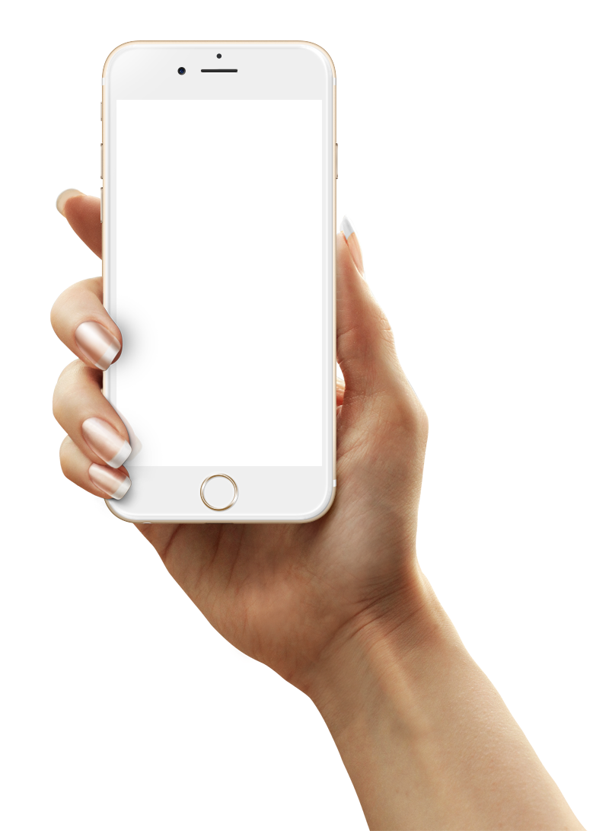
Final Product
Reach
An Instagram Analytics Tool
The Reach program, through organised development, preparation, teamwork, and communication, has evolved into a fully functioning application.
The feature of providing statistics for not only professional influencers but also casual users, gives Reach a unique selling point and exclusive information for the user.
The use of user accounts provides a personalised experience for the user with high functionality.
This collaborative experience has allowed for all group members to improve their skills holistically.
Together the group worked effectively and efficiently to produce a high-quality program which utilises a range of coding techniques.

Slide 12
Future Improvements
1
Improve user friendliness
2
Exception handling
In future we hope to create more personalised prompts for the end user.
We have made use of exception handling for Strings, however in future we would like to add this for integers.
Reach
3
File handling
4
Advance tips and feedback
Make use of storage of new users who register whilst using the system.
Add more tips and feedback for the user as the program grows.

Slide 13
Demonstration and Questions

