Slide 1
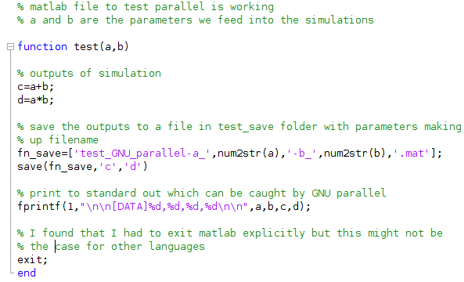
Input parameters ‘a’ and ‘b’
Execute some commands to be saved to a file
Save simulation output to a specific file
Display simulation output

