Slide 1


HELLO WELCOME TO PETCODESHOP ENJOY!
INTRODUCTION
Petcodeshop is a program that will help you in terms of choosing a best quality of pet. Also a stress reliever for you. If you love animals then, this program is for you.
next

Slide 2

LIFE IS BETTER WITH PETS
next

Slide 3



search or type url
Petshop.com

Slide 4
www.petcodeshop
Menu
Register
Login
Forget Credential
Shop

Slide 5
www.petcodeshop
Create my account
Please fill the information below :
Enter username:
iman
Password:
12345
Enter
Menu

Slide 6
Registration is Successful
back
continue

Slide 7
www.petcodeshop
LOG IN
Username :
iman
Password:
12345
Log in
Menu

Slide 8
login is Successful
back
continue

Slide 9
www.petcodeshop
Search your account by username
Search your account by password
Menu

Slide 10
Enter your remembered username: iman
Congrats Account Found
Password is: 12345
back
continue

Slide 11
Enter your remembered Password: 12345
Congrats Account Found
Username is: iman
back
continue

Slide 12
www.petcodeshop
Welcome to Petshop
Enter your username:
iman
Password:
12345
Enter
Menu

Slide 13
www.petcodeshop
Cashier : Nicole
Proceed to the list of pets
Present [Y] for Yes and [N] for no

Slide 14
THANK YOU TO RESPOND
back
continue

Slide 15



www.petcodeshop.com
Pet’s Code shop
List of Pets
Rabbit
1.MINI REX php 450.00
2.Holland lop php 350.00
3.MINI LOP php 350.00
4.LION HEAD RABBIT php 500.00
5.LOP RABBIT php 300.00
continue

Slide 16
www.petcodeshop.com
Pet’s Code shop
List of Pets
Dog
6.Shit-tzu php 5000.00
7.Pug php 8000.00
10.Pomeranian php 10000.00
8.Siberian Husky php 15000.00
11.Beagle php 10000.00
9.Labrador Retriever php 25000.00
12.Chihuahua php 15000.00
Back
continue

Slide 17
www.petcodeshop.com
Pet’s Code shop
List of Pets
Cat
13.Persian Cat php 5000.00
14.Siamese Cat php 8000.00
17.Russian Blue php 8000.00
15.Himalayan Cat php 7000.00
18.American Curl php 4000.00
16.Exotic Shorthair php 10000.00
19.American Shorthair php 6000.00
Back
continue

Slide 18
www.petcodeshop.com
Pet’s Code shop
List of Pets
Fish
20.Betta fish php 500.00
21.Flower horn php 800.00
22.Gold fish php 150.00
23.Guppy php 150.00
24.Molly php 150.00
Back

Slide 19
www.petcodeshop.com
What kind of pets would you buy:
1
Back
Next

Slide 20
www.petcodeshop.com
What kind of pets would you buy:
2
Back
Next

Slide 21
www.petcodeshop.com
What kind of pets would you buy:
3
Back
Next

Slide 22
www.petcodeshop.com
What kind of pets would you buy:
4
Back
Next

Slide 23
www.petcodeshop.com
What kind of pets would you buy:
5
Back
Next

Slide 24
www.petcodeshop.com
What kind of pets would you buy:
6
Back
Next

Slide 25
www.petcodeshop.com
What kind of pets would you buy:
7
Back
Next

Slide 26
www.petcodeshop.com
What kind of pets would you buy:
8
Back
Next

Slide 27
www.petcodeshop.com
What kind of pets would you buy:
9
Back
Next

Slide 28
www.petcodeshop.com
What kind of pets would you buy:
10
Back
Next

Slide 29
www.petcodeshop.com
What kind of pets would you buy:
11
Back
Next

Slide 30
www.petcodeshop.com
What kind of pets would you buy:
12
Back
Next

Slide 31
www.petcodeshop.com
What kind of pets would you buy:
13
Back
Next

Slide 32
www.petcodeshop.com
What kind of pets would you buy:
14
Back
Next

Slide 33
www.petcodeshop.com
What kind of pets would you buy:
15
Back
Next

Slide 34
www.petcodeshop.com
What kind of pets would you buy:
16
Back
Next

Slide 35
www.petcodeshop.com
What kind of pets would you buy:
17
Back
Next

Slide 36
www.petcodeshop.com
What kind of pets would you buy:
18
Back
Next

Slide 37
www.petcodeshop.com
What kind of pets would you buy:
19
Back
Next

Slide 38
www.petcodeshop.com
What kind of pets would you buy:
20
Back
Next

Slide 39
www.petcodeshop.com
What kind of pets would you buy:
21
Back
Next

Slide 40
www.petcodeshop.com
What kind of pets would you buy:
22
Back
Next

Slide 41
www.petcodeshop.com
What kind of pets would you buy:
23
Back
Next

Slide 42
www.petcodeshop.com
What kind of pets would you buy:
24
Back
Next

Slide 43
www.petcodeshop.com
HOW MANY:
1
Back
Next

Slide 44
www.petcodeshop.com
HOW MANY:
1
Back
Next

Slide 45
www.petcodeshop.com
Do you add pet?:
16. Exotic Shoirhair
Back
Next

Slide 46
www.petcodeshop.com
Do you add pet?:
10. Beagle
Back
Next

Slide 47
www.petcodeshop.com
HOW MANY:
1
Back
Next

Slide 48
www.petcodeshop.com
HOW MANY:
1
Back
Next

Slide 49
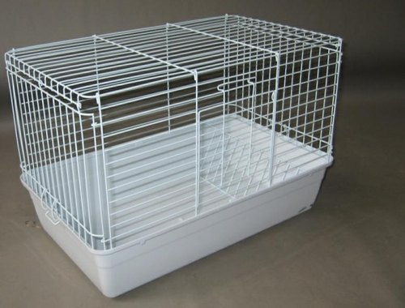
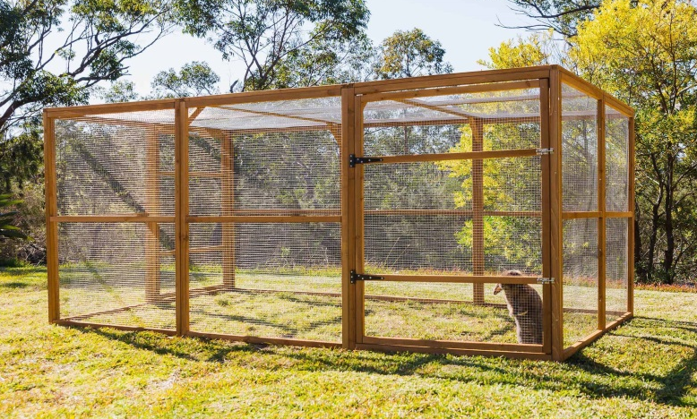
www.petcodeshop
=Cage=
Cage for Dog, Cat and Rabbits
CAGE
1.Small cage php 500-1000
2.Big cage php 2500-3000
Back
Next

Slide 50
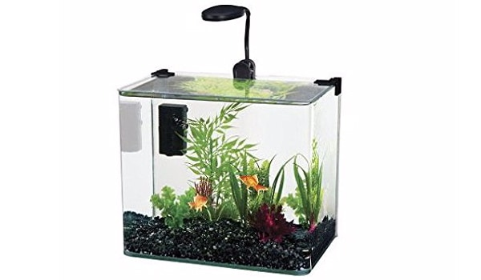
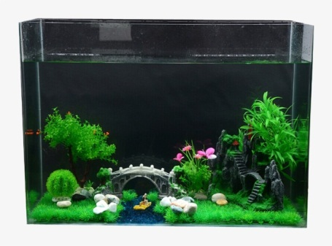
www.petcodeshop
=Aquarium=
Fish
3.Small aquarium php 500-1000
4.Big aquarium php 2500-3000
Back
Next

Slide 51
www.petcodeshop
5.None
Back

Slide 52
www.petcodeshop
=Cage=
Cage for Dog, Cat and Rabbits
CAGE
1.Small cage php 500-1000
2.Big cage php 2500-3000
Back
Next

Slide 53
www.petcodeshop
=Aquarium=
Fish
3.Small aquarium php 500-1000
4.Big aquarium php 2500-3000
Back
Next

Slide 54
www.petcodeshop
5.None
Back

Slide 55
www.petcodeshop.com
What types of cage or aquarium:
1
Back
Next

Slide 56
www.petcodeshop.com
What types of cage or aquarium:
1
Back
Next

Slide 57
www.petcodeshop.com
HOW MANY:
1
Back
Next

Slide 58
www.petcodeshop.com
HOW MANY:
1
Back
Next

Slide 59
www.petcodeshop.com
What types of cage or aquarium:
1
Back
Next

Slide 60
www.petcodeshop.com
HOW MANY:
1
Back
Next

Slide 61
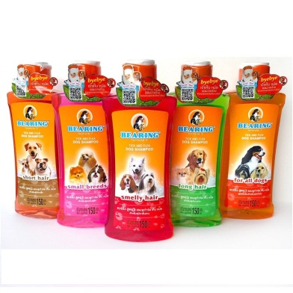
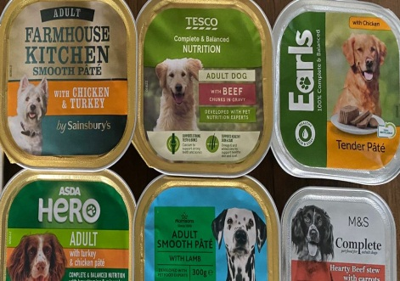
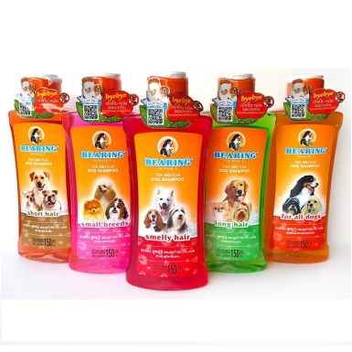
www.petcodeshop
Accessories
Shampoo PHP 500
Food for pet php 2500-3000
None
Back

Slide 62
www.petcodeshop
Accessories
Shampoo PHP 500
Food for pet php 2500-3000
None
Back

Slide 63
www.petcodeshop.com
What accessories you need to buy:
1
Back
Next

Slide 64
www.petcodeshop.com
What accessories you need to buy:
1
Back
Next

Slide 65
www.petcodeshop.com
How many?:
1
Back
Next

Slide 66
www.petcodeshop.com
How many?:
1
Back
Next

Slide 67
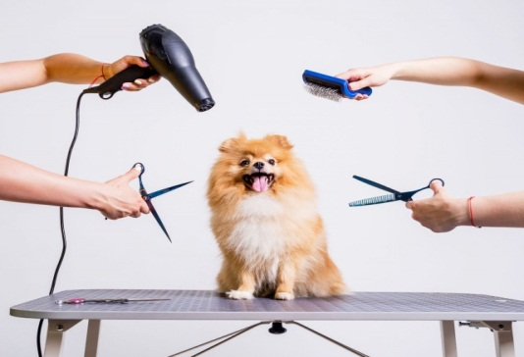
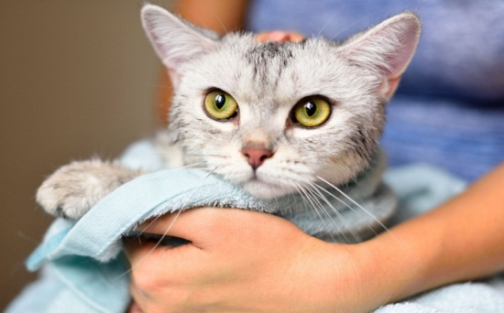
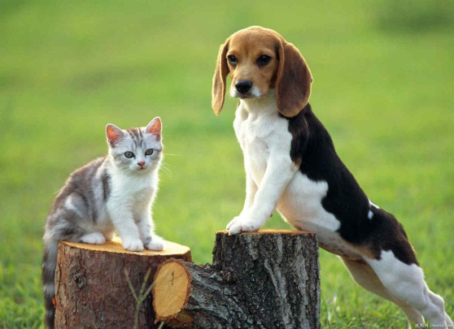
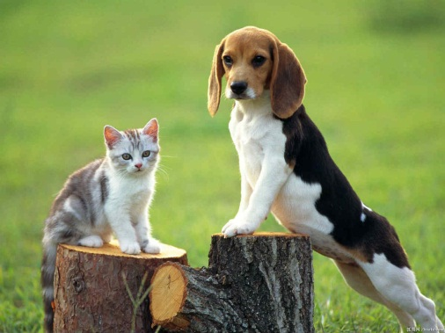
www.petcodeshop.com
SERVICES
Grooming php 1000
Bathing php 300
Dog and Cat Training php 1500.00
Back
Next

Slide 68
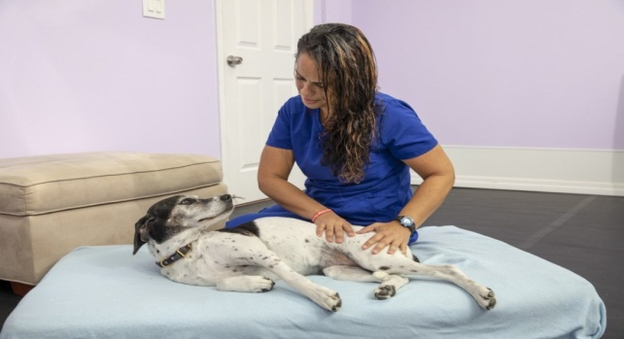
www.petcodeshop.com
SERVICES
Pet Message Therapy PHP 800.00
None
Back

Slide 69
www.petcodeshop.com
SERVICES
Grooming php 1000
Bathing php 300
Dog and Cat Training php 1500.00
Back
Next

Slide 70
www.petcodeshop.com
SERVICES
Pet Message Therapy PHP 800.00
None
Back

Slide 71
www.petcodeshop.com
What Services do you need:
1
Back
Next

Slide 72
www.petcodeshop.com
What Services do you need:
1
Back
Next

Slide 73
www.petcodeshop.com
How many?:
1
Back
Next

Slide 74
www.petcodeshop.com
How many?:
1
Back
Next

Slide 75
a
www.petcodeshop.com
AMOUNT TO BE PAID:14250
YOUR CASH IS:P20000
Back
Next

Slide 76
www.petcodeshop.com
a
AMOUNT TO BE PAID:23800
YOUR CASH IS:P30000
Back
Next

Slide 77
www.petcodeshop.com
Discount
DO YOU HAVE SENIOR ID:
No
Yes

Slide 78
www.petcodeshop.com
Discount
DO YOU HAVE SENIOR ID:
No
Yes

Slide 79
www.petcodeshop.com
Discount
Enter your name: iman
Enter your Age:64
Enter your Senior ID:123456
Enter bill amount:20,000
Back
Yes

Slide 80
www.petcodeshop.com
Discount
Enter Discount percentage:20%
After discount yourbill is: 16,000
Back
Yes

Slide 81
www.petcodeshop.com
Payment Option
BDO
BPI
Gcash
Cash
Back

Slide 82
www.petcodeshop.com
BDO
Transfer amount
16,000
Please enter your bank account number or Gcash Number: 123456
Back
Enter

Slide 83
www.petcodeshop.com
BPI
Transfer amount
16,000
Please enter your bank account number or Gcash Number: 123456
Back
Enter

Slide 84
www.petcodeshop.com
Gcash
Gcash name:PETCODESHOP
Gcash number: 09182354904
Please enter your bank account or Gcash Number:09955883119
Back
Enter

Slide 85
www.petcodeshop.com
Cash
This payment will received by: pet code shop
Your change is:5750
Back
Enter

Slide 86
www.petcodeshop.com
OFFCIAL Receipt
-Pets code shop-
Your ordered for number:
Cash: p 20000
Total quantity 6
Change: p 5750
Total:14250
Thank you please come again!
Back
Enter

Slide 87
www.petcodeshop.com
Also try our other Services
1.Grooming p 1000
2.Bathing p 800
3.Dog and Cats Training p 1500
4.Pets Massage Therapy p 900
Back
Enter

Slide 88
www.petcodeshop.com
WE ACCEPT ALL KINDS OF OCCASIONS
For *orders comment or suggestion please contact:09169475449
Email: petcodeshop@yahoo.com
Back
Enter

Slide 89
www.petcodeshop.com
Discount
Enter your name: iman
Enter your Age:64
Enter your Senior ID:123456
Enter bill amount:30,000
Back
Yes

Slide 90
www.petcodeshop.com
Discount
Enter Discount percentage:20%
After discount yourbill is: 24,000
Back
Yes

Slide 91
www.petcodeshop.com
Payment Option
BDO
BPI
Gcash
Cash
Back

Slide 92
www.petcodeshop.com
BDO
Transfer amount
16000
Please enter your bank account number or Gcash Number: 123456
Back
Enter

Slide 93
www.petcodeshop.com
BPI
Transfer amount
16000
Please enter your bank account number or Gcash Number: 123456
Back
Enter

Slide 94
www.petcodeshop.com
Gcash
Gcash name:PETCODESHOP
Gcash number: 09182354904
Please enter your bank account or Gcash Number:09955883119
Back
Enter

Slide 95
www.petcodeshop.com
Cash
This payment will received by: pet code shop
Your change is:5750
Back
Enter

Slide 96
www.petcodeshop.com
OFFCIAL Receipt
-Pets code shop-
Your ordered for number:
Cash: p 30000
Total quantity 6
Change: p 6200
Total:23,800
Thank you please come again!
Back
Enter

Slide 97
www.petcodeshop.com
Also try our other Services
1.Grooming p 1000
2.Bathing p 800
3.Dog and Cats Training p 1500
4.Pets Massage Therapy p 900
Back
Enter

Slide 98
www.petcodeshop.com
WE ACCEPT ALL KINDS OF OCCASIONS
For *orders comment or suggestion please contact:09169475449
Email: petcodeshop@yahoo.com
Back
Enter

Slide 99
www.petcodeshop.com
Thank you
Enter

Slide 100
www.petcodeshop.com
Thank you
Enter

