Slide 1

LEarning to Code
Coordinator: Konstantinos Emmanouilidis
ΙΕΕΕ SB of thrace
2017-2018

Slide 2

What is Python?
Variables
String Functions
Casting
Basic Operators
Input & Output
Decision Making

Slide 3
What is python ?
object-oriented
interpreted
high-level programming language with dynamic semantics.
Useful modules and packages
Lot’s of libraries….

Slide 4
What is Python?
Variables
String Functions
Casting
Basic Operators
Input & Output
Decision Making

Slide 5

Variables
memory locations to store values
No need for type declaration of a variable
Automatical declaration while assigning values in variables

Slide 6
Variable types
Numbers (Αριθμοί)
store numeric values
Strings (Αλφαριθμητικά)
set of characters represented in the quotation marks
Boolean (Λογικές Μεταβλητές )
True or False
Lists (Λίστες)
Next time….
Tuple
Coming soon….
Dictionary

Slide 7

VARIABLE Assignment
The equal sign (=) is used to assign values to variables
Python allows you to assign a single value to several variables simultaneously

Slide 8

Strings
A set of characters in quotes (single or double)
Use double quotes especially when the string has single quotes itself.
There is no character type. Character = string of length 1

Slide 9
String Operators
 |  | If a=“Hello” and b=“Python”
+ | Concatenation (Ενώνει string μεταξύ τους) | a + b gives “HelloPython”
* | Repetition (Ενώνει τόσα αντίγραφα του αριστερού τελευσταίου όσος είναι ο δεξιά τελεστής) | a*2 gives “HelloHello”
[] | Slice (Δίνει ένα χαρακτήρα του string) (index starts from 0) | a[1] gives “e”
[ : ] | Range Slice (Δίνει τους χαρακτήρες από ένα εύρος του string) | a[1:4] gives “ell”
in | Membership (Επιστρέφει True αν ένας χαρακτήρας υπάρχει στο string) | (H in a) gives True
not in | Membership (Επιστρέφει True αν ένας χαρακτήρας δεν υπάρχει στο string) | (M not in a) gives True
% | Format (Aλλάζει το format του string) | See at next section

Slide 10
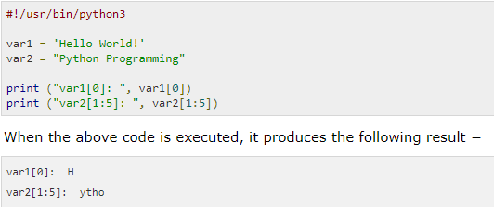
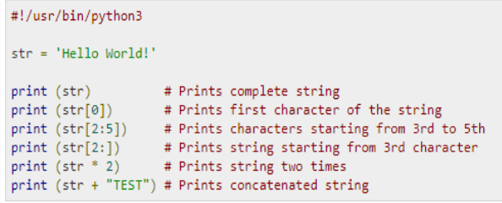
Examples

Slide 11
STRING FORMATTING OPERATOR
Format Symbol | Conversion
%c | character
%s | string conversion via str() prior to formatting
%i | signed decimal integer
%d | signed decimal integer
%u | unsigned decimal integer
%o | octal integer
%x | hexadecimal integer (lowercase letters)
%X | hexadecimal integer (UPPERcase letters)
%e | exponential notation (with lowercase 'e')
%E | exponential notation (with UPPERcase 'E')
%f | floating point real number
%g | the shorter of %f and %e
%G | the shorter of %f and %E

Slide 12
ΕXample
print ("My name is %s and weight is %d kg!" %('Zara', 71))
When the above code is executed, it produces the following result:
“My name is Zara and weight is 71 kg!”

Slide 13
Escape Characters - Backslash notation
\n | New line
\nnn | Octal notation, where n is in the range 0.7
\r | Carriage return
\s | Space
\t | Tab
\v | Vertical tab
\x | Character x
\xnn | Hexadecimal notation, where n is in the range 0.9, a.f, or A.F
\a | Bell or alert
\b | Backspace
\cx | Control-x
\C-x | Control-x
\e | Escape
\f | Formfeed
\M-\C-x | Meta-Control-x

Slide 14
What is Python?
Variables
String Functions
Casting
Basic Operators
Input & Output
Decision Making

Slide 15
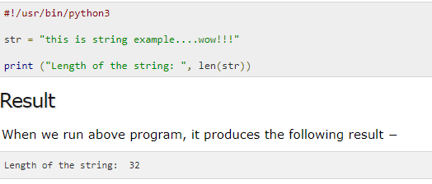
The len() Function
Returns the length of the string
Syntax : len( string)

Slide 16
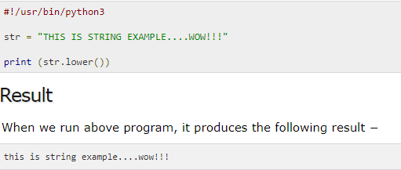
The lower() Function
Function lower() returns a copy of the string in which all case-based characters have been lowercased.
Syntax : string.lower()

Slide 17
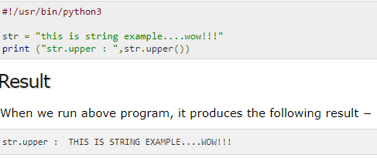
The upper() function
The upper() method returns a copy of the string in which all case-based characters have been uppercased.
Syntax : string.upper()

Slide 18
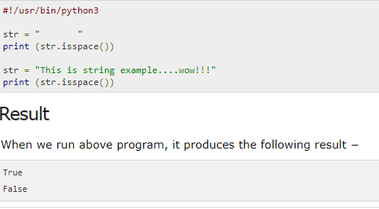
The isspace() Function
The isspace() method checks whether the string consists of whitespace.
Returns true if there are only whitespace characters in the string and there is at least one character,otherwise false.
Syntax : string.isspace()

Slide 19
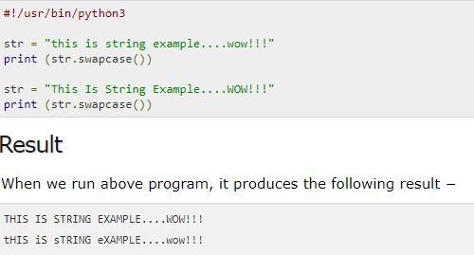
The swapcase() function
The swapcase() method returns a copy of the string in which all the case-based characters have had their case swapped.
Syntax : string.swapcase()

Slide 20
What is Python?
Variables
String Functions
Casting
Basic Operators
Input & Output
Decision Making

Slide 21
CASting
int(x) Μετατροπή του x σε ακέραιο.
2. float(x) Μετατροπή του x σε float.
3. long(x) Μετατροπή του x σε long int.
4. str(x) Μετατροπή του x σε string.
5. complex(real[,imag]) Μετατροπή του x σε μιγαδικό.
6. chr(x) (όπου x ακέραιος) Μετατροπή x σε χαρακτήρα.
7. tuple(x) Μετατροπή του x σε tuple.
8. list(x) Μετατροπή του x σε λίστα.
9. set(x) Μετατροπή του x σε set.
10. frozenset(x) Μετατροπή του x σε frozen set.

Slide 22
What is Python?
Variables
String Functions
Casting
Basic Operators
Input & Output
Decision Making

Slide 23
Operators(Τελεστεσ)
Arithmetic (Αριθμητικοί)
Comparison (Σχεσιακοί)
Logical (Λογικοί)
Assignment Operators (Ανάθεσης)
Bitwise Operators
Membership Operators
Identity Operators

Slide 24
Arithmetic Operators
 |  | If a=2 and b=5
+ | Addition | a + b = 7
- | Subtraction | a – b = -3
* | Multiplication | a * b = 10
/ | Division | b / a = 2.5
% | Modulus: returns the remainder of the division. | b % a = 1
** | Power(Exponent) | a**b =32
// | Floor Division | b//a = 2 and 5.0//2.0 = 2.0

Slide 25
Comparison Operators
 |  | If a=2 and b=5
== | Equals sign | (a == b) is False
!= | Not equals sign | (a!= b) is True
> | Greater than sign | (a > b) is False
< | Less than sign | (a < b) is True
>= | Greater than or equal sign | (a >= b) is False
<= | Less than or equal sign | (a <= b) is True

Slide 26
Logical Operators
 |  | If a=True and b=False
and | Logical AND: If both the operands are true then condition becomes true. | (a and b) is False.
or | Logical OR: If any of the two operands is true then condition becomes true. | (a or b) is True.
not | Logical NOT: Reverses the logical state of its operand. | not(a and b) is True.

Slide 27
Assignment Operators
= | Assigns values from right side operands to left side operand | c = a + b assigns (a + b) to c
+= | Assigns the sum of left and right operand to the left operand | c += a equivalent to c = c + a
-= | Assigns the result of the subtraction of right operand from the left operand | c -= a equivalent to c = c - a
*= | Assign the result of multiplication to the left operand | c *= a equivalent to c = c * a
/= | Assign the result of division to the left operand | c /= a equivalent to c = c /a
%= | Assign the result of modulus to the left operand | c %= a equivalent to c = c % a
**= | Assign the result of the power to the left operand | c **= a equivalent to c = c ** a

Slide 28
Other types of operators
Bitwise Operators
Perform bit-by-bit operation
Membership Operators
Test for membership in a sequence, such as strings, lists, or tuples.
in : returns 1 if left operand belongs to right operand
not in : returns 1 if left operand doesn’t belong to right operand
Identity Operators
Compare the memory locations of two objects.

Slide 29
What is Python?
Variables
String Functions
Casting
Basic Operators
Input & Output
Decision Making

Slide 30
BAsic Input and Output
Output
print() function
Prints objects to the text stream file
Input
input([prompt])
If the prompt argument is present, it is written to standard output without a trailing newline. The function then reads a line from input, converts it to a string and returns it.
!!! Necessary casting: int(input([prompt])) in order to compare with integers

Slide 31
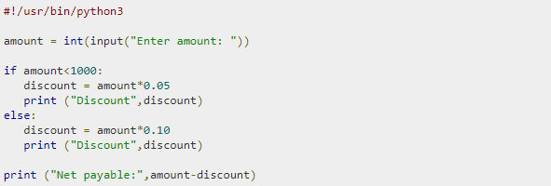
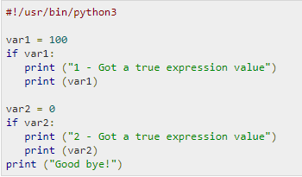
Examples

Slide 32
What is Python?
Variables
String Functions
Casting
Basic Operators
Input & Output
Decision Making

Slide 33
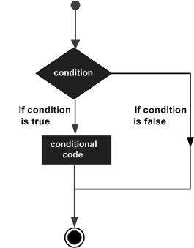
Decision Making

Slide 34
IF Statement
If Syntax
if condition:
statement 1
statement 2
statement 3
.
.
.
If…Else Syntax
if expression: statement(s) else: statement(s)
If...Elif...Else Syntax
if expression1: statement(s) elif expression2: statement(s) elif expression3: statement(s) else: statement(s)

Slide 35
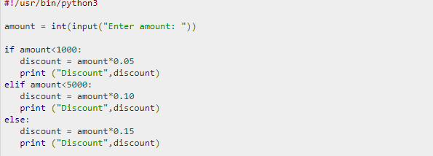
Statements in a block are uniformly indented after the : symbol.

Slide 36
Exercises

Slide 37
Odd or even?
Write a program that reads an integer from the user.
Then your program should display a message indicating whether the integer is even or odd.

Slide 38

solution

Slide 39
Is it a Leap Year?
Write a program that reads a year from the user and displays a message indicating whether or not it is a leap year.

Slide 40



Solution
Results:

Slide 41
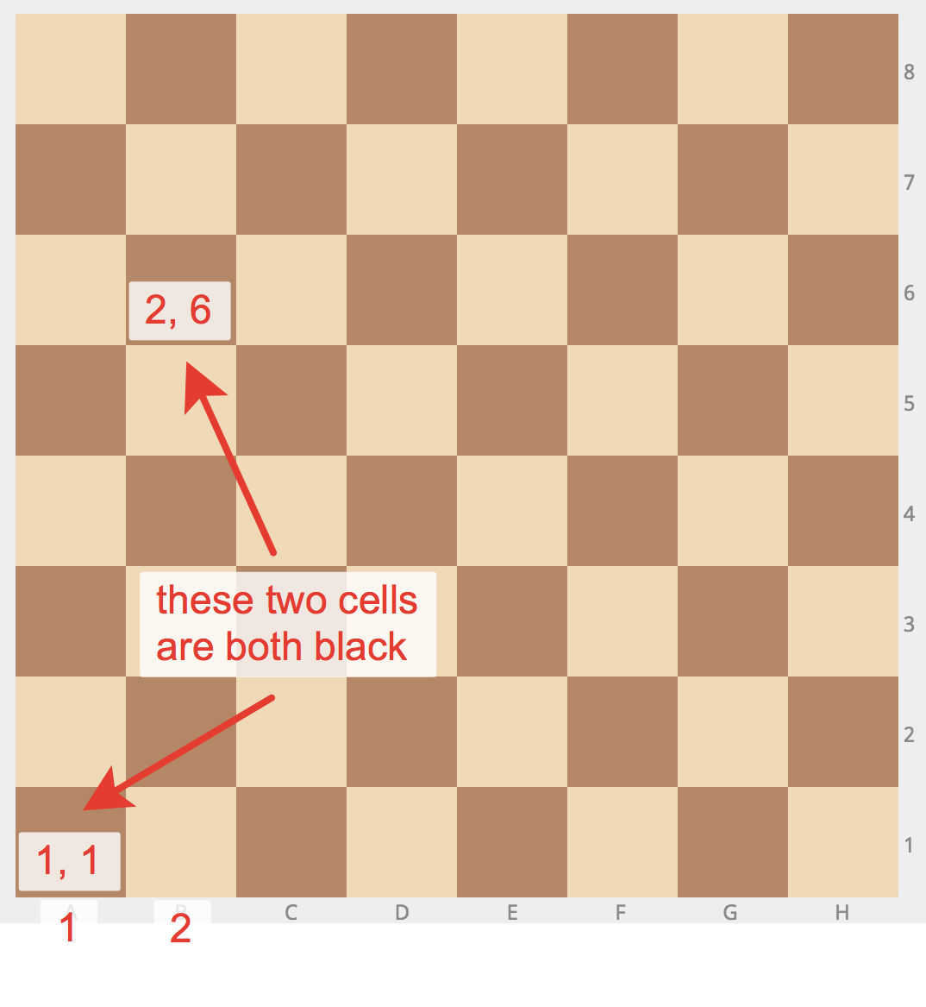
What Color is THAT Square?
Write a program that reads a position in the chessboard from the user.
Display a message indicating whether it’s a white or a brown cell.

Slide 42
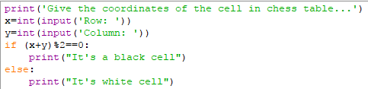

Solution
Result:

Slide 43
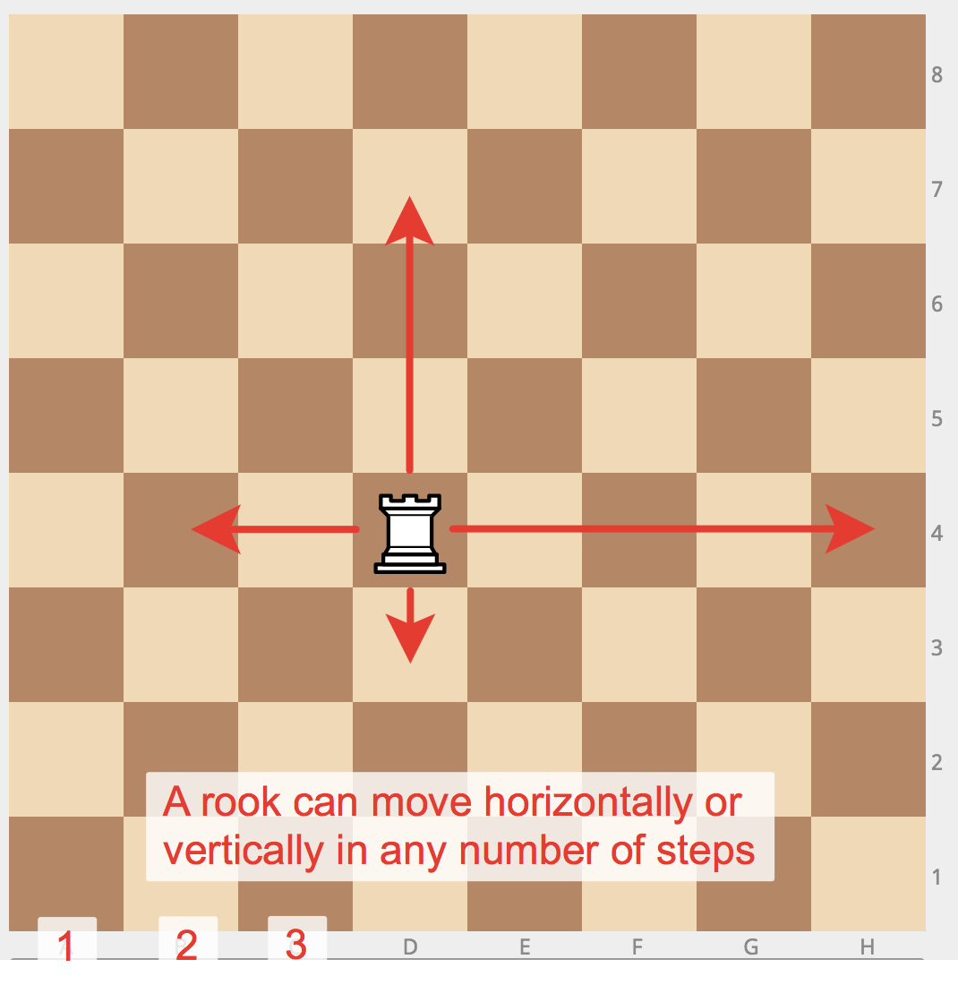
«Rook move»
Given two different cells,
determine if a rook can go from the first cell to the second in one move.
Input: four numbers from 1 to 8, each specifying the column and row number, first two - for the first cell, and then the last two - for the second cell.
Print YES if a rook can go from the first cell to the second in one move, or NO otherwise.

Slide 44
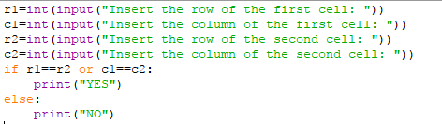
solution

Slide 45

Roulette Payouts
For this game a roulette has 37 spaces on it (18 black, 18 red, 1 green).
The green space is numbered 0.
Red spaces :
1, 3, 5, 7, 9, 12, 14, 16, 18, 19, 21, 23, 25, 27, 30 32, 34,36.
The remaining integers between 1 and 36 are black spaces.

Slide 46
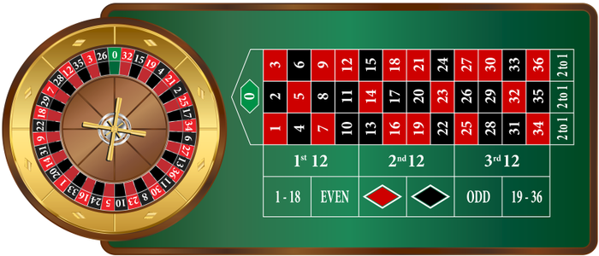
Many different bets can be placed in roulette:
Single number (1 to 36 or 0)
Red versus Black
Odd versus Even
(Note that 0 does not pay out for even)
Write a program that simulates a spin of a roulette wheel by using Python’s random number generator.
The player should start with 100$ and get extra 100$ when he wins, whereas loose 10$ when he bets wrong.
Display its time the outcome of the game and the player’s money.The game should stop after pushing the button ‘s’ or ‘S’.

Slide 47
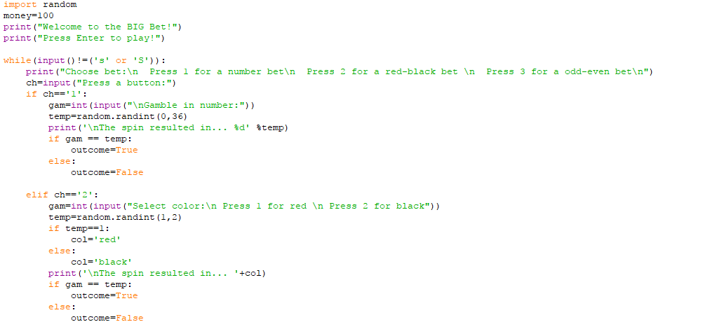
Solution

Slide 48
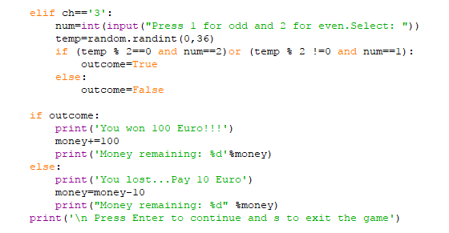
solution

