Slide 1
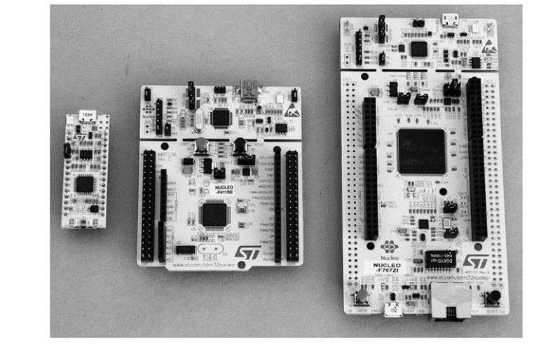
Arm controller with stm32 nucleuo board Overview with online tools

Slide 2
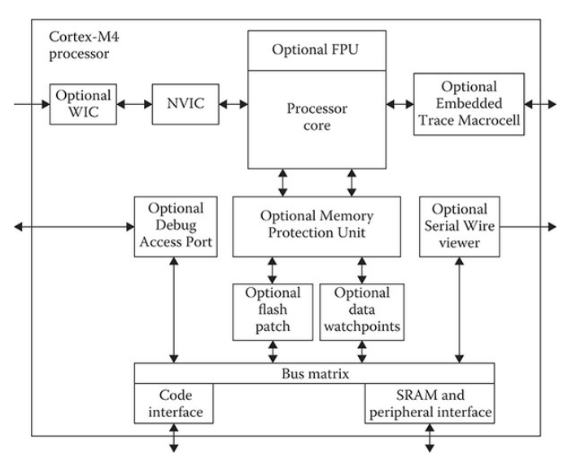
Principal mcu components
1) Processor
The processor used in nucleo-32 is the arm cortex m-4 32 bit processor
Block diagram
Specification for the arm cortex m-4 processor
Floating point unit(fPU)
Low power 32 bit processor
Memory protection unit (mpu)
Nested vector interrupt controller(nvic)
Trace, breakpoint, and jtag capabilities
Advanced high performance bus

Slide 3
2) Memory The Cortex M-4 processor uses a Harvard architecture. This means that program instructions are stored and retrieved from a memory separate and distinct from the memory that holds data.
3) Peripherals
The peripherals are what make the MCU viable for its intended purposes

Slide 4
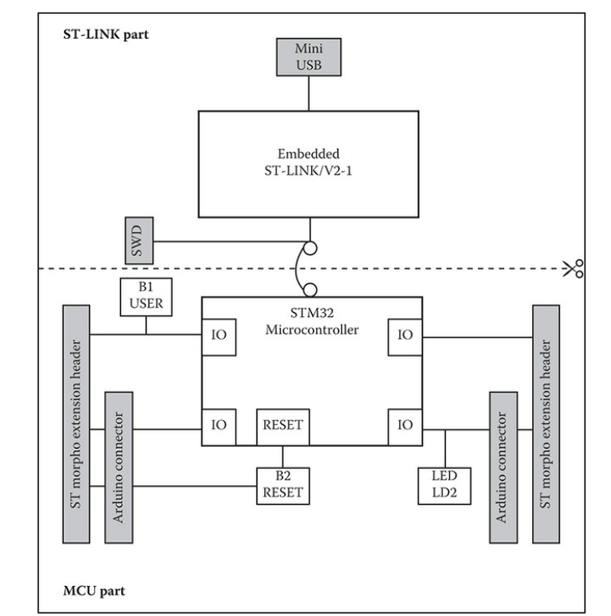
Nucleo-64 board layout
the board is actually made of two sections, the top section being a ST-LINK/V2-1 programmer and the bottom section is the STM32 MCU. The bottom section is also fitted with two sets of connectors. One set is compatible with the Arduino shield pin configuration and other set is the ST Morpho pinout configuration. There are two push buttons, B1 and B2, shown in the figure. B1 is multipurpose, while B2 is the reset push button

Slide 5
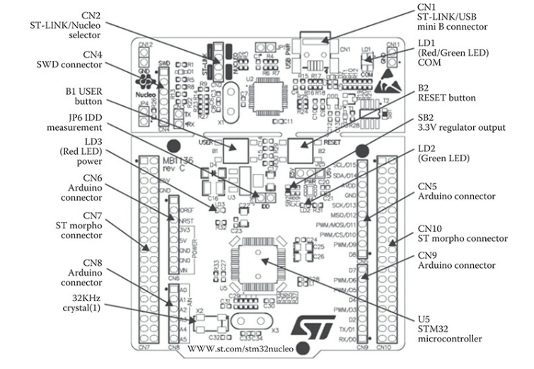
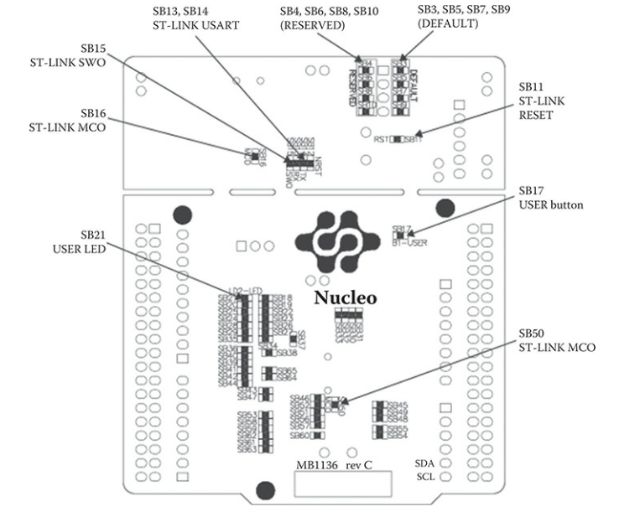

Slide 6
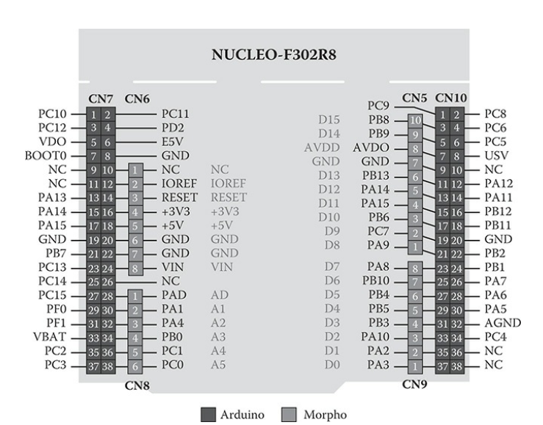
Nucleo-64 pin out diagram There are two sets of pinouts one belonging to the Arduino and the other to the ST Morpho

Slide 7
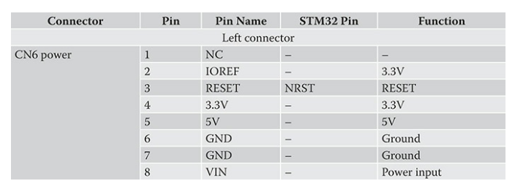
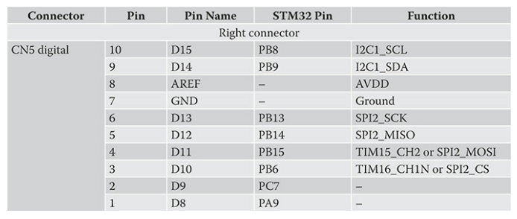
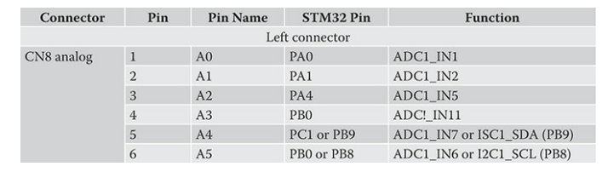
Connectors CN5, CN6, CN8, and CN9 belong to the Arduino set. Connectors CN7 and CN10 belong to the Morpho set. The Morpho connectors are two double rows of 38 pins for a total of 76 pins. The Arduino connectors are single-row connectors totaling 32 pins in all spread across four connectors.
Arduino Connectors
Cn6
Cn8
Cn5

Slide 8
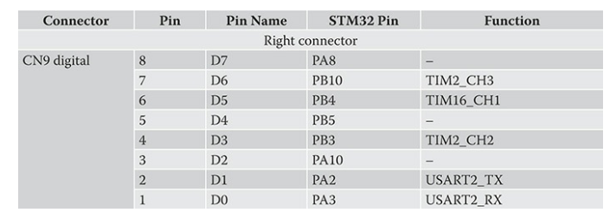
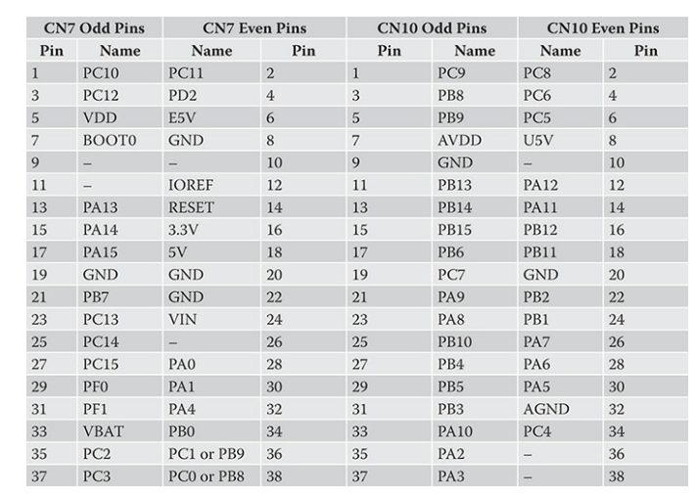
CN9
Morpho Connectors

Slide 9
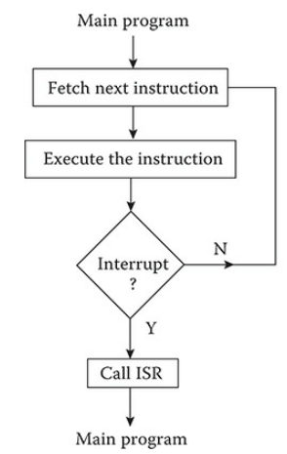
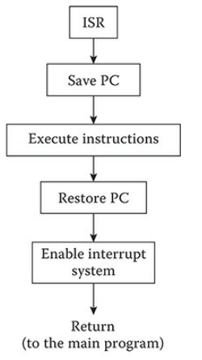
Nested Vectored Interrupt Controller (NVIC)
FLOW DIAGRAM

Slide 10
NVIC USED IN THE NUCLEO-64 MCU PROJECT BOARD
specifications:
• Sixteen interrupt lines
• Sixteen priority levels
• Up to 62 maskable interrupt channels
• Low-latency interrupt processing
• Processing of late arriving, higher priority interrupts
• Supporting tail chaining
• Interrupting entry restored on interrupt exit with no instruction
overhead

Slide 11
External Interrupt/Event Controller (EXTI)
General-Purpose Inputs/Outputs (GPIOs)
Analog-to-Digital Converter (ADC)
Each of the 51 GPIO pins can be configured by software as output with push-pull or open-drain and with or without pull-up or pull-down. They can also be configured as floating input, with or without pull-up or pull-down. Most GPIO pins have peripheral alternate functions as can be seen in the above tables. All GPIOs are high-current-capable and have limited speed selection to better manage internal noise, power consumption, and electromagnetic emission.
There is one 12-bit ADC that has 16 channels. ADC conversions can be done in either a single-shot or scan mode. In the scan mode, an automatic conversion is performed on a preselected group of analog inputs. An interrupt can be generated if a converted voltage is outside preset threshold. In addition, a specific channel conversion can be triggered by the TIM1, TIM2, TIM3, TIM4, or TIM5 timers.
There is an external interrupt/event controller that uses 23 edge-detector lines to generate interrupt/event requests. Each line may be independently
configured to select the trigger event such as leading edge, trailing edge, or
both.

Slide 12
LEDs
Push Buttons
LD1 is a tricolor LED located on the ST-LINK PCB and provides information concerning the state of communications between the ST-LINK, the host PC, and the main MCU. The following list shows the various LED states and the corresponding meaning: • Slow blinking Red/Off: at power-on before USB initialization Fast blinking Red/Off: after the first correct communication between the PC and ST-LINK/V2-1 (enumeration) Red LED On: when the initialization between the PC and ST-LINK/V2-1 is complete • Green LED On: after a successful target communication initialization • Blinking Red/Green: during communication with target • Green On: communication finished and successful • Orange On: communication failure
LD2 is a green LED-labeled user and connected to Arduino signal D13 (CN5/CN6), which corresponds to STM32 I/O PB13 • When the I/O value is HIGH, the LED is on • When the I/O value is LOW, the LED is off
LD3 is a red LED that indicates that the Nucleo-64 board is powered on and 5-V power is available.
There are two push buttons on the board:
• B1 USER: The user button is connected to the I/O PC13 (CN7/23) of the MCU. This pin is pulled high through a 47K resistor. When B1 is pressed the pin is grounded.
• B2 RESET: This push button is connected to NRST, and is used to RESET the MCU.

Slide 13
BLINKING OF AN LED
Hal_init(); ----- Initialize The Hardware Abstraction Layer(hal) Framework
Systemclock_config();-----initialize And Configure The Clock System
Mx_gpio_init();----- Initialize And Configure All The Enabled Gpio Pins
E.G steps:
Include All Library
Put Program In The Main Void Structure(int main(void){})
Reset All Peripherals By Initializing The Flesh Interface
Hal_Init();
Configure the system clock(SystemClock_Config();)
Initialize all configure peripherals( MX_GPIO_Init();)
Put all code in the infinite loop and close the main structure ( while (1) {} }

