Slide 1
ESCAPE ROOM: “CASINO WORLD”
Linh Pham
Olivier Babiard
Emmanuel Aron
Katya Kraft

Slide 2
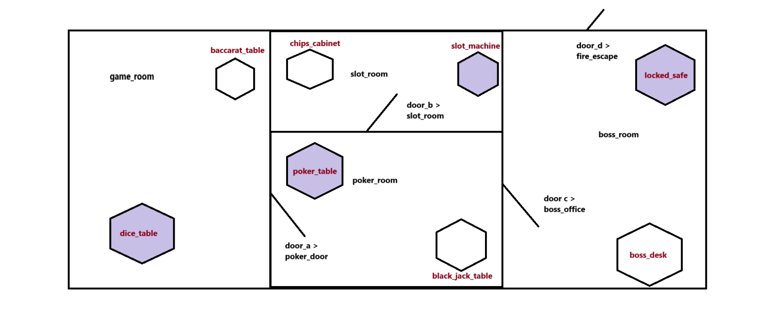
Project Overview
How is the game’s structure organized?
The escape room is structured like a casino, all rooms and objects following that theme.
4 different rooms with different objects categories related between each other:

Slide 3
Project Overview
Which features did you add to the game?
We added 4 different mini games to add an extra step to retrieve the keys:
Roll the dice game
Card Game
Slot Machine
Guess the password
Which functions do you have ?
def start_game():
def play_room(room): def explore_room(room):
def get_next_room_of_door(door, current_room):
def examine_item(item_name):

Slide 4
Technical Challenge
What was the most important technical challenge you faced?
The biggest challenge was understanding the overall logic of the game. It took time to grasp how everything was structured and how different parts interacted.
Also to think and implement the extra mini-games that we wanted to add. We encountered several errors along the way.
How did you overcome that challenge?
By thoroughly reviewing the code and discussing it as a team until we fully understood it.
We were able to identify and fix the errors, by working together and considering different solutions.

Slide 5
Big Mistake
What was the biggest mistake you made during this project?
At the start, we struggled with proper organization. While we discussed our goals and ideas, we didn’t create a solid plan to follow.
Additionally, we relied on Olivier to take the lead, when we could have collaborated more effectively as a group.
What did you learn from it?
We learned the importance of organizing ideas from the beginning. Writing them down and practicing effective project management makes the process smoother and more efficient.
We also realized that working together as a cohesive team is essential for better outcomes, rather than depending on a single person.

Slide 6
CASINO WORLD DEMO

Slide 7
THANK YOU!
CASINO WORLD
Linh Pham
Olivier Babiard
Emmanuel Aron
Katya Kraft

