Slide 1
Family Circles
Net New Build + Video Time-Slider
Product journey, working prototype, and remaining decisions
October 2026 · Family-Circles
01
Notes:
Sources: docs/2026-09-29-circles-net-new-build-prd.md; docs/2026-09-29-video-time-slider-prd.md; docs/2026-10-03-phase-build-evidence.md. App screenshots are local component previews with synthetic data.

Slide 2
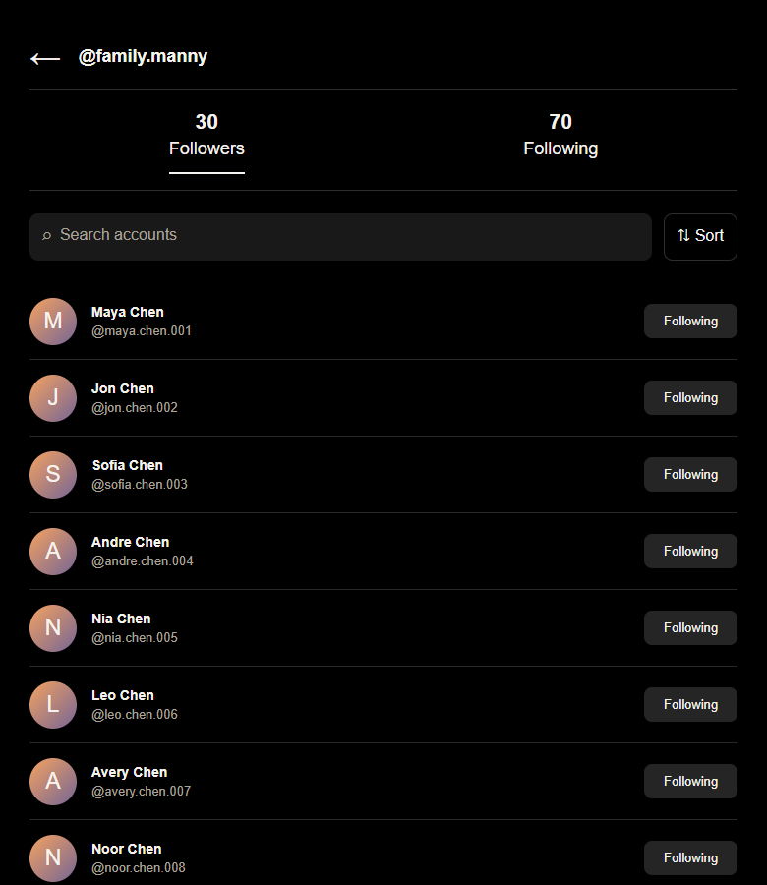
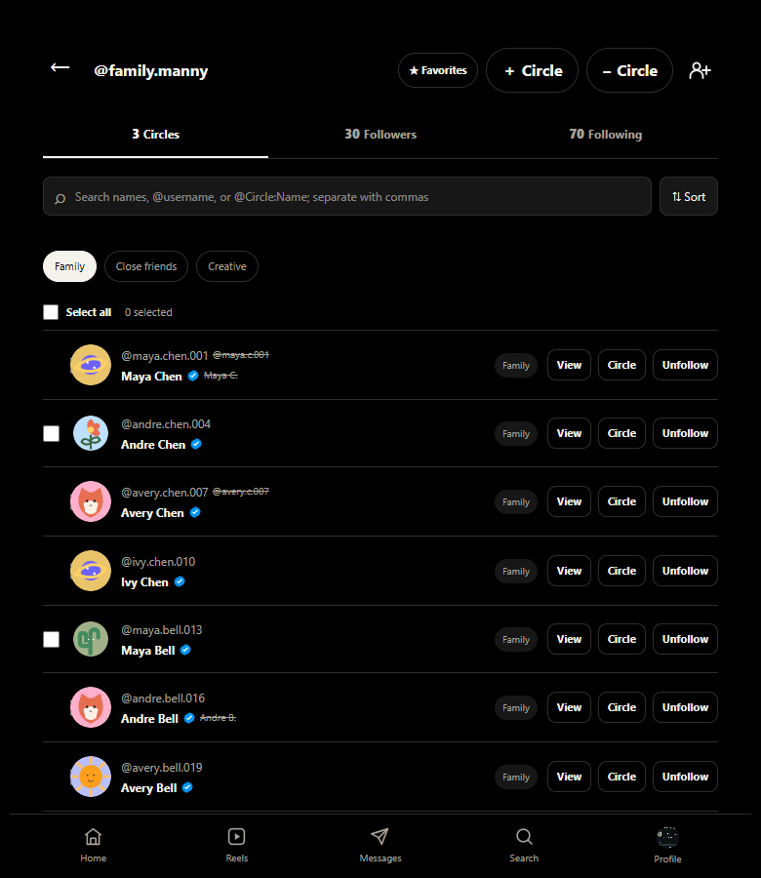
Circles account view
BEFORE · RECONSTRUCTION
CURRENT APP · LOCAL PREVIEW
132 synthetic accounts in the directory. Circle membership now helps the host organize the accounts they follow.
02
Notes:
The left view reconstructs the user-described pre-Circles baseline; no historical pre-Circles screenshot exists in this repository. The right view renders current src/Dashboard.jsx with synthetic data. The 132 count is from src/lib/familyData.js. Current worktree UI changes are uncommitted.

Slide 3
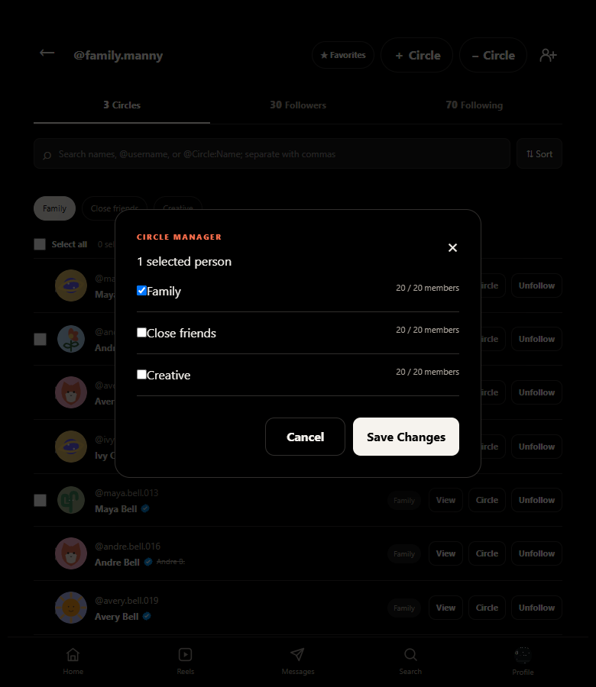
Private Circle management
One person can belong to more than one Circle.
The host selects an account, opens Circle, and changes only the checked memberships.
Removing someone from a Circle leaves the follow relationship intact.
03
Notes:
Circles PRD User Journey 1 and Journey 4; src/Dashboard.jsx Circle manager; docs/2026-10-03-phase-build-evidence.md Phase 3. Image uses a local synthetic account. UI screenshot is a working-copy preview; authenticated runtime was not verified.

Slide 4
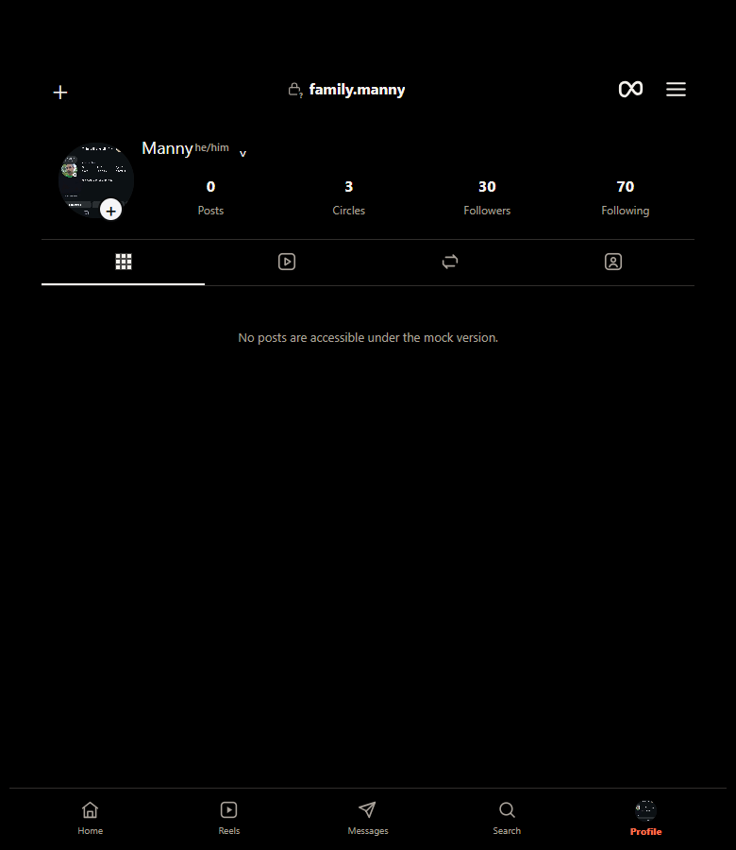
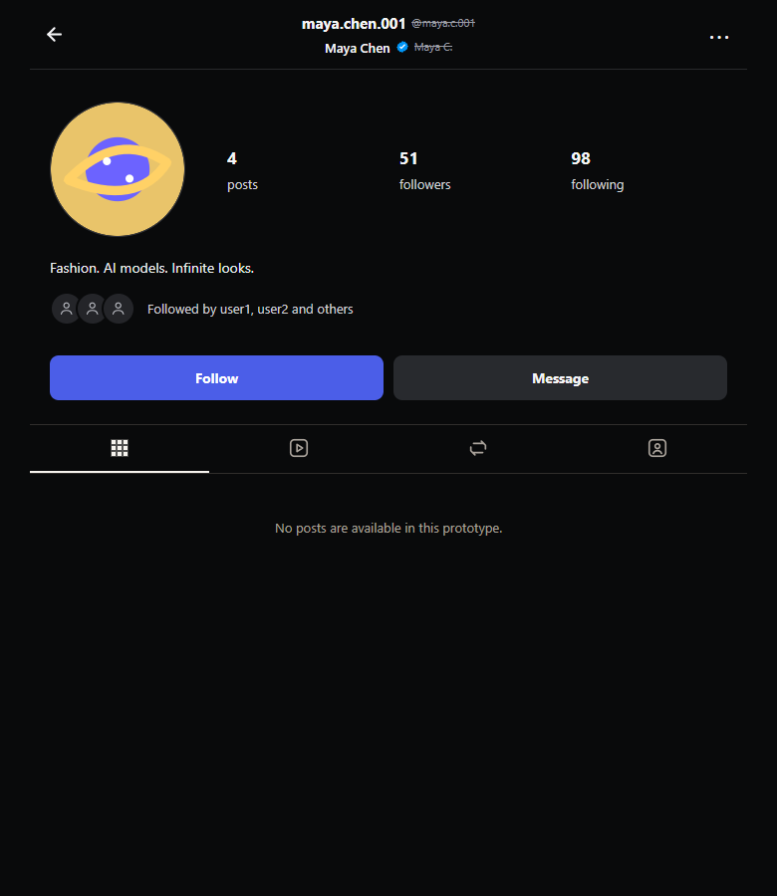
Host and visited profiles
HOST PROFILE
VISITED USER PROFILE
The host keeps a separate profile. Synthetic users open their own visited-profile identity.
04
Notes:
Rendered current src/Dashboard.jsx and src/pages/UserProfile.jsx with app-local synthetic data. The visited profile uses each person's own ID and name, per docs/phases/Phase-05-synthetic-profile-reels.md. The current working tree includes uncommitted profile display edits.

Slide 5
Circles user journey
NET NEW BUILD · PRD JOURNEYS 1–4
01 Organize followed accounts into private Circles
02 Choose a Circle or ALL to find the accounts that matter
03 Recognize an account when its app-controlled name changes
04 Adjust membership without an accidental unfollow
Focused Home post filtering and confirmed availability still need an operational result source.
05
Notes:
Circles PRD section 3, User Journeys 1–4. Current prototype supports account organization and local relationship state. Operational Home feed filtering and account availability remain unimplemented per docs/2026-10-03-phase-build-evidence.md. Name-change cues are present in the uncommitted local working tree and should not be called released.

Slide 6
Circles value: Vitamin · Painkiller · Steroid
VITAMIN
Private lists of followed accounts with an ALL view
PAINKILLER
Focus on chosen accounts; reorganize without unfollowing
STEROID
Stable identity and recent-name cues keep relationships recognizable
PRD value promise. Feed filtering and truthful availability remain future product work.
06
Notes:
Source: docs/2026-09-29-circles-net-new-build-prd.md section 2b. The slide compresses the PRD text; availability and feed filtering are PRD goals, not implemented operational flows. Stable-ID and membership helper checks are documented in docs/2026-10-03-phase-build-evidence.md.

Slide 7
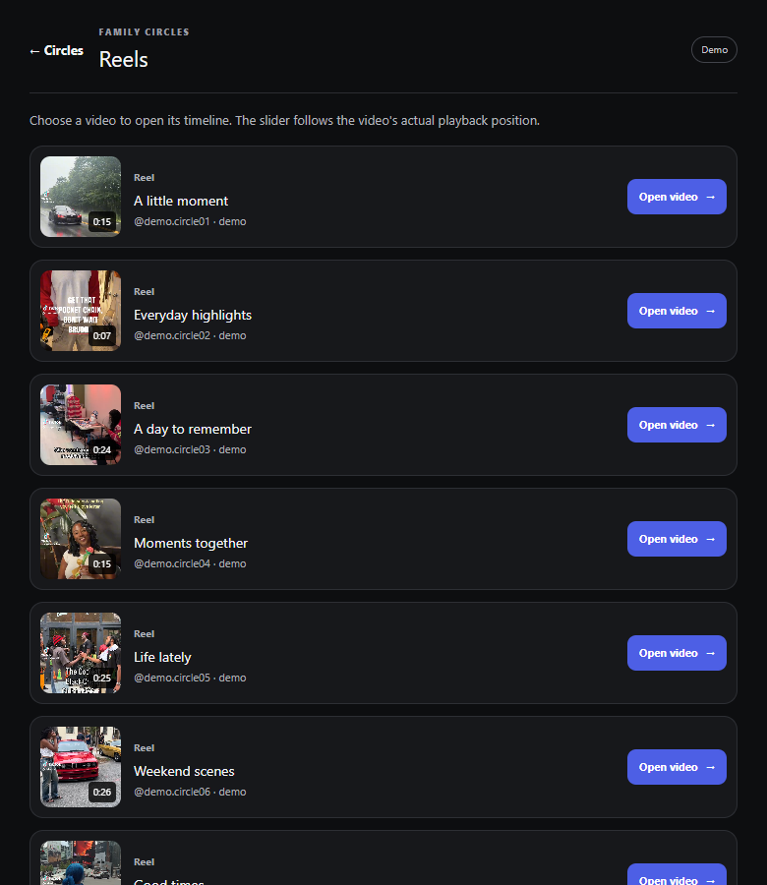
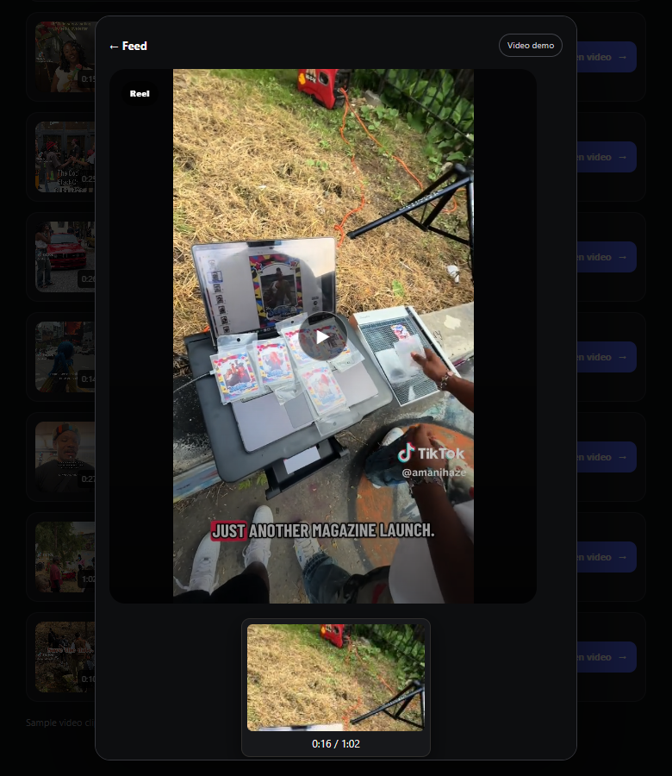
Video demo and time slider
LOCAL REELS DEMO
SEEK + SYNCHRONIZED PREVIEW
Ten bundled MP4 clips demonstrate the feature. The labels are fictional demo accounts.
07
Notes:
Source: src/pages/ReelsTimeframe.jsx, src/components/VideoTimeSlider.jsx, src/components/VideoScrubPreview.jsx, and docs/2026-10-03-phase-build-evidence.md. Screenshots captured from a local production-built component preview. Clips are local app assets; no Instagram media integration.

Slide 8
Video Time-Slider user journey
NEW FEATURE · PRD JOURNEY 1
01 Open a supported video you can view
02 Drag or use the keyboard to choose a time
03 Inspect the matching frame and timestamp
04 Resume from the selected position
P0 seeking and P1 preview are demonstrated on local Reels. Touch and other media surfaces need separate verification.
08
Notes:
Source: docs/2026-09-29-video-time-slider-prd.md section 3, User Journey 1; docs/2026-10-03-phase-build-evidence.md Phases 6–7. The feature currently works in local demo surfaces. Do not infer all requested video surfaces are operational.

Slide 9
Video feature value: Vitamin · Painkiller · Steroid
Value framing derived from the New Feature PRD
VITAMIN · P0
Visible position and duration with direct seeking
PAINKILLER · P1
Preview the moment while scrubbing, without replaying the whole clip
STEROID · P2
Precision range, return marker, and persistent speed are planned
09
Notes:
The Video PRD does not name a Vitamin/Painkiller/Steroid framework. This is an editorial interpretation of docs/2026-09-29-video-time-slider-prd.md sections 2a and 3. P0 slider and P1 preview have standalone runtime evidence in docs/2026-10-03-phase-build-evidence.md. P2 controls are not integrated.

Slide 10
Current build and open decisions
DEMONSTRATED
STILL OPEN
Private Circle membership and selection
Stable account identity
Synthetic visited profiles
Local MP4 playback, seeking, and preview
Operational Home feed and availability
Video gesture timing and Favorite conflict
Story completion and supported surfaces
Persistent speed and precision mode
The name-cue and profile-layout edits in this working copy still need final UI verification.
10
Notes:
Sources: docs/2026-10-03-phase-build-evidence.md and the local app preview on feat/complete-remaining-phases. No live hosted Supabase or external platform integration is claimed.

