Slide 1
Afya Smart
AI-powered triage & queue management for fairer, faster public healthcare
Any phone. No app. No internet. USSD *384#
RIDC PT Innovation Hackathon 2026 · Software (Web & Mobile)
Emmanuel Stephen Barnabas · github.com/emmanuelbarnabas/afya-smart

Slide 2
The problem: public clinics are slow — and unfairly so
Tanzania · 1 doctor per ~10,000 people; most citizens own a basic phone
• Long, opaque queues. Patients arrive at 5am, wait 4–6 hours, and never know their position or who is being seen before them.
• No triage before arrival. A stroke and a refill prescription wait in the same line; the emergency case is discovered too late.
• Smartphone-only digital health. Apps and QR check-in exclude the majority who use 2G feature phones.
• Hidden bias. Women, rural patients and walk-ins systematically wait longer — nobody measures it, so nobody fixes it.

Slide 3
Solution: triage before you leave home, queue before you arrive
• USSD on any phone. Patient dials *384#, answers a short symptom interview in Kiswahili/English — no smartphone, no internet, no app install.
• AI urgency triage. ML model (gradient boosting) + rule-based red-flag safety net returns RED / YELLOW / GREEN with a reason.
• Smart booking. Nearest facility, first free slot with predicted wait — confirmed by SMS with an appointment ID.
• Fair live queue. One queue per facility on the nurse's dashboard: urgency-banded FIFO, emergency bypass, ageing override.
• Accountability. A fairness report compares average waits by sex, age, facility and urgency — bias becomes visible and fixable.

Slide 4
How it works — the patient journey
1. Dial *384#
2. Describe symptoms
3. Triage result
USSD session, Kiswahili or English
Keyword interview → structured features
RED / YELLOW / GREEN + reason + advice
4. Book a slot
5. SMS confirmation
6. Fair queue on arrival
Facility choice, date, time — capacity-aware
Appointment ID + reminder before the day
Position on nurse dashboard, live updates
Total time on the phone: under 2 minutes. Walk-ins and anonymous patients (no SIM) supported.

Slide 5
AI triage: ML where it helps, rules where it must never fail
• Safety net first. Rule-based red-flag detection (chest pain, stroke signs, bleeding…) always overrides the model.
• Gradient-boosting classifier trained on 12,000 synthetic symptom profiles (ml-v2).
• Clinician feedback loop. Nurse records the real urgency after consultation → measured against prediction → retraining.
• Graceful degradation. Model load failure falls back to rules-only; every prediction carries a version + reason.
89.4%
88.4%
Overall accuracy (ml-v2)
Recall on EMERGENCY cases
12,000
107
Training samples / version
Automated tests passing

Slide 6
Fairness by design — the feature hackathons rarely ship
• Measured, not assumed. Average and 90th-percentile waits grouped by sex × age band × facility × urgency × walk-in vs booked.
• Ageing override. priority = urgency_weight × 60 − minutes_waited — a GREEN patient who waited long overtakes a fresh YELLOW.
• Emergency bypass is audited. Every bypass is flagged and reviewable — speed never erases accountability.
• Clinician overrides kept. Nurses can re-grade urgency; the override is stored with who/when/why.
• Open report. /fairness renders the numbers as charts anyone — including patients — can inspect.

Slide 7
Technology stack
Built exactly as proposed — Python-first, deployable on lightweight hosting
Patient access (no smartphone needed)
USSD & SMS via Africa's Talking API
Backend / API
Python — FastAPI (SQLAlchemy, Alembic migrations)
AI / ML
Python — gradient-boosting triage classifier + time-series slot-demand forecast
Database
PostgreSQL (production) / SQLite (offline demo) — same models
Facility dashboard
React.js, mobile-first for low-end Android tablets/phones
Patient app
Installable PWA (works on 2G, no app-store dependency)
Hosting
Lightweight cloud (uvicorn) behind Cloudflare tunnel — small payloads on weak links

Slide 8
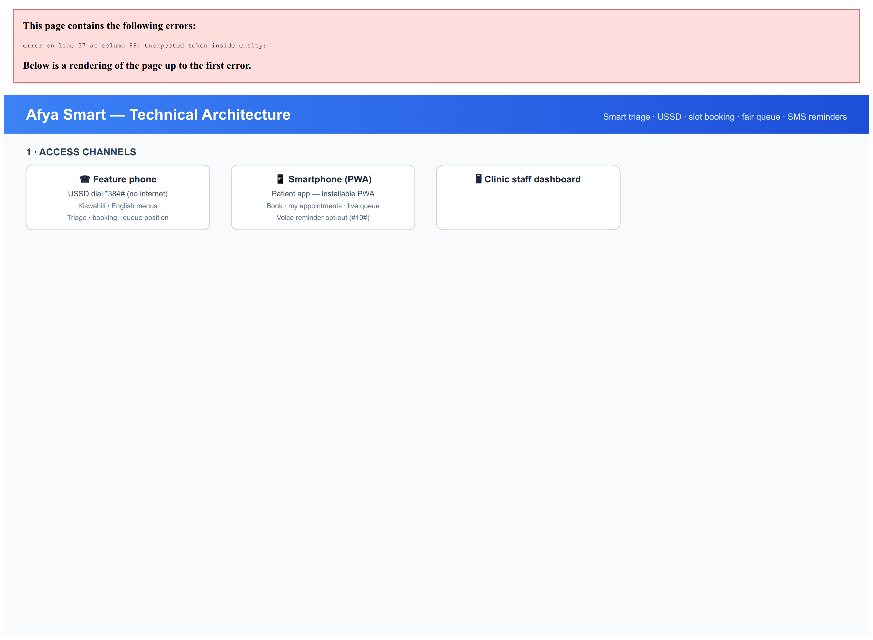
Technical architecture
Single FastAPI service · SQLite/PostgreSQL · Africa's Talking · runs offline-first

Slide 9
Working prototype — end to end, today
6
5
4
2
USSD menus: triage, book, my appointments, facility search, health guide, opt-out
Seeded facilities across Dodoma, Morogoro & Singida regions
Apps in one: USSD · patient PWA · nurse dashboard · SMS reminders
Channels for USSD: live Africa's Talking callback + built-in simulator
• Full data model: patients (incl. anonymous), facilities + services, slots, appointments, queue entries, triage sessions — all Alembic-migrated.
• Integrations live: Africa's Talking USSD + SMS reminders with dedup, Cloudflare tunnel for a public HTTPS URL on demo day.
• Deployable anywhere: uvicorn + SQLite works on a laptop with no internet — important for rural clinics.
• Honest prototype: clearly labelled not-for-clinical-use; triage rules need medical sign-off before real patients.

Slide 10
Impact — why this matters for Tanzania
• Cuts waiting time. Pre-arrival triage + booked slots mean stable, predictable visits instead of 5am queues.
• Catches emergencies earlier. RED flags surface before the patient joins the line — the nurse sees them first on the dashboard.
• Includes everyone. Feature phones, walk-ins and SIM-less patients use the same fair system.
• Gives clinics evidence. Forecasts demand per slot; the fairness report turns equity from a slogan into a metric.
• Scales by SMS. No app downloads, no data bundles — the channel Tanzania already uses for everything.

Slide 11
Success looks like
The exact metrics from our proposal — measured before/after the pilot
• Reduced average physical wait time. Baseline vs post-pilot, measured in minutes at the facility (analytics already records every wait).
• Correct deferral rate. % of USSD triage sessions that correctly deferred non-urgent cases to self-care or a booked slot — validated against clinician review (feedback loop is live).
• Flatter demand curve. Smaller gap between peak-hour and off-peak volume after slot adoption — the forecast shows expected wait per slot to steer patients off the 6–9 AM peak.
• Adoption rate. Patients per week using USSD booking vs walk-in, plus repeat usage (tracked per patient).
• Zero missed emergencies. No case where a true emergency was delayed by triage or queue flow — audited via emergency-bypass flags and facility incident review.

Slide 12
Roadmap
• Now (hackathon). USSD triage + booking, nurse dashboard, fairness report, SMS reminders — all working.
• Next 3 months. Pilot with 2–3 public dispensaries; medical board review of triage rules; voice (IVR) menu for low literacy.
• Next 6 months. Retrain triage on real clinician feedback; integrate CHAT/WhatsApp channel; county-level demand dashboards.
• 12 months. District health authority deployments; open fairness metrics published per facility.

Slide 13
The ask
• Pilot partners. Public clinics willing to run a 90-day pilot with the nurse dashboard and USSD line.
• Clinical review. Medical professionals to sign off (and challenge) the triage rules — a stated condition of this prototype.
• Mentorship on compliance. Tanzania Medicines and Medical Devices Authority (TMDA) and data-protection (PDPA) pathways.
• Follow-on support. Compute credits and Africa's Talking credits to keep the demo line alive past the hackathon.
Afya Smart — because your place in the queue should never depend on who you are.
github.com/emmanuelbarnabas/afya-smart · demo at /demo on the live server

