Slide 1

SIWES Report: Experience at HiiT Plc
Mini project: a network-flow-based Trojan Horse detection system for IoT devices
[Your name] [Reg. No.]
Department of Computer Science, University of Uyo
[Month, Year]
Notes:
Introduce yourself, SIWES, and the host organisation, HiiT Plc. One sentence on the mini project: a system that spots a Trojan Horse on IoT devices such as cameras by watching their network traffic, nothing else.

Slide 2
What this presentation covers
1
SIWES and HiiT Plc
2
Skills acquired
3
The mini project
The scheme, the company, my placement
What the training built in me
Problem, aim, design and how it works
4
Live demonstration
5
Testing and evidence
6
Conclusion
The lab and an infection you can watch
Automated, positive and negative test results
Results, lessons and recommendations
Notes:
Six parts: the scheme and the company; what I learned; the project itself, including its problem and aim; a live demo of the lab; test evidence with real screenshots; and the conclusion.

Slide 3





About SIWES
1973
ITF administers and funds the scheme
NUC, NBTE, NCCE set academic standards
The Industrial Training Fund launched SIWES so that graduates meet real working conditions before they leave university.
Institution places, supervises and assesses
Host organisation trains and mentors the student
Student keeps a logbook and writes the report
The ITF itself was established in 1971.
Notes:
SIWES began in 1973 because employers complained that graduates knew theory but lacked practical skill. Five parties make it work: the ITF, the academic regulators, the university, the host company and the student.

Slide 4
About HiiT Plc, the host organisation
60,000+
4
CPN
4
graduates trained
cities with CPN-accredited centres
registered Nigerian IT company
lines of business
Lagos, Abuja, Ibadan and Kano; instructor-led online classes reach learners elsewhere.
IT training
Software
Consultancy
Publishing
SIWES programme
Sources: BusinessDay (2020); HiiT Plc company profile
Notes:
HiiT Plc is an indigenous Nigerian IT company with CPN-accredited centres in four cities and more than 60,000 graduates. It works in training, software, consultancy and publishing, and runs a SIWES programme, which is where I trained. Confirm the founding year and head office from the company profile before presenting.

Slide 5

My placement at HiiT Plc
Placement details
Work completed
Flow-analysis engine in Python
Host
HiiT Plc
Branch
[branch / centre]
Web interface and JSON API (Flask)
Unit
[unit / department]
Docker camera laboratory
Period
[start date] to [end date]
Harmless trojan and fake C2 server
Supervisor
[industry supervisor]
24 automated tests, all passing
Institution
[institution supervisor]
README, PDF, Word and slide documentation
Notes:
Fill in the highlighted details: branch, unit, dates and supervisors. The six work packages on the right all feed into the mini project that follows, and are the evidence base for the SIWES logbook.

Slide 6






Skills acquired during the placement
Network flow analysis
IoT & cyber security
Containers & Windows
Reading traffic for behaviour, not content
Trojans, command-and-control, MITRE ATT&CK
Docker Compose lab; a Windows-compatible fallback
Python & Flask
Testing & Git
Technical writing
Layered, testable backend and web API
24 pytest cases; branches and a pull request
README, PDF, Word report and slide decks, all generated from the code
Notes:
Six areas of growth, all built while making the mini project: flow analysis, IoT security concepts, containers plus a Windows fallback, Python and Flask, testing with version control, and technical documentation generated straight from the code so it never goes stale.

Slide 7
The Mini Project
Design and implementation of a network-flow-based Trojan Horse detection system for IoT devices
Notes:
Transition from the placement overall to the main technical deliverable: the detector itself.

Slide 8




Problem statement
No on-device protection
IoT devices cannot run endpoint security agents, so detection has to happen on the network, not on the device.
Signatures miss new malware
Antivirus signatures only catch malware already analysed; a Trojan variant slips straight past them.
Healthy traffic looks regular too
A camera streams video on a fixed schedule already, so a naive "regular = suspicious" rule floods analysts with false alarms.
Testing needs to be safe
Demonstrating detection must not involve real malware or put a real network at risk.
Notes:
Four problems drove the design: cameras cannot host security software; malware signatures lag behind new variants; legitimate camera traffic is itself periodic, so naive rules misfire; and any demonstration must be safe.

Slide 9
Aim and objectives
Aim: design, implement and test a lightweight, agentless system that detects Trojan-like behaviour on IoT devices from network-flow data, explains each finding, and supports containment -- with a safe laboratory to demonstrate it.
1. Define a flow-record schema any tool (Zeek, Suricata, routers) can produce
5. Provide a web interface and API to upload, review and quarantine
2. Detect known-bad contacts, odd ports, beaconing, scans and large transfers
6. Build an isolated test lab with simulated cameras and a harmless trojan
3. Use a per-device baseline, so legitimate periodic traffic is never reported
7. Verify everything with automated, positive, negative and lab tests
4. Map every finding to MITRE ATT&CK and give each device a 0-100 risk score
Notes:
The aim in one sentence: a lightweight, agentless Trojan detector that explains its findings and supports containment, demonstrable in a safe lab. Seven objectives operationalise it, from the flow schema through to the four kinds of testing in a few slides' time.

Slide 10
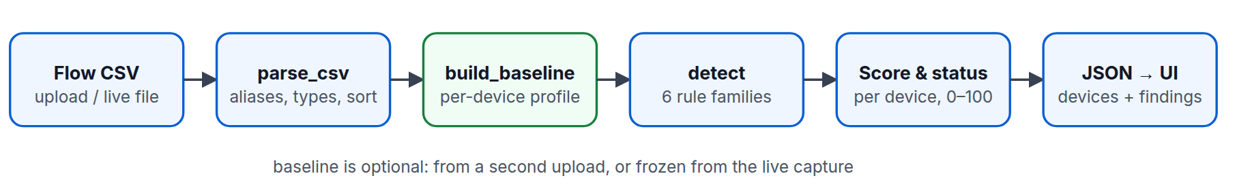
How detection works
1 Parse and normalise
2 Compare with a baseline
3 Score and report
Column aliases, ISO or epoch timestamps, and clear errors for bad files.
Known-good ports and peers per device decide what is normal.
Findings carry severity and ATT&CK; each device gets a 0-100 score.
Notes:
A flow CSV goes through three stages. Parsing makes different exports uniform. The optional baseline records what each device normally does. The rules then produce findings, each mapped to MITRE ATT&CK, and a risk score per device.

Slide 11
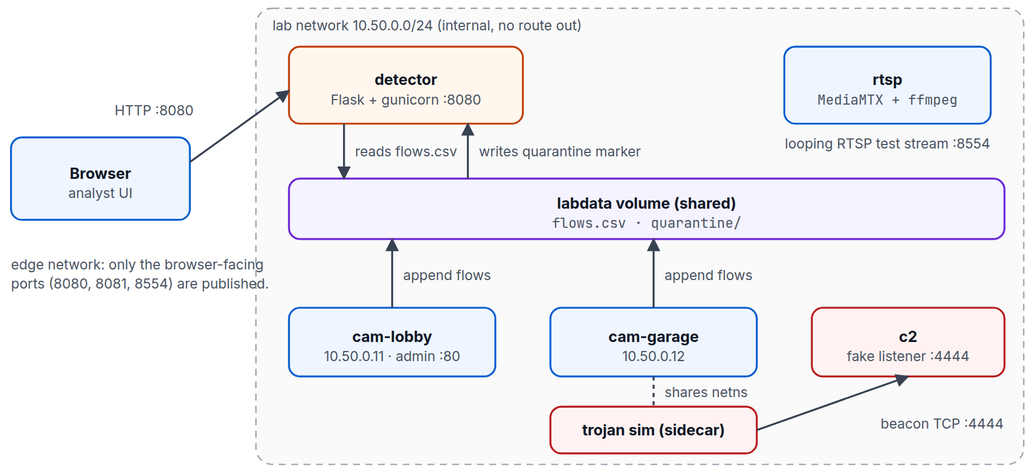
System architecture
The lab network is internal: no route to the internet
The trojan shares a camera's network namespace
A shared volume carries flows.csv and quarantine markers
Harmless: EICAR test string, fake C2, no real payload
Docker Compose
Flask + gunicorn
MediaMTX + ffmpeg
Notes:
Everything runs in containers on an internal network with no route out. The trojan simulator shares a camera's network namespace, so its beacons carry that camera's address. Flow records go to a shared volume that the detector reads, and quarantining a device drops a marker file the simulator honours.

Slide 12
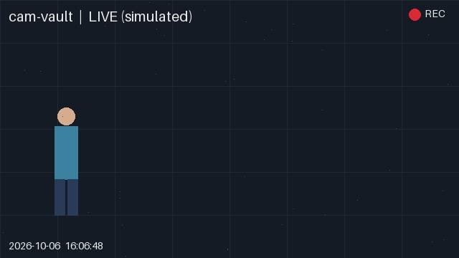
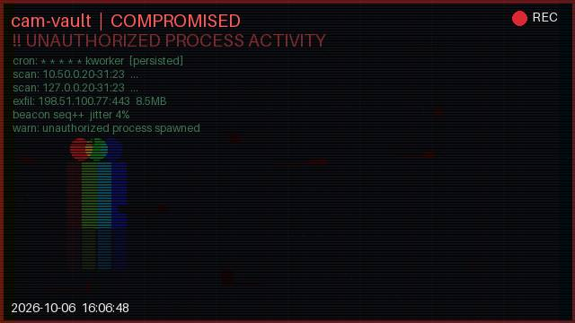
Watch an infection happen
Before: normal video
After: feed glitches, virus activity overlaid
A new camera, "cam-vault", starts already infected. Its picture visibly breaks up and shows the virus's real activity (connections, file drops) -- so an audience can SEE the infection.
Windows support
Live streaming video
Pre-infected camera
Ready to host online
Notes:
The newest addition: a camera called cam-vault that starts already infected. Instead of just a score on a dashboard, its video feed itself glitches and overlays the virus's real fake activity. Also recently added: the whole lab now runs on Windows with one command, the cameras stream real-looking live video, and the detector is ready to be hosted online for a demo link.

Slide 13
Detection rules
Rule | Fires when | Severity | ATT&CK
Known-bad IP | Contact with a threat-intelligence listed address | Critical | T1071
Suspicious port | Ports such as 23, 4444, 6667 and 31337 | High | T1571
Unusual port | Port outside the baseline and camera defaults | Medium | T1571
New external peer | Destination never seen in the baseline | Medium | T1071
Beaconing | 6+ flows, jitter CV <= 0.25, peer outside baseline | High | T1029
Scan burst | 10+ hosts or ports within 60 s | High | T1018 / T1046
Large transfer | 5 MB or more to one external address | High | T1041
Size outlier | Flow above baseline mean + 4 sigma | Medium | T1030
Notes:
Eight rule families, each tied to a MITRE ATT&CK technique. Beaconing is the interesting one: it measures how regular the gaps between flows are, using the coefficient of variation, and only applies to peers outside the device baseline. Thresholds are constants at the top of engine.py.

Slide 14
Scoring and baselines
Why a baseline?
Healthy cameras are periodic too: video every ~10 s, NTP, heartbeats.
Beaconing counts only for peers outside a device's baseline.
A 15 s beacon scores about 0.02 on jitter, far below the 0.25 limit.
Clean
< 10
Suspicious
10-49
Compromised
50+
0 findings on the clean capture
Notes:
Each finding adds a weight: critical 40, high 25, medium 10, low 3, capped at 100. Under 10 is clean, 10-49 suspicious, 50+ compromised. The baseline is what stops false alarms: regular traffic to known peers is ignored, regular traffic to a new peer is not.

Slide 15
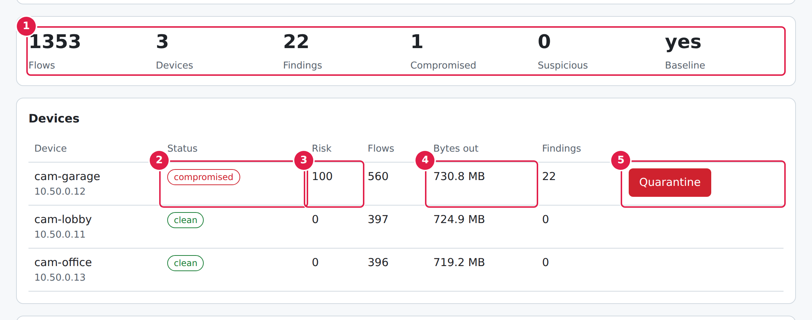
The detector in action
Infected sample: cam-garage compromised (score 100); other cameras clean.
Notes:
Live demo here if possible: load the infected sample. Point to the numbered callouts: summary tiles, status pill, risk score, bytes out and the Quarantine button.

Slide 16
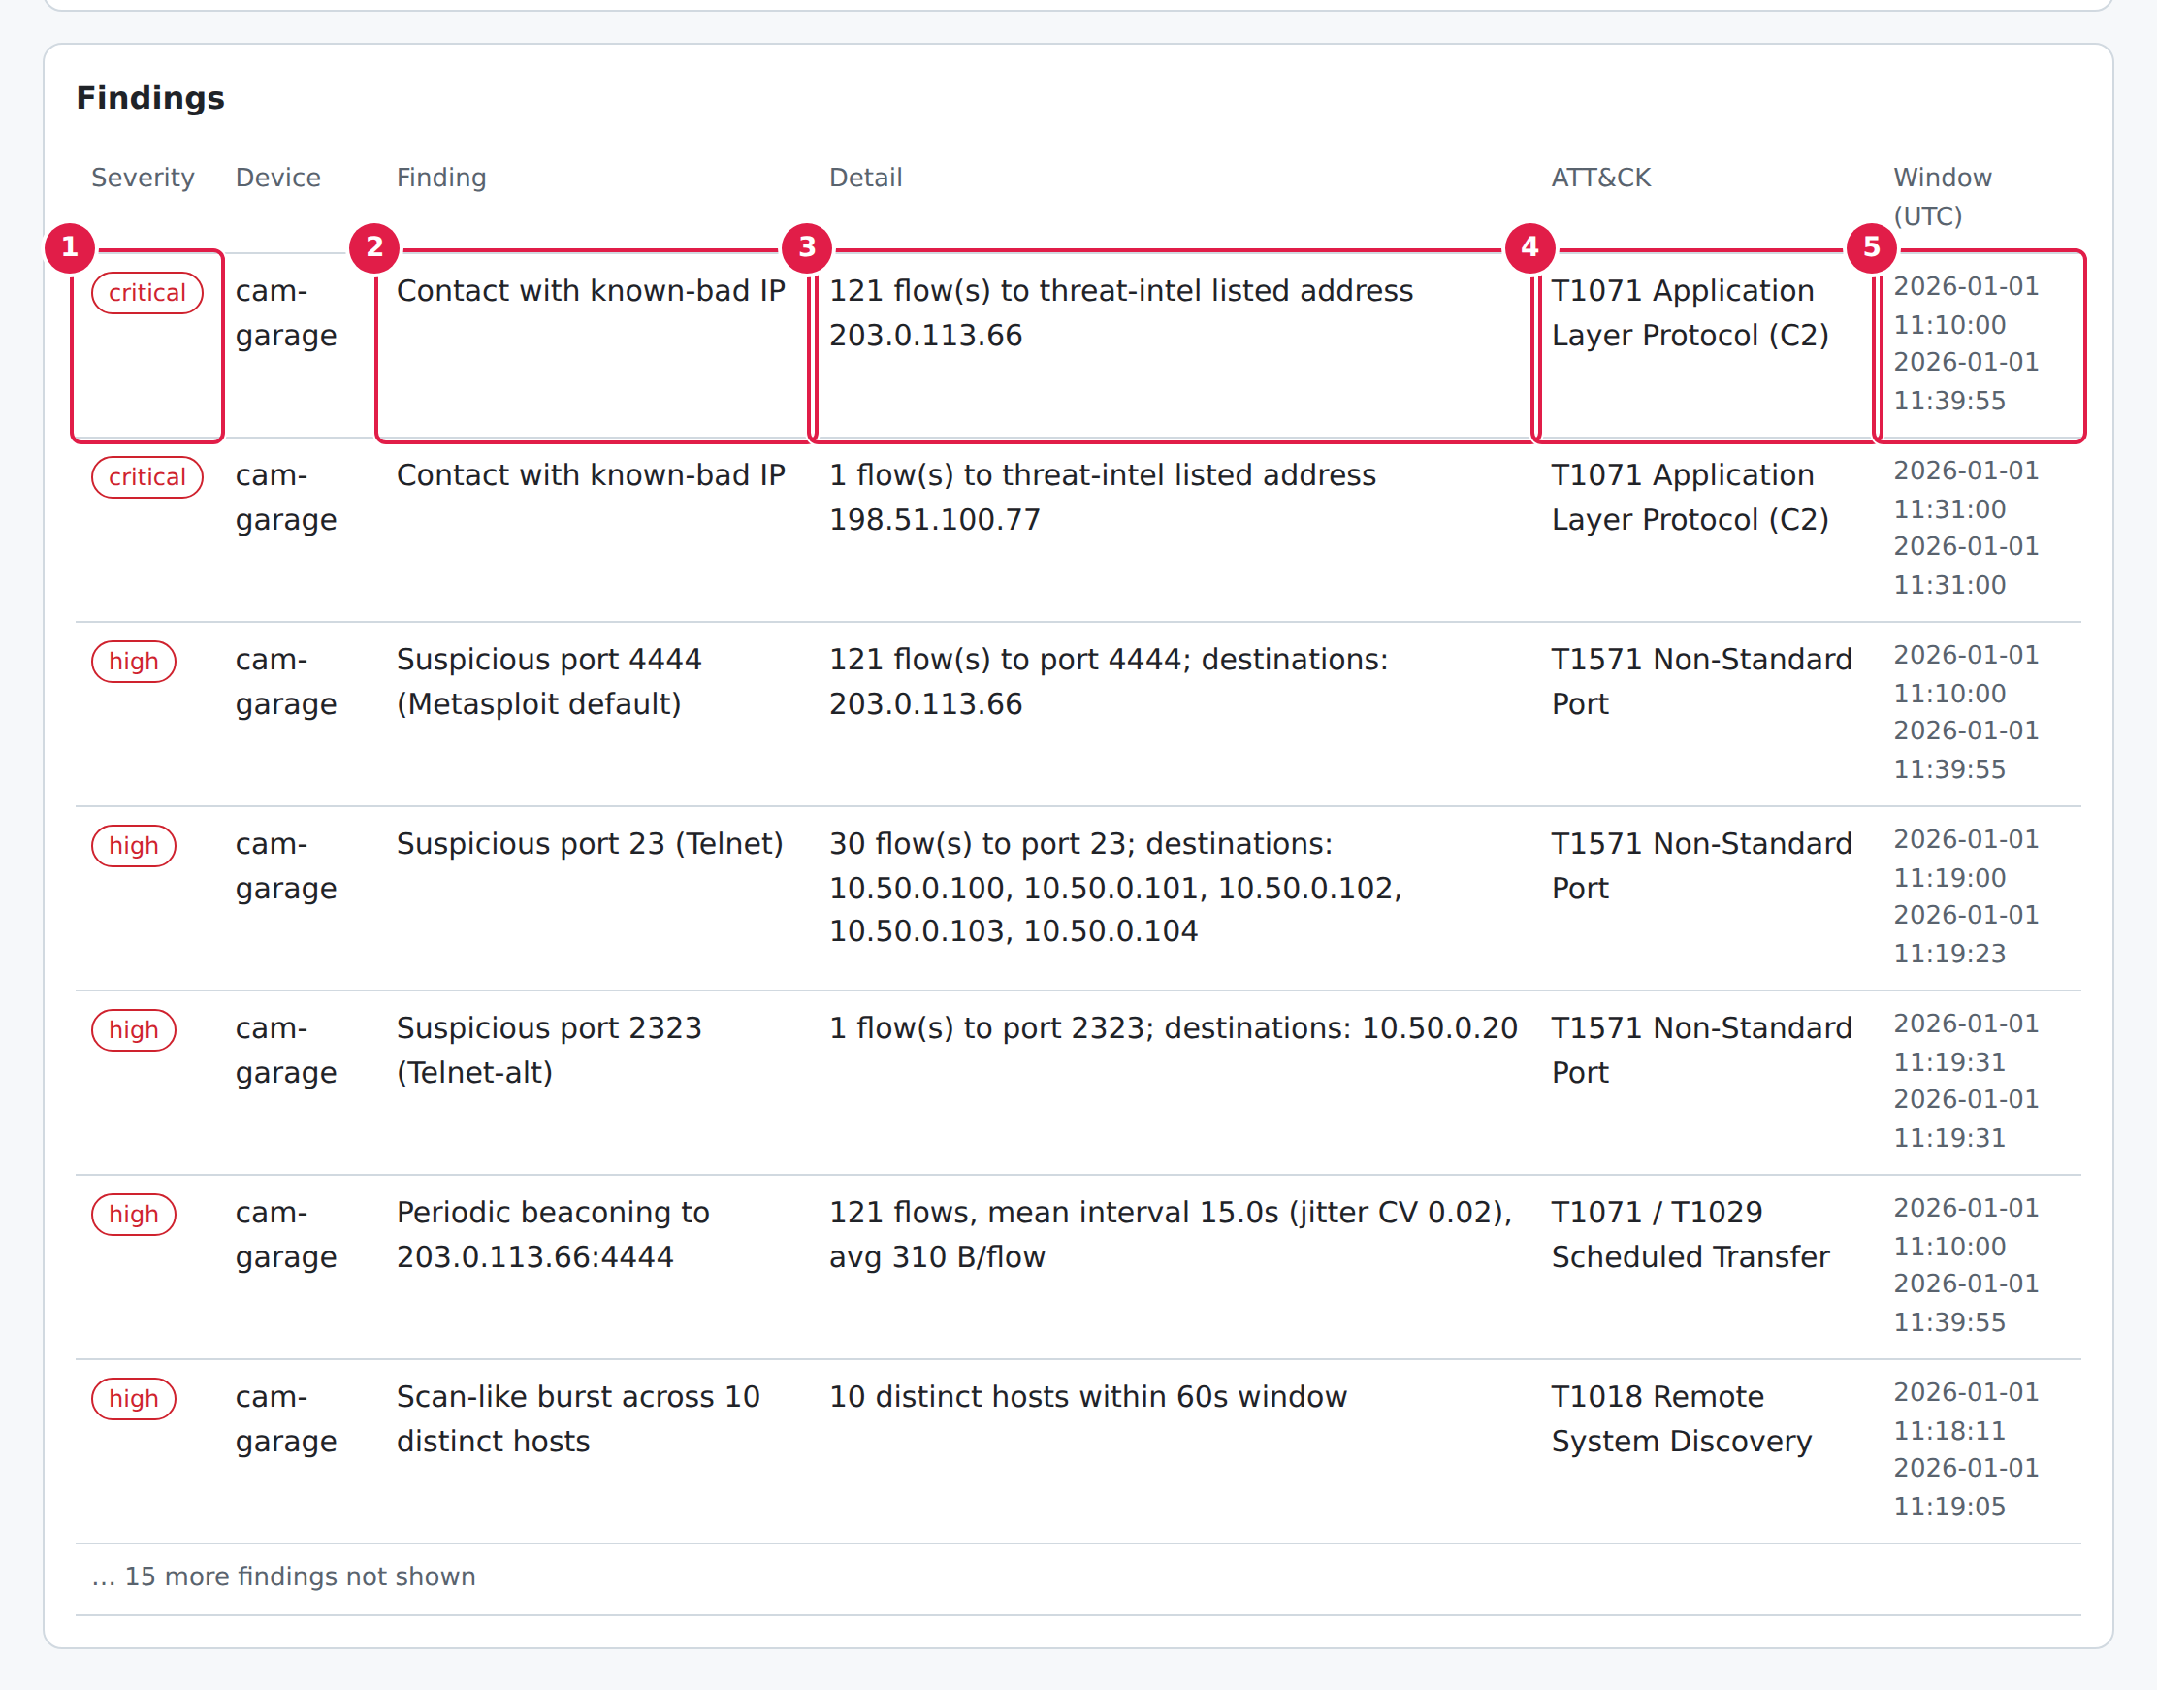
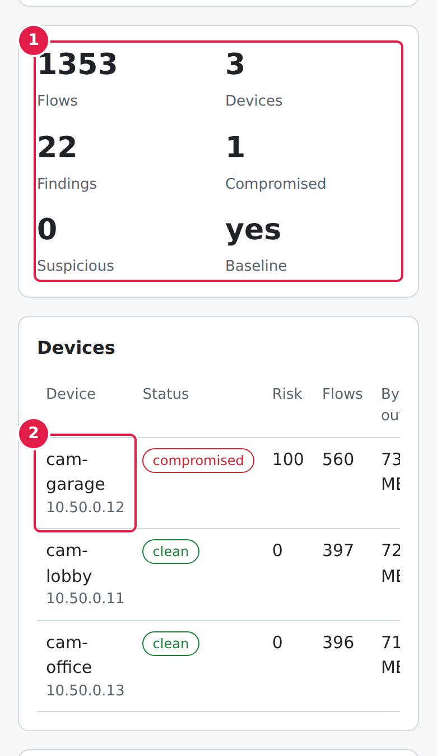
Findings explained, and on a phone
Severity, evidence and ATT&CK technique for every finding
Tables scroll inside their cards on a phone
One-click Quarantine and Release
Notes:
The findings table explains each detection in plain words and in ATT&CK terms. The same page works on a phone, which suits on-call triage. The sample has 22 findings; the screenshot shows the first seven.

Slide 17
Testing & Evidence
Three kinds of proof: an automated test suite, and real screenshots of positive and negative cases
Notes:
Three kinds of evidence follow: the automated pytest suite running green, then real screenshots proving the positive cases (it catches the infected camera) and the negative cases (it leaves healthy traffic and bad input alone).

Slide 18

Evidence 1: automated test suite
Every one of the 24 tests, not a sample -- real output, captured just now
python -m pytest -v trojan-lab/tests
test_app.py::test_upload_with_baseline................................PASS
test_app.py::test_upload_rejects_bad_csv..............................PASS
test_app.py::test_no_file.............................................PASS
test_app.py::test_sample_and_quarantine_roundtrip.....................PASS
test_app.py::test_quarantine_rejects_traversal........................PASS
test_app.py::test_live_capture_missing_gives_actionable_error.........PASS
test_app.py::test_live_capture_present................................PASS
test_engine.py::test_clean_capture_has_no_findings[True]..............PASS
test_engine.py::test_clean_capture_has_no_findings[False].............PASS
test_engine.py::test_infected_device_flagged_others_clean[True].......PASS
test_engine.py::test_infected_device_flagged_others_clean[False]......PASS
test_engine.py::test_beacon_interval_reported.........................PASS
test_engine.py::test_column_aliases_and_epoch.........................PASS
test_engine.py::test_missing_columns_message..........................PASS
test_engine.py::test_empty_or_headers_only[]..........................PASS
test_engine.py::test_empty_or_headers_only[timestamp,device\n]........PASS
test_engine.py::test_irregular_traffic_not_beacon.....................PASS
test_flowlog_camera.py::test_flowlog_header_once_and_all_rows.........PASS
test_flowlog_camera.py::test_flowlog_windows_fallback_path............PASS
test_flowlog_camera.py::test_default_data_dir_env.....................PASS
test_flowlog_camera.py::test_camera_requires_login....................PASS
test_flowlog_camera.py::test_camera_snapshot_is_jpeg..................PASS
test_flowlog_camera.py::test_camera_stream_is_live_mjpeg..............PASS
test_flowlog_camera.py::test_camera_shows_compromise_when_infected_marker_presentPASS
============================== 24 passed in 0.48s ==============================
24/24
Notes:
This is a real, just-captured pytest run, not a mock-up -- every one of the 24 tests is listed here, not a sample, and all 24 pass. It covers the detection engine's rules, the web API, the Windows-compatible flow logger, and the live camera stream.

Slide 19
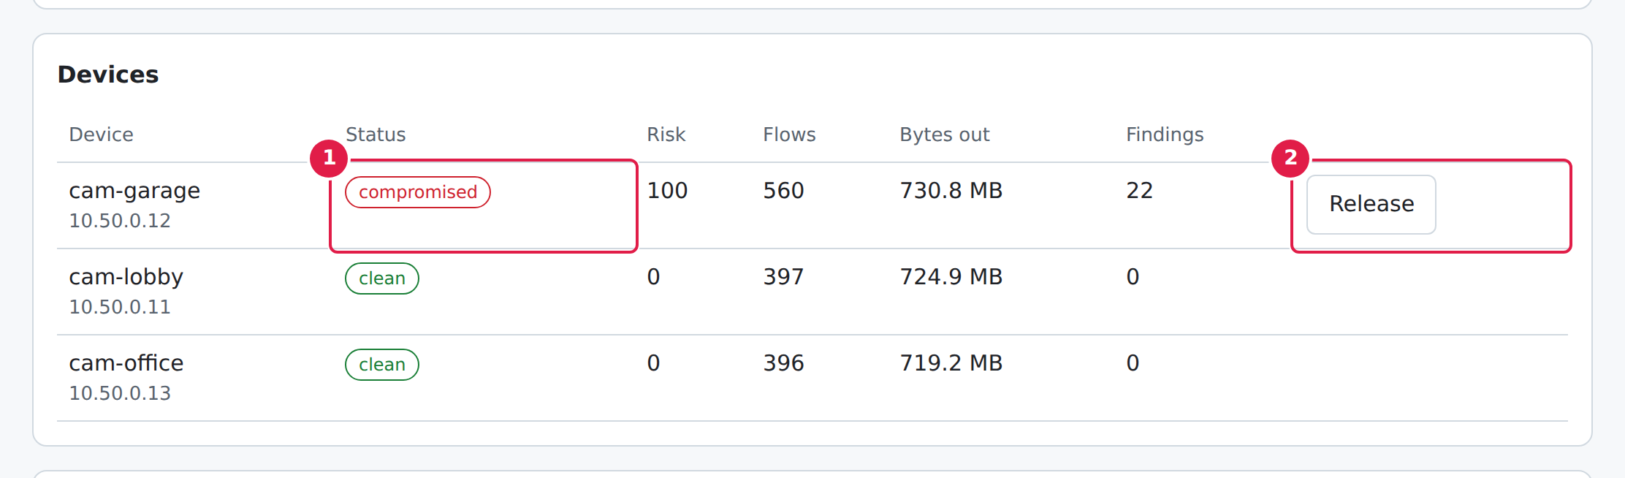
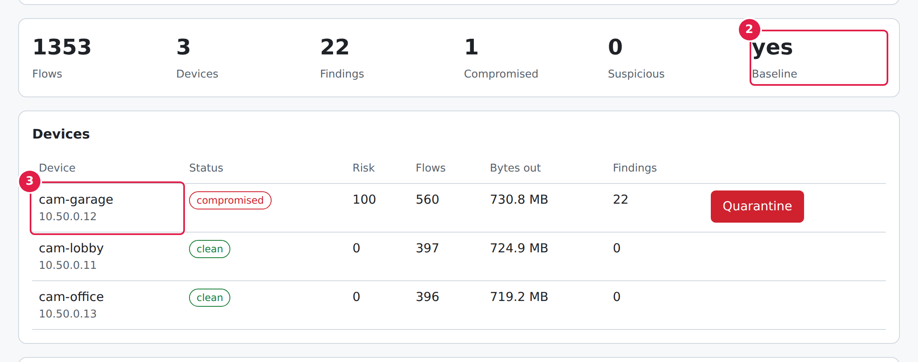
Evidence 2: positive test cases
Proving the detector catches what it should
P7: live lab capture
P6: quarantine action
Reads flows.csv written by the running lab
P1: infected sample
One click removes the simulated persistence
cam-garage flagged compromised, score 100
PASS
PASS
PASS
Notes:
Three positive cases, each a real screenshot of the running app: the infected sample is caught and scored; the Quarantine button actually removes the simulator's persistence files; and the live lab capture is read correctly while the lab is running.

Slide 20
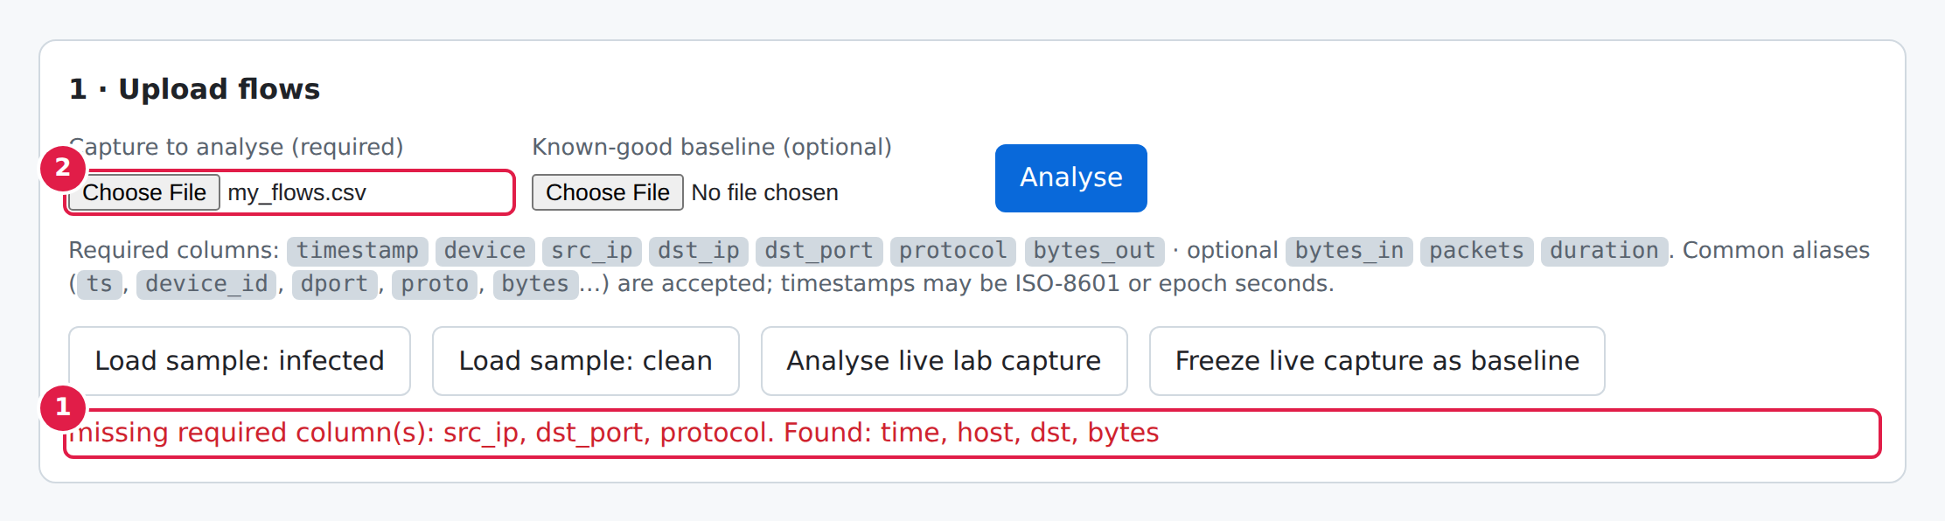
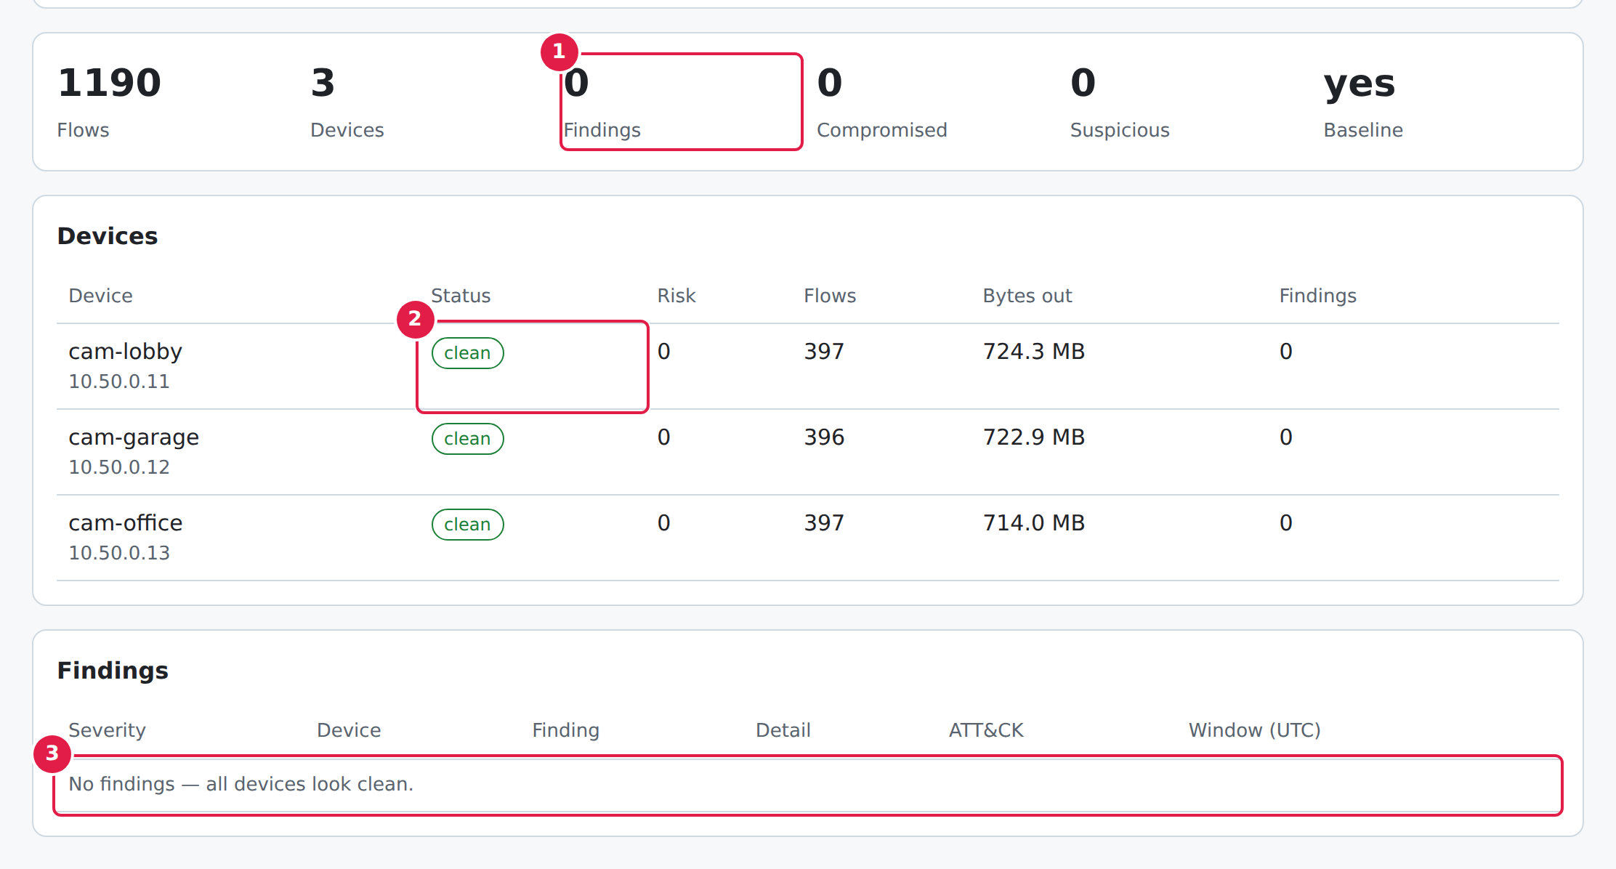
Evidence 3: negative test cases
Proving it rejects bad input and does not cry wolf
N7: clean traffic
0 findings on 1,190 healthy flows -- no false alarms
N1: malformed CSV
PASS
Missing columns -> HTTP 400 with a clear message, not a crash
PASS
Notes:
Two negative cases: a malformed CSV is rejected with a readable error instead of crashing, and the clean traffic sample -- which is just as regular as the infected one -- produces zero false alarms, because of the baseline logic shown earlier.

Slide 21
Results at a glance
24/24
22
0
100
automated tests pass
findings on the infected sample
false alarms on clean traffic
risk score given to the infected camera
cam-garage
compromised, score 100
cam-lobby
clean, score 0
cam-office
clean, score 0
Infected sample: 1,353 flows from 3 cameras. Clean sample: 1,190 flows. Same engine, same thresholds -- just different input.
Notes:
All tests pass. The infected capture produces 22 findings, all on cam-garage, which scores 100. The clean capture is just as regular but produces no findings -- evidence that the baseline avoids false positives.

Slide 22
What testing found, and current limits
Defects found & fixed
Current limitations
Healthy traffic was first mistaken for beaconing -> fixed with the baseline
Lab's test IPs were treated as private -> LAN ranges now listed explicitly
Baseline lives in memory -> noted as an open item
Heuristic rules, tuned on simulated data
Cannot inspect encrypted payloads
No built-in login -- do not expose it publicly as-is
Docker layer still needs a run on a Docker host
Notes:
Testing paid for itself: two of the three defects found changed the design before anyone else could hit them. To be upfront: the rules are heuristic, it cannot see inside encrypted traffic, it has no login screen, and the Docker layer still needs a run on a machine with Docker.

Slide 23
Conclusion & recommendations
What I achieved
Recommendations
A working, tested Trojan detector for IoT flows
A safe, repeatable camera lab -- now with a camera you can watch get hacked
24/24 automated tests, plus real positive and negative evidence
Practical skills in security, containers, Python, Windows and documentation
HiiT: a written task schedule and a named reviewer for each intern
University: earlier security and DevOps content, more supervisory visits
ITF: prompt allowances and closer placement monitoring
Notes:
Summarise: the system works on the samples, the lab makes it demonstrable and now visible, and I gained real practical skills. Recommendations: HiiT should give interns written task schedules and reviewers; the university should bring security and DevOps content earlier; the ITF should pay allowances promptly and monitor placements.

Slide 24
Thank you
Questions?
Code, tests and documentation: github.com/emmanuelekopimo/build-with-ai
Notes:
Invite questions. Likely ones: why not signatures, how false positives are avoided (the baseline), and whether the trojan is real (no -- it is a harmless simulator on an isolated network).

