Slide 1

IoT Trojan Detector
Catching a hidden virus on a smart camera by watching its internet traffic
Notes:
Title slide. One line: this project finds a hidden Trojan on a smart camera by watching the camera's network traffic, not by touching the camera itself.

Slide 2




The problem
Smart cameras are everywhere
Weak default passwords
Cheap, always on, rarely updated
Many still use admin/admin
A virus can hide inside one
It can't run antivirus
It still shows video, but secretly "calls home"
Too small, too simple to protect itself
Notes:
Smart cameras are a favourite target: cheap, always online, often still using the factory password. A hidden virus (a "Trojan") can infect one and keep streaming video normally while secretly talking to an attacker. The camera itself has no room to run security software.

Slide 3
The idea: watch the traffic, not the camera
A camera leaves a trail even if nobody looks at the video: who it talks to, how often, on what "door" (port), and how much data.
Normal camera
sends video
to its recorder
Infected camera
ALSO talks to a
stranger, on a timer
This project reads that trail (a CSV of flow records) and flags the difference.
Notes:
Instead of inspecting the camera, we look at its network traffic: every connection leaves a record of who it talked to, how often and how much data moved. A normal camera only talks to its recorder and a few known services. An infected one also beacons to a stranger on a timer. This project reads those records and spots the difference.

Slide 4






What the tool does
Upload your traffic
9 warning signs
A score per device
A CSV file, or use the sample / live lab
Odd ports, repeated "beacons", scans, big uploads
0 to 100: clean, suspicious, or compromised
One-click quarantine
A safe mini lab
Works on phones too
Cut off a suspect device
Fake cameras + a harmless pretend virus to test it on
Same page, smaller screen
Notes:
Six things the tool does: take a traffic file as input; look for nine warning signs; turn that into a simple score and status per device; let you quarantine a bad device with one click; and it all runs in a safe mini lab with fake cameras, so nobody needs a real camera or a real virus. It also works on a phone.

Slide 5
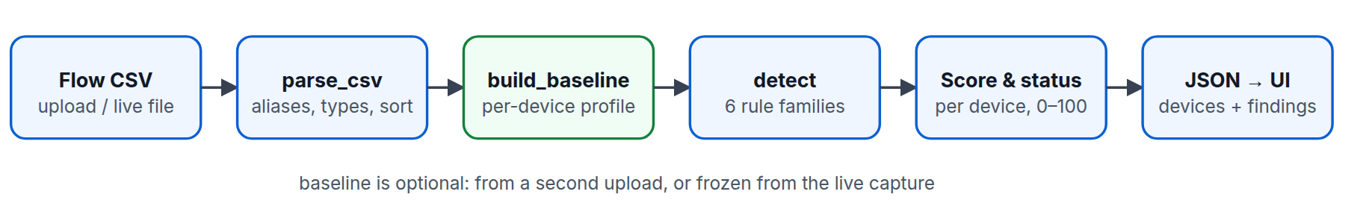
How it decides
1. Read the file
2. Know what's normal
3. Spot and score
Clean up dates, names and numbers
Learn each camera's usual habits (optional)
Flag anything odd, add up a risk score
Notes:
Three simple steps: read and clean the uploaded file; optionally learn what's normal for each camera, so a routine check-in isn't mistaken for a virus; then check for nine warning signs and add up a score.

Slide 6
The 9 warning signs
Known-bad address: Talking to an address already on a blocklist
"Beaconing": Checking in like clockwork — a sign of remote control
Suspicious door (port): Using a port hackers commonly use
Scanning: Knocking on many doors or many neighbours fast
Unusual door (port): Using a door it never used before
Big upload: Sending a large amount of data out at once
New stranger: Talking to someone it never talked to before
Size doesn't match: A single transfer far bigger than its usual habit
Notes:
Nine checks in plain terms: a known-bad address, an unusual or suspicious port, a brand-new contact, regular check-ins (beaconing — a classic remote-control sign), scanning many hosts or ports fast, and anything about data volume that is unusually large.

Slide 7
Why it doesn't cry wolf
The trap
The fix
A healthy camera is ALSO regular: it streams video every 10 seconds and checks the clock
A simple "regular = suspicious" rule would flag every normal camera
Teach the tool who each camera normally talks to (a "baseline")
Only a check-in to a NEW, unknown address counts as suspicious
Result: the clean sample gets 0 false alarms
Notes:
A normal camera is itself very regular, so a naive "regular traffic = virus" rule would flag every healthy camera. The fix is a baseline: teach the tool who each camera normally talks to. A regular check-in to a known address is ignored; the same regularity to a brand-new address is flagged. Result: zero false alarms on the clean sample.

Slide 8
A safe lab to test it in
Pretend cameras + a harmless pretend virus — nothing real is ever at risk
Notes:
To show the tool working, the project includes a small safe lab: pretend cameras and a harmless pretend virus, so nothing real is ever touched.

Slide 9
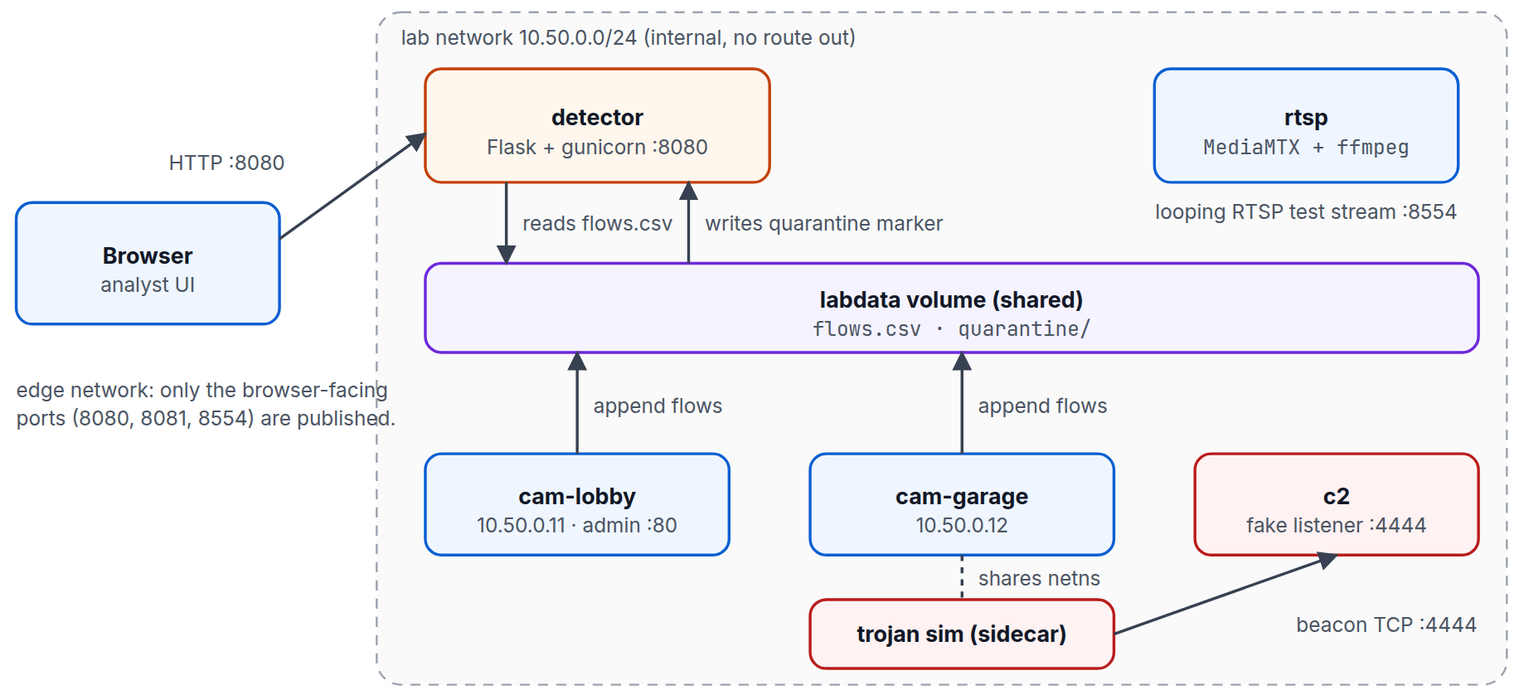
What's in the lab
3 pretend cameras — one is already infected on startup
A pretend "attacker" server the virus checks in with
The detector, reading everyone's traffic
Sealed off from the internet — nothing can leak out
Notes:
The lab has three pretend cameras, a pretend attacker server, and the detector watching everyone's traffic. It is sealed off from the real internet, so nothing can ever get out.

Slide 10
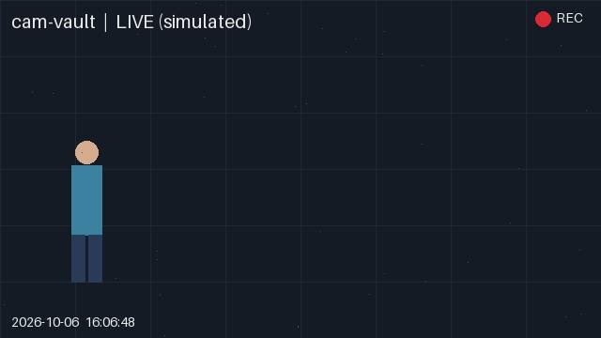
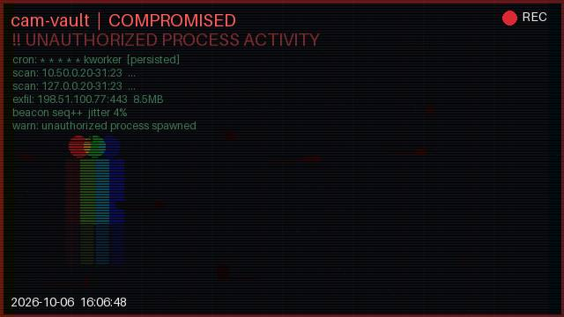
New: watch an infection happen
Before: normal video
After: screen glitches + shows what the virus is doing
A new camera, "cam-vault", starts already infected. Its picture visibly breaks up and overlays the virus's real activity (fake connections, fake file drops) — so you can SEE the infection, not just read about it.
Notes:
This is the newest piece: a third camera called cam-vault that starts already infected. Instead of just a score on a dashboard, its video feed itself visibly glitches and shows an overlay of the pretend virus's real activity — the fake process, its fake connections, the fake scan. It makes the infection visible, not just reported.

Slide 11
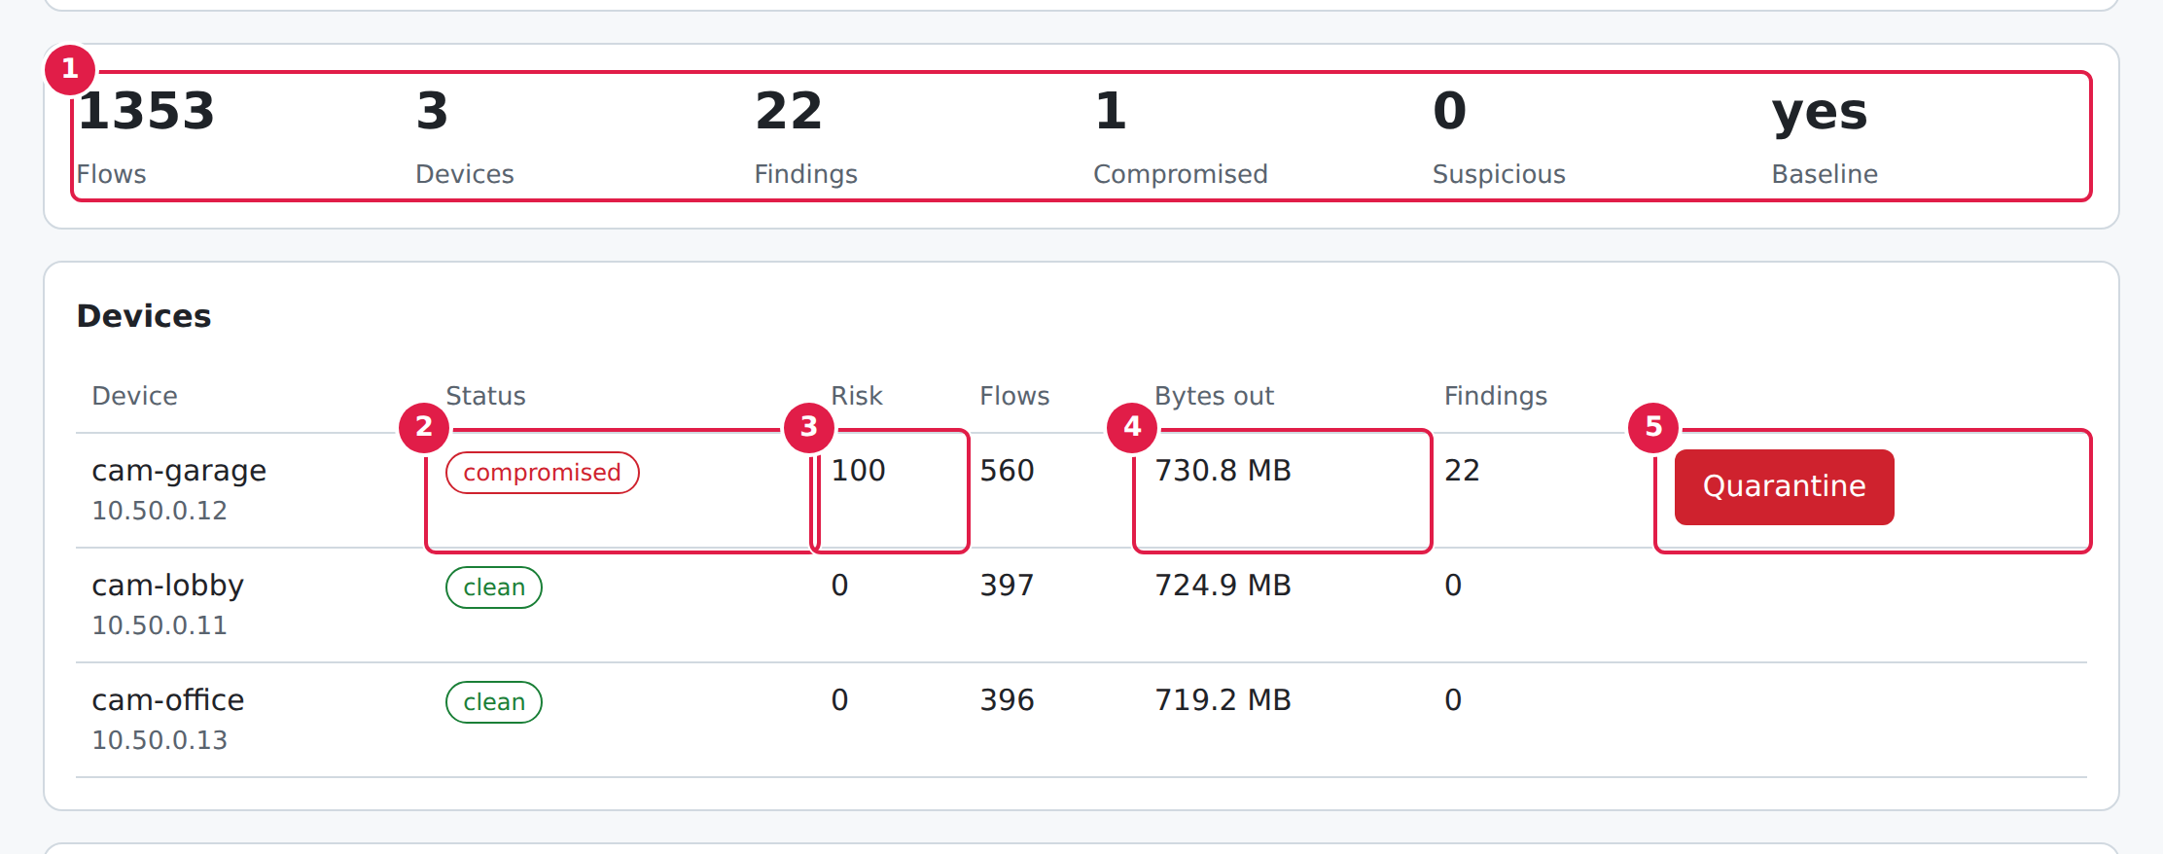
What you see in the detector
Test run: one camera (cam-garage) is flagged compromised with a risk score of 100; the other two stay clean.
Notes:
This is the actual detector screen after analysing a test capture: one camera flagged compromised with a risk score of 100, the other two cameras stay clean.

Slide 12
Does it actually work?
24/24
22
0
100
automated checks pass
warnings found on the infected test
false alarms on clean traffic
risk score given to the infected camera
In short: it catches the infected camera, leaves the healthy ones alone, and every automated check passes.
Notes:
In short: every automated check passes, the infected camera is caught with a high risk score, and the clean traffic produces zero false alarms.

Slide 13



Recent upgrades
Works on Windows now
Real-looking live video
Not just Mac/Linux; one command starts everything
Cameras now stream moving video you can watch in a browser
A camera you can watch get hacked
Ready to put online
cam-vault — infected from the start, glitching feed
Can be hosted on a free/cheap site for demos
Notes:
Four recent additions: it now runs on Windows with one command; the pretend cameras stream real-looking moving video; a new camera lets you literally watch it get hacked; and the detector is ready to be hosted online for a live demo link.

Slide 14
What it can't do (yet)
It reads TRAFFIC PATTERNS, not the content of messages — it can't see inside encrypted data
The rules are hand-written, not learned from millions of real attacks (yet)
It has no login screen — don't put it on the open internet without adding one
The pretend virus is 100% harmless: it never touches real files or sends real data anywhere
Notes:
To be upfront: it reads traffic patterns, not message contents, so it can't see inside encrypted data. The rules are hand-written, not machine-learned. It has no login screen yet, so it shouldn't be put on the open internet as-is. And the test virus is completely harmless — it never touches a real file or sends real data anywhere.

Slide 15
Thank you
Questions?
Code: github.com/emmanuelekopimo/build-with-ai
Notes:
Close. Invite questions.

