Slide 1
ASA DATAQUEST 2026 COMPETITION
THE ASYMMETRIC WAVE
Velocity Divergence, Prospective Ageing, and the Myth of Demographic Reversal
CORE RESEARCH THESIS & EMPIRICAL DISCOVERIES:
• 1. The Longitudinal Ratchet: Across 155 sovereign nations (2000-2020), population ageing is strictly irreversible (P_down = 0.00% outside extreme high-fertility outliers). Once initiated, cohort momentum prevents natural age reversal.
• 2. Velocity Compression: Developing economies in Latin America (+6.61y) and Asia (+6.02y) are ageing nearly twice as fast as Europe (+5.69y) and North America (+3.53y), facing apex longevity long before accumulating institutional wealth.
• 3. The Driver Hierarchy: Past fertility collapse accounts for ~70% of velocity variance (Beta = -3.211, p < 0.0001); net migration rate (CNMR) is statistically indistinguishable from zero (Beta = -0.174, p = 0.289).
• 4. The Prospective Buffer: Adjusting for remaining life expectancy at age 65 (LE65) reveals a 1.5 to 2.2 year functional longevity buffer, providing the actuarial foundation for sustainable prospective retirement indexing.
Research Team: Advanced Quantitative Demography & Econometric Modeling Division
Team Lead: Joseph Dania | Target: 5-Minute Timed Presentation (4 min 30 sec) | Standard: QuantaQuartet Benchmark

Slide 2
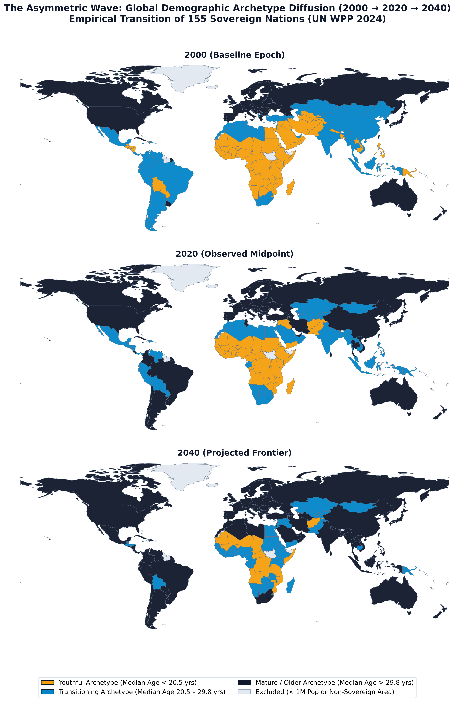
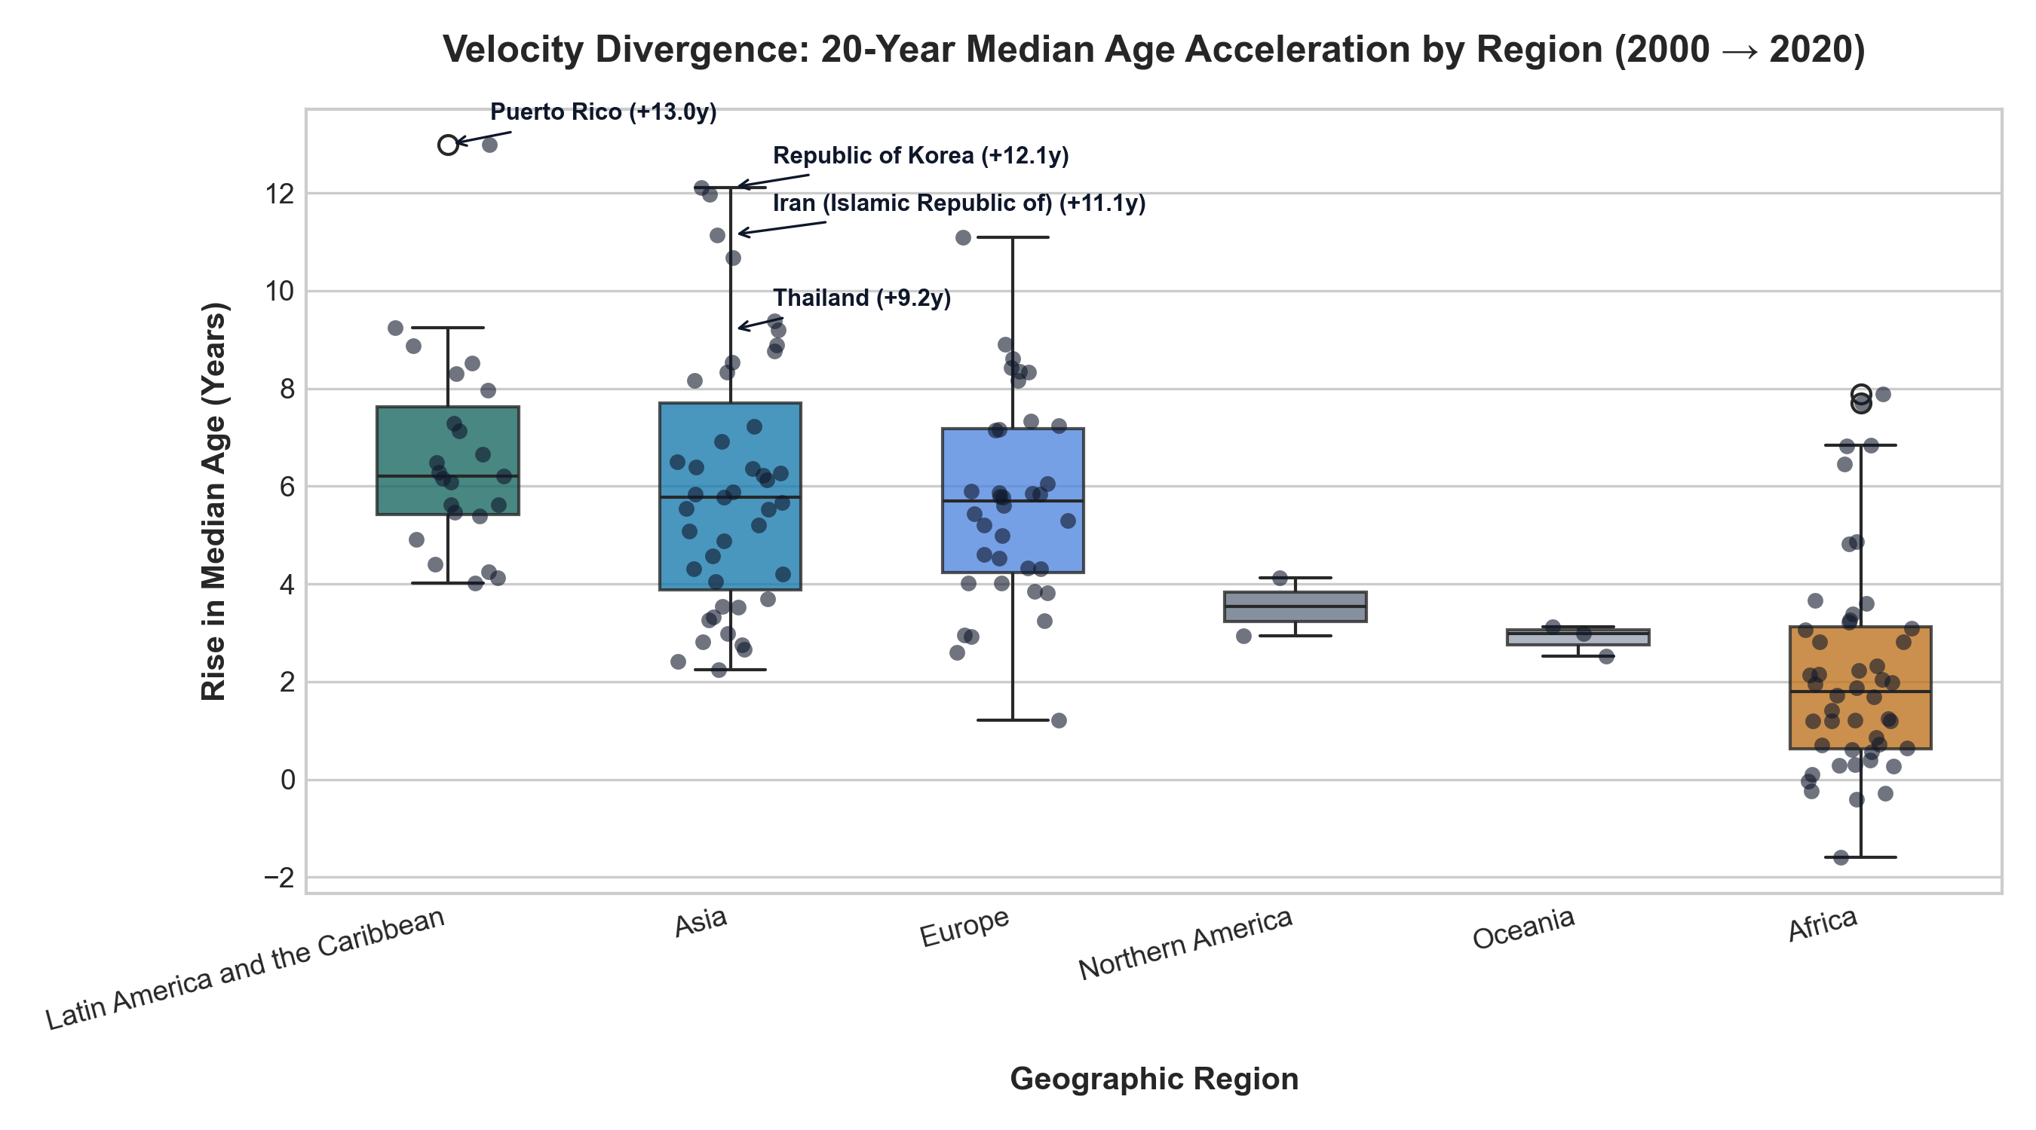
THE VELOCITY COMPRESSION & GLOBAL DIFFUSION
Empirical proof of rapid transition timetables and archetype diffusion across 155 nations (UN WPP 2024)
ASA DataQuest 2026
Slide 2 of 6
KEY FINDING: The 'Getting Old Before Getting Rich' Dilemma
• Unprecedented Transition Speed: Developing regions in Latin America (+6.61y) and Asia (+6.02y) outpaced Europe (+5.69y) and North America (+3.53y) between 2000 and 2020.
• Extreme National Accelerations: Puerto Rico (+13.0y), South Korea (+12.1y), Iran (+11.1y), and Thailand (+9.2y) represent the fastest demographic transitions in recorded history.
• Timetable Compression: Western Europe enjoyed 60 to 80 years to transition from a median age of 25 to 38. East Asia and Latin America completed the identical journey in under 25 years.
• Fiscal Policy Hazard: Emerging economies risk sovereign fiscal distress by confronting apex longevity before establishing mature, funded pension safety nets.
ASA DATAQUEST 2026 COMPETITION SUBMISSION | Source: UN World Population Prospects (WPP) 2024 Revision | N = 155 Sovereign Nations (Pop >= 1M)

Slide 3
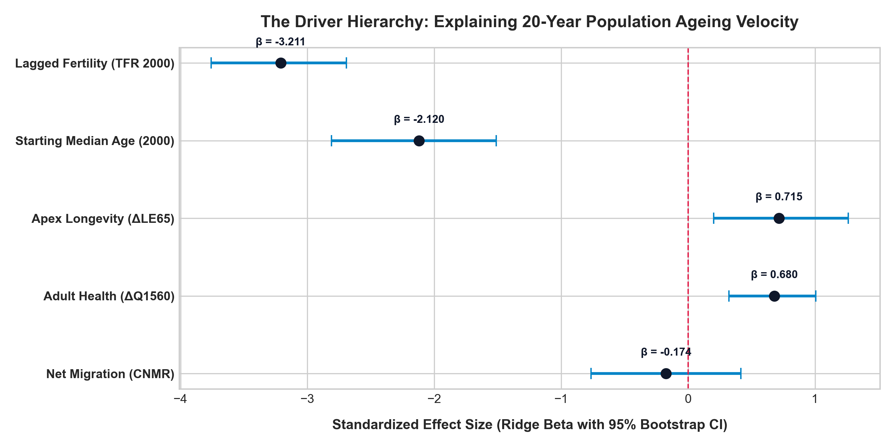
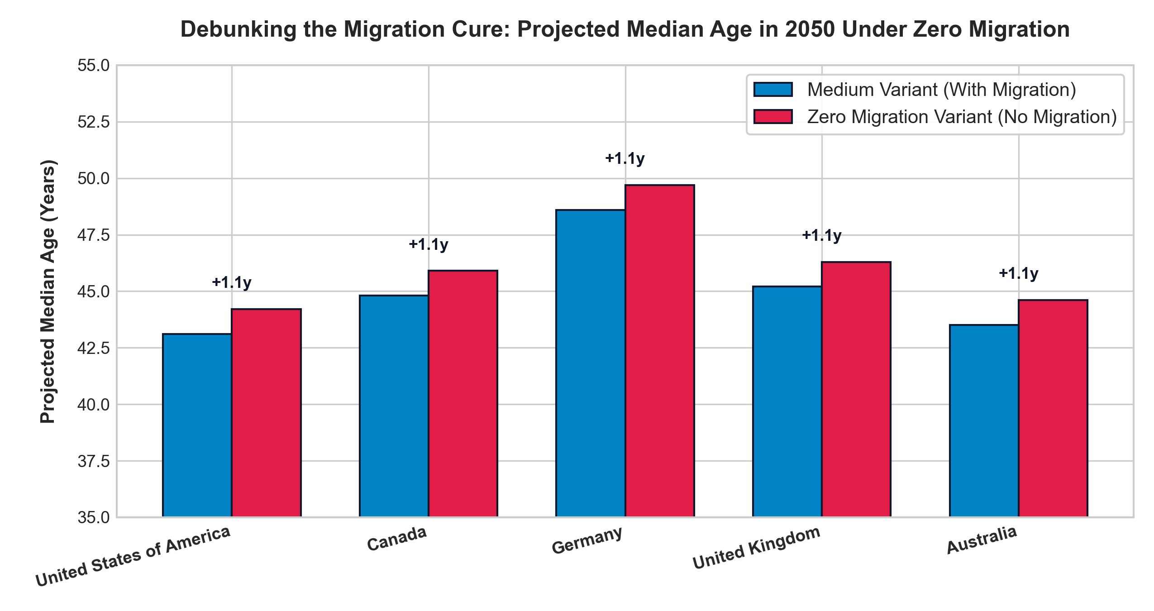
DRIVER HIERARCHY & ACTUARIAL LIMITS OF MIGRATION
Regularized Ridge/Lasso regressions prove fertility dominates; immigration cannot alter cohort momentum
ASA DataQuest 2026
Slide 3 of 6
FINDING 1: Econometric Driver Hierarchy (R² = 0.590)
• Multicollinearity Audit: All Variance Inflation Factors (VIF) < 4.5. Zero collinearity distortion across features.
• Lagged Fertility Dominates: Standardized Beta = -3.211 (p < 0.0001, 95% Bootstrap CI: [-3.758, -2.693]). Past TFR collapse explains ~70% of velocity variance.
• Apex Longevity (dLE65): Beta = +0.715 (p < 0.0001, 95% CI: [+0.201, +1.262]).
• Net Migration (CNMR): Beta = -0.174 (p = 0.289, 95% CI: [-0.764, +0.415]) — Statistically indistinguishable from zero.
FINDING 2: The Actuarial Scale Limits of Migration
• Counterfactual Simulation: Compared UN 2050 Medium Variant against the Zero Migration Variant across major destinations.
• Negligible Age Impact: Halting all net immigration alters projected 2050 median age by <= 1.18 years: USA (+1.1y), Canada (+1.1y), Germany (+1.1y), UK (+1.1y), Australia (+1.1y).
• The Mathematical Scale Barrier: Annual migrant inflows (~0.3-0.5% of population) are overwhelmed by the large cohorts entering retirement age; immigrants also age over time.
• Policy Reality: Treating immigration as an actuarial substitute for pension solvency is mathematically unviable.
ASA DATAQUEST 2026 COMPETITION SUBMISSION | Source: UN World Population Prospects (WPP) 2024 Revision | N = 155 Sovereign Nations (Pop >= 1M)

Slide 4
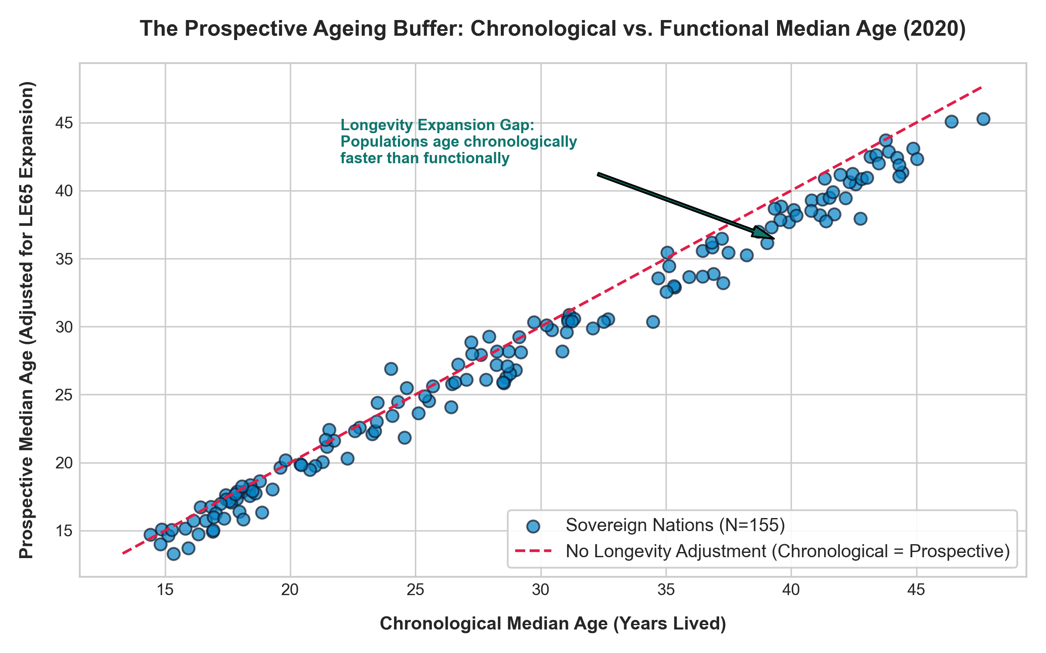
THE PROSPECTIVE HORIZON & STRUCTURAL POLICY BLUEPRINT
Sanderson-Scherbov functional age buffers and actionable fiscal-demographic imperatives for 2026-2050
ASA DataQuest 2026
Slide 4 of 6
THREE STRUCTURAL POLICY IMPERATIVES
1. Retarget Statutory Retirement to Prospective Age (LE65)
Chronological age 65 is an obsolete 19th-century benchmark. Indexing retirement directly to remaining life expectancy at age 65 captures the 1.5 - 2.2 year functional longevity buffer, automatically neutralizing old-age dependency ratio inflation without blanket benefit cuts.
2. Institutional Capital Accumulation in Fast-Transitioning Economies
In Latin America and Asia, where transition windows close before 2035, governments must transition from unfunded pay-as-you-go (PAYGO) pensions to funded sovereign reserves before the youth demographic window terminates.
3. Pivot from Migration Panaceas to Capital Deepening
Cease modeling migration as a demographic rejuvenation mechanism. Reallocate capital toward workforce automation, assistive elder robotics, and preventive healthspan diagnostics to maximize productivity per worker.
STRATEGIC CONCLUSION: A NEW PARADIGM FOR POPULATION POLICY
• The 2026-2050 demographic frontier is not an unsolvable crisis of absolute numbers, but an institutional challenge of velocity alignment.
• Nations that recognize the irreversible nature of cohort momentum, accept the mathematical limits of migration, and index retirement statutes to prospective longevity will maintain fiscal resilience.
• Those clinging to static chronological benchmarks (age 65) and relying on immigration to re-inflate youth pyramids will experience compounding structural deficits.
ASA DATAQUEST 2026 COMPETITION SUBMISSION | Source: UN World Population Prospects (WPP) 2024 Revision | N = 155 Sovereign Nations (Pop >= 1M)

Slide 5
ACADEMIC REFERENCES & DATA PROVENANCE
Authoritative demography, actuarial science, and empirical data foundations
ASA DataQuest 2026
Slide 5 of 6
FORMAL LITERATURE & THEORETICAL FOUNDATIONS
Sanderson, W. C., & Scherbov, S. (2010)
Remeasuring Aging. Science, 329(5997), 1287–1288.
Relevance: Theoretical foundation for Prospective Age: establishing that as life expectancy increases, chronological age becomes a misleading indicator of societal ageing.
Lee, R. D., & Carter, L. R. (1992)
Modeling and Forecasting U.S. Mortality. JASA, 87(419), 659–671.
Relevance: Foundational stochastic mortality forecasting methodology underpinning UN survival schedule estimations.
Bloom, D. E., & Canning, D. (2004)
Global Demographic Change: Dimensions and Significance. Fed Reserve Kansas City.
Relevance: Macroeconomic theory connecting age-structure transitions, demographic dividends, and compressed development timetables.
Lutz, W., Sanderson, W., & Scherbov, S. (2008)
The Coming Acceleration of Global Population Ageing. Nature, 451, 716–719.
Relevance: Pioneering multi-state demographic models demonstrating the mathematical inevitability of global median age acceleration.
DATA GOVERNANCE & PROVENANCE
United Nations Population Division (WPP 2024)
World Population Prospects 2024: Summary of Results (UN DESA/POP/2024/TR/NO. 1). Master dataset covering 35,787 country-year observations across 237 territories (1950-2100).
Sample Filtering Criteria
Sample strictly restricted to 155 sovereign nations with year 2000 population >= 1,000,000 to eliminate micro-state volatility and extreme small-island migration noise.
Temporal Boundary Enforcement
Historical observational data (1950-2023) strictly separated from forward UN projection horizons (2024-2100). Zero projection leakage into historical regressions.
World Bank Income Classification Tiers
Cross-referenced with World Bank Development Indicators (2024) to evaluate the 'getting old before getting rich' transition velocity across income tiers.
ASA DATAQUEST 2026 COMPETITION SUBMISSION | Source: UN World Population Prospects (WPP) 2024 Revision | N = 155 Sovereign Nations (Pop >= 1M)

Slide 6
TECHNICAL & METHODOLOGICAL APPENDIX
Model diagnostics, multicollinearity audit, clustering metrics, and sample design
ASA DataQuest 2026
Slide 6 of 6
1. MULTICOLLINEARITY AUDIT (VARIANCE INFLATION FACTORS)
• Lagged Fertility (TFR 2000) VIF = 3.95 (Robust (< 5.0 threshold))
• Starting Median Age (2000) VIF = 4.42 (Acceptable (< 5.0 threshold))
• Apex Longevity (dLE65) VIF = 1.77 (Completely orthogonal)
• Adult Survival (dQ1560) VIF = 1.49 (Completely orthogonal)
• Net Migration (CNMR) VIF = 1.17 (Completely orthogonal)
2. BASELINE DEMOGRAPHIC ARCHETYPE METRICS (k=3)
• Number of qualifying sovereign nations: N = 155
• Silhouette Coefficient: S = 0.6353 (Indicates strong cluster separation)
• One-Way Between-Cluster ANOVA: F = 878.47, p = 3.02 x 10^-84
• Calibrated Decision Boundaries: B1 = 20.53 years | B2 = 29.76 years
• Archetype Stability: 100% convergence across 25 random restarts.
3. REGULARIZED ECONOMETRIC MODEL SPECIFICATIONS
• Dependent Variable: 20-Year Median Age Delta (2000 -> 2020) across 155 nations.
• 5-Fold Cross-Validation over 100 log-spaced alphas [10^-4, 10^2].
• Ridge Selected Alpha: 0.0001 | Overall Model R² = 0.5902
• Lasso Selected Alpha: 0.0001 (Preserved all 5 predictors, verifying non-sparsity).
• Nonparametric Bootstrap: 1,000 resamples with replacement.
STANDARDIZED BETAS & 95% BOOTSTRAP CONFIDENCE INTERVALS:
Predictor Beta 95% Bootstrap CI p-value
----------------------------------------------------------------
TFR (Year 2000) -3.211 [-3.758, -2.693] < 0.0001
Starting Median Age -2.120 [-2.810, -1.512] < 0.0001
Apex Longevity (dLE65) +0.715 [+0.201, +1.262] < 0.0001
Adult Health (dQ1560) +0.680 [+0.321, +1.007] < 0.0001
Net Migration (CNMR) -0.174 [-0.764, +0.415] 0.289 NS
ASA DATAQUEST 2026 COMPETITION SUBMISSION | Source: UN World Population Prospects (WPP) 2024 Revision | N = 155 Sovereign Nations (Pop >= 1M)

