Slide 1
BELLABEAT
Smart-Device
Usage Analysis
6,547
Avg. daily steps
6h 59m
From raw Fitbit records to evidence-based customer and marketing implications
Avg. sleep
2,189
Avg. calories
Excel • Power BI • Business Analysis
ASK → PREPARE → PROCESS → ANALYZE → SHARE → ACT
01

Slide 2
PORTFOLIO CASE STUDY
Executive summary
35
457
410
32 days
Participants
Daily records
Sleep records
Study window
• Recorded behavior was dominated by sedentary and light activity.
• Participants averaged about 6,547 steps and 6h 59m of sleep per recorded observation.
• Daily steps had a moderate positive association with calorie expenditure (r = 0.581).
• Hourly activity rose through the day and reached its highest average around 7 PM.
• Findings are exploratory: the source is historical third-party data, not Bellabeat customer data.
02

Slide 3
ASK
Business problem & questions
Objective
Identify evidence-based smart-device usage patterns that could inform Bellabeat's marketing strategy and customer-engagement activities.
01
What are some trends in smart-device usage?
02
How could these trends apply to Bellabeat customers?
03
How could these trends influence Bellabeat's marketing strategy?
03

Slide 4
PREPARE
Data & analytical approach
Daily activity
Sleep
Hourly activity
457 records • 35 users
Engagement, steps, intensity, calories
410 cleaned records • 24 users
Sleep duration, time in bed, efficiency
24,084 records • 34 users
Steps, intensity and calories by hour
Analytical framework
Business Question → Supporting Measure → Validated Data → Analysis → Finding → Insight → Business Implication
• Excel: cleaning, validation, PivotTables, descriptive statistics and correlation analysis.
• Power BI: Power Query, star-schema modelling, DAX measures and interactive dashboard design.
04

Slide 5
PROCESS
Data preparation & quality
Dates & timestamps
Sleep duplicates
Standardized daily, sleep and hourly date/time fields for reliable analysis.
Removed 3 confirmed redundant records: 413 → 410 observations.
Hourly alignment
Activity–sleep match
Steps, intensity and calories confirmed aligned at User ID + ActivityHour.
Only 12 of 457 daily activity records matched sleep records (≈2.63%).
Key limitation
The dataset is historical (2016), has uneven participant coverage, and does not represent Bellabeat customers directly.
05

Slide 6
ANALYZE
Device usage & physical activity
6,547
8–32 days
52.74%
5,946
Avg. daily steps
Coverage range
Zero very-active
Median steps
Average daily minutes by activity level
Interpretation
Recorded daily time was dominated by sedentary and light activity. Moderate and higher-intensity activity occurred less consistently.
Coverage varied substantially across participants, so recorded days should not be treated as confirmed device-wearing days.
06

Slide 7
ANALYZE
Sleep & calorie patterns
6h 59m
91.65%
2,189
r = 0.581
Avg. sleep
Sleep efficiency
Avg. calories
Steps ↔ calories
Sleep
Calories
Sleep duration ranged from 58 to 796 minutes, showing substantial variation across observations. Average time in bed was about 7h 38m.
Because only 12 daily activity records matched sleep observations, activity–sleep relationships were not generalized.
Daily steps showed the strongest positive relationship with calorie expenditure among the activity measures examined. The scatter-plot model produced R² = 0.338.
These results indicate association, not causation.
07

Slide 8
ANALYZE
Time-of-day behavior
~3 AM
Lowest activity
~7 PM
Highest average
Activity was lowest overnight, rose substantially from around 6 AM, remained elevated through the day, and reached its highest hourly average at 7 PM (~529 steps).
08

Slide 9
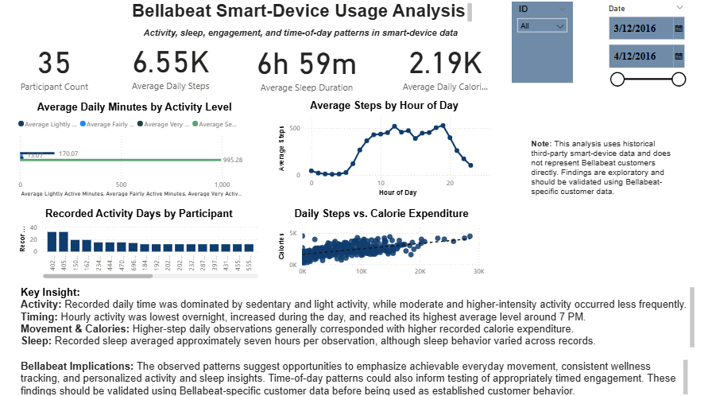
SHARE
Interactive Power BI dashboard
35
Participants
6.55K
Avg. steps
6h 59m
Avg. sleep
Participant and date slicers support interactive exploration. Measures were reconciled against the Excel analysis before final presentation.
09

Slide 10
SYNTHESIS
Answers to Bellabeat's business questions
1 Smart-device trends
Predominantly sedentary/light activity; variable sleep; movement positively associated with calories; clear time-of-day pattern; uneven recording coverage.
2 Application to customers
Potential value in manageable daily movement, personalized activity/sleep insights, behavior-aware reminders, and consistent tracking — subject to Bellabeat-specific validation.
3 Marketing implications
Test messaging around accessible daily wellness, personalization, consistent tracking and behavior-informed engagement rather than intensive exercise alone.
10

Slide 11
ACT
Recommendations
01
Promote achievable everyday movement
Test messaging and features that encourage manageable increases in movement and reductions in prolonged sedentary behavior.
02
Strengthen personalized wellness insights
Help users understand their own activity, sleep and connected wellness patterns over time.
03
Test behavior-informed engagement
Experiment with communication timing and consistent-tracking mechanisms using Bellabeat's own customer data.
Implementation principle
Validate → Experiment → Measure → Scale
11

Slide 12
CONCLUSION
Limitations & skills demonstrated
Limitations
Skills demonstrated
• Historical third-party data; not Bellabeat customers.
• Uneven participant coverage and unknown enrollment periods.
• Sleep available for fewer participants; only 12 activity records matched sleep observations.
• No Bellabeat sales, campaign-response, demographic or engagement data.
• Statistical relationships are associative, not causal.
• Excel data cleaning, validation, PivotTables and descriptive analysis
• Correlation analysis and interpretation
• Power Query and star-schema data modelling
• DAX measures and interactive Power BI dashboard design
• Business-question framing, insight synthesis and evidence-based recommendations
Project takeaway
A complete ASK → ACT analysis that connects technical work to business decisions while respecting data limitations.
12

