Slide 1
DATA ANALYTICS CASE STUDY
Online Retail
Sales & Customer
Performance
From 541,909 transaction lines to an executive commercial performance view.
Google BigQuery × Power BI
PORTFOLIO

Slide 2
01 / BUSINESS QUESTION
The problem was not missing data — it was missing commercial visibility.
BUSINESS PROBLEM
OBJECTIVE
Build a reliable commercial performance view and surface patterns, risks and opportunities that management can act on.
Revenue, customer, product and market activity existed in the transaction data, but not in a decision-ready view.
ANALYTICAL LENSES
REVENUE
CUSTOMERS
How much, when, and what drove change?
Who contributes value and who repeats?
The analysis needed to turn transactions into evidence.
PRODUCTS
GEOGRAPHY
Which merchandise performs after cancellations?
Where is revenue concentrated?
ONLINE RETAIL SALES & CUSTOMER PERFORMANCE ANALYSIS
02

Slide 3
02 / DATA & PROCESS
The analysis preserved the raw source, then built a defensible transaction model.
RAW
PROFILE
CLASSIFY
MODEL
VALIDATE
541,909
lines
→
Missing IDs,
negative qty
→
Sales,
cancellations
→
Processed
view
→
SQL KPI
benchmarks
RAW ROWS
MISSING CUSTOMERID
CANCELLATION ROWS
POTENTIAL DUPLICATES
541,909
24.93%
9,288
5,268
No rows dropped in processing
Customer analysis is identifiable-only
Included in net revenue
Retained: not provably erroneous
Key modelling decision: LineValue was not automatically treated as revenue. Transaction type determined whether a row belonged in commercial KPIs.
ONLINE RETAIL SALES & CUSTOMER PERFORMANCE ANALYSIS
03

Slide 4
03 / EXECUTIVE SNAPSHOT
The business generated £9.76M in net transactional revenue from 19,959 sales orders.
NET REVENUE
ORDERS
CUSTOMERS
AOV
UNITS SOLD
£9.76M
19,959
4,338
£488.94
5.59M
after recorded cancellations
distinct sales invoices
identifiable sales customers
net revenue ÷ orders
customer sale units
SUPPORTING SIGNALS
£10.66M
−£896.8K
84.02%
65.58%
Gross Sales
Cancellation Value
UK Revenue Share
Repeat Customer Rate
ONLINE RETAIL SALES & CUSTOMER PERFORMANCE ANALYSIS
04

Slide 5
04 / REVENUE TREND
Late-2011 growth came mainly from more orders, customers and units - not a major AOV increase.
NOVEMBER 2011
£1.46M
strongest complete month
AUG → NOV CHANGE
• Revenue +110.7%
• Orders +103.6%
• Customers +78.0%
• Units +78.9%
• AOV +3.5%
* December 2011 contains only data through 9 December and is not comparable with complete months.
ONLINE RETAIL SALES & CUSTOMER PERFORMANCE ANALYSIS
05

Slide 6
05 / CONCENTRATION
Commercial performance is highly concentrated by both geography and customer value.
GEOGRAPHIC CONCENTRATION
CUSTOMER CONCENTRATION
84.02%
60.05%
of net revenue came from the UK
of identifiable-customer revenue came from the top 10%
United Kingdom
84.02%
Netherlands
2.92%
69.86%
revenue from 833
high-value, high-frequency customers
EIRE
2.70%
Germany
2.27%
Implication: retention risk matters because a relatively small customer group contributes disproportionate value.
France
2.02%
ONLINE RETAIL SALES & CUSTOMER PERFORMANCE ANALYSIS
06

Slide 7
06 / PRODUCT PERFORMANCE
Net product ranking prevented a £168K fully cancelled transaction from becoming a false 'top product'.
VALIDATED LEADER
VALIDATION CASE
REGENCY CAKESTAND
3 TIER
PAPER CRAFT,
LITTLE BIRDIE
£164.76K
+£168.47K
−£168.47K
net revenue
sale
matching cancellation
13,022 net units • 1,988 sales orders
NET CONTRIBUTION = £0
Non-merchandise codes such as DOT, POST, M, AMAZONFEE and S were excluded from merchandise rankings.
ONLINE RETAIL SALES & CUSTOMER PERFORMANCE ANALYSIS
07

Slide 8
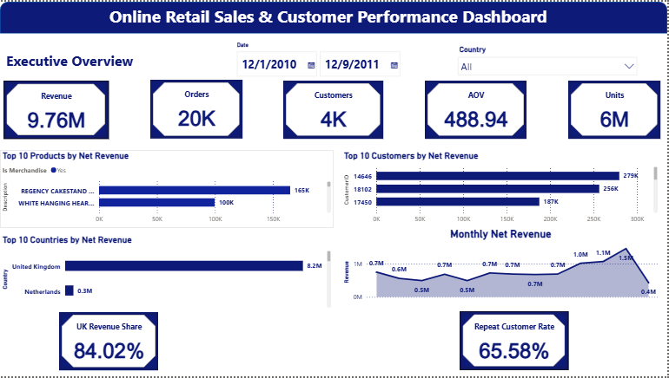
07 / DASHBOARD
The Power BI layer turns the validated SQL logic into an interactive executive view.
Slicers recalculate revenue, orders, customers, AOV, units, product ranking and customer ranking while preserving the validated business rules.
ONLINE RETAIL SALES & CUSTOMER PERFORMANCE ANALYSIS
08

Slide 9
08 / ACTION
The evidence points to three priorities: retain value, plan around demand, and test diversification.
01
02
03
Protect high-value customers
Strengthen product & demand planning
Assess geographic diversification
Use repeat-purchase and value concentration insights to prioritize retention, service and account management.
Use validated product performance and strong demand periods to guide inventory, merchandising and promotions.
Protect the UK core while testing whether high-AOV international markets can support commercially viable growth.
ONLINE RETAIL SALES & CUSTOMER PERFORMANCE ANALYSIS
09

Slide 10
09 / LIMITS & CLOSE
The dashboard improves visibility - but it does not claim what the data cannot prove.
BOUNDARIES
CASE STUDY OUTCOME
• Customer findings exclude missing CustomerID transactions.
• December 2011 is partial through 9 December.
• Net revenue is not profit; cost and margin data are absent.
• No marketing spend, targets or attribution data are available.
• Patterns are associative, not causal.
A reproducible commercial analysis that connects business framing, SQL validation, Power BI reporting and evidence-based action.
ASK → PREPARE → PROCESS → ANALYZE → SHARE → ACT
ONLINE RETAIL SALES & CUSTOMER PERFORMANCE ANALYSIS
10

