Slide 1
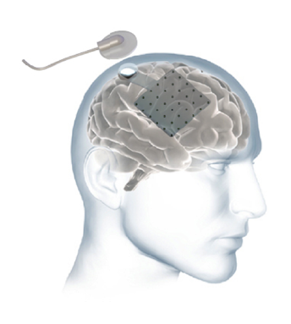
Connection
to computer
Electrodes
grid
Implant
electronics

