Slide 1
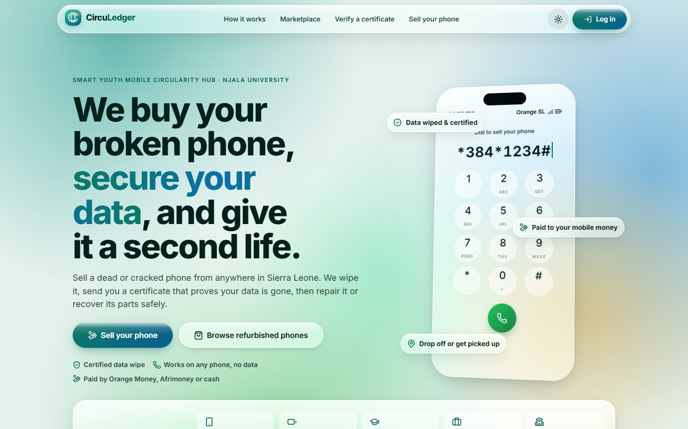
Smart Youth Mobile Circularity Hub · Njala University
CircuLedger web app
A page-by-page walkthrough
50 screens across five workspaces, in the order a user meets them.
Captured from the running app. Data shown is sample data from the API guide’s examples, not live Hub data.
UNDP × Samsung Youth Mobile Circularity Innovation Challenge · Sierra Leone
Notes:
Title. The deck walks through every page of the CircuLedger web app in order: public site, Operations, Workshop, Field, then Marketplace and the citizen portal. All screenshots use sample data.

Slide 2
Five workspaces, one app
1
2
3
4
5
Public site
Operations
Workshop
Field
Marketplace & citizens
Anyone · no login
Admin · Operations lead
Technician
Field agent
Buyers · sellers
Landing, certificate check, sign-in and the live USSD & SMS demo.
The Hub’s dashboard: intake to resale, money, people and impact.
Mobile-first bench app: scan, wipe & certify, decide, dismantle, recover.
Mobile route for pickups: call the seller, collect, fix locations.
Certified refurbished phones for buyers, and a portal for sellers.
12 pages
23 pages
6 pages
3 pages
6 pages
Notes:
Contents. The app has five workspaces; each section of the deck covers one, and every slide shows one page.

Slide 3
Public site
01 Landing page
Anyone · no login
02 How it works
03 Sell your phone
04 Drop-off points
05 Verify a certificate
Landing, certificate check, sign-in and the live USSD & SMS demo.
06 Log in
07 Create an account
08 USSD simulator
09 USSD: request confirmed
Route: /
10 SMS simulator
11 Design system
12 Friendly error pages
Notes:
Public site. Landing, certificate check, sign-in and the live USSD & SMS demo. Used by: Anyone · no login. Pages in this section: Landing page, How it works, Sell your phone, Drop-off points, Verify a certificate, Log in, Create an account, USSD simulator, USSD: request confirmed, SMS simulator, Design system, Friendly error pages.

Slide 4
Landing page
1
Public site
Route /
Public home page: the promise, two calls to action (sell / browse) and a floating glass phone typing the USSD code.
Notes:
Landing page (/). Public home page: the promise, two calls to action (sell / browse) and a floating glass phone typing the USSD code.

Slide 5
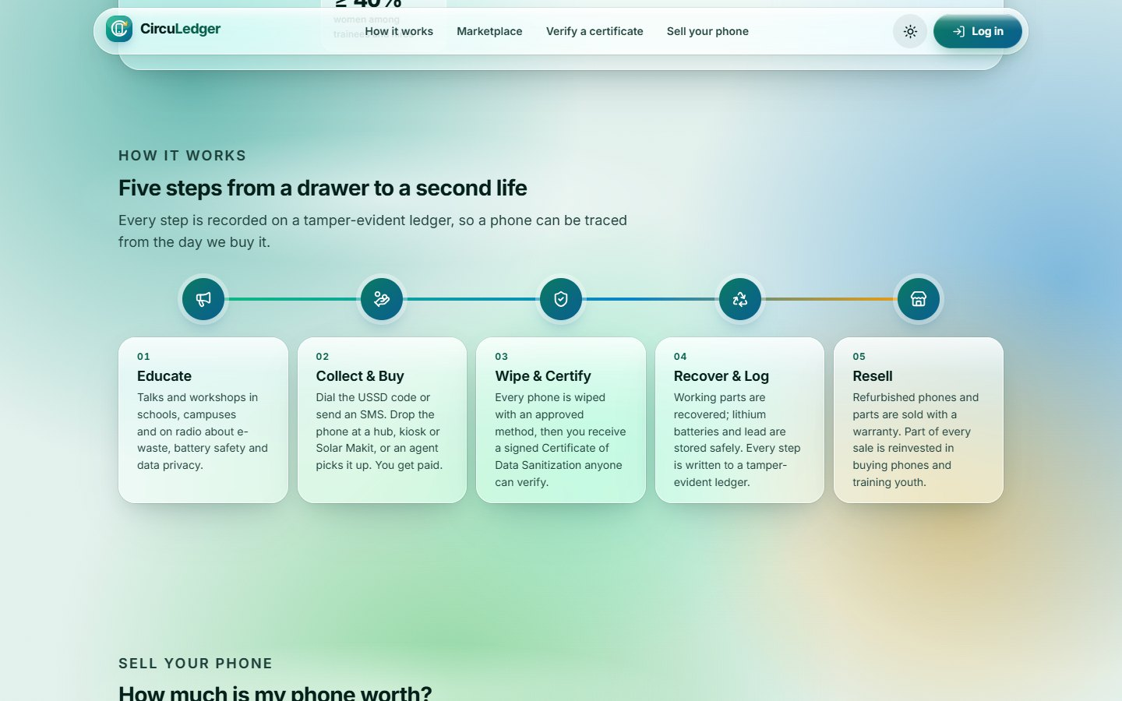
How it works
2
Public site
Route /
The five-stage pipeline (Educate → Collect & Buy → Wipe & Certify → Recover & Log → Resell) as an animated glass timeline, plus the pilot targets strip.
Notes:
How it works (/). The five-stage pipeline (Educate → Collect & Buy → Wipe & Certify → Recover & Log → Resell) as an animated glass timeline, plus the pilot targets strip.

Slide 6
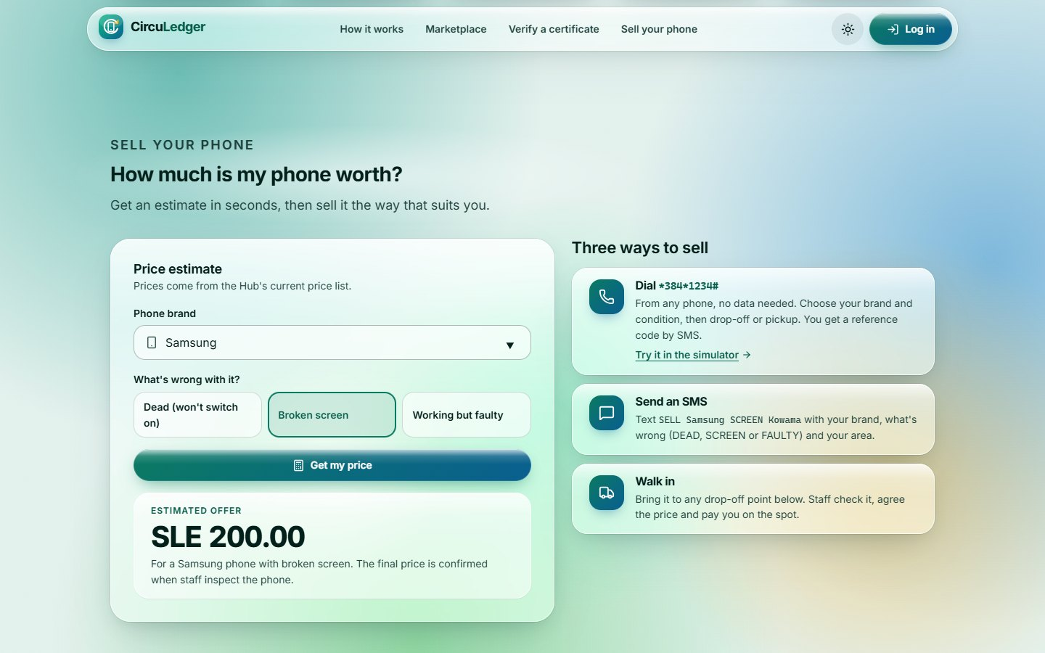
Sell your phone
3
Public site
Route /
Instant price estimate from the public pricing quote, the three ways to sell (USSD, SMS, walk-in) and the drop-off points.
Notes:
Sell your phone (/). Instant price estimate from the public pricing quote, the three ways to sell (USSD, SMS, walk-in) and the drop-off points.

Slide 7
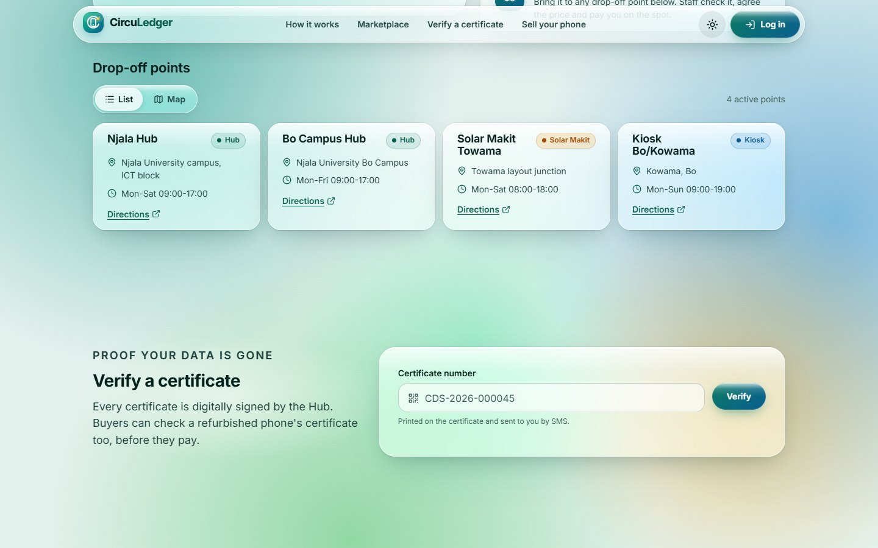
Drop-off points
4
Public site
Route /
Active drop-off points (hubs, kiosks, Solar Makits) as cards with opening hours and directions; a map view is one tab away.
Notes:
Drop-off points (/). Active drop-off points (hubs, kiosks, Solar Makits) as cards with opening hours and directions; a map view is one tab away.

Slide 8
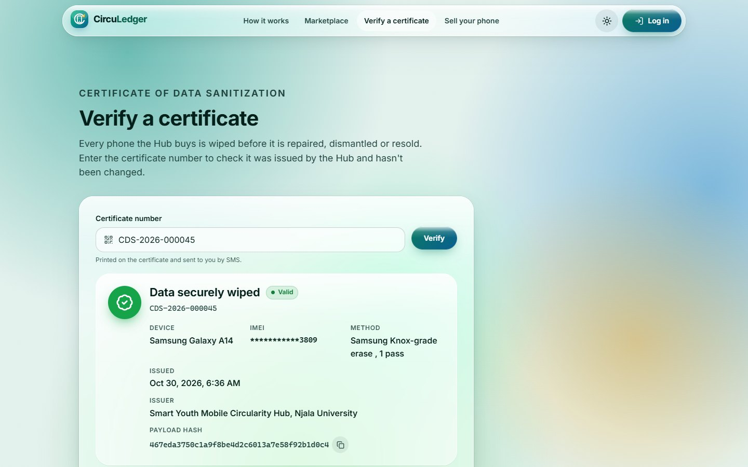
Verify a certificate
5
Public site
Route /verify/:certificateNumber
Anyone can check a Certificate of Data Sanitization: the result card shows the device, masked IMEI, erase method and signature hash.
Notes:
Verify a certificate (/verify/:certificateNumber). Anyone can check a Certificate of Data Sanitization: the result card shows the device, masked IMEI, erase method and signature hash.

Slide 9
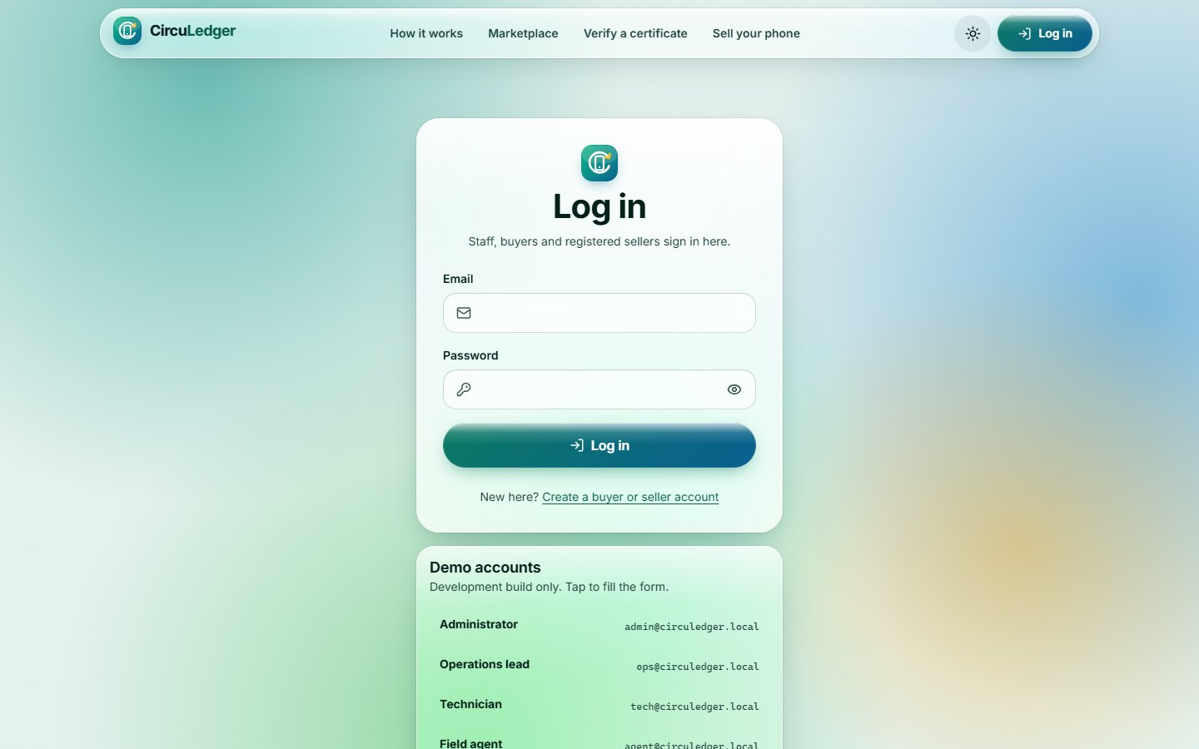
Log in
6
Public site
Route /login
One sign-in for every role. Development builds list the demo accounts; after five wrong passwords the 15-minute lockout message appears.
Notes:
Log in (/login). One sign-in for every role. Development builds list the demo accounts; after five wrong passwords the 15-minute lockout message appears.

Slide 10
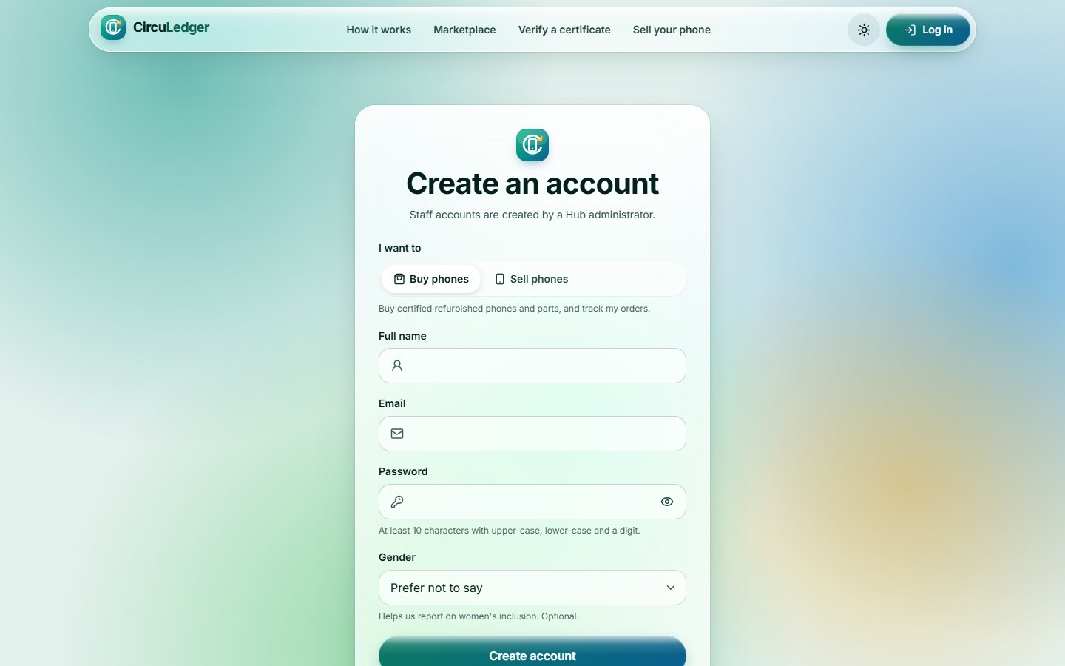
Create an account
7
Public site
Route /register
Self-registration for buyers and sellers (citizens). Citizens add the phone they dial USSD from, so their earlier requests appear.
Notes:
Create an account (/register). Self-registration for buyers and sellers (citizens). Citizens add the phone they dial USSD from, so their earlier requests appear.

Slide 11
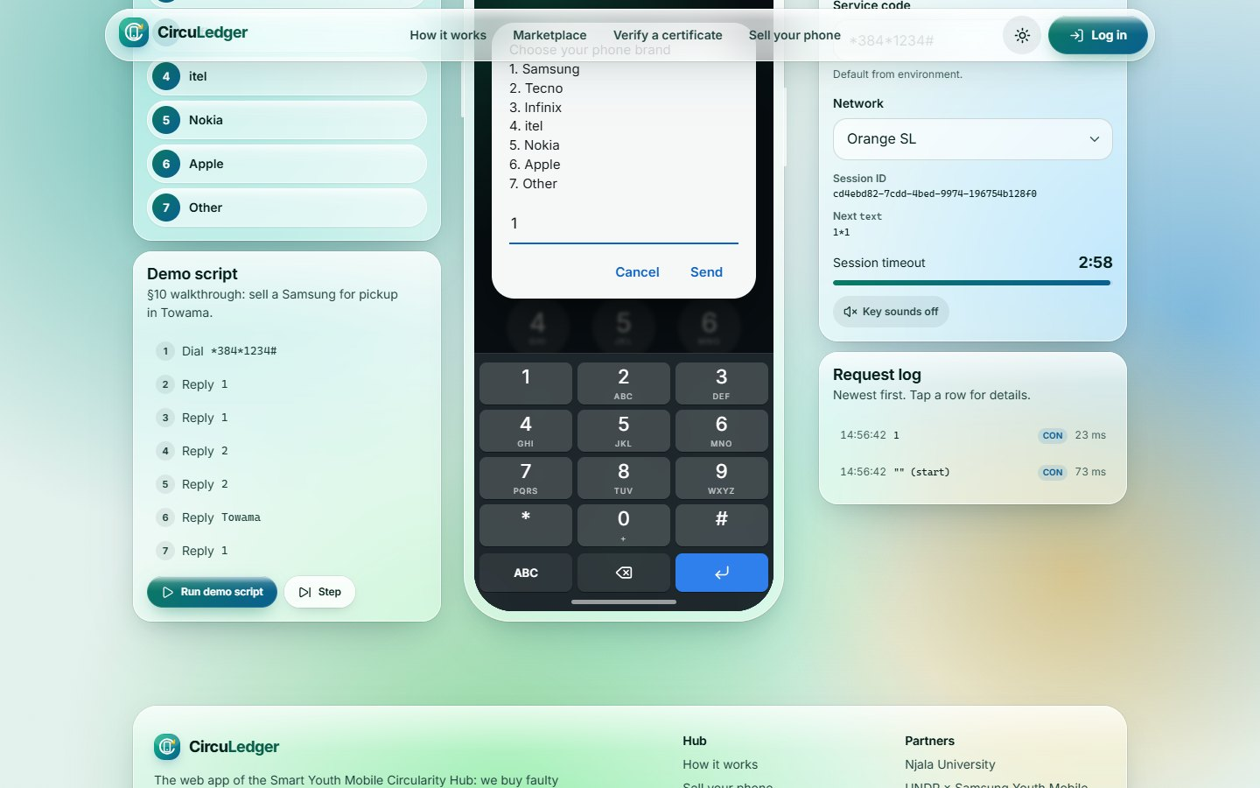
USSD simulator
8
Public site
Route /demo/ussd
A glass phone talking to the real USSD webhook: menus come from the API, with quick-select chips, a session timer and a request log.
Notes:
USSD simulator (/demo/ussd). A glass phone talking to the real USSD webhook: menus come from the API, with quick-select chips, a session timer and a request log.

Slide 12
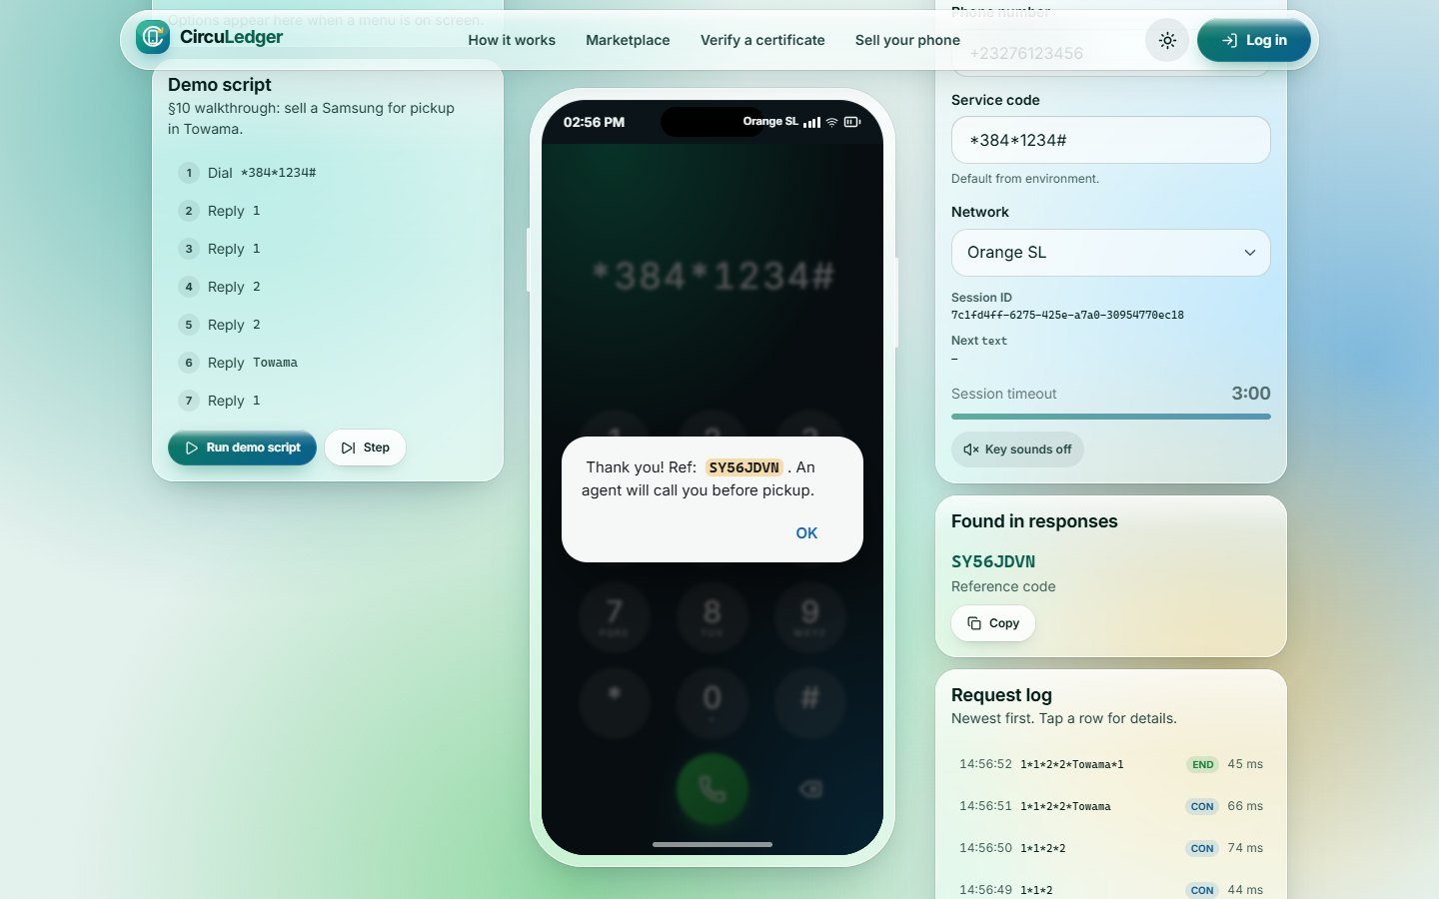
USSD: request confirmed
9
Public site
Route /demo/ussd
The final END message highlights the reference code, with Copy and lookup actions. "Run demo script" plays the whole walkthrough.
Notes:
USSD: request confirmed (/demo/ussd). The final END message highlights the reference code, with Copy and lookup actions. "Run demo script" plays the whole walkthrough.

Slide 13
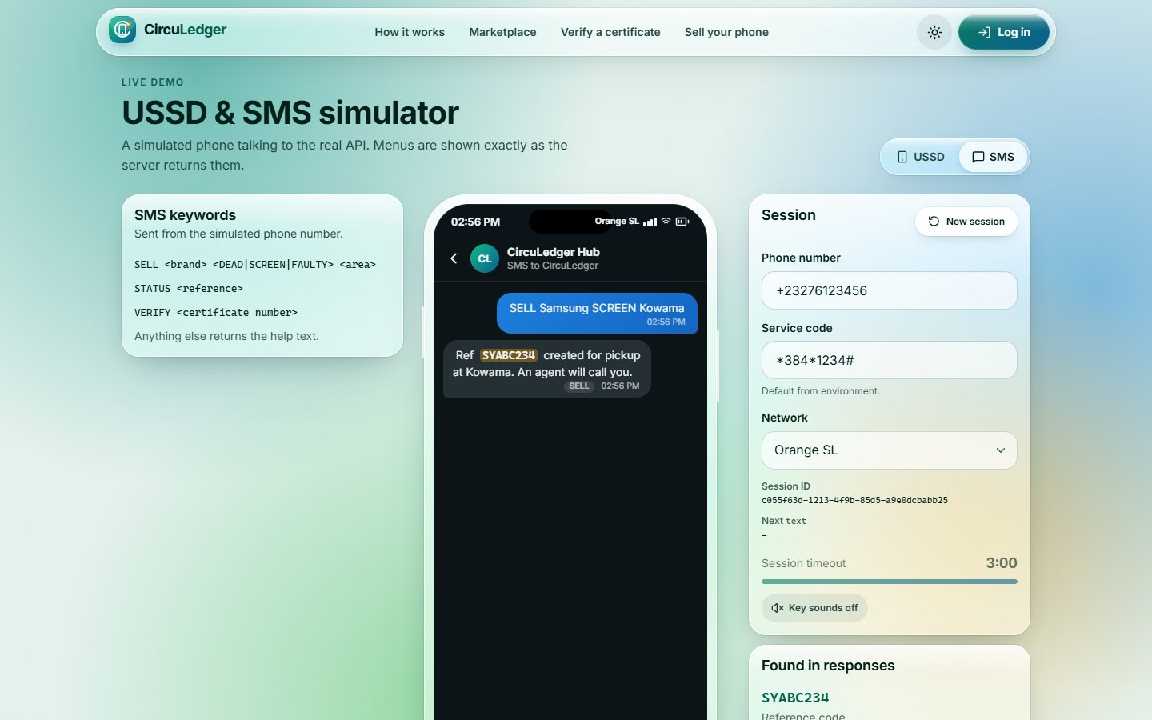
SMS simulator
10
Public site
Route /demo/ussd
Messages-style chat against the SMS webhook: SELL, STATUS and VERIFY keywords with quick-reply chips.
Notes:
SMS simulator (/demo/ussd). Messages-style chat against the SMS webhook: SELL, STATUS and VERIFY keywords with quick-reply chips.

Slide 14
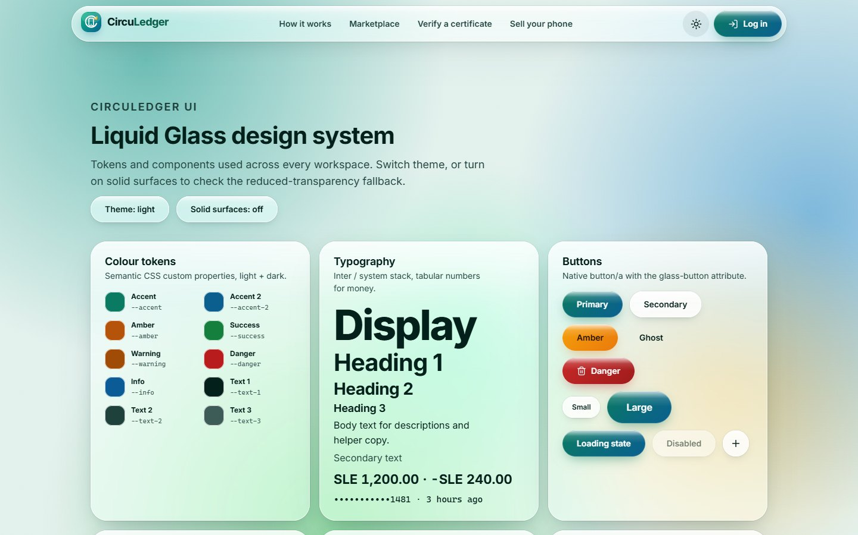
Design system
11
Public site
Route /design-system
Living reference for the Liquid Glass library: tokens, typography, buttons, fields, tabs, status pills, KPI tiles and overlays.
Notes:
Design system (/design-system). Living reference for the Liquid Glass library: tokens, typography, buttons, fields, tabs, status pills, KPI tiles and overlays.

Slide 15
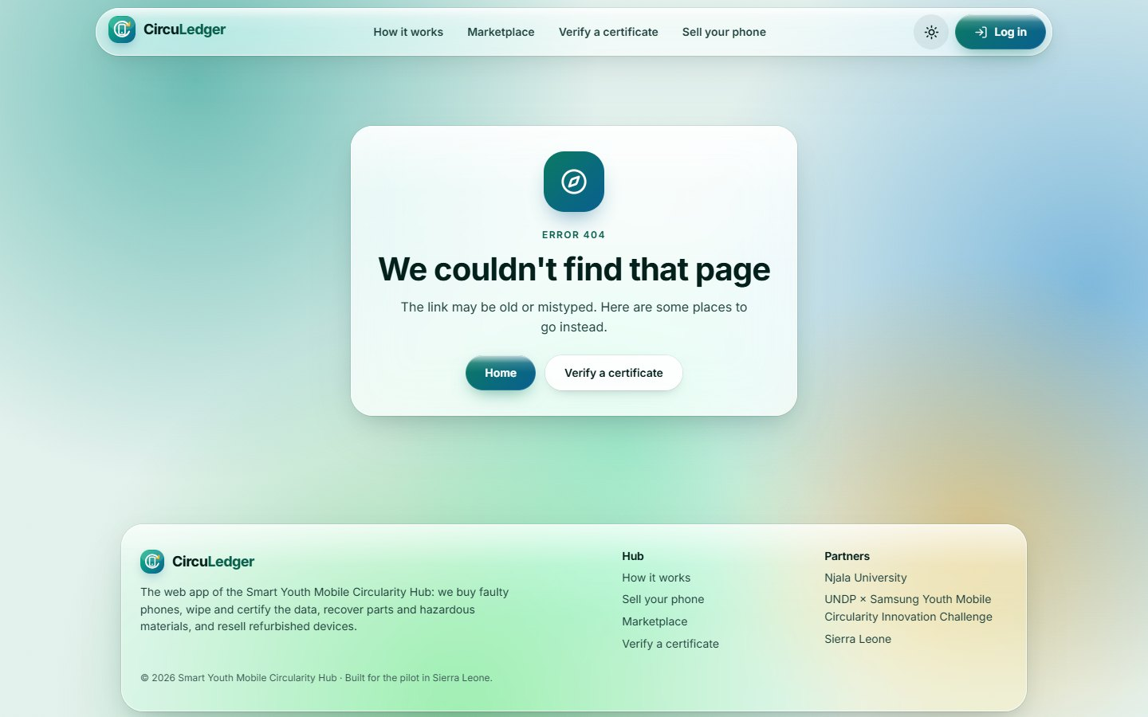
Friendly error pages
12
Public site
Route /403 · /404
Unknown routes (404) and role-forbidden areas (403) land on glass error pages with a way back to the right workspace.
Notes:
Friendly error pages (/403 · /404). Unknown routes (404) and role-forbidden areas (403) land on glass error pages with a way back to the right workspace.

Slide 16
Operations
13 Operations home
25 Ledger explorer
Admin · Operations lead
14 Weekly trends
26 Listings
15 Command palette
27 Listing editor
16 Reports
28 Orders
17 Intake inbox
29 Funds & reinvestment
The Hub’s dashboard: intake to resale, money, people and impact.
18 Unlocated pickups
30 Pricing matrix
19 Dispatch planner
31 Training & jobs
20 Devices register
32 Awareness
21 Device detail
33 Hazardous materials
Route: /ops
22 Purchase desk
34 Users
23 Certificates
35 Drop-off points
24 Certificate detail
Notes:
Operations. The Hub’s dashboard: intake to resale, money, people and impact. Used by: Admin · Operations lead. Pages in this section: Operations home, Weekly trends, Command palette, Reports, Intake inbox, Unlocated pickups, Dispatch planner, Devices register, Device detail, Purchase desk, Certificates, Certificate detail, Ledger explorer, Listings, Listing editor, Orders, Funds & reinvestment, Pricing matrix, Training & jobs, Awareness, Hazardous materials, Users, Drop-off points.

Slide 17
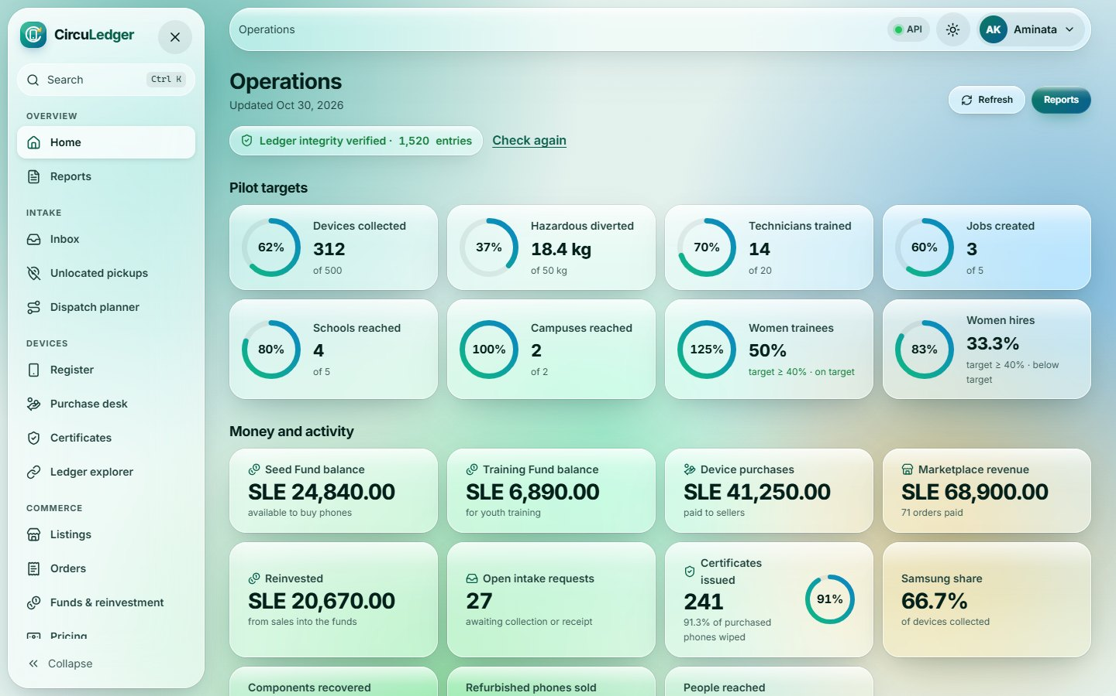
Operations home
13
Operations
Route /ops
Pilot targets as progress rings, money and activity tiles, a ledger-integrity badge and the API health dot in the top bar.
Notes:
Operations home (/ops). Pilot targets as progress rings, money and activity tiles, a ledger-integrity badge and the API health dot in the top bar.

Slide 18
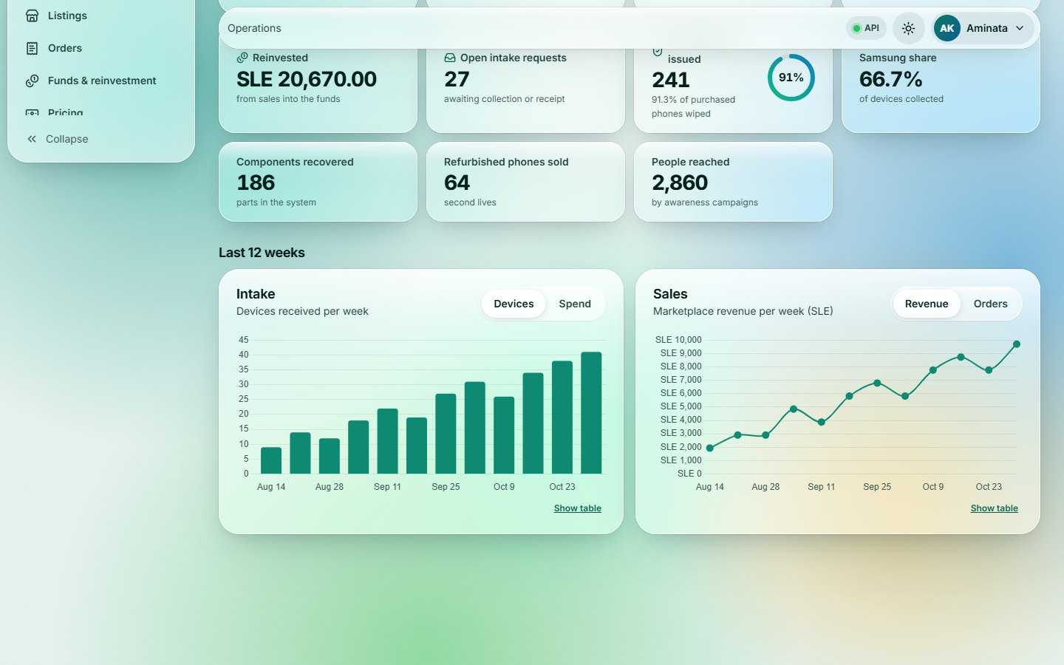
Weekly trends
14
Operations
Route /ops
Intake and sales over the last 12 weeks. One measure per chart (toggle Devices / Spend, Revenue / Orders), each with a table view.
Notes:
Weekly trends (/ops). Intake and sales over the last 12 weeks. One measure per chart (toggle Devices / Spend, Revenue / Orders), each with a table view.

Slide 19
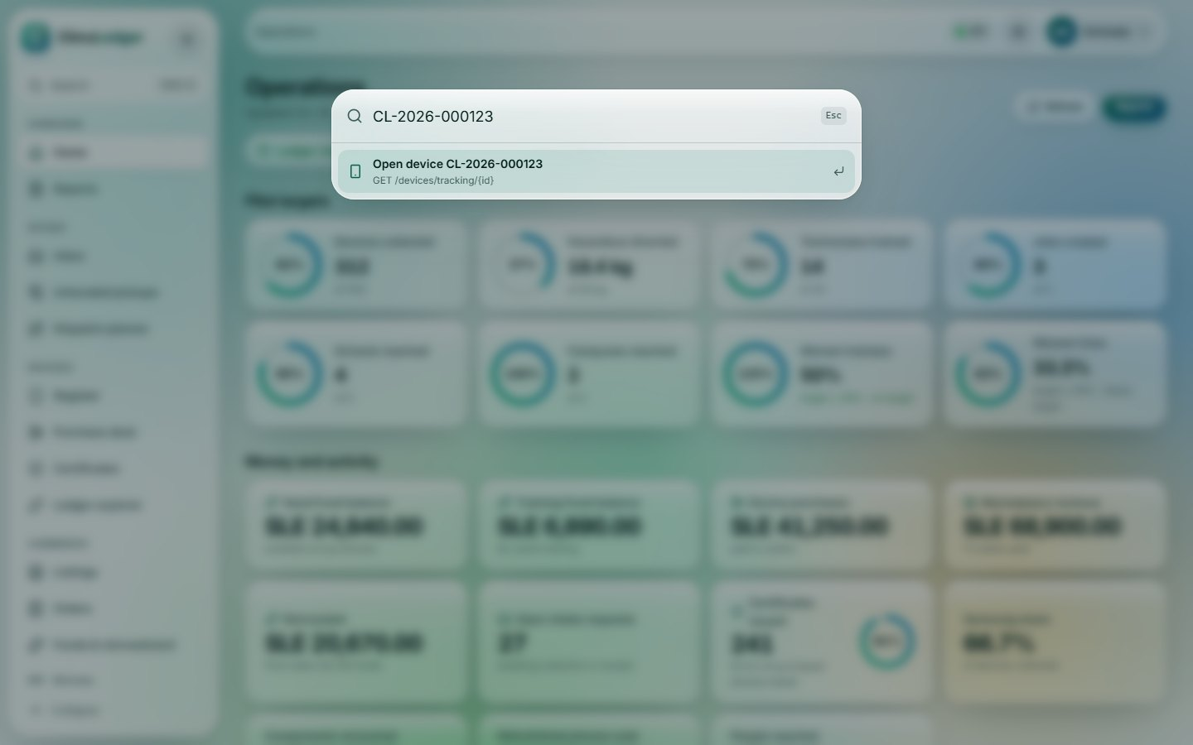
Command palette
15
Operations
Route /ops
Ctrl/Cmd+K jumps to any screen or looks up a tracking ID, certificate number or intake reference.
Notes:
Command palette (/ops). Ctrl/Cmd+K jumps to any screen or looks up a tracking ID, certificate number or intake reference.

Slide 20
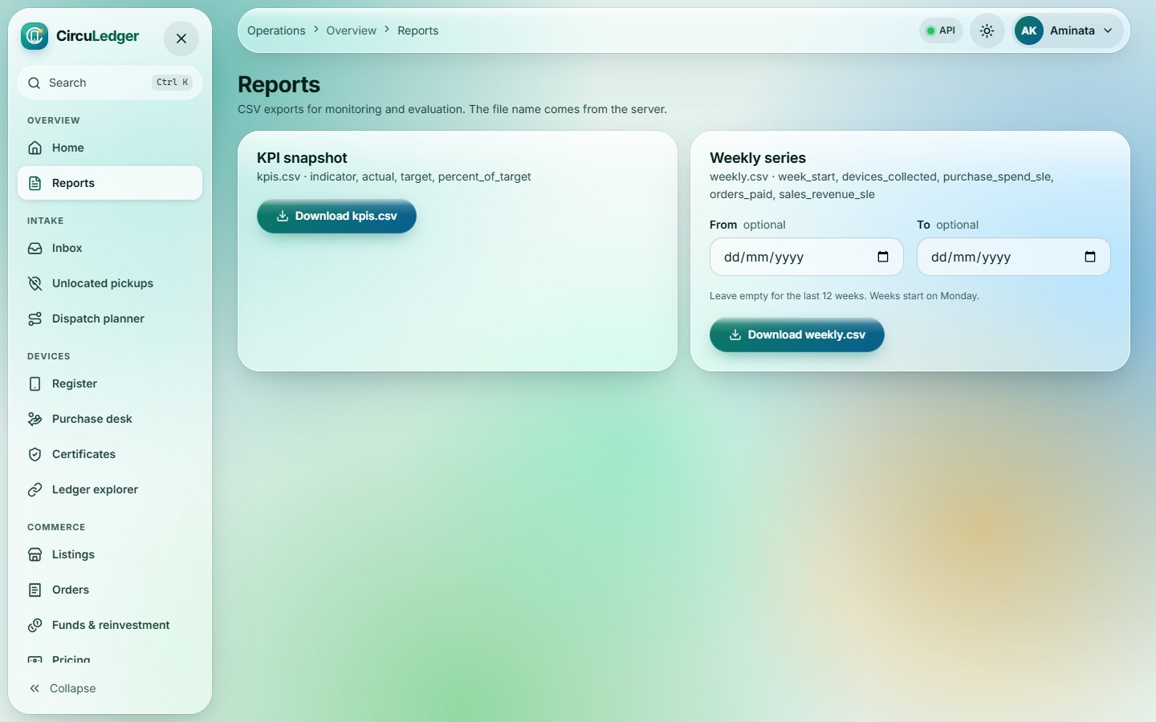
Reports
16
Operations
Route /ops/reports
CSV exports for monitoring & evaluation (KPI snapshot and weekly series), downloaded with the auth header.
Notes:
Reports (/ops/reports). CSV exports for monitoring & evaluation (KPI snapshot and weekly series), downloaded with the auth header.

Slide 21
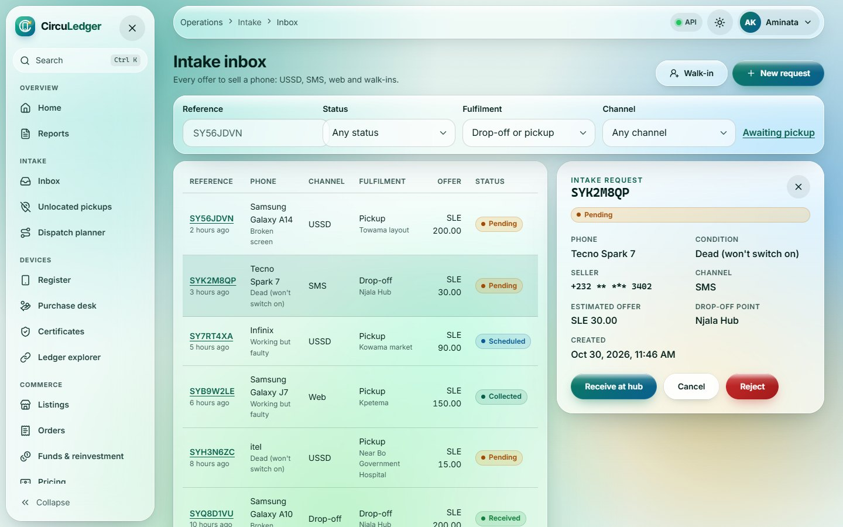
Intake inbox
17
Operations
Route /ops/intake
Every sell request from USSD, SMS, web and walk-ins. Filters live in the URL; the detail panel shows only the actions valid for its state.
Notes:
Intake inbox (/ops/intake). Every sell request from USSD, SMS, web and walk-ins. Filters live in the URL; the detail panel shows only the actions valid for its state.

Slide 22
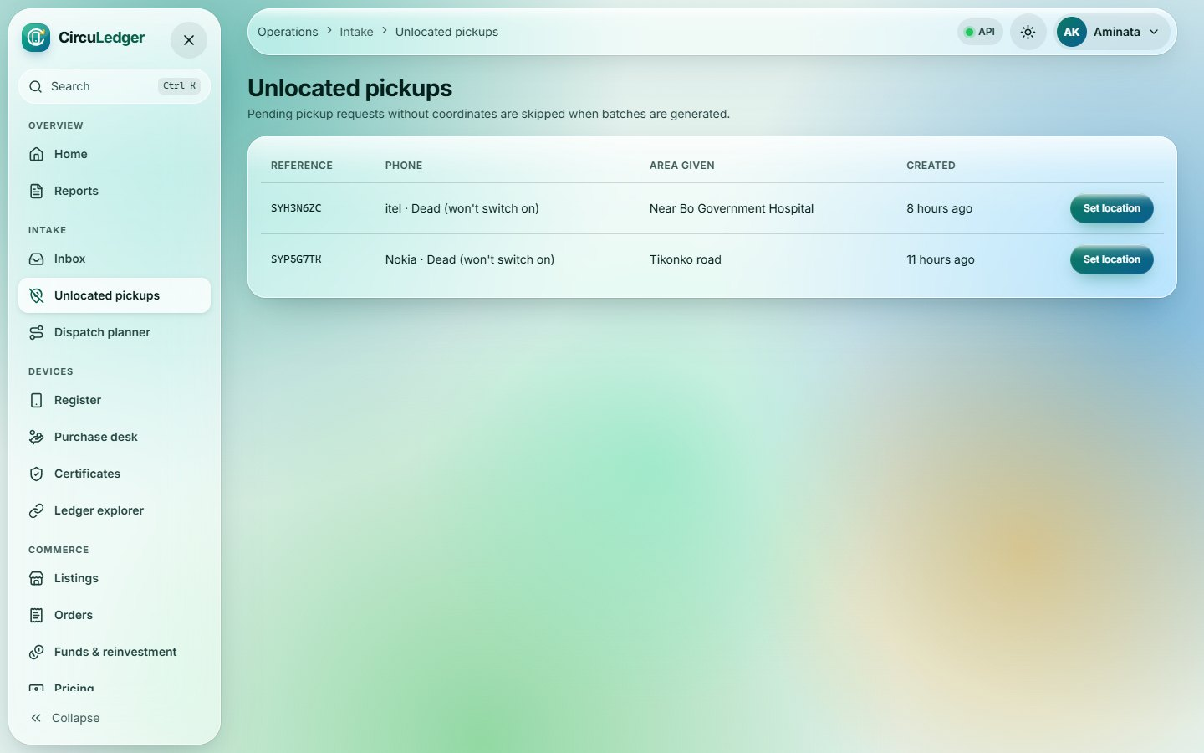
Unlocated pickups
18
Operations
Route /ops/intake/unlocated
Pending pickups without GPS coordinates (skipped by batching), fixed from the phone’s location or typed coordinates.
Notes:
Unlocated pickups (/ops/intake/unlocated). Pending pickups without GPS coordinates (skipped by batching), fixed from the phone’s location or typed coordinates.

Slide 23
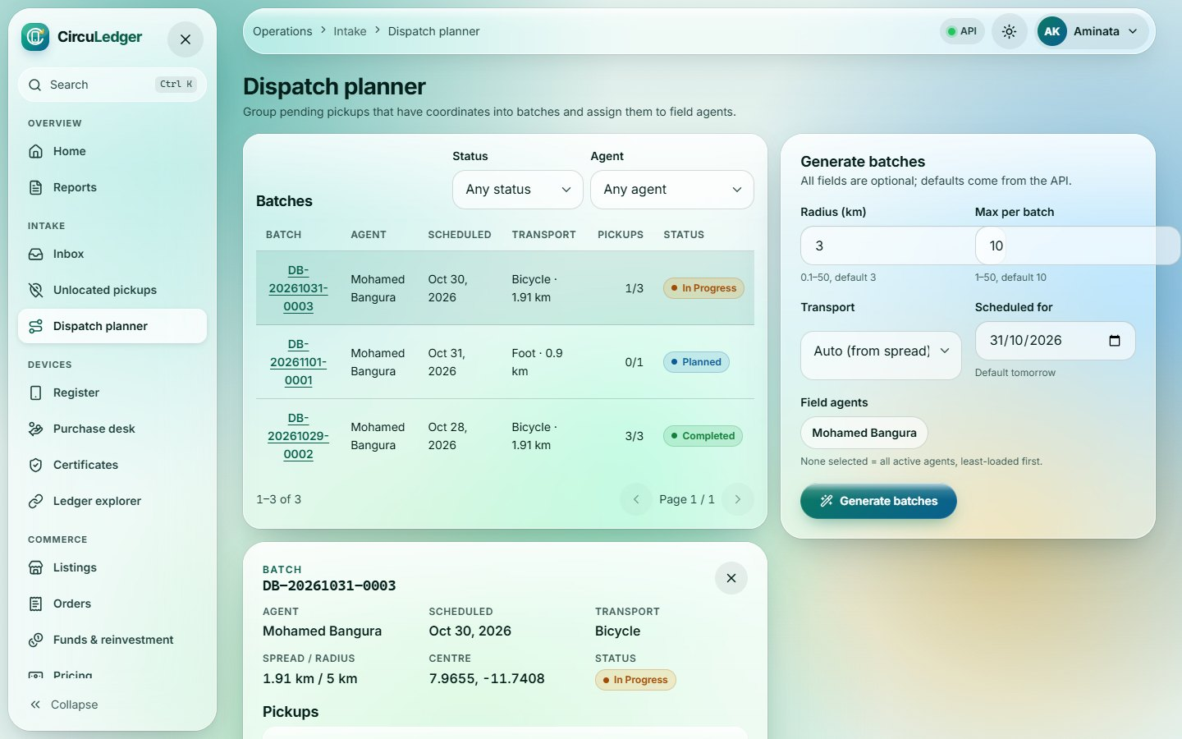
Dispatch planner
19
Operations
Route /ops/dispatch
Generates distance-based pickup batches for field agents and lists them with progress; a batch opens to show its pickups.
Notes:
Dispatch planner (/ops/dispatch). Generates distance-based pickup batches for field agents and lists them with progress; a batch opens to show its pickups.

Slide 24
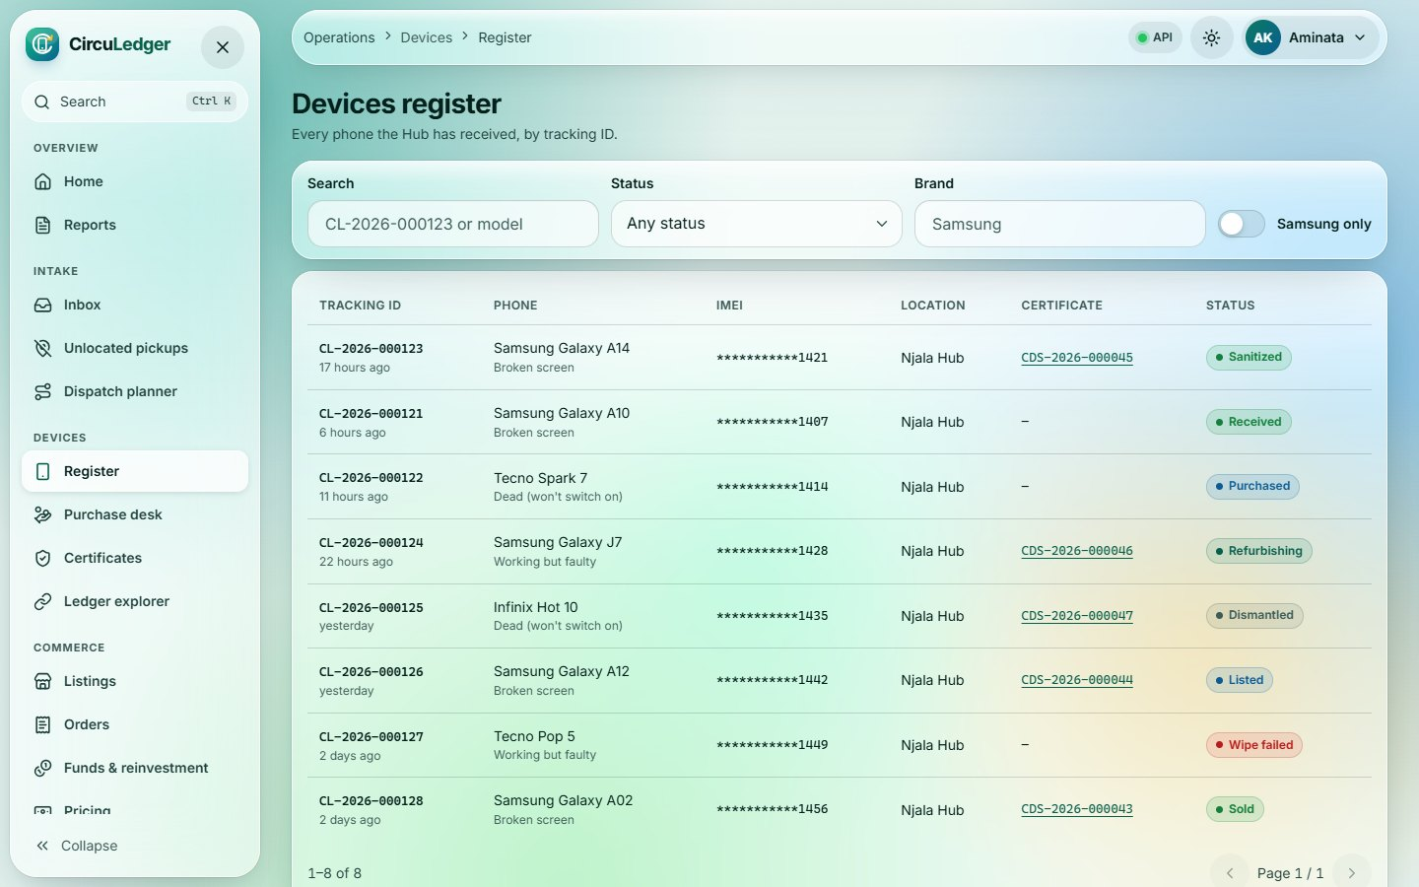
Devices register
20
Operations
Route /ops/devices
Every phone received, by tracking ID, with status, location and certificate. Search is debounced and filters are shareable.
Notes:
Devices register (/ops/devices). Every phone received, by tracking ID, with status, location and certificate. Search is debounced and filters are shareable.

Slide 25
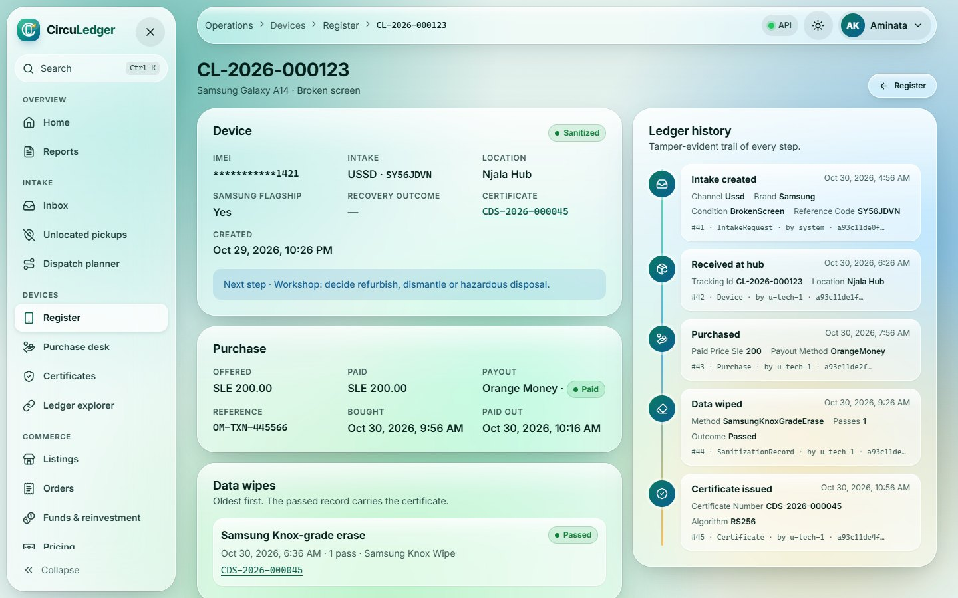
Device detail
21
Operations
Route /ops/devices/:id
Facts, purchase and wipe records next to the tamper-evident ledger timeline of every step the phone went through.
Notes:
Device detail (/ops/devices/:id). Facts, purchase and wipe records next to the tamper-evident ledger timeline of every step the phone went through.

Slide 26
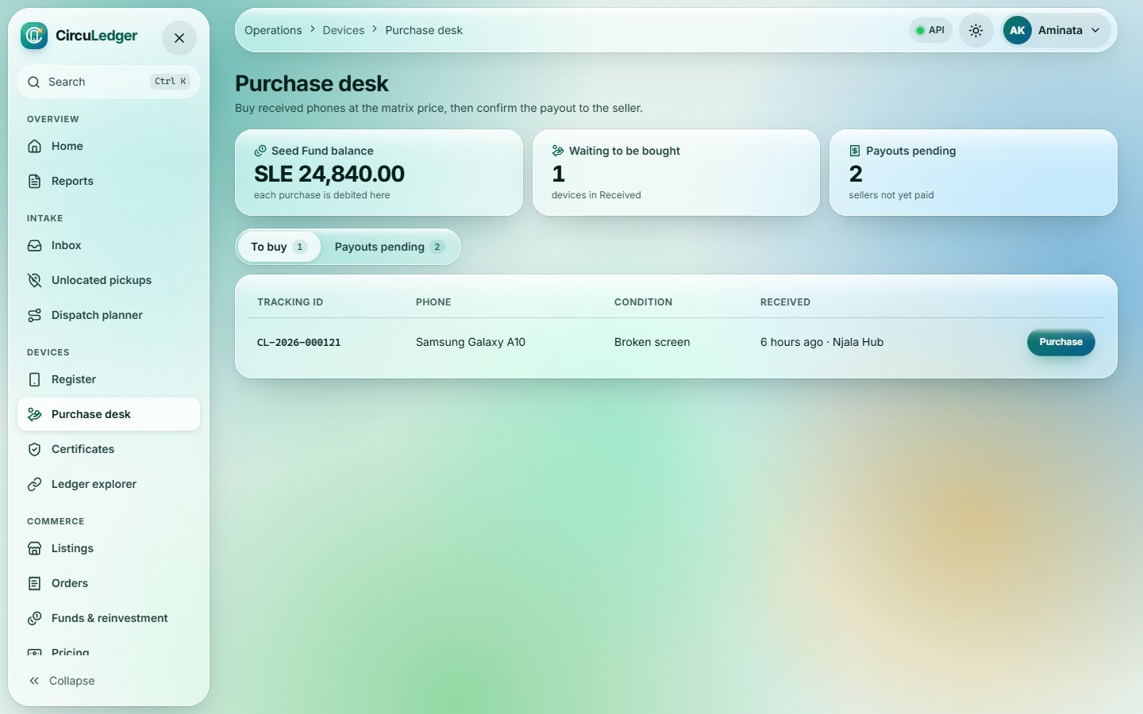
Purchase desk
22
Operations
Route /ops/purchase
Buys received phones from the Seed Fund at the price-list quote, then records the mobile-money payout to the seller.
Notes:
Purchase desk (/ops/purchase). Buys received phones from the Seed Fund at the price-list quote, then records the mobile-money payout to the seller.

Slide 27
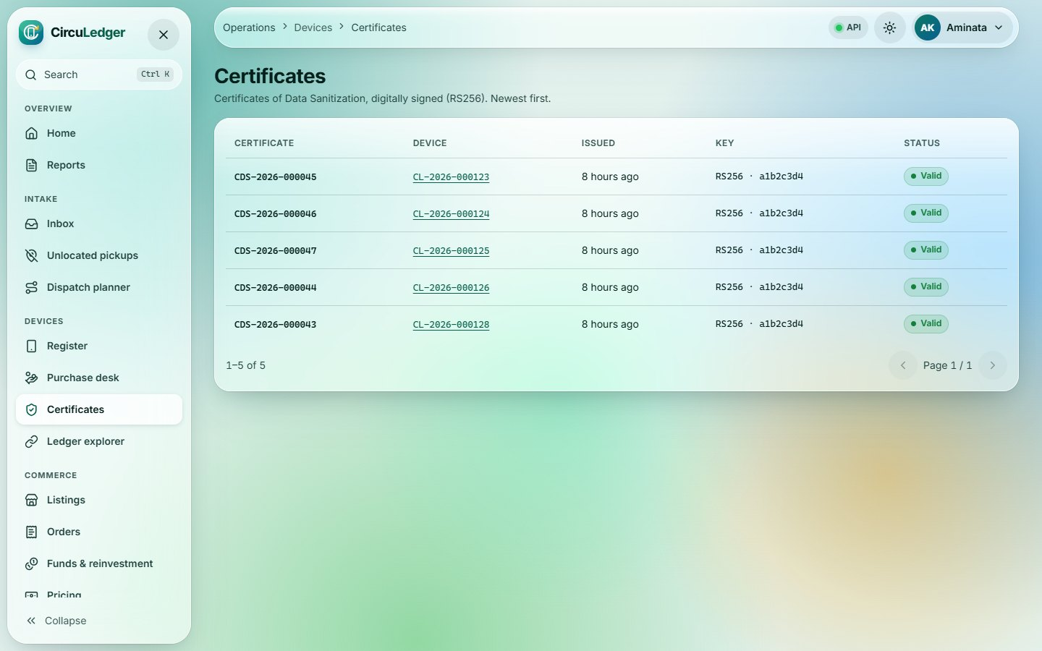
Certificates
23
Operations
Route /ops/certificates
All Certificates of Data Sanitization (RS256-signed), newest first, with validity status.
Notes:
Certificates (/ops/certificates). All Certificates of Data Sanitization (RS256-signed), newest first, with validity status.

Slide 28
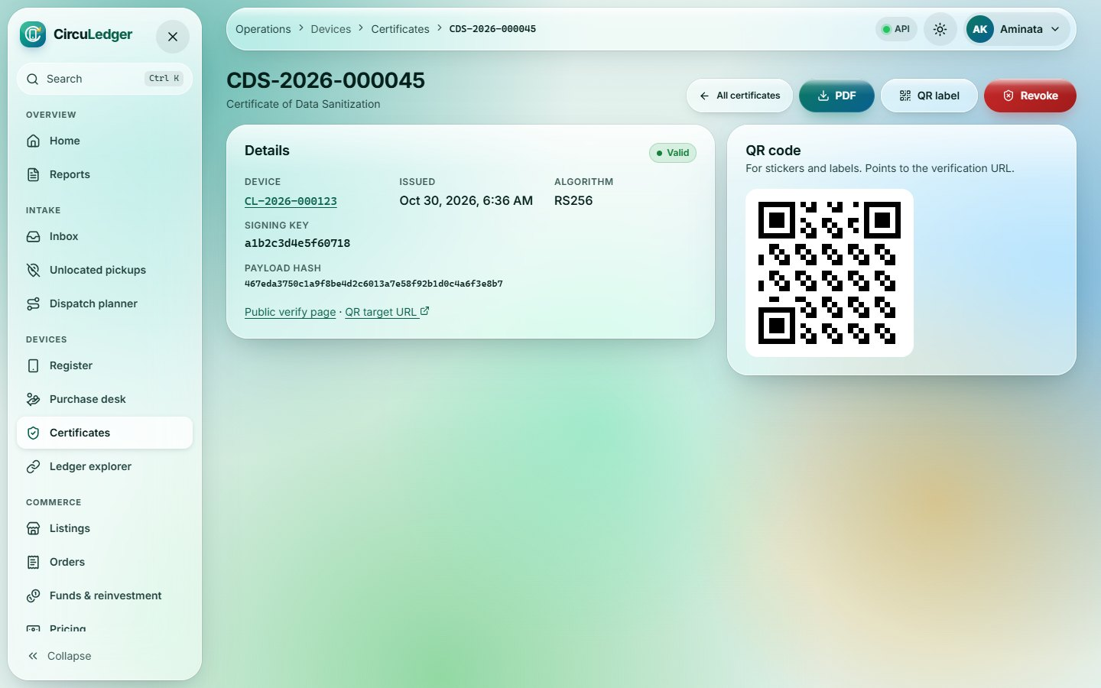
Certificate detail
24
Operations
Route /ops/certificates/:certificateNumber
Signature details, QR label preview, PDF and QR downloads, and Admin-only revocation.
Notes:
Certificate detail (/ops/certificates/:certificateNumber). Signature details, QR label preview, PDF and QR downloads, and Admin-only revocation.

Slide 29
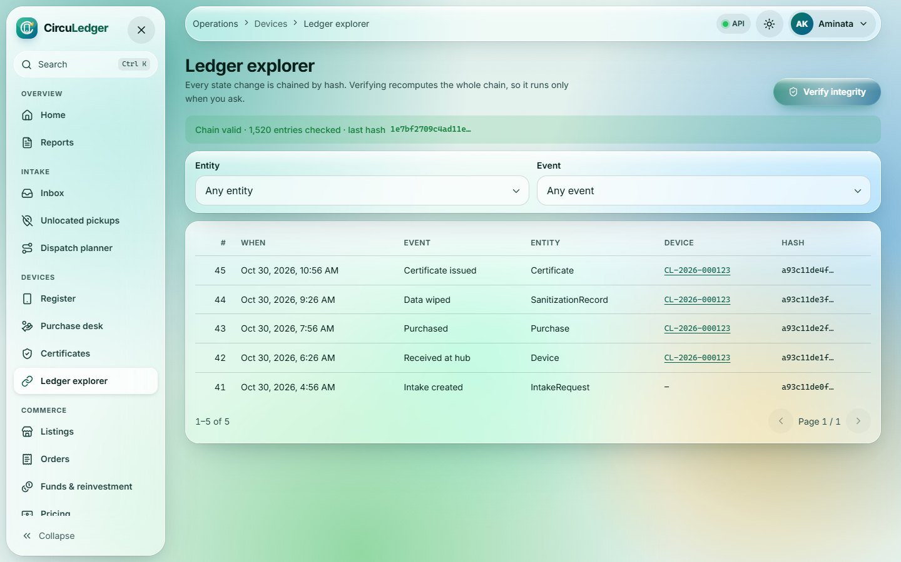
Ledger explorer
25
Operations
Route /ops/ledger
Browse the hash-chained ledger by entity or event and recompute the whole chain on demand.
Notes:
Ledger explorer (/ops/ledger). Browse the hash-chained ledger by entity or event and recompute the whole chain on demand.

Slide 30
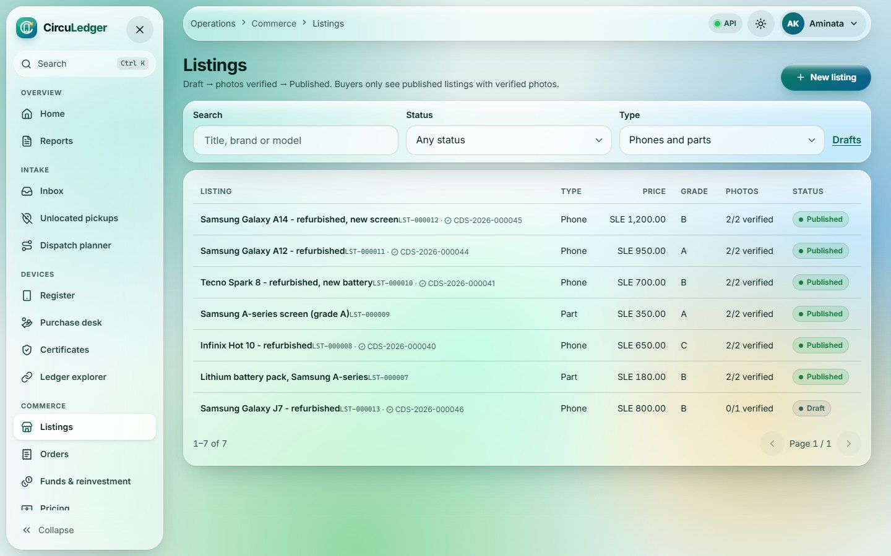
Listings
26
Operations
Route /ops/listings
Marketplace listings for refurbished phones and parts: Draft → photos verified → Published.
Notes:
Listings (/ops/listings). Marketplace listings for refurbished phones and parts: Draft → photos verified → Published.

Slide 31
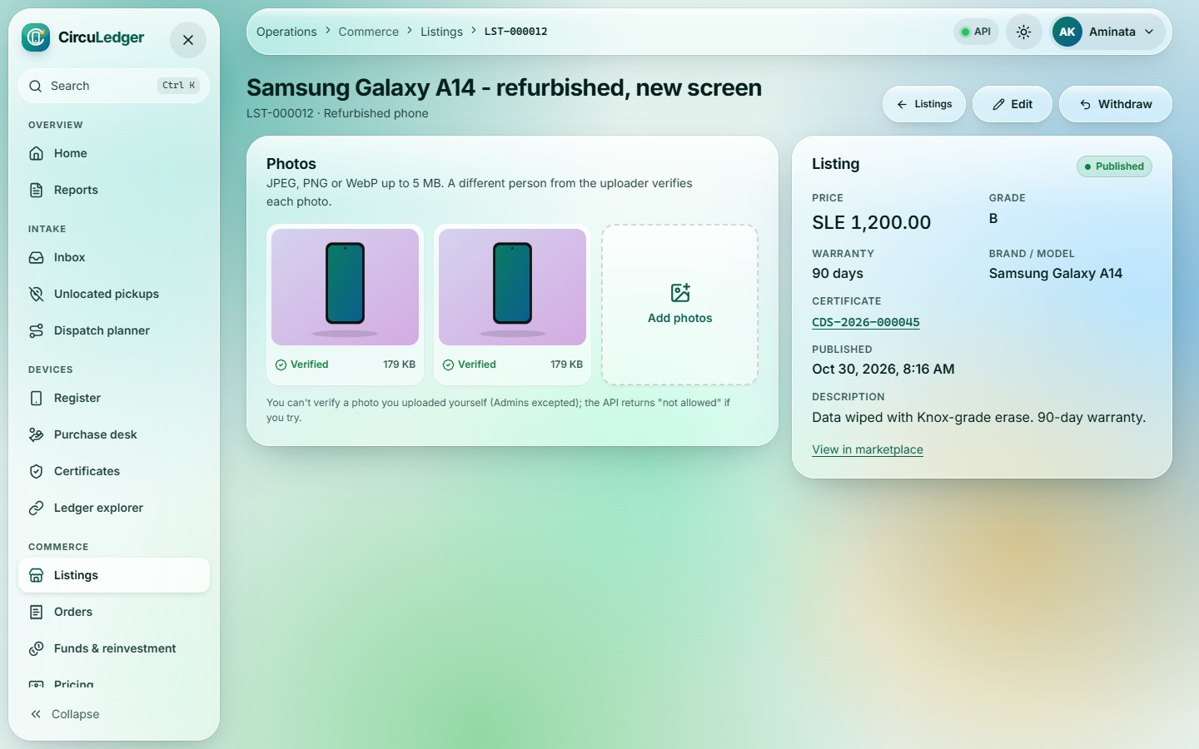
Listing editor
27
Operations
Route /ops/listings/:id
Photo evidence (verified by a second person), price and warranty; Publish unlocks once a photo is verified.
Notes:
Listing editor (/ops/listings/:id). Photo evidence (verified by a second person), price and warranty; Publish unlocks once a photo is verified.

Slide 32
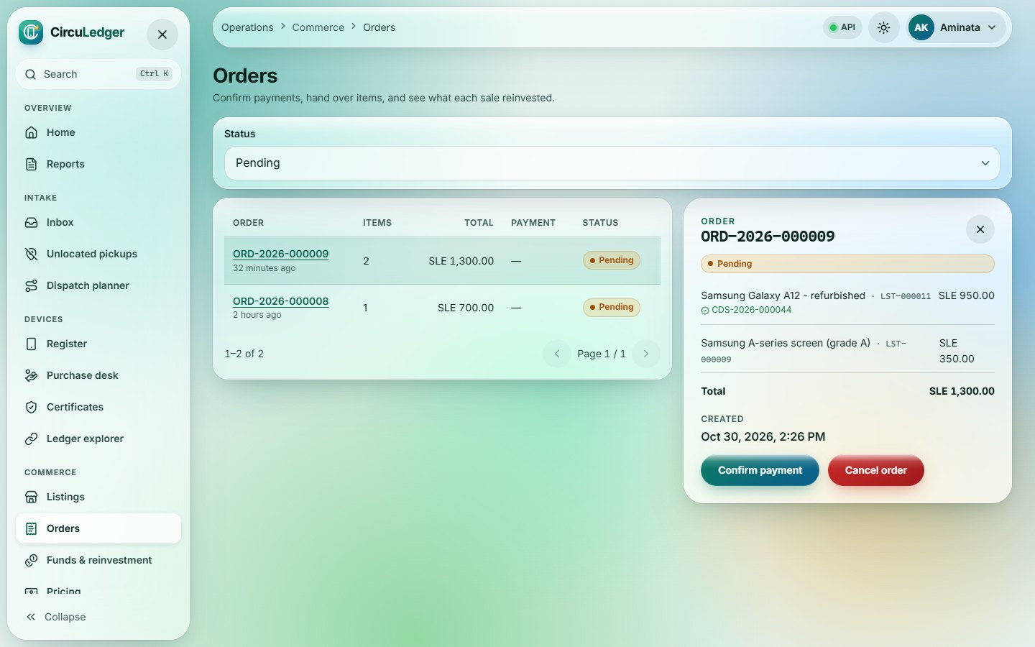
Orders
28
Operations
Route /ops/orders
Confirm payments, hand over items and see how much of each sale was reinvested into the funds.
Notes:
Orders (/ops/orders). Confirm payments, hand over items and see how much of each sale was reinvested into the funds.

Slide 33
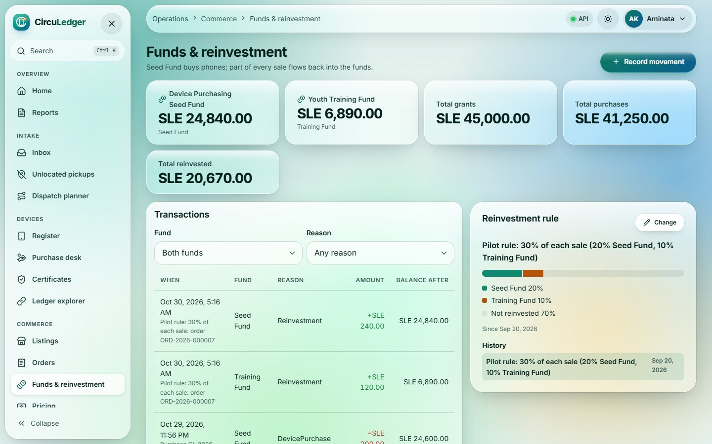
Funds & reinvestment
29
Operations
Route /ops/funds
Seed and Training Fund balances, every transaction, and the reinvestment rule with its history.
Notes:
Funds & reinvestment (/ops/funds). Seed and Training Fund balances, every transaction, and the reinvestment rule with its history.

Slide 34
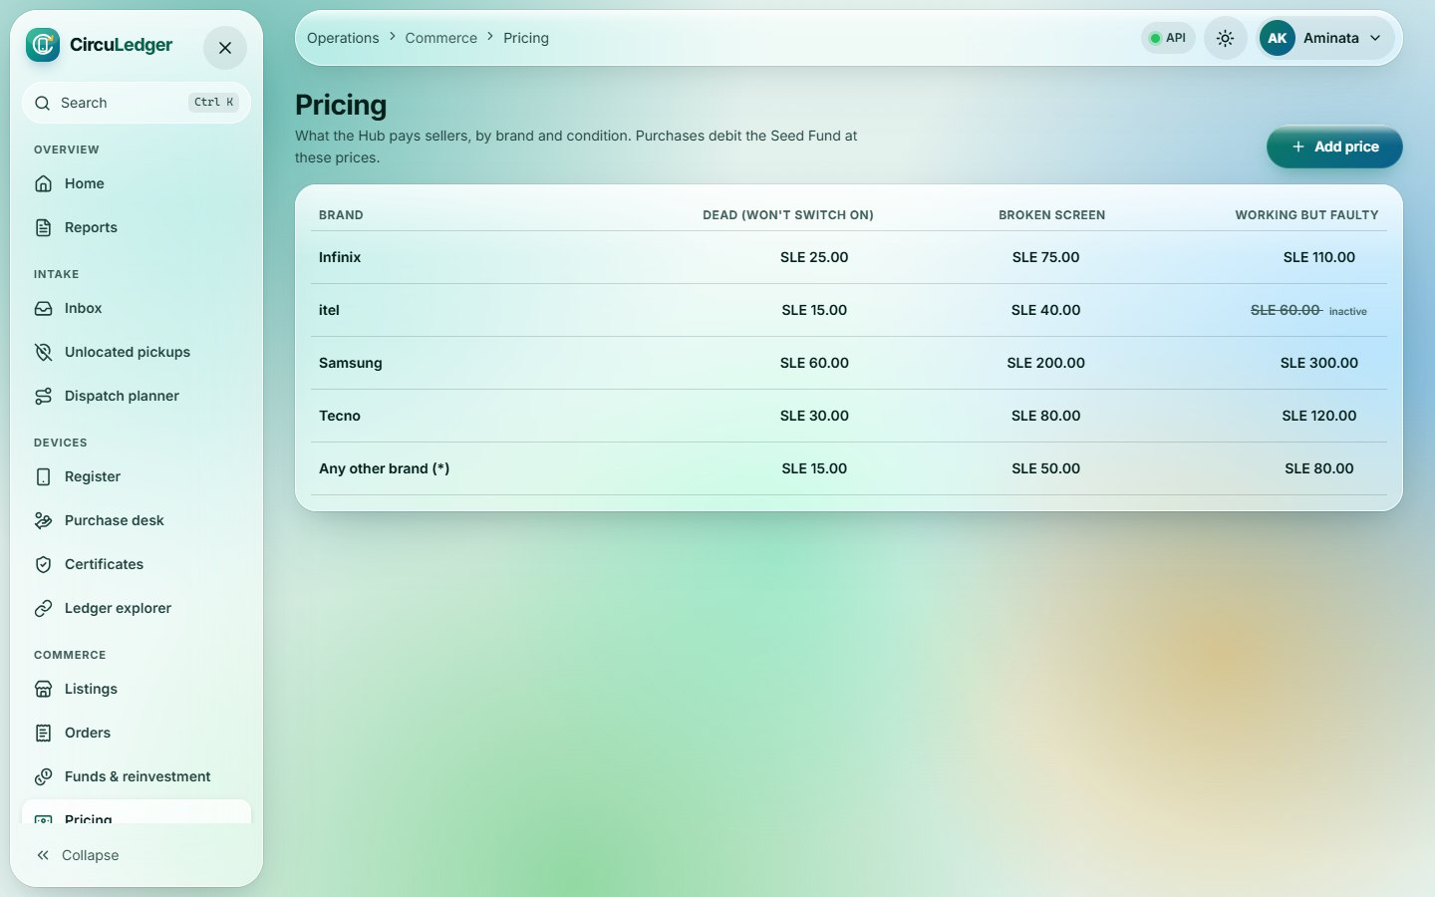
Pricing matrix
30
Operations
Route /ops/pricing
What the Hub pays sellers by brand and condition, with a "*" fallback for any other brand. Click a cell to edit.
Notes:
Pricing matrix (/ops/pricing). What the Hub pays sellers by brand and condition, with a "*" fallback for any other brand. Click a cell to edit.

Slide 35
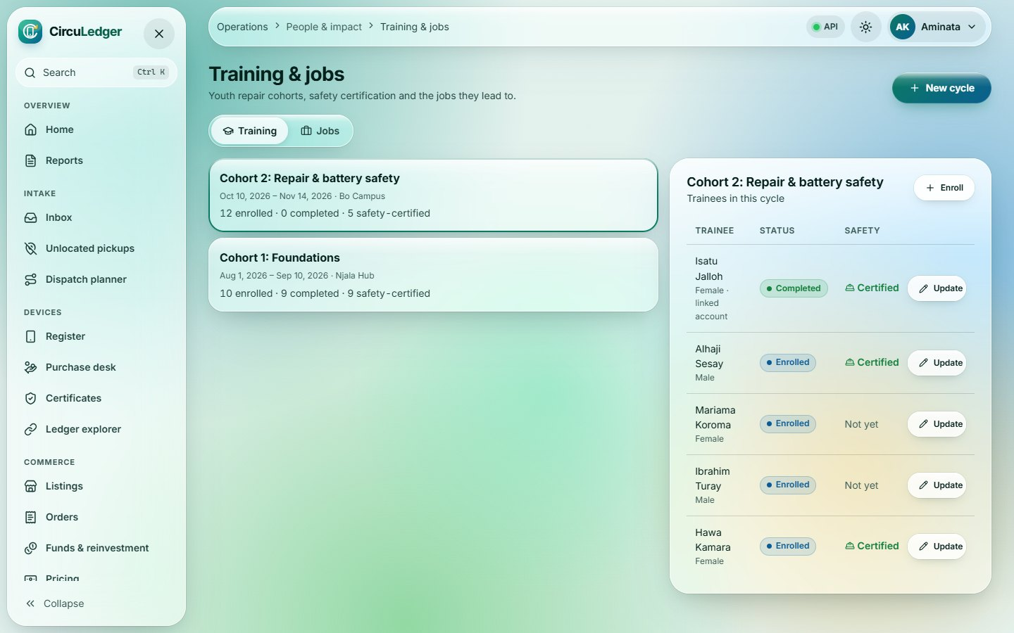
Training & jobs
31
Operations
Route /ops/training
Youth repair cohorts, enrollments and safety certification (which unlocks dismantling), plus jobs created.
Notes:
Training & jobs (/ops/training). Youth repair cohorts, enrollments and safety certification (which unlocks dismantling), plus jobs created.

Slide 36
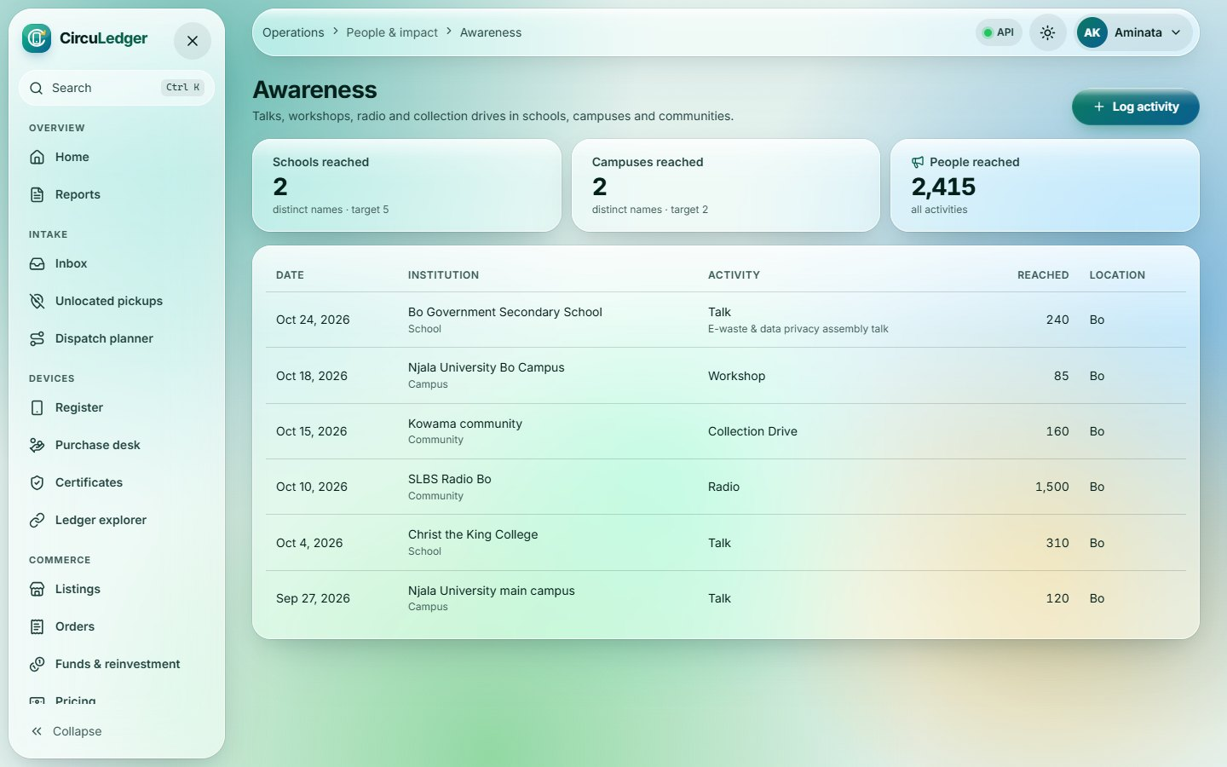
Awareness
32
Operations
Route /ops/awareness
School, campus, radio and community activities. Schools and campuses are counted by distinct name, so names autocomplete.
Notes:
Awareness (/ops/awareness). School, campus, radio and community activities. Schools and campuses are counted by distinct name, so names autocomplete.

Slide 37
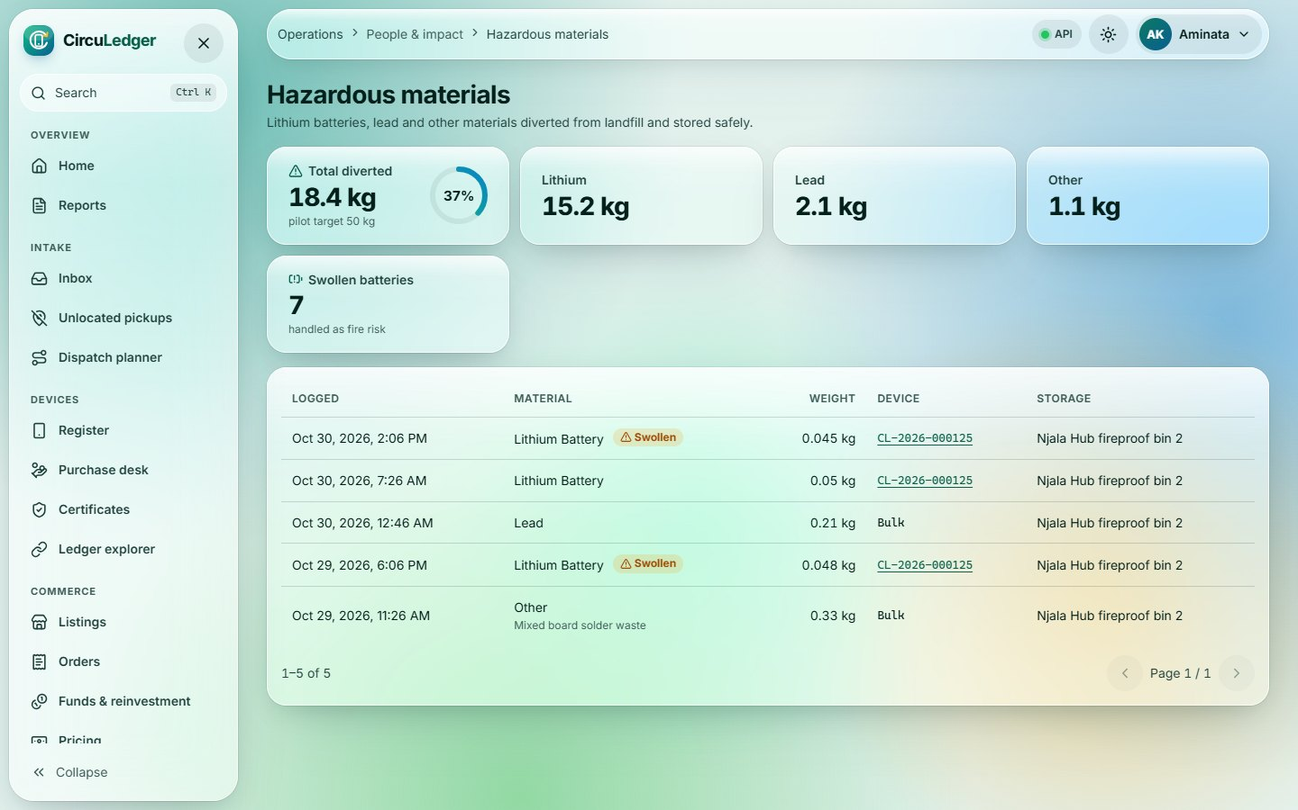
Hazardous materials
33
Operations
Route /ops/hazardous
Lithium, lead and other materials diverted and stored safely, against the 50 kg target; swollen batteries flagged.
Notes:
Hazardous materials (/ops/hazardous). Lithium, lead and other materials diverted and stored safely, against the 50 kg target; swollen batteries flagged.

Slide 38
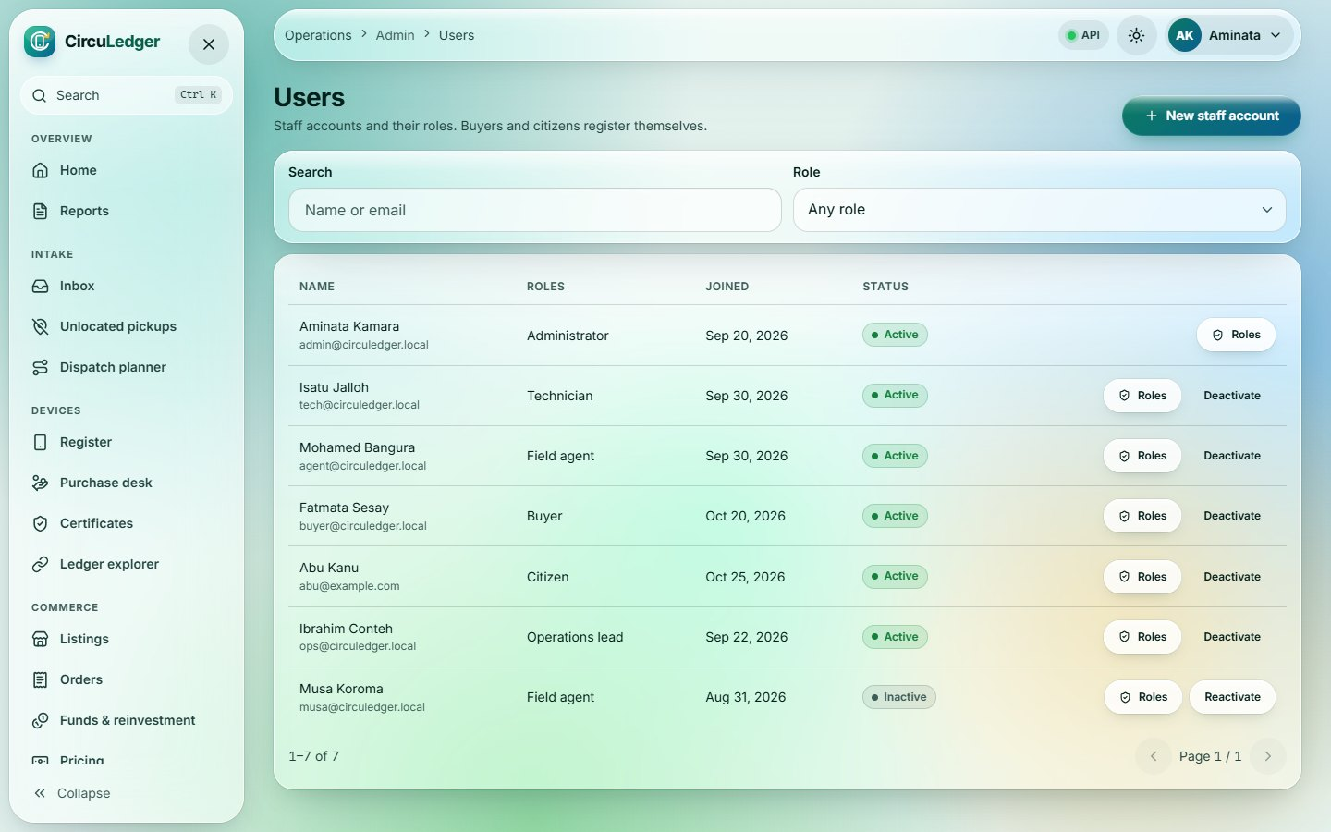
Users
34
Operations
Route /ops/users
Admin-only staff accounts: create, edit roles, deactivate. Role changes apply at the next login.
Notes:
Users (/ops/users). Admin-only staff accounts: create, edit roles, deactivate. Role changes apply at the next login.

Slide 39
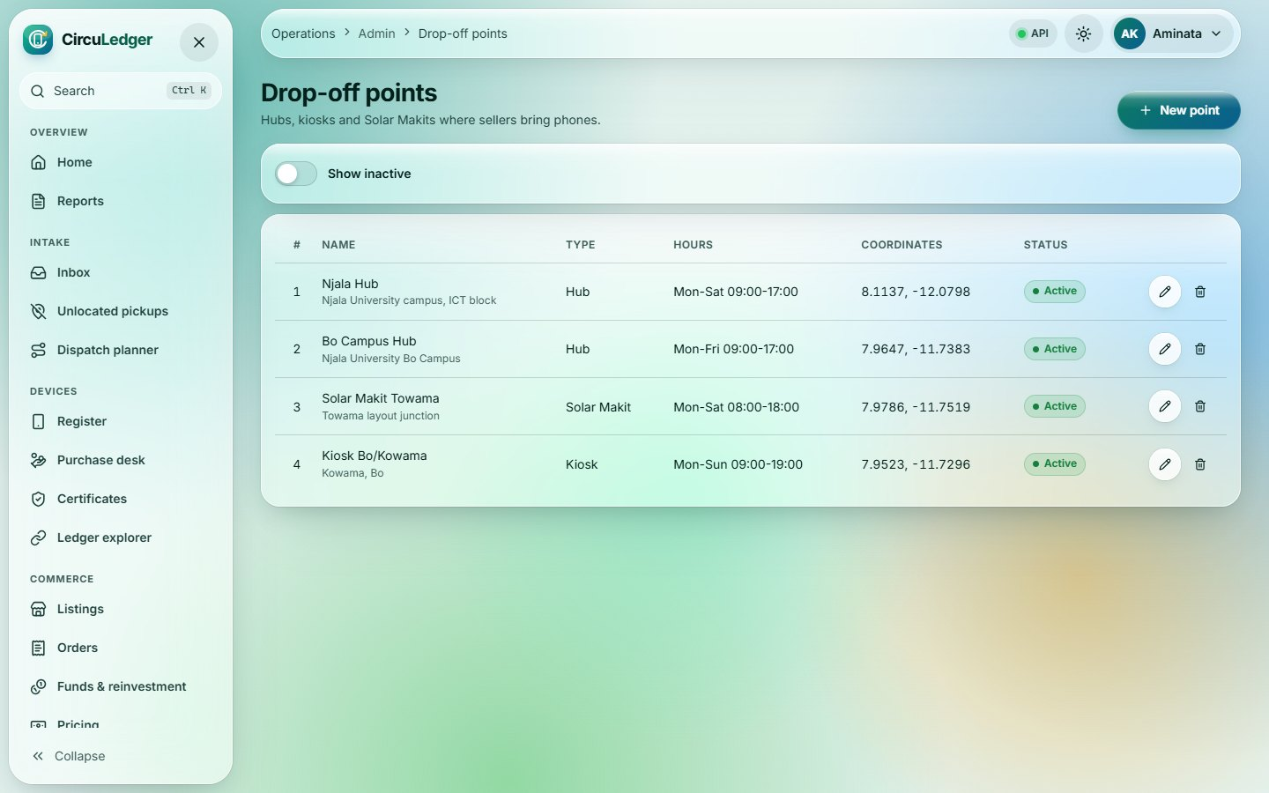
Drop-off points
35
Operations
Route /ops/drop-off-points
Hubs, kiosks and Solar Makits; display order sets the USSD menu order, coordinates are checked against Sierra Leone bounds.
Notes:
Drop-off points (/ops/drop-off-points). Hubs, kiosks and Solar Makits; display order sets the USSD menu order, coordinates are checked against Sierra Leone bounds.

Slide 40
Workshop
36 Workshop: scan
Technician
37 Wipe & certify
38 Decide outcome
Mobile-first bench app: scan, wipe & certify, decide, dismantle, recover.
39 Recover & log
40 Receive phones
Route: /workshop
41 Photos for listings
Notes:
Workshop. Mobile-first bench app: scan, wipe & certify, decide, dismantle, recover. Used by: Technician. Pages in this section: Workshop: scan, Wipe & certify, Decide outcome, Recover & log, Receive phones, Photos for listings.

Slide 41
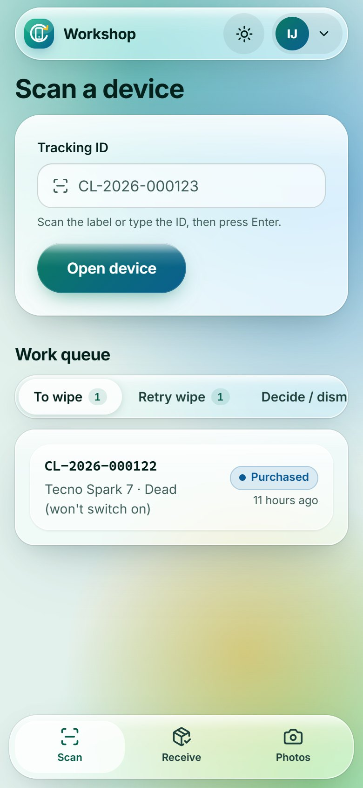
Workshop: scan
36
Workshop · phone
Route /workshop
Mobile-first. Scan a tracking-ID label (or use the camera), and work through queues: to wipe, retry, decide, recover.
Notes:
Workshop: scan (/workshop). Mobile-first. Scan a tracking-ID label (or use the camera), and work through queues: to wipe, retry, decide, recover.

Slide 42
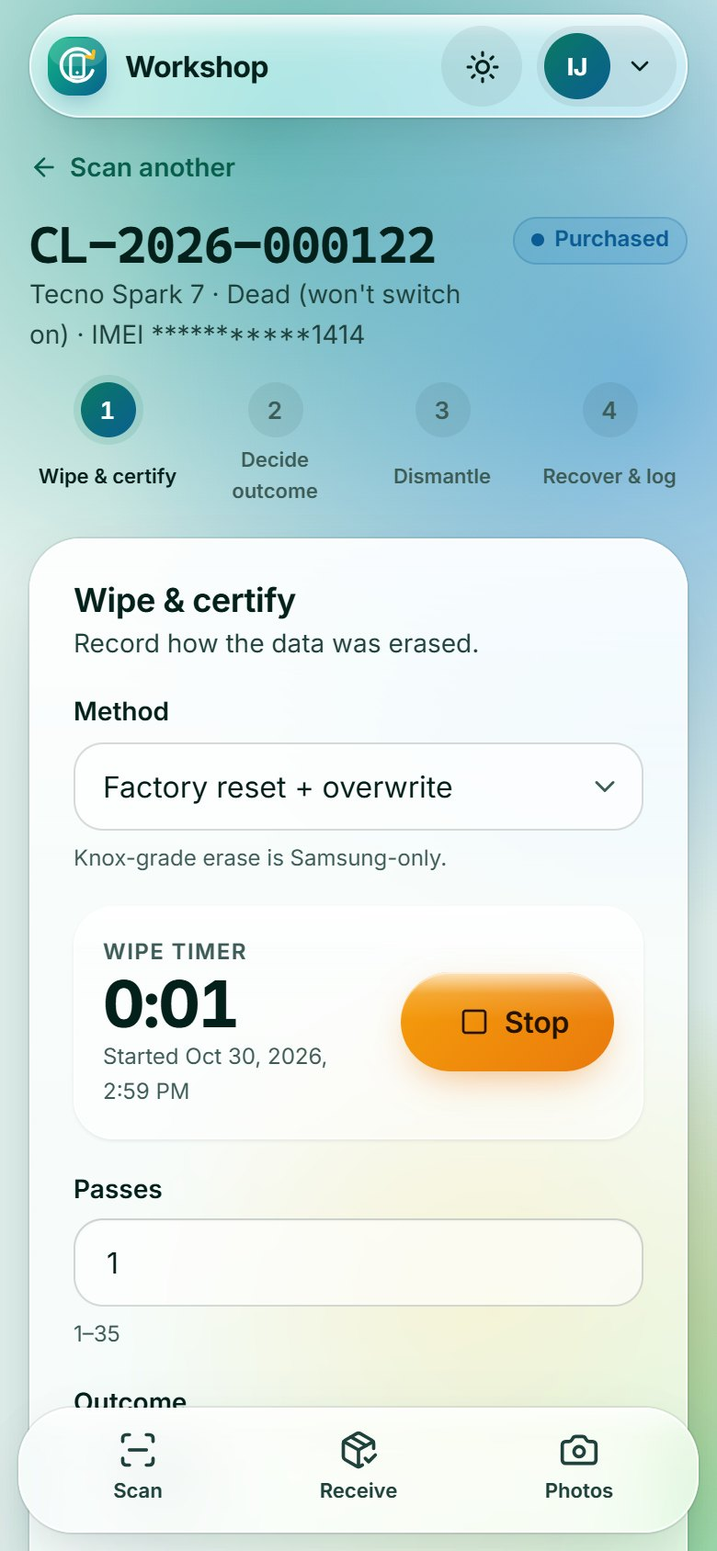
Wipe & certify
37
Workshop · phone
Route /workshop/device/:id
One main action per screen. The wipe timer fills start/finish times; a passed wipe issues the certificate automatically.
Notes:
Wipe & certify (/workshop/device/:id). One main action per screen. The wipe timer fills start/finish times; a passed wipe issues the certificate automatically.

Slide 43
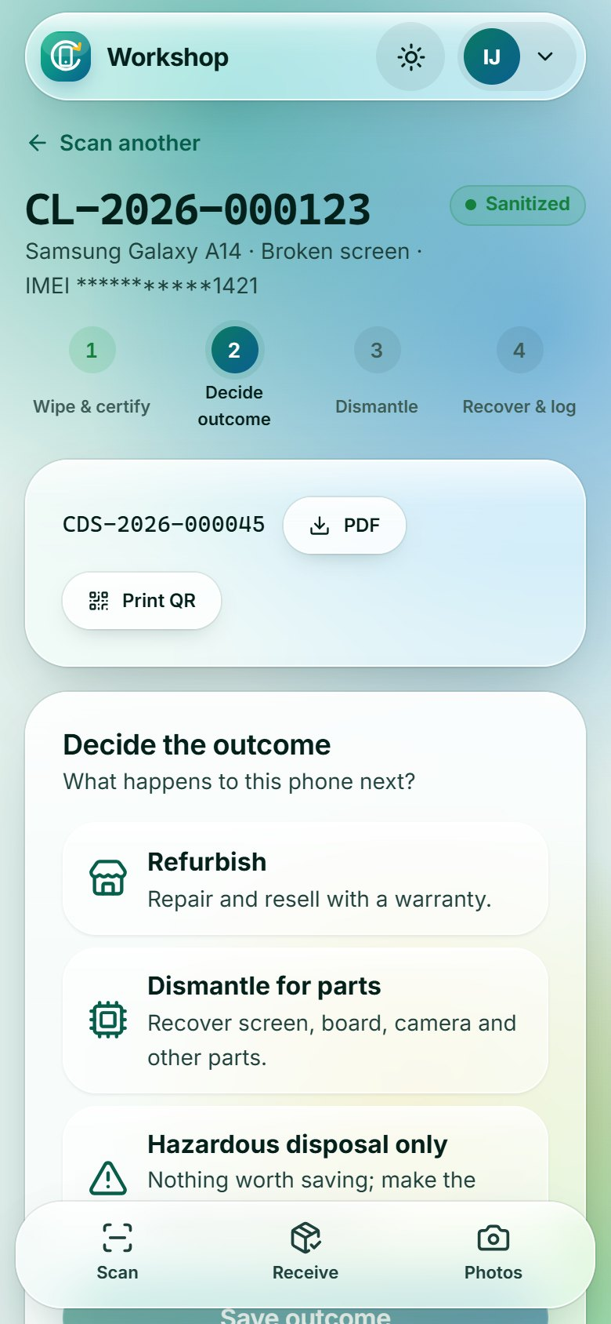
Decide outcome
38
Workshop · phone
Route /workshop/device/:id
Refurbish (only with a valid certificate), dismantle for parts, or hazardous disposal; PDF and QR label are at hand.
Notes:
Decide outcome (/workshop/device/:id). Refurbish (only with a valid certificate), dismantle for parts, or hazardous disposal; PDF and QR label are at hand.

Slide 44
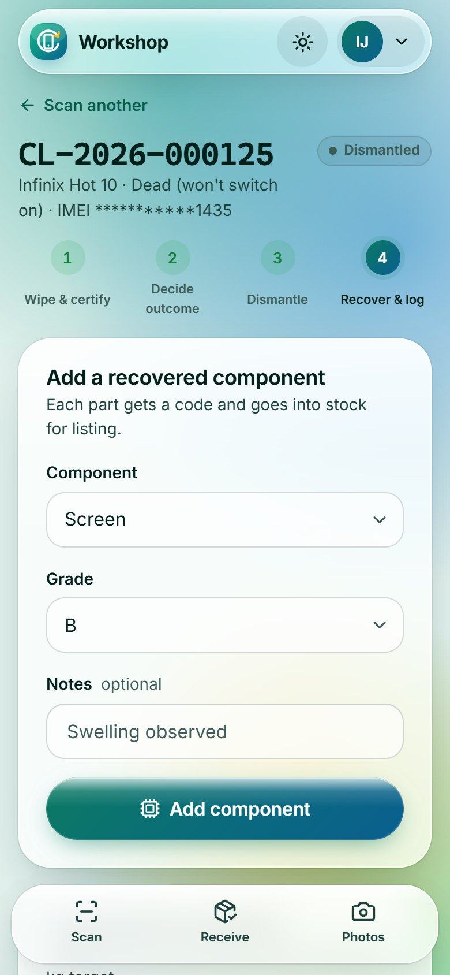
Recover & log
39
Workshop · phone
Route /workshop/device/:id
After dismantling: add recovered components to stock and log hazardous material by weight and storage location.
Notes:
Recover & log (/workshop/device/:id). After dismantling: add recovered components to stock and log hazardous material by weight and storage location.

Slide 45
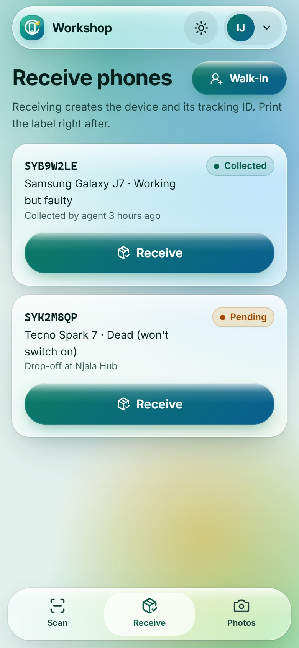
Receive phones
40
Workshop · phone
Route /workshop/receive
Drop-offs and collected pickups waiting at the hub, plus walk-in sellers. Receiving creates the device and its tracking ID.
Notes:
Receive phones (/workshop/receive). Drop-offs and collected pickups waiting at the hub, plus walk-in sellers. Receiving creates the device and its tracking ID.

Slide 46
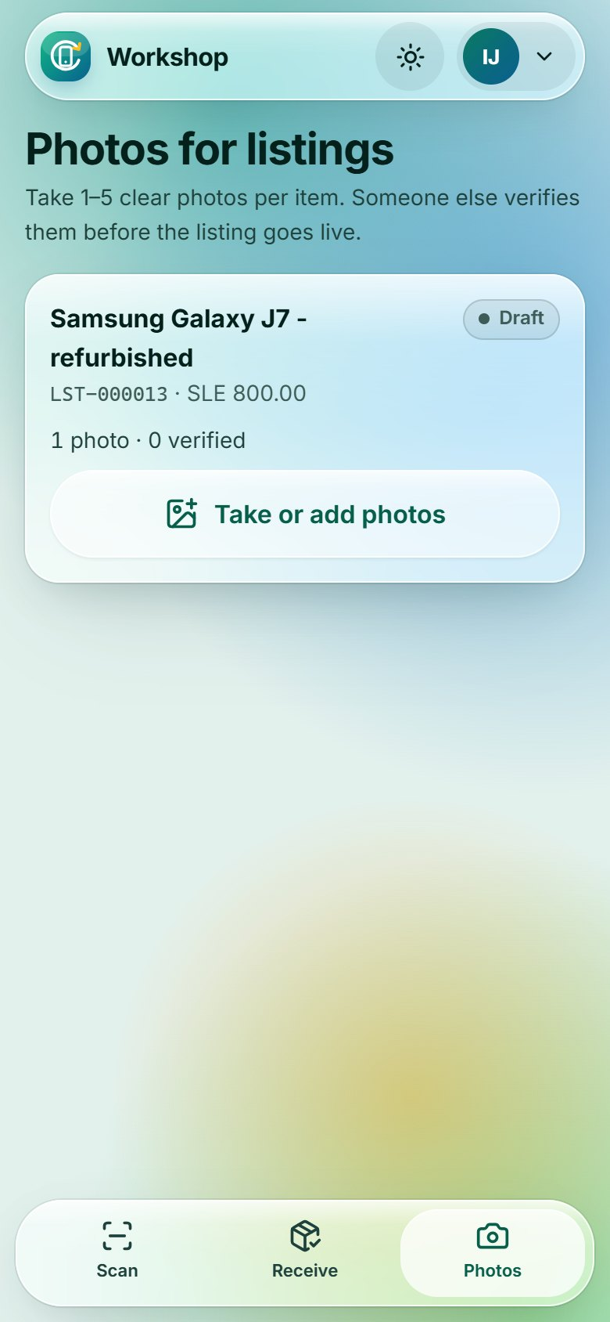
Photos for listings
41
Workshop · phone
Route /workshop/photos
Technicians photograph Draft listings straight from the phone camera; Operations verifies before publishing.
Notes:
Photos for listings (/workshop/photos). Technicians photograph Draft listings straight from the phone camera; Operations verifies before publishing.

Slide 47
Field
42 Field: my route
Field agent
43 Pickup detail
44 Fix location
Mobile route for pickups: call the seller, collect, fix locations.
Route: /field
Notes:
Field. Mobile route for pickups: call the seller, collect, fix locations. Used by: Field agent. Pages in this section: Field: my route, Pickup detail, Fix location.

Slide 48
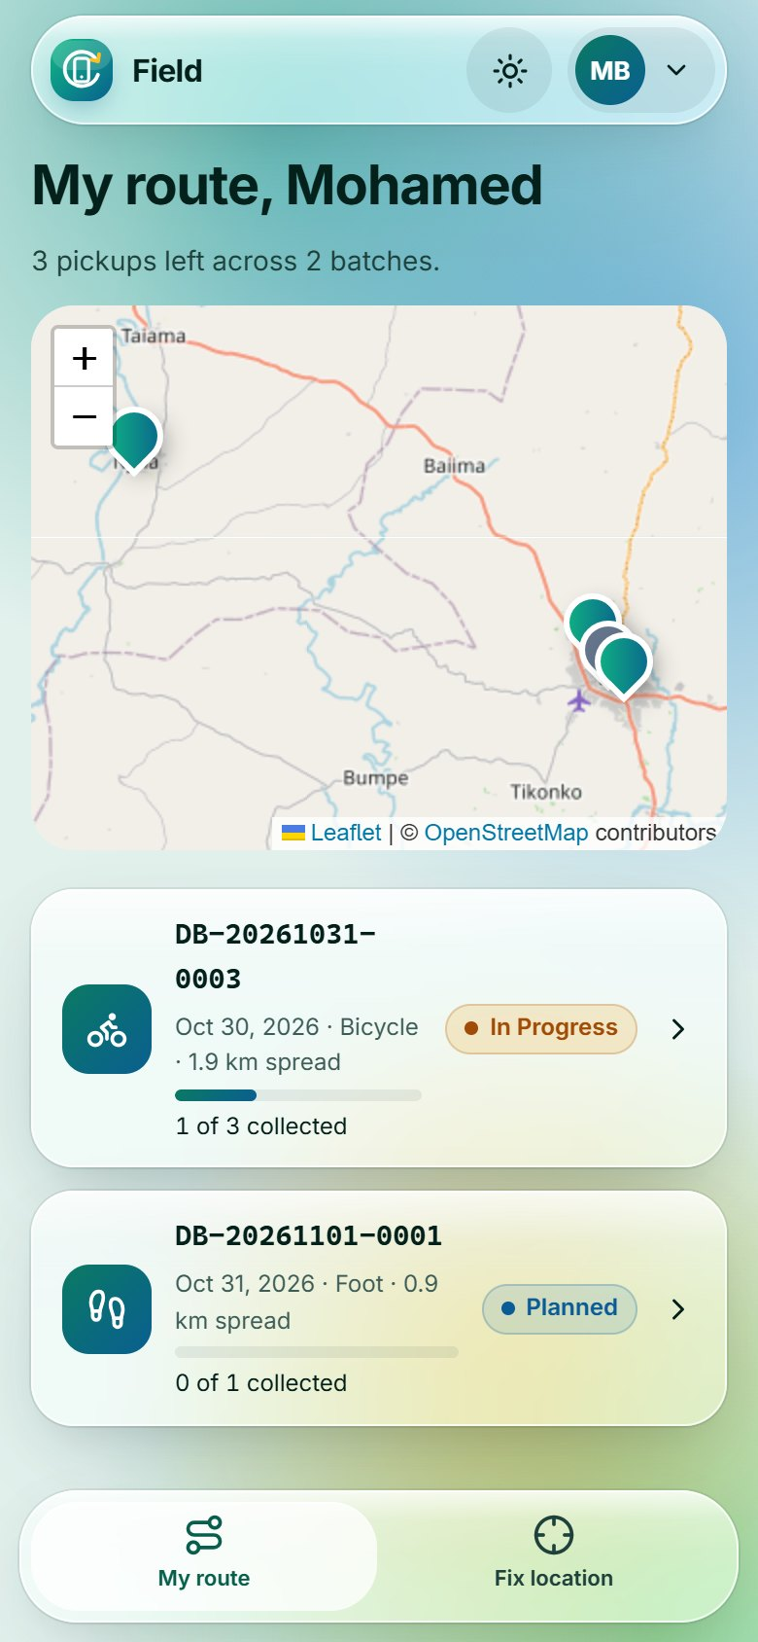
Field: my route
42
Field · phone
Route /field
The agent’s open batches, soonest first, with a map of every pickup and progress per batch.
Notes:
Field: my route (/field). The agent’s open batches, soonest first, with a map of every pickup and progress per batch.

Slide 49
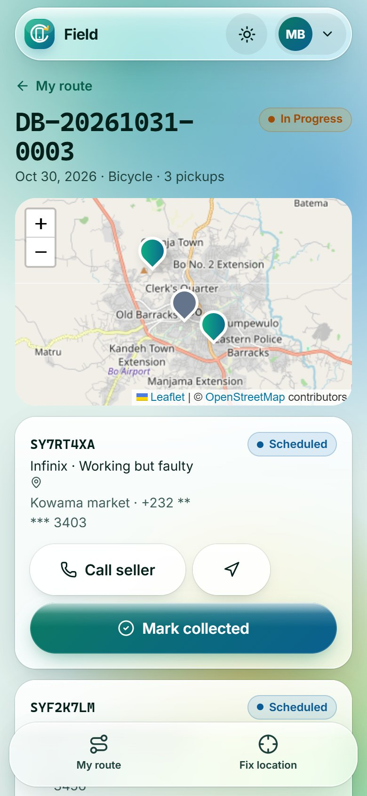
Pickup detail
43
Field · phone
Route /field/batch/:id
Call seller (the full number is fetched only on tap and never stored), directions, and Mark collected.
Notes:
Pickup detail (/field/batch/:id). Call seller (the full number is fetched only on tap and never stored), directions, and Mark collected.

Slide 50
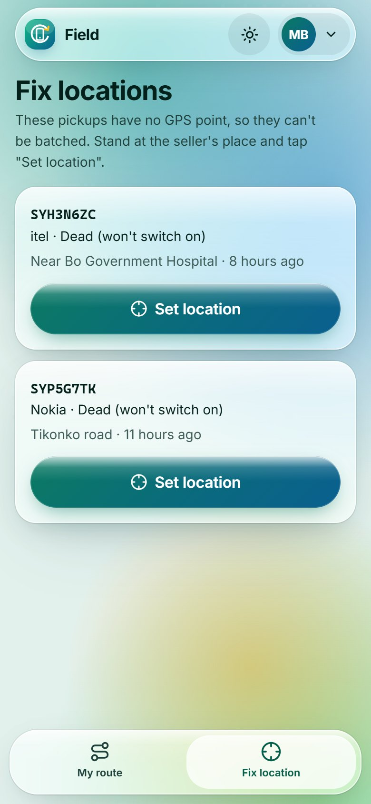
Fix location
44
Field · phone
Route /field/locate
Pending pickups without GPS: stand at the seller’s place and set the location from the phone.
Notes:
Fix location (/field/locate). Pending pickups without GPS: stand at the seller’s place and set the location from the phone.

Slide 51
Marketplace & citizens
45 Marketplace
Buyers · sellers
46 Product page
47 Cart & checkout
Certified refurbished phones for buyers, and a portal for sellers.
48 My orders
49 Order detail
Route: /marketplace · /citizen
50 Citizen portal
Notes:
Marketplace & citizens. Certified refurbished phones for buyers, and a portal for sellers. Used by: Buyers · sellers. Pages in this section: Marketplace, Product page, Cart & checkout, My orders, Order detail, Citizen portal.

Slide 52
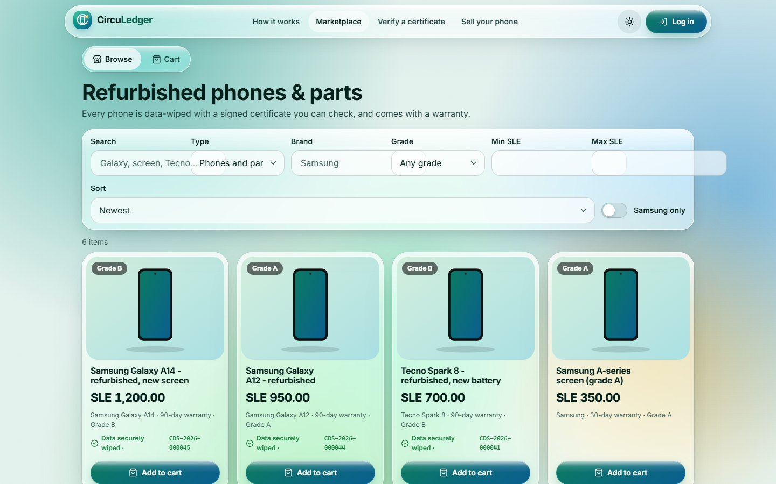
Marketplace
45
Marketplace & citizens
Route /marketplace
Certified refurbished phones and parts with filters, sort and debounced search. The green badge means data securely wiped.
Notes:
Marketplace (/marketplace). Certified refurbished phones and parts with filters, sort and debounced search. The green badge means data securely wiped.

Slide 53
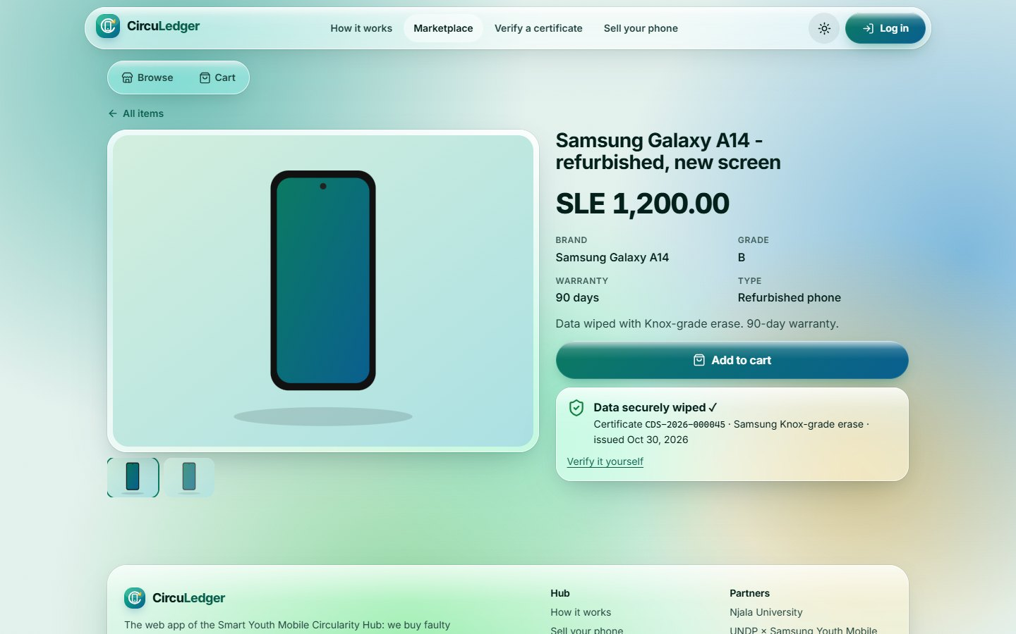
Product page
46
Marketplace & citizens
Route /marketplace/listing/:id
Photos, grade and warranty, with the certificate checked live against the public verify endpoint as a trust badge.
Notes:
Product page (/marketplace/listing/:id). Photos, grade and warranty, with the certificate checked live against the public verify endpoint as a trust badge.

Slide 54
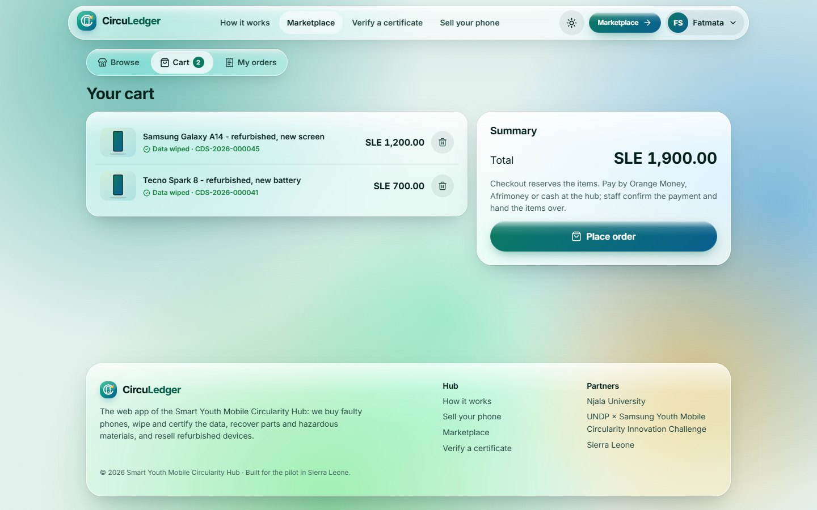
Cart & checkout
47
Marketplace & citizens
Route /marketplace/cart
Client-side cart; checkout reserves items atomically, and anything another buyer took is removed with a clear message.
Notes:
Cart & checkout (/marketplace/cart). Client-side cart; checkout reserves items atomically, and anything another buyer took is removed with a clear message.

Slide 55
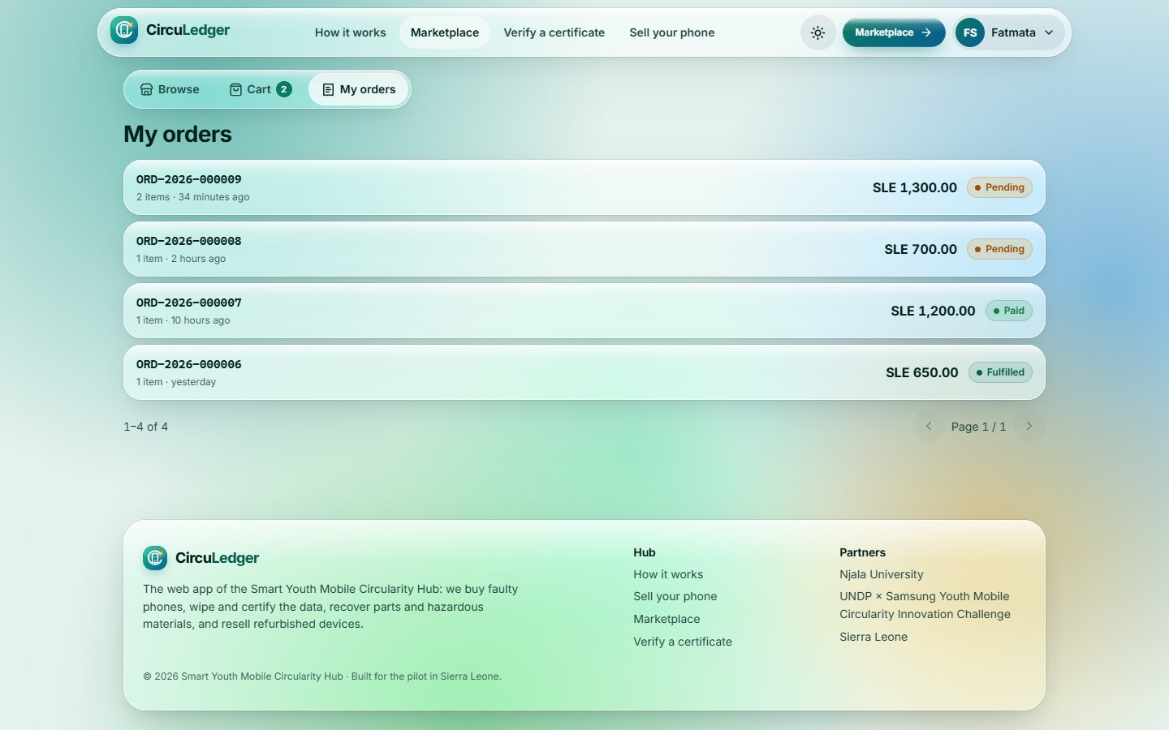
My orders
48
Marketplace & citizens
Route /marketplace/orders
A buyer’s orders with status; pending orders can be cancelled.
Notes:
My orders (/marketplace/orders). A buyer’s orders with status; pending orders can be cancelled.

Slide 56
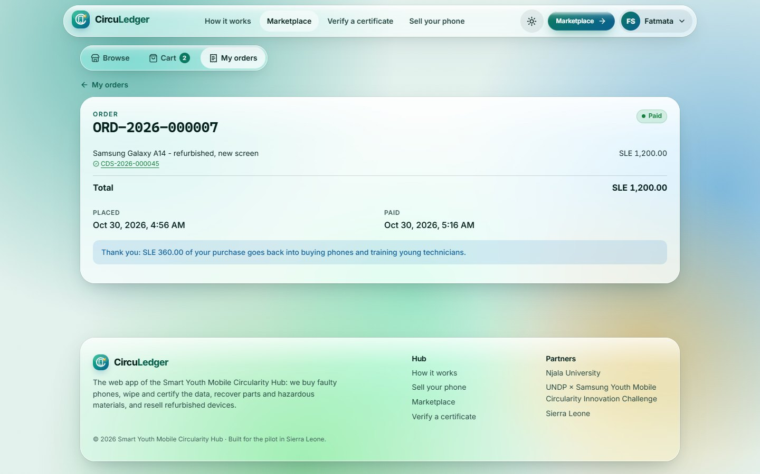
Order detail
49
Marketplace & citizens
Route /marketplace/orders/:id
Items with their certificates, payment and hand-over times, and how much of the purchase was reinvested.
Notes:
Order detail (/marketplace/orders/:id). Items with their certificates, payment and hand-over times, and how much of the purchase was reinvested.

Slide 57
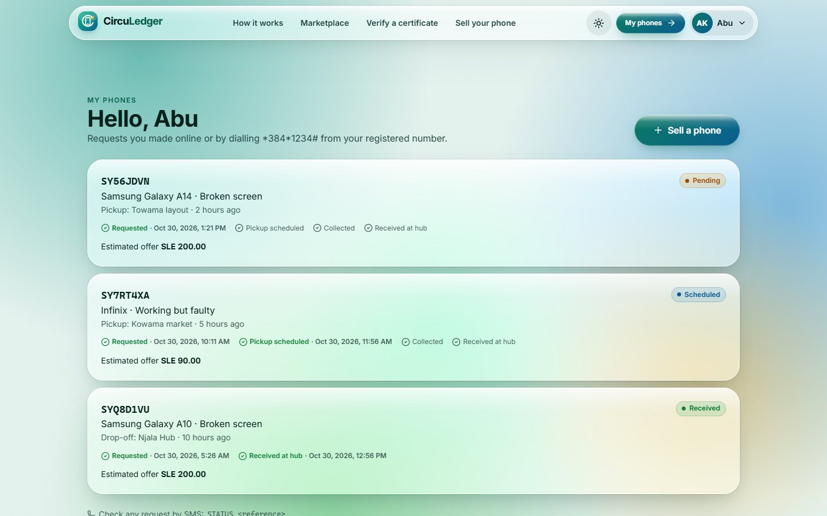
Citizen portal
50
Marketplace & citizens
Route /citizen
A seller’s requests (online or by USSD from the registered number) with progress steps, and "Sell a phone".
Notes:
Citizen portal (/citizen). A seller’s requests (online or by USSD from the registered number) with progress steps, and "Sell a phone".

Slide 58
Ready for the live API
50
70
1
0
screens across five workspaces
unit tests passing
end-to-end test written (USSD → Ops), to run with the API
lint errors (with accessibility rules)
Next: run the app and the end-to-end test against the real CircuLedger API.
Screens in this deck use sample data from the API guide’s examples; open questions for the backend team are listed in the project README.
Notes:
Summary. Every workspace is built and tested; the remaining step is to run it end to end against the live API. Screenshots used sample data.

