Slide 1
EVENT DATA PIPELINE & INSIGHTS
Synthetic Event Survey Analytics
Five Community Health Events | Python & Pandas
Emmanuel Owusu-Ampaw
Independent Data Analytics Portfolio Project

Slide 2
Executive Summary
325 synthetic survey records analyzed across five community health events
Awareness: Very/Extremely Aware was 21.9% pre-survey vs. 29.8% post-survey (+7.9 pp)
Doctor Comfort: Comfortable/Very Comfortable was 16.9% vs. 21.2% (+4.3 pp)
Device Use: Regular monitoring device use was 27.4% vs. 26.5% (-0.8 pp)
Event Variation: Positive satisfaction ranged from 14.3% to 43.3%
Synthetic dataset; pre- and post-survey responses were analyzed as separate groups, not matched individuals.

Slide 3
Methodology & Data Quality
Methodology
• Combined five synthetic event worksheets into one analysis-ready dataset
• Standardized columns, categories, and data types
• Preserved event labels, dates, participant IDs, and survey phase
• Compared pre- and post-survey response distributions
Data Quality
• Checked missing values and duplicate records
• Validated row counts and standardized categories
• Used reproducible Python / pandas transformations
• Documented assumptions and analysis limitations

Slide 4
Participant Profile
325 synthetic survey records
196 pre-survey and 129 post-survey records
5 fictional community health events
Survey phases: Pre-Survey and Post-Survey
Age groups: 18–34, 35–49, 50–64, and 65+
The synthetic dataset preserves event, date, participant ID, and survey phase for group-level comparisons.

Slide 5
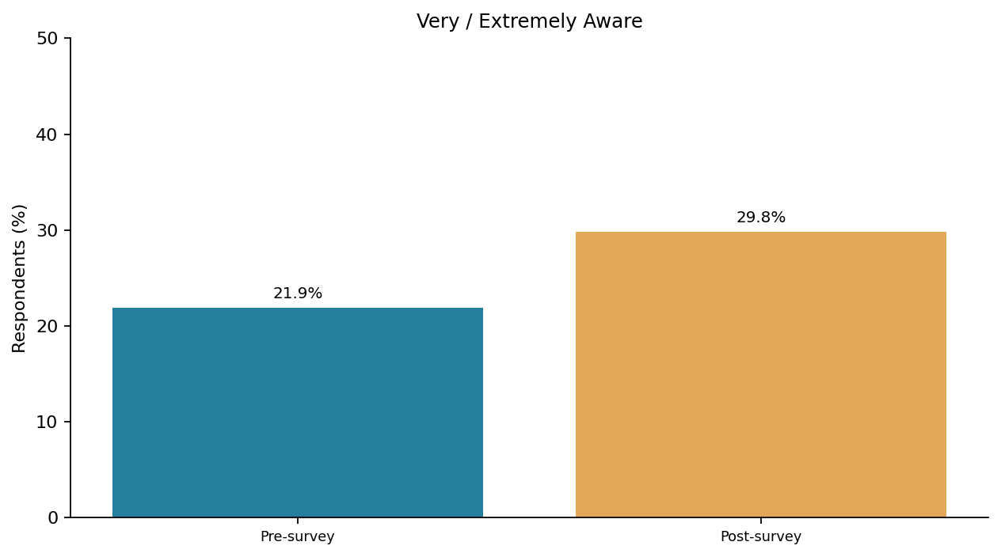
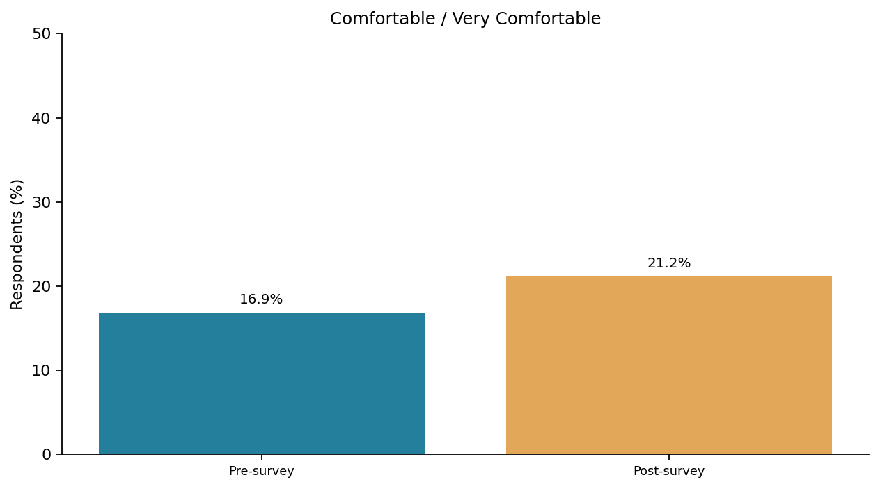
Awareness & Doctor Comfort
Awareness: 21.9% → 29.8% Very/Extremely Aware (+7.9 pp)
Doctor Comfort: 16.9% → 21.2% Comfortable/Very Comfortable (+4.3 pp)
Key takeaway: Post-survey groups reported modestly higher awareness and comfort. These are descriptive differences, not evidence of causation.

Slide 6
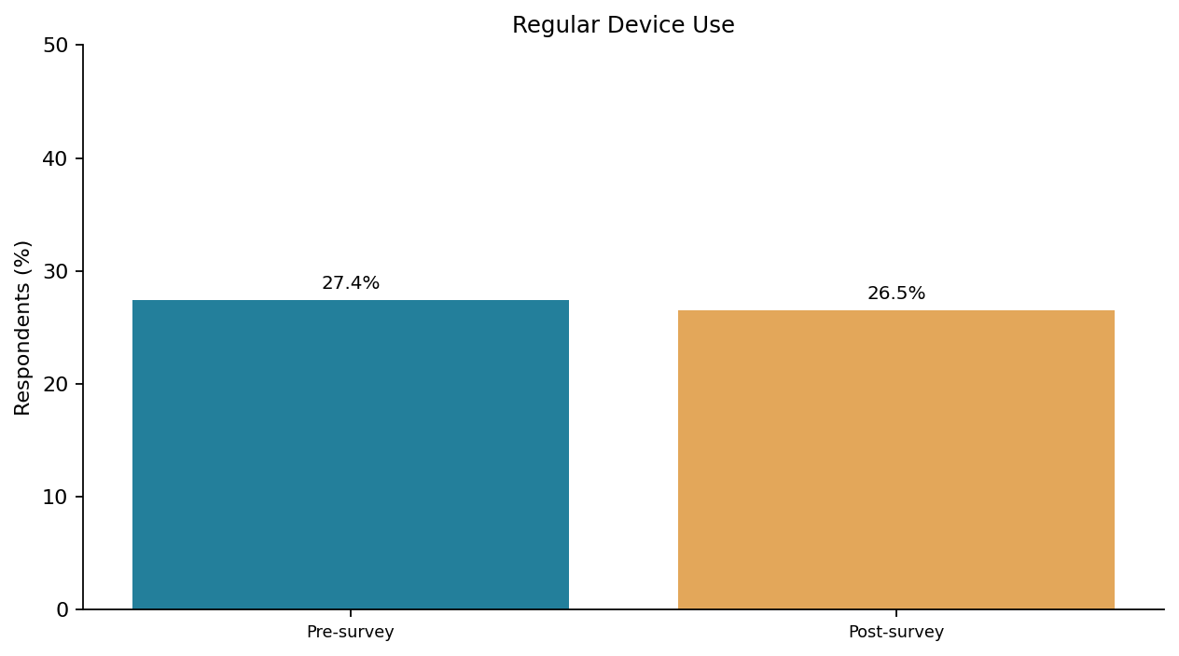
Health Monitoring Device Use
27.4% Pre-Survey → 26.5% Post-Survey
-0.8 percentage-point difference (rounded)
Key takeaway: Regular device use was similar in both survey groups.

Slide 7
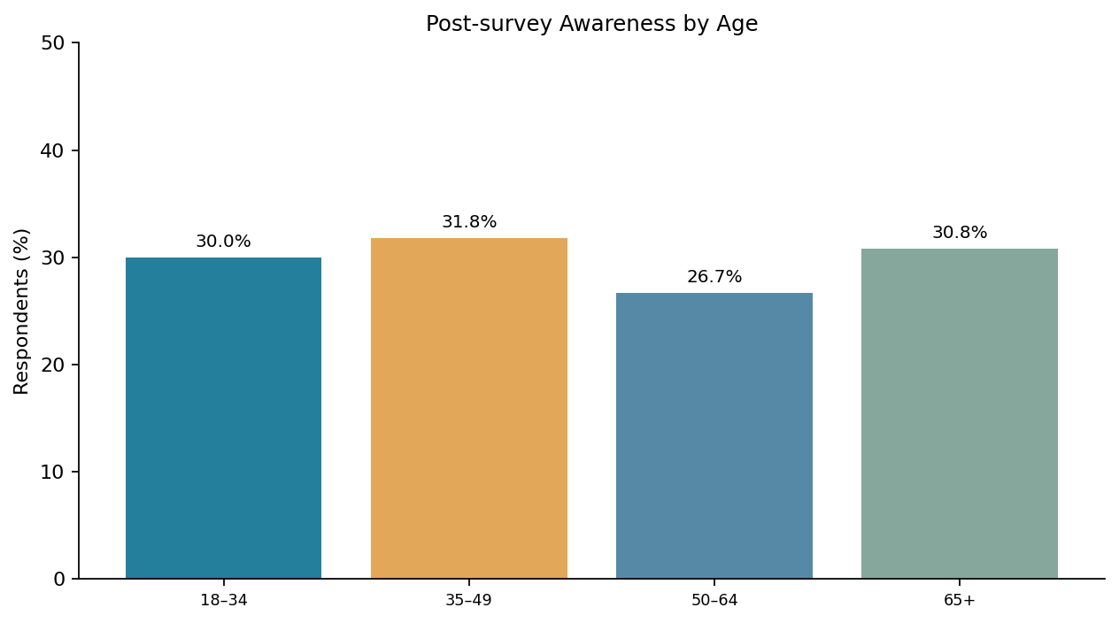
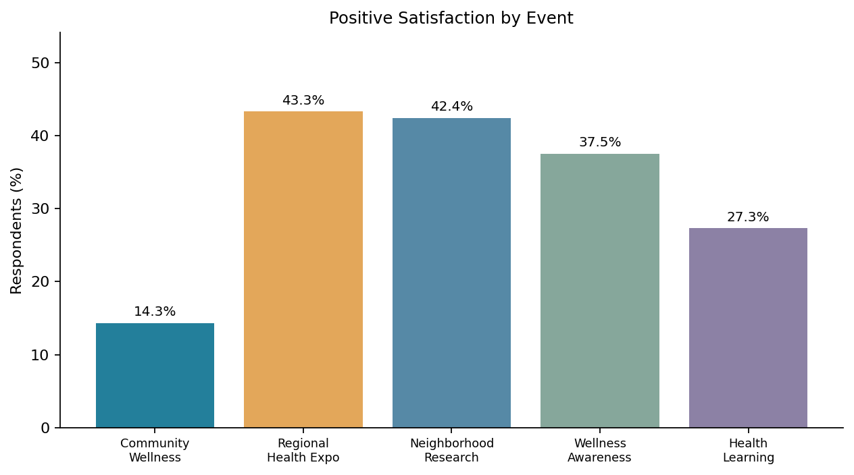
Age & Event Differences
Age: Post-survey high awareness ranged from 26.7% (50–64) to 31.8% (35–49).
Event: Positive satisfaction ranged from 14.3% (Community Wellness Forum) to 43.3% (Regional Health Expo).
Recommendations & Limitations
Recommendations: Investigate variation in satisfaction across synthetic events; explore targeted awareness education; assess barriers to health-monitoring device use.
Limitations: Data are fully synthetic. Survey phases are not individually matched and observed group differences do not establish causal effects.

