Slide 1
Web Event Analysis

Slide 2
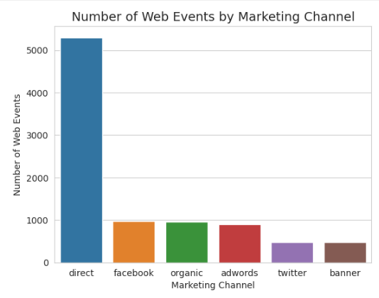
Number of events by marketing channel
The chart shows that direct traffic dominates other channels with more than 50% of events followed by facebook, organic and adwords.Twitter and banner generate the least traffic.

Slide 3
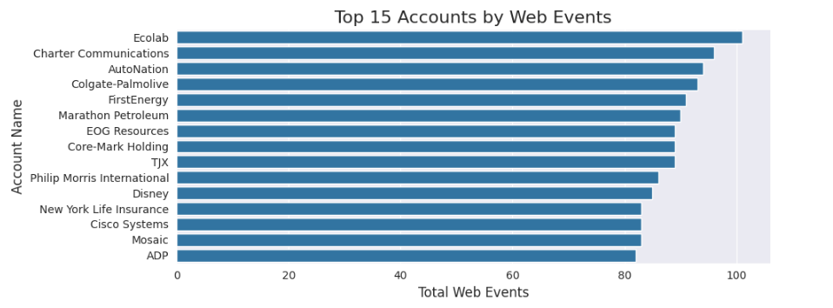
TOP 15 Accounts by Web Events

