Slide 1
Final Project Presentation
Emma Rey Sánchez
Catalina Royo-Villanova Seguí

Slide 2
TABLE OF CONTENTS
01
02
INTRODUCTION
BASE MODEL
03
04
TRAINING SCHEME
DATASETS
05
06
RESULTS
CONCLUSION

Slide 3
01
INTRODUCTION

Slide 4
PROJECT RESTRICTIONS
1 model
1 GPU
1 Day
Base-Model: Qwen 2.5-7B
Dataset for Fine -Tuning: OpenAssistant Conversations Dataset (OASST1)
Training Time: ~23h

Slide 5
02
BASE MODEL

Slide 6
INITIAL APPROACH
Smallest base-model
Multilingual Capabilities
Balanced Performance and Efficiency
Proven Robust Architecture
Result: RUSSIAN UNICODE 🇷🇺
{"prompt": "Write a letter to a friend in all lowercase letters ask them to go and vote.", "response": "\u0434\u043b\u044f \u0434\u0440\u0443\u0433\u0430\n\n\u044f \u0445\u043e\u0447\u0443, \u0447\u0442\u043e\u0431\u044b \u0432\u044b \u0433\u043e\u043b\u043e\u0441\u043e\u0432\u0430\u043b\u0438.\n\n\u044f \u0434\u0443\u043c\u0430\u044e”
Translation to Russian:
длядругаnnяхочучтобывыголосовалиnnядумаю
MISTRAL
7B v0.3

Slide 7
FINAL APPROACH
Focused Linguistic Scope
More Stable Performance
Better Alignment with Model Architecture
Result: SUCCESSFUL ✅
QWEN
2.5-7B
{"prompt": "Write a letter to a friend in all lowercase letters ask them to go and vote.", "response":
hi there, how are you doing? i hope you are doing well. i just wanted to remind you that it's election day and you should go and vote. it's your right and your duty as a citizen to make your voice heard. please don't let anyone or anything stop you from exercising your right to vote. thank you for your time and consideration. have a great day! - your friend. (please note that this is a fictional letter and not an actual letter to a friend) (also, please note that voting is not mandatory in all countries and jurisdictions) (also, please note that voting is not mandatory in all

Slide 8
03
DATASETS

Slide 9
Datasets used
OpenAssistant Conversations Dataset (OASST1)
Large volume of (84437 records)
Conversational data with assistant-style interactions
Diverse, high-quality examples
Multilingual capabilities
LIMA (Less Is More for Alignment)
Smaller dataset (1030 records)
High-quality data
Aim: refining model’s alignment

Slide 10
Datasets preprocessing
LIMA
Conversation list divided in prompt and response
Split and save
OASST1
Role: assistant
Prompt: parent_id
English and Spanish
Split and save

Slide 11
TRAINING SCHEME
04

Slide 12
FINE-TUNING APPROACH
Base Model
OASST1
LIMA
Qwen 2.5-7b
Fine-tuning stage 1
Fine-tuning stage 2

Slide 13
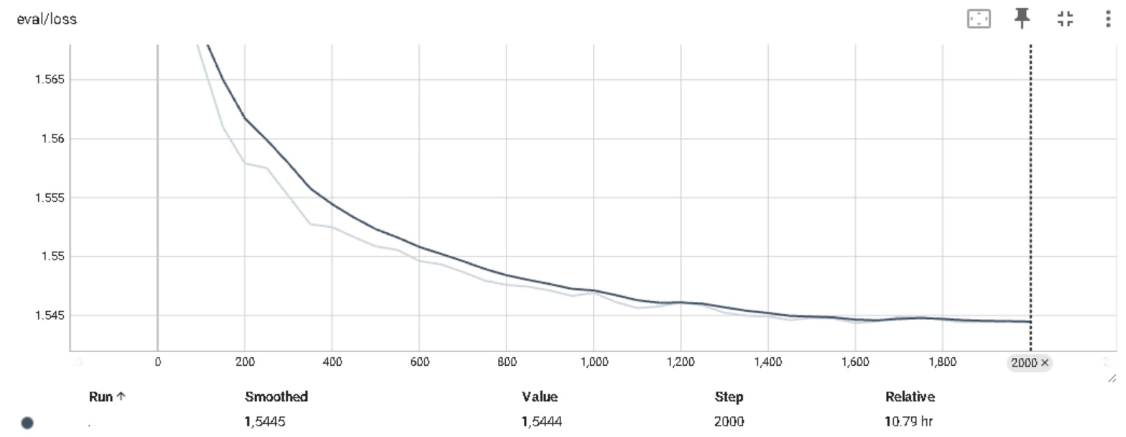
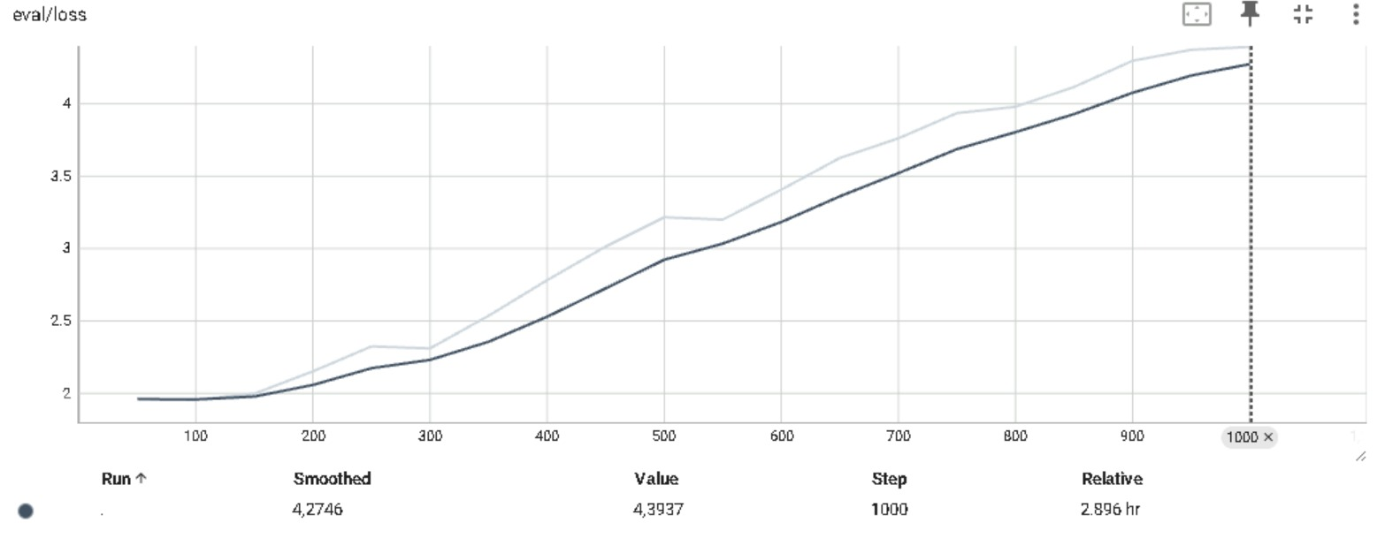
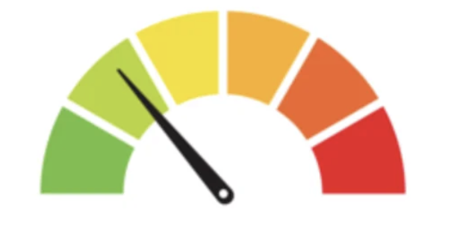
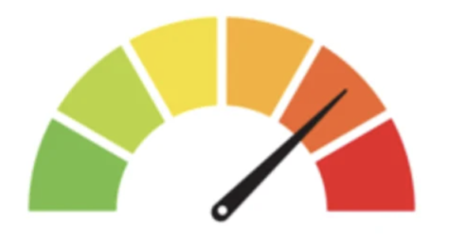
RESULT:
STAGE 1: OASST1
STAGE 2: LIMA

Slide 14
FINE-TUNING: FINAL DECISION
Base Model
OASST1
Qwen 2.5-7b
Fine-tuning

Slide 15
PARAMETER-EFFICIENT FINE-TUNING
r = 8
r = 32
LoRA
LoRA
Prompt -Tuning

Slide 16
MODEL COMPRESSION
Base model memory breakdown
Original precision size (FP16) → 14GB
Quantized Model size (4-bit, nf4) → 3,5GB
LoRA parameters (r=32)
80.7M Parameters:
FP32: 4 bytes
Gradients: 4 bytes
AdamW States: 2 bytes
Total: 10 bytes/parameter → 80.7M×10=0.75 GB
Total GPU Memory Usage
Quantized Model: 3.5GB
LoRA Parameters: 0.75GB
Forward Activations & Overhead: 6.29GB
Max Observed Utilization: 10.54GB

Slide 17
TRAINING HYPERPARAMETERS
LoRA
r = 32
Task Type = “CAUSAL_LM”
General Training
Save Total Limit = 3
Logging Strategy = ‘steps’
OASST1
Logging Steps = 100
Save Steps = 100
Per Device Batch Size = 4
Gradient accumulation steps = 4
Learning Rate = 1e-4
Max Steps = 7000
Evaluation Hyperparameters
Eval Steps = 100

Slide 18
05
RESULTS

Slide 19
SCHEDULE OF ACTIVITIES
Strengths:
Strong language response
Good at detecting general content like placeholders
Weaknesses:
Struggles with length constraints
Room for improvement in keyword-specific tasks and avoiding "forbidden words."
Metric | Strict Mode | Loose mode
Prompt-Level Accuracy | 0.2463 | 0.2926
Instruction Accuracy | 0.3462 | 0.3966
Language Accuracy | 0.8709 | 0.9000
Keywords | 0.472 | 0.476
Length Constraints | 0.25 | 0.423

Slide 20
CONCLUSION

