Slide 1
European Soccer Database
Final Project · Deliverable 4 · soccer_proj
Emmanuel Arthur · Database Class · Spring 2026
Notes:
~30 sec. Introduce yourself and the project. Mention Kaggle European Soccer data, Postgres schema soccer_proj, and that the video covers design, reflection, and a short demo.

Slide 2
Dataset overview
Source: Kaggle European Soccer Database (SQLite export → CSV → PostgreSQL)
Scope: 11 countries, 11 leagues, ~26K matches (2008–2016), teams, players, attributes
Business context: same kind of data clubs, sports media, and analytics vendors use for reporting
Schema soccer_proj with 7 base tables + views for common joins
Total loaded rows across all tables: 222,796
Notes:
~1 min. Explain scope, then one sentence on business: organizations use match + player history for performance review, content strategy, and market comparison—not just hobby stats.

Slide 3
Why I chose this dataset
I have followed European club soccer since childhood (Man United, then Bayern Munich)
The domain is familiar: leagues, seasons, home/away, points, streaks, betting odds
Business-style questions: league scoring trends, defensive strength, player development, odds vs results
Good mix of dimensions (country, league, team, player) and facts (matches, ratings)
Graduate requirement: 30 English questions that map to real SELECT workloads
Notes:
~45 sec. Personal tie-in, then say my 30 questions mirror reports a front office or analyst might ask.

Slide 4
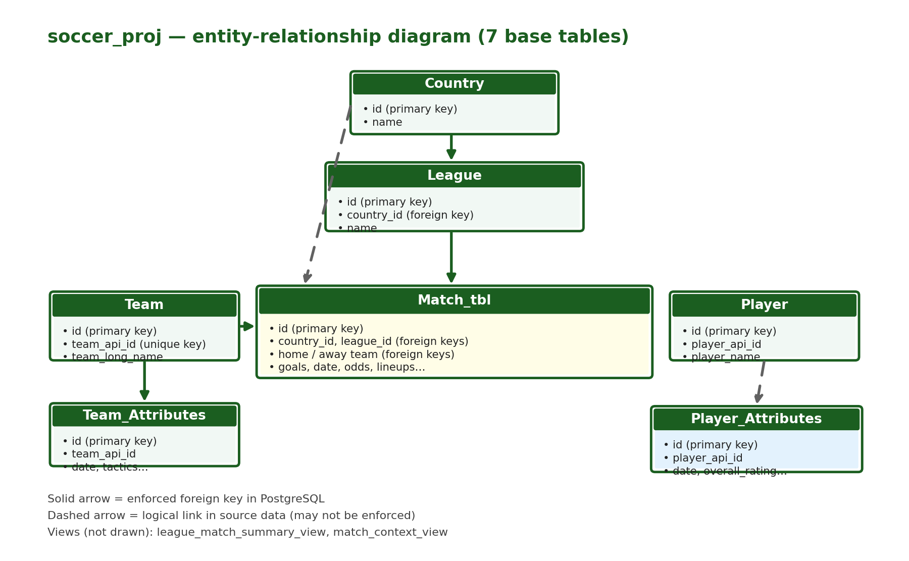
ER diagram — soccer_proj
Initial and final use the same 7 tables
Data model for business reporting: Country/League/Team/Player = who & where; Match_tbl = transactions (each game); attributes = snapshots over time. Views = ready-made reports.
Notes:
~1.5 min. Walk the diagram: Country → League → Match_tbl; Team for home/away; attribute history tables. Say final ERD matches initial; views sit on top.

Slide 5
Hardest part
Loading and typing: SQLite → CSV → Postgres with consistent column names and NULL handling
Match_tbl is very wide (lineup API IDs, many bookmaker columns) — easy to get joins wrong
Writing correct multi-step SQL (common table expressions, window functions) for streaks and lineup-based ratings
Deciding which foreign keys to enforce vs document-only when source data has orphan keys
Keeping 30 project questions aligned with what the data actually supports
Notes:
~1 min. Be specific: mention one query that was hard (e.g. Q10 unbeaten streak) or one load issue.

Slide 6
What I learned
Design first: ERD and keys matter before writing dozens of queries
JOIN choice changes results (INNER vs LEFT) — always check row counts
Views encapsulate repeated 4–5 table joins; indexes help filter/join columns on Match_tbl
Window functions (partition rows per team/season, compare to prior rows) for streaks and trends
Documentation + reproducible load scripts save time at deliverable deadline
Notes:
~1 min. Tie learning to class topics: normalization, SQL, physical design (indexes for grad).

Slide 7
SQL confidence now
Comfortable with the most common SQL: SELECT, JOINs, GROUP BY, HAVING, subqueries, CASE
Comfortable creating views (for example league_match_summary_view, match_context_view)
Overall: much more confident than at the start of the semester — I can debug by counting rows
DBeaver plus the EXPLAIN command helped me see when a query execution plan looked expensive
Notes:
~45 sec. Honest self-assessment; mention you can read and adapt SQL you did not write before.

Slide 8
What I would do next (more time)
Enforce more foreign keys after data cleaning; add CHECK constraints on goals and dates
Materialized views or summary tables for league/season dashboards
More indexes tuned using EXPLAIN on the slowest of the 30 queries
Data quality report: missing lineups, duplicate player identifiers, odds outliers
Optional: BI dashboard (Tableau/Power BI) on views for non-technical stakeholders
Notes:
~45 sec. Tie next steps to business: cleaner data + dashboards = decisions faster for ops teams.

Slide 9
DEMO: Tables + row counts
DBeaver · schema soccer_proj
Demo these core tables (foreign key relationships) in DBeaver — columns + row count:
Country — 11 rows (parent; League.country_id → Country.id)
League — 11 rows (country_id foreign key; Match_tbl.league_id → League.id)
Team — 299 rows (home/away team_api_id on Match_tbl)
Match_tbl — 25,979 rows (hub: country_id, league_id, home/away teams, goals)
All 7 tables combined — 222,796 rows total
Notes:
~1 min. LIVE DEMO. Expand Country → League → Match_tbl in the tree. Run SELECT COUNT(*) on each (or show counts from write-up). Open Match_tbl LIMIT 5 to show league_id, country_id, home_team_goal, away_team_goal. Mention Player_Attributes is largest (183,978) but skip opening it unless you have time.

Slide 10
DEMO: Intermediate query (Q16)
Joins + GROUP BY + AVG (no CASE)
Question: Which countries had the highest average goals per match?
Tables: Match_tbl → League → Country · INNER JOIN, GROUP BY, AVG (no CASE)
SQL (copy into DBeaver on soccer_proj):
SELECT c.name AS country, AVG((m.home_team_goal + m.away_team_goal)::numeric) AS avg_goals_per_match FROM soccer_proj."Match_tbl" m JOIN soccer_proj."League" l ON l.id = m.league_id JOIN soccer_proj."Country" c ON c.id = l.country_id GROUP BY c.name ORDER BY avg_goals_per_match DESC;
Notes:
~1 min. LIVE DEMO. Run Q16.
SELECT c.name AS country,
AVG((m.home_team_goal + m.away_team_goal)::numeric) AS avg_goals_per_match
FROM soccer_proj."Match_tbl" m
JOIN soccer_proj."League" l ON l.id = m.league_id
JOIN soccer_proj."Country" c ON c.id = l.country_id
GROUP BY c.name
ORDER BY avg_goals_per_match DESC;
Say: regional report—which country’s leagues produce the most goals per match.

Slide 11
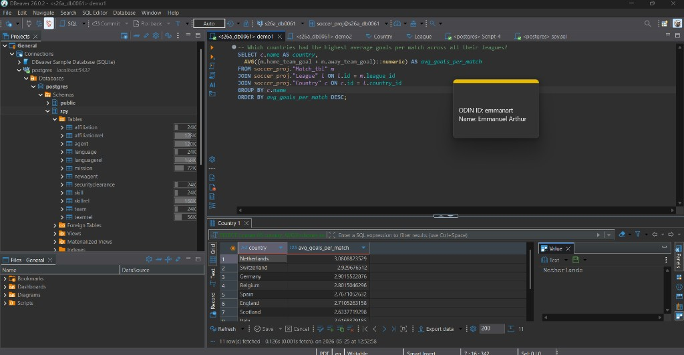
DEMO Q16 — Query results
DBeaver · demo1 · Netherlands leads avg goals per match
Notes:
~30 sec. Show this screenshot or live results. Highlight top countries (Netherlands, Switzerland, Germany).

Slide 12
DEMO: Advanced query (Q18)
Join with OR + conditional aggregates
Question: Which teams most frequently kept clean sheets?
Tables: Team + Match_tbl · JOIN with OR · two CASE inside SUM · GROUP BY
SQL (copy into DBeaver on soccer_proj):
SELECT t.team_long_name, SUM(CASE WHEN m.home_team_api_id = t.team_api_id AND m.away_team_goal = 0 THEN 1 ELSE 0 END + CASE WHEN m.away_team_api_id = t.team_api_id AND m.home_team_goal = 0 THEN 1 ELSE 0 END) AS clean_sheets FROM soccer_proj."Team" t JOIN soccer_proj."Match_tbl" m ON m.home_team_api_id = t.team_api_id OR m.away_team_api_id = t.team_api_id GROUP BY t.team_long_name ORDER BY clean_sheets DESC LIMIT 30;
Notes:
~1 min. LIVE DEMO. Run Q18.
SELECT t.team_long_name,
SUM(CASE WHEN m.home_team_api_id = t.team_api_id AND m.away_team_goal = 0 THEN 1 ELSE 0 END
+ CASE WHEN m.away_team_api_id = t.team_api_id AND m.home_team_goal = 0 THEN 1 ELSE 0 END) AS clean_sheets
FROM soccer_proj."Team" t
JOIN soccer_proj."Match_tbl" m
ON m.home_team_api_id = t.team_api_id OR m.away_team_api_id = t.team_api_id
GROUP BY t.team_long_name
ORDER BY clean_sheets DESC
LIMIT 30;
Clean sheets = defensive KPI clubs track home and away.

Slide 13
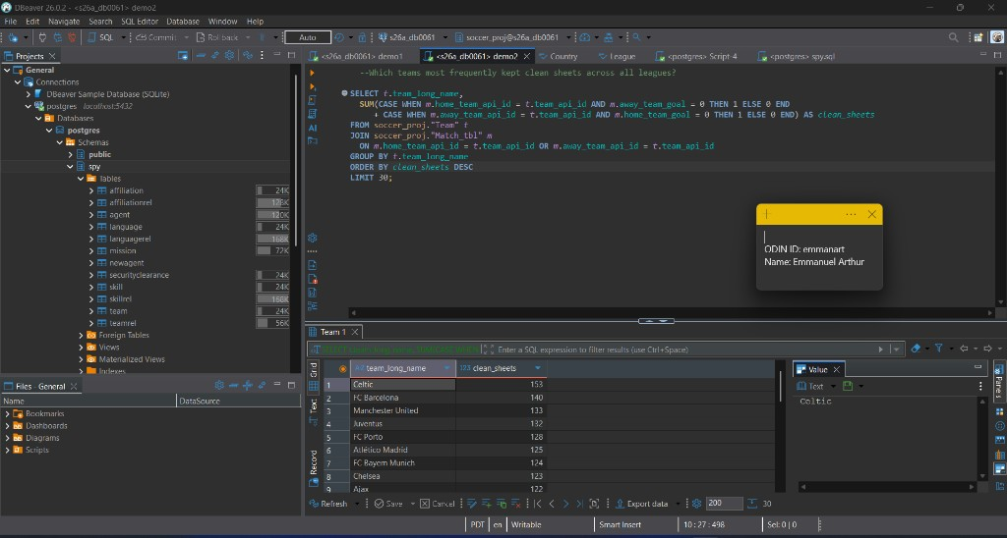
DEMO Q18 — Query results
DBeaver · demo2 · Celtic leads clean sheets
Notes:
~30 sec. Show screenshot or live results. Celtic, Barcelona, Manchester United at top.

Slide 14
Business applications
Why this project matters outside class
Club / league operations: season KPIs (goals, clean sheets, home vs away) for coaching and scouting
Media & broadcasting: compare markets (e.g. avg goals by country) for scheduling and storytelling
Betting & risk (data in Match_tbl): historical odds vs outcomes; favorite win rates
Talent / HR analog: Player_Attributes over time ≈ employee skill ratings for hiring and development
Same database patterns as retail (product sales by region) or finance (metrics over time)
Notes:
~45 sec. Closing slide before Q&A. Pick two examples. Star schema: dimensions + facts; views = canned reports for business users.

Slide 15
Thank you
Questions?
Deliverable 4 write-up + video link in submission
Notes:
~15 sec. Close; remind grader where video URL lives in the doc.

