Slide 1

Dayne | Elliot | Emma | Cameron | Suzanne

Slide 2


The MySpy Team
Dayne
Getaway Driver
Elliot
Gadget Specialist
Emma
Night-Owl Operative
Cameron
Sleep-deprived Spy
Suzanne
Hacker

Slide 3
Overview
What Changed
Time constraints restricted us.
Out of scope.
Overhauled UI for use ability.
Direct connections.
Updated data base.
Where we are
No encryption of posted messages.
No store.
Full Direct messaging and posting capabilities.
Full contract page.
Secure connectivity.
Original
Encrypt Messages on Site.
Gadget Store.
Connect spies.
Contract Spies.
Security.
Elliot

Slide 4
Major features
Contract Listings – Users can post and accept spy-related job contracts.
Direct Messaging – Secure one-to-one communication between users.
Contact via Listings – Ability to reach out directly to the poster of a contract from the listing.
Search and Connect – Search for spies and initiate conversations based on profile or contract.
Security – Full user authentication and data security using third-party providers and RLS.
Emma

Slide 5
Features not listed
Features Postponed for This Version
Clubs/Group Chats – We planned social spaces for multiple spies to coordinate.
Full Encryption Layer – We have secure data auth, but postponed full end-to-end encryption for messages.
Achievements Board – A public spy achievements board where users can show off completed missions and milestones.
Future Additions
Interactive Spy Map – Location based map where spies can pin activity zones or mission regions.
Spy Gadget Marketplace/Shop – A buy/sell platform for spy gear, gadgets, tools, etc.
Performance Improvements – Optimize data flow and loading speed as the number of users, messages, and contracts grows.
Emma

Slide 6
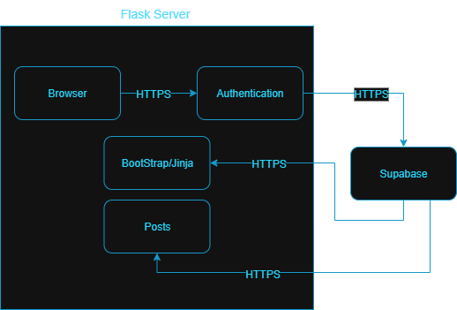
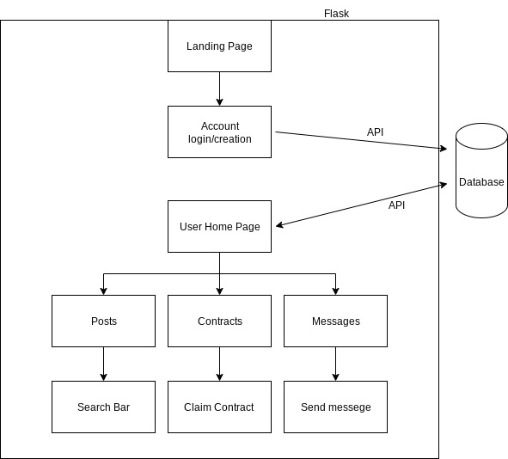
ARCHITECTURE
Browser
Flask as a server​
Supabase​
Back to BootStrap/Jinja
Dayne

Slide 7
Lessons Learned
Most Difficult Tasks
Jinja and Flask was not very readable.
Most Interesting Tasks
Supabase was cool with its schema visualizer and its many built in security features.
What we Would Change
Take advantage of github issues and or our Kanban board more. We didn't use it well to see what each person was working on.
Other Notes
Github and github branches were so valuable for this project and in general.
Flask is slow for connections and with data flow.
Implementing Supabase also brought its own challenges, as youface was built on tinydb.
Implementing Supabase earlier would have also allowed us to work more on youface and handlers so we could've done more.
Cam

Slide 8
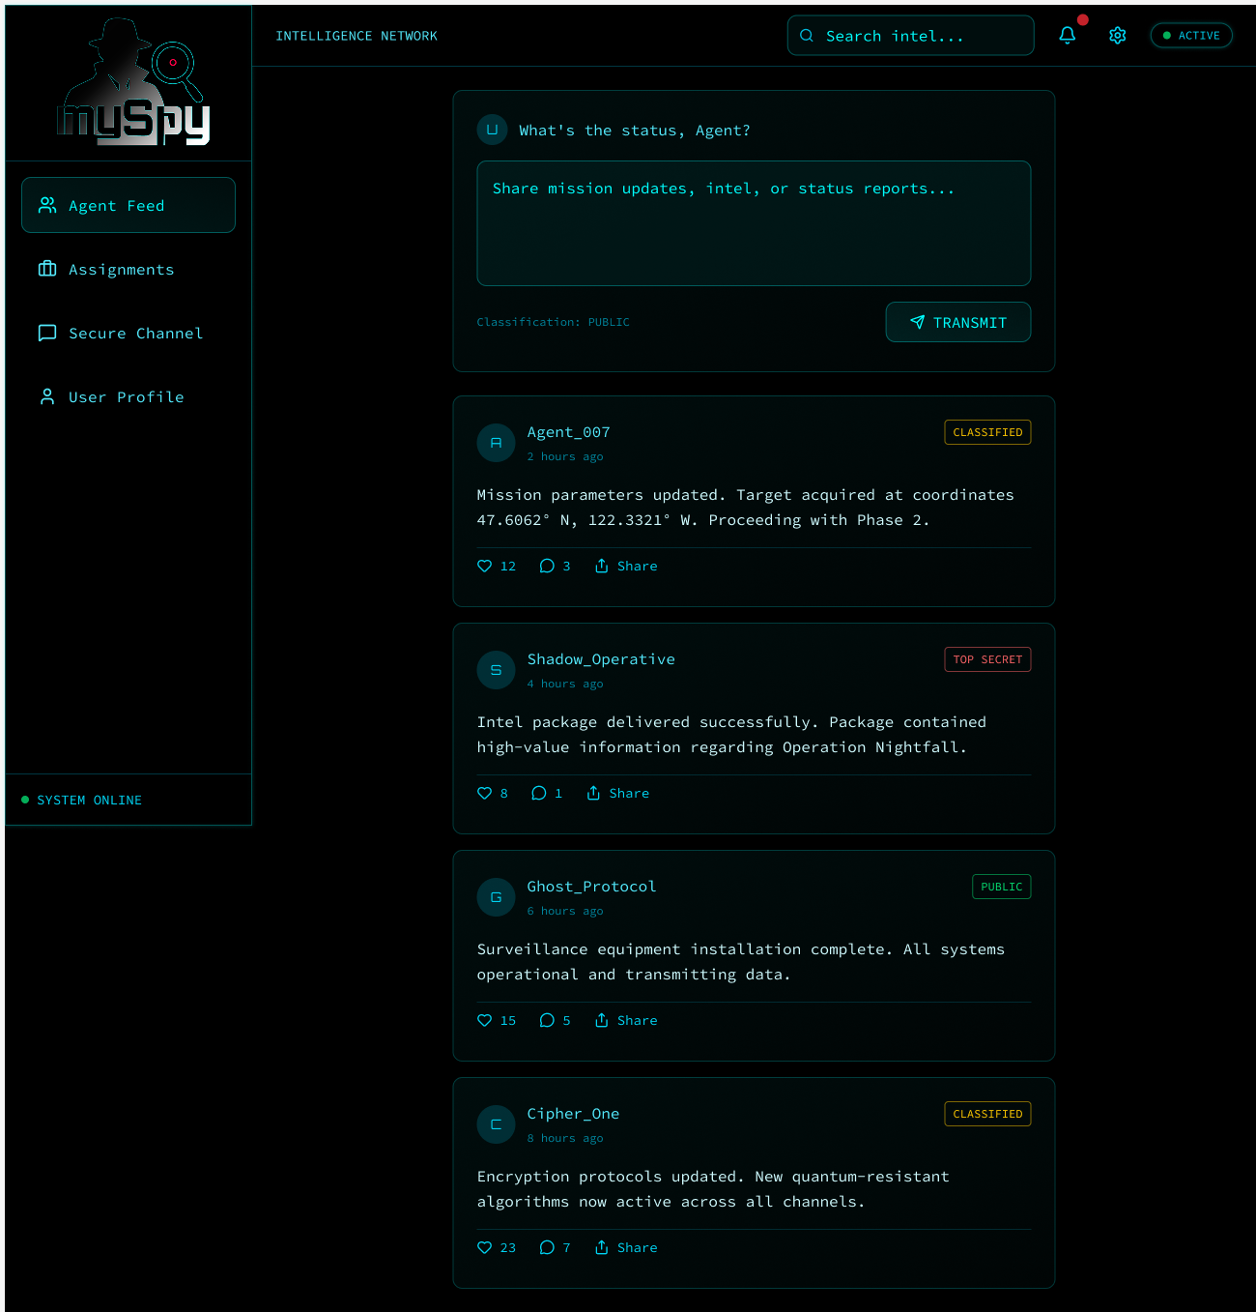
Site Walkthrough
Suzanne

Slide 9


M yspy: Stay Hidden. Stay Connected.
All in one place for all your spy needs.
Contact other spies and handlers.
Find handlers in your area.
Post securely, building your reputation.
Questions?

