Slide 1
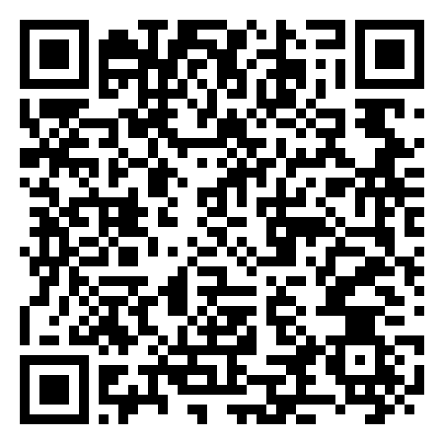
BEFORE WE BEGIN · 开始之前
讲座前问卷
Pre-Survey
请用手机扫码填写简短问卷（约 1–2 分钟）
Please scan with your phone to complete a short survey (about 1–2 minutes)
Early Autism Awareness Project · HCSTC · Oct 25, 2026

Slide 2
HOPE CHINESE SCHOOL · HCSTC
自闭症早期征兆与及时干预
Early Autism Signs & Timely Intervention
希望中文学校 · 泰森角校区 · Marshall High School 食堂
周日 · 2026年10月25日 · 下午 3:00–4:00
Sunday, Oct 25, 2026 · 3:00–4:00 p.m. · Cafeteria
Emma Zheng · Early Autism Awareness Project
Guest: Sandi Horton-Lafferty · FCPS Early Childhood Assessment Team (ECAT)
中英双语 · 北维州 / DMV 资源 · 面向 0–5 岁幼儿家长
Hope Chinese School (HCSTC) · Marshall High School
Notes:
Welcome families. Introduce yourself and Sandi. Audience: parents of children ages 0–5. DMV-focused resources.

Slide 3
介绍
INTRODUCTION
大家好！感谢希望中文学校泰森校区的家长们今天来到这里。
Hello everyone! Thank you for joining us at Hope Chinese School (Tysons).
我叫郑安欣（Emma Zheng）。我的项目致力于帮助华语家庭认识自闭症早期征兆，并顺利对接美国本地免费或低门槛的筛查与早期干预服务。
My project helps Chinese-speaking families recognize early autism signs and connect with accessible U.S. screening and early intervention services.
今天也邀请了 Fairfax County Public Schools 幼儿评估团队（ECAT）心理专家 Sandi Horton-Lafferty 与大家交流。
We are also joined by Sandi Horton-Lafferty, psychologist with the FCPS Early Childhood Assessment Team.
Early Autism Awareness Project · HCSTC · Oct 25, 2026
Notes:
Thank Hope Chinese School. Introduce Emma and Sandi. Emphasize accessible U.S. screening pathways.

Slide 4
我的使命
MY MISSION
为华府地区华语家庭弥合信息缺口。
Bridge the information gap for Chinese-speaking families in the DMV.
双语网站与在线筛查工具
Bilingual website &
screening tool
可免费分发的宣传手册
Free pamphlets
中文学校与社区双语讲座
Workshops at Chinese
schools & community sites
Early Autism Awareness Project · HCSTC · Oct 25, 2026
Notes:
Bridge the information gap for Chinese-speaking families in the DMV.

Slide 5
为什么这很重要
WHY THIS MATTERS
80% → 90%
18 月
脑容量：3岁约达成人80%，5岁约90%
Brain size: ~80% of adult size by age 3, ~90% by age 5
自闭症有时早在18个月或更早即可被发现
Autism can sometimes be detected at 18 months or younger
越早识别、越早支持，通常越有利于沟通、社交与日常适应能力的长期发展。
Earlier identification and support are generally associated with better long-term communication, social, and adaptive outcomes.
Early Autism Awareness Project · HCSTC · Oct 25, 2026
Notes:
Brain size ~80% adult by age 3, ~90% by age 5. Autism sometimes detectable at 18 months or younger. Earlier support generally better outcomes.

Slide 6
为什么早期干预有效
EARLY INTERVENTION WORKS
神经可塑性：大脑改变的能力
Neuroplasticity: the brain's ability to change
• 早期干预可以重塑大脑连接
Early intervention can strengthen brain connections
• 越早开始支持，通常效果越好
Starting support earlier is generally associated with better outcomes
• 在沟通、学习和社交技能方面取得更好效果
Better outcomes in communication, learning, and social skills
Early Autism Awareness Project · HCSTC · Oct 25, 2026
Notes:
Neuroplasticity. Starting support earlier is generally associated with better outcomes.

Slide 7
华语移民家庭常见挑战
COMMON CHALLENGES
挑战 Challenge
说明 What it means
语言与文化隔阂
Language & culture
不清楚如何用英语向医生描述担忧
Hard to describe concerns to pediatricians in English
等待观望
"Wait and see"
错过尽早开始支持的机会
Misses the chance to start support early
不知从何开始
Where to start
不知道县政府、学校筛查免费且可及
Unaware that county/school screenings are free and accessible
身份顾虑
Documentation worries
申请转介时不需要 SSN，只需姓名和联系方式；其他问题可询问 ITC
A referral does not require an SSN, just a name and contact info; ask ITC about anything else
Early Autism Awareness Project · HCSTC · Oct 25, 2026
Notes:
Normalize barriers. Referral does not require SSN; ask ITC about anything else.

Slide 8
美国推荐筛查时间
U.S. SCREENING TIMELINE
美国儿科学会 (AAP) / CDC 建议
American Academy of Pediatrics (AAP) / CDC guidance
• 每次体检：发育监测（developmental monitoring / surveillance）
Developmental monitoring (surveillance) at every well-child visit
• 至少在 9、18、30 个月：标准化发育筛查
Standardized developmental screening at least at 9, 18, and 30 months
• 18 与 24 个月：专门的自闭症筛查（如 M-CHAT-R/F；CDC 不特别认可任何单一工具）
Autism-specific screening at 18 and 24 months (e.g., M-CHAT-R/F; CDC does not endorse any single tool)
• 任何年龄：若发现技能丧失或倒退，请尽快联系儿科医生，不要等到下次体检
Any age: contact your pediatrician promptly if skills are lost or regress; don't wait for the next visit
• 另外：若对发育有任何担忧，可随时要求额外筛查；CDC 里程碑清单不能取代正式筛查
Also: if you have any developmental concern, you can ask for extra screening at any time; CDC milestone checklists do not replace formal screening
Early Autism Awareness Project · HCSTC · Oct 25, 2026
Notes:
AAP/CDC guidance: monitoring, standardized screens at least 9/18/30 mo, autism screen 18 and 24 mo, act on regression, extra screening anytime; checklists do not replace formal screening.

Slide 9
识别早期迹象 · 社交
EARLY SIGNS · SOCIAL
• 喂食或玩耍时眼神交流有限或短暂
Limited or fleeting eye contact during feeding or play
• 叫名字时没有反应（CDC 里程碑：约 9 个月）
Not responding to name (CDC milestone: by about 9 months)
• 家长指向物体时不跟着看
Not following when a parent points to an object
• 很少或没有假想游戏（CDC 里程碑：约 30 个月）
Little or no pretend play (CDC milestone: by about 30 months)
里程碑年龄依据 CDC 2022 修订版；每个孩子发育节奏不同，有担忧请咨询儿科医生。
Milestone ages follow CDC's 2022 revised checklists; children develop at different rates. If you have concerns, talk to your pediatrician.
Early Autism Awareness Project · HCSTC · Oct 25, 2026
Notes:
CDC 2022: name response by ~9 months; pretend play by ~30 months. Children develop at different rates.

Slide 10
识别早期迹象 · 沟通与行为
EARLY SIGNS · COMMUNICATION & BEHAVIOR
• 12 个月不会咿呀学语，或 16–18 个月不会说单个词
No babbling by 12 months, or no single words by 16–18 months
• 12 个月不会挥手再见；15 个月不会用手指要东西；18 个月不会用手指给你看
Not waving bye-bye by 12 months; not pointing to ask by 15 months; not pointing to show by 18 months
• 重复动作：拍手、摇晃、旋转物体
Repetitive motions: hand-flapping, rocking, spinning objects
• 对日常声音或光线极度敏感
Extreme distress with everyday sounds or lights
黄金法则（任何年龄） · Golden rule (any age)
任何言语、眼神、手势或社交能力的倒退，请尽快咨询儿科医生。
Any regression in speech, eye contact, gestures, or social skills needs prompt evaluation by a pediatrician.
Early Autism Awareness Project · HCSTC · Oct 25, 2026
Notes:
Communication and sensory/repetitive signs. Golden rule: prompt pediatrician evaluation for regression.

Slide 11
居家观察要点
WHAT TO WATCH FOR AT HOME
留意这 4 件事 · Four things to watch for
当你和孩子说话/玩耍时，他会看你吗？
Looks at you when you speak/play?
如果你指向玩具，孩子会看向玩具吗？
Looks at a toy when you point?
孩子会指给你看有趣的东西吗？
Points to show you something interesting?
当你对孩子微笑时，他会回以微笑吗？
Smiles back when you smile?
如果对其中任何一项不确定，或有其他担忧，请咨询儿科医生，并询问发育与自闭症筛查（如 M-CHAT-R/F）。这份清单不是筛查工具。
If you are unsure about any of these, or have other concerns, talk to your pediatrician and ask about developmental and autism screening (e.g., M-CHAT-R/F). This list is not a screening tool.
Early Autism Awareness Project · HCSTC · Oct 25, 2026
Notes:
Four things to watch. This list is not a screening tool; ask pediatrician about M-CHAT-R/F if unsure.

Slide 12
北维州本地资源
NORTHERN VIRGINIA (DMV) RESOURCES
• Infant & Toddler Connection (ITC) (703) 246-7121：0–3 岁早期干预的统一入口，任何人都可转介；服务不论家庭支付能力。转介无需 SSN。
ITC (703) 246-7121: single point of entry for early intervention, ages 0–3. Anyone can refer; services regardless of ability to pay. No SSN needed to make a referral.
• Child Find (FCPS) 571-423-4121：20 个月–5 岁免费发育筛查（Fairfax County / Fairfax City 居民）；孩子需在 9 月 30 日前满 2 岁。Falls Church City 另有自己的 Child Find。
Free developmental screening, ages 20 months–5 years (Fairfax County / City residents); child must turn 2 by Sept 30. Falls Church City has its own Child Find.
• Autism Society of Northern Virginia (ASNV) · asnv.org：讲座、家庭支持与社区资源。
Education programs, support groups, and community resources.
Early Autism Awareness Project · HCSTC · Oct 25, 2026
Notes:
ITC (703) 246-7121 is the single point of entry for ages 0–3. No SSN needed to make a referral. Child Find 571-423-4121.

Slide 13
美国全国资源
U.S. NATIONAL RESOURCES
• CDC "Learn the Signs. Act Early"：免费里程碑清单与家庭追踪工具（含中文资料）。
Free milestone checklists and family trackers (materials available in Chinese).
• Autism Speaks 100-Day Kit：确诊后 100 天的实用行动指南（适用于 4 岁及以下儿童家庭；有中文版）。
Practical first-100-days toolkit after a diagnosis (children 4 and under; Chinese available).
• NIH / NICHD：自闭症与早期干预循证信息。
Evidence-based autism and early intervention information.
• 本项目网站：双语宣传册、互动筛查工具与资源列表。
Our site: bilingual pamphlets, interactive screener, and resource list.
emmaz-sv.github.io/early-autism-awareness
Early Autism Awareness Project · HCSTC · Oct 25, 2026
Notes:
CDC Act Early, Autism Speaks 100-Day Kit (4 and under), NIH, project website.

Slide 14
寻求支持 4 步骤
4 STEPS TO SEEK SUPPORT
1
观察与记录 · Observe & track
记下具体担忧，对照里程碑清单。 Track concerns with milestone checklists.
2
咨询儿科医生 · Ask pediatrician
主动要求 M-CHAT-R/F 筛查。 Ask for an M-CHAT-R/F screen.
3
综合评估 · Full evaluation
中高风险时转介发育儿科或早期干预团队。 Refer if moderate/high risk.
4
启动早期干预 · Start early intervention
Fairfax ITC (703) 246-7121（0–3）或 FCPS Child Find 571-423-4121（20 个月–5 岁）。怀疑有迟缓即可转介；转介无需 SSN。
Early Autism Awareness Project · HCSTC · Oct 25, 2026
Notes:
Observe, ask pediatrician for M-CHAT-R/F, full evaluation if needed, start via ITC or Child Find; no SSN for referral.

Slide 15
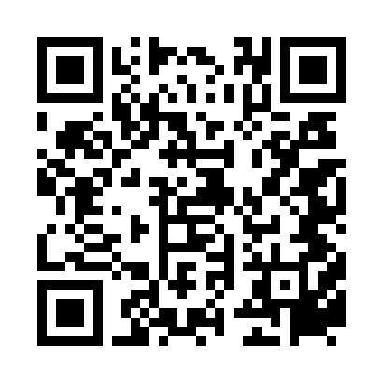
家长今日行动清单
ACTION PLAN FOR TODAY
带回一份手册
Take a pamphlet home
把早期预警检查表贴在冰箱上。
Keep the checklist on your refrigerator.
追踪发育里程碑
Track milestones
观察孩子未来两周的沟通与互动。
Watch communication and interaction over the next 2 weeks.
约儿科 / 拨打 ITC
Call pediatrician or ITC
保存 ITC (703) 246-7121（0–3 岁）；要求筛查。
Save ITC (703) 246-7121 (ages 0–3); request screening.
扫码访问网站
Scan the website
免费双语资料与互动筛查工具。
Free bilingual materials and interactive screener.
Early Autism Awareness Project · HCSTC · Oct 25, 2026
Notes:
Pamphlet, track milestones, call pediatrician or ITC (703) 246-7121, scan website.

Slide 16
核心要点
KEY TAKEAWAY
早期发现，及时帮助
EARLY DETECTION · TIMELY SUPPORT
不要等待 · DON'T WAIT 不要观望 · DON'T "WAIT AND SEE"
• 如果发现迹象，立即寻求帮助。 If you notice signs, seek help promptly.
• 越早开始干预，通常效果越好。 The earlier support starts, the better outcomes tend to be.
• 你是孩子最好的倡导者；转介无需 SSN。
You are your child's best advocate; a referral does not require an SSN.
Early Autism Awareness Project · HCSTC · Oct 25, 2026
Notes:
Early detection, timely support. Do not wait. Earlier support generally better. Referral does not require SSN.

Slide 17
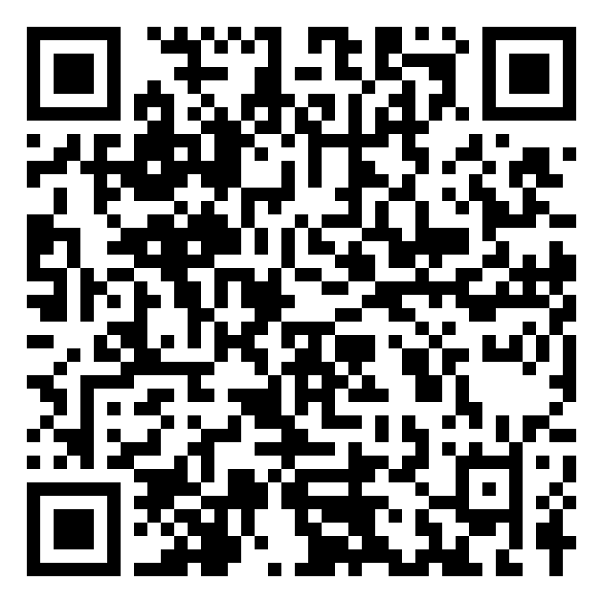
BEFORE YOU LEAVE · 离开前
讲座后问卷
Post-Survey
请扫码填写讲座后问卷，帮助我们改进（约 1–2 分钟）
Please scan to complete the post-survey and help us improve (about 1–2 minutes)
Early Autism Awareness Project · HCSTC · Oct 25, 2026

Slide 18
谢谢
THANK YOU
问答环节 · Questions & Answers
Emma Zheng · ezhengva@gmail.com
emmaz-sv.github.io/early-autism-awareness
Fairfax ITC · (703) 246-7121
扫码获取在线资源
Scan for online resources
早期发现 · 及时帮助 · 点亮未来
Early detection · Timely support · Brighter futures
Early Autism Awareness Project · HCSTC · Oct 25, 2026
Notes:
Q&A. Leave email, website, and Fairfax ITC (703) 246-7121 on screen.

