Slide 1
OXTR Gene Expression in Patients with Amyotrophic Lateral Sclerosis
Tingting Zhao, PhD, MSN, RN; Zequan Wang, MSN, RN
School of Nursing
University of Connecticut
March 6, 2021

Slide 2
Background (con’t)
Amyotrophic lateral sclerosis (ALS) is a non-demyelinating neurodegenerative disease in adults characterized by progressive muscle paralysis. Muscle paralysis is determined by the degeneration of motoneurons in the motor cortex brainstem and spinal cord. The ALS pathogenetic mechanisms are still unclear.

Slide 3
Background (con’t)
The OXTR, a 7-transmembrane G protein-coupled receptor capable of binding to either Gi or Gq proteins, activates a set of signaling cascades, such as the MAPK, PKC, PLC, or CaMK pathways. The cellular response to OXT include of neurite outgrowth, cellular viability, and increased survival.

Slide 4
Background (con’t)
RNA-sequencing (RNA-Seq) technology is a high-throughput sequencing technology which has developed rapidly in recent years. It can study gene function, gene structure and gene expression changes at the level of gene transcription and explore the genetic evidence supporting ALS treatment of peripheral nerve injury.

Slide 5
Significance
In this study, RNA-seq technology was used to reveal the relevant transcriptome changes and conduct in-depth and thorough analysis, which is conducive to the development and maintenance mechanisms of peripheral nerve injury and provides a theoretical basis for massage treatment of peripheral nerve injury.
Notes:
https://trace.ncbi.nlm.nih.gov/Traces/sra/?run=SRR2558724

Slide 6
Research goal
To compare OXTR gene expression level to elucidate genetic differences between the ALS and neurologically healthy control groups that may contribute to disease pathology.
Notes:
https://trace.ncbi.nlm.nih.gov/Traces/sra/?run=SRR2558724

Slide 7
Experimental Design
Subjects: 7 sporadic ALS and 8 neurologically healthy control people
Procedures:
Postmortem cervical spinal section was used to extract total RNA.
Individual Illumina Total Stranded RNA-sequencing libraries for each sample
Each library was sequenced with >50 million 2X150 sequencing reads on the NextSeq500.
Notes:
https://trace.ncbi.nlm.nih.gov/Traces/sra/?run=SRR2558724

Slide 8
Experimental Design
What we are going to do:
1. Download the selected data from NCBI by using sratoolkit.
2. Analyze the quality of RNA sequence and trim the data
3. Compare the OXTR gene expression in two groups.
Notes:
https://trace.ncbi.nlm.nih.gov/Traces/sra/?run=SRR2558724

Slide 9
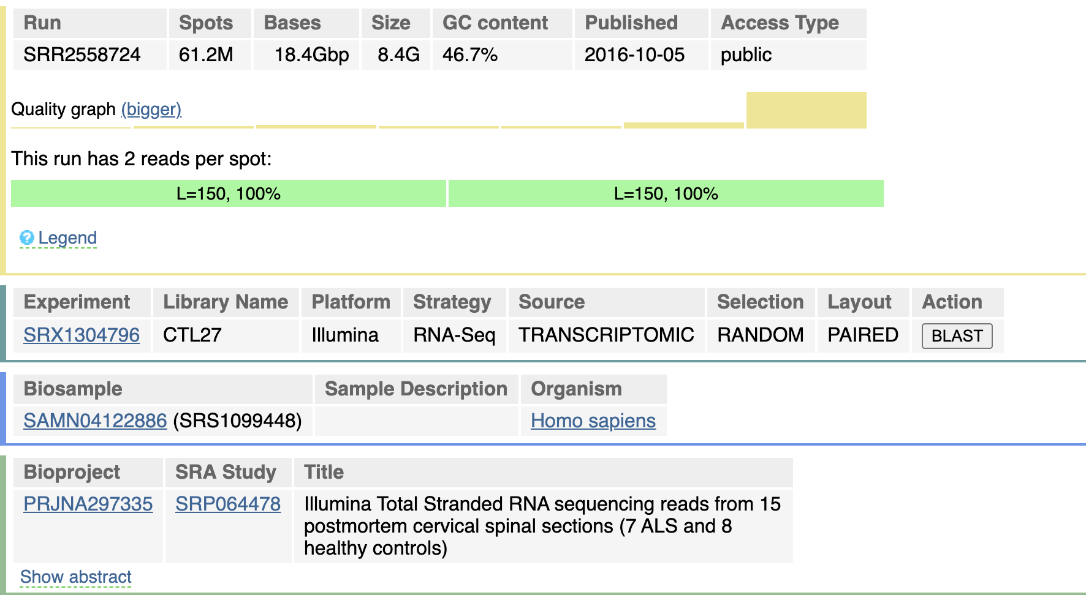
Abstract: The author isolated total RNA using postmortem cervical spinal section homogenates from 7 sporadic ALS and 8 neurologically healthy control samples. They next prepared individual Illumina Total Stranded RNA-sequencing libraries for each sample. They sequenced each library with >50 million 2X150 sequencing reads on the NextSeq500. Their goal was to generate gene expression data for use in systems biology analyses to elucidate differences between the sALS and neurologically healthy control groups that may contribute to disease pathology.
Notes:
https://trace.ncbi.nlm.nih.gov/Traces/sra/?run=SRR2558724

Slide 10
isolate | Neurologically Healthy Control
age | 84
biomaterial provider | James Bennett, 3050A Berkmar Drive, Charlottesville, VA 22901
sex | female
tissue | Postmortem Cervical Spinal Section Homogenate
ethnicity | Caucasian
label | CTL27
"20 20 micron sections of cervical spinal tissue embedded in OCT were cut using a Cryostat and placed in Qiazol provided in Qiagen miRNeasy's kit. We homogenized the tissue in Qiazol with a thin syringe and needle, and we followed the rest of the Qiagen miRNeasy kit's instructions with the optional DNase treatment. Libraries were then prepared using 500 ng RNA input into Illumina's Stranded Total RNA kit after ensuring the RNA was not significantly degraded and had an RQI score >7 with the Biorad Experion. "

