Slide 1
OXTR Gene Expression in Patients with Amyotrophic Lateral Sclerosis
Group Two: Tingting Zhao, Zequan Wang
School of Nursing
University of Connecticut
March 9, 2021

Slide 2
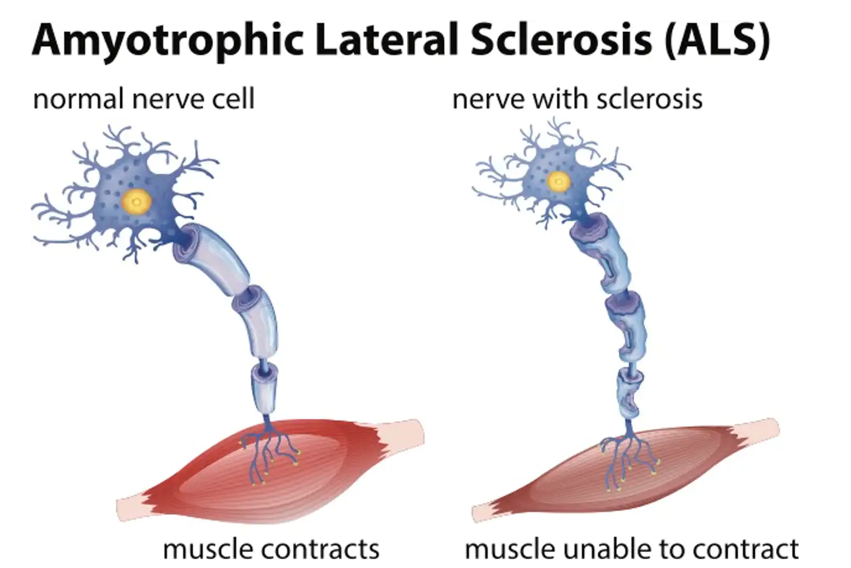
Background
Amyotrophic lateral sclerosis (ALS) is a non-demyelinating neurodegenerative disease in adults characterized by progressive muscle paralysis. Muscle paralysis is determined by the degeneration of motoneurons in the motor cortex brainstem and spinal cord. The ALS pathogenetic mechanisms are still unclear.

Slide 3
Background (con’t)
The OXTR (Oxytocin Receptor), a 7-transmembrane G protein-coupled receptor capable of binding to either Gi or Gq proteins, activates a set of signaling cascades, such as the MAPK, PKC, PLC, or CaMK pathways. The cellular response to OXT include of neurite outgrowth, cellular viability, and increased survival.

Slide 4
Background (con’t)
RNA-sequencing (RNA-Seq) technology is a high-throughput sequencing technology which has developed rapidly in recent years. It can study gene function, gene structure and gene expression changes at the level of gene transcription and explore the genetic evidence supporting ALS treatment of peripheral nerve injury.

Slide 5
Significance
Evidence has shown that the OXTR is a risk gene related to the etiology of neuropathy. By assessing and comparation of the gene expression level between ALS and healthy control group, we can understand the potential pathological mechanisms of ALS.
Notes:
https://trace.ncbi.nlm.nih.gov/Traces/sra/?run=SRR2558724

Slide 6
Research goal
To compare OXTR gene expression level to elucidate genetic differences between the ALS and neurologically healthy control groups that may contribute to disease pathology.
Notes:
https://trace.ncbi.nlm.nih.gov/Traces/sra/?run=SRR2558724

Slide 7
Research Question
What is the association between OXTR gene expression and ALS incidence?
Notes:
https://trace.ncbi.nlm.nih.gov/Traces/sra/?run=SRR2558724

Slide 8
What questions remain?
The author did not explore novel transcripts specific to ALS group in this dataset. And we are going to examine OXTR and other candidate gene expression level to see whether OXTR alone or together with other genes to influence the incidence of ALS.
Notes:
https://trace.ncbi.nlm.nih.gov/Traces/sra/?run=SRR2558724

Slide 9
Previous Experimental Design
Subjects: 7 sporadic ALS and 8 neurologically healthy control people
Procedures:
Postmortem cervical spinal section was used to extract total RNA.
Individual Illumina Total Stranded RNA-sequencing libraries for each sample
Each library was sequenced with >50 million 2X150 sequencing reads on the NextSeq500.
Notes:
https://trace.ncbi.nlm.nih.gov/Traces/sra/?run=SRR2558724

Slide 10
Our Experimental Design
1. Download the selected data from NCBI by using sratoolkit.
2. Analyze the quality of RNA sequence and trim the data
3. Compare the OXTR gene expression in two groups.
Notes:
https://trace.ncbi.nlm.nih.gov/Traces/sra/?run=SRR2558724

Slide 11
Navigating data from NCBI’s Sequence Read Archive （SRA）
We found our interested gene in the PubMed and located the SRA number in the article.
We pop into NCBI’s SRA which gives us all of the information and accession numbers that are related to the study .
We firstly downloaded SR Toolkit to operate on SRA runs.
Configure download directory (default:/Users/<user_name>/ncbi/public)
$prefetch SRR2558724 and we ended up with a compressed sra file.
We will download fastq-dump later and then transfter the sra file into fastq file format.

Slide 12
Downloading data code
zequanwang@zequans-mbp Documents % ls
zequanwang@zequans-mbp Documents % cd sratoolkit.2.10.9-mac64
zequanwang@zequans-mbp sratoolkit.2.10.9-mac64 % ls
CHANGES README.md schema
README-blastn bin
README-vdb-config example
zequanwang@zequans-mbp sratoolkit.2.10.9-mac64 % cd bin
zequanwang@zequans-mbp bin % ./vdb-config -i
zequanwang@zequans-mbp bin % ./prefetch SRR2558724
2021-03-08T01:51:00 prefetch.2.10.9: 1) Downloading 'SRR2558724'...
2021-03-08T01:51:00 prefetch.2.10.9: Downloading via HTTPS...
2021-03-08T02:11:30 prefetch.2.10.9: HTTPS download succeed
2021-03-08T02:11:49 prefetch.2.10.9: 'SRR2558724' is valid
2021-03-08T02:11:49 prefetch.2.10.9: 1) 'SRR2558724' was downloaded successfully

Slide 13
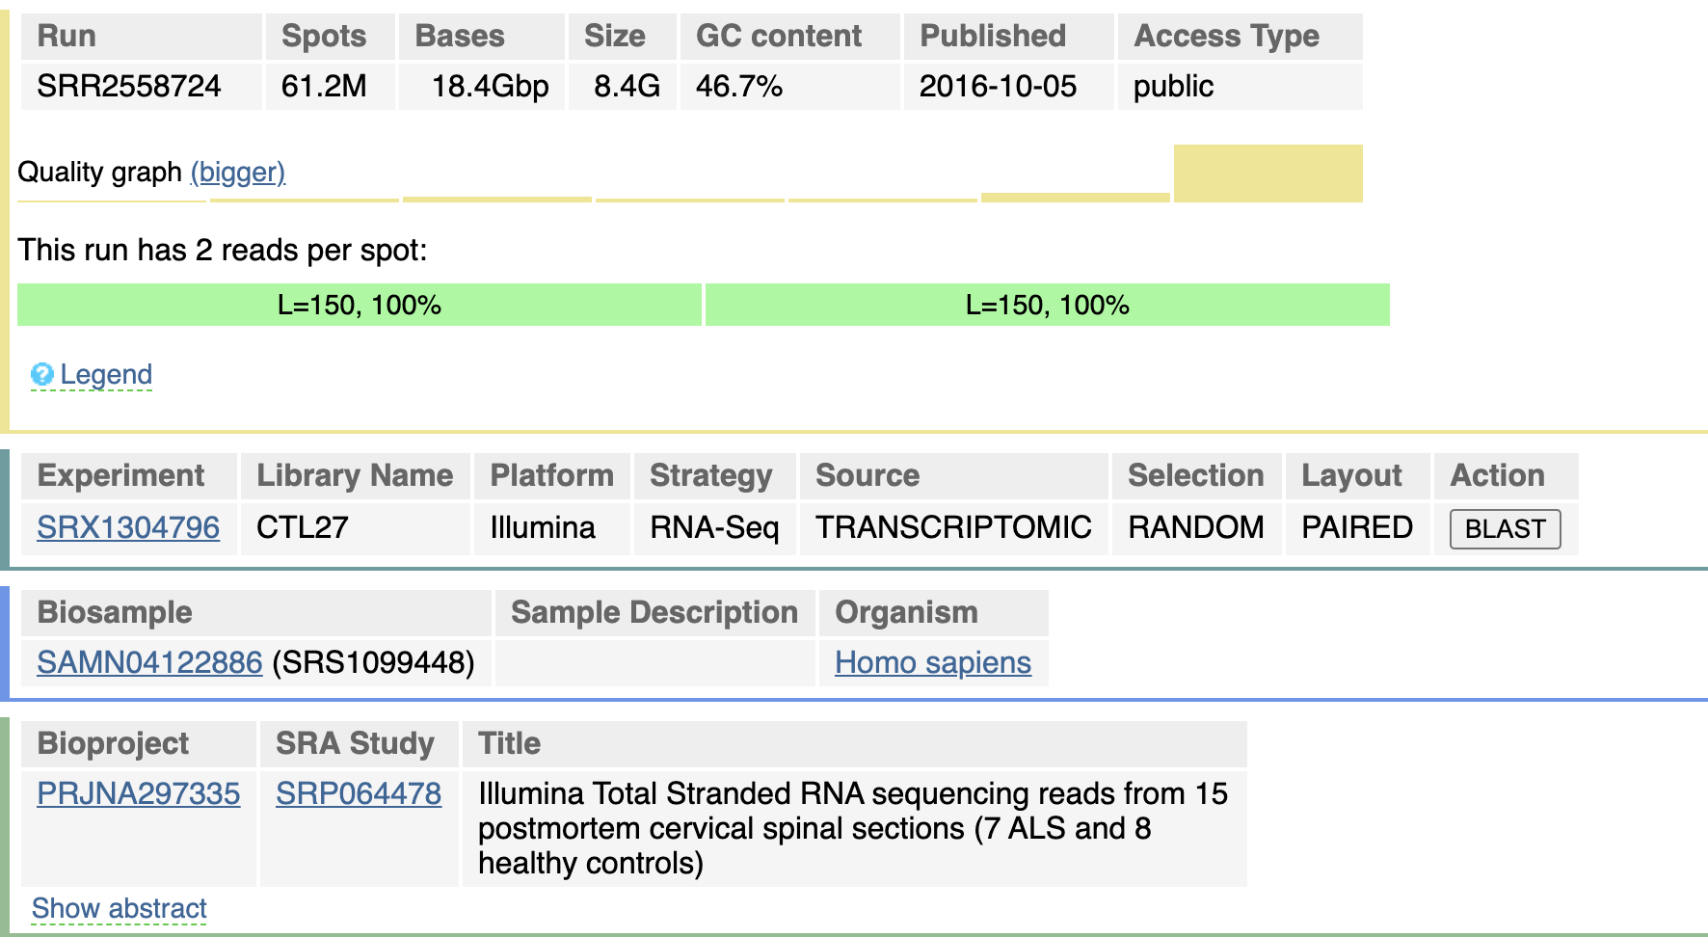
Abstract: The author isolated total RNA using postmortem cervical spinal section homogenates from 7 sporadic ALS and 8 neurologically healthy control samples. They next prepared individual Illumina Total Stranded RNA-sequencing libraries for each sample. They sequenced each library with >50 million 2X150 sequencing reads on the NextSeq500. Their goal was to generate gene expression data for use in systems biology analyses to elucidate differences between the sALS and neurologically healthy control groups that may contribute to disease pathology.
Notes:
https://trace.ncbi.nlm.nih.gov/Traces/sra/?run=SRR2558724

