Slide 1


Mushroom Classification Using Machine Learning
Erin McIsaac
COSC-A406: Machine Learning
May 2025

Slide 2
What Problem Are We Solving?
Mushroom foraging can be dangerous due to toxic species that resemble edible ones
The goal: Predict whether a mushroom is edible or poisonous based on physical characteristics
Dataset from UCI Machine Learning Repository, include 8,214 labeled samples

Slide 3
Mushroom Dataset
Rows: 8,124
Features: 22 categorical (i.e. cap shape, odor, gill color)
Target Variable: class (edible = e, poisonous – p)
No missing values; all features were encoded using LabelEncoder

Slide 4
Machine Learning Models
K-Nearest Neighbors (KNN)
Logistic Regression
Random Forest Classifier*
XGBoost*
Neural Netwrok (TensorFlow)*

Slide 5
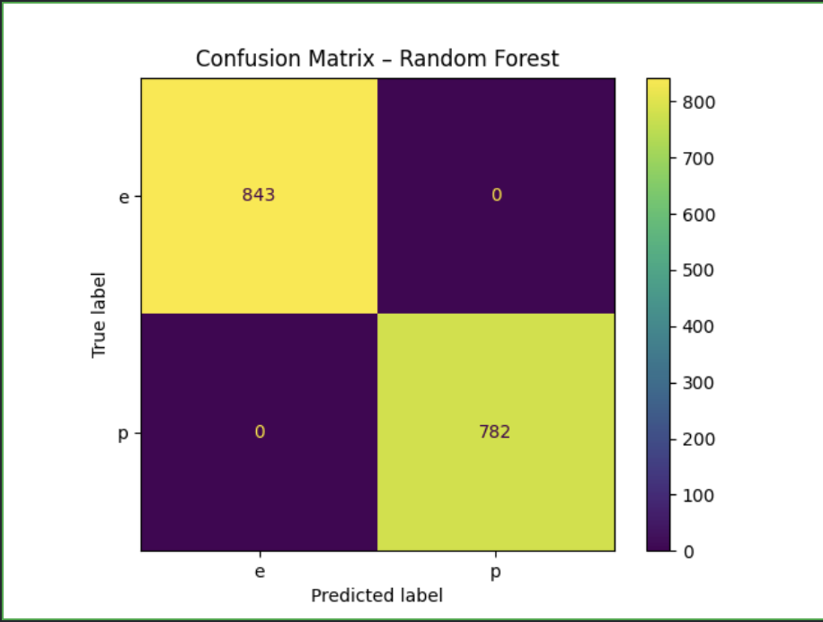
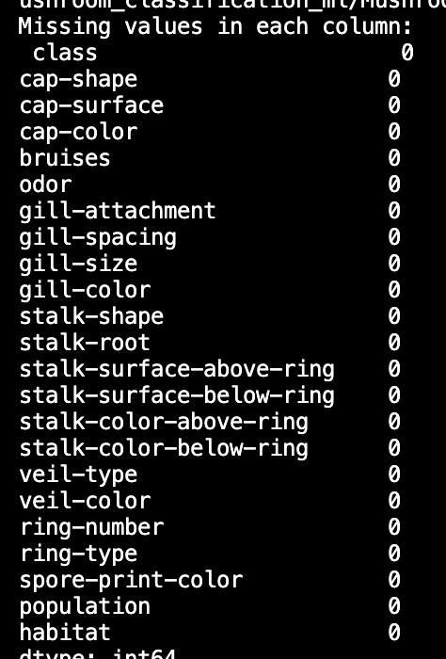
Model Evaluation – Random Forest
Showcased high precision and recall (no missing data)
Zero misclassification between edible and poisonous classes

Slide 6
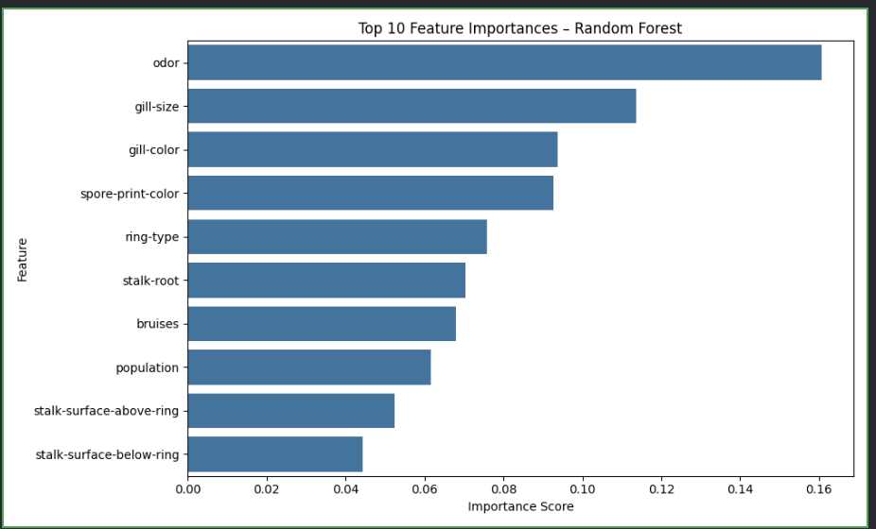
Results: Top Influential Features
Feature importance derives from Random Forest model

Slide 7
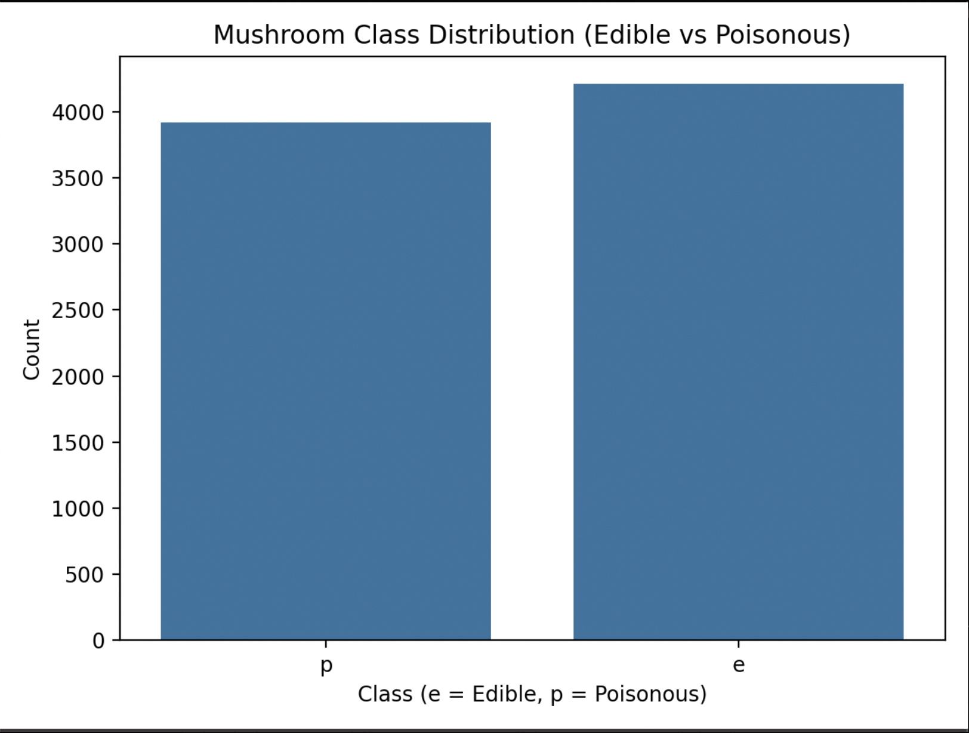
Results: Class Distribution

Slide 8
Model Accuracy Results
Model | Accuracy
KNN | 99.63%
Logistic Regression | 94.71%
Random Forest | 100.0%
XGBoost | 100.00%
Neural Network | 100.00%

Slide 9
Key Takeaways
Random Forest, Neural Networks, and XGBoost were the most accurate
Neural Networks adds computational complexity
Dataset quality (well-separate classes + strong features) made classification highly effective
ML can support safe foraging and toxicology research

Slide 10
Potential Improvements
Use a real-world dataset with more class overlap or noise
Build a mobile app for real-time mushroom classification (photo imaging)
Implement model explainability (i.e. SHAP values)

Slide 11
References
UCI Mushroom Dataset – https://www.kaggle.com/datasets/uciml/mushroom-classification
TensorFlow, XGBoost, Scikit-Learn documentation

